Slide 1
Alternative Formats for Learning Patient Safety –
Faculty Development
John Gosbee, MD, MS
VA National Center for Patient Safety
John.Gosbee@med.va.gov www.patientsafety.gov
Notes:
Additions and edits by J Gosbee (e.g., objectives added)

Slide 2
Location in our VA NCPS Curriculum Toolkit
Content
Patient Safety Introduction
Human Factors Engineering
Etc…
Instructor Preparation
Swift and Long Term Trust
“Selling the Curriculum”
Etc…
Alternative Education Formats
Pt Safety Case Conference (M&M)
Pt Safety on Rounds (Modulettes)
One-month Elective
Etc…

Slide 3
Objectives for this Session
Provide concrete tactics for using adult learning model during safety curriculum efforts
Early anecdotal success…
  Soon to be more concrete/quantitative
Lessons learned
  How to make it work in your world!
Notes:
Ah yes, pitfalls

Slide 4
A Call to Action…
ACGME Competencies (2003)
  Systems-Based Practice: Residents must demonstrate an awareness of and responsiveness to the larger context and system of health care and the ability to effectively call on system resources to provide care that is of optimal value.
  Residents are evaluated on their use of systematic approaches to reduce errors and improve patient care and their assistance in the development of system improvements

Slide 5
ACGME Requirements
Tangible, documentable teaching sessions
Tangible, documentable activities for “practice”
Something to put in their “log book”

Slide 6
Barriers to Addressing Patient Safety in Medical Education
Imposter syndrome
  “They might find out that I don’t really belong here.”
Cognitive dissonance
  “Doesn’t happen here.”
Cultural Attitudes
  “Name, blame and shame.”
Systems vs. Individuals
  Responsibility to identify and remediate deficiencies in learners

Slide 7
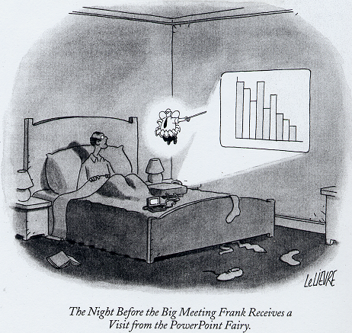
Need for Creative Solutions to these Significant Barriers
Powerpoints will NOT cut it!
And,…need both:
  “Initial inoculation”
  “Booster shots!”
Notes:
PPT Fairy from the New Yorker Feb 04
Even with help from the PowerPoint Fairy, retention is only ~5%

Slide 8
Alternative Formats Cover a Wide Range of Activities and Formality
Doc-U-Dramas (later)
Modified Case Conferences (later)
Working Rounds (Modulettes) following this!
Others (Brief Success Stories)
  Orientation
  Self-study and Journal Club (e.g., using Web M&M)
  Homework (spanning weeks or months)
  Projects (spanning months or a “research” year)
  Month-long rotation “Patient Safety Consult Service”
  Year(s) for Scholarly Activity
  Teaching your colleagues!!

Slide 9
Orientation
Australian Community Teaching Hospital
  John Wakefield
  “Stations” for each new house officer to learn/interact
VA Hospital
  Susan Lott (for VA people, see Outlook)
  During July one-day session, she gets 30 min
  Focuses on basics; and herself as resource

Slide 10
Self-Study
University of California – San Diego med students
  Short meeting with mentor prior to longer RCA session
  Assignments to read up on one or two types of vulnerability
West Virginia University Anesthesiology Residents
  Journal Club
  Some articles chose from “Web M&M”

Slide 11
“ Homework”
Should be…
  Easy enough to do with minimal mentoring
  Bounded with clear beginning and end
  Integrated with reality so as not to breed cynicism
Example frameworks/assignments
  What is a system and how does it relate to health care?
  Structured approach to hazard identification

Slide 12
“Patient Safety Homework” Case Studies
Cleveland VA Urgent Care Rotation Residents
  Anne Tomolo, MD
  “Outcomes card” to fill out over weeks or months
  Discover what happened and why to select patients
University of Michigan
  Resident hand-off issues documented and analyzed
  Raj Mangrulkar, MD

Slide 13
Projects
University of Minnesota Med and Nursing Students
  You tell me…I heard about this indirectly
  Final report heard and acted upon by operational committee
Univ of Michigan
  Took actual event, 6 weeks of analysis
  Reported to Univ Hosp Patient Safety committee

Slide 14
Month-long rotation “Patient Safety Consult Service”
In place at Univ of Michigan
  Fourth year medical student elective in place (no one signed up yet)
  R3 for Internal Medicine (2004-5 year)
  Surgery?
Other sites?

Slide 15
Year(s) of Scholarly Activity
University of Pittsburgh → Pt safety House officer
  Eric Mardenstein
  “Rewarding”, “frustrating”, and “learning to be an advocate”
University of Wisconsin → MD/PhD
  Bentzi Karsh, PhD and others lead in IE, Pop Health
  Masters “Patient Safety Certificate” courses

Slide 16
Year(s) of Scholarly Activity
Dartmouth University
  Combined Preventive Medicine and “Primary Care Residency
  See Brochure – adds two years…but CMS “pays” for the time
University of Missouri – 50% Fam Medicine Fellow
  Wendy Madigosky with MS2’s (lots of assessment)
  She is publishing her two year experience soon
  Super-plugged in to both Univ and VA patient safety operations

Slide 17
Teaching your colleagues!!
Scholarly pursuit (research, education, practice)
  HRSA gave 4 grants in 2001 (sort of)
University of Washington – Nursing & Medical School
  http://interprofessional.washington.edu/fliepps/
  HRSA grant to train faculty leaders in the best practices of interprofessional teaching and learning patient safety

Slide 18
Conclusion
There is more than one way to get started
It is dependent on your ability to change it
(Probably) dependent on recruiting 1-2 other colleagues to sustain it

