Slide 1
US CMS
Overview of US CMS
Pre-Ops/M&O
Dan Green
US CMS Program Manager
May 20, 2003

Slide 2
Outline
CMS Planning
US CMS Planning - Schedule
Pre - operations and Operations with CD4-a and CD4-b.
WBS 18 (Common Ops), 19 (Ops Office), 20 (Upgrade R&D) and 21 (Management Reserve)
Issues and Funding Guidance.
RP - management

Slide 3
CTF: Surface Commissioning & Slice Tests
CTF working group (Lazic)
Preliminary study of meaning of, and possibilities for, “slice tests” (Lazic)
work continuing towards CTF note
objectives
equipment, services, other resources
interaction with other users
Proposals received for: a) HB, HE, ME and MB individual tests (10% slices)
b) HB/HE/HF integrated test
c) HE/ME integrated tests before/during SX magnet test
e.g. using horizontal cosmics to test 20 deg sector(s) of the detectors on YE1+ and YE1-
continuing during magnet test with tracking through magnet
using internal & external (scintillator) trigger.
Evaluate in CTF:
subject to constraints from assembly, basic detector testing & magnet test

Slide 4
CTF:Surface Commissioning & Slice Tests
Hardware of HB-, HB+, HE- + some CSC + SX5 infrastructure available soon:
=> First activities on subdetector commissioning not expected before Sept 03
(interference from test beams & Annual Review period expected).
=> Services for surface building & control barrack are ordered.
Power for 3x7 racks has been installed.
Cooling water and gas are foreseen for June-Sept this year
Network and phones ordered.
but..
“Slice tests” are for completely connected
debugged
commissioned subdetectors.

Slide 5
CTF: Surface Commissioning & Slice Test
Initial subdetector commissioning: (2003-2004) sequence may look like:
1)Connection to on-yoke services :water, gas, power etc and readout.
2)Connection by “slice” to SX5 services. Cabling detectors <−−> control room
3)DSS activated & security checked by GLIMOS and/or TIS
4)Gas/cooling/LV power/HV power channel-by-channel checks.
5)Checking all the detectors survived shipping and installation. Test beam DAQ
6)Calibration & system fault-finding (noise etc). Test beam DAQ
(eg source-testing HB+ and HB- is ~ 2 months)
==> Finish initial commissioning of 1’st subdetector by earliest Q1 2004.
To consider:
CMS construction is the priority: avoid interference
eg Changes of configuration must not be hindered by fixed cable plant
Coordinate CMS assembly and subdetector cabling/commissioning in CTF

Slide 6
CTF: Surface Commissioning & Slice Tests
Advanced commissioning: (2004-2005)
7)Test FED’s as a data-source (1’st stage of CMS DAQ)
8)Test generation of trigger primitives.
- needs minimal set of hardware :
subdetector primitives to trigger system
L1 accept from trigger to subdetector readout?
- minimal set of trigger software and firmware also needed.
9) More advanced tests with elements of final DAQ chain.
To consider:
TriDAS system preparation for installation in SCX has priority
-avoid diverting effort and resources from critical path
-optimised procurement of hardware elements of the “final DAQ chain”
does not match a temporary installation in SX5 control room in 04-05.

Slide 7
CMS Electronics Week (May 03)
Summary of Conclusions
Installation and Commissioning
  Review of ‘Burn In’ Techniques (~ 50°C for ~ 3 Days)
  Sub-Detector Plans make good Progress
  Plans not inconsistent with V33, Trigger and DAQ
  No Show Stoppers
  Develop Plans for September 2003
  Demonstration of Rack Wizard – Very Useful
  Complete Definition of USC – June CMS Week, UXC Later
  Calendar for ESRs in 2003 Agreed

Slide 8
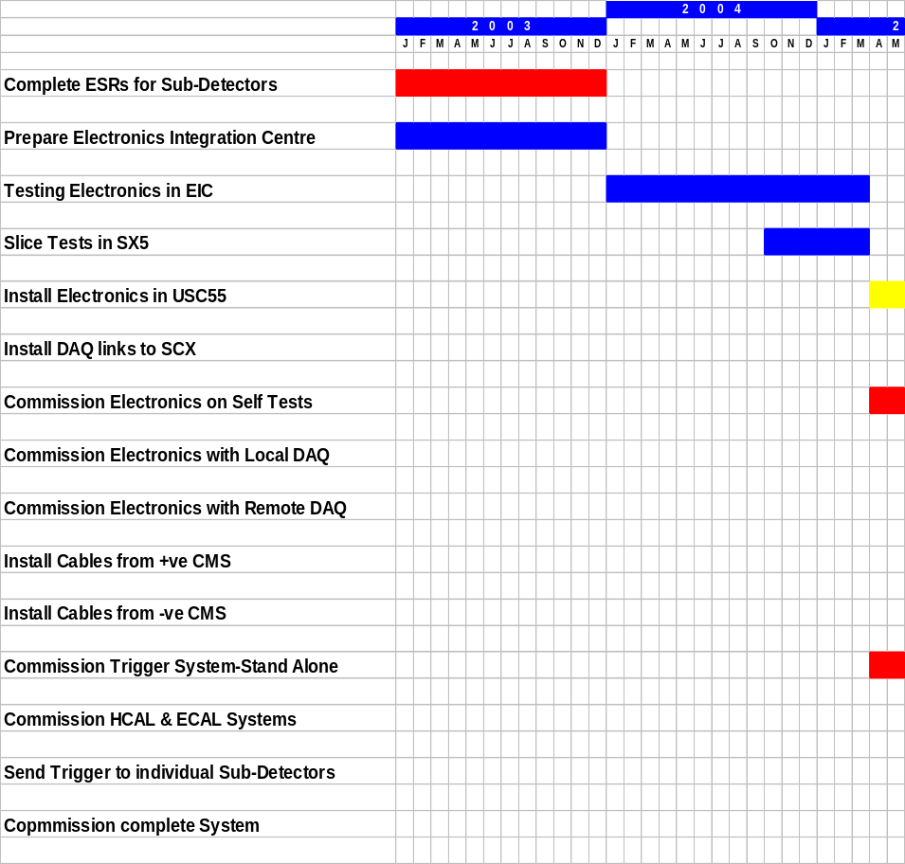
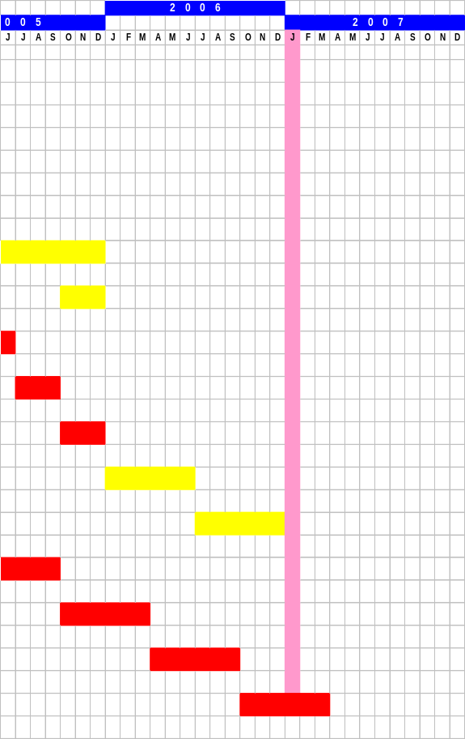
CMS Electronics Installation Plans

Slide 9
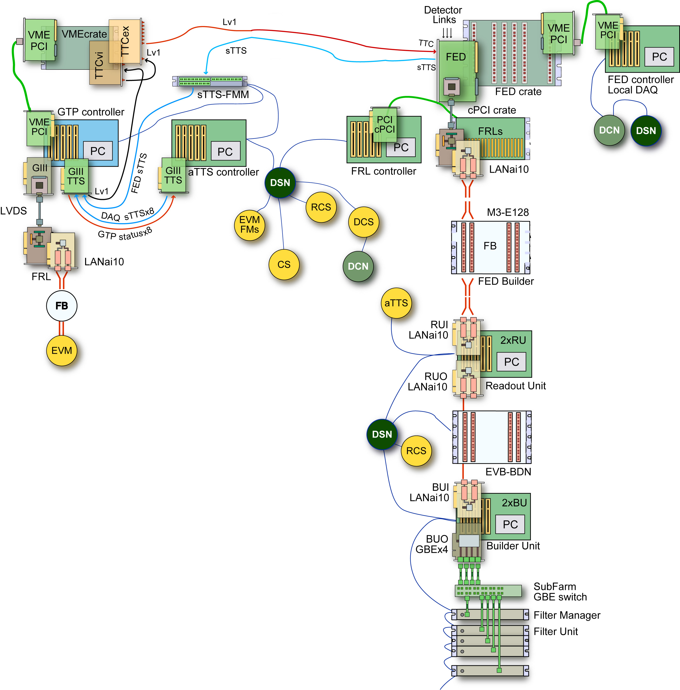
DAQ Systems (local/global)
Detector local DAQ
Readout: FED-VME (~< 20 MB/s)^{(*)}
Trigger: Local TCS/FED polling
RU/BU/FU: CrateC PC
EVB: GBE (DSN/swicthes)
FU: CrateC PC(or Network PCs)
^{(*)}In the Lab also: PC+GIII-FED kit
CMS global DAQ
Readout: FED Builders
Trigger: Central GTPtoEVM
RU/BU: Readout Builder
EVB: GBE (DSN/switches)
FU: Event FIlter
TriDAS local DAQ
Readout: FRL-PCI (~< 100 MB/s)
Trigger: Local TCS/FRL polling
RU/BU: FRL PCs
EVB: GBE (DSN/switches)
FU: Network PCs

Slide 10
DAQ Activities
  2001-2003 TDR demonstrators
  D2S: 4 FED builders, Readout Builder: 1 64x64, Event Filter: 1 Sub farm
  Detector slice test beam local DAQ-DCS systems
  2003-2005 Preseries and H/S design
  D2S: 4 FED builders, Readout Builder: 1 64x64, Event Filter: 1 Sub farm
  Detector slice test beam local DAQ-DCS systems
  2004-2006 Data to surface (D2S)
  S-Llink64 LVDS links and FED data mergers Local Mass storage
  production and installation
  Front-end Readout Link system (FRL)
  FED Builder
  RUI interface
  2003-2005 Detector Controls
  Detector subsystem integration. Central DCS

Slide 11
DAQ – Activities (II)
  services
  2005-2007 DAQ integration
  Run Control servers and networks
  Local storage and remote archive communication
  2006-2007 Readout Builder (RB)
  Readout Unit (RUS, RUO, RUM)
  Readout Builder Data Network (BDN)
  Builder Unit (BUI,BUO, BUM)
  Event Manager and control networks (RCN, BCN)
  2006-2007 Event Filter (EF)
  Filter Farm Networks
  Sub Farm Managers and Filter Units

Slide 12
Schedule
US CMS adopts the CMS master planning – currently called V33
The CMS ML in V33 are tie points for both detector construction planning and M&O planning.
Pre - operations begins in FY03 after SX5 installation with HCAL and ME commissioning (not subject to CERN schedule).
Operations begins after final installation in UX5 with the “pilot run” currently planned for March, 2007 (installation and commissioning on track – beneficial occupancy)
Therefore, M&O costs from FY02 to FY07 can be estimated with little schedule risk.

Slide 13
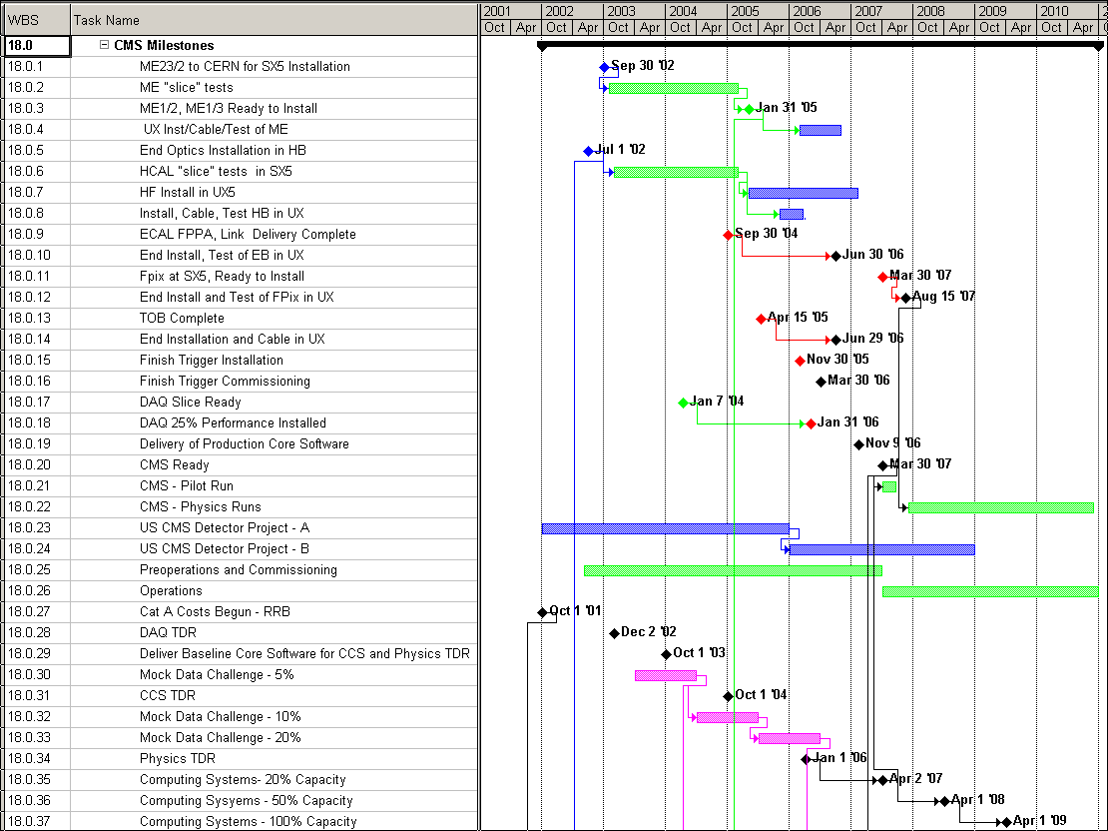
Project “Complete” -> M&O
M&O begins with commissioning and preops in SX5 in FY03. Aim to ~ end Project in FY05, with completion in FY08 – UX5 installation. Slice tests tied to VCR/PAC and DC. This strategy minimizes delays in the Physics.

Slide 14
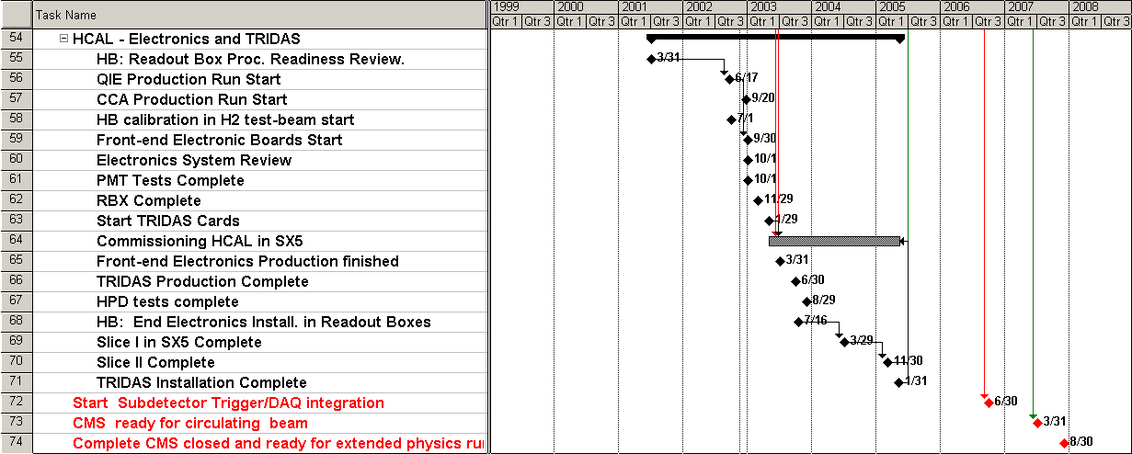
HCAL – Preops in Sx5
People who know the detectors
Alignment
Calibration
Data Bases
Have a big leg up on doing competitive physics analyses.

Slide 15
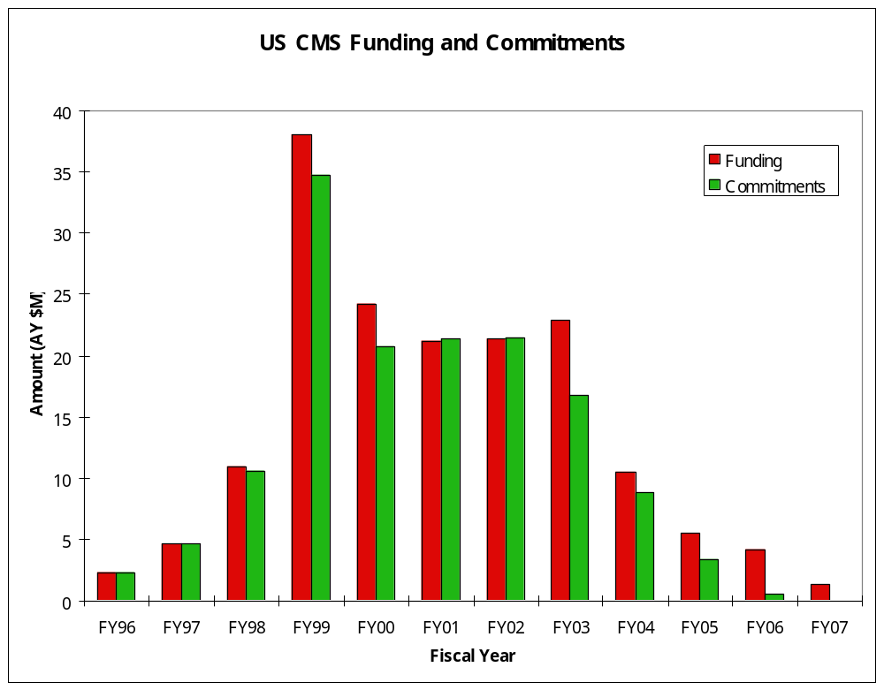
“Endgame” and CD4
The US CMS deliverables will be 96% complete in FY05 and finally installed in UX5 by FY07. The BA has evolved to reflect this fact. Thanks to DOE for adjusting CD4.
50% contingency

Slide 16
M&O for US CMS
We have had resource loaded schedules for Lehman reviews in May 2001 and June 2002.
The agency guidance is for a unitary “Research Program” so that the partition between SWC and M&O must be decided before M&O planning can begin.
The SWC manager has provided a set of reduced scope plans. The “bare bones” or ~ constant level of effort on CSA software engineers has been adopted.
The M&O effort has had the detector work scrubbed hard. However, costs for Physics Analysis Centers have been retained.

Slide 17
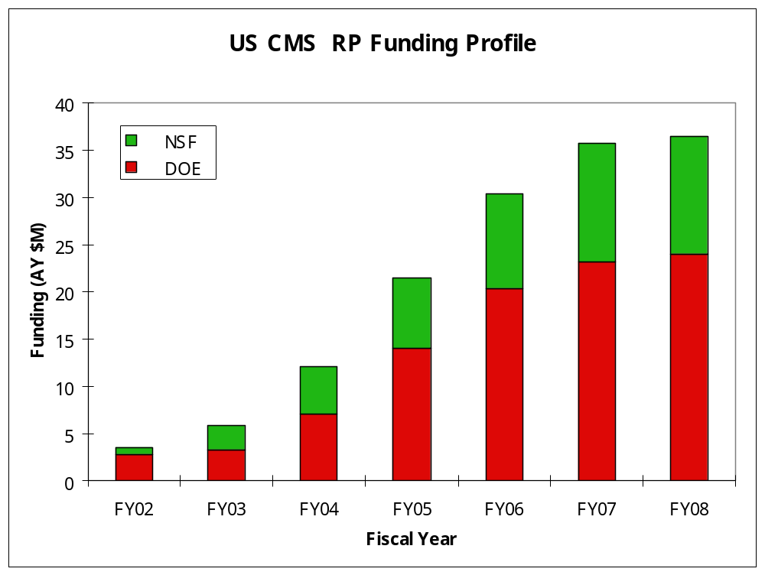
Current Guidance from DOE/NSF
US CMS was instructed to plan scope to fit inside this guidance.

Slide 18
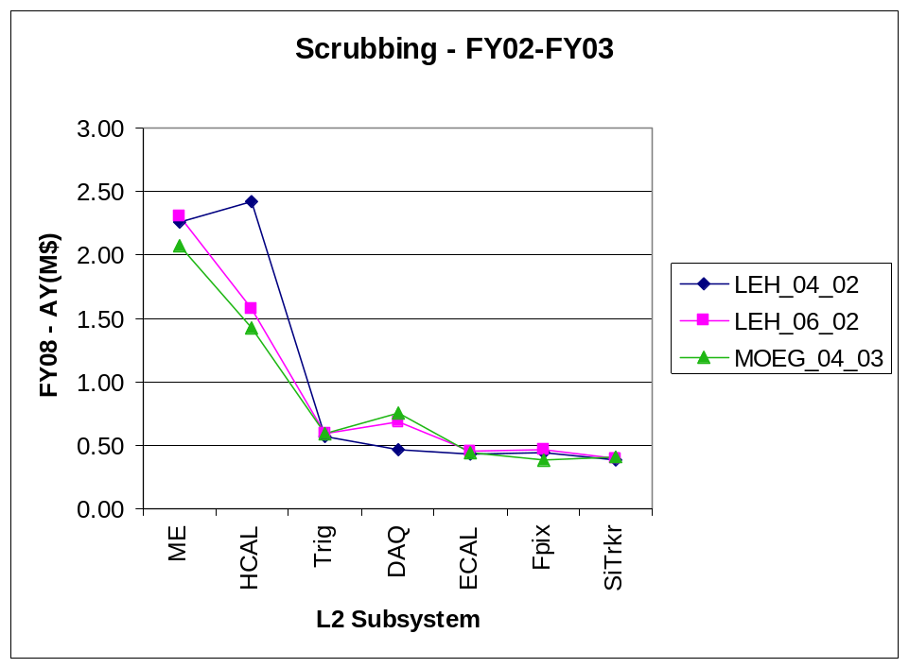
Scrubbing History
DAQ
Slice tests
We have responded to new DOE/NSF guidance from 04/02 to 06/02. The present plan represents another round of scrubbing – total L2 subsystem costs in FY08 (~ steady state) have dropped from 6.96 AY(M$) -> 6.45 -> 6.06. All L2 skilled repairs were placed in the US with cost per use (institutional memory studied.

Slide 19
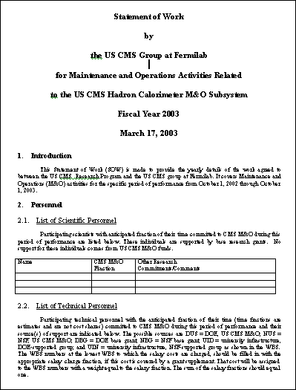
SOW for FY03 M&O
In FY02, the costs were ~ entirely Category A. For FY03 there are L2 subsystem costs associated with pre - operations in the above ground assembly hall SX5. The ME and HCAL subsystems are the most active.

Slide 20
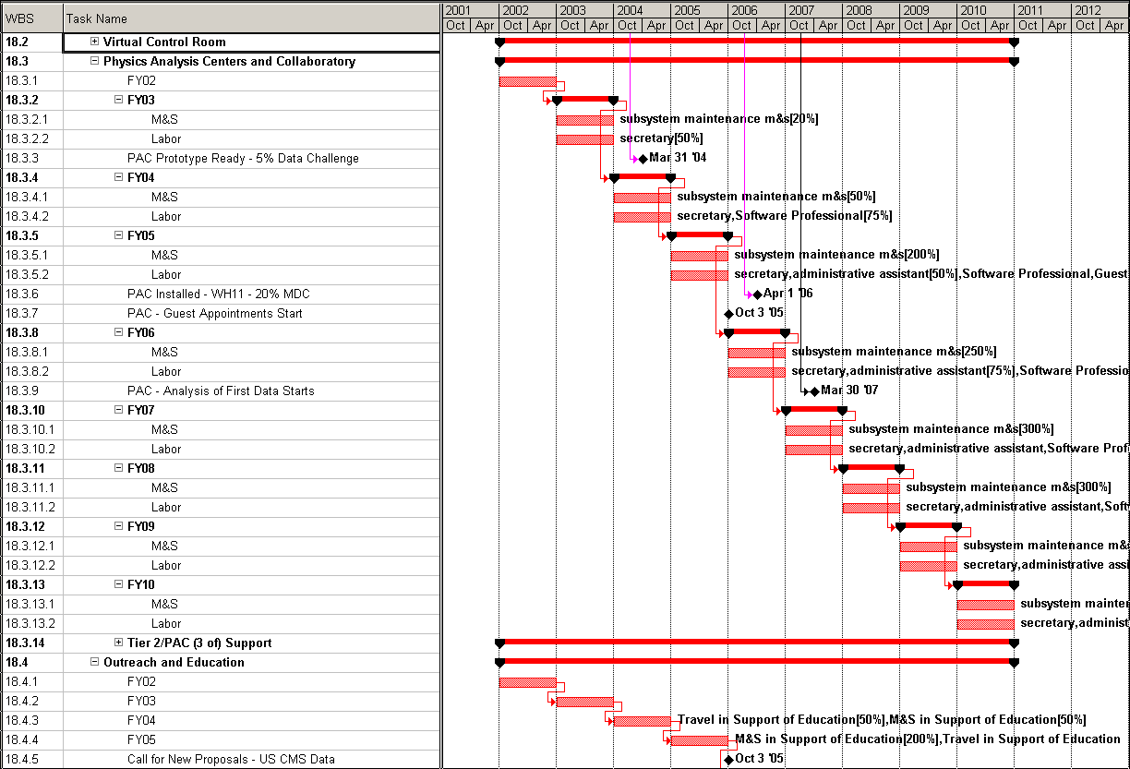
WBS 18 - LHC Physics in the US
In US CMS, planning is in place for a “collaboratory” or virtual laboratory. Elements are Virtual Control Room (commissioning, shifts and US accelerator community) and Physics Analysis Centers ( teleconf, analysis groups). VCR/PACwill save on travel funds and provide a nucleation point for a critical mass of physicists. This support will go directly and solely to US HEP physicists.

Slide 21
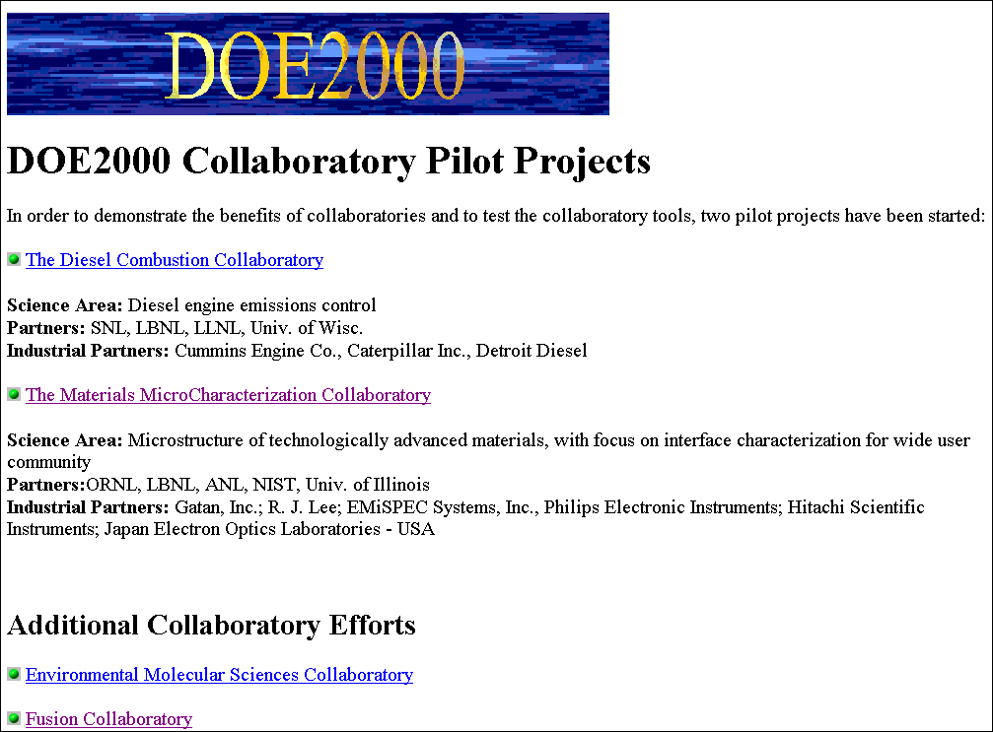

How to do US CMS Physics?
The funding agencies are already involved in “virtual” collaborations and laboratories. Astronomers propose a National Virtual Observatory (NVO). NSF has supported the NVO. Our model is the “collaboratory”. Medium ITR submitted to NSF for “collaboratory tools”.

Slide 22
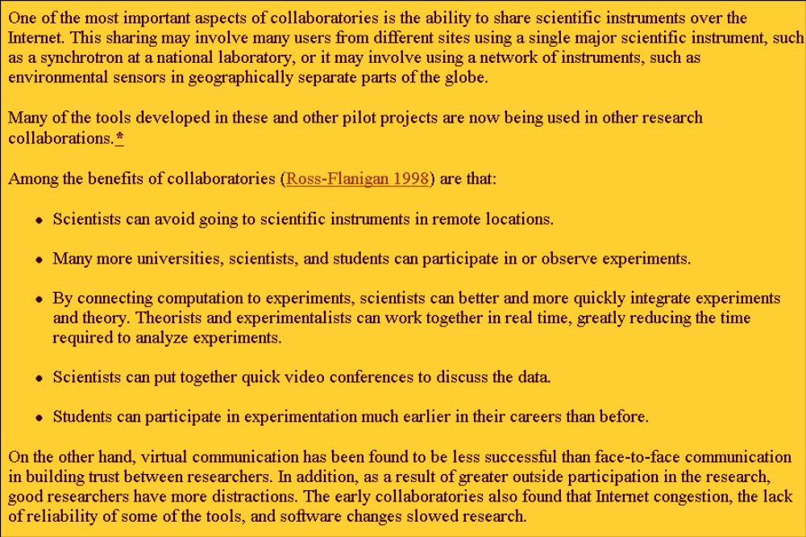
Advantages of the Model

Slide 23
Initial Dialogue with US CMS
Jay Hauser – Fermilab could become a natural meeting point …. Fabulous if user groups had a way to plug in computing resources of their own into a high-speed network fabric at Fermilab
Viv O’Dell – Having a critical mass of physicists local to one place is important for a successful analysis.
Jim Branson – I also don’t have complete faith in videoconferencing for physics and would support space for visitors (including myself) at FNAL. ---- If we don’t supply space we will never get the critical mass to form there. ---- The US program will lose tremendously if we can only do forefront physics by traveling to Europe.
David Stickland – I hope this gets support. I believe it is a sound model.
Bob Clare – I would greatly prefer to be able to do physics in the US instead of having to travel to CERN. I see FNAL as the US CMS host lab and as the natural location for US based efforts.
Gena Mitselmakher – I like very much the concept of the virtual control rooms.
John Hauptman – You have my support on this issue. I forsee a strong center at Fermilab where I can couple strongly.
Sarah Eno – its great to have students and postdocs around to work with. It makes research more fun.
Jim Rohlf - I strongly support the idea of CMS data analysis in the US. … I think you are acting on the issue at just the right time
Chris Tully – if we really want to make this a world-wide effort on analysis, we need an more convenient center in the US. I would therefore think it would be good to have a similair station at Fermilab.. It would be important to have some leading physicists take extended stays at Fermilab.
With 5 more pages of dialogue. Full discussion of need for and requirement of the PAC within US CMS. PAC @ FNAL will make the CDF/D0 → CMS “handoff” easier.

Slide 24
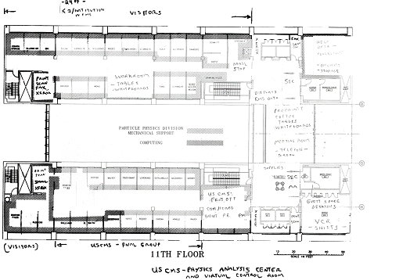
The VCR and PAC on WH11

Slide 25
VCR Requirements
A dedicated room
IP based system with multi-site connection capability
Easily upgradeable
Real-time communication between remote locations
High audio-visual quality
High priority to security and redundancy
Create a “virtual presence” capability
Environment should give remote individuals a perception they are all in the same room
Necessary for confidence building between remote individuals, especially for real-time tasks like accelerator and detector controls
Will require appropriate placement of multiple microphones, speakers, and cameras in the rooms.

Slide 26
VCR/PAC Planning
Status Update
  In the process of starting a multi-year R&D effort to establish a CMS Virtual Control Room and Physics Analysis Center.
  A proposal before June 1, 2003
  Will require active involvement of Fermilab Computing Division and CERN IT Division

Slide 27
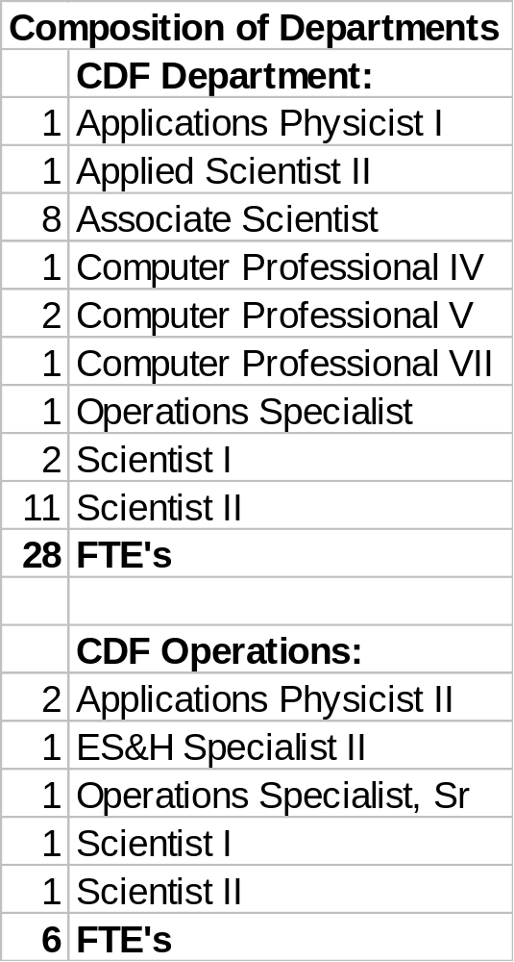
Scaling by CDF Run II
CDF has an Operations and a distinct physics analysis group.
Ops: PO @ CERN SWF:
1 Ops Spec 1 Eng
2 Tech/App Phy 1 Sen Tech
1 Sec 1 Comp Spec
1 FTE ESH 1 Sec
CDF: PAC+VCR:
4 Comp Prof 2 Comp Spec
1 Ops Spec 1 Tech
2 AA 1 AA + 1 Sec
2 Guest Sci

Slide 28
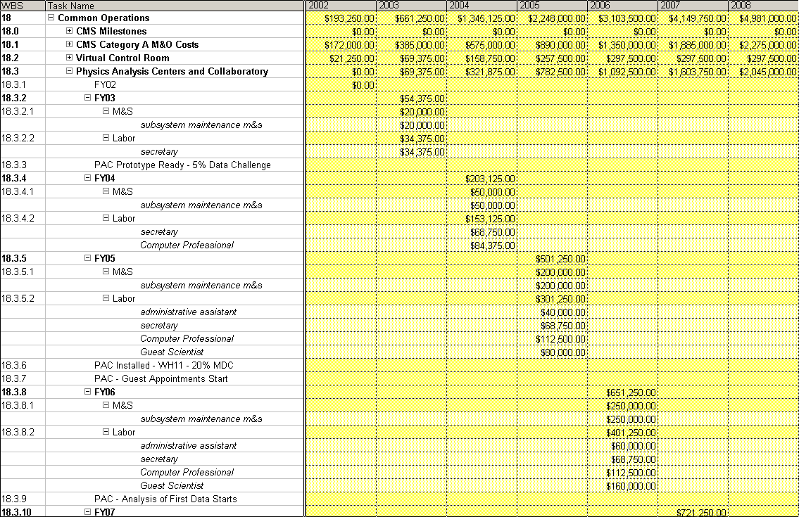
Common Ops – WBS18
Note that Category A costs are ~ half of all Common Ops costs

Slide 29
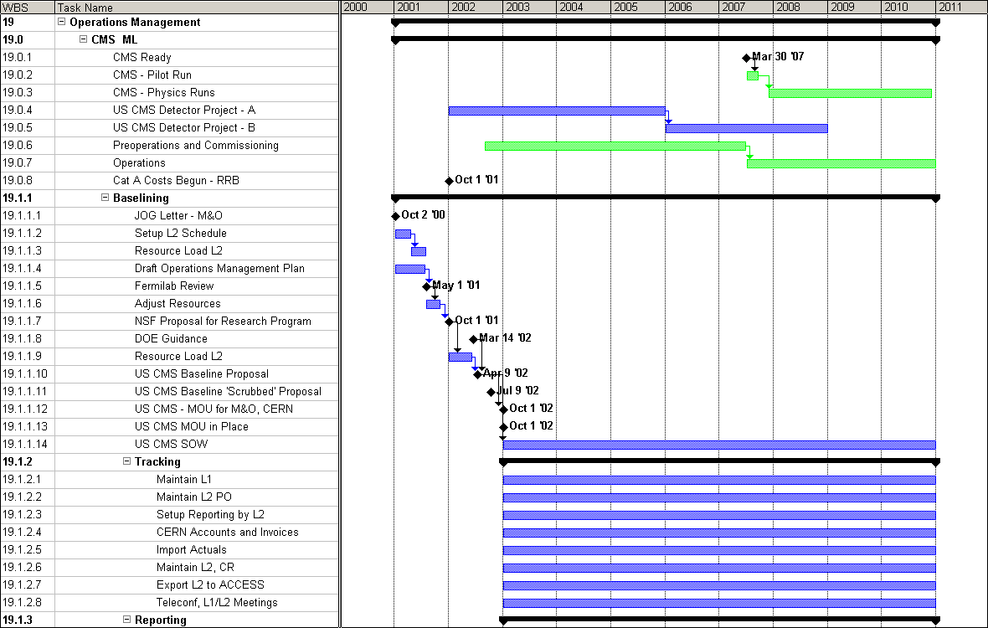
WBS 19 – Operations Management
US CMS has been planning M&O since the start of FY01. The plan is now quite mature
This review – scrub again

Slide 30
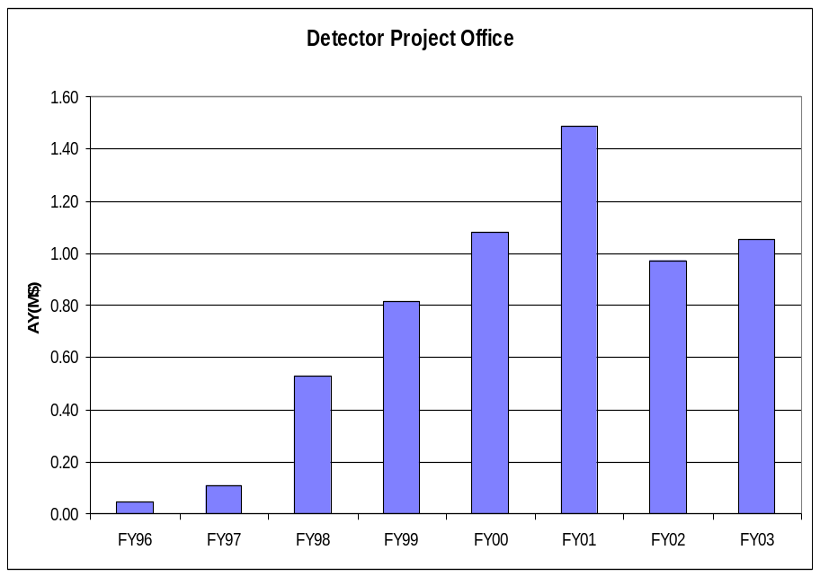
Scaling from the Detector Construction PO
We need not report earned value for the Research Program. Nevertheless, good management practice means that we will track and report actual costs and use signed invoices and prior management approval of all costs. There is a third major PO at CERN, with an overall strawboss + lead tech (economy of scale).
Loan to SWC

Slide 31
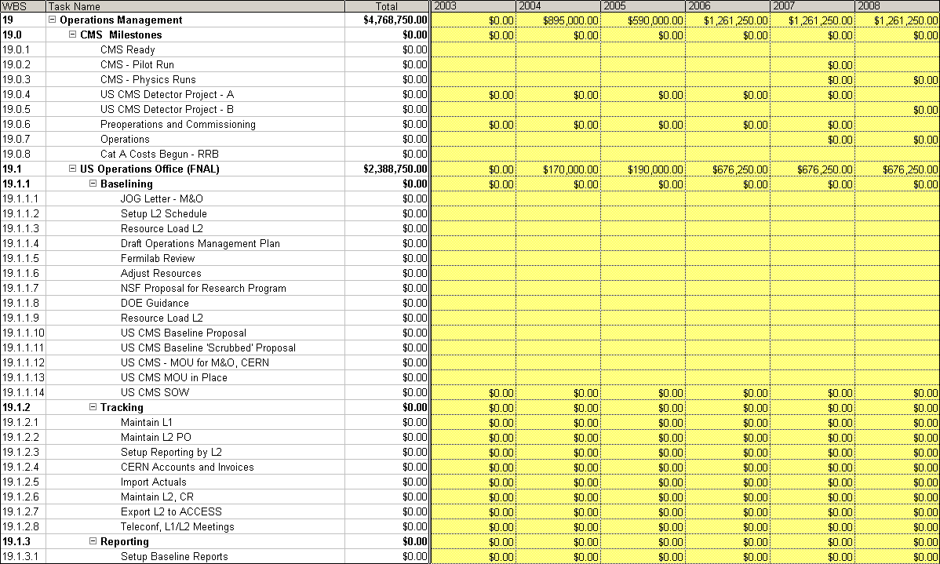
WBS 19 – Ops Management
We need 3 branches of the PO. FNAL + NEU as before (detector) but with a new and major CERN branch. Note detector 90 % done by FY04 → using detector contingency

Slide 32
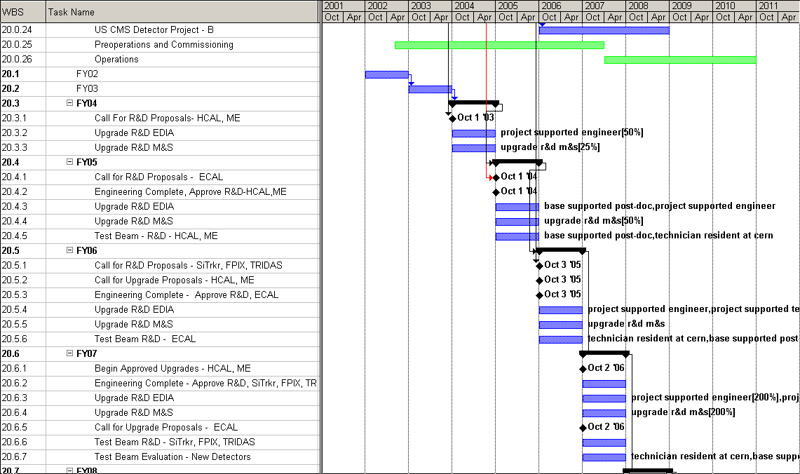
WBS 20 - Upgrade R&D
Start when
installation
complete
The LHC machine plans the Luminosity upgrade for ~ 2012 - 2014. Economy of scale to supply EDIA + drafting for L2 R&D

Slide 33
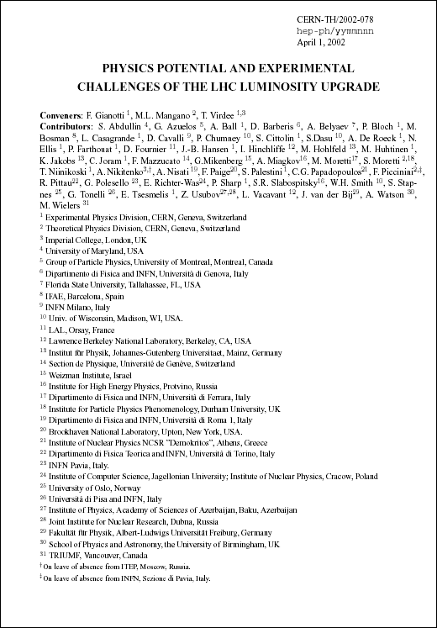
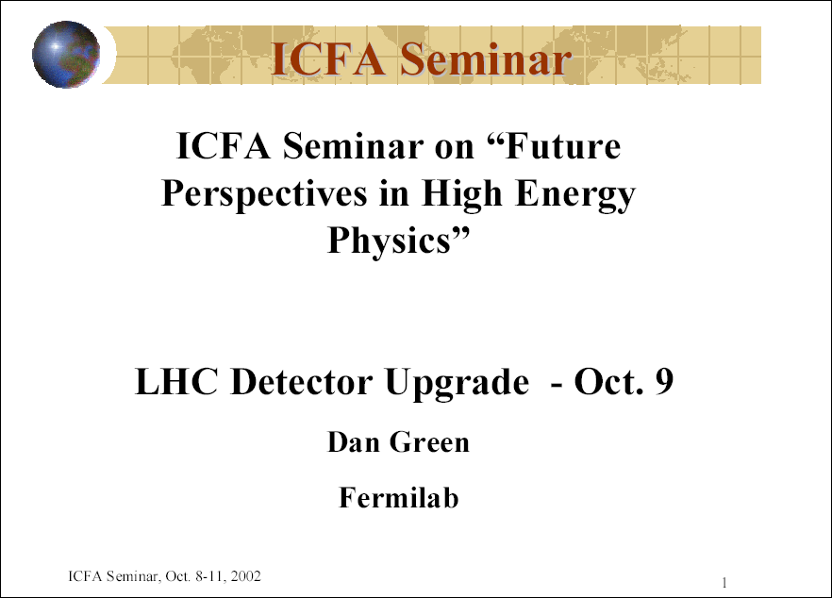
R&D on Luminosity Upgrades
Planning for the detector upgrades has begun. Based on the R&D times needed for the present detectors ATLAS and CMS, it is now time to start upgrade R&D. Plan has only 2 FTE in FY05 – slow rampup.

Slide 34
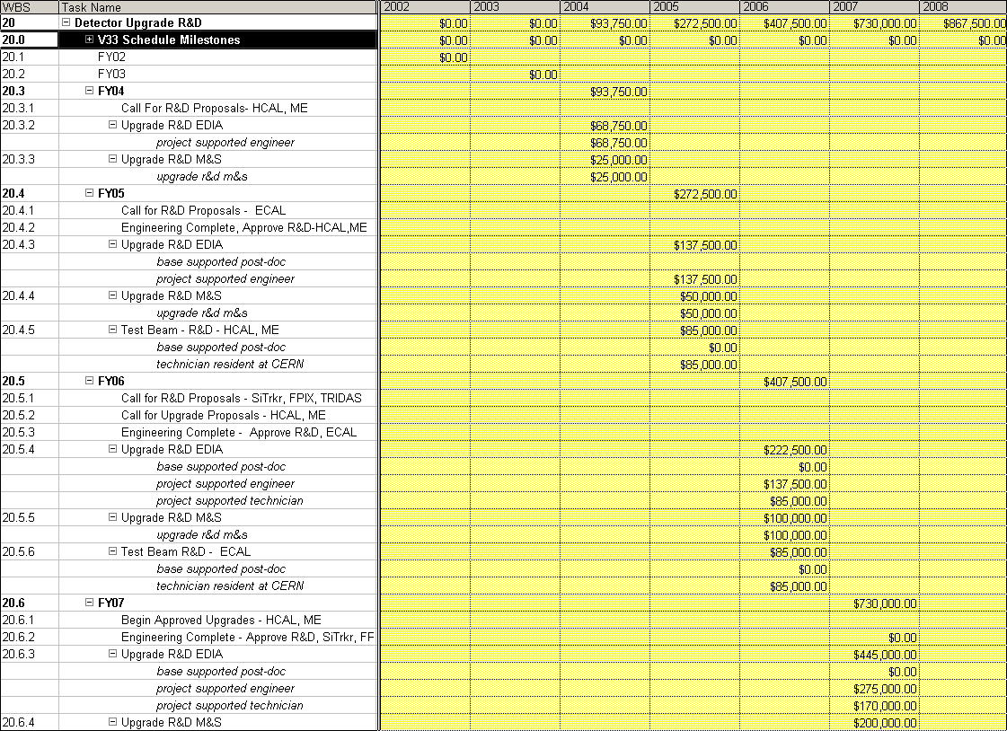
Costs for Upgrade R&D
There is a slow start in FY04 for HCAL and ME since they are installed in SX5 and are in the commissioning phase of preops.

Slide 35
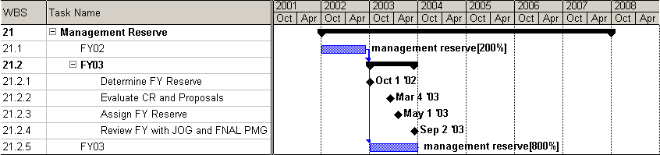
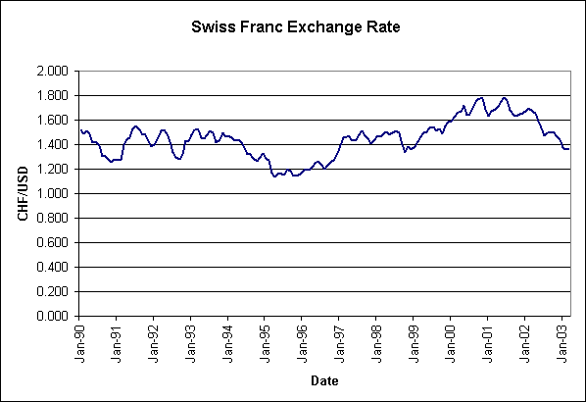
WBS 21 – Management Reserve
The current plan calls for 25 % reserve (10 -20% in FY03-FY05). Reduced MR means less management agility.During the FY, Change Request proposals will be entertained. Any assignment of reserve above 0.5 M$ goes through the FNAL PMG.

Slide 36
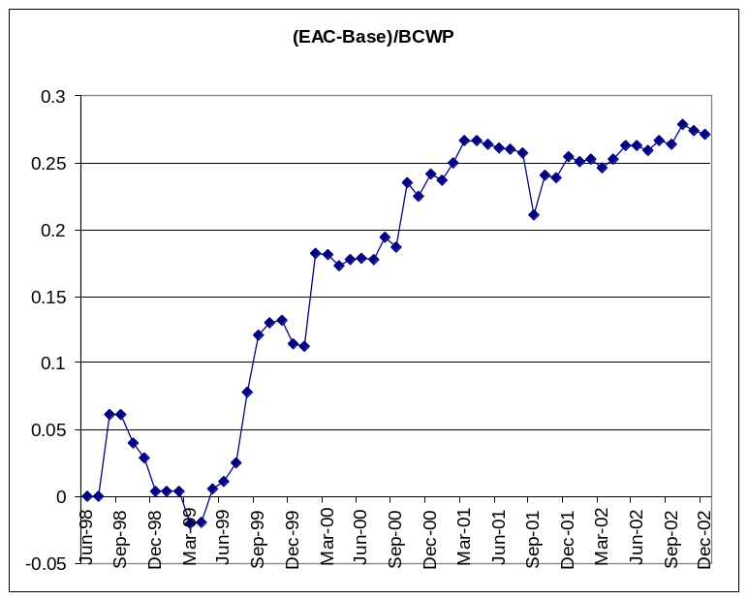
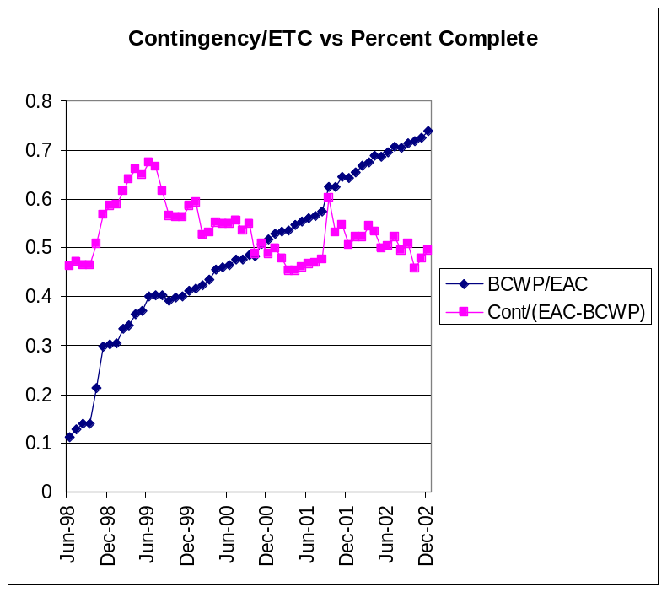
Contingency Use in Detector Construction
We used about 25% of the work performed on contingency. We kept a level of contingency which was 50% of the estimated cost to complete. Thus, 25% management reserve seems ~ correct. It roughly agrees with the bottoms up contingency assessment.

Slide 37
US CMS M&O – FY07
Subsystems – 7.6 M$/yr (D0 scale)
Comm Ops – 4.7 M$/yr, Cat A (2.2 M$/yr), PAC, VCR, E&O (CDF Dept.)
Ops Office – 1.4 M$/yr (US CMS
detector construction PO)
Upgrade R&D – 0.8 M$/yr
Reserve – 3.5 M$/yr (US CMS
contingency use)
-----------------------------------------------
18 M$/yr with 65 FTE E + T + 70 FTE PD (~150/2 FTE available to US CMS by redirection of effort within the collaboration)

Slide 38
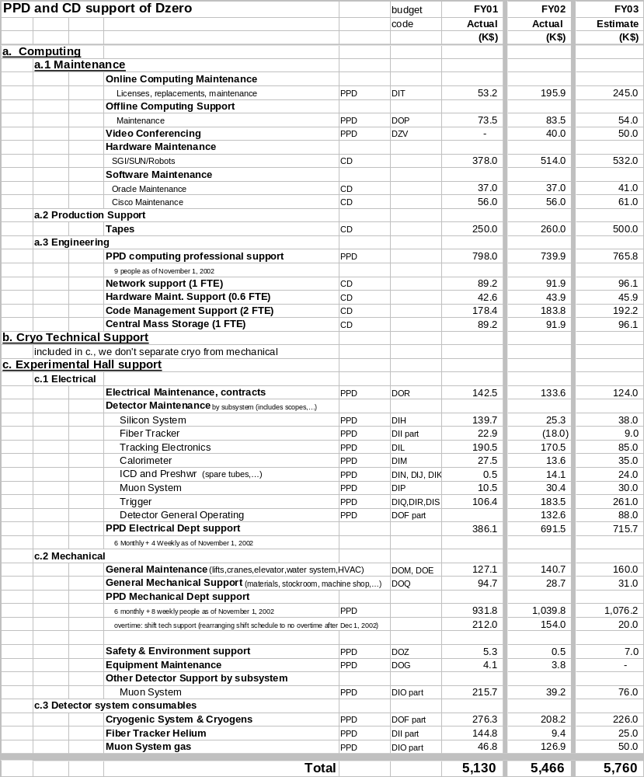
L2 - M&O Scaling from CDF/D0
FNAL Support of D0:
Remove CD support
Remove Cat A costs – no common costs, no consumables
Remove visitors
Find that there are ~ 25 FTE at Fermilab alone in support of subsystems and with base costs of ~ 3.8 M$/yr.

Slide 39
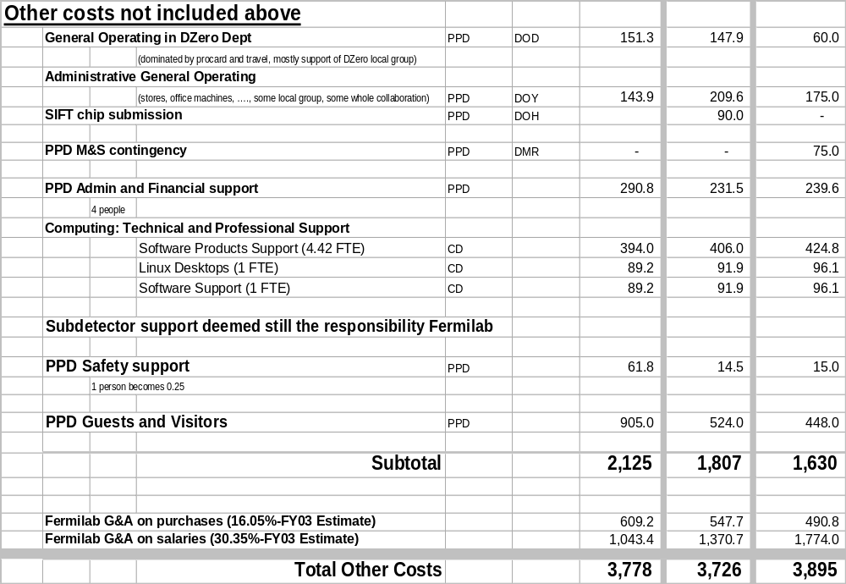
L2 Scaling -D0 - Admin, G&A
With G&A on the M&S and SWF of 2.1 M$ in FY03, the crude total for D0 support – at FNAL alone – for detector M&O is ~ 5 M$/yr. Some CD support for database personnel etc. should be added into this total. Compare to ~ 7.6 M$/yr for L2 subsystems for US CMS.

Slide 40
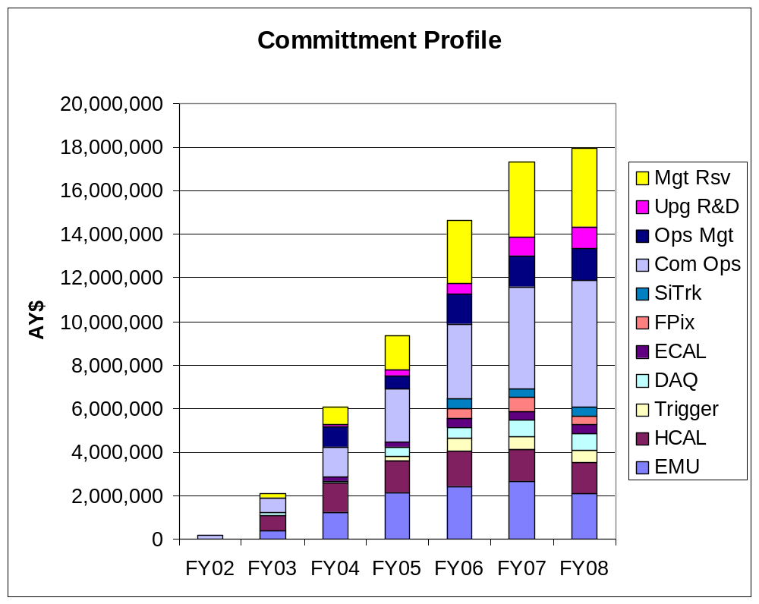
Scrubbed M&O - Totals
Has support (NSF) for 3 Physics Analysis Centers - probably at Tier 2 sites. We would like to do more to support US physicists doing analysis at their home institutes or at a “local” PAC.
n.b. – MR, Ops Office and R&D in 03-05

Slide 41
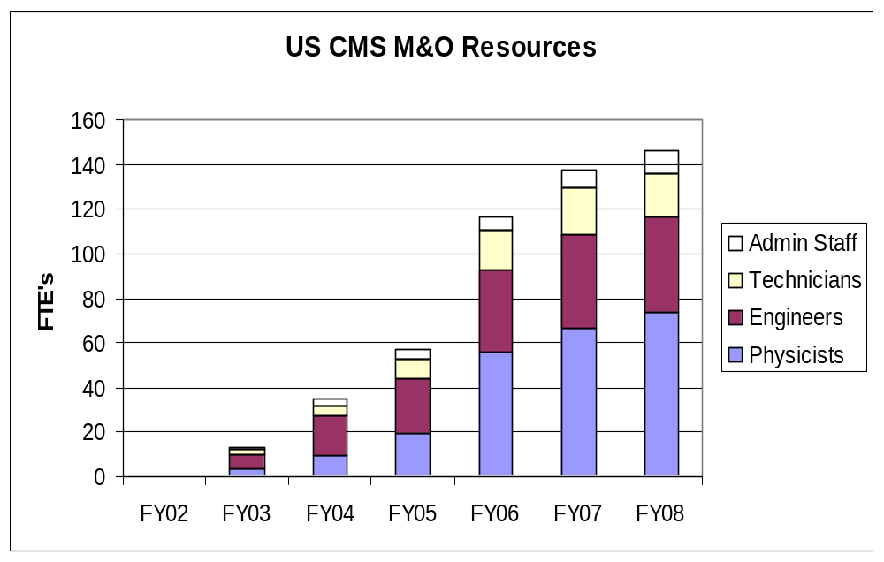
US CMS M&O Resources
Note that the Construction Project is ~ done by FY05. The major growth category for M&O is physicists -> base program.
BaBar – a second
Reality check

Slide 42
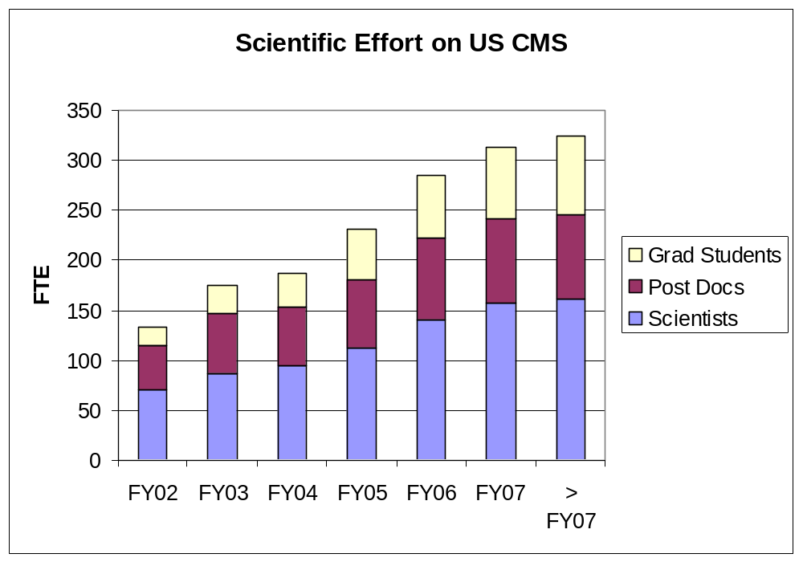
US LHC and the RP
US CMS has made a survey of intent. It appears US CMS will grow by a factor ~ 2 by FY07. US CMS is clearly committed to the Physics.
In addition, new groups will join before first beam.
Compare GS +PD committed to FTE physicist resources needed. Matches is ~ 50% duty factor – service work + Physics analysis.

Slide 43
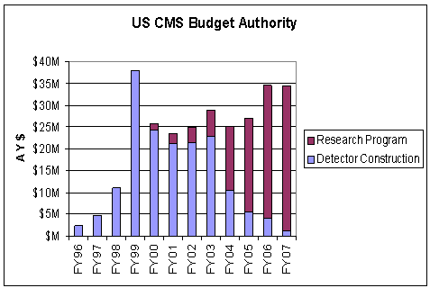
Agency Guidance for the RP
The US CMS community has carefully estimated and scrubbed the costs for the Research Program. US CMS estimates that more support would be very useful in FY04-05. Present planning within the guidance provided in the Budget Authority delays R&D for upgrades, slows the SWC ramp up (bare bones), and reduces the MR to a level which limits management agility.

Slide 44
Project and Program
US CMS
Detector
Construction
Project
(< ’05, < ’07)
PM
Dept. PM
US CMS
Research Program
(> ’03)
Program
Manager
SWC
PM
M&O
PM
VCR/PAC
PO

Slide 45
Summary
CMS are actively planning for commissioning.
US CMS schedule is tied to CMS and CERN, but preops are ~ not subject to CERN schedule.
Early Physics → SX5 “slice” tests.
M&O planning is matured and well scrubbed.
Reality checks for VCR/PAC, Ops Office, MR and L2 subsystems using CDF, D0, BaBar and the US CMS Construction Project are made and seen to be plausible.
US CMS has cut to fit within agency guidance. There are several items not within the scope of the guidance.
We need to make progress in filling slots in the US CMS line management .

Slide 46
Dialogue - II
Benn Tannenbaum – I agree that this is something that we must do in order to maintain a viable US HEP community….. Many oif the ideas and problem solving happen during casual hallway interactions. Unless there is a critical mass of physicists somewhere in the US, everyone will head to CERN.
Joel Butler - All that is required is the will to do this. … the requirement to spend large amounts of time overseas, while it may attract some people, may encourage a lot of good people to look at fields other than HEP.
John Womersley – they won’t come, and shouldn’t, unless Fermilab is also the intellectual center for CMS physics. .. we need to be physics leaders in CMS and not just detector builders.[
Tim Bolton – I see a lot of advantages to an analysis center at Fermilab for KSU types.
Terry Watts – How about an experienced secretary?
Sarah Eno – I really believe its time for at least 1 Fermilab permanent person working full time on CMS physics.

Slide 47
Continuing Dialogue
Comments Received After the Fermilab Letter of Support
Chris Tully
hi Dan,
Having a physics analysis center at Fermilab is essential for
US CMS. My two students and I have recently obtained IDs and computer
accounts at the lab and plan to make more use of the facilities.
If there is something we can do in the way of helping with the center
or showing our support for it, then please let us know.
Chris
Hans Wenzel
Dear dan
I definietly want to be involved. I am especially interested in setting
up a PAC. But ok one can discuss details. There definitely has to be enough
mainpower
for support and sysadministration (we are currently very short handed)
and the hardware should be set up correctly from the start.
Anyhow keep me involved in any discussions.
cheers
hans
Regina Demina
Hi Dan,
i fully support your effort. we just hired a postdoc with the main task of cms
analysis work. please let me know if there is anything i could do to help
prepare for the review of the US CMS Research Program in April, 2002.
regards,
regina.

Slide 48
Continuing – II
Bob Cousins
Dear Dan,
I don't know if you are getting any responses to your email about the
analysis center at FNAL, but I thought I would throw in my small two
bits just so you know someone else is out there who appreciates the work
you are doing. ……
So, thank you for all the work it took to bring it thus far, and please
feel free to cite me as someone who strongly supports the physics
analysis center at Fermilab.
Best regards,
Bob
Winston Ko
Dear Dan and Lothar,
Thank you for your "Build it and they will come" document. I am writing to
say that "indeed we will come!" Congratulations on garnering support for
the Physics Analysis Center (PAC) and the Virtual Control Room (VCR)
projects from the Fermilab Directorate.

Slide 49
Continuing - III
Bob Clare
Dear Dan (and colleagues),
I was quite pleased to see the letter from Mike Witherell outlining
the plans for US-CMS support. This represents a major commitment by the
lab for an experiment that is based elsewhere. The Wilson hall is "prime"
real estate. A full floor is a very significant commitment. A full floor
allows the possibility of forming a critical mass.
I personally think that this is a good idea. I am well aware that the
center for CMS is at CERN. There will always be a need for people to be
at CERN. But, especially for those of us on the West Coast, getting to
CERN is an expensive undertaking. Expensive not just for the travel
costs, but for the time lost. And let's not forget the nine hour time
difference.
Thus, I think that a center at FNAL, serving the needs of US-based
physicists is a plan that can work. Especially with the FNAL plan to
support a number of guest scientists to seed an anlysis center. Clearly
such a center will not work without a critical mass. Clearly such a
center needs to be attractive to tip the scales towards going there
rather than going to CERN. This will not happen over night. It may not
happen at all. But I, for one, think that it is worth the attempt.
There are also a large number of institutes that are both in CMS as well
as in FNAL experiments. Such a center can only be a "good" thing for
these groups as well.
This, at least, are some of my thoughts on the subject. It won't be easy
to get it up and running. The alternative, however, is to continue
operating in the mode that we have all gotten used to: "send your people
to CERN and deal with it". Is *that* really better?
Bob

Slide 50
Continuing - IV
Jim Branson
This is truly good news for US CMS. While all of us have been supporting this
for a long time, Dan Green (and Lothar Bauerdick) have really made this happen.
I am particularly heartened by the promise Visiting Scientist positions at
Fermilab.
The Physics Analysis Center is a topic that all of US CMS should be interested
in. It will affect all of us. In particular it will have some effect on the
Software and Computing Project, which is also centered at Fermilab. The
prospect of a significant base of local users will benefit the S&C project.
Lucien Cremaldi
I am big favor of the physics analysis center at Fermilab.
Most people are presently interested in porting CMS code to their
local linux box. This is still not easily done from Fermilab.
Fermilab computer security is overburdening. I haven't been able to log in
months due to this kerboros keyed login procedure. You might offload this
duty (cms updates) to a university tier site. Universities generally find it easier to deal with other universities- similar problems.
Fermilab software releases are behind. Example, I just had changes made to
the forward pixel geometry -> cms125. Last release from Fermilab was cms121?
Maybe some exaggeration here, but the downloads from CERN must keep pace

Slide 51
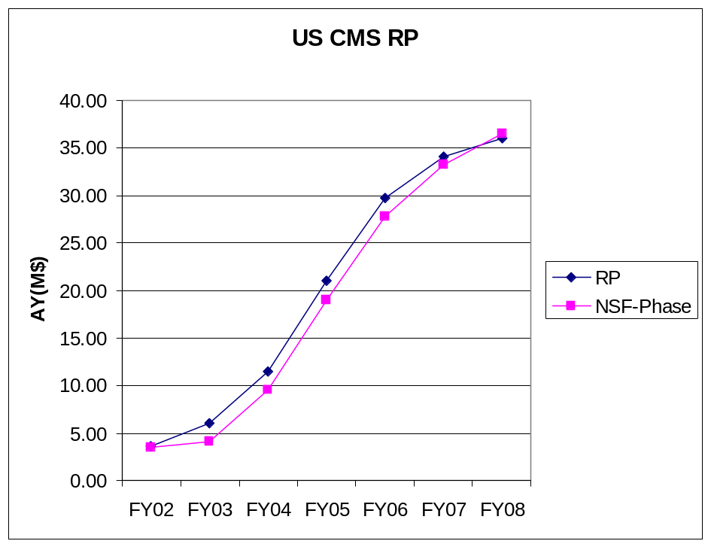
NSF “Phase” Issue
When NSF funds arrive as per “guidance”, they will arrive late in the FY. Meanwhile, the RP effort is largely personnel costs which are ongoing. Therefore, we will just make the “bare bones” SWC effort and the “scrubbed” M&O effort but with a cash flow problem.
New “loan” needed? It must be paid back out of RP in FY04 or FY05 – CD4-a

Slide 52
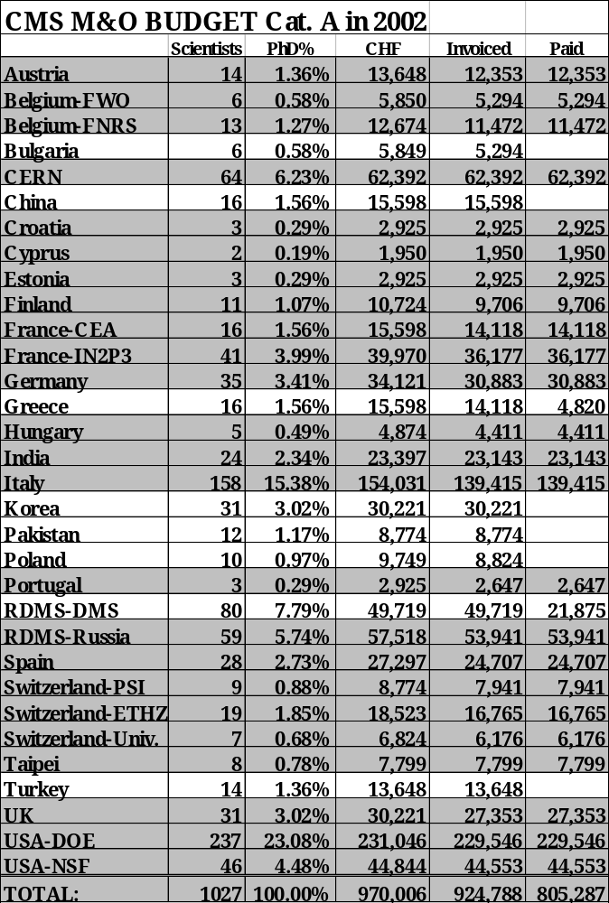
FY02 – Cat A
US CMS began Category A payments in FY02. They are pro rata based on a scrubbed list of PhD physicists in US CMS. US CMS is the largest single group in CMS ~ 25%.

Slide 53
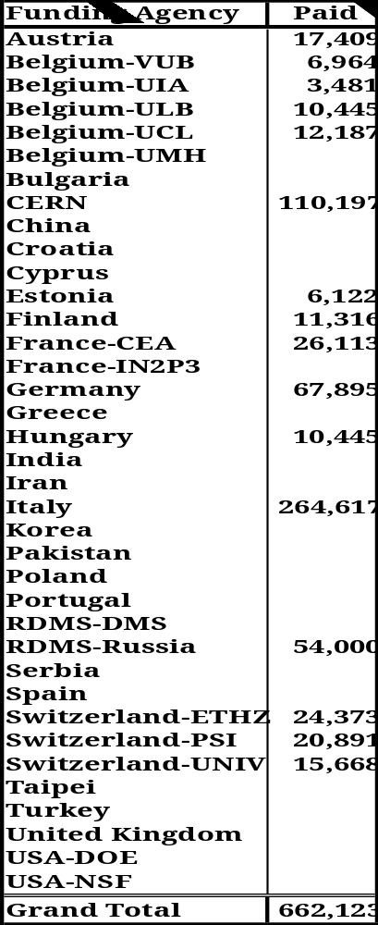
FY03 – Cat A
FY03 Category A payments were delayed by the US continuing resolution. The level of costs is ~ double that of FY02. Estimated payment is 335 k$.
US CMS have advocated, and for ME, HCAL have adopted, a strategy of “you built it, you maintain it”. Therefore, the use of common Category B costs is minimal.

Slide 54
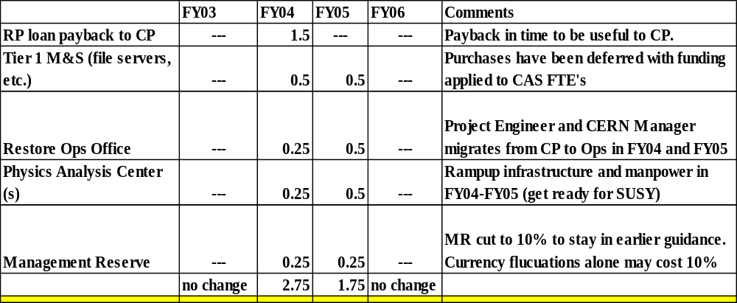
What if BA Increased?
In order to avoid “layoffs” of software engineers, a loan to SWC of 0.5 M$ was made in FY02. With NSF funds arriving late, a second loan of ~ 1.0 M$ would be needed in FY03. There are also incremental (scope increase) requests for LCG support. We slowed RP PO using Detector contingency.

Slide 55
Comments on RP Cost Estimate vs Funding
Based upon earlier guidance, US CMS cut RP to ‘bare bones’;
  Instructed M&O and S&C managers to reduce FY03-FY06 to minimum.
  Loaned ~$1.5M from construction project to RP (S&C).
  Shifted operations support from RP to CP (contingency use).
  Reduced/delayed Upgrade R&D.
  Reduced Management Reserve from 25% to 10% in FY03-FY05.
    Lowers management agility.
  Cut hardware purchases from Tier 1 to ~$0.
    Endangers Data Challenge (DC04).
  Reduced/delayed PAC support for Tier 2
    Risk support for US physicists for early LHC physics.

Slide 56
Issues
The ramp up of the RP is crucial. FY03 and FY04 will either get us a good start on preparation for Physics or we will drop the ball on Data Challenges and the Physics TDR.
A firm commitment by NSF and DOE is absolutely necessary if we are to plan rationally. The M&O Evaluation Group and SWC Reviews are a good start.

Slide 57
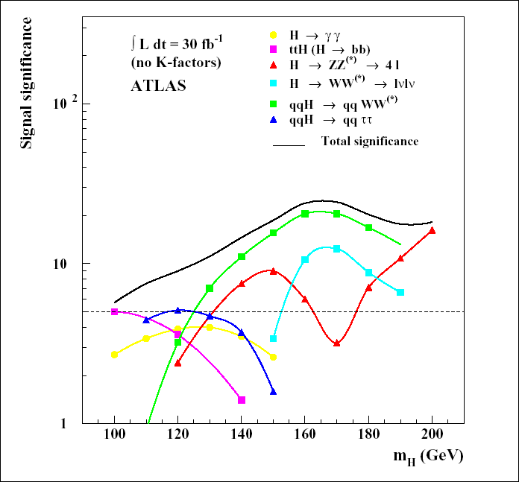
LHC - SM Higgs
The LHC detectors are designed to find the SM Higgs. Low mass is covered by γγ, ttH(bb), qqH(WW*,ττ). A low mass Higgs has many accessible decay modes → couplings measured. Plot is 3 months at 1/10 design luminosity.

Slide 58
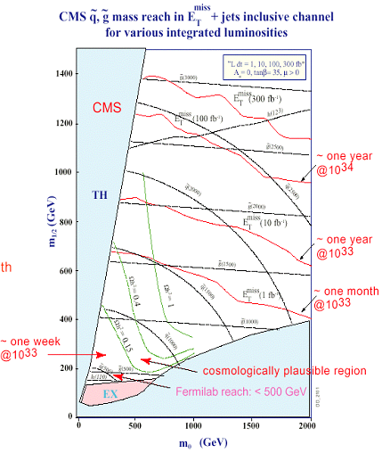
LHC - SUSY
Energy matters! One month at 1/10 design luminosity extends mass reach by a lot.
LHC experiments must be ready on “week one” for new Physics.
That perception defines the US CMS strategy of “slice tests” in SX5 of ME and HCAL with a “portable trigger” from the US and with a “portable DAQ” since the US supplies the first 1/8 of the DAQ – a stand alone segment.

Slide 59
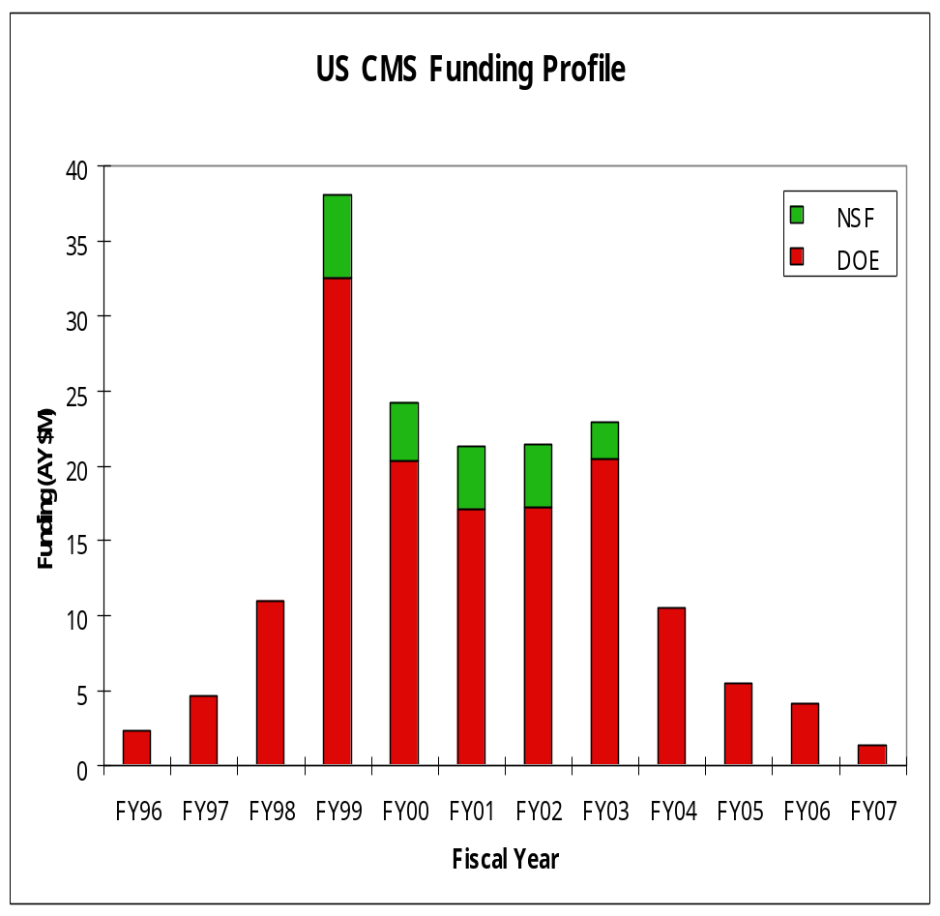
Detector Project - Endgame
The US CMS detector deliverables will be 96% complete in FY05 and finally installed in UX5 by FY07. The BA has evolved to reflect this fact. The Detector Project is ~ over by FY05. The softer profile allows US CMS to maintain the SWC effort at a ~ flat level in FY02 through FY04.

Slide 60
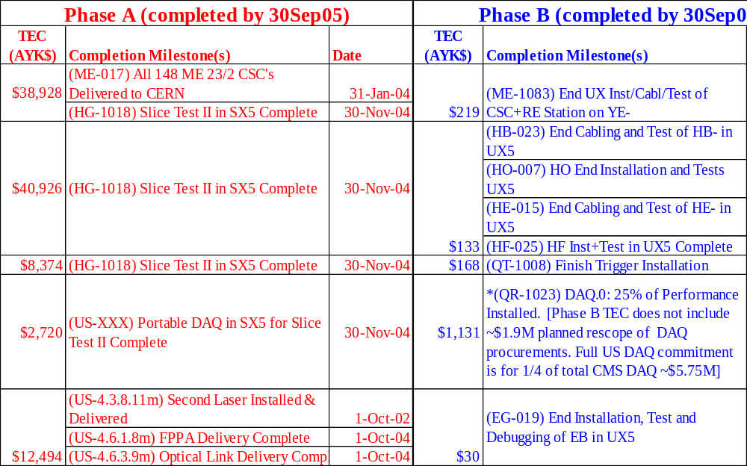
ML for CD4-A, B

Slide 61
Preparation for this Review
WBS Dictionary - notes field of MS PROJECT updated. Contingency ~ Management Reserve has been updated.
SOW have been written for FY03 because preops is in train after ME and HCAL installation in SX5.
Schedule – synched to V33 CMS master schedule and scrubbed to ~ meet guidance.
Costs – resource sheets updated to cover specific, fully burdened, people. Category A updated after CMS Scrutiny Group.
Handoff (CD4-a, CD4-b) from construction to preops and ops made crisper.

Slide 62
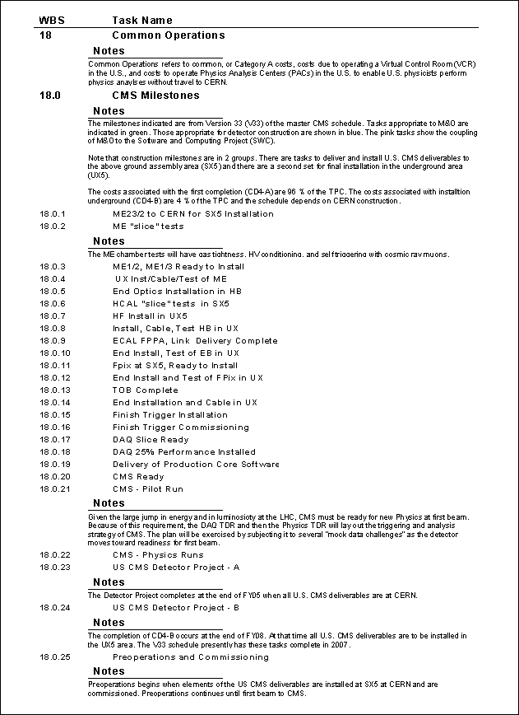
WBS Dictionary - Notes
MS PROJECT files have been created by the L2 managers with full resource loading. The BOE is provided by the “notes” field and available in the WBS Dictionary.
A contingency analysis has been made and is captured in the schedule files.

Slide 63
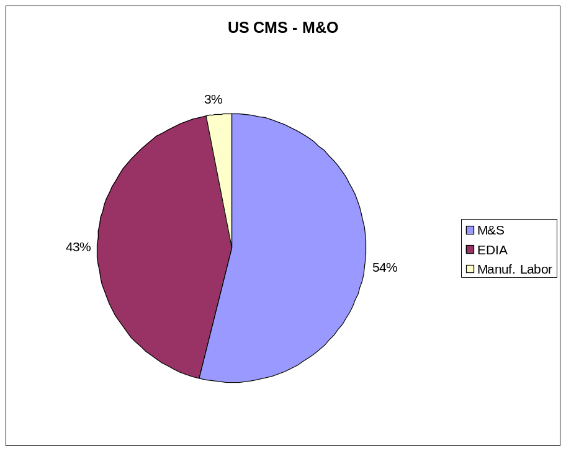
Sort M&O Costs
Essentially half EDIA and half M&S. M&S costs can be estimated well. EDIA tasks are bottoms up and reality checked by “scaling”

Slide 64
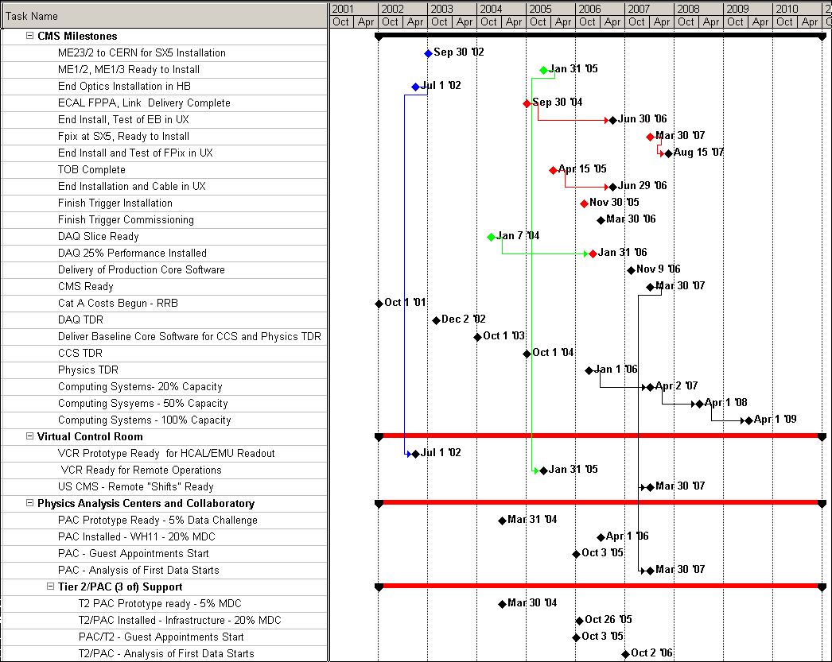
ML for RP – V33
Tie points from Computing Systems – DC – Physics TDR – VCRs and PACs. The RP is a unitary plan to do Physics in the U.S.

Slide 65
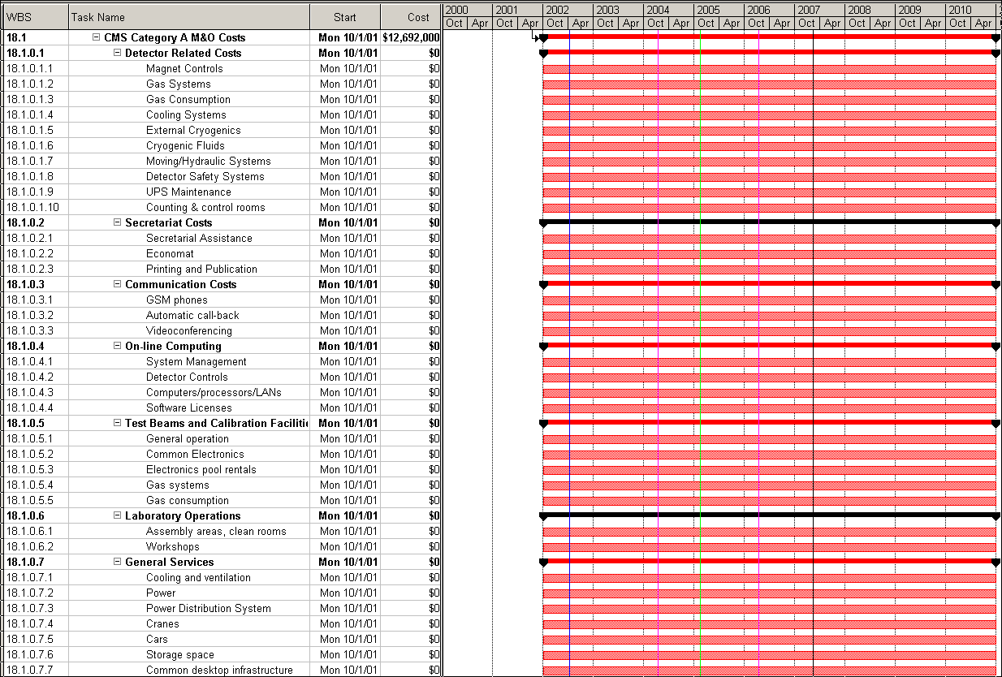
WBS 18 – Common Costs

Slide 66
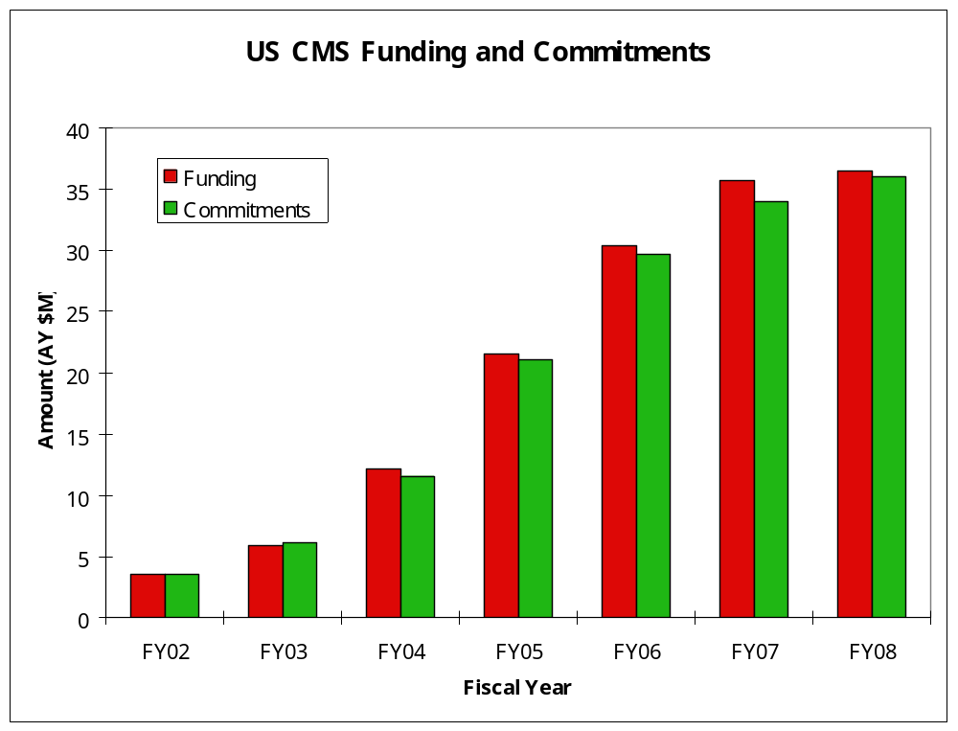
Comparing BA and Commitments
We are asked to cut to fit within the guidance and have complied.

Slide 67
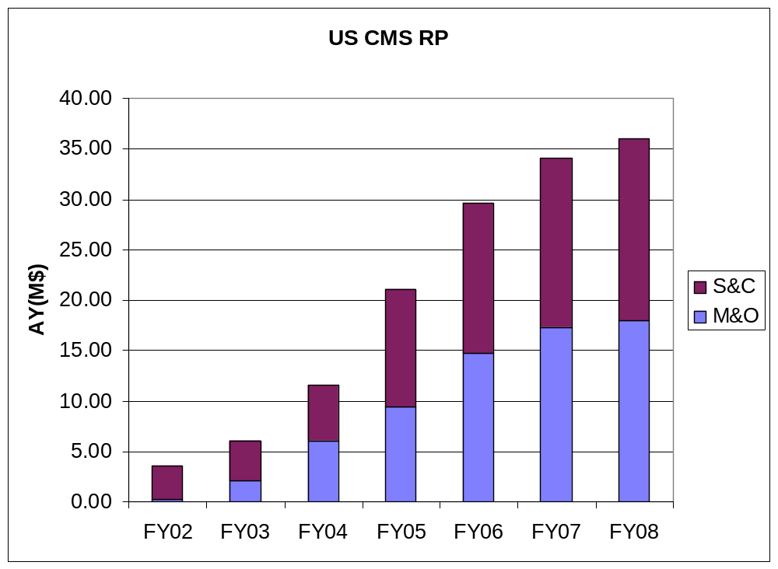
From M&O to the US CMS RP
SWC “bare bones” model used to stay within the agency guidance.

Slide 68
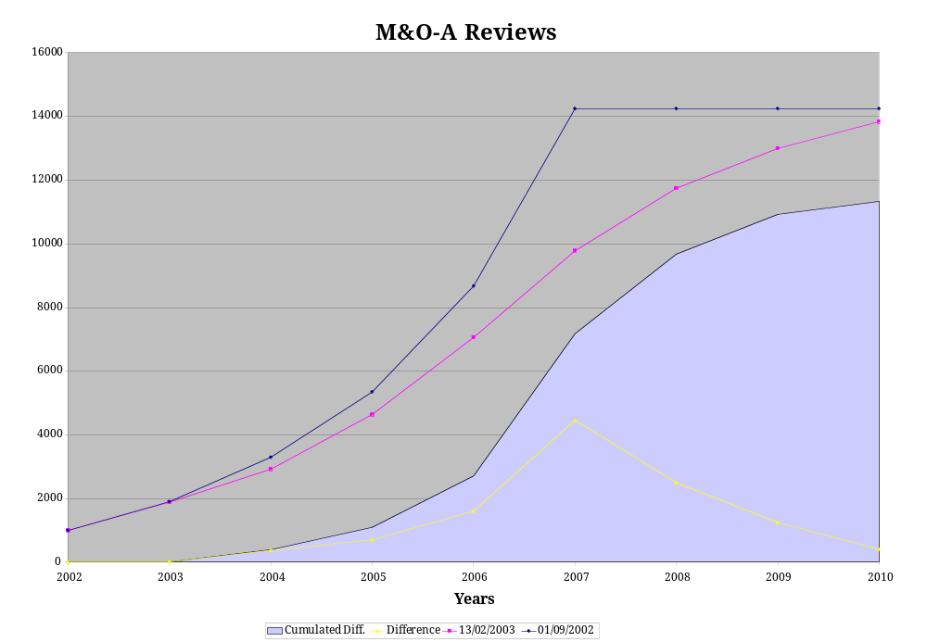
CMS – Cat A and Scrutiny
Proposed
Scrubbed
CMS have proposed a set of Common – or Category A – costs and they have been vetted by an external Scrutiny Group. They come to ~ 12 MCHF in CY2010.

