Slide 1
Update on WHO research and training activities on drug use
Vladimir Poznyak, MD, PhD
Management of Substance Abuse
Department of Mental Health and Substance Abuse
World Health Organization, Geneva
NIDA International Forum, Orlando, 18 June 2005

Slide 2
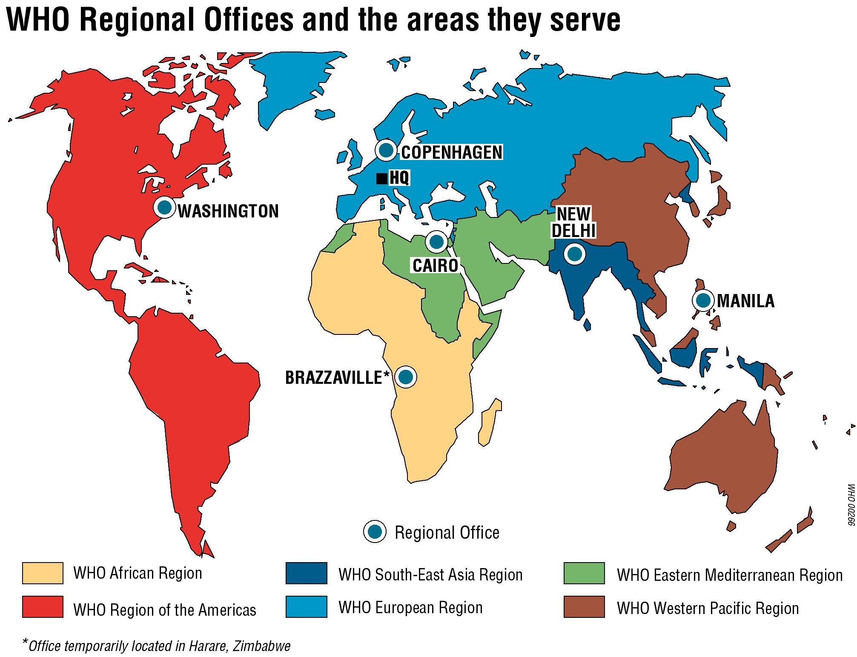

Slide 3
Support for Training and Research from WHO
Possibilities of funding from:
  WHO country offices
  WHO regional offices
  WHO Headquarters in Geneva
    International collaborative research projects involving at least 2 WHO regions
    In line with strategic directions of WHO and approved areas of work
World Health Organization

Slide 4
WHO Priority Areas for 2006-2010 on Substance Abuse
Global research and policy initiatives on alcohol
  Policy guidance and support for implementation and evaluation of strategies and programmes to reduce alcohol-related harm worldwide
Prevention and management of substance use disorders in health care system
  Development and promotion of effective interventions for substance use disorders integrated within primary health care (PHC) S
Drug dependence treatment and HIV/AIDS
  Advocacy, normative guidance and capacity building on treatment and service delivery for IDUs directed towards HIV prevention and care
World Health Organization

Slide 5
Areas of Educational/Training Activities
Alcohol and drug epidemiology
  Short training workshops, e.g. in Benin, 2005
  Training of researchers/professionals in the framework of particular research projects
    WHO Collaborative Study on Alcohol and Injuries
    Alcohol, Culture and Gender
    WHO Drug Injection Study Phase II
Screening and brief interventions in health care settings
Treatment of opioid dependence, including evaluation of treatment
World Health Organization

Slide 6
WHO-sponsored Fellowship Programs
WHO Mental Health Fellowship Programme (6-9 month training in WHO Collaborating Centers (Australia, Canada, UK)
International Travel Fellowship programmes
  WHO-CPDD-NIDA
  WHO-ISAM (International Society of Addiction Medicine)

Slide 7
WHO HIN Access to Research Initiative (HINARI)
One of four major initiatives of the UN Millennium Action Plan, Sept 2000
Supports public health programs and priorities
Partnership between WHO and journal publishers
First Health InterNetwork success: major breakthrough in making content available
Delivers over 2400 biomedical journals online, free or at low cost, to health institutions in 113 low-income countries

Slide 8
WHO Research Projects on Drugs
Comparative quantification of disease burden attributable to illicit drug use (WHO, 2004)
WHO Drug Injection Study Phase II
WHO ASSIST Project: Phase III
WHO Collaborative Research Project on Drug Dependence Treatment and HIV/AIDS
World Health Organization

Slide 9
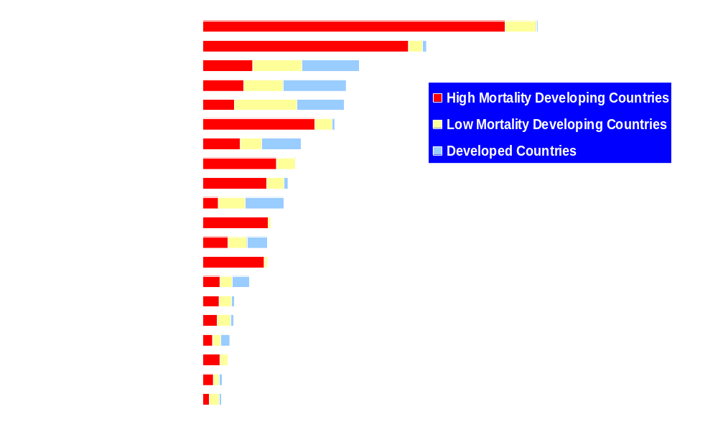
Disease burden (DALYs) in 2000 attributable to selected leading risk factors (world)
Source: WHR, 2002
Number of Disability-Adjusted Life Years (000s)
World Health Organization

Slide 10
Burden of Disease (DALYs) Attributable to Illicit Drug Use
World (in 2000): 11 488 000 (0.8%)
Males: 8 769 000 (76%)
Females: 2 719 000 (24%)
World Health Organization

Slide 11
Burden of Disease (DALYs) Attributable to Illicit Drug Use, by Age
5-14 | 15-29 | 30-44 | 45-59 | >60
177000 | 5691000 | 4397000 | 1211000 | 12000
1% | 50% | 38% | 11% | 0.1%
World Health Organization

Slide 12
Deaths Attributable to Illicit Drug Use
Estimated mortality (in 2000): 194 058
Males: 149 425 (77%)
Females: 44 463 (23%)
  AIDS: 59 000 (30.4%)
  Opioid overdose: 69 152 (35.6%)
  Suicide: 32 216 (16.6%)
  Trauma: 33 689 (17.4%)
World Health Organization

Slide 13
WHO Alcohol, Smoking and Substance Involvement Screening Test (ASSIST)
Developed by international group of researchers
Initially 12 item and now (V3.0) 8 item instrument
Screens for health risks & problems associated with any psychoactive substance use
Designed to provide lifetime and current (past 3 months) estimates of substance use and related risk
World Health Organization

Slide 14
Stages of the WHO ASSIST Project
Phase I (1997-1999)
  Planning and ASSIST development
  International Feasibility and Reliability Study of the ASSIST
Phase II (2000-2002)
  International Validity Study of the ASSIST
  Feasibility Study of Brief Interventions Linked to the ASSIST
Phase III (2003-2005)
  International Study of Efficacy of Brief Interventions Linked to the ASSIST (randomized clinical trial)
    Study sites in: Australia, Brazil, India, Thailand, USA
Phase IV (2006-…)
World Health Organization

Slide 15
WHO ASSIST Study Group
Robert Ali# (Australia)
Elia Awwad* (Palestinian Territory)
Thomas Babor # (USA)
Fiona Bradley* (Ireland)
Tecla Butau* (Zimbabwe)
Michael Farrell (UK)
Maria L Formigoni (Brazil)
Rachel Humeniuk**# (Australia)
Richard Isralowitz* (Israel)
Jaroon Jittiwutikarn** (Thailand)
Roseli Boerngen de Lacerda (Brazil)
Walter Ling** (USA)
John Marsden (UK)
Bonnie McRee* (USA)
Maristela Monteiro #(WHO)
Sekai Nhiwatiwa** (Zimbabwe)
Hem Raj Pal (India)
Vladimir Poznyak** #(WHO)
Maritza Rubio-Stipec* (Puerto Rico)
Sara Simon (USA)**
Janice Vendetti (USA)*
* - Phase I only
** - Phase II only
# - Involvement in study development and coordination
World Health Organization

Slide 16
ASSIST Manuals for Field Testing
WHO-ASSIST. Guidelines for Use in Primary Care
Brief Intervention for Problematic Substance Use. A Manual for Use in Primary Care
The Substance Users Guide to Cutting Down or Stopping
World Health Organization

Slide 17
Report on alcohol use and sexual risk behaviour (WHO, 2004)
Overall objective: establish determinants of alcohol related sexual behaviours in diverse communities and cultures in the context of HIV.
Study sites:
  Belarus
  India
  Kenya
  Mexico
  Romania
  Russia
  South Africa
  Zambia

Slide 18
Area of work: substance abuse and HIV/AIDS
WHO Collaborative Project on Drug Dependence Treatment and HIV/AIDS
  Outcome and process evaluation of pilot or recently established ST programmes
  Study sites in: China (Beijing), Indonesia (Jakarta, Bali), Iran (Tehran), Lithuania (Vilnius, Kaunas, Klaipeda), Poland (Warsaw, Lodz), Thailand (Bangkok), Ukraine (Kherson, Kiev)
  Guide on HIV prevention in drug treatment settings
World Health Organization

Slide 19
WHO Collaborative Project on Drug Dependence Treatment and HIV/AIDS
WHO Opioid Substitution Therapy Study Group:
Robert Ali, Rachel Humeniuk, David Newcombe (Australia), Sithisat Chiamwongpaet (Thailand), Sergey Dvoryak (Ukraine), Boguslaw Habrat, Jacek Moskalewicz (Poland), Ratna Mardiati, Riza Sarasvita (Indonesia), Azarakhsh Mokri (Iran), Vladimir Poznyak (WHO Geneva), Emilis Subata (Lithuania), Ambros Uchtenhagen, Ulrich Frick (Switzerland), Chengzheng Zhao, Shi Jie (China).
World Health Organization

Slide 20
Overview of the samples in MMT in 2 sites (R. Mardiati, R. Sarasvita, S. Chiamwongpaet)
SITE | HIV | HCV | AVERAGE DOSAGE
Indonesia (N=99) | 57% (N=65) | 92% (N=55) | 32 mg
Thailand (N=118) | 50% (N=115) | 94% (N=111) | 28 mg
World Health Organization

Slide 21
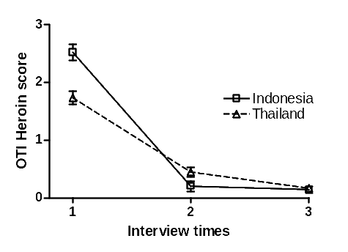
Heroin use in patients in Indonesia and Thailand at 3 and 6 month follow up

Slide 22
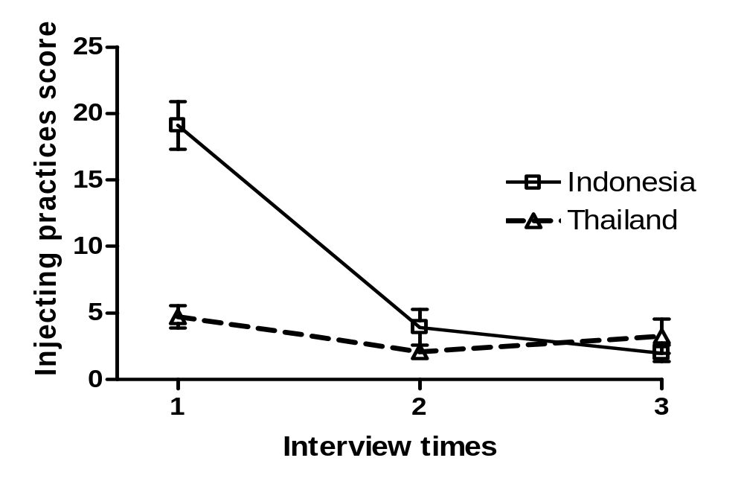
Drug injecting in patients in Indonesia and Thailand at 3 and 6 month follow up

Slide 23
Other Recent WHO Activities on Substitution Therapy for Opioid Dependence
WHO/UNODC/UNAIDS Position Paper on Substitution Therapy in Management of Opioid Dependence and HIV Prevention
The practices and context of pharmacotherapy of opioid dependence in Central and Eastern Europe. WHO, 2004
Proposals for methadone and buprenorphine to be included in the WHO Model List of Essential Medicines
  Under "Psychotherapeutic medicines/Medicines used in substance dependence"
Development of WHO guidelines on treatment of opioid dependence in collaboration with UNODC

Slide 24
WHO Management of Substance Abuse
www.who.int/substance_abuse/
E-mail: poznyakv@who.int
World Health Organization

