Slide 1
Cloud Emissivity Change
NAMX, ops NAM:
The cloud layer emissivity (E) associated with a cloud optical depth (D) is currently parameterized as E = 1-.exp(-0.75*D),
  where D=∑ (a_{w}q_{w}+a_{i}q_{i})dp (0.75 from Harshvardhan)
NAMY:
E=1.-exp(-1.66*1.5*D)
  The 1.66 factor agrees with the equation in the WRF RRTM (depends on angle, frequency)
  The extra 1.5 factor accounts for larger absorption coefficients (a_{w}, a_{i}) used in NCAR's RRTM to convert from cloud mixing ratios to optical cloud depths.

Slide 2
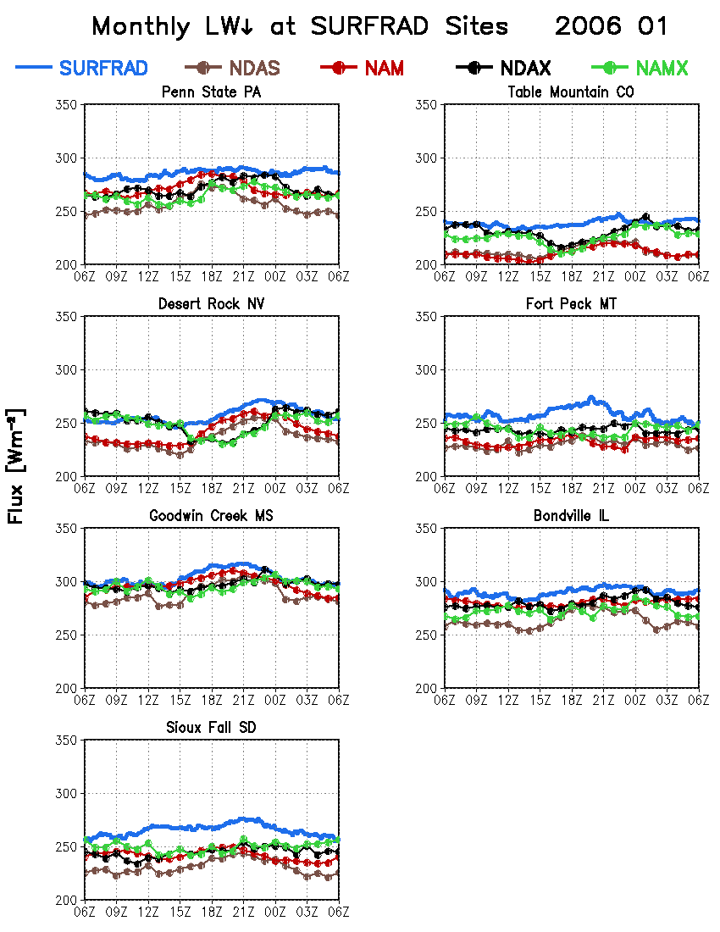
Low Bias in LWdn

Slide 3
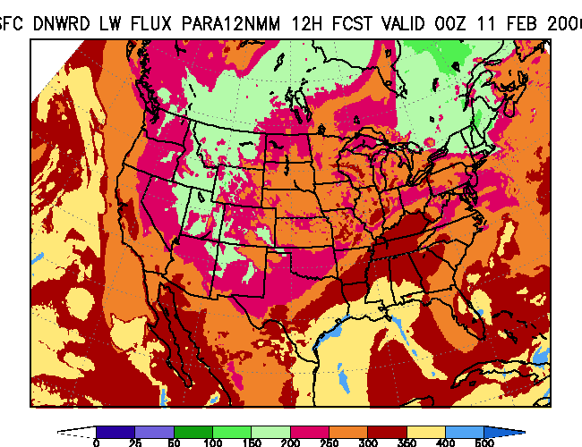
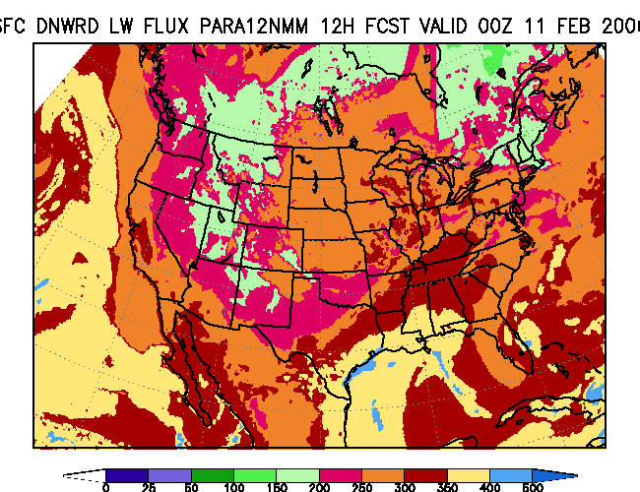
2006021012 (E. Coast snowstorm) NMM Launcher Run w/ NAM ICs
Increased Cloud
Emissivity
NMM Control

Slide 4
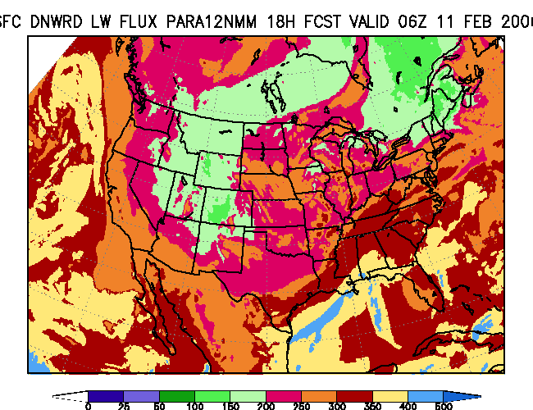
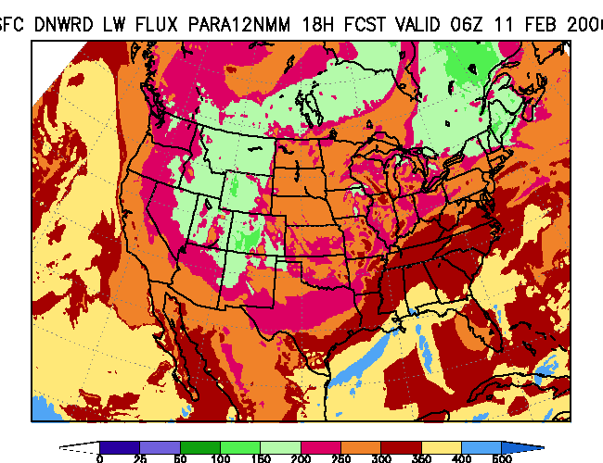
Increased Cloud
Emissivity
NMM Control

Slide 5
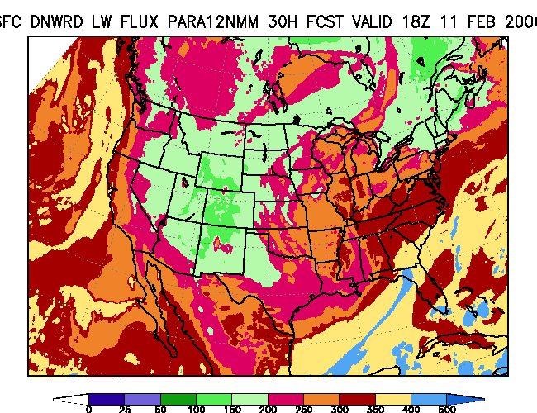
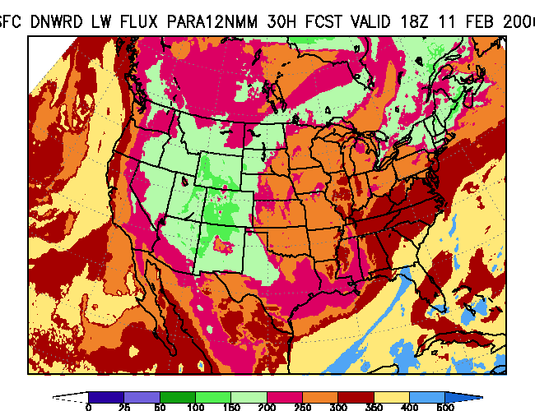
Increased Cloud
Emissivity
NMM Control

Slide 6
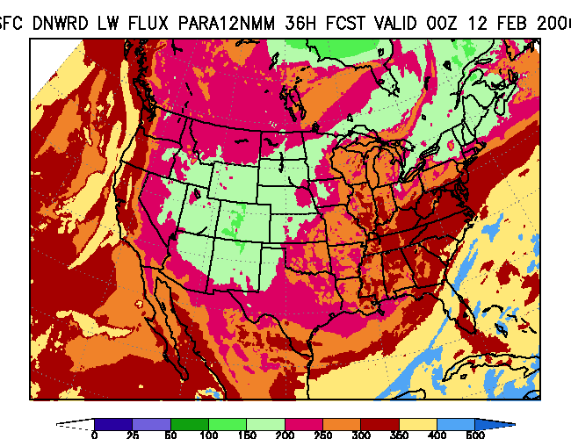
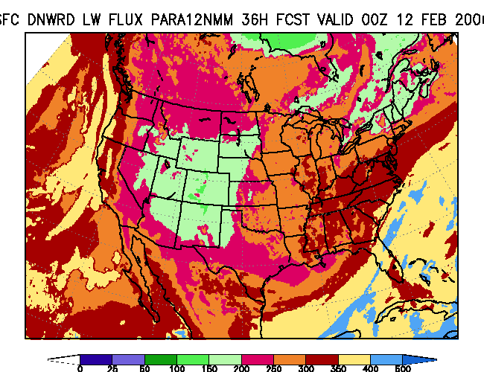
Increased Cloud
Emissivity
NMM Control

Slide 7
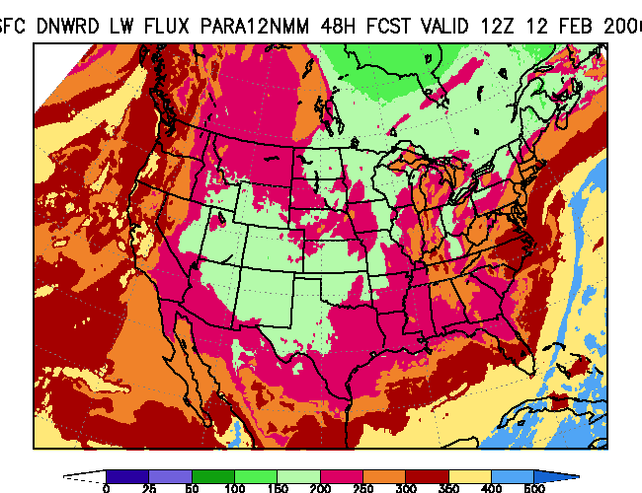
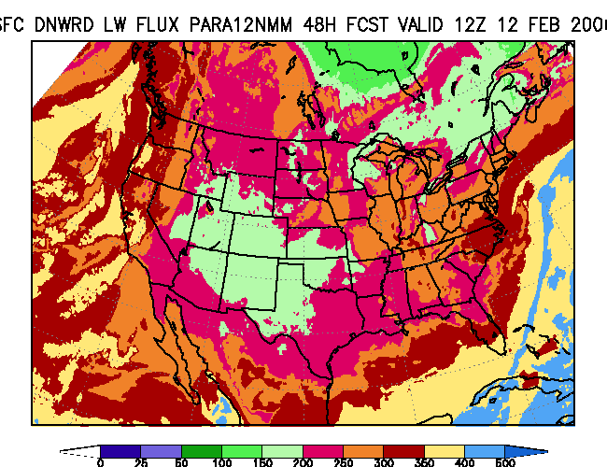
Increased Cloud
Emissivity
NMM Control

Slide 8
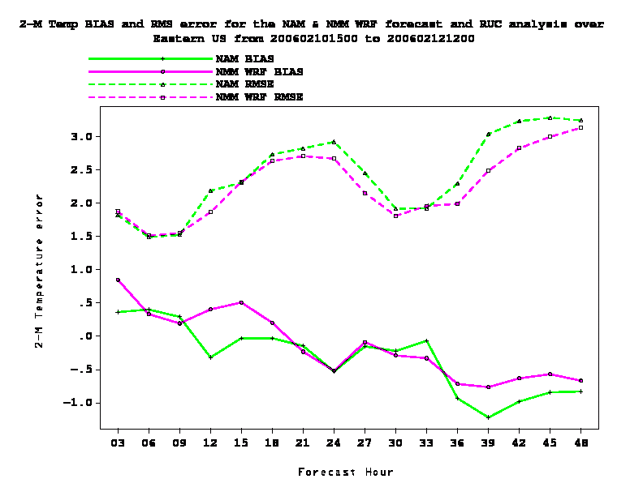
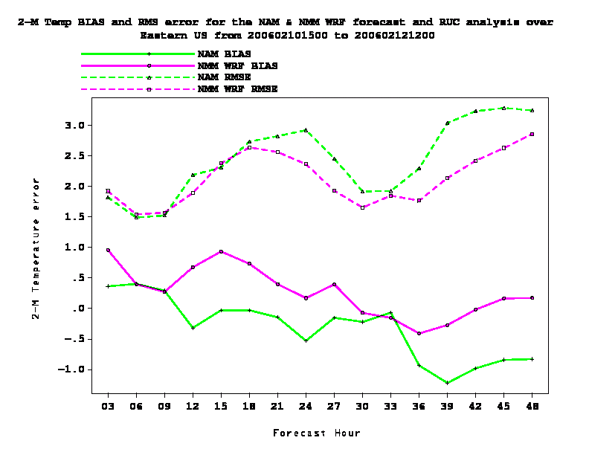
2-m T verif over East
(2006021012 snowstorm)
Increased Cloud
Emissivity
NMM Control

Slide 9
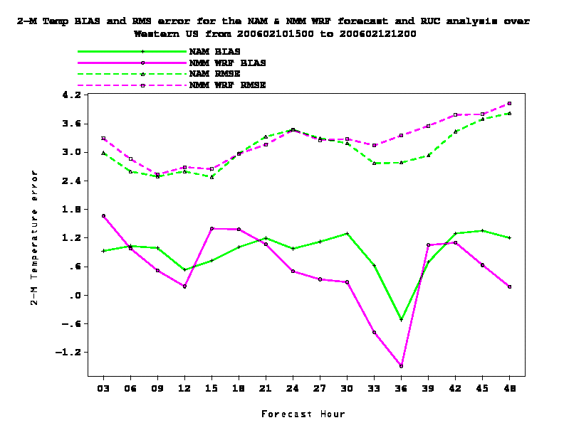
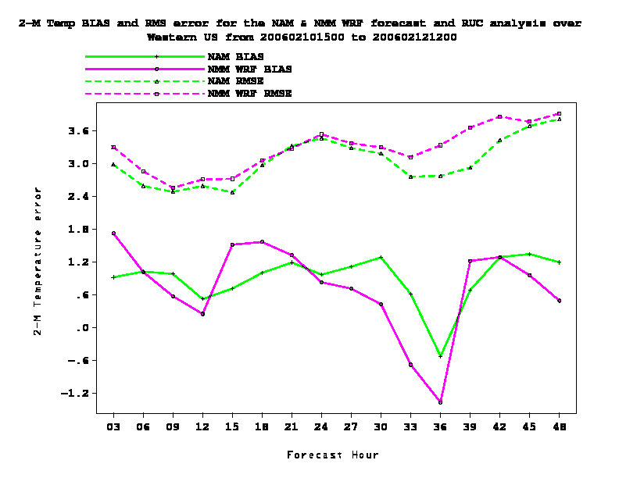
2-m T verif over West
(2006021012 snowstorm)
Increased Cloud
Emissivity
NMM Control

Slide 10
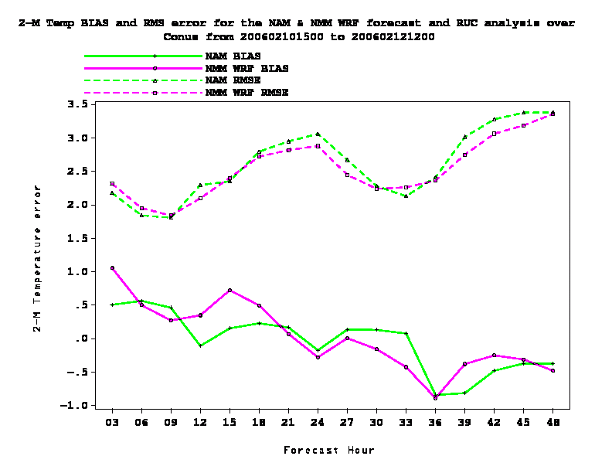
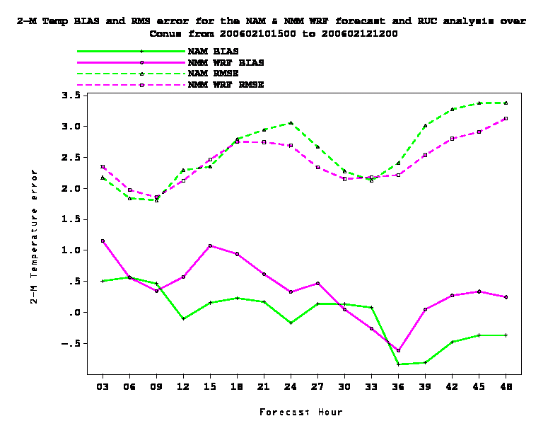
2-m T verif over CONUS
(2006021012 snowstorm)
Increased Cloud
Emissivity
NMM Control

Slide 11
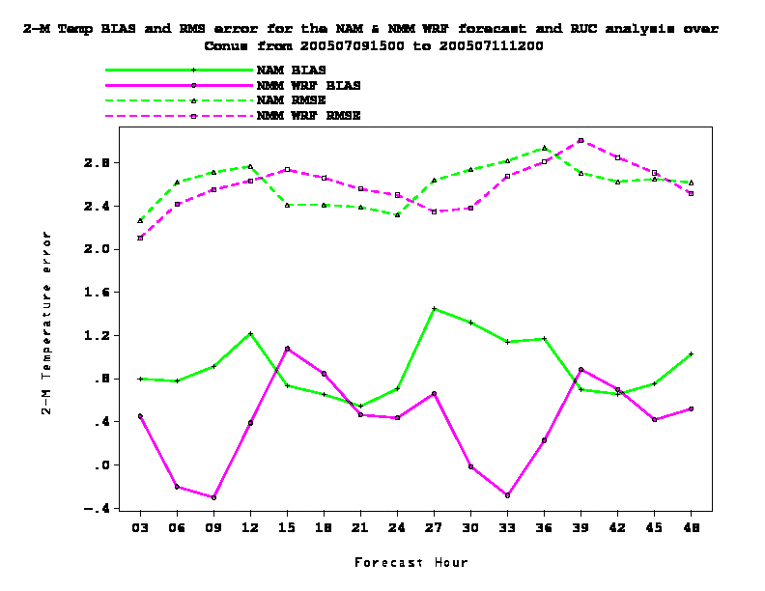
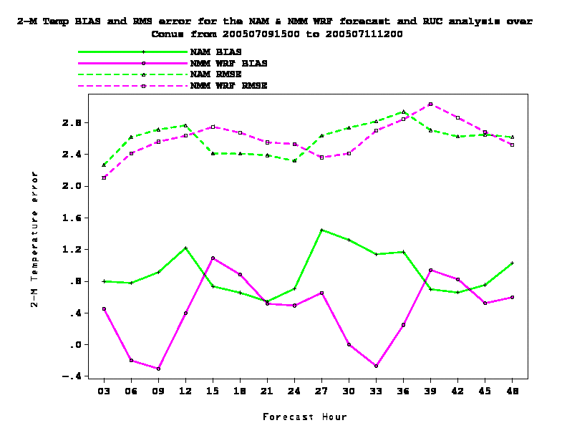
2-m T verif over CONUS
(2005070912 -- “Dennis” + AQ)
Increased Cloud
Emissivity
NMM Control

Slide 12
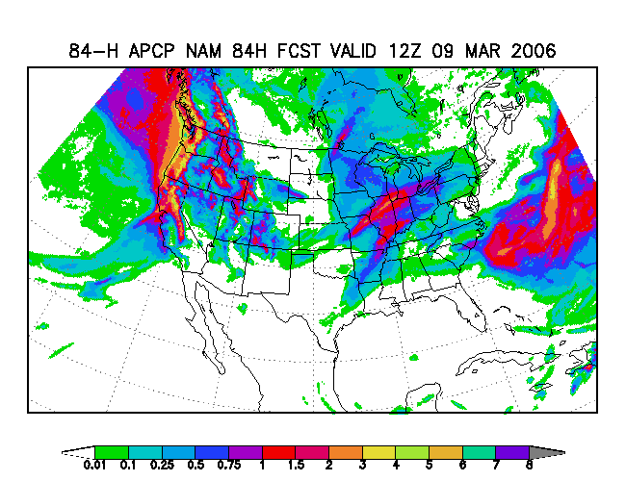
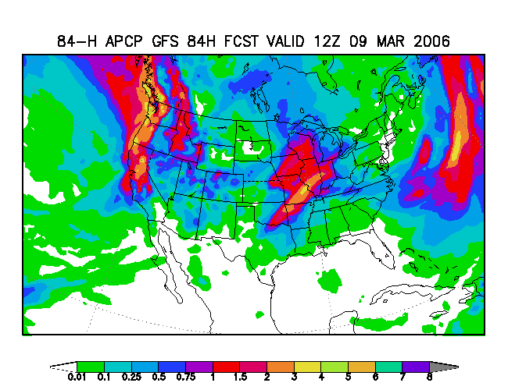
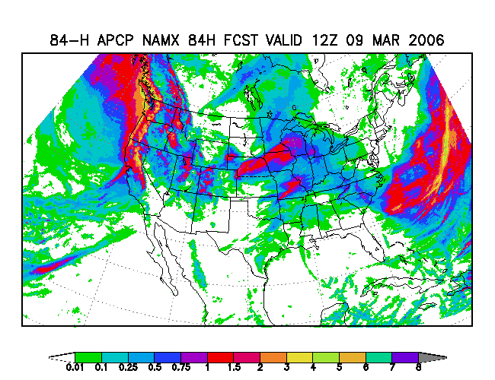
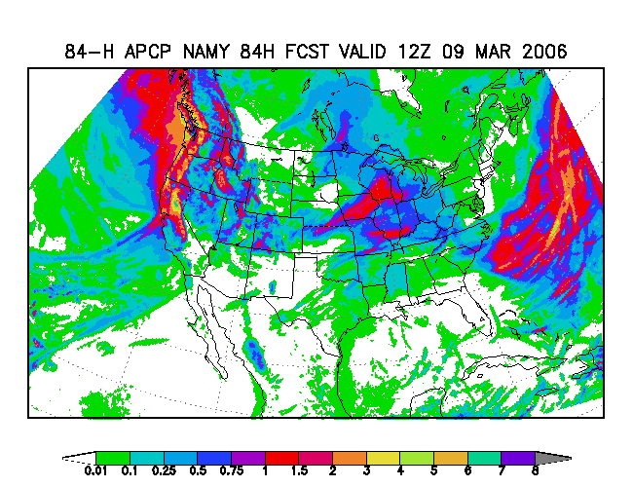
84h precip from latest parallel runs

Slide 13
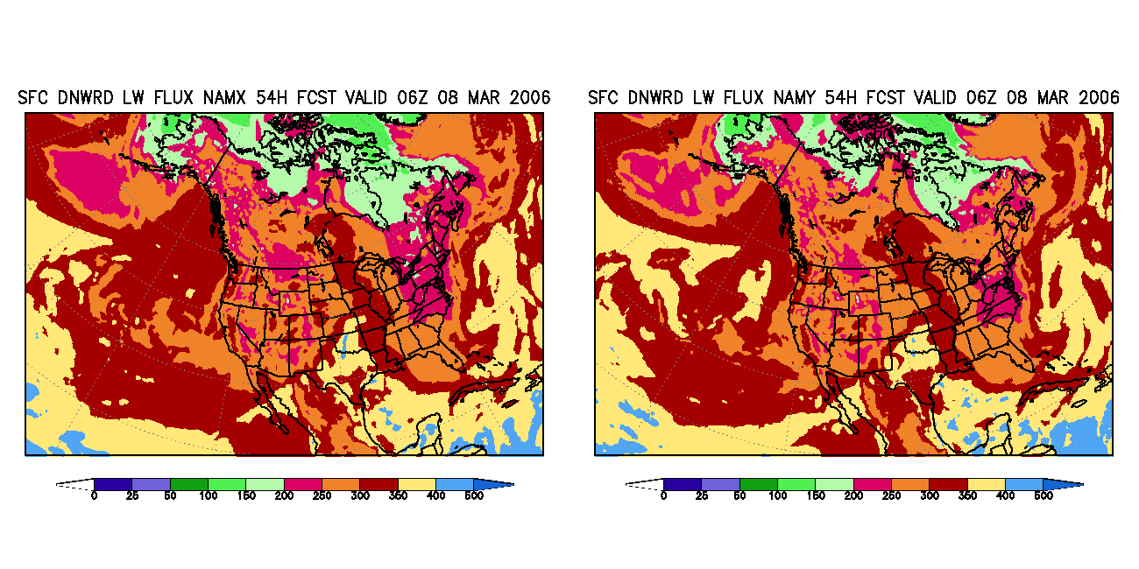
Sample 54-h LWdn from latest parallel run

Slide 14
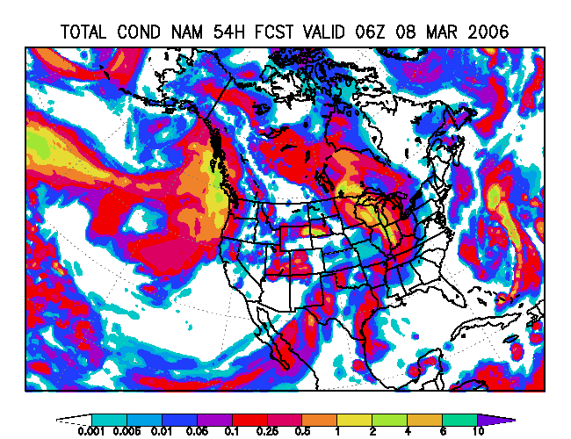
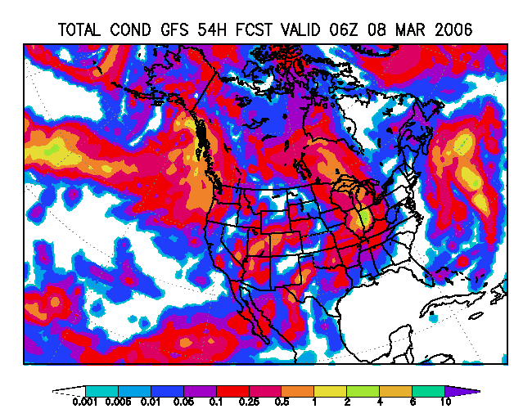
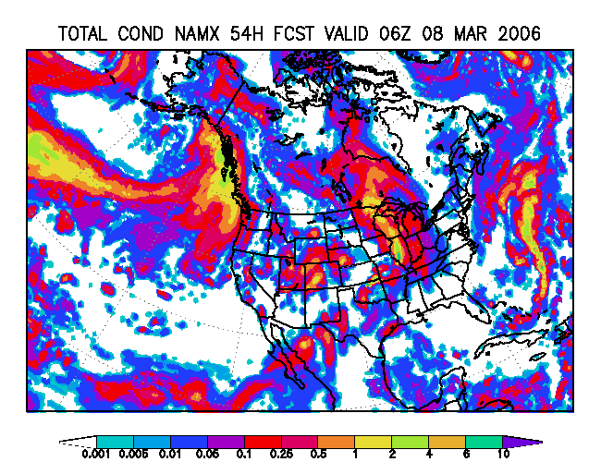
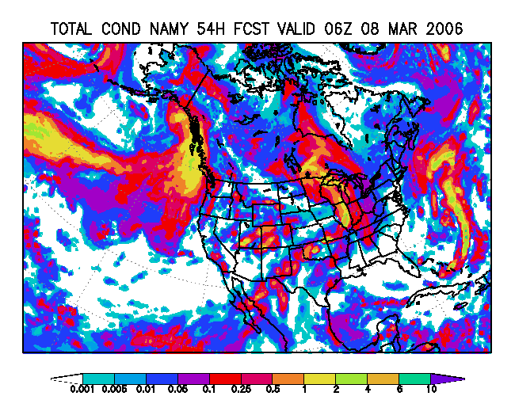
Total column-integrated condensate (water + ice) at 54 h

Slide 15
Additional tests – motivated by NAMX cold bias (>500 mb) & low heights
Microphysical experiments
  Many more ice particles at colder temps
  (problem – persistent anvil over SE part of grid for 2005070912 case – “Zhao-like”)
  Played with “RHgrd”
    Fixed values (0.975, 0.95) => currently 1.0
    Decreasing RHgrd with height / model thickness
    Precip and ice fields were surprisingly insensitive;
    some impacts on (low?) liquid water clouds
  Mixed results for objective verification
  48h runs were pretty insensitive to microphysics changes

Slide 16
NAMX cold bias after 48h
2006022400 cycle
Saved 2006022400 parallel forecast page
700-mb NAMX-NAM temperatures
2006022400 sounding page

Slide 17
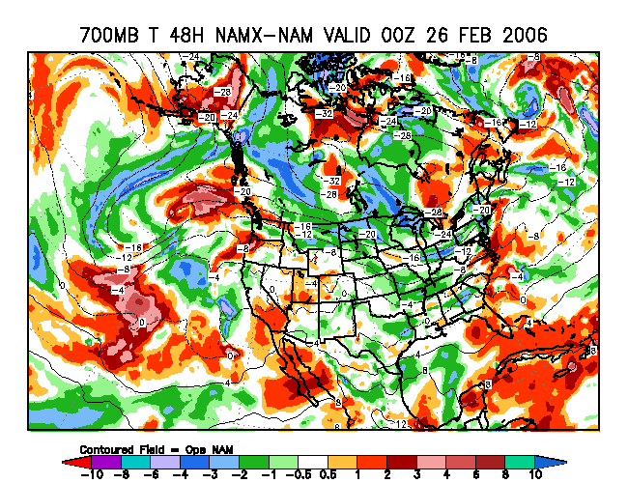
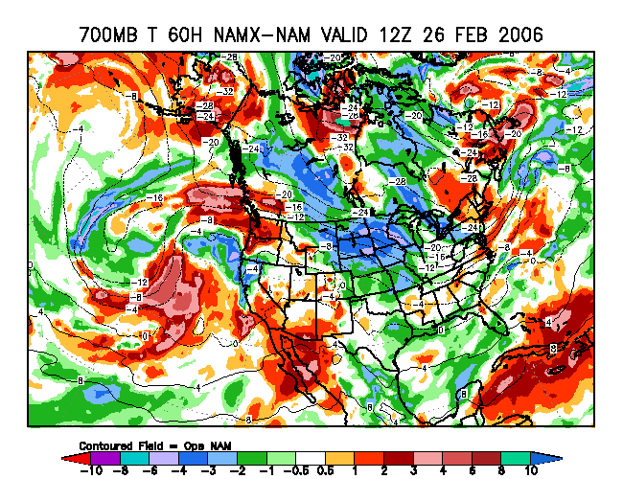
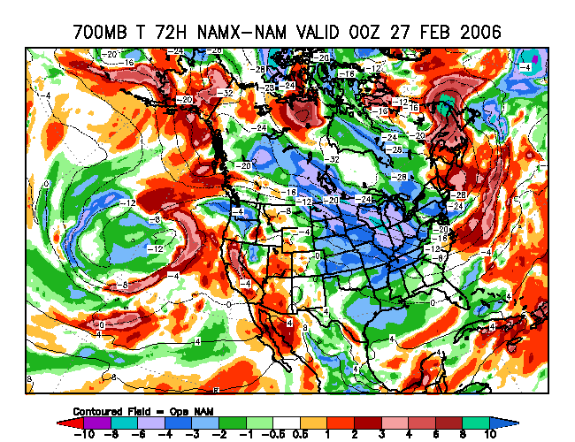
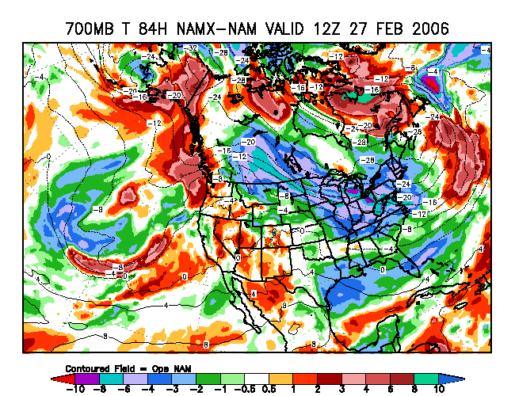
700-mb NAMX-NAM T (48-84h)

Slide 18
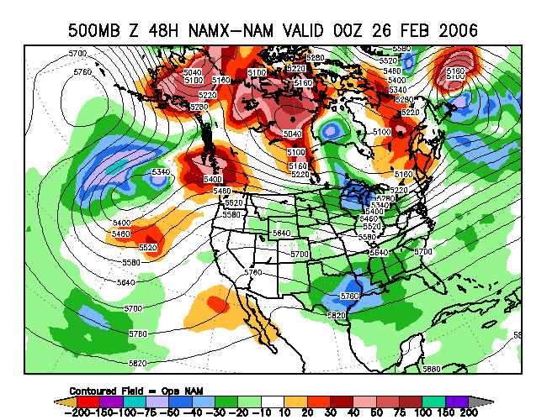
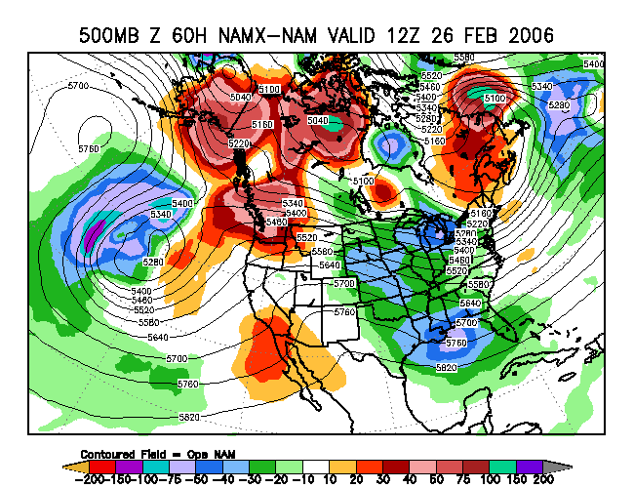
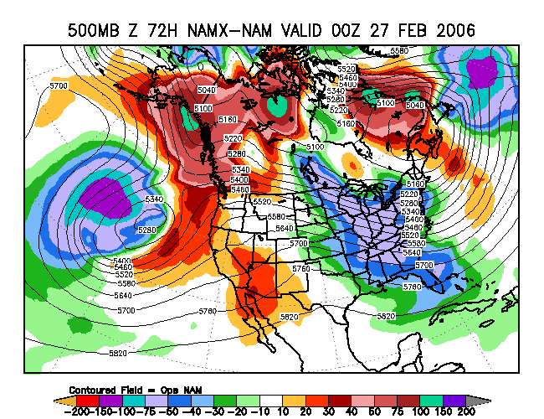
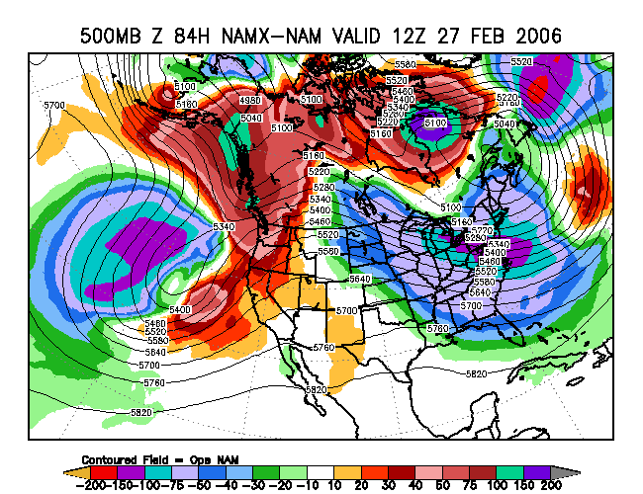
500-mb NAMX-NAM Z (48-84h)

Slide 19
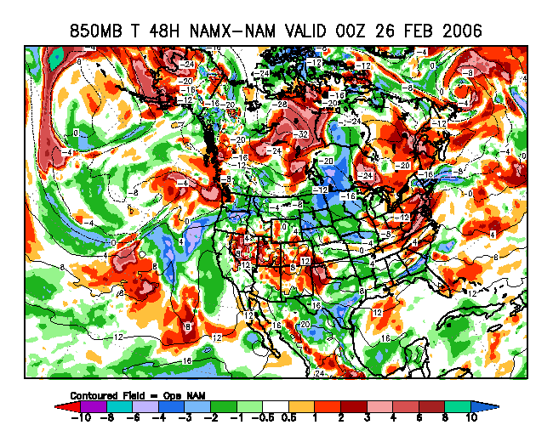
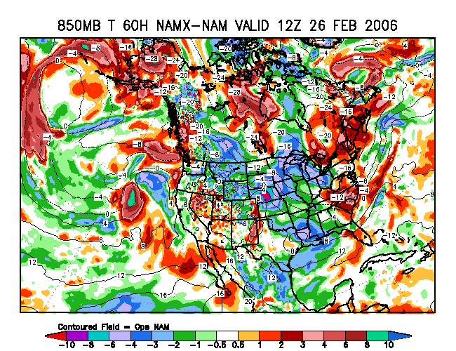
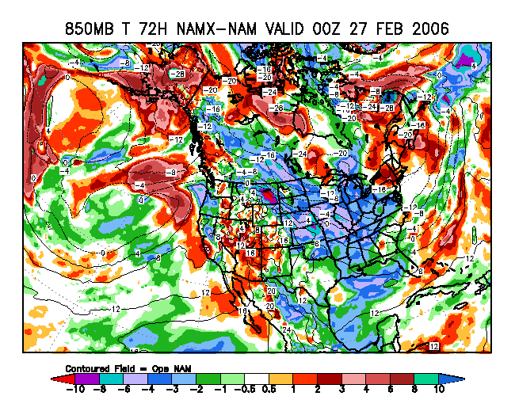
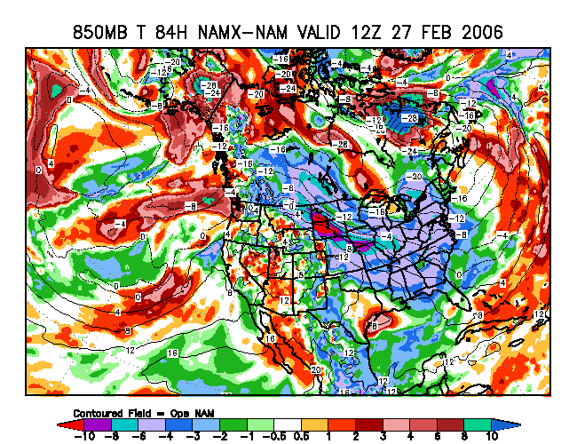
850-mb NAMX-NAM T (48-84h)

Slide 20
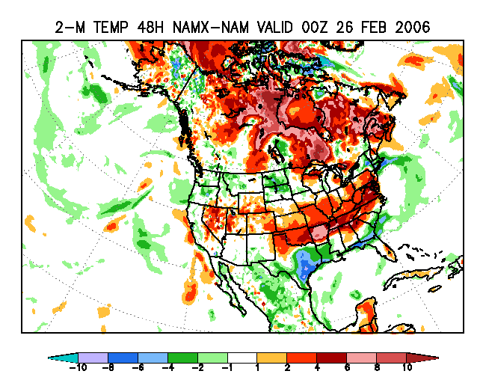
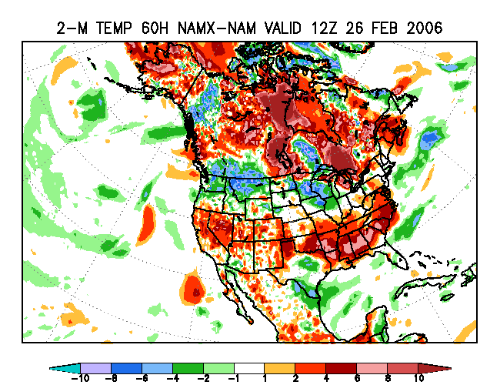
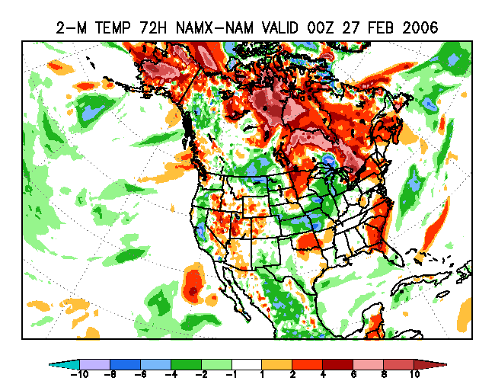
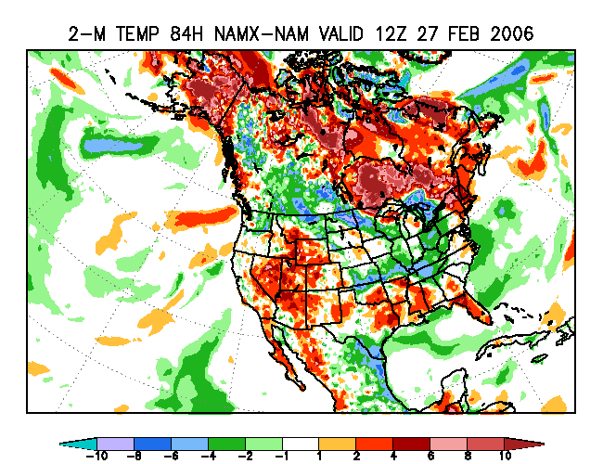
2-m NAMX-NAM T (48-84h)

Slide 21
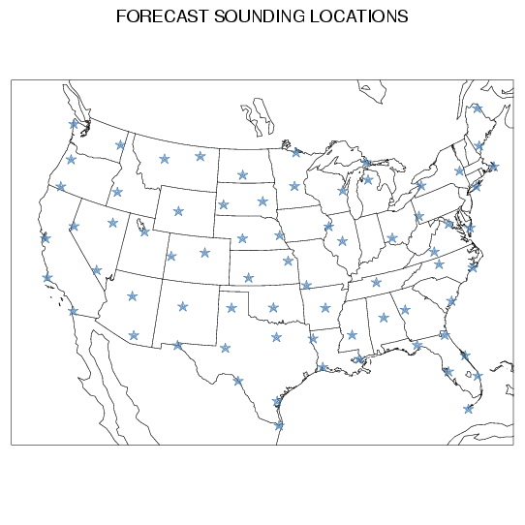
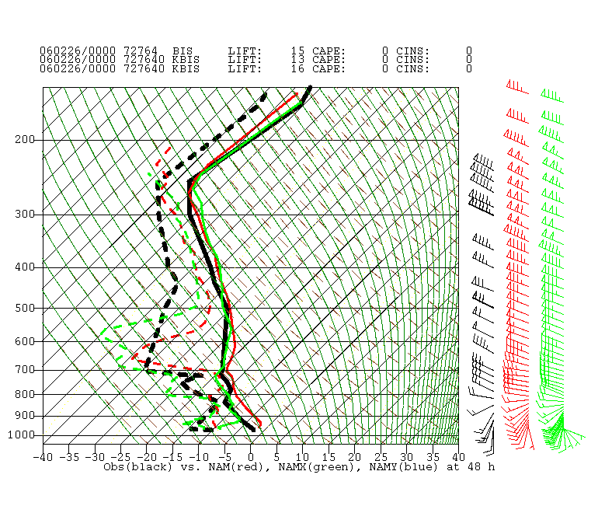
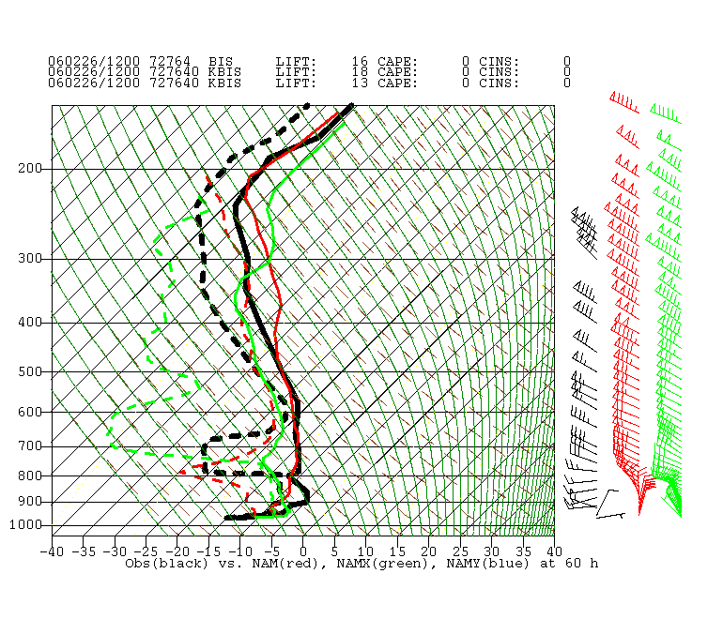
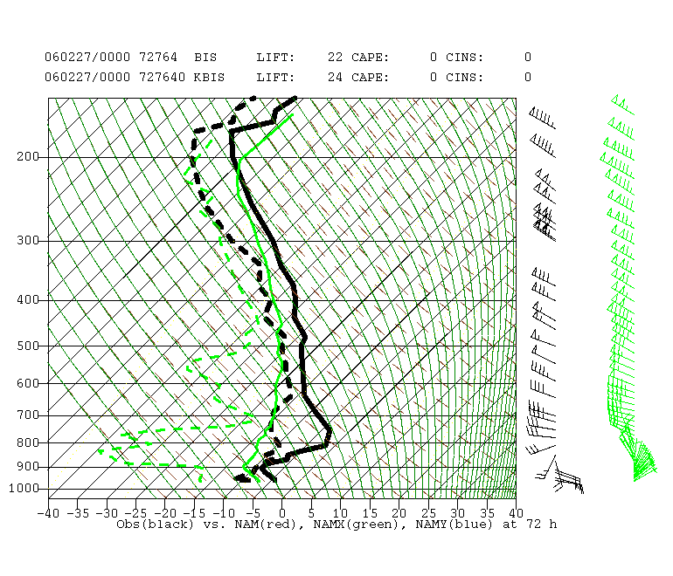
Bismarck, ND (48, 60, 72h)
OBS (black) NAM (red) NAMX (green)

Slide 22
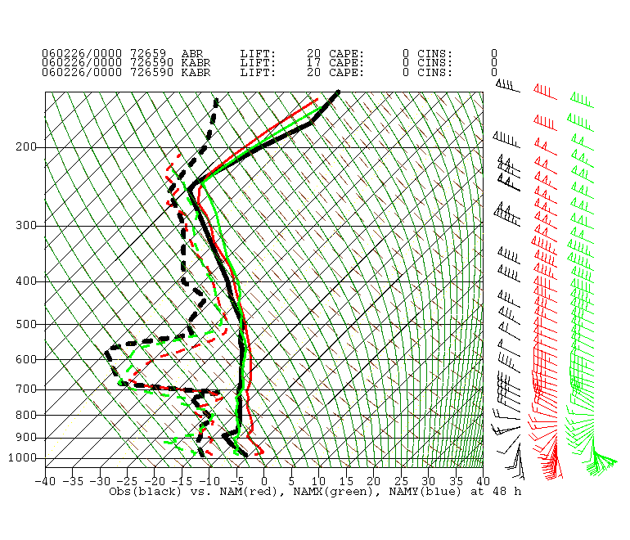
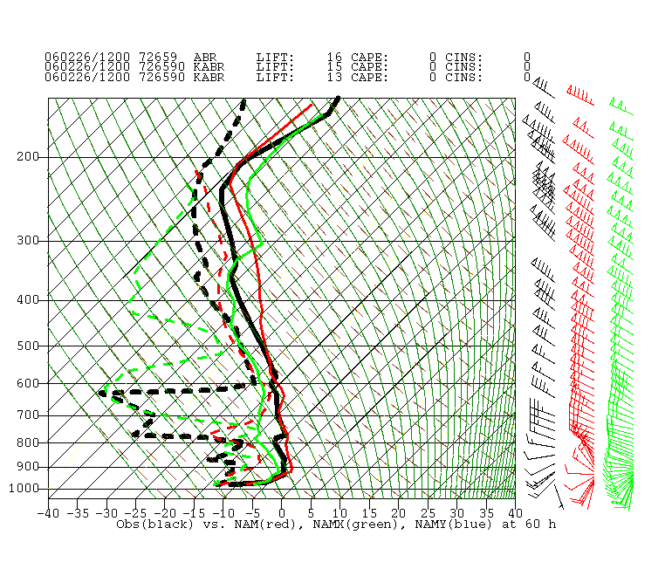

Aberdeen, SD (48, 60, 72h)
OBS (black) NAM (red) NAMX (green)

Slide 23



International Falls, MN (48, 60, 72h)
OBS (black) NAM (red) NAMX (green)

Slide 24



Minneapolis, MN (48, 60, 72h)
OBS (black) NAM (red) NAMX (green)

Slide 25



Green Bay, WI (60, 72, 84h)
OBS (black) NAM (red) NAMX (green)

Slide 26



Alpena, MI (60, 72, 84h)
OBS (black) NAM (red) NAMX (green)

Slide 27
Supplemental Slides
48-72, 60-84h precip
48-84h total condensate

Slide 28




48-72h precip (top)
60-84h precip (bottom),
NAM (left), NAMX (right)

Slide 29

Total column condensate
NAM, NAMX (48h)

Slide 30

Total column condensate
NAM, NAMX (60h)

Slide 31

Total column condensate
NAM, NAMX (72h)

Slide 32

Total column condensate
NAM, NAMX (84h)

