Slide 1
NOAA
National Weather Service
Data Rescue Support
Richard Crouthamel, D.Sc.
Douglas Klotter
Data Rescue...Before it’s too late!

Slide 2
Partnerships/Relationships
Crouthamel and Klotter …
  Funded by Riverside Technology, inc. under contract with NWS International Activities Office
  Directors of a non-profit entity – The International Environmental Data Rescue Organization (IEDRO)

Slide 3
What is IEDRO?
The International Environmental Data Rescue Organization
Non-profit 501(c)(3) organization dedicated to locating, rescuing and digitizing all environmental data, worldwide
IEDRO works in partnership with governments, foundations, and individuals to obtain funding and implement Data Rescue and Digitization
http://IEDRO.ORG

Slide 4
Data Rescue…Why now?
Existing hydromet data exists on poor quality paper
Poor quality inks fade with time
Data records are subjected to unique temperature, humidity and dust extremes
Paper archives scattered in warehouses, barns, homes
Paper data often discarded due to lack of storage

Slide 5
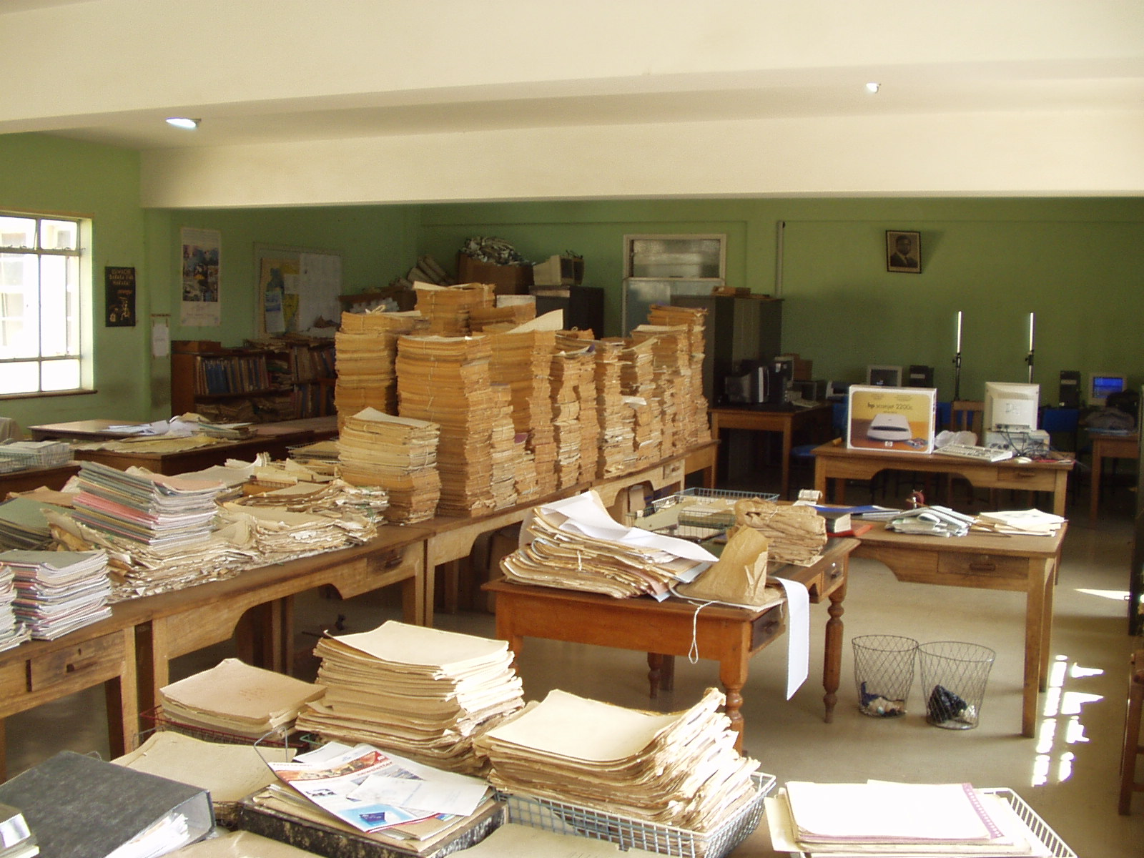
Typical ‘good’ Archive

Slide 6
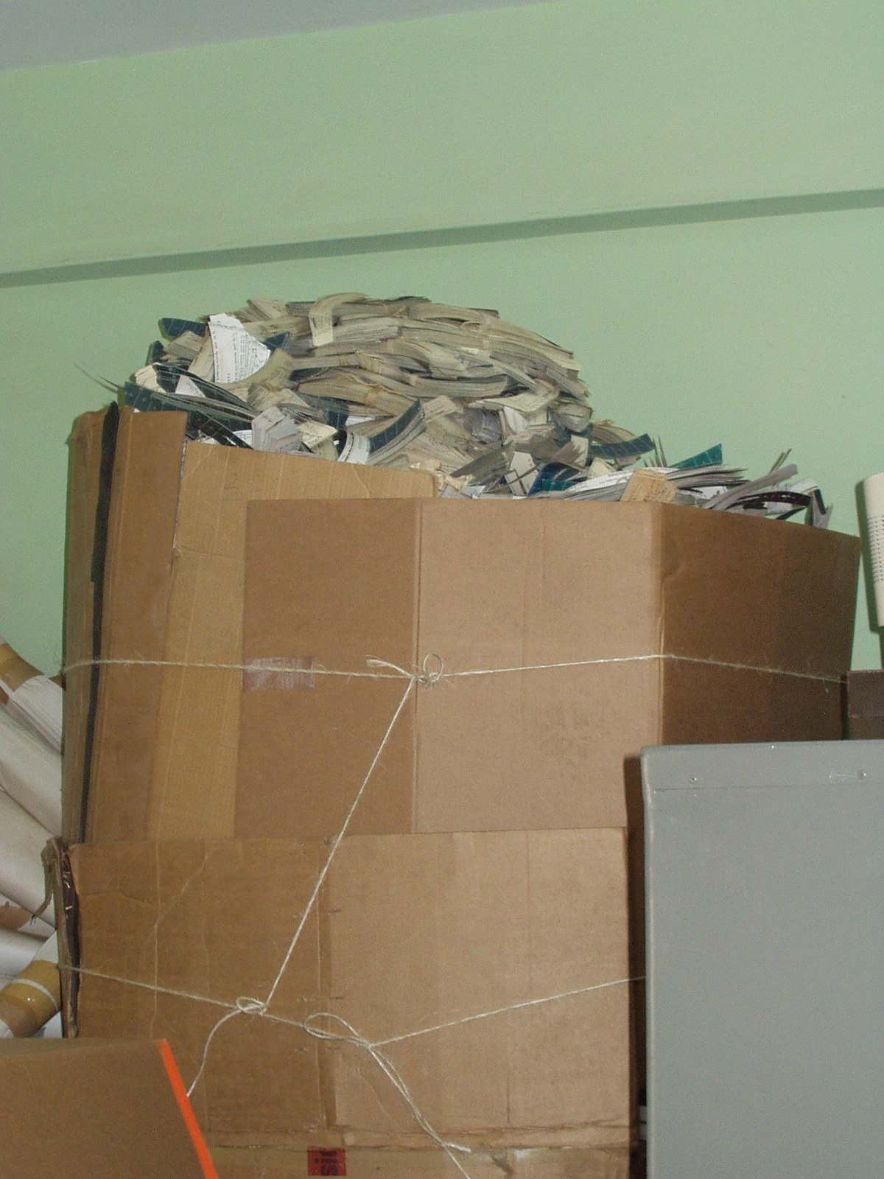
Less than “good” archive (Pyroheliometer Records)

Slide 7
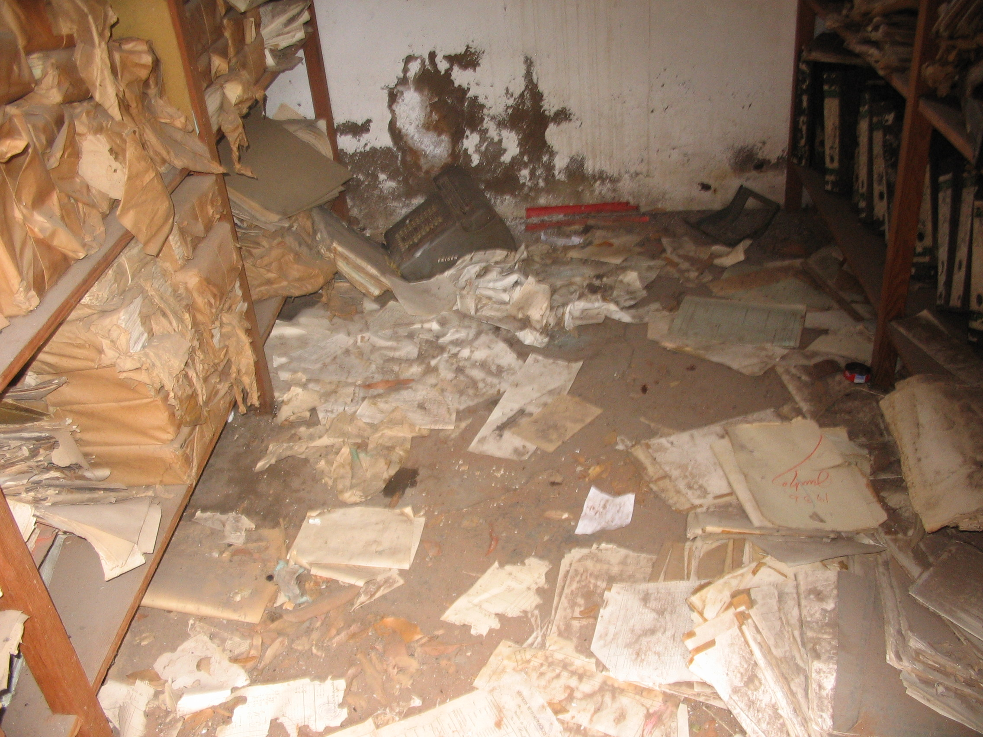
Poor Archive!

Slide 8
Data Rescue Activities
CURRENTLY with the NWS
  Hydrometeorological Upper-air Data
  Hydrometeorological Surface Data
FUTURE POSSIBILITIES (NWS/IEDRO)
  Glacier Photographs
  Strip chart data
  Bathymetric Data

Slide 9
Progress so far…
Approximately 250,000 upper-air observations have been rescued in 6 African countries so far
Data is now being rescued at two sites in Uruguay (36,000 images representing about 108,,000 surface observations) and at a private museum in Chile (30,000 surface observations)
“Open and Unrestricted Exchange of digitized Data” has been accepted by all participating countries

Slide 10
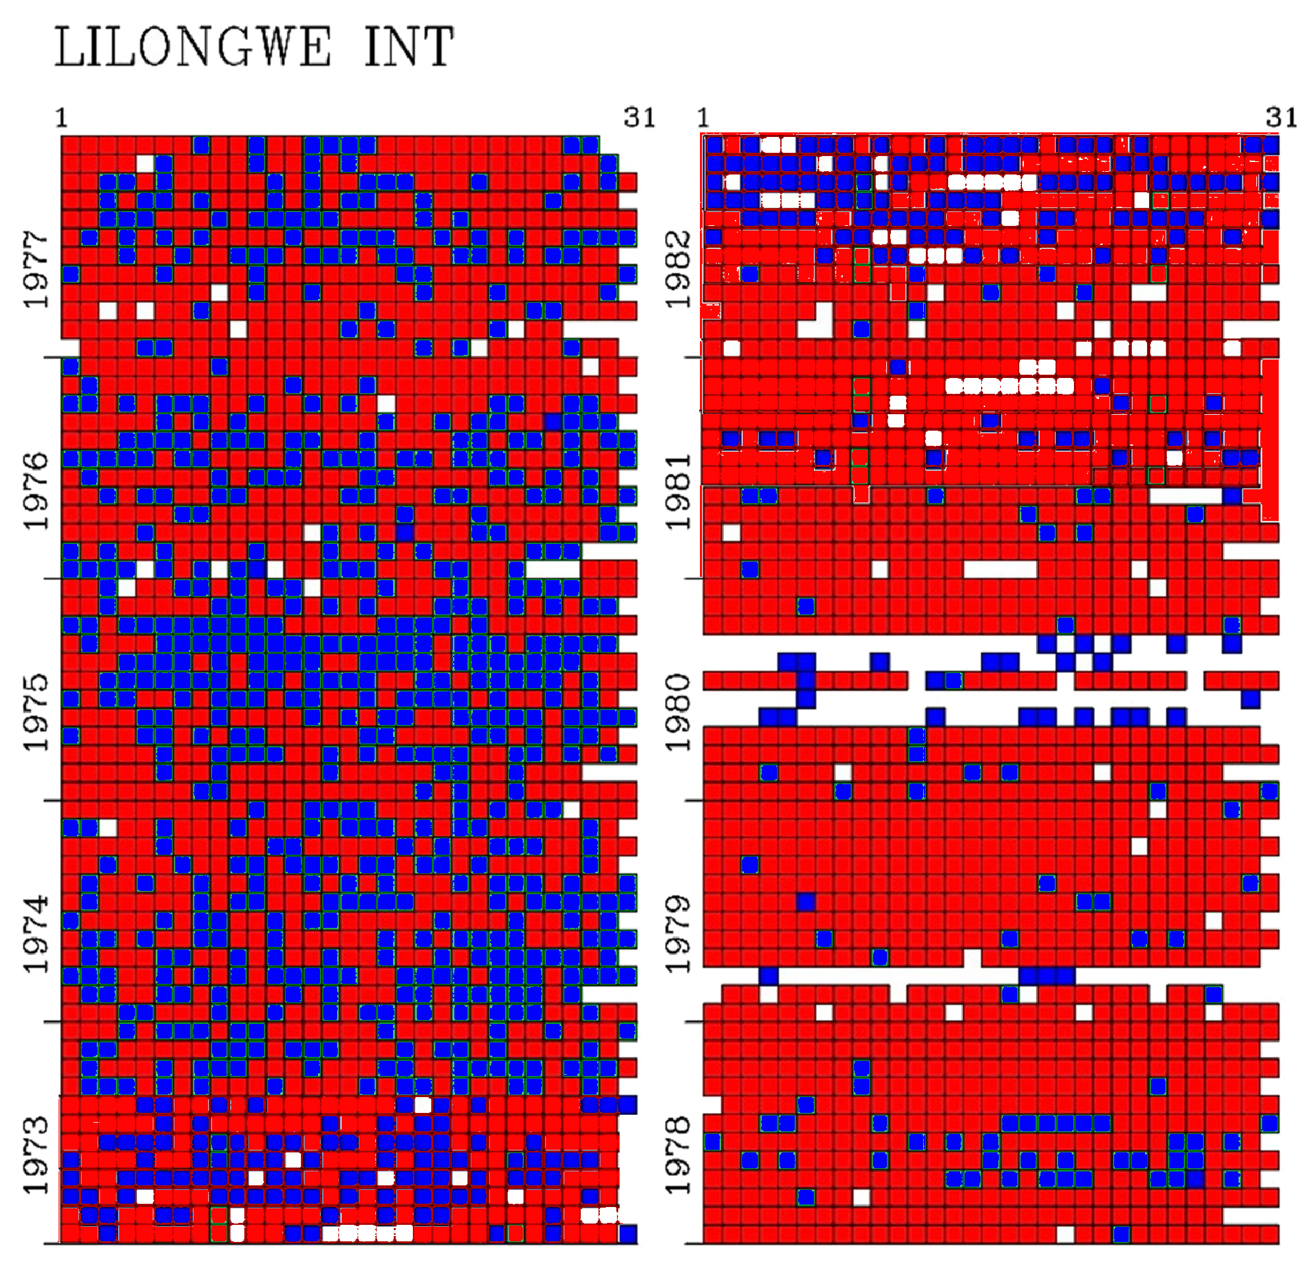
Representative Progress

Slide 11
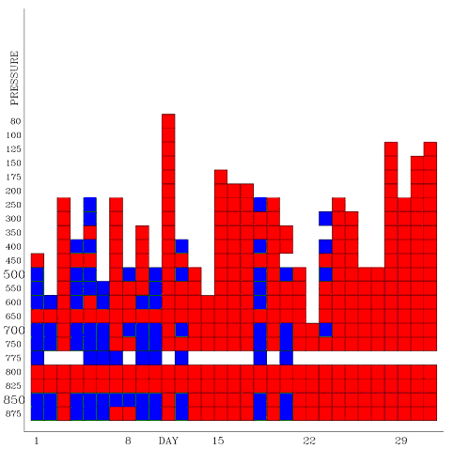
More Good News

Slide 12
Continuing Data Rescue efforts
Digitization of the following data sources:
  6 African countries (Kenya, Malawi, Mozambique, Niger, Senegal, Zambia)
  2 South American Countries (Chile, Uruguay)
  Data Rescue Failure due to local management problems (Dominican Republic)

Slide 13
Priorities for Data Rescue
Data vulnerability
NOAA’s need for the digitized data
In-country support availability
Keying requirements for NCDC contractors

Slide 14
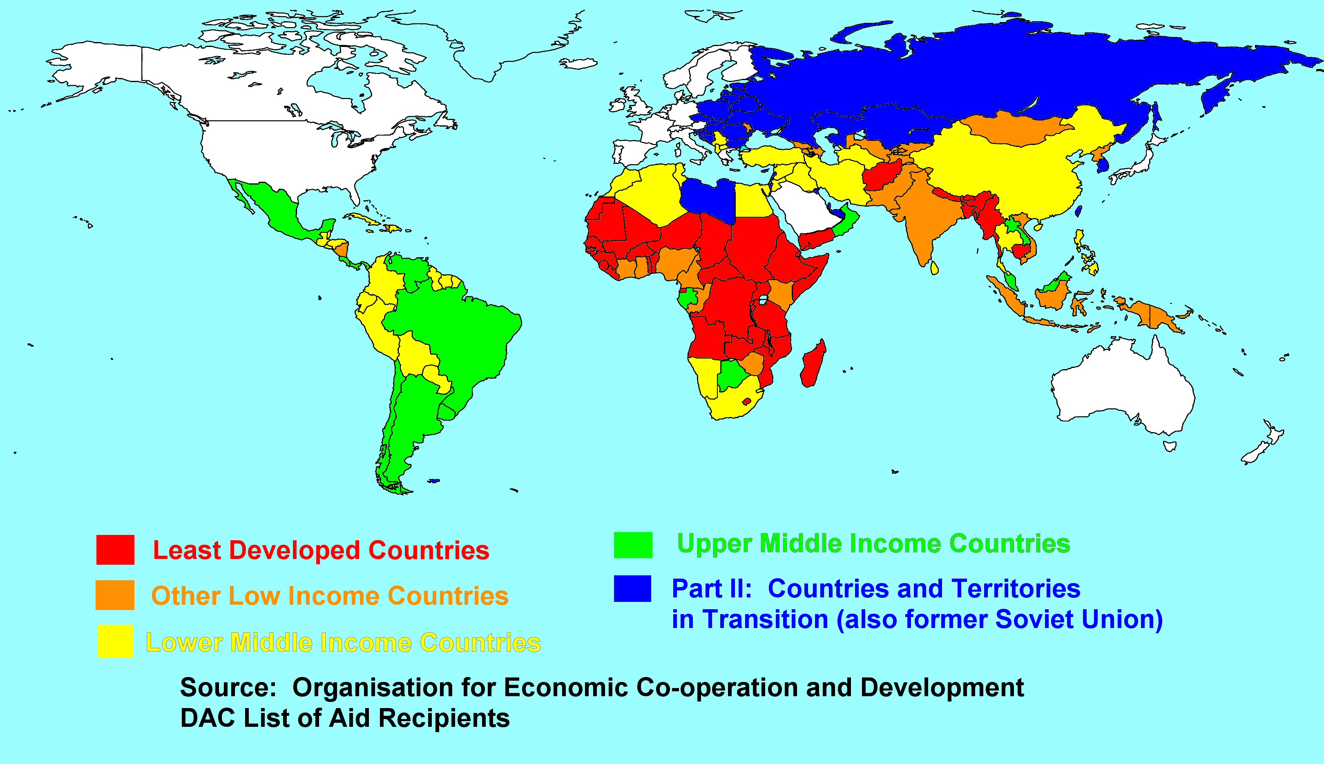
Vulnerability…tied to a country’s wealth

Slide 15
NOAA’s need for the digitized data
Africa (large data holes)
Southern Hemisphere (fewer data sites)
Central America (NCEP precipitation analysis)

Slide 16
In-country support availability
Focuses on organizations where the data rescue equipment & support represents a substantial contribution to their operations resulting in proactive, voluntary (free labor) support
  Africa – most NMSs are poor
  Southern Hemisphere – non-government entity has limited support (museum)
  Central America - most NMSs are poor

Slide 17
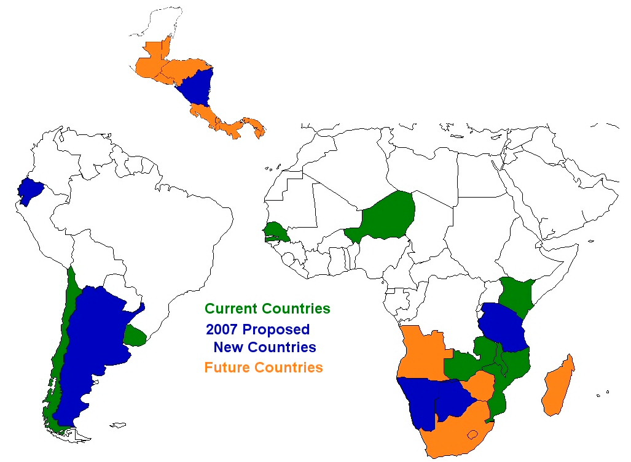
FY2007 NWS New Proposals
Current : Chile, Uruguay, Kenya, Malawi, Mozambique, Niger, Senegal, Zambia
2007 Proposed: Argentina, Ecuador, Nicaragua, Tanzania, Botswana, Namibia
Future: Guatemala, El Salvador, Belize, Honduras, Costa Rica, Panama, Angola, Zimbabwe, Madagascar, South Africa
:

Slide 18
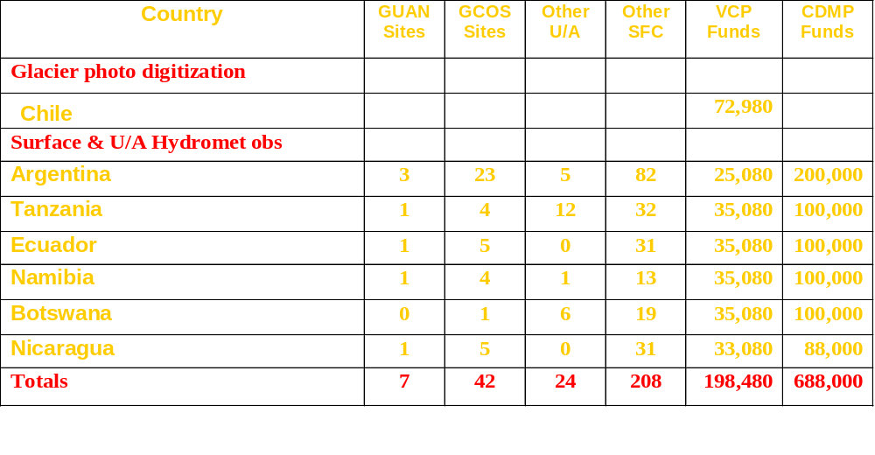
FY2007 Proposals

Slide 19
GENERIC PROBLEM
Countries are reluctant to “give away” data without any immediate benefit.
  Limited staff and no funds to pay for imaging
  Little contact between NOAA and the countries
  Still lack of conviction that data rescue is important
  Time for NOAA to digitize data measured in years

Slide 20
Still lack of conviction that data rescue is important
NOAA and IEDRO staff must compile overwhelming scientific evidence of need for historic environmental data
Cost/Benefit studies, engineering examples, input from agriculture, medicine, transportation fields should be included
Benefits not only to world community
but also to individual communities

Slide 21
Time for NOAA to digitize data measured in years
Current data rescue countries are disappointed with the lengthy time the digitization process is taking
NOAA, with perhaps some IEDRO funding needs to examine specific ways the digitization process can be speeded up.
  Better on-site preparation and operations
  Better scheduling by NCDC contractors

Slide 22
Conclusion
We’ve made a good solid start at rescuing foreign hydrometeorological data
We must challenge the existing paradigms we have been using to keep the effort going to solve the data gathering and digitization problems
We need more frequent communication among NCDC, the contractors and those of us providing the imaged data

Slide 23
Thank You!
Thank you from both the NWS International Activities Office and IEDRO for funding these very important efforts!

