Slide 1
Module 4: Phase II ESA
1
2
3
4
5
4
Phase II ESA

Slide 2
Phase II ESA - Purpose
Evaluate Recognized Environmental Conditions (RECs) identified in Phase I ESA
Identify potential contaminant source areas
Identify the types and concentrations of chemicals present, and which media they impact
Provide information on extent of contamination
Evaluate potential risk to receptors
Comparison to relevant criteria to determine need for cleanup or risk management
Required if applying for EPA Brownfields Cleanup Grant

Slide 3
Phase II ESA
A “clean” Phase II is NOT a guarantee against environmental liability.
A Phase II does NOT provide an estimate of cleanup costs.
A Phase II will NOT identify every contaminant.
A Phase II will NOT provide alternatives for remediation.

Slide 4

Phase II ESA - Methodologies
First critical step in evaluating a Phase II ESA report is understanding the specific methodology used:
  ASTM E1903 Phase II (currently being revised)
  State-specific guidance
  CERCLA/Brownfields
  RCRA
  Voluntary cleanup programs
Notes:
First and most important things you need to understand as you begin to evaluate a report include:
Why the report was done – what prompted the report to be performed?
Under what regulatory program (state, federal, or voluntary) was the work conducted
Different regulatory programs have different requirements
Refer to Example State guidance and provide list of state programs
ASTM E1903-97(2002) is the current Phase II standard, but it is being revised.

Slide 5
Phase II ESA - Planning
Work Plan Elements
  Field Sampling Plan (FSP)
  Quality Assurance Project Plan (QAPP)
  Health & Safety Plan (HSP)
Notes:
Not always separate plans – could be in one consolidated plan, or part of proposal.

Slide 6
Phase II ESA - Planning
Field Sampling Plan (FSP)
  Objectives
  Site background and history
  Conceptual site model (CSM)
  Types of media sampled
  Sample locations and rationale
  Sample frequency, depths
  Analytical testing
  Schedule
  Deliverables
Notes:
Explain what a CSM is briefly – primary and secondary contaminant sources, primary/secondary release mechanisms, exposed media (soil, gw, air), potential receptors (human and ecological), and exposure routes (inhalation, dermal contact, ingestion).

Slide 7
Phase II ESA - Planning
Quality Assurance Project Plan (QAPP)
  Project description and responsibilities
  Data Quality Objectives (DQOs)
  Field sampling procedures
  Analytical methodologies
  Sampling handling and custody procedures
  Equipment calibration
  Data review and validation methods
  Quality assurance activities
  Corrective actions

Slide 8
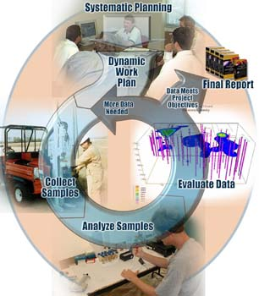
Phase II ESA - Planning
Dynamic and Adaptive Sampling Approaches
  Systematic planning
  “Real-time” field methods
  Adaptive sampling strategy
  Triad
  Expedited Site Characterization
  Accelerated Site Characterization
  Rapid or Adaptive Site Characterization
Notes:
Leads to a more efficient and cost-effective characterization, and ultimate cleanup
Systematic planning of a site characterization project must be performed before any field activities begin by using a well-rounded technical team. With stakeholder input, the team determines the site decisions, which are clearly stated goals and objectives for the investigation. Once the site decisions are defined, the kind of information needed to support scientifically and legally defensible site decisions can be determined. From this, a Conceptual Site Model (CSM) can be constructed, and the types and quality of data needed to fill existing information gaps can be established.
When the data quality needs have been determined (i.e., establish DQOs), the analytical methods/equipment are selected that will be used to supply that data. If site decisions can be made with qualitative or semi-quantitative data, field methods can often be used. Even when quantitative data is needed, a wide variety of rugged field analytical equipment and methods now exist that permit the generation of high quality data at the site location.
On-site generation of data provides "immediate" decision-making capability which can rapidly and efficiently guide characterization efforts by means of an adaptive sampling strategy, which uses the previous day's results to feed into the CSM and decision-making process to direct the collection of the next round of samples. This permits rapid location and definition of hotspots, guides the removal or treatment of contaminated media, and quickly identifies when enough information has been collected to address the site decision. It is then easy to minimize the collection and analysis of uninformative samples, to avoid unnecessary treatment, and to tell when the project is "done," thus saving time and money. The use of a dynamic workplan often allows projects to be completed in only one field mobilization.

Slide 9

Review of Existing Information
Prior Phase I or Phase II reports
Environmental database reports
Topographic maps
Aerial photos
Sanborn maps
Site documents
Interviews
Visual inspection
Notes:
The document review, interviewing, and site reconnaissance is typically where a Phase site assessment ends. In some instances, the Phase I will identify a high likelihood that current or historic contamination may exist. To help better define the nature and extent of the contamination, a Phase II progresses to collecting samples of various environmental media.

Slide 10
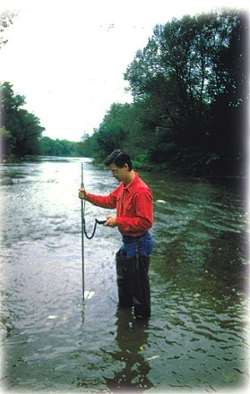
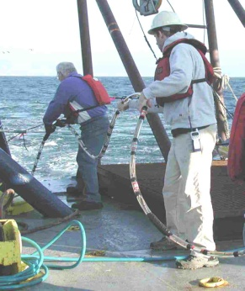
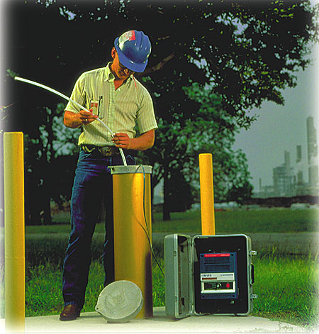
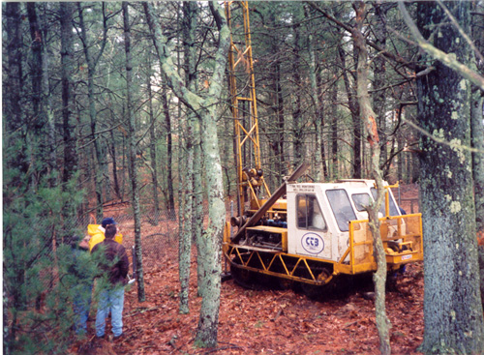
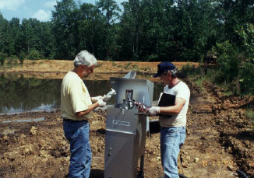
Sampling Environmental Media
Soils
  Surface
  Subsurface
Ground Water
Surface Water
Sediment
Air
Waste/Wastewater
Notes:
Next - familiarize you with the types of sampling techniques used for various environmental media, what they are used for, which of the technique provide more representative and reliable data.
Lead Paint
Asbestos

Slide 11
Field Screening Techniques
PID/FID
X-Ray Fluorescence (XRF)
Membrane Interface Probe (MIP)
Small-Diameter Wells/Microwells
Soil gas analysis
Vapor diffusion samplers
Field GC/MS
Notes:
Discuss how each technique is used and what contaminants it is for

Slide 12
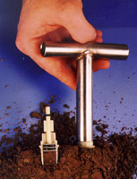
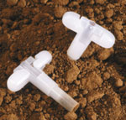
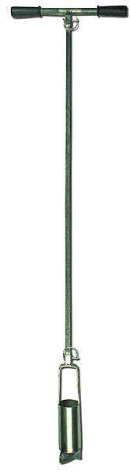
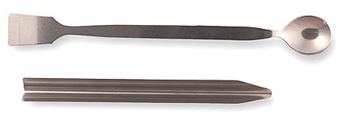
Sample Collection – Surface Soil
Surface Soil samples may be collected to provide lateral extent of surface contamination, samples appropriate for risk assessment, or focus on visibly impacted areas.
  Hand Auger
  Trowel/spatula
  TerraCore/ Encore
  Grab/Composite
Notes:
Surface soil (generally corresponds to the top 6-inches to 1 foot of soil) – collected to determine lateral extent of surface contamination, often from localized spills and releases (fuels, chemicals) but also from deposition of airborne contaminants over larger areas.
Surface soil data are often used in human health and ecological risk assessments – people and organisms frequently contact, therefore it is important to look at.
Techniques include:
Hand augers
Trowels
Spatulas or Spoons
Encore/Terra Core samplers – technique used to collect sample for VOC analysis (benzene, solvents) – it is extremely important that samples for VOC be collected immediately after removing the soil from the ground, otherwise the contaminants can volatilize quickly, and the concentration will not be representative of the actual conditions.
No one technique is necessarily better than the other.

Slide 13
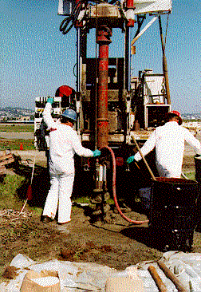
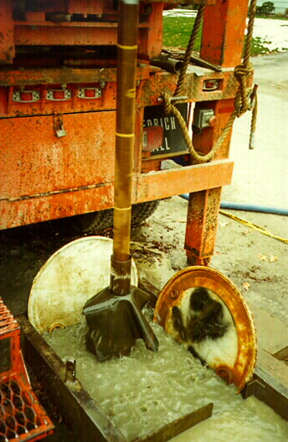
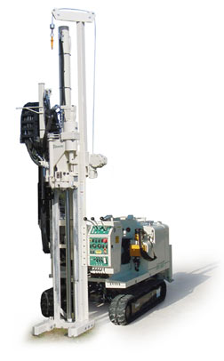
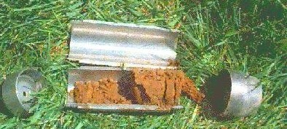
Sample Collection – Subsurface Soil
Subsurface soil samples may be collected to identify geologic materials, provide extent of contamination at depth, understand soil impacts to ground water, identify subsurface sources, or detail migration.
  Auger/Rotary Drilling
  Direct Push/Vibratory
  Hand Auger
  Bedrock coring
Notes:
Subsurface soils (generally correspond to depths greater than the top 1 foot of soil) – collected to identify the geologic nature of the soils and rock beneath the property and to provide vertical extent of contamination, often in situations where contaminant sources may have been buried at depth (such as a UST, sewer lines), or from contaminants that have migrated deeper into the soil and ground water.
Techniques for obtaining subsurface soils vary depending on how deep you want to go and what type of materials you are drilling through:
Drill rigs vary – hollow stem auger or rotary drilling – generally are more labor intensive, time consuming, produce more soil wastes, but can get very deep (100’s to 1000’s of feet)
Direct push/vibratory rigs (Geoprobe) - Less labor intensive, quickly delineate soil, little waste generated - but limited depth range (10’s to 100 feet)
Hand augers – only go up to 5 to 10 feet deep
Again, no one technique is necessarily better than the other. However, certain types of drilling (mud rotary, drive and wash, coring) require the use of water or other fluids and these fluids can interfere with samples collected for chemical analysis – the fluid acts to dilute the concentrations present in the aquifer. So it is important when evaluating a site assessment report – to recognize which type of drilling method is used, and insure that the proper techniques were used if samples were collected for chemical analysis.

Slide 14
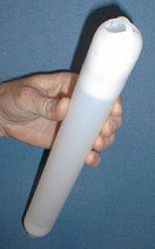
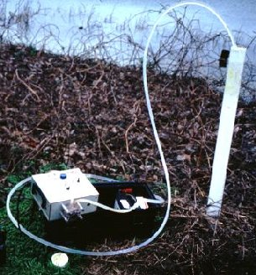

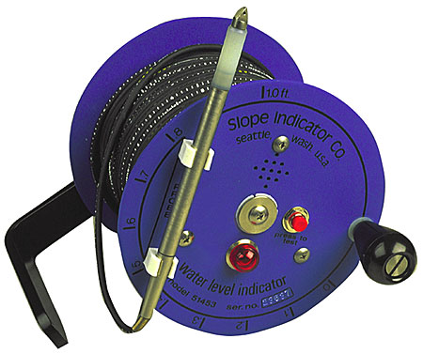
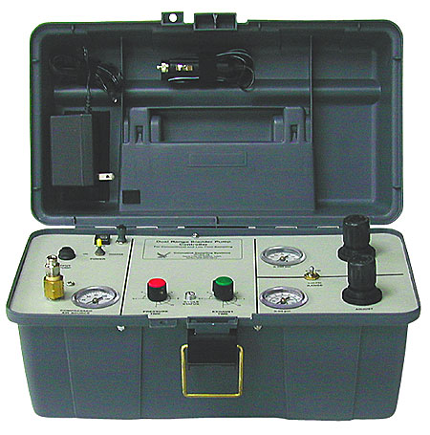
Sample Collection – Ground Water
Ground water samples may be collected to assess aquifer chemistry, contamination, plume size and migration.
  Low-Flow (Low-Stress)
  Traditional
  Bailers
  Passive Diffusion
  Piezometers
Notes:
Ground water samples are collected to characterize the nature of contamination in the aquifer (type of chemical, and how high of a concentration), and the size and extent of the impacted ground water/plume. The quality of a ground water sample is important bc of comparison to criteria, and use in risk assessments.
Techniques for obtaining gw samples vary - and each has its advantages and disadvantages:
Low-flow (low stress): nowadays is the preferred method for collecting representative and high quality samples. Can be accomplished with different types of pumps – pump the water are a very slow rate, thereby mimicking the natural flow rate through the aquifer. Method reduces agitation of the sample, minimizing volatilization (preserving the concentration of VOCs) and minimizing suspension on sediments (which often causes the metals results to be high, and not reflective of true aquifer conditions). Low-flow sampling can be relatively time consuming, and equipment intensive. One the Superfund site that we work on – it is the principle means of collecting gw samples.
Submersible Pumps – pumping wells at a higher volume (3 – 5 times the volume in the well). Still used – but generally involves a higher degree of agitation, causing potential for loss of volatiles and higher suspended sediments/metals concentrations. Also produces more waste.
Bailers – are still used today – simply lowering a plastic/Teflon cylindrical device down the well to purge and collect sample. Again - higher degree of agitation, causing potential for loss of volatiles and higher suspended sediments/metals concentrations.
Passive Diffusion Samplers – sometimes referred to as PDB samplers - relatively new and innovative technique involved placing a distilled water-filled bag into the well, allowing it to sit for a period of time (couple weeks to months), removing the bag and filling sample bottles. Works on diffusion principles, where any contaminants in the aquifer diffuse into the bag and equilabrate. Has been used successfully in long-term monitoring programs. Important limitation – is that it is only applicable for use on volatile contaminants (TCE, BTEX, etc.) and is not to be used for in organic contaminants such as metals, pesticides, etc.
Piezometers -
Water table measurements are also collected to determine ground water table elevations, which aid in evaluating the direction and speed of ground water flow. Use to determine where and how fast contaminants might be flowing.
Well development – As you are evaluating a ESA report, and there are new wells installed, it is important to see whether well development was performed - the process of removing sediments and fluids from the well soon after it is installed to remove impacts from the drilling process. As mentioned before, drilling can introduce fluids that act to dilute contaminant concentrations. Also – sediments left behind could result in high metals concentrations, not representative of the true aquifer conditions.

Slide 15
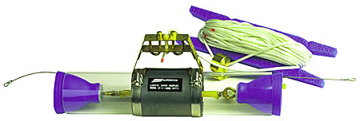
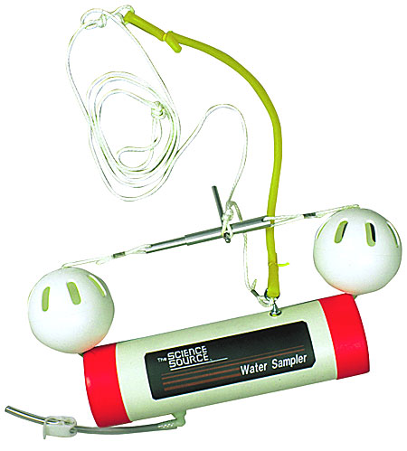
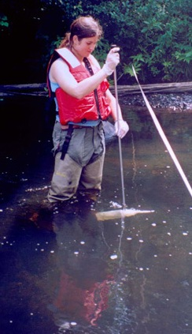
Sample Collection – Surface Water
Surface water samples may be collected to provide aerial extent of surface contamination, assess risk, or evaluate compliance with permits.
  Kemmerer bottle
  Bomb sampler
  Dip sampler
Notes:
Surface water samples are collected to assess the nature and horizontal/vertical extent of contamination or to evaluate compliance with discharge permits (waste water, storm water) from facilities. As with other media - data can be used to support risk assessments (HHRA or ERA) to determine potential risk to humans and/or ecosystem.

Slide 16
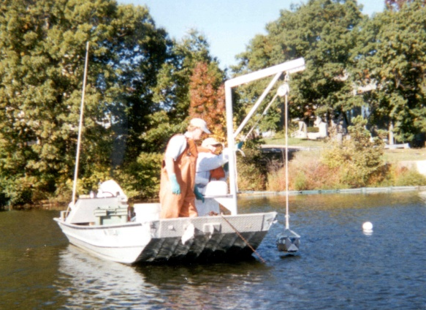
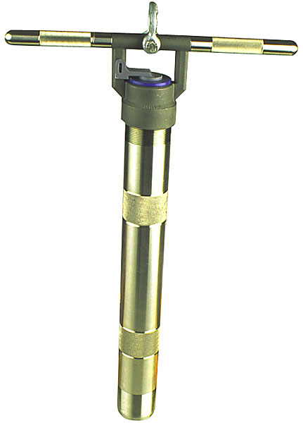
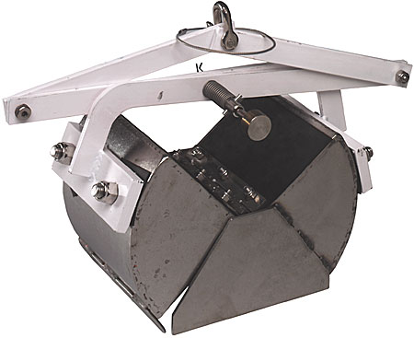
Sample Collection – Sediment
Sediment samples may be collected to define nature and extent of contamination, understand impacts from discharges, assess risk, or scope remediation costs.
  Bottom dredge
  Grab
  Hand corer
  Hand auger
  Trowel/spoon
  Stream bottom sampler (benthic invertebrates)
Notes:
Sediment samples
Unlike surface water – where you often see dilution of contamination, sediments act by trapping contaminants over time. Runoff, waste water, storm water discharging to water bodies (lakes, rivers, wetlands, oceans) accumulate over time, and do not necessarily dilute or degrade naturally.
Techniques include:
Grab/Dredge samplers – typical clamshell construction, closure is triggered when it hits the sediment, snapping shut and collecting sediment. Preferred method bc is captures are materials, including the fine particles (muds, clays, silts) that often associated with highest organic contaminant concentrations.
Core samplers – also good technique, and allows user to assess vertical extent of contamination – can penetrate deep into sediments to determine how deep contaminants exist, aid in scope of remediation.
Hand augers/trowel spoon – useful for shallow water (< 1 foot), but not recommended for deeper water. As you pull sampler through water column, potentially lose fine-grained particles (clays/silts) and underestimate true contaminant concentrations.

Slide 17
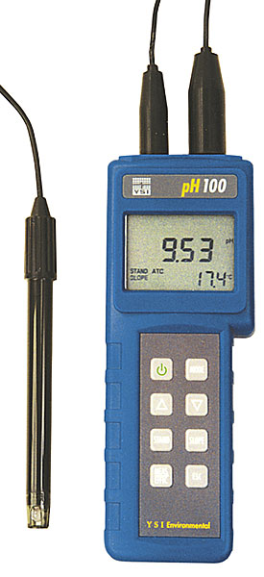
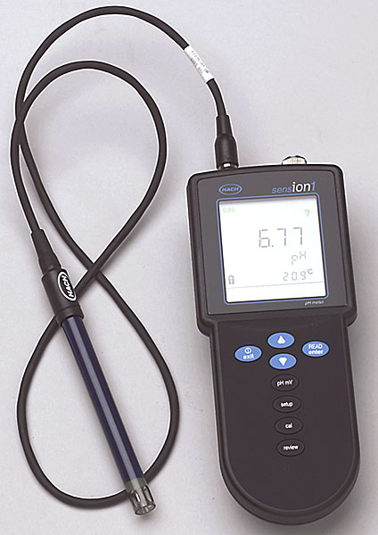
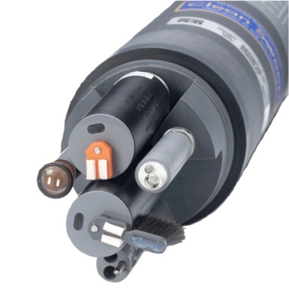
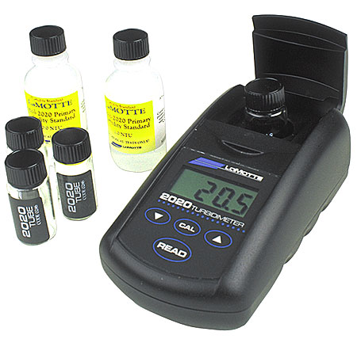
Water Quality Monitoring
Field testing for water quality parameters such as dissolved oxygen, temperature, pH, turbidity, conductivity, dissolved solids, redox potential (ORP), color, and chlorine content.
  Multi-parameter hand-held instruments (YSI, HACH)
  Continuous monitors
  Test kits
Notes:
During ground water, surface water, and waste water sampling – various instruments can be used to test for water quality parameters listed here. These provide some real-time indication of important parameter that affect how certain contaminants may act or breakdown in certain water bodies. For example: a ground water with a low dissolved oxygen (or lack of oxygen) may suggest a high degree of biological activity that may contribute to the natural breakdown of contaminants, and support natural attenuation.
Different types of instruments:
Multi-parameter – measures up to 5 to 6 parameters simultaneously
Continuous
Test kits – adding reagents to a water sample and measuring chemical concentrations (like ferrous iron). Gives a rough field measurement of certain chemicals – not necessarily – not necessarily a replacement for laboratory analysis.

Slide 18
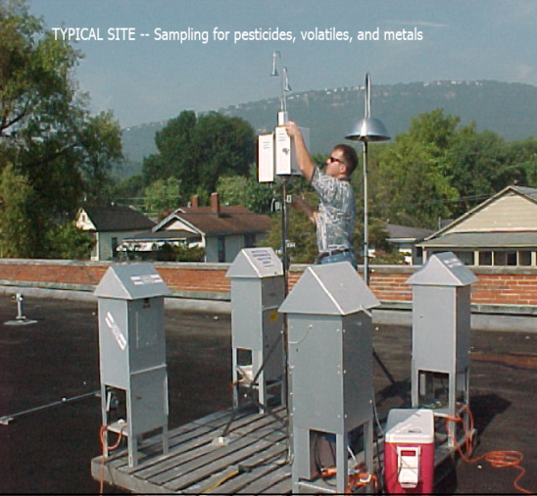
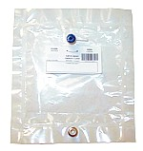
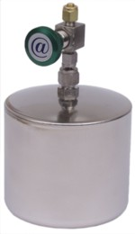
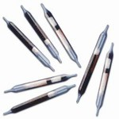
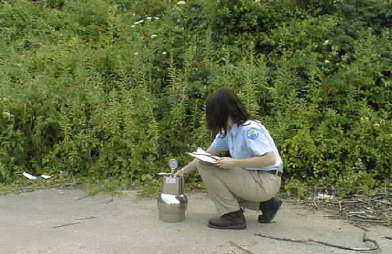
Sample Collection – Air
Air samples may be collected to assess immediate or long-term airborne impacts, compliance with regulations.
  High Volume Samplers
  Summa Canister
  Tedlar Bag
  Adsorbents (Charcoal, Tenax)

Slide 19
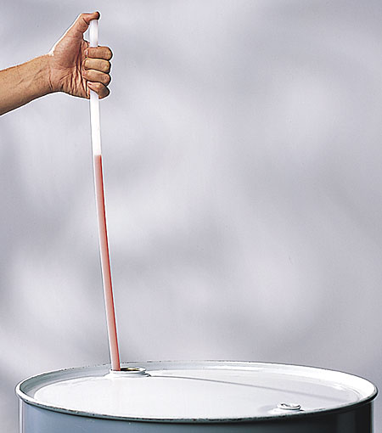
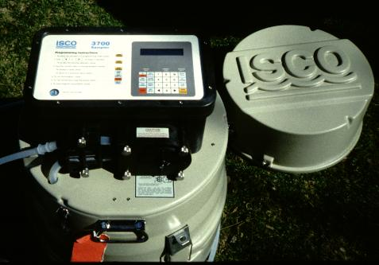
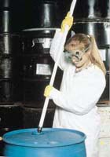
Sample Collection – Waste/Wastewater
Waste samples may be collected to characterize waste for safe and legal handling, transport, and disposal.
  Automated ISCO
  Coliwasa
  Drum thief sampler

Slide 20
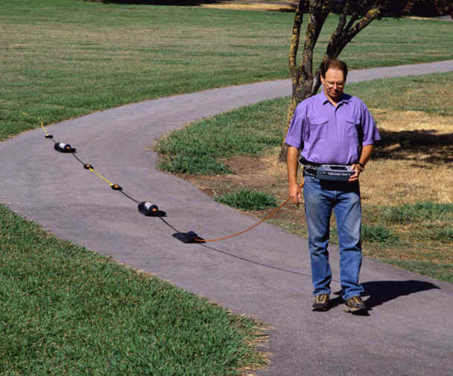
Geophysical Surveys
Helps characterize sites with limited site disturbance
Man-made obstructions and waste
Bedrock depths, aquifer properties, water depth, fracture patterns
Uses remote sensing techniques for underground imaging
  Ground penetrating radar
  Magnetometry
  Electrical resistivity
  Seismographs, Sonar
Notes:
Geophysical surveys – useful to determine physical properties of soils, rock, and ground water, such as: depth and thickness of geologic units, stratigraphy – continuity of geologic units; type of material and conductivity – all this aids in evaluating the transport of contaminants in the subsurface.
Surface and down hole techniques involve using ground penetrating radar, resistivity, seismography, sonar -
Limited usage in areas with dense utility networks, buildings, etc., but it is a relatively inexpensive method of characterizing the subsurface, but with a moderate degree of uncertainty.

Slide 21
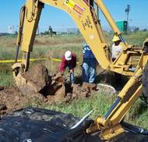
Geology
Overburden
  Sand and Gravel – high conductivity (K)
  Silt and Clay – low conductivity
Bedrock
  Fractured
  Competent
Notes:
When interpreting geologic data, it is important to understand the types of soil data presented on boring logs and geologic cross sections.
Types of soil or bedrock can have a significant influence on how ground water flows, and whether contaminants may or may not migrate:
Sand and Gravel – are relatively conductive materials, meaning ground water and contaminants may flow readily through such materials.
Silt and Clay – on the other hand, are relatively resistant to flow – and can act as a barrier to flow and contaminant transport and DNAPLs. Contaminants can get adsorbed/bound up into these materials, and are very difficult to remove/remediate. When ground water contaminants migrate into these materials, it can cause ground water clean up times to extend for years and years.
Bedrock – underlying consolidated formation. One time was though to be a relatively impermeable barrier to contaminant flow (and in some cases is). But many sites have seen highly fractured bedrock – and contaminants have migrated into the fractures and permeated the rock matrix itself. Like silt and clay soil – fractured bedrock can be extremely difficult to clean up.

