Slide 1

Taking Action on Climate Change and Sustainability
PG&E Partnership Options
August 30, 2007
Notes:
Mention background
Green ribbon task force
Keith Reed opened the series
Been involved in the series
Book end

Slide 2

About PG&E and Our Business
What we do:
Deliver safe, reliable, and environmentally responsible gas and electricity to approximately 15 million Californians
Electric and gas distribution customers | 5.1 MM electric 4.2 MM gas
Electric transmission circuits | 18,610 miles
Gas transmission backbone | 6,136 miles
Electric generation capacity | 6,000 MW

Slide 3

PG&E’s Climate Change Commitment
"The link between greenhouse gas emissions and the Earth’s warming climate is convincing, the potential consequences are serious and the need for action is urgent.“
— Peter A. Darbee, Chairman of the Board, CEO and President, PG&E Corporation
“PG&E is committed to leading by example when it comes to climate change. That means more than just minimizing the greenhouse gas emissions from our operations. It also means maximizing the opportunity we have to lead efforts to establish responsible policies and programs to address global climate change.”
— Adopted by PG&E Corporation, May 2006

Slide 4

PG&E’s Approach:
Integrated Products and Solutions
Energy
Efficiency
Education
Outreach
GHG
Emissions
Neutralization
Renewable
Energy
Partnership

Slide 5
Energy Efficiency is the Fastest, Cheapest Solution
Over the past 30 years, California per capita energy use has remained relatively flat compared to the 50% increase in U.S. per capita energy use.
14,000
12,000
10,000
8,000
6,000
4,000
2,000
California
United States
0
1960
1962
1964
1966
1968
1970
1972
1974
1976
1978
1980
1982
1984
1986
1988
1990
1992
1994
1996
1998
2000
2002
2004
2006
2008
Source: California Energy Commission

Slide 6
Energy Efficiency as a Resource
A kilowatt-hour saved from energy efficiency does just as much work as a kilowatt-hour from a power plant
But a kilowatt-hour from energy efficiency is preferable:
  Does not produce any greenhouse gases
  Does not incur transmission, distribution or transformation losses
  Does not require the permitting or construction of a power plant or transmission lines
  It is quick to “construct” and begins to “produce” power almost immediately

Slide 7
The Numbers Talk…
In 1976, PG&E became one of the first utilities in the nation to offer energy efficiency and demand management programs for our customers.
During the first 30 years, PG&E’s energy efficiency programs:
Saved more than 118 million megawatt-hours and 10.7 billion therms from installed measures (cumulative lifecycle savings)
Saved enough annual electricity to power over 18 million homes and enough annual natural gas to heat 15 million homes
Helped California avoid building 24 large power plants
Kept over 125 million tons of C0₂ out of the atmosphere, based on combined electric and natural gas cumulative lifecycle savings
Data represent PG&E accomplishments from 1976 – 2005.
Notes:
148 million MWh = total lifecylce cumulative from 1976 through 2004, so it’s the energy savings we expect to achieve as a result of energy-efficient measure that have been installed through program year 2002. Measures can yield energy savings for up to 20 years.
Total electric bill reductions resulting from energy savings from 1976 through 2002 = $9.9 billion.
Total electric expenditures from 1976 through 2002 = approximately $1.8 billion.
$9.9 – $1.8 = approximately $8 billion

Slide 8
2006 - 2008 Energy Efficiency Portfolio
Moves towards an integrated customer-based focus
Portfolio includes: financial incentives and rebates, training, education, energy audits, emerging technology projects, energy codes and standards support, marketing and outreach, and evaluations
Multiple delivery channel opportunities: utility programs, partnerships, third parties
Mass Market: single family, multifamily and small business customers
Targeted Markets:
Agriculture & Food Processing
Hospitality & Lodging
Health Care & Biotech
High Tech
Large Commercial & Institutional
  Manufacturing & Heavy Industry
  Residential New Construction
  Retail
  Schools, Colleges & Universities
  Water Treatment

Slide 9


Appliance Standards – A Big Impact
2,000 kWh
18 cu. ft. frost-free refrigerator
Energy Usage per year
700 kWh
490 kWh
417 kWh
1970
1993
2001
2006
Notes:
Source of slide? Katherine?

Slide 10
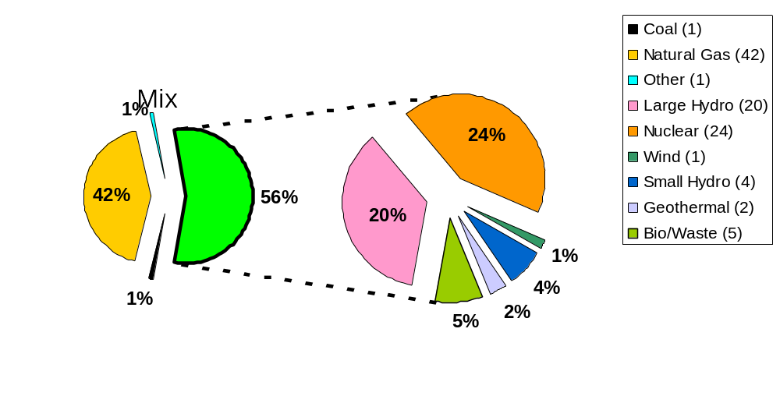
Committed to Clean Energy
Note: Delivery mix includes all of PG&E’s owned generation plus all of PG&E’s power purchases.
Notes:
This slide represents our 2005 delivery mix – 56% of which came from carbon-free and/or renewable sources.

Slide 11
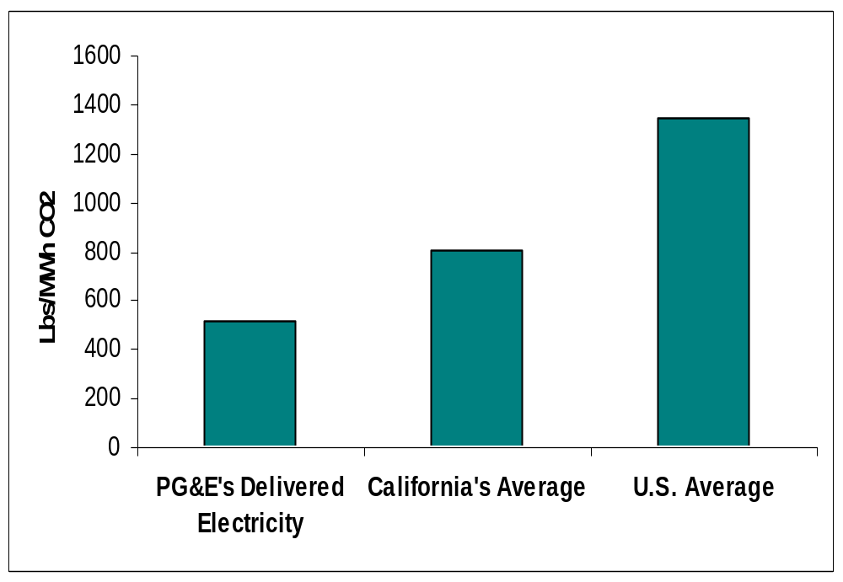
PG&E’s GHG Footprint
Absolute CO₂ Emissions:
18 million tons per year
1,342
804
520
2004 CERES CO₂ Ranking:
93 of 100
Note: All figures for emissions from electric power generation
Notes:
Benchmarking Energy Intensity
- This slide presents PG&E’s lbs-per-MWh of CO2 emissions as compared to California and national data.
- It helps demonstrate our clean energy portfolio from an energy intensity perspective.
2004 NRDC/CERES Ranking
PG&E also ranked well in a recent report from NRDC/CERES entitled, “Benchmarking Air Emissions of the 100 Largest Electric Power Producers in the United States”:
PG&E was ranked the 7th cleanest utility for CO2 emissions (93 out of 100)
PG&E is listed as the 34th largest electric power generator
The report is based on 2004 plant ownership and emissions data

Slide 12
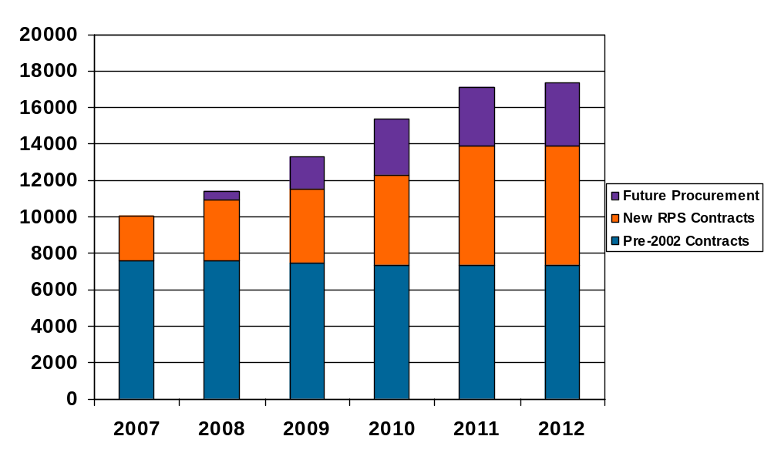
PG&E Aggressively Pursuing Renewables Beyond 20%
19%
20%
16%
13%
GWhs
12%
Year

Slide 13
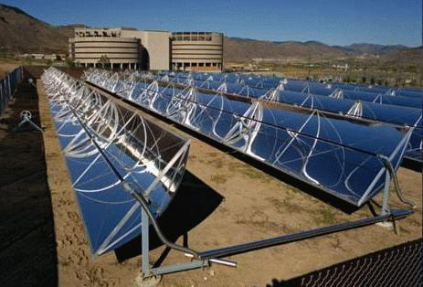


Eligible Renewables - Emerging
Solar Energy
BioGas
Ocean Power
California has significant Solar resources that closely follow PG&E’s load profile
PG&E has announced power purchase agreements with:
- CleanTech America (5MW)
- GreenVolts (2MW)
- Solel (553 MW)
California has significant resources for bio-methane generation and capture
PG&E has announced gas purchase agreements with BioEnergy Solutions and Microgy for the purchase of pipeline-quality biogas from dairy waste.
PG&E is examining the potential of both wave energy and tidal energy for electric generation.
PG&E has announced the “WaveConnect” project to examine wave energy off the California coast and a project to examine tidal energy under the golden gate bridge.

Slide 14
California Solar Initiative (CSI)
Long-term solar incentive program
  Statewide goal: 3,000 MW of new solar generation by 2017
Provides $2+ billion in incentives over the next decade (~ $1 billion in PG&E territory)
Emphasis on performance-based incentives
Nonresidential and Residential Retrofit projects are administered by PG&E
www.pge.com/solar

Slide 15
Self-Generation Incentive Program (SGIP)
Incentives for clean and renewable on-site generation
  Wind turbines
  Renewable fuel cells
  Renewable fuel internal combustion engines and large gas turbines
  Certain non-renewable technologies
  (e.g., fuel cells, waste gas, etc.)
  www.pge.com/selfgen

Slide 16
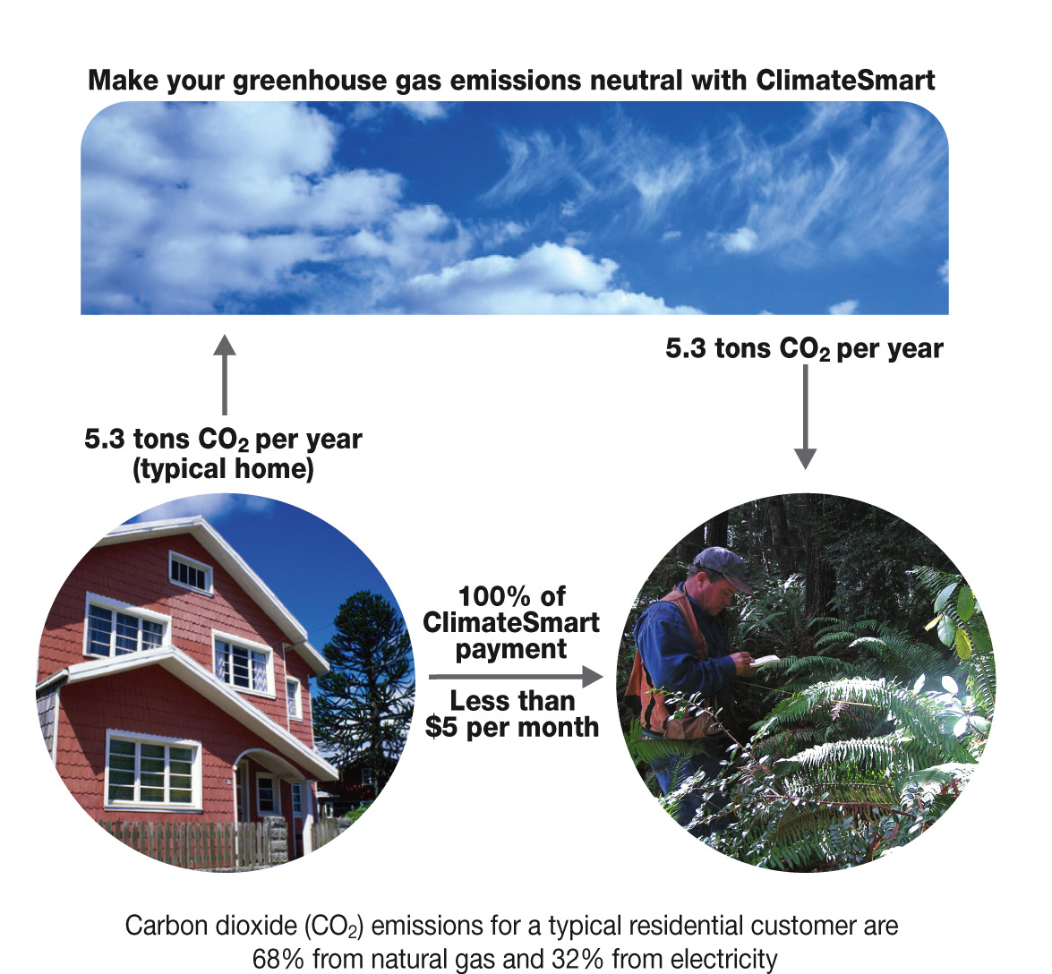
ClimateSmart – “Climate Neutral” Energy
Notes:
Unintended consequence = new biz opportunities

Slide 17

An introduction to ClimateSmart
On June 28, PG&E launched ClimateSmart, a first-of-its-kind voluntary program that allows PG&E customers to take action to reduce greenhouse gases.
How it works:
Reduces 100% of greenhouse gas emissions associated with enrolled participant’s energy use. (Customers with multiple accounts can choose accounts to enroll.)
Cost is fixed – $0.00254 per kWh and $0.06528 per therm.
100% of your money goes to independent CA projects that meet stringent criteria developed by CA Climate Action Registry.
All reductions will be registered and retired.
GHG reductions for communities reported annually.
Notes:
“Today's forest loss and depletion is roughly 25 percent of all CO2 emissions globally …. We simply cannot reach our goals of having a more livable climate without working constructively with forests.”
– Laurie Wayburn
“Today, we lose more forest than any other land type. We lose twice as many acres of forestland a year as we lose farmland. When you lose those forests, you lose not only the carbon that's in them today. You lose the future sequestration … California loses about 40,000 plus acres of forest land a year to development and conversion. But we can refill our forest banks in California. California has some of the most productive forest carbon sinks in the world."
– Laurie Wayburn
“The pro [of the ClimateSmart approach] is the recognition that … farms, forests, and ranches have the ability to sequester carbon out of the atmosphere. They also have the ability to emit carbon…. [We need] to recognize this fact and to really wrap our arms around how to involve the land sector – forests, ranches, farms – in this low carbon future.”
– Eric Holst

Slide 18
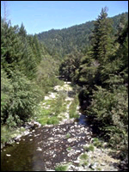
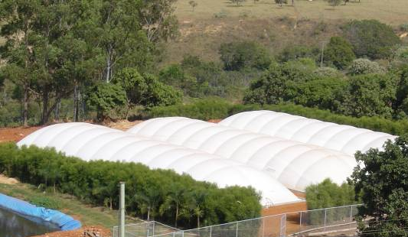
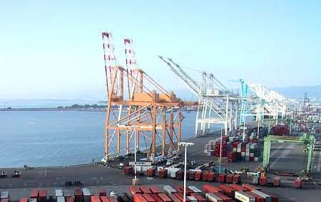
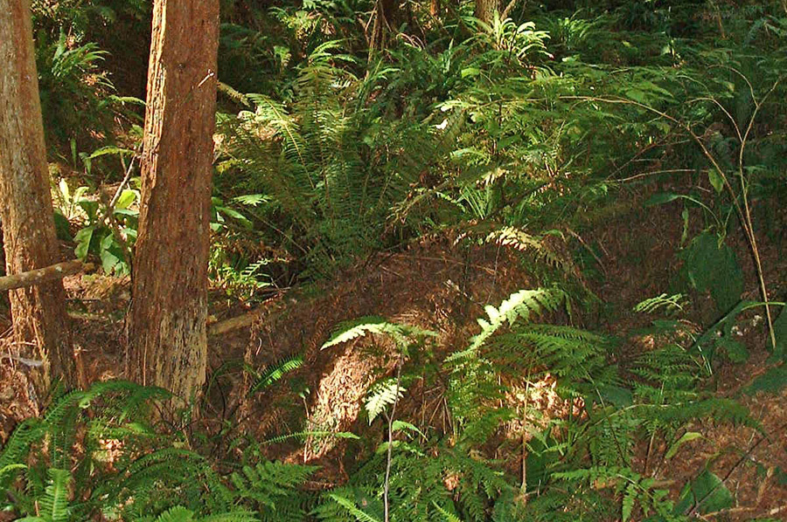
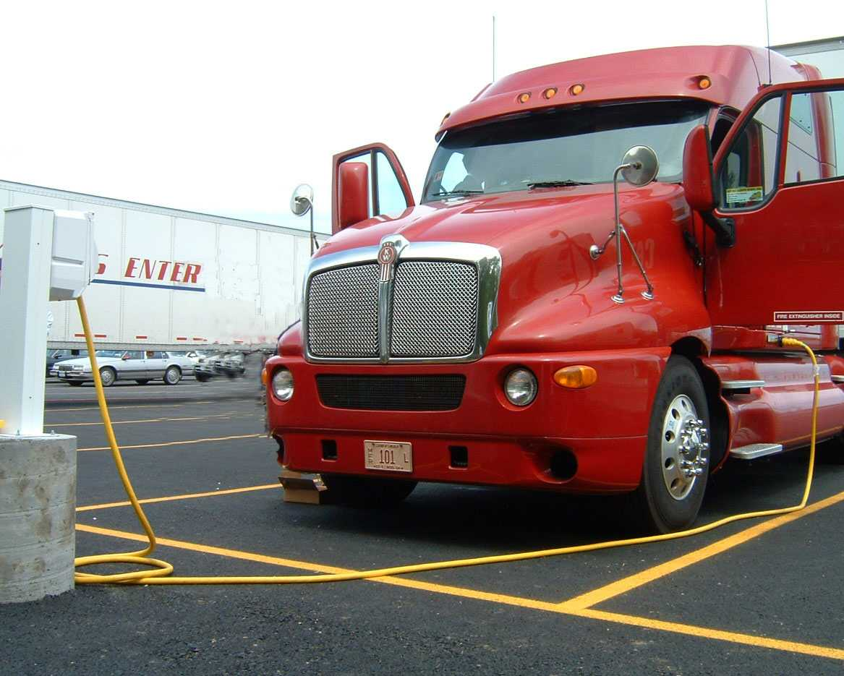
Greenhouse Gas Emission Reduction Projects
California Climate Action Registry – Current and Potential Protocols
Types of Projects
Reforestation /
Conservation
Dairy Methane
Capture
Potential
Others*
Example of
Potential Projects
Garcia River
Methane Gas Mitigation Projects
Port Electrification
van Eck Forest
Truck Stop Electrification
Benefits
Ecosystem preservation
Long-term carbon sequestration
Reduce impact of methane (a GHG that is 21x more potent than CO₂)
Reduce emissions
Reduce smog
Provide cleaner air
* Protocols for these potential projects have not yet been defined.

Slide 19
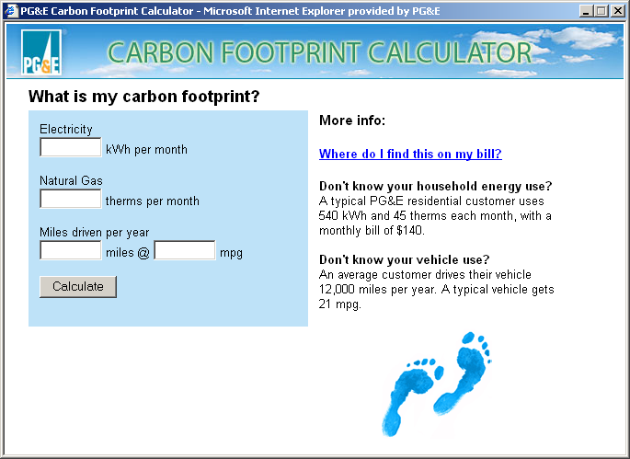
Calculate your carbon footprint
http://www.pge.com/carbonfootprint/

Slide 20
Sustainable Communities Vision
A sustainable community protects and enhances the overall health, natural environment, and quality of life of its members and maintains the fundamental balance between its economy, equity and ecology.
PG&E envisions sustainable communities that embody principles to support a high quality of life within the carrying capacity of one planet and strive to achieve the following One Planet Living objectives:
Zero Carbon: Reducing carbon dioxide emissions by optimizing building and infrastructure energy demand and supplying from zero or low carbon and renewable resources.
Zero Waste: Achieving a substantial reduction of waste flows to landfill by reducing waste production and valuing all materials as potential resources, through reuse, reprocessing or generating energy from waste.
Sustainable Water: Reducing energy used in water supply and waste water management; reducing flooding risks and conserving water resources.
Sustainable Transportation: Reducing the need to travel, providing alternatives to private car use, and providing more sustainable private car options.
Local and Sustainable Materials: Maximizing the use of local, reclaimed, recycled and non-toxic materials that have low-embodied energy.

Slide 21
Sustainable Communities Program
Existing PG&E Programs
Additional Programs
Energy Efficiency &
Demand Response
Incentives, education for demand side management
Sustainable Communities Education
Green Building 101, event sponsorships, job training
PG&E Sustainability Center
Green
Cities
California Solar Initiative (CSI)
Incentives for PV solar installations and non-PV thermal solar installations (AL pending)
Green
Neighborhoods
Sustainable Communities Tech Assistance
Green design and consulting services
Green city general plans, carbon reduction strategies
Green
Buildings
Self Generation
Incentive Program (SGIP)
Incentives for distributed generation
Sustainable Communities Incentives
LEED certification, energy innovation, shade trees
Green city planning tools
ClimateSmart
Opt-in to neutralize carbon emissions
Green
Neighborhoods
Clean Air Vehicle Programs
Reduce greenhouse gas and toxic exhaust emissions in transportation sector; assess low emissions vehicles
Green
Cities
Sustainable Communities Pilot Projects
Investments in neighborhood energy centers, district heating & cooling, trigeneration, vehicle to grid

Slide 22
How PG&E Customers Can Help Mitigate Climate Change
Energy Efficiency
  Access to funding for energy efficiency programs - $1 Billion for 2006-2008
  82 Customer Programs targeted to each class of customer
  Three delivery channels – Third Party (48 programs), Partnerships (20 programs) and Core PG&E programs (14 market programs)
Demand Response - temporary electric capacity on very short notice for spikes in load or short term deficiencies in supply
  Energy Use Audits
  Technical Assistance
  Automated Demand Response
Solar
  California Solar Initiative funding and support - $2 Billion statewide
  Statewide goal: 3,000 MW of new solar generation by 2017
ClimateSmart
  Allows customers to combat climate change by offsetting the greenhouse gas emissions associated with their energy use

Slide 23
What you can do
Some things you can do to reduce CO₂ from your home | The average home emits 10,600 lbs. (5.3 tons) CO₂ per year
Replace lighting with 5 CFLs Install a new energy-efficient clothes washer Install a high-efficiency central natural gas furnace | -170 lbs. CO₂ per year -260 lbs. CO₂ per year -1,000 lbs. CO₂ per year
Revised home energy emissions | 9,170 lbs. CO₂ per year Estimates may vary depending on products installed.
Sign up for ClimateSmart | -9,170 lbs. CO₂ per year
Your impact on the environment | 0 lbs. CO₂ per year

Slide 24
Supporting the Community
California State Parks Foundation
Committee for Green Foothills
Environmental Education (e.g. Hidden Villa, Walden West, etc.)
Joint Venture Silicon Valley Climate Change Task Force
PG&E Solar Schools/Solar Habitat programs
Santa Clara University “Solar Decathalon”
Santa Clara Valley Audubon Society
Silicon Valley Energy Watch
Silicon Valley Leadership Group “Clean and Green” Action Plan
Volunteer Center of Silicon Valley “Green Challenge”
Notes:
Here are a few Sonoma County-based organizations PG&E has provided charitable contributions to since 2005:
American Red Cross, Sonoma Chapter
$5,000 for 2nd Annual Awards Breakfast – Real Heros
Community Foundation Sonoma County
$15,000 for Celebrate Community Program
Adult Literacy League of Sonoma County
$1,500 for Finley Center ESL classes
Climate Protection Campaign
$7,500 for Climate Change Video
California State Parks Foundation
$1,000 Earth Day grant for 2006
Stewards of the Coast and Redwoods
$500 for Earth Day 2005

Slide 25

The “Real” Cause of Global Warming
Photo courtesy of Dr. Stephen Schneider, Stanford University

