Slide 1
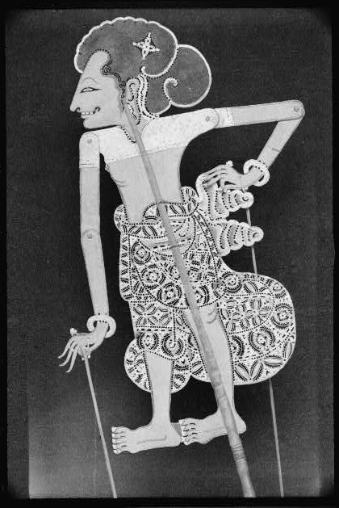
Making Wajangs [Shadow Puppets] in Bali
The following sequence of photographs was taken of the artist, I Wara of Negara, making a wajang or shadow puppet on November 4, 1937.
This particular wajang figure is called “I Darma.”

Slide 2
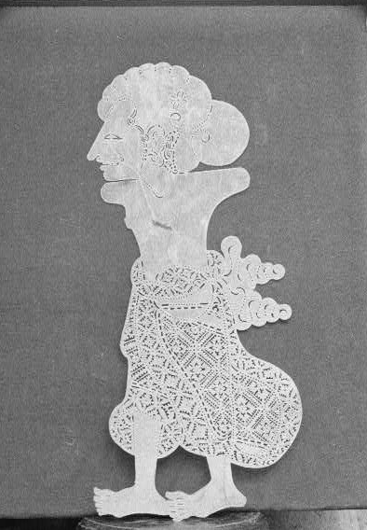
Making Wajangs [Shadow Puppets] in Bali
According to Mead in Balinese Character, I Darma is one of five brothers who are heroes of an epic shadow play called “Berata Joeda.”
He is the eldest of the brothers and is known for being both wise and quiet.

Slide 3
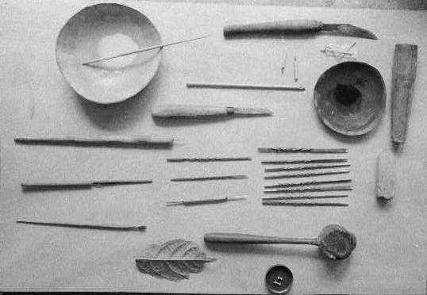
Making Wajangs [Shadow Puppets] in Bali
This is a photograph of the tools used by I Wara in making his wajang. The specific name of each tool is documented in Mead and Bateson’s field notes.

Slide 4
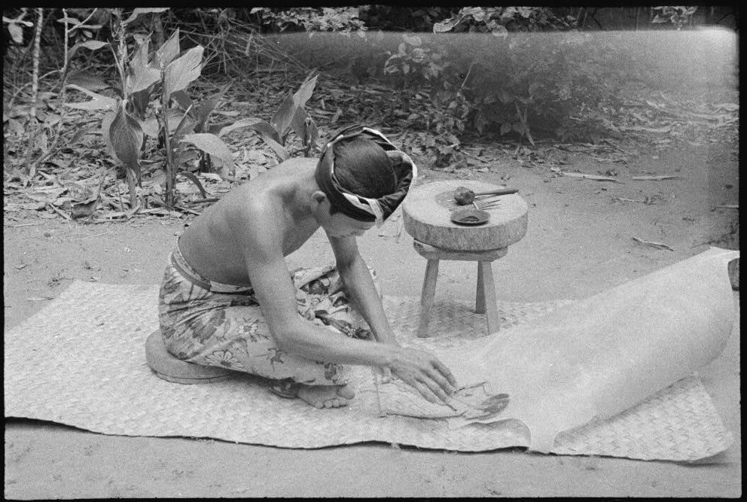
Making Wajangs [Shadow Puppets] in Bali

Slide 5
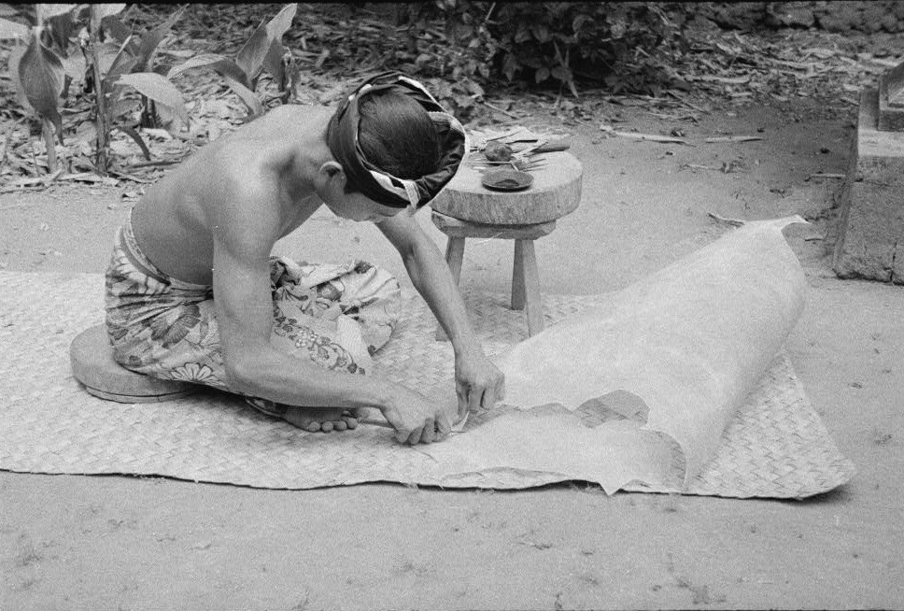
Making Wajangs [Shadow Puppets] in Bali

Slide 6
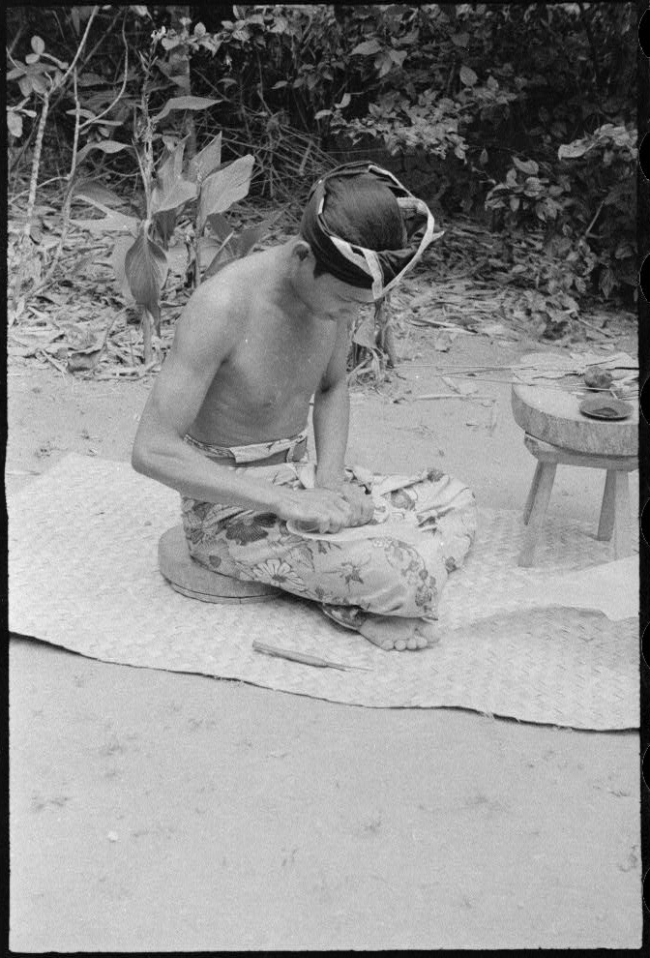
Making Wajangs [Shadow Puppets] in Bali

Slide 7
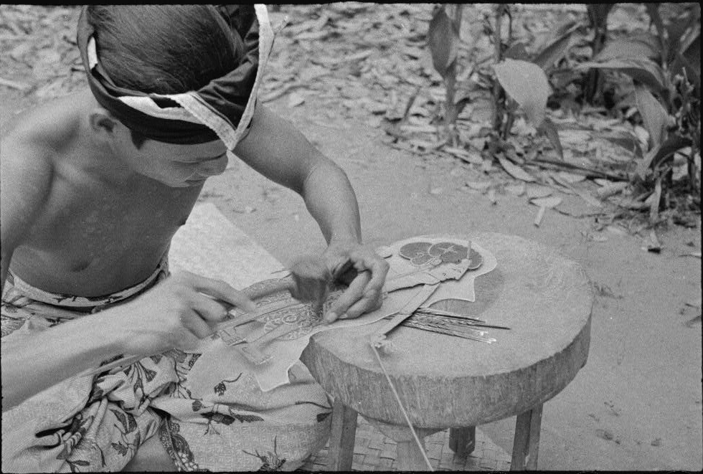
Making Wajangs [Shadow Puppets] in Bali

Slide 8
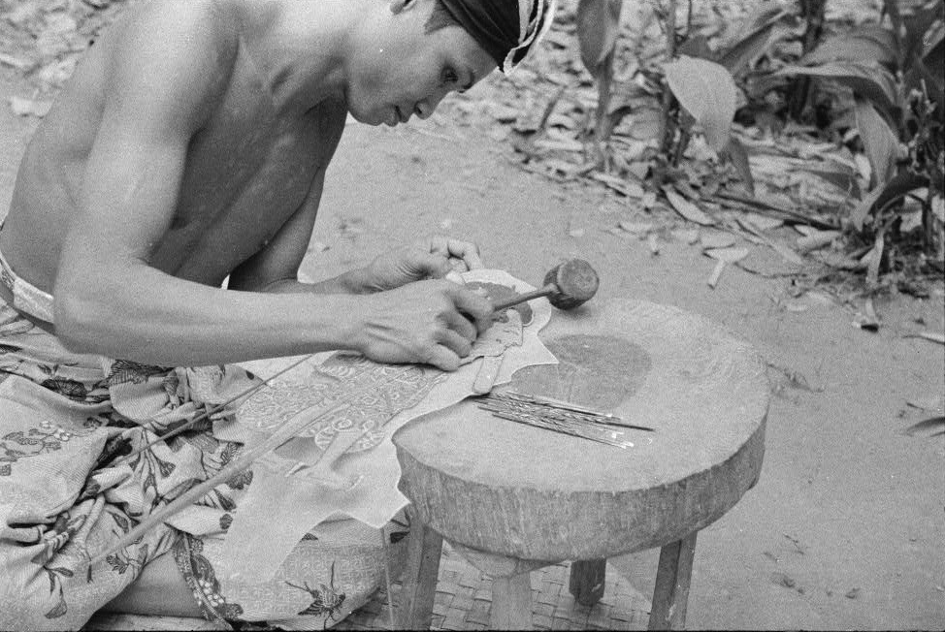
Making Wajangs [Shadow Puppets] in Bali

Slide 9
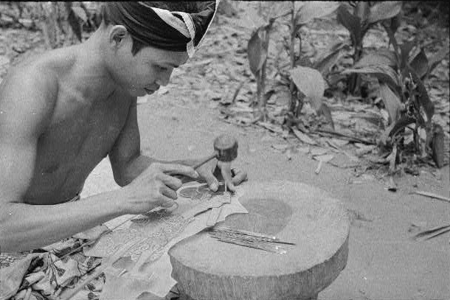
Making Wajangs [Shadow Puppets] in Bali

Slide 10
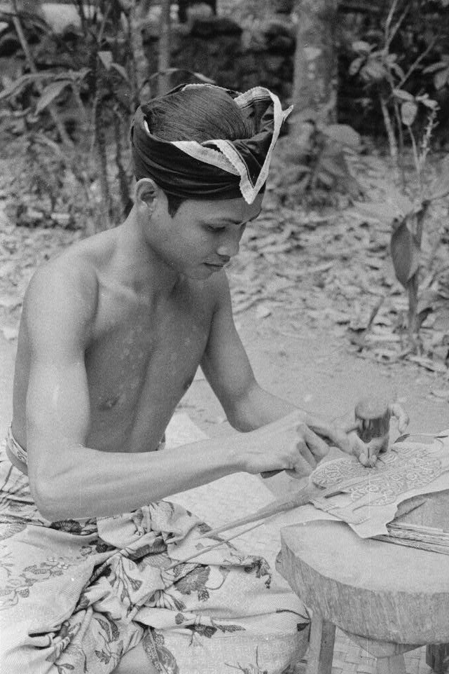
Making Wajangs [Shadow Puppets] in Bali

Slide 11
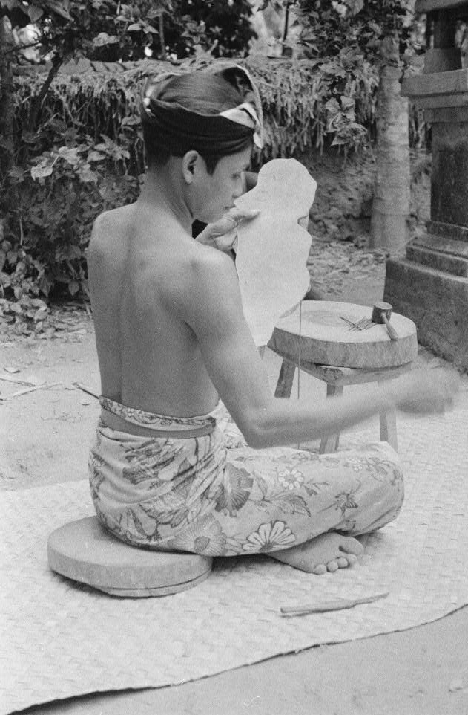
Making Wajangs [Shadow Puppets] in Bali

Slide 12
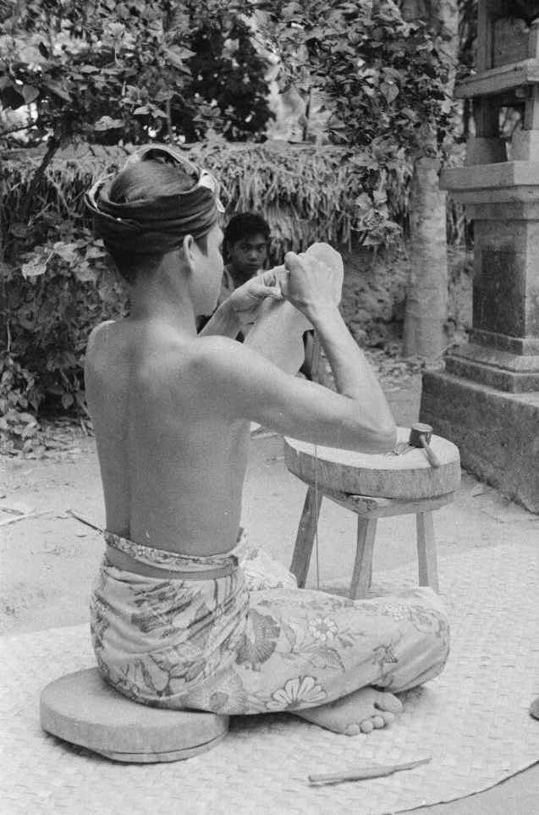
Making Wajangs [Shadow Puppets] in Bali

Slide 13
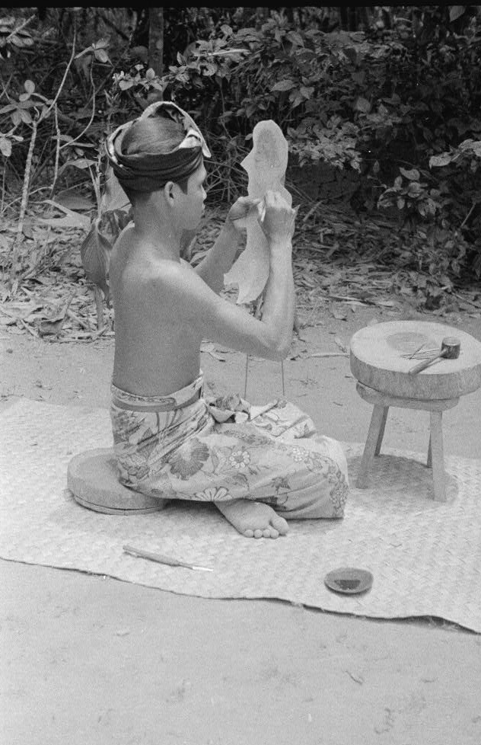
Making Wajangs [Shadow Puppets] in Bali

Slide 14
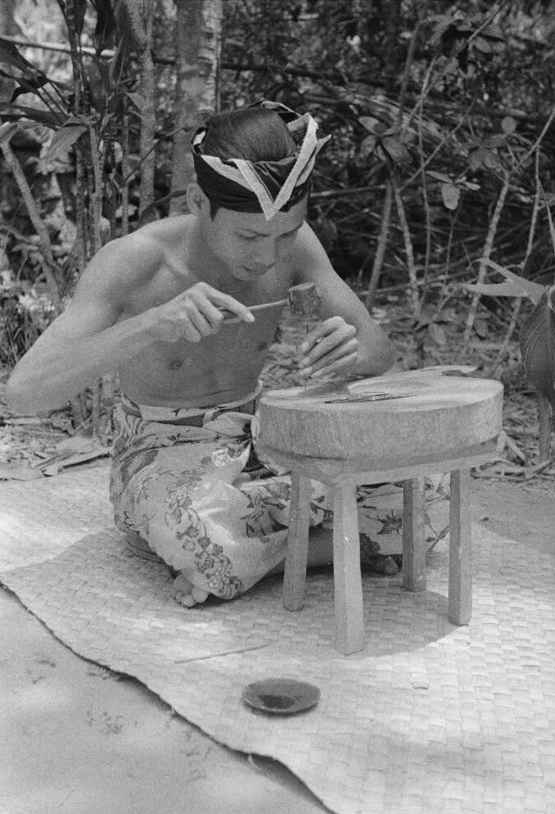
Making Wajangs [Shadow Puppets] in Bali

Slide 15
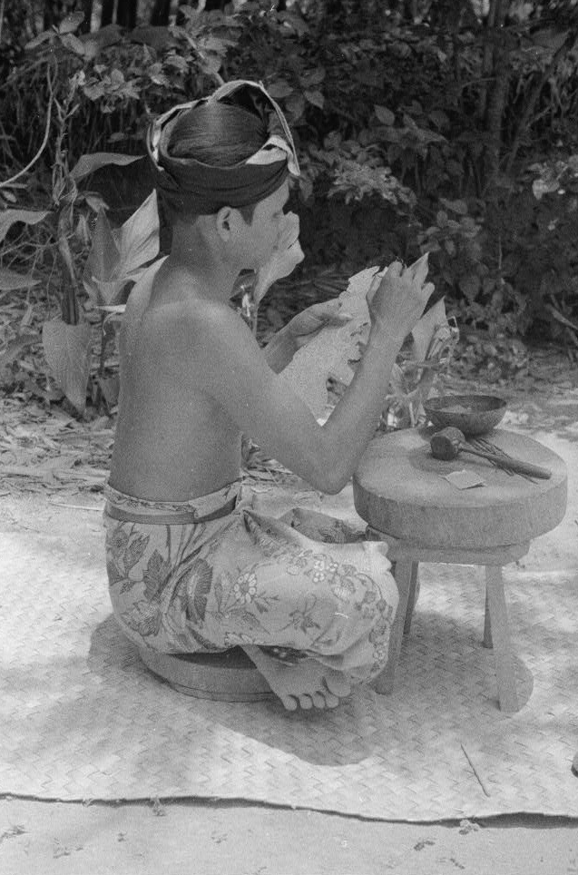
Making Wajangs [Shadow Puppets] in Bali

Slide 16
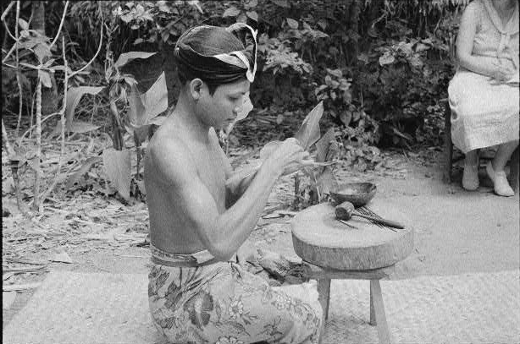
Making Wajangs [Shadow Puppets] in Bali
Margaret Mead can be seen sitting in the upper right corner taking notes.

Slide 17
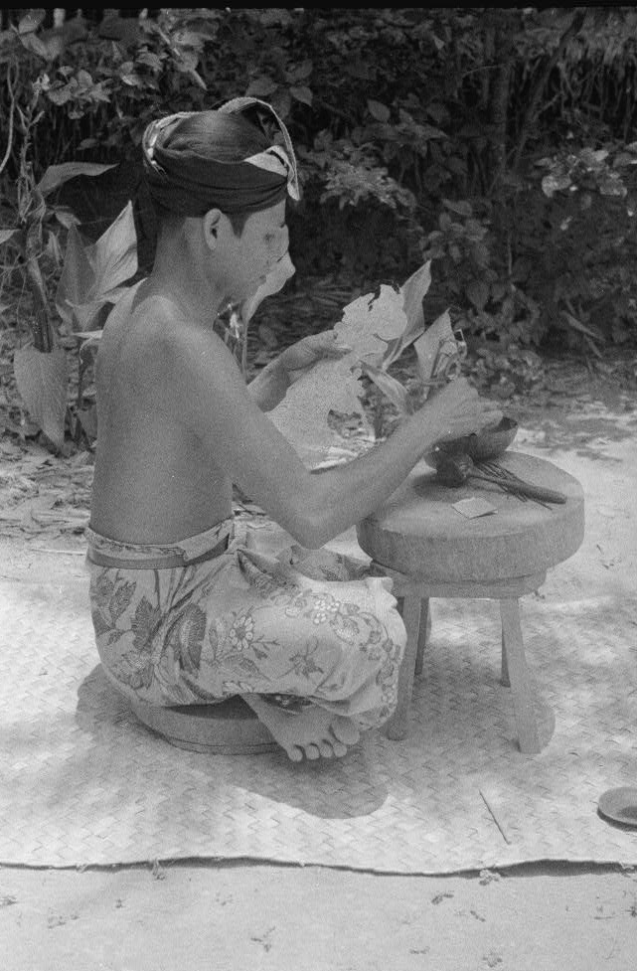
Making Wajangs [Shadow Puppets] in Bali

Slide 18
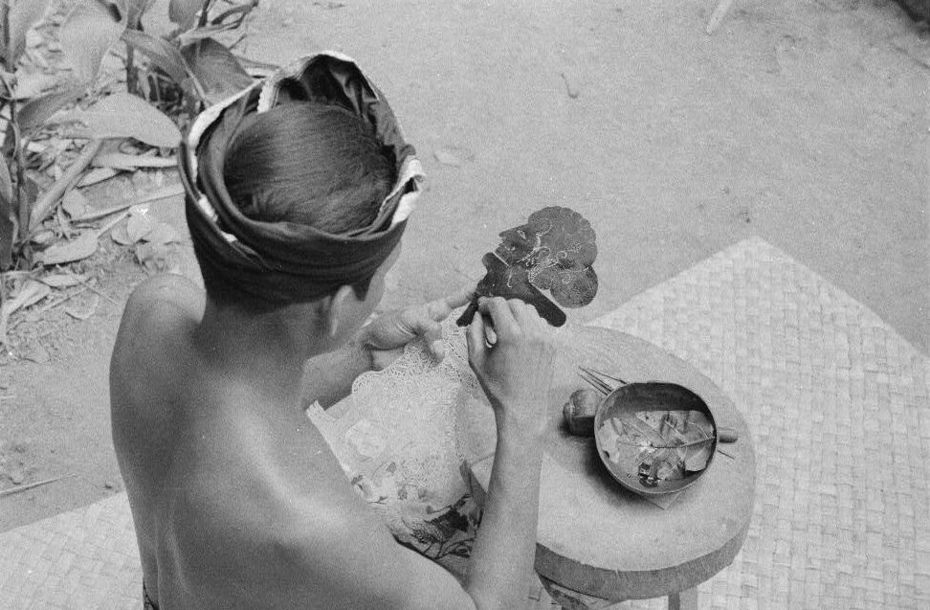
Making Wajangs [Shadow Puppets] in Bali
In this photograph, I Wara is painting the puppet.

Slide 19
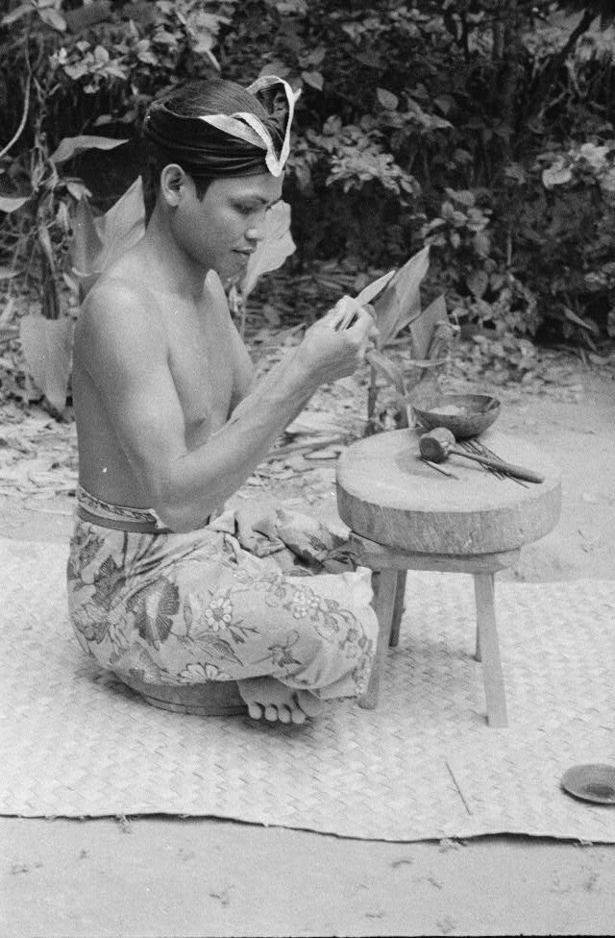
Making Wajangs [Shadow Puppets] in Bali

Slide 20
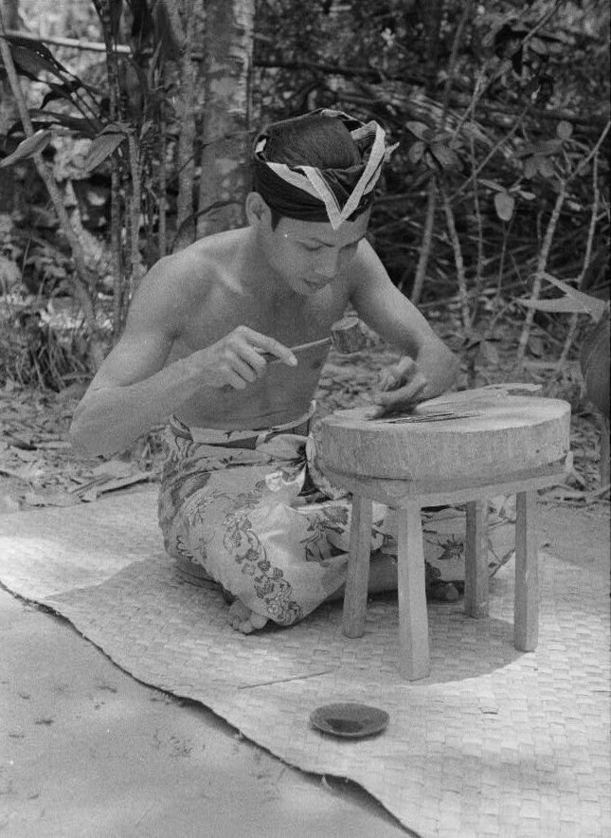
Making Wajangs [Shadow Puppets] in Bali

Slide 21
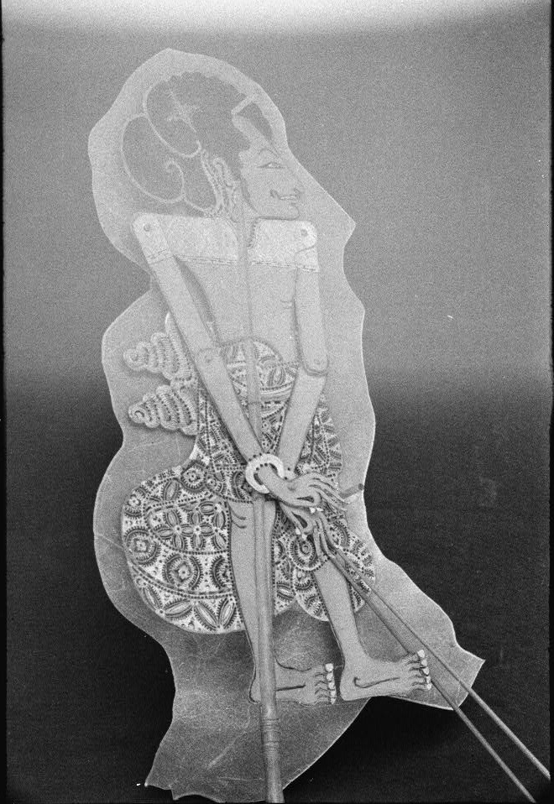
Making Wajangs [Shadow Puppets] in Bali
All of the photographs and a large selection of the field notes from this field trip have been digitized and are available online in the Manuscript Reading Room.

