Slide 1

Community-acquired Pneumonia
Thomas J. Marrie
University of Alberta
Edmonton, AB

Slide 2
Definition - CAP
Two or more of fever, chills, cough, purulent sputum, pleuritic chest pain,plus a new opacity on CXR
Problems with definition –
CXR – neither sensitive or specific

Slide 3
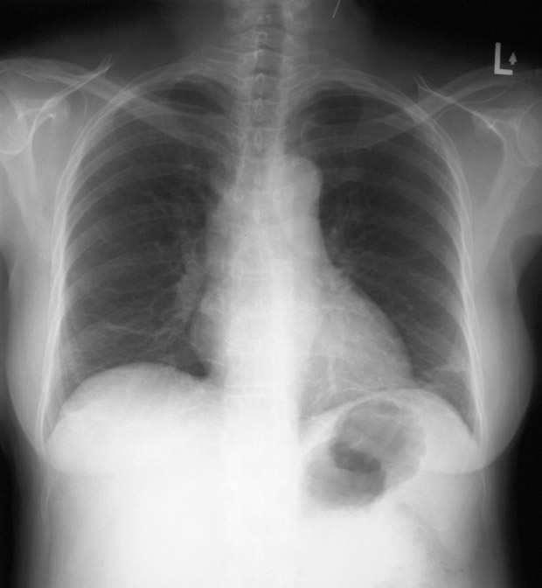

Slide 4
Previous slide
Pt with BPP – CXR reported as atelectasis and not as pneumonia.
Clinical features were those of pneumonia.

Slide 5
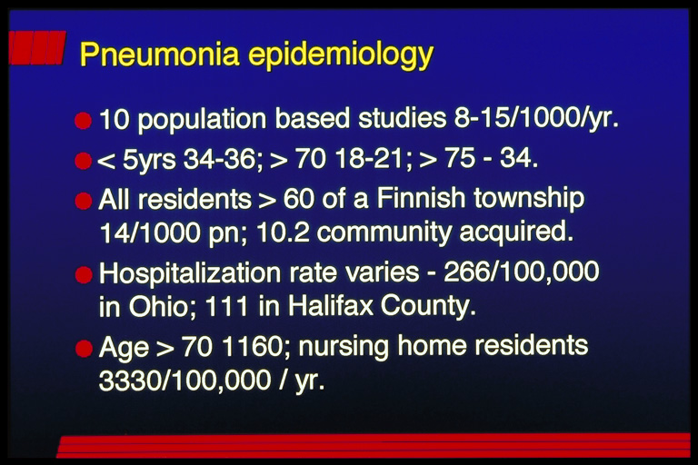

Slide 6
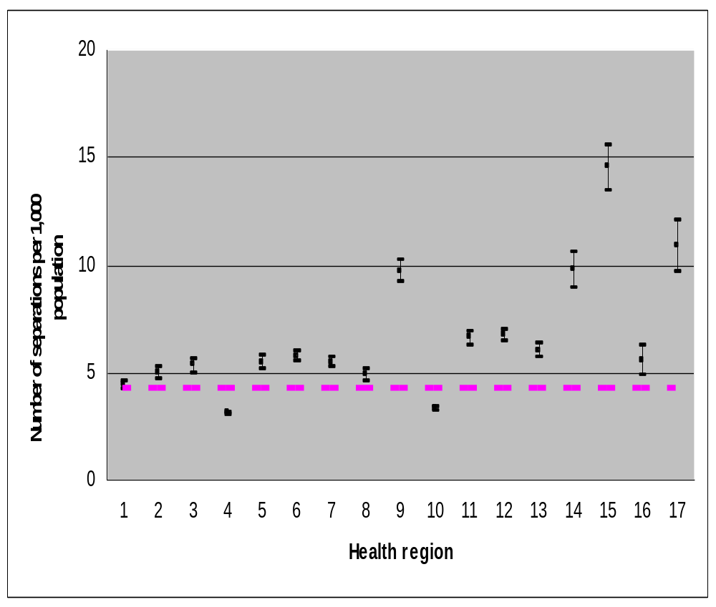

Slide 7

Age specific hospitalization rate/1000 for CAP in Alberta

Slide 8
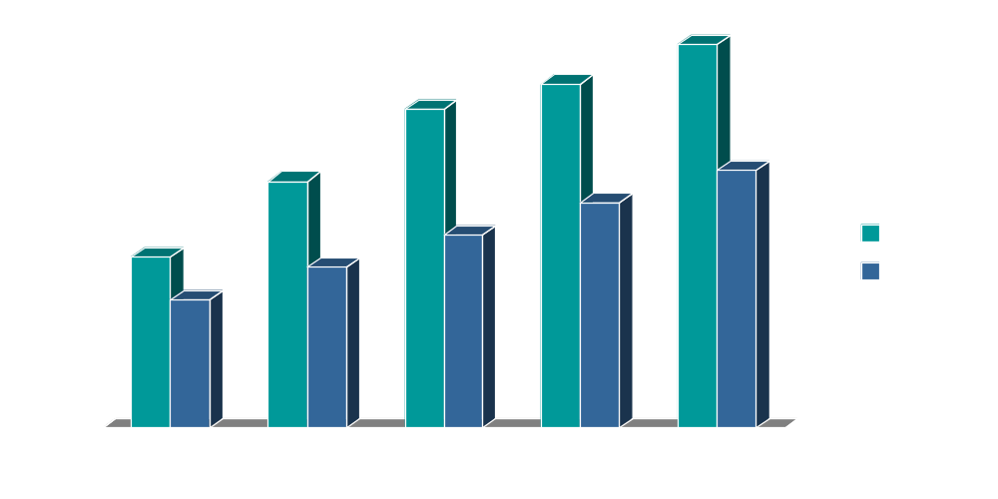
Age specific length of stay (days) for CAP in Alberta – overall 9.15

Slide 9
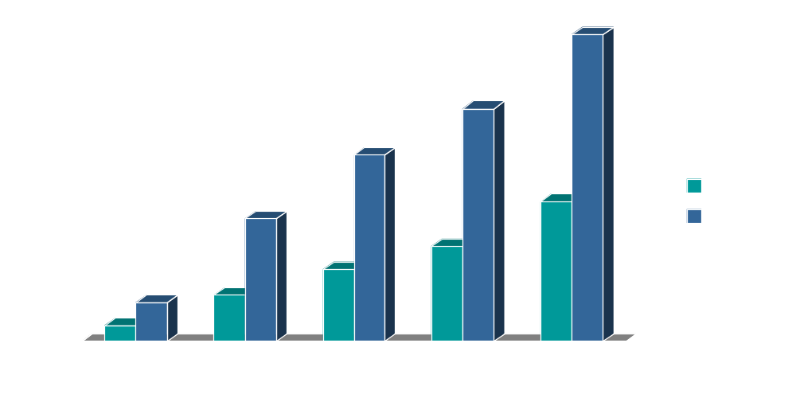
In hospital and one year age specific mortality rates CAP – Alberta.

Slide 10
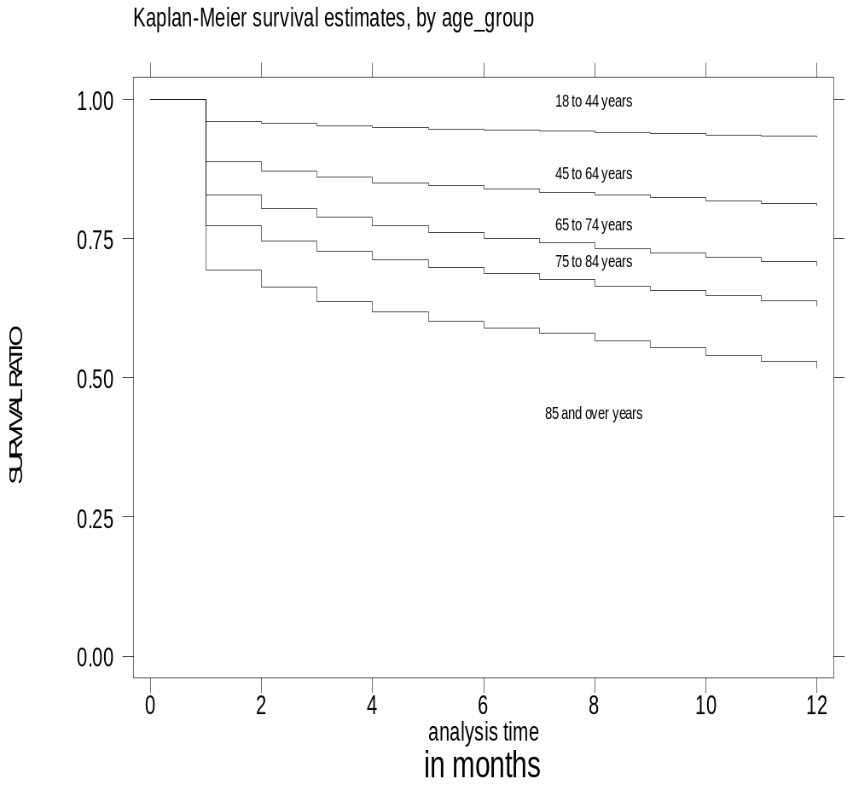

Slide 11
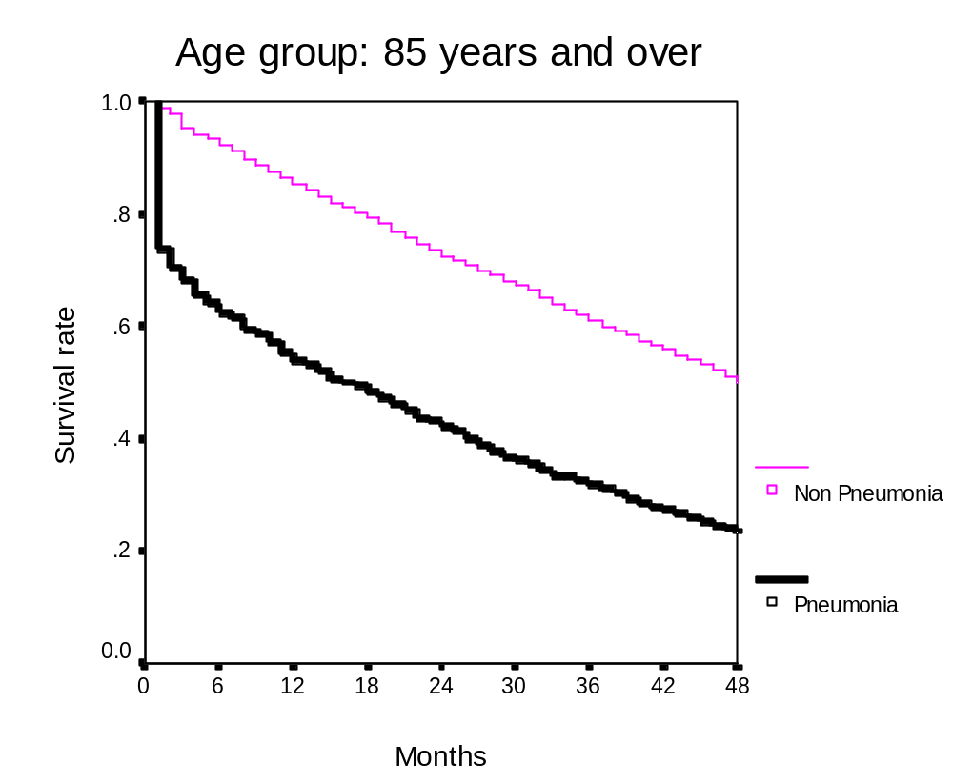

Slide 12
Pneumonia in elderly in US – Kaplan et al AJRCCM 2002; 165: 766-772
1997 – 623,718 medicare recip hosp for CAP
18.3/1,000
4.3% - from a NH; 10.6% died
22.4% to ICU; 7.2% mechanical ventil
$4.4 billion of which 2.1 was for ICU care
Mean LOS 7.6 d at a cost $6,949
Men younger than women, more likely to suffer from Gm Neg infection and more likely to die.

Slide 13
Total Patients – two yrs
(9558)
Pathway
7734
(81%)
Excluded
1824
(19%)

Slide 14
CAP pathway
Total
7734
Outpatient
4259 (55%)
Inpatient
3475 (45%)
Yr 1
2027
(48%)
Yr 2
2232
(52%)
Yr 1
1656
(48%)
Yr 2
1819
(52%)
Repeat
100
(5%)
Unique
1927
(95%)
Repeat
38
(2%)
Unique
1618
(98%)
Repeat
126
(6%)
Unique
2106
(94%)
Repeat
42
(2%)
Unique
1777
(98%)

Slide 15
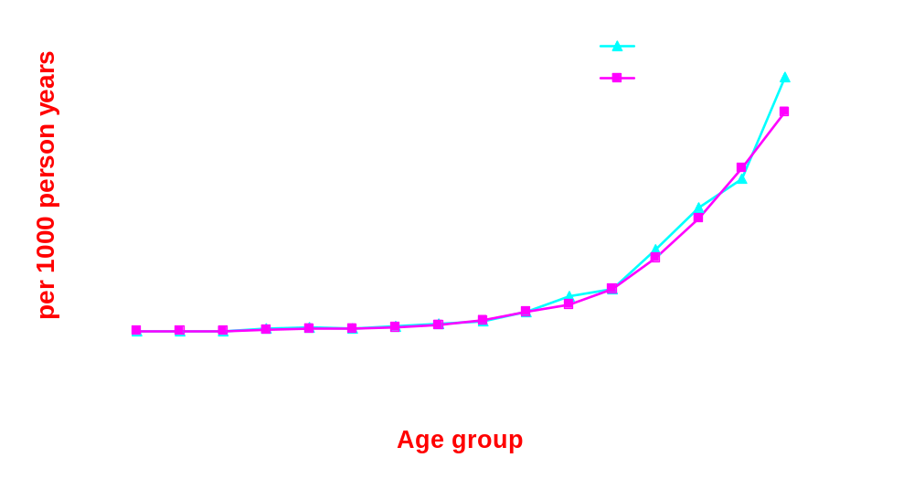
Total pneumonia admission rate
in year 1 and year 2

Slide 16
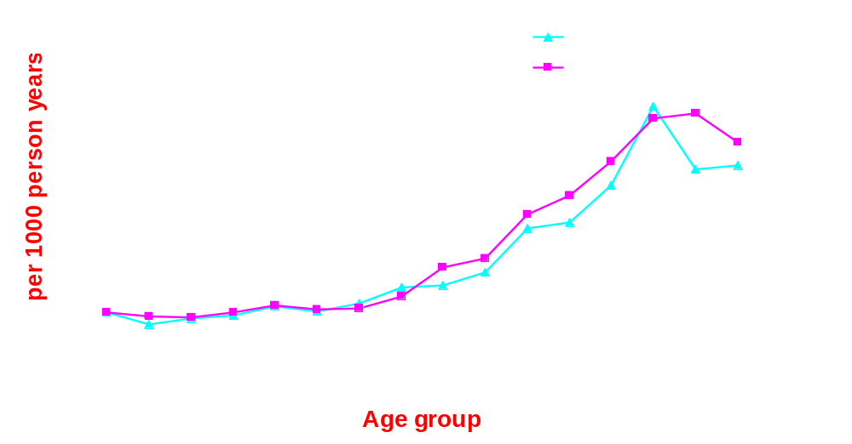
ICU admission rate in year 1 and year 2

Slide 17
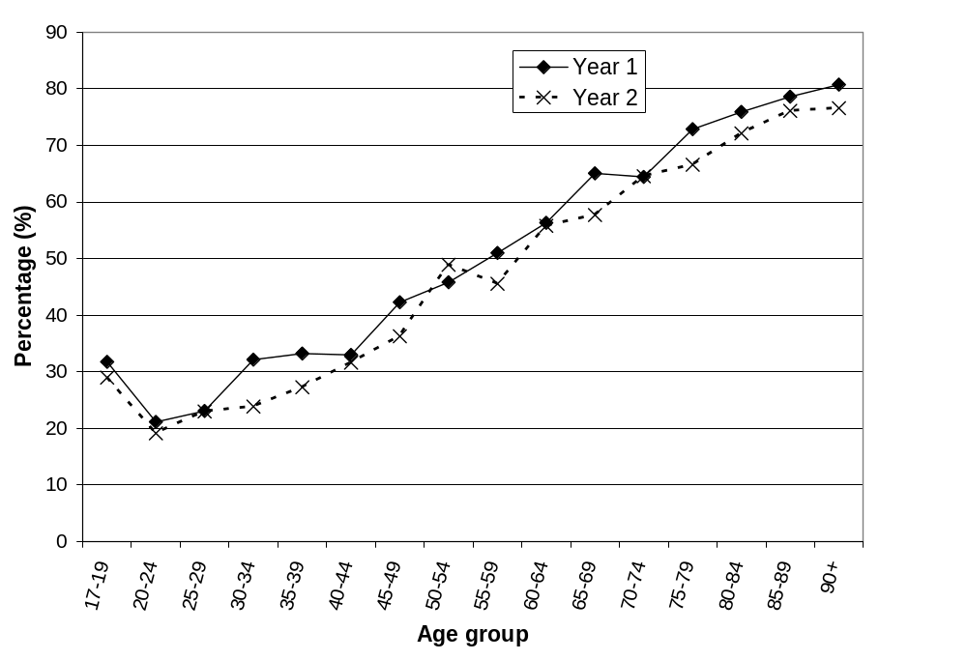
Percent of patients who were admitted according to age group

Slide 18
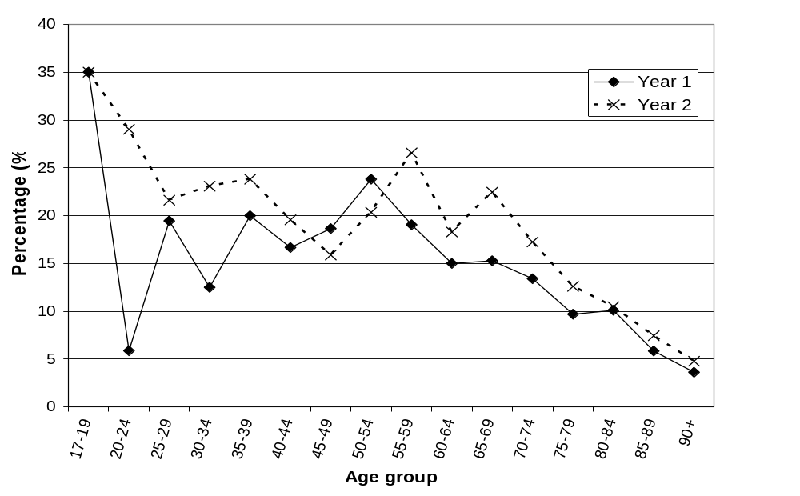
Percent of patients in each age group who were admitted to ICU

Slide 19
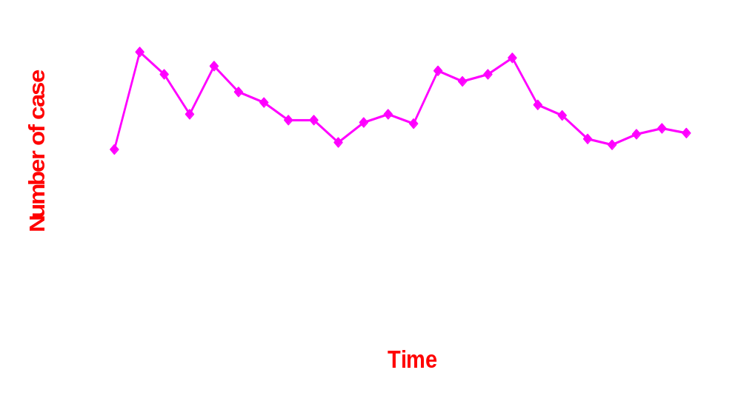
Pneumonia monthly distribution
from Nov 15, 2000 to Nov 14, 2002

Slide 20
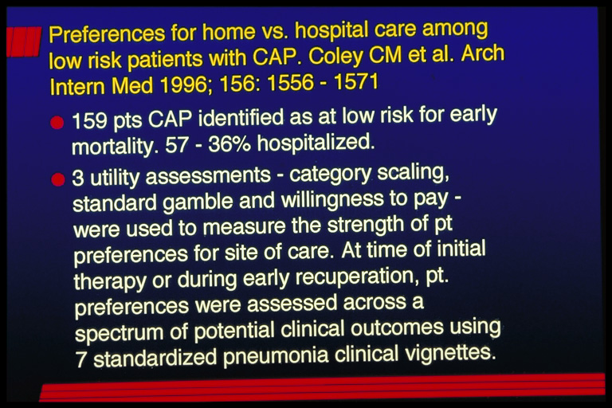

Slide 21
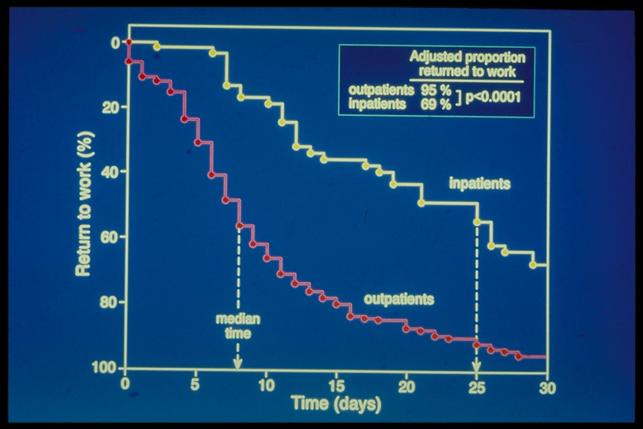

Slide 22
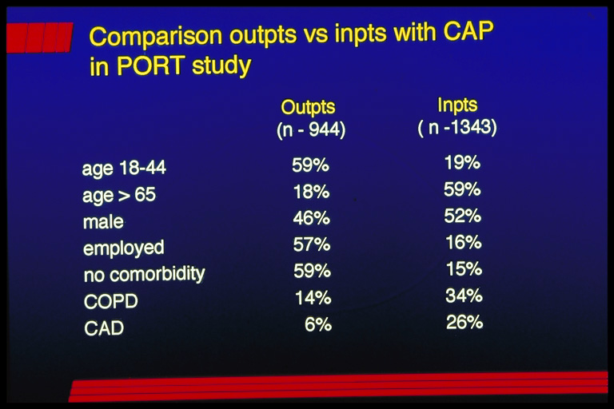

Slide 23
Outpatients vs inpatients PORT-outcomes according to risk class
Outpts Inpts
N deaths N deaths
1. 587 0 185 1(0.5%)
2. 244 1(0.4%) 233 2 (0.9%)
72 0 254 3(1.2%)
40 5(12.5%) 446 40(9%)
1 0 225 61(27%)
944 6(0.6%) 1343 107(8%)

Slide 24
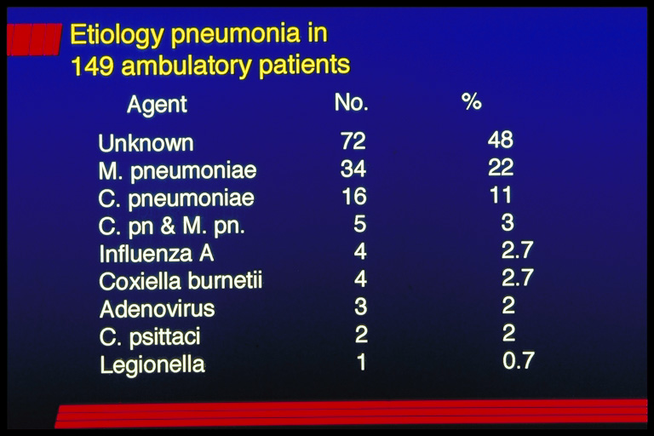

Slide 25
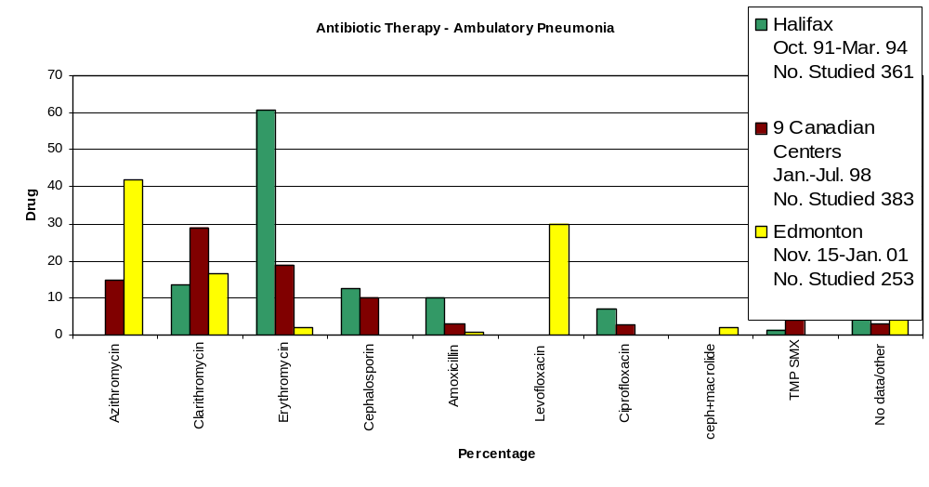
Evolution of antibiotic therapy for ambulatory pneumonia – results from various Can studies

Slide 26
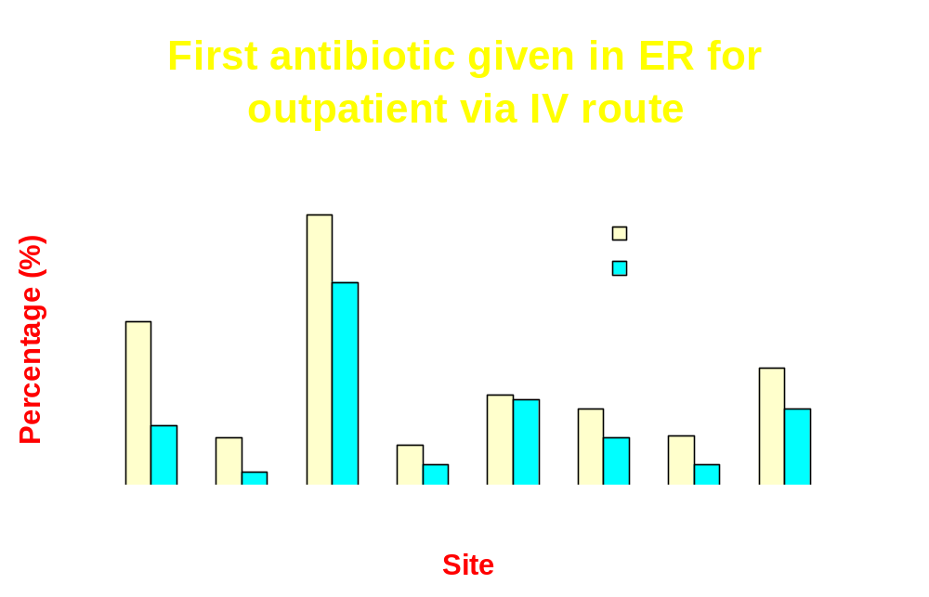

Slide 27
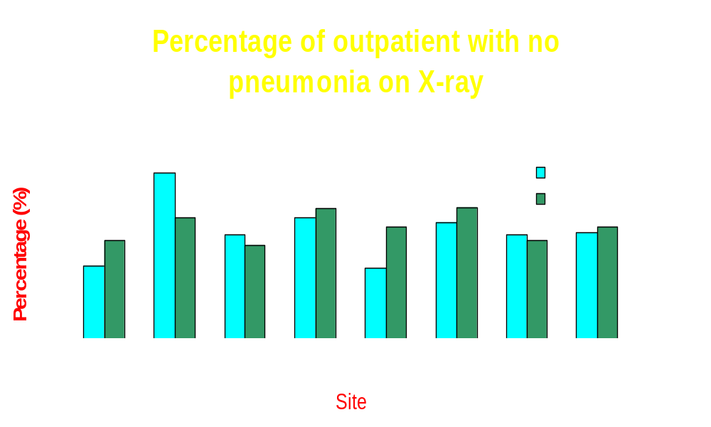

Slide 28
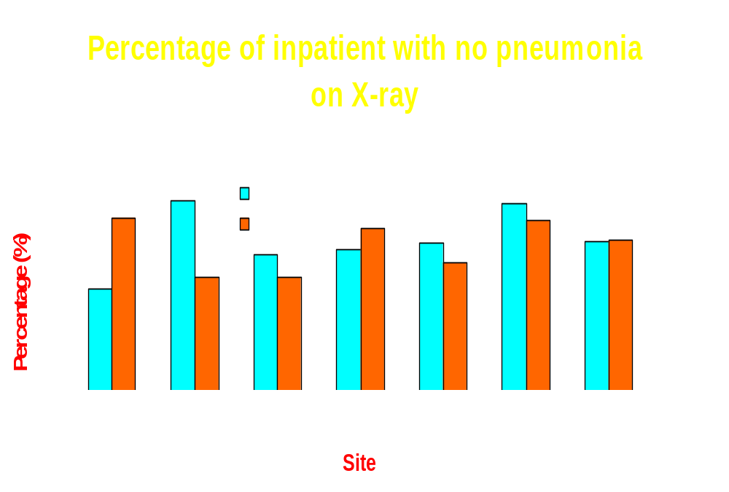

Slide 29
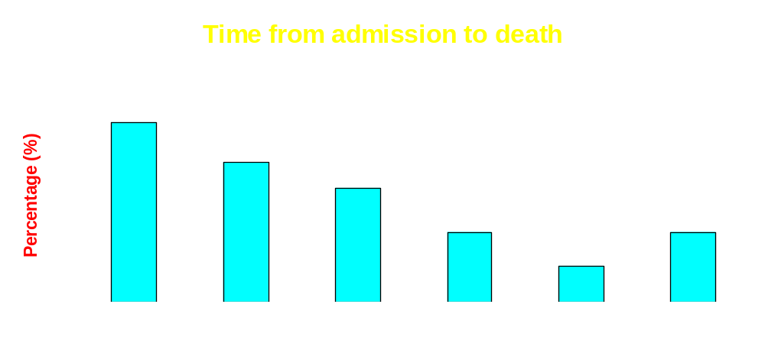

Slide 30
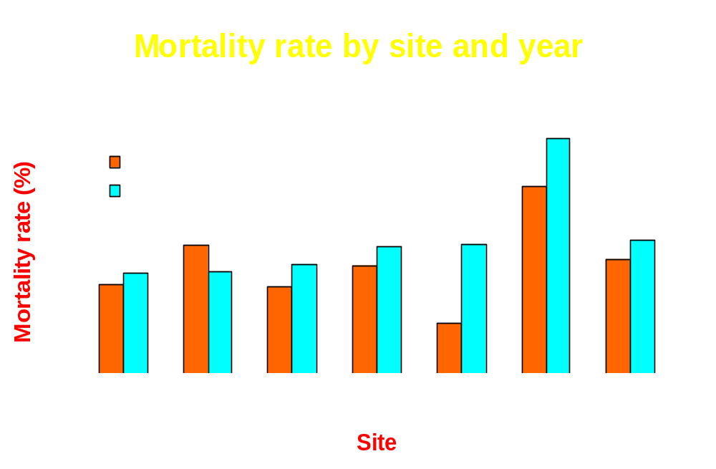

Slide 31
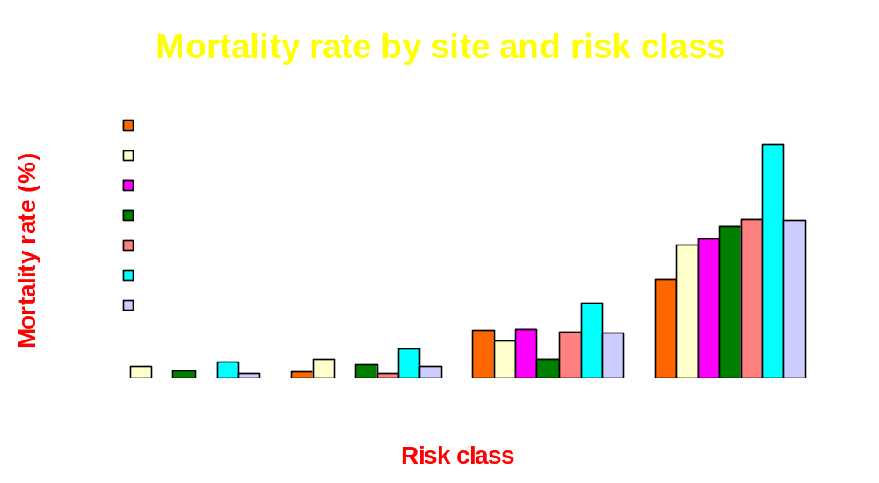

Slide 32
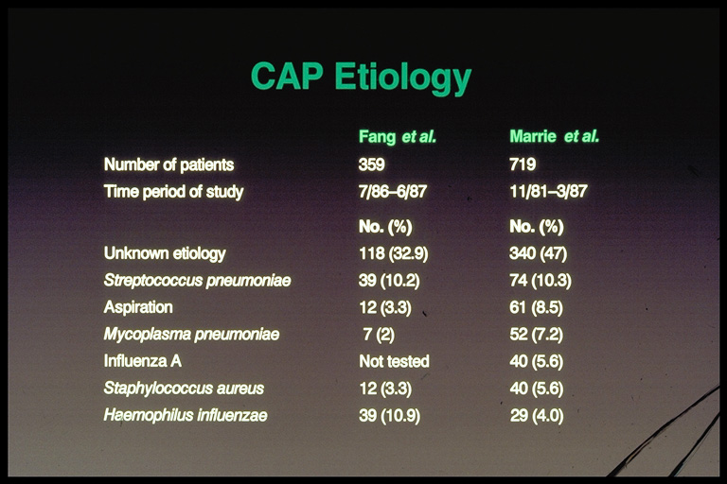

Slide 33
Etiology CAP – Ohio study Arch Intern Med 1997; 157: 1709-18
Jan 1 – Dec 31, 1994 - > 14,000 adm dx CAP; 3881 met initial eligibility criteria; 812 met clinical criteria but had neg CXR; 60 met x-ray criteria but not clinical criteria; 71 – neither. 2776 patients were the subject of the paper
Definite Probable Possible Total
S. pneumoniae 154 33 164 351 (12.6%)
H. influenzae 10 31 143 184 (6.6%)
GNB 24 26 74 124 (4.5%)
S. aureus 12 4 78 94 (3.4%)
M. Pneumoniae 67 337 404( 32.5%)
C. Pneumoniae 29 143 172 (8.9%)
Legionella spp 47 16 63 (3%)

Slide 34
Etiology CAP requiring hospitalization using pneumococcal urinary antigen plus other tests
Nottingham, UK – 1998 – 271 pts
S. pneumoniae 126 46%
Hamilton, NZ- 420 pts with CAP; 169 controls
S. pneumoniae 120 29%
Controls were negative
High false positive rate in children [ due to high carriage rate of S. pneumoniae
In adults sensitivity 80% and specificity 97 – 100%

Slide 35
Total number of patients with CAP
(9558)
Pathway
7734 (81%)
Excluded
1824 (19%)
Outpatient
4259 (55%)
Inpatient
3475 (45%)
Unique visit
4033 (95%)
Unique visit
3395 (98%)
Blood culture done
793 (20%)
Blood culture done
2239 (66%)
Positive blood culture
41 (5.2%)
Positive blood culture
154 (6.9%)
S. pneumoniae
24 (59%)
S. pneumoniae
76 (49%)

Slide 36
CAP pathway
Total
7738
Outpatient
4259 (55%)
Inpatient
3479 (45%)
Unique
4032
(95%)
Unique
3394
(98%)
Sputum done
199
(5%)
Sputum done
1190
(35%)
Positive sputum culture
87
(44%)
Positive sputum culture
343
(29%)

Slide 37
Microorganism isolated from sputum | Admission type
 | Outpatient |  | Inpatient
 | No. | % | No. | %
STREPTOCOCCUS PNEUMONIAE | 28 | 32.2 | 108 | 31.5
STAPHYLOCOCCUS AUREUS | 9 | 10.3 | 54 | 15.7
HAEMOPHILUS INFLUENZAE | 27 | 31.0 | 53 | 15.5
PSEUDOMONAS AERUGINOSA | 4 | 4.6 | 28 | 8.2
MORAXELLA CATARRHALIS | 7 | 8.0 | 27 | 7.9
HAEMOPHILUS SPECIED | 3 | 3.4 | 19 | 5.5
STREPTOCOCCUS PYOGENES | 4 | 4.6 | 9 | 2.6
KLEBSIELLA PNEUMONIAE | 1 | 1.1 | 9 | 2.6
ENTEROCOCCUS SPECIES |  |  | 8 | 2.3
E.COLI |  |  | 8 | 2.3
STAPHYLOCOCCUS SPECIES |  |  | 7 | 2.0
HAEMOPHILUS PARAINFLUENZAE | 6 | 6.9 | 7 | 2.0
CORYNEBACTERIUM PSEUDODIPHTHERITICUM | 1 | 1.1 | 7 | 2.0
SERRATIA MARCESCENS | 1 | 1.1 | 7 | 2.0

Slide 38
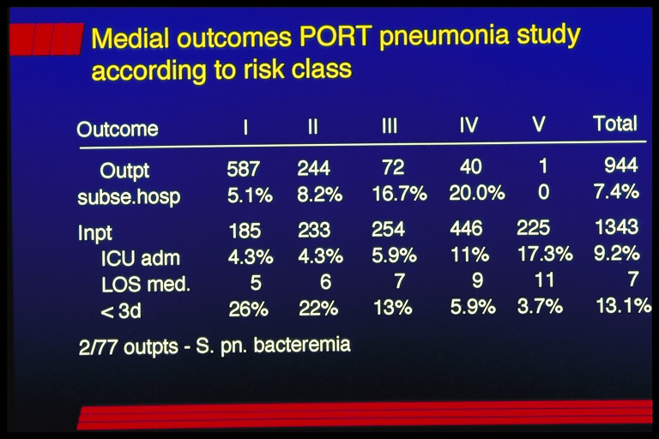

Slide 39
Associations Between Initial Antimicrobial Therapy and Medical Outcomes for Hospitalized Elderly Patients With Pneumonia
Review of records of 12,945 Medicare pts
>65 y hospitalized with CAP
Initial treatment associated with a lower
30-day mortality
  2nd-generation cephalosporin + macrolide [HR-0.71 (0.52-0.96)]
  Non-pseudomonal 3rd generation ceph
  [HR 0.74 (0.6-0.92)] + macrolide
  FQ alone [HR 0.64 (0.3-0.94)]
Gleason et al. Arch Intern Med. 1999;159:2562.

Slide 40
Associations Between Initial Antimicrobial Therapy and Medical Outcomes for Hospitalized Elderly Patients With Pneumonia (cont’d)
Increased 30-day mortality associated with
  Beta-lactam/beta-lactamase inhibitor
  plus macrolide [HR 1.77]
  Aminoglycoside plus another agent
  [HR 1.43]
Gleason et al. Arch Intern Med. 1999;159:2562.

Slide 41
Associations Between Initial Antimicrobial Therapy and Medical Outcomes for Hospitalized Elderly Patients With Pneumonia (cont’d)
Ceftriaxone, cefotaxime, ceftizoxime – 26.5%
Cefuroxime – 12.3%
Non-pseudomonal 3rd gen ceph +
macrolide – 8.8%
Gleason et al. Arch Intern Med. 1999;159:2562.

Slide 42
Associations Between Initial Antimicrobial Therapy and Medical Outcomes for Hospitalized Elderly Patients With Pneumonia (cont’d)
30 day mortality – 15.3%
(11.2% CAP; 27.5% lTCF)
Mortality with
  2nd gen ceph + macrolide – 8.9%
  BL/BLI + macro – 24%
Gleason et al. Arch Intern Med. 1999;159:2562.

Slide 43
