Slide 1
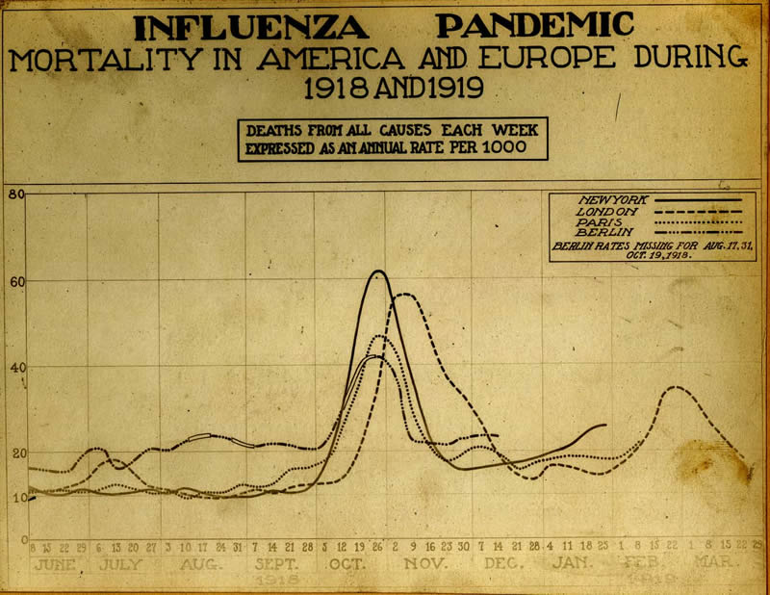
Pandemic Influenza
Patrick O’Carroll, MD, MPH
Regional Health Administrator
Public Health Service Region X

Slide 2
Outline
What’s all the fuss about?
Background and Context
  Influenza
  Avian Influenza
Current State of Affairs
What’s Being Done by PH Community
What You Can Do to Protect:
  Your work environment
  Yourself and your family

Slide 3



What’s all the Fuss about?
A quick summary
of the issue
Notes:
Dr. Mike Osterholm on Oprah

Slide 4
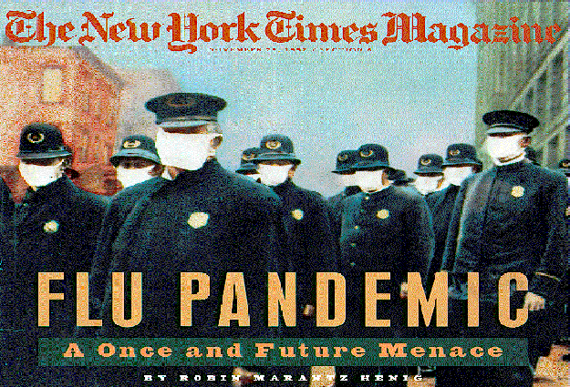
Influenza: Scary Facts
In 1918, the so-called "Spanish flu" killed
675,000 Americans — more than have
died on all battlefields in the 20th Century combined
Estimated 40-50 million deaths worldwide from the 1918 influenza pandemic
Influenza pandemics have occurred for hundreds of years—three in the 20th Century (1918, 1957, 1968)
“Bird flu” (A/H5N1 strain) is now spreading rapidly among birds—and it is a relative of the Spanish flu virus
Among persons infected by A/H5N1, high mortality rate among previously healthy children and young adults
Most “conditions” for a pandemic have been met
Notes:
The Economic Impact of Pandemic Influenza in the United States: Priorities for Intervention
Martin I. Meltzer, Nancy J. Cox, and Keiji Fukuda
We estimated the possible effects of the next influenza pandemic in the United States and analyzed the economic impact of vaccine-based interventions. Centers for Disease Control and Prevention, Atlanta, Georgia, USA,
Using death rates, hospitalization data, and outpatient visits, we estimated 89,000 to 207,000 deaths; 314,000 to 734,000 hospitalizations; 18 to 42 million outpatient visits; and 20 to 47 million additional illnesses. Patients at high risk (15% of the population) would account for approximately 84% of all deaths. The estimated economic impact would be US$71.3 to $166.5 billion, excluding disruptions to commerce and society.

Slide 5
Conditions for a Flu Pandemic
Widespread and spreading prevalence of a new influenza virus subtype in migratory birds; broad host range
Continued outbreaks among domestic poultry
Mammalian infection (cats, pigs, etc.) lethal
Virus is evolving
Sporadic human cases (208 reports as of May 12, 2006)
  Most in young and healthy
  Case-fatality 55% (115 deaths as of May 12, 2006)
  Rare person-to-person transmission
Sustained and rapid person-to-person transmission

Slide 6
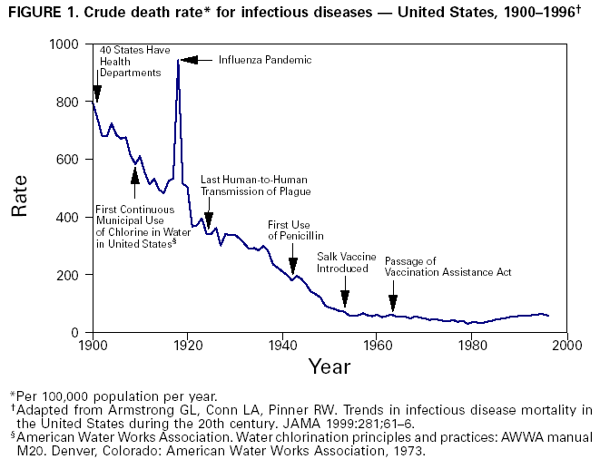
TL

Slide 7
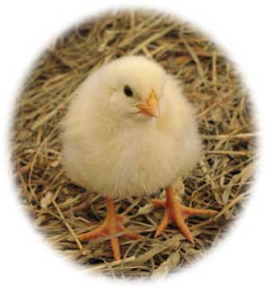
Influenza:
Not-So-Scary Facts
There is currently no pandemic of H5N1
(avian flu-derived) human influenza
1918 all-infectious-disease US mortality
rate of ~950/100,000 people means
>99% of Americans survived
  Of those infected in U.S., influenza death rate ~2.5%
Other 20th Century pandemics much less severe than 1918 pandemic: ~50 (1918) vs. 2 (1957) vs.1 (1968) million deaths
PH authorities have been working hard to improve preparedness for several years now

Slide 8
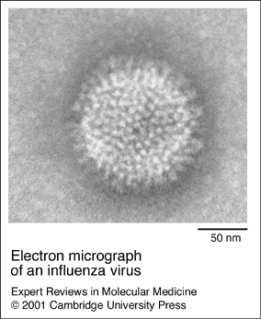
Background and Context
Human and Avian Influenza
Notes:
ETYMOLOGY:Italian, from Medieval Latin influentia, influence (so called apparently from the belief that epidemics were due to the influence of the stars).
AKA grippe
According to Noble, the first clearly recorded epidemic was one that struck Europe in 1173 to 1174. In Japan the first comprehensive review of epidemic records was made by Fujikawa in the early 20th century, who listed 46 epidemics between 862 and 1868. Of the ten pandemics since the 1700s that have been certified by Beveridge nine have struck Japan as well.

Slide 9
Background and Context:
Human Influenza
Been with us for a very long time (at least since 12th C)
Annually, the U.S. experiences 36,000 deaths and 200,000 hospitalizations from regular old influenza
Influenza virus types A and B cause human epidemics
Two influenza A antigens (parts of the virus to which our immune systems react) mutate regularly: Hemagglutinin (H) and Neuraminidase (N)
  15 kinds (“shapes”) of H; 9 kinds of N. Virologists refer to a combination as, say, A/H1N1 (1918), or A/H3N2 (today)
Antigenic drift (limited human immunity) vs. shift (no immunity)
Pandemics—worldwide epidemics—occur after a shift; typically infect 15-40% of a population
Notes:
Testing for avian influenza A (H5N1) is indicated for hospitalized patients with
radiographically confirmed pneumonia, acute respiratory distress syndrome (ARDS), or other severe respiratory illness for which an alternate diagnosis has not been established, AND
history of travel within 10 days of symptom onset to a country with documented H5N1 avian influenza in poultry and/or humans (for a regularly updated listing of H5N1-affected countries, see the OIE website and the WHO website).
Testing for avian influenza A (H5N1) should be considered on a case-by-case basis in consultation with state and local health departments for hospitalized or ambulatory patients with:
documented temperature of >38°C (>100.4°F), AND
one or more of the following: cough, sore throat, shortness of breath, AND
history of contact with poultry (e.g., visited a poultry farm, a household raising poultry, or a bird market) or a known or suspected human case of influenza A (H5N1) in an H5N1-affected country within 10 days of symptom onset.

Slide 10
What changes are needed for A/H5N1 to become a pandemic virus?
Just one: Increased transmissibility among humans
Can occur through two mechanisms:
  “Reassortment”: genetic exchange between human and avian viruses during co-infection of a human or pig. (Sudden)
  Adaptive mutation: slower process of gradual increase in transmissibility through subsequent infections of humans. (Time for us to respond)

Slide 11
Background and Context:
Avian Influenza
Avian influenza, or “bird flu”, is a contagious disease of animals caused by viruses that normally infect only birds and, less commonly, pigs. Avian influenza viruses are highly species-specific, but have, on rare occasions, crossed the species barrier to infect humans
In domestic poultry two main forms: pathogenic and non-pathogenic. Pathogenic spreads rapidly, up to 100% mortality
Only viruses of the H5 and H7 subtypes are known to cause the highly pathogenic form of avian flu
Wild waterfowl (e.g., ducks) are considered the natural reservoir of all influenza A viruses.
It appears some migratory birds are directly spreading the H5N1 virus in its high-path form. Further spread
is expected, so don’t be surprised…

Slide 12
Background and Context:
Avian Influenza
Current outbreaks of H5N1 high-path avian flu are the largest and most severe on record. Many countries simultaneously affected, resulting in the loss of many birds.
Despite the death or destruction of an estimated 150 million birds, the virus is now considered endemic in many parts of Indonesia and in parts of Cambodia, China, et al.
The H5N1 virus has been confirmed in poultry in northern Nigeria; first time in Africa. Also Azerbaijan, Bulgaria, Greece, Italy, Slovenia, Iran, Austria, Germany, Egypt, India and France…
Control of the disease in poultry is expected to take several years. This is a time of great concern.
Notes:
Countries that have experienced confirmed outbreaks of H5N1 infection among poultry and other birds in 2005-2006 include Bulgaria, Cambodia, China (including Hong Kong SAR), Croatia, Greece, Italy, Indonesia, Kazakhstan, Mongolia, Nigeria, Romania, Russia, Thailand, Turkey, Ukraine, and Vietnam. Poultry outbreaks were also reported in Japan, Laos, and Malaysia during 2004.

Slide 13
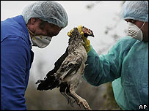

Slide 14
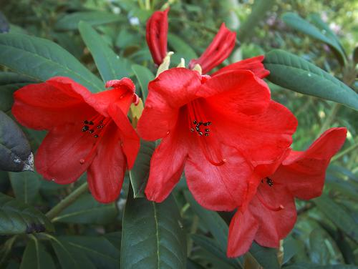
Current Situation
A status report
as of May 2006

Slide 15
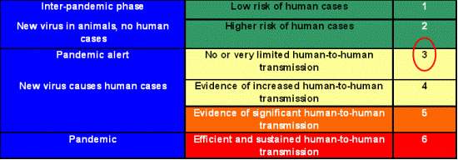
Current Phase of Alert per WHO Global Influenza Preparedness Plan

Slide 16
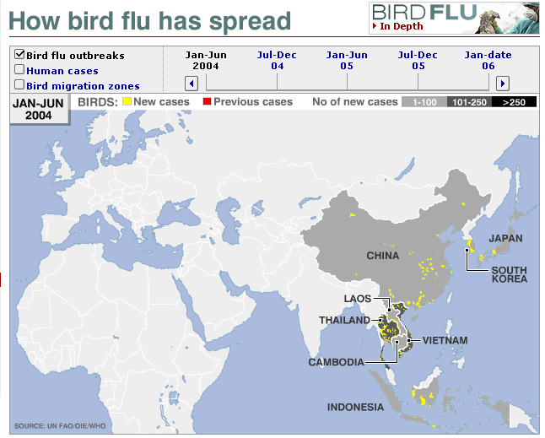
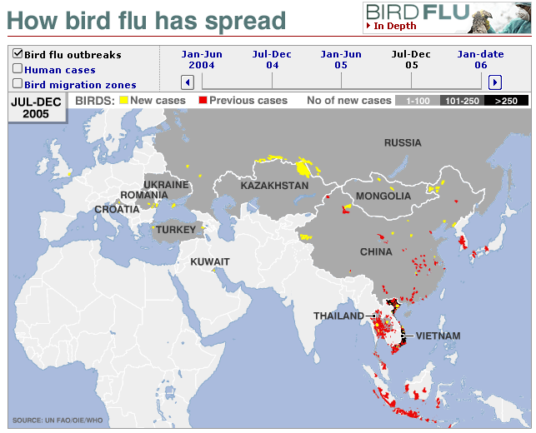
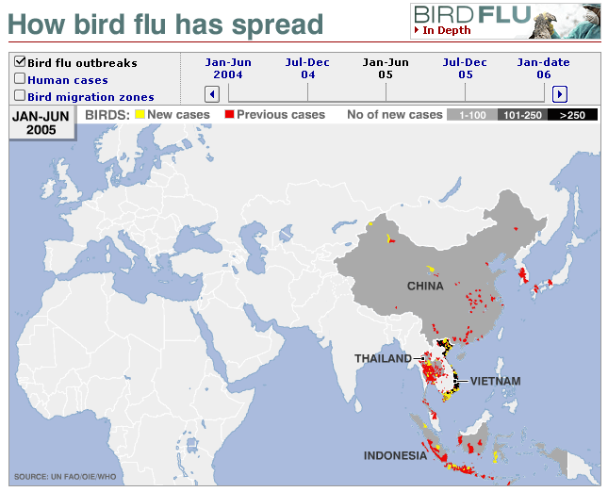
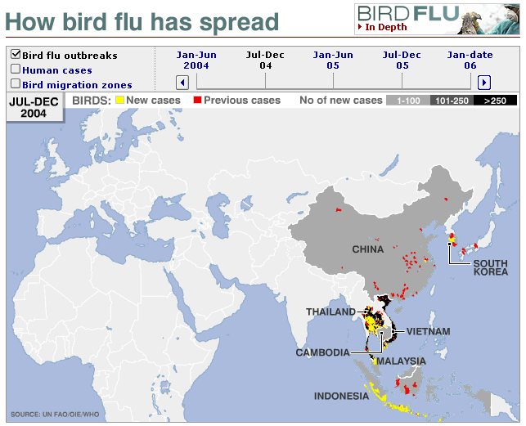
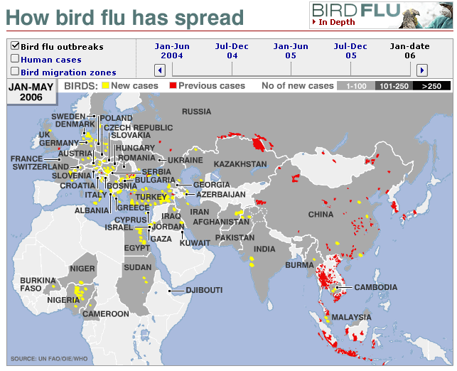

Slide 17
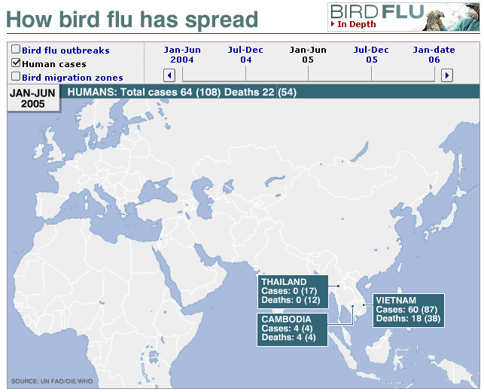
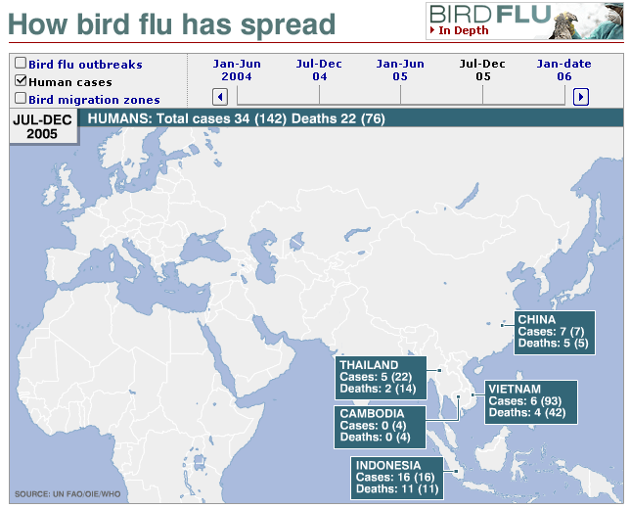
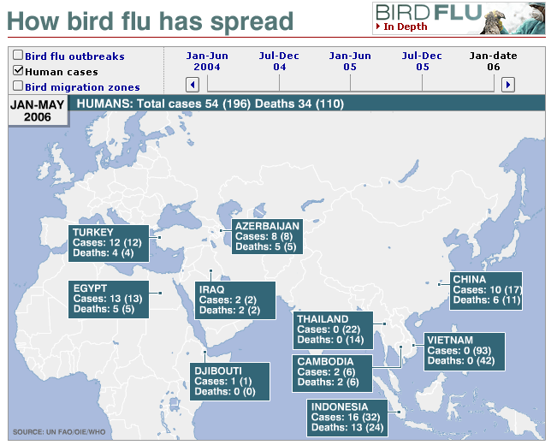
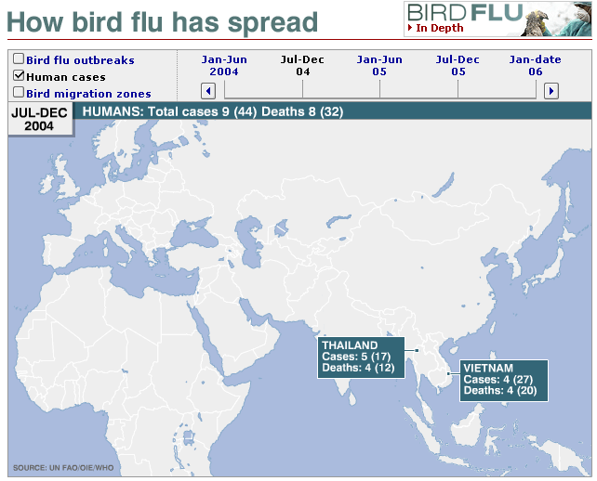
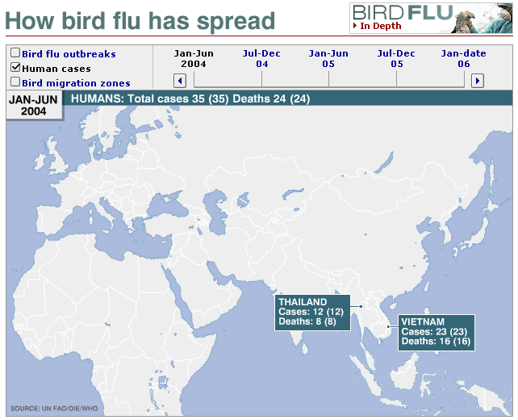

Slide 18
Cumulative Number of Confirmed Human Cases of Avian Influenza A/(H5N1) Reported to WHO
12-May-06
 | 2003 |  | 2004 |  | 2005 |  | 2006 |  | Total
Country | Cases | Deaths | Cases | Deaths | Cases | Deaths | Cases | Deaths | Cases | Deaths
Azerbaijan | 0 | 0 | 0 | 0 | 0 | 0 | 8 | 5 | 8 | 5
Cambodia | 0 | 0 | 0 | 0 | 4 | 4 | 2 | 2 | 6 | 6
China | 0 | 0 | 0 | 0 | 8 | 5 | 10 | 7 | 18 | 12
Djibouti |  |  |  |  |  |  | 1 | 0 | 1 | 0
Egypt | 0 | 0 | 0 | 0 | 0 | 0 | 13 | 5 | 13 | 5
Indonesia | 0 | 0 | 0 | 0 | 17 | 11 | 16 | 14 | 33 | 25
Iraq | 0 | 0 | 0 | 0 | 0 | 0 | 2 | 2 | 2 | 2
Thailand | 0 | 0 | 17 | 12 | 5 | 2 | 0 | 0 | 22 | 14
Turkey | 0 | 0 | 0 | 0 | 0 | 0 | 12 | 4 | 12 | 4
Viet Nam | 3 | 3 | 29 | 20 | 61 | 19 | 0 | 0 | 93 | 42
Total | 3 | 3 | 46 | 32 | 95 | 41 | 64 | 39 | 208 | 115
WHO reports only laboratory-confirmed cases.
Notes:
4 more cases, two more deaths (in China and Indonesia—both additional deaths in Indonesia) from 13-Feb to 27-Feb

Slide 19

What’s Being Done by Public Health Authorities?

Slide 20
WHO recommends all nations:
strengthen national preparedness
reduce opportunities for a pandemic virus to emerge
improve the early warning system
delay initial international spread
accelerate vaccine development
countries with adequate resources should stockpile antiviral drugs for use at the start of a pandemic

Slide 21

U.S. Strategy for
Pandemic Influenza
Three pillars:
  Preparedness and Communication: Activities
  that should be undertaken before a pandemic to ensure preparedness, and the communication of roles and responsibilities to all levels of government, segments of society and individuals.
  Surveillance and Detection: Domestic and international systems that provide continuous “situational awareness,” to ensure the earliest warning possible to protect the population.
  Response and Containment: Actions to limit the spread of the outbreak and to mitigate the health, social and economic impacts of a pandemic

Slide 22
1. Preparedness and Communication
Enhanced Planning for a Pandemic at every level
Communicating Expectations and Responsibilities
Producing and Stockpiling Vaccines, Antiviral Medications and Medical Material
Establishing Distribution Plans for Vaccines and Antiviral Medicines
Advancing Scientific Knowledge and Accelerating Development
  Research and development of vaccines, antiviral meds, adjuvants and diagnostics represents our best defense against a pandemic.

Slide 23

Influenza vaccine
The vaccine against seasonal influenza will
not protect against a pandemic virus
Vaccines effective against a pandemic
virus are not yet available
Vaccine against a pandemic virus are not expected to be available for several months after the start of a pandemic
(the vaccine must closely match the virus)
Current global production capacity falls far short of the demand expected during a pandemic

Slide 24
Drugs to Treat Influenza
Two drugs (in the neuraminidase inhibitors class), oseltamivir (Tamiflu) and zanamivir (Relenza) can reduce the severity and duration of illness caused by seasonal influenza
The H5N1 virus is expected to be susceptible to these neuraminidase inhibitors—but Rx must be given early
Main constraint—cost and production capacity!
  At present manufacturing capacity, which has recently quadrupled, it will take a decade to produce enough oseltamivir to treat 20% of the world’s population.
An older class of antiviral drugs, amantadine and rimantadine, could potentially be used against pandemic influenza, but resistance to these drugs can develop rapidly—and did so this past year!

Slide 25
2. Surveillance and Detection
Ensuring Rapid Reporting of Outbreaks
  e.g., by ensuring transparency, scientific cooperation and rapid reporting of avian and human influenza cases, and
  Support the development of the proper scientific and epidemiologic expertise in affected regions
Using Surveillance to Limit Spread
  E.g., Develop mechanisms to rapidly share information on travelers who may be carrying or may have been exposed to a pandemic strain of influenza, and
  Expand and enhance mechanisms for screening and monitoring animals that may harbor viruses with pandemic potential

Slide 26
3. Response and Containment
Containing (slow, limit) Outbreaks
Leveraging National Medical and Public Health Surge Capacity
Sustaining Infrastructure, Essential Services and the Economy
Ensuring Effective Risk Communication

Slide 27
What you can do
To protect yourself and your family
To prepare your work environment

Slide 28
You are the Critical Infrastructure!
Establish an ethic of infection control in the workplace that is reinforced during the annual influenza season, to include, if possible, options for working offsite while ill, systems to reduce infection transmission, and worker education.
Establish contingency systems to maintain delivery of essential goods and services during times of significant and sustained worker absenteeism.
Where possible, establish mechanisms to allow workers to provide services from home if public health officials advise against non-essential travel outside the home.
Establish partnerships with other members of your sector
to provide mutual support and maintenance of essential services during a pandemic.

Slide 29
Protecting Yourself and Your Family
“Individual action is perhaps the most important element of pandemic preparedness and response” –HHS Plan
Educate yourself about pandemic influenza
Be prepared to follow public health guidance that may include limitation of attendance at public gatherings and non-essential travel for several days or weeks.
Keep supplies of meds & materials at home, to support essential needs of the household for several days if necessary. Consider pneumonia vaccine.
In the event of a pandemic, take precautions to prevent the spread of infection to others if a family member has symptoms of influenza.

Slide 30
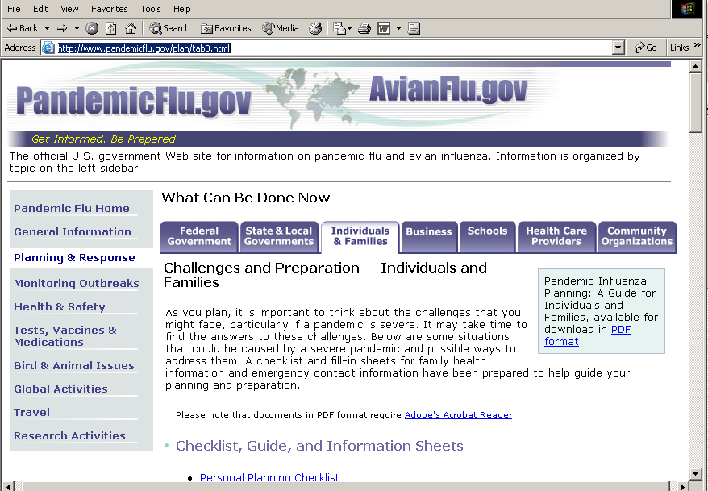

Slide 31

“
These germs of disease have taken toll of humanity since the beginning of things… But by virtue of this natural selection of our kind we have developed resisting power; to no germs do we succumb without a struggle, and to many … our living frames are altogether immune …
By the toll of a billion deaths man has bought his birthright of the earth, and it is his against all comers… For neither do men live nor die in vain.
”

Slide 32
Pandemic Influenza
Patrick O’Carroll, MD, MPH
Regional Health Administrator
Public Health Service Region X

