Slide 1
Comments on Dark Energy Experiments
Tim Mckay
July 14, 2001
Outline:
  General comments on techniques
  Some scary lensing details
  Comments on survey depths

Slide 2
Measurements of dark energy
Basic approaches:
Cluster counting
  X-ray selection: Flux limited
  SZ surveys: redshift independence
  Lensing surveys: clean mass selection?
  Optical surveys (!)
Structure Formation
  Galaxy LSS from spectroscopic surveys
  Weak lensing power spectrum
Angular diameter distance
  Strong lensing statistics
Luminosity distance
  Type Ia SNe

Slide 3
What to worry about…
Age of statistical astronomy, large samples are not a problem
Systematics will limit all these experiments: Predictions must include estimates of these
Cluster counting:
Mass thresholds, cluster evolution…
Structure formation:
Bias, selection function….
Strong lens surveys:
Selection effects, halo profiles….

Slide 4
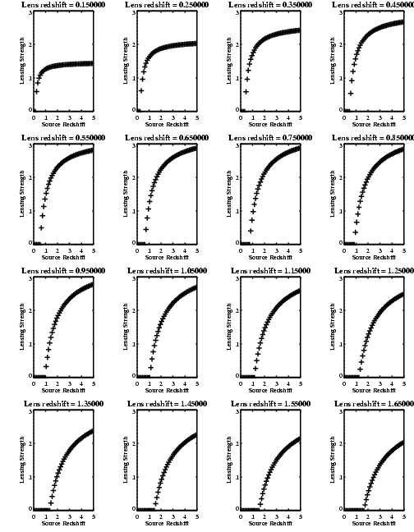
An example from lensing, mass scale…

Slide 5
Some predictions…
SNe will play a key role:
  Discovered dark energy
  Local physics….
  Systematics known
    Evolution
    Dust
    Malmquist bias
    Lensing magnification
Ground or space?

Slide 6
Comparison of ground and space based optical surveys
We have completed detailed comparisons of ground based and space based optical surveys from first principles
Gary Bernstein, 2001, submitted to PASP
  Calculations for PSF photometry
  Includes undersampled and dithered images
  Includes cosmic ray rates
  Includes intra-pixel sensitivity variations (10% gutters)
  Calculated for point source and galaxy photometry
  Determines astrometric errors
  Determines galaxy shape errors
Allows us to answer some commonly arising questions about imaging strategies:
  What amount of dithering is ideal?
  What pixel size optimizes the productivity of a camera?
  Which is more efficient; space-based or ground-based observing?

Slide 7
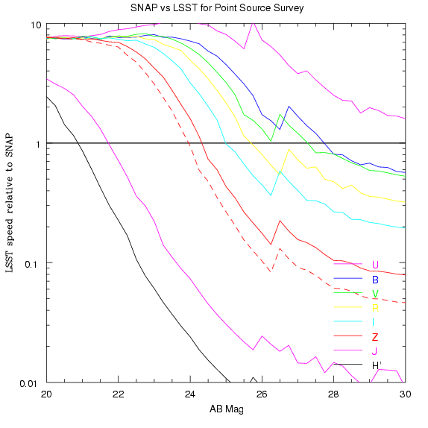
Supernova survey efficiency for SNAP and LSST:
  LSST is better at z<0.7
  SNAP is much faster for high-z objects
z=0.8
z=1.0
z=1.5
Brightness and B band wavelength of SNe Ia at peak
Discovery brightness to prevent Malmquist bias
Brightness and V band wavelength of SNe Ia at peak

Slide 8
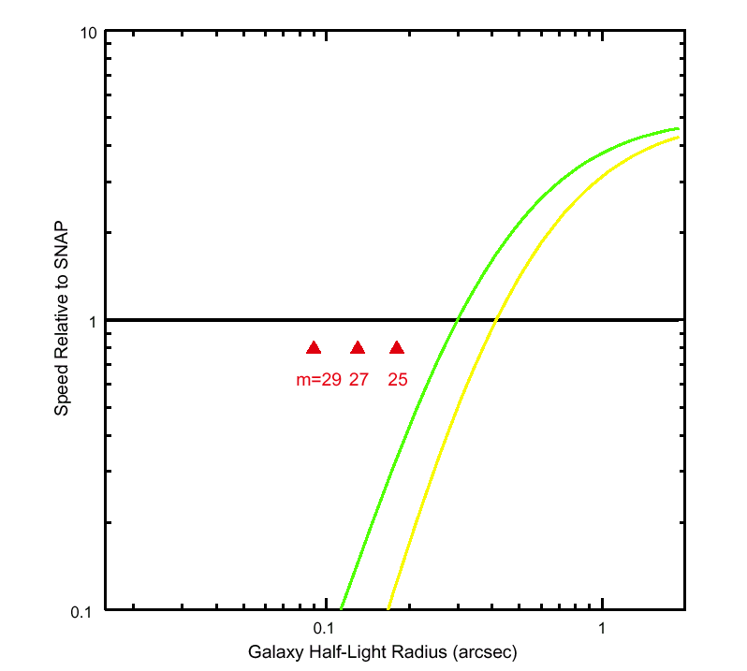
Weak Lensing Survey Speed: including effects of galaxy size
Galaxies must be resolved for use in weak lensing analyses. HDF studies (Gardner & Satyapal, 2000) show that galaxies become much smaller at faint magnitudes.
0.5” seeing
Median HDF galaxy sizes at 3 magnitudes
0.7” seeing
Approximately 85% of galaxies with r<30 are between r=27 and 30….

Slide 9
A few conclusions
Many techniques required to constrain dark energy
All will be systematics limited
Sensitivity estimates should include reasonable systematics guesses
Only SNe have detected dark energy and faced systematics:
They will play a key role in the coming decade

