Slide 1
Public Expectations in 20-30 Years:
More of the Same or Can We Shape
Public Opinion?

Slide 2
Public Attitudes toward Fire
Some evidence of improved ecological understanding, BUT:
FEAR
Expectation of protection
Expectation of success
Intolerance of smoke

Slide 3
Therefore:
Fire is still scary and bad.
Fire is considered preventable.
The benefits of fire are still not embraced.

Slide 4
Comprehensive fire management cannot be accomplished without a change in public expectations.

Slide 5
From the QFFR:
Expanding Community Education should…promote the concept of creating fire adapted communities that complement the fire adapted ecosystems that they adjoin.
Strategy should support communities organizing to…above all become more comfortable (and knowledgeable) with prescribed and natural fires in their environs.
The goal is a paradigm shift, where the public would expect that fire would be allowed to play its natural role and question why we would propose to put fires out.

Slide 6
From the 10-year Comprehensive Strategy (Dec. 2006)
Goal 3, Task 2:
Further develop and implement a public education campaign such as the National Wildfire Coordination Group (NWCG) Wildland Fire: A Natural Process to complement Smokey Bear’s message of fire safety. The campaign will emphasize fire’s role in ecosystems and the benefits of fire management to ecosystems and public health and safety.
  Collaboration Level: All
  Lead Collaborator(s): Stakeholders, NWCG
  Implementation timeframe: Fall 2008

Slide 7
Steering Committee
BLM, Cynthia Moses-Nedd
I-Chiefs, Bob Roper
NACo, Abby Friedman
NASF, Dan Smith
National Coalition Prescribed Fire Councils, Zach Prusak
NIFC/BLM, Don Smurthwaite
National Park Service, Roberta D’Amico
TNC, L.McCarthy, W. Fulks, E. Brunson
Northern Arizona University, Tom Sisk
Oregon Association of Counties, Eric Schmidt
USDA Forest Service, Maureen Brooks, Randy Philips
WGA, Jay Jensen
TWS, Greg Aplet,Tom Fry
Wisconsin DNR, Catherine Regan

Slide 8
Shaping Future Public Expectations:
Laying the Foundation to Influence Opinion and Behavior

Slide 9
What is public education?
Strategic communication
Not lobbying

Slide 10

Strategic Communication…
  Builds consensus
  Persuades
  Changes behaviors
  Conditions the environment for policy

Slide 11
Critical Aspects of Strategic Communications Programs
Polling
Messaging
Targeting audiences
Delivering the Message
Measuring impacts

Slide 12
Message Development
  What message produces change?
  Simple, clear, concise, consistent language
  Rational or emotional
  Create urgency
  Call to action
  2-3 maximum
  Use poll results

Slide 13
Identify the Audience
  Who are they and why are they important?
  Demographics matter
  Who responds to rational or emotional messages?
  Smart use of resources
  Use poll results

Slide 14
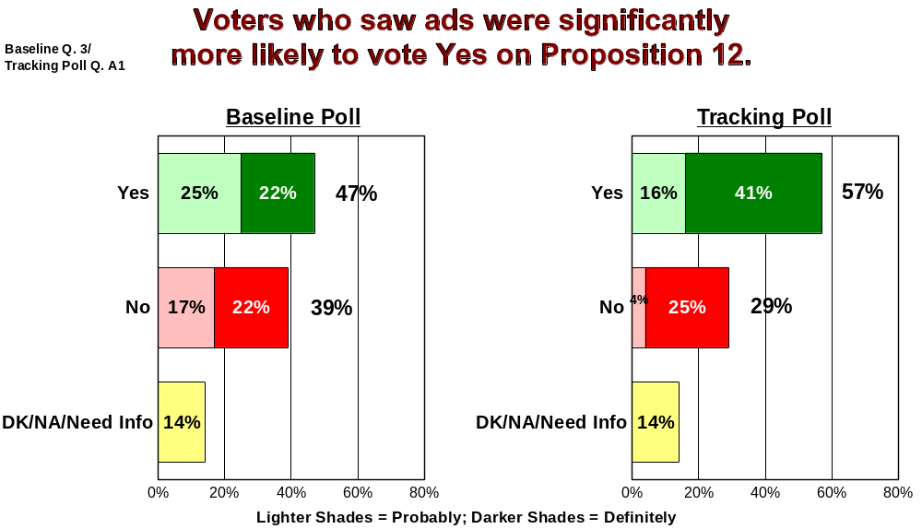
Notes:
Both passed. This slide shows how opinions changed before and after the campaign. The light green is those who say they will probably vote yes and the dark green is those who are definate they will vote yes. The pink is voters who think they will vote no and the red is those who will definitely vote no.
You can see the Yes vote increased by 10% after the campaign and the number of likely but not certain voters decreased.

Slide 15
Phase I: RESEARCH
Goal: Identify national and regional public attitudinal barriers (fears, mistrusts, opposition) and opportunities (favorable language, spokespeople) related to fire and fire use as a basis for developing campaign key messages and delivery vehicles.
Strategy: Establish strategic, diverse group of “steering committee” stakeholders to design research (polling), help obtain research funding, and plan and execute campaign development workshop.
Actions:
  Obtain funding necessary to conduct research (~$200,000).
  Hire polling and media consultant.
  Conduct and analyze research activities (focus groups, polling).
  Plan Feb. 2008 workshop to develop campaign structure and elements.
Timeframe: May to January 2008

Slide 16
Phase IIA:
IDENTIFY CAMPAIGN ELEMENTS
Goal: Define final campaign framework (key messages and delivery mechanisms) based on research insights.
Strategy: Host multiple-day, face-to-face workshop with consultant, steering committee(+) group of stakeholders.
Actions:
  Disseminate research results to key experts (e.g. public information officers), compile comments and incorporate into campaign elements.
  Conduct workshop to (1) Review research results, provide workshop attendees with strategic message training, and (2) Develop campaign key messages and delivery mechanisms (local, state, federal).
Timeframe: February 2008

Slide 17
Phase IIB:
DEVELOP CAMPAIGN MATERIALS
Goal: Finalize final proofs of campaign materials and/or develop guidelines for local development and use of campaign materials.
Strategy: Reconvene steering group to translate campaign framework developed in workshop into sample campaign materials.
Actions:
  Continue to work with consultant(s) in developing/determining:
    Guidelines for local production of campaign materials.
    Develop budget based on delivery vehicles and campaign materials and seek public and private funding.
Timeframe: February thru May 2008

Slide 18
Phase III: DELIVERY
Deliver campaign plan to implementing partners
Timeframe: Summer 2008

Slide 19
Campaign Development Timeline
Summer 2007: Raise funds ($200 K) for Research/Campaign Development
Fall 2007: Research/Polling/Focus group work
Winter 2008: Workshop to define campaign elements
Spring 2008: Development of campaign materials
Summer 2008: Delivery

Slide 20
Public Expectations in 20-30 Years:
More of the Same or Can We Shape
Public Opinion?

