Slide 1
Pediatric Analgesic Use
Debra L. Friedman MD
Seattle Cancer Care Alliance

Slide 2
Utilization
Thoughts and beliefs
Availability of agents
Supportive Care
Clinical setting

Slide 3
Administration
Preparations
Route
Dose
Conflicting health issues
Other external issues

Slide 4
Evaluation
Who evaluates the pain management?
What is evaluated?
Where is the pain management evaluated?
When is the pain management evaluated?

Slide 5
Patient and Family Concerns
Physicians thought and beliefs
Belief in child’s pain
Pain is scary and unsettling
Listen to parents and children
Consult with other experts
Children are not little adults

Slide 6
Patient and Family Concerns
Provide communication, education
Initiate use of analgesics early
Do not fear addiction
Give parents and children respect and appreciate their areas of expertise, capability and strength
Involve children and family in decisions

Slide 7
Standards and Policies
Joint Commission on Accreditation of Healthcare Organizations
World Health Organization
American Academy of Pediatrics
Agency for Health Care Policy and Research
Federal Drug Administration
American Pain Society
American Academy of Pain Medicine
American Society of Addiction Medicine

Slide 8
What is pain?
Pain is an unpleasant, sensory and emotional experience, associated with actual or potential tissue damage, or described in terms of such damage.
International Association for the Study of Pain

Slide 9
Pain Assessment in Children
Address the various components and match the intervention to the individual situation
  Affective
  Behavioral
  Cognitive
  Sensory
  Physiological

Slide 10
Routes of Analgesic Administration in Children
  Oral
    Taste
    Preparation
    Onset of action
    Bioavailability
    Other physiologic conditions
  Intramuscular Painful administration
    Wide fluctuations in absorption from muscle
  Intravenous: continuous or intermittent
    Safety
    Comfort
    Doses and special dilutions

Slide 11
Routes of Analgesic Administration in Children
  Transmucosal
    Issues of safety
    Confusion with candy
    Appropriate monitoring and dosing
  Subcutaneous continuous infusions
    Rarely used due to need for local anesthetic
  Transdermal
    Delay until full onset of action
    Ability to dose appropriately in young children
    Other physiologic conditions
  Regional analgesia
    Used in young infants or children with chronic lung disease

Slide 12
Dosing issues in children
Children are not little adults
Dosing should not be guided by fears of addiction
Use of established guidelines as a starting point
Escalate doses with goal of comfort with tolerable side effects
Pharmacokinetics

Slide 13
Agents to treat mild pain
Acetaminophen
Ibuprofen
Choline Magnesium Salicylate
Naproxen

Slide 14
Agents to treat moderate pain
Codeine, hydrocodone, oxycodone
+/-acetaminophen
Ketorolac

Slide 15
Agents to treat severe pain
Morphine
Hydromorphone
Fentanyl
Methadone

Slide 16
Adjunctive medications
Antipyretics
Anxiolytics
Sedatives
Antipruritics
Antiemetics
Antidepressants
Anticonvulsants
Antispasmodics

Slide 17
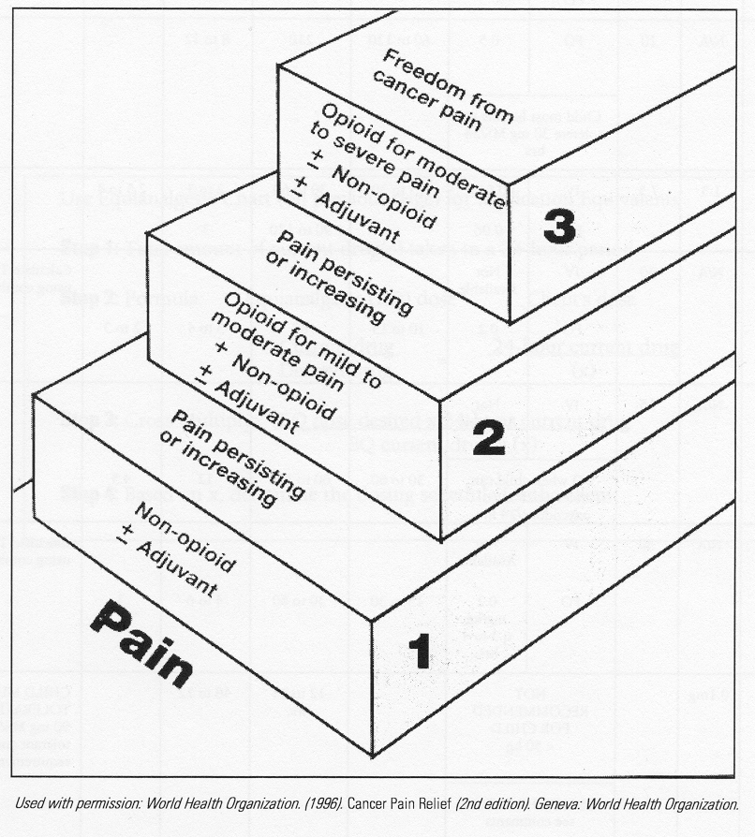
Levels of treatment intensity

Slide 18
Opioid Pharmacokinetics
Morphine
  First-pass metabolism results in poor and unpredictable bioavailability from oral dosing
  30% plasma protein-bound
  Detoxification by glucuronidation in liver
  Prolonged clearance and lower clearance rates in infants
  Half-life decreases with increasing age
  High inter-individual variability

Slide 19
Opioid Pharmacokinetics
Codeine
  70% bioavailability from oral dosing
  25% plasma protein-bound
  Metabolized to morphine (10%) and norcodeine
  Excreted in urine as inactive forms
  Half-life 2.5-2.5 hours

Slide 20
Opioid Pharmacokinetics
Fentanyl
  Highly lipophilic, redistributes into muscle/fat
  80 - 85% plasma protein-bound
  90% metabolized in the liver to inactive metabolites
  Half-life much shorter in infants and young children with higher clearance

Slide 21
Opioid Pharmacokinetics
Methadone
  Highly lipophilic, redistributes into muscle/fat
  80 - 85% plasma protein-bound
  90% metabolized in the liver and eliminated in the urine (<10% unchanged)
  Half-life shorter in children than adults

Slide 22
Common Uses of Opioids in Children
Mechanically ventilated neonates, infants and children
Procedural pain
Acute trauma or illness, including surgery
Sickle cell anemia vasooclusive crises
Burns
Cancer pain

Slide 23
Intensive Care Unit
Fentanyl may increase ICP and increase chest wall rigidity
Morphine may cause some venodilatation
Concerns over respiratory depression may limit dosing
Altered hepatic or renal function
Pain may be more difficult to assess or time may not be taken to assess pain management
Tobias et al. Ped Clin N Amer 41:1269-1292,1994
Chambliss et al. Curr Opin Pediatr 9:246-253, 1997
Jacob et al. J Pain Symptom Manage 20:59-67

Slide 24
Emergency Department
Comparison of pediatric and adult centers
  Doctors are less likely to order analgesics for children
  Children are less likely to receive analgesics, even when ordered
  Children more likely to receive non-narcotic agents
  Administration of analgesics are delayed, under-dosed
  Home medications and instructions are inadequate
  Adverse effects of procedural analgesia with appropriate monitoring is rare
  Friedland et al. Ped Emerg Care 13:103-106, 1997
  Pena et al. Ann Emerg Med 34:483-491, 1999
  Bernardo et al. J Trauma Nurs 4:13-21, 1999
  Schechter et al. Pediatrics 77:11-15, 1986
  Selbst et al. Ann Emerg Med 19:1010-1013, 1990
  Hauswald et al. Pediatr Emerg Care 13:263, 1996
  Jacob et al. J Pain Symptom Manage 20:59-67, 2000

Slide 25
Sickle Cell crises
Combinations of opioids and non-steroidal agents
Infusional continuous and bolus infusions
Avoidance of meperidine
Need transition from infusional to oral or transdermal
Delay in starting analgesics
Need for observational units
Confusion between tolerance, physical dependence and addiction
American Pain Society 1999
Yaster et al. Pediatr Clin N Amer 47:69-710, 2000
Bohan. Emerg Clin N Amer 19:233-238, 2001
Shapiro. J Pain Symptom Manage 14:168-174, 1997
Shapiro. Pain 61:139-144, 1995
Jacob et al. J Pain Symptom Manage 20:59-67

Slide 26
Cancer Pain
Pain may be chronic and may require combinations of agent types and administrations
Many sets of guidelines exist, but uniformity within and among centers is lacking
Under-medication is a common issue, especially towards end of life
Physiologic conditions dictate choice of agent, mode of administration and dosing
Need transition from hospital to home setting
Zeltzer et al., Berde et al., Pediatrics 86:818-831, 1990
Tyc et al. J Pediatr Oncol Nurs 15:207-215, 1998
Collins et al. J Pediatr 126:653-657, 1995
Galloway et al. Pediatr Clin N Amer 47:711-746, 2000
World health Organization 1996, 1998
American Pain Society 1999
Jacob et al. J Pain Symptom Manage 20:59-67

Slide 27
Research Directions
Congressional provision declares this decade as the “Decade of Pain Control and Research”
National Pain Care Policy Act of 2001
  White House conference on pain care
  National center within NIH
  Funding for education/training through the Agency for Health Care research and Quality
  Pain care standards for Medicare + Choice plans
  Annual report on Medicare expenditures
  Pain medicine to be treated as physician specialty

Slide 28
Focus for Pediatric Research
Epidemiology and utilization practices
Pharmacokinetics and pharmacodynamics
Mechanisms of action
All new agents should have pediatric trials
Older agents need pediatric trials
Broader dosage forms and routes of administration
Adequate supply of drugs
Combinations of different drug classes
Combinations of pharmacologic and non-pharmacologic pain management
De-stigmatize patients, families and doctors

Slide 29
Education and Research
Health care providers
Children and adolescents
Parents
The greater community
Pharmaceutical industry
Federal Drug Administration
National Institutes of Health
Other granting agencies

