Slide 1
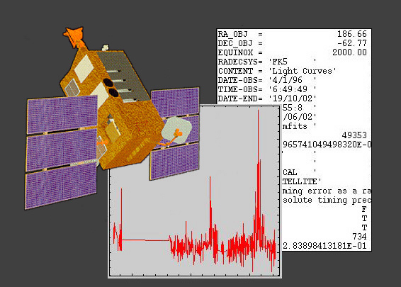
Student Hera: NASA Spectroscopy Activities, Analysis, and Data in Your Classroom
Dr. Jim Lochner (USRA)
Sara Mitchell (SP Systems)
NASA/GSFC Astrophysics Science Division
Notes:
This presentation is a summary of Student Hera, featuring each of the tutorials.
Originally presented at NSTA- Charlotte, Fall 2008.

Slide 2
Data in the Classroom
Astronomy data analysis offers students:
applications in science and math concepts
opportunities to improve inquiry and research skills
engagement in real-world problem solving
an understanding of relationship between data and theory
learning of concepts within an exciting context
a connection with NASA and other institutions
experience with what “real scientists” do
Using data in the classroom shows that anyone
can do “real science” – it’s not scary!

Slide 3
NASA & Data
NASA has petabytes of data from its satellites, manned exploration, and research programs
1 petabyte of information = approximately 50 times the size of the entire print collection of the U.S. Library of Congress
Data is ever-growing with new missions – and with newer technology, data gets bigger
Specialized data management has been created for NASA’s unique storage needs
Notes:
A petabyte is a billion megabytes. (or a million gigabytes)

Slide 4
HEASARC & Data
(High Energy Astrophysics Science Archive Research Center)
HEASARC contains 16 terabytes of data from 26 satellite observatories
The largest collection of X-ray and gamma-ray data on stars, black holes, pulsars, supernova remnants, and galaxies
Astronomers from around the world download the data via Browse
  Download volume equals size of the archive every 6 months
Notes:
The HEASARC data holdings are from a variety of satellite missions, going back to the 1970’s.
Browse is a tool used developed by the HEASARC to access its data archives.

Slide 5
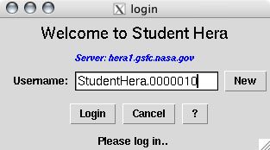
Welcome to Student Hera!
Student Hera brings real astronomy into the classroom!
Students use the same software and methods as scientists to study objects in space such as black holes, pulsars, and binary stars.
One small download brings the universe to your fingertips.

Slide 6
What are Hera and Student Hera?
Hera provides an interface to satellite data and analysis tools which are used by scientists.
  Neither tools or data need to be downloaded to user’s local computer.
Hera is used by scientists around the world.
Student Hera is a scaled-down interface which provides selected data sets and tools for teachers and students.
  Web pages provide tutorials of the analysis for students.

Slide 7
Astronomy Data & Analysis
Timing
  Measure how the intensity of X-rays from an object varies with time
  Stars, Binary Star Systems, Black Holes, Pulsars
Imaging
  See where the X-rays are coming from
  Supernova Remnants, Clusters of Galaxies
Spectroscopy
  Measure the energy of the X-rays
  Stars, Binary Systems, Black Holes, Supernova Remnants, Galaxies, etc.
Notes:
Astronomy data and analysis falls in these three broad categories. Student Hera provides three tutorials covering these.
“Timing” data measures how the object’s intensity varies with time.
“Imaging” data allows us to see what the object looks like. With “false color” techniques, we can view objects in wave bands other than optical
“Spectroscopy” data measures the energy of the X-rays, allowing us to determine the physical mechanisms which give rise to the radiation.

Slide 8
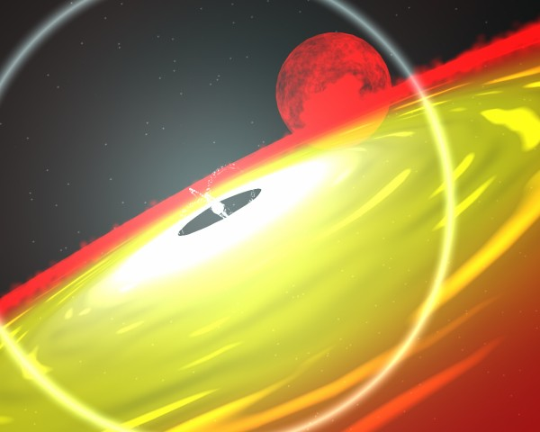
Tutorial #1: Timing
Objective: determine the period of a binary star system
  System contains a pulsar and a normal star
Students make predictions for what the orbit looks like
Students estimate period by plotting the light curve
Students obtain period using a Chi-squared analysis technique
Students compare shape of light curve and compare with their predictions
Notes:
Each tutorial provides science background and exercises that walk the student through the concepts and using the analysis tools.
The Timing tutorial is a good place to start.
A pulsar is a type of neutron star. This object shines in X-rays when matter from its nearby binary companion flows toward the pulsar. As the matter circles around the pulsar, the pressure and density rise, causing the temperature to rise. As the temperature rises, the matter emits X-rays.
The closer the two stars are to each other, the more X-rays we see. So if the X-ray intensity varies as the two stars orbit each other, what type of orbit might they be in? (Answer: elliptical).

Slide 9
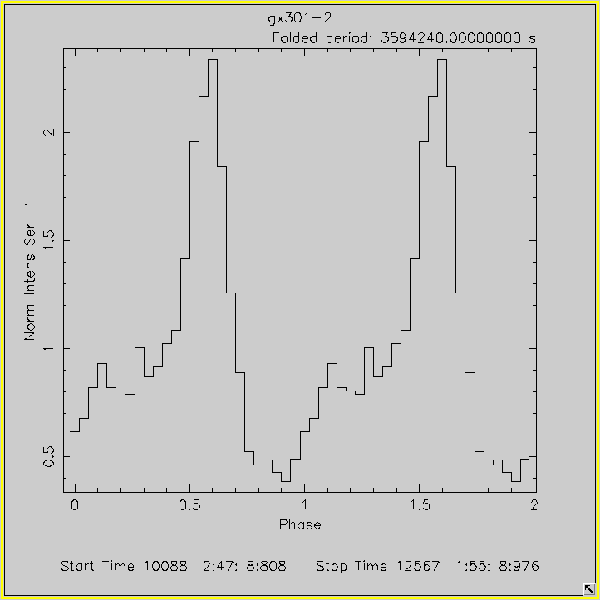
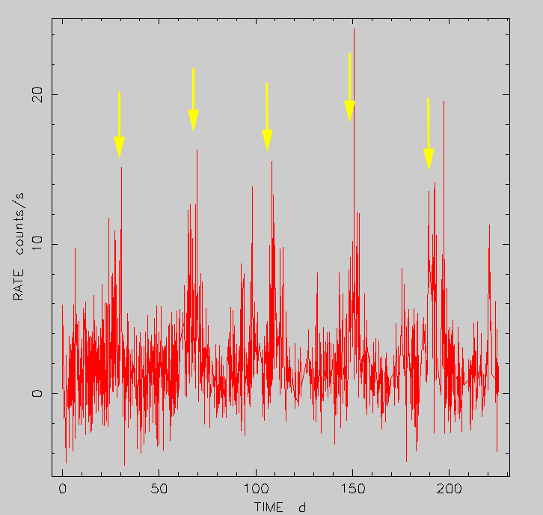
Tutorial #1: Timing
Light Curve
Folded Light Curve
Notes:
The Timing tutorial can be used with either middle school or high school students:
[Left Figure] In the timing tutorial, students plot the light curve, adjusting the amount of data to plot. Students identify a pattern in the light curve and visually estimate a period. For middle school students, this is a natural stopping point in the lesson.
[Right Figure] Using their estimated period, high school students use techniques to better determine the period. They end with a plot of the “Folded Light Curve”, which depicts the light curve averaged over the period. Students then compare this with their predictions for the nature of the orbit.

Slide 10
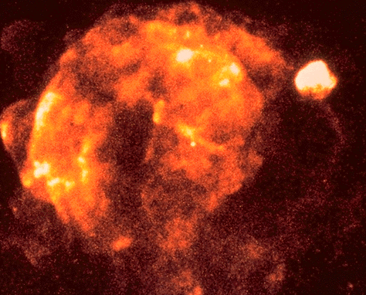
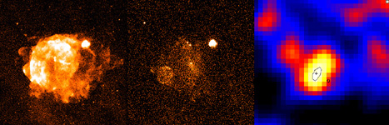
Tutorial #2: Imaging
Students search the image of a supernova remnant in different energy bands
From gamma-ray data, they discover, as astronomers did, a new supernova remnant
Notes:
Image in upper right is the Vela Supernova Remnant (SNR)
In the bottom row of three images:
Left - The Vela SNR (filling most of the image) and the smaller Puppis A SNR (near the 2 o'clock position at the edge of Vela) in ROSAT Image at X-ray energies 0.1-2.4 KeV;
Center - ROSAT Image for X-ray energies 1.3-2.4 KeV;
Right - COMPTEL Image (from the Compton Gamma Ray Observatory) of newly discovered Supernova Remnant

Slide 11
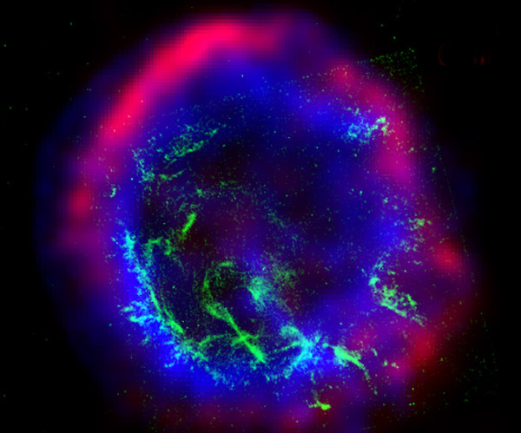
Tutorial #3: Spectroscopy
Examine a supernova remnant
  An exploded star and element “factory”
Determine the elemental composition
Students model the spectrum with different types of x-ray emission mechanisms and spectral lines
Notes:
The image is a composite of Radio (red), Optical (green), and X-ray (blue)
Here’s the APOD description of the image of E0102-72
Not all stars form a big Q after they explode. The shape of supernova remnant E0102-72, however, is giving astronomers a clue about how tremendous explosions disperse elements and interact with surrounded gas. The above image is a composite of three different photographs in three different types of light. Radio waves, shown in red, trace high-energy electrons spiraling around magnetic field lines in the shock wave expanding out from the detonated star. Optical light, shown in green, traces clumps of relatively cool gas that includes oxygen. X-rays, shown in blue, show relatively hot gas that has been heated to millions of degrees. This gas has been heated by an inward moving shock wave that has rebounded from a collision with existing or slower moving gas. This big Q currently measures 40 light-years across and was found in our neighboring SMC galaxy. Perhaps we would know even more if we could buy a vowel.

Slide 12
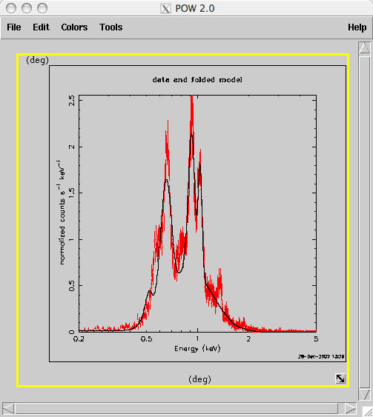
Tutorial #3: Spectroscopy
Students find evidence of oxygen, neon and
magnesium in a supernova remnant.
Notes:
In analyzing a spectrum, students match the data with models which describe types of emission mechanisms.
In the spectroscopy module, students first choose a model for the overall continuum. They then insert lines to model the distinct emission lines seen in the data. They then match the energies of those lines with known energies of emission lines from common elements. They find the supernova remnant contains oxygen, neon, and magnesium.

Slide 13
Using Student Hera
It’s easy to get started with Student Hera in the classroom. The website leads you through installation and getting started.
Student Hera requires one 10MB download from the website. An installation wizard to guide you through set-up. Just click on the Student Hera icon on your desktop, and you’re ready to go!

Slide 14
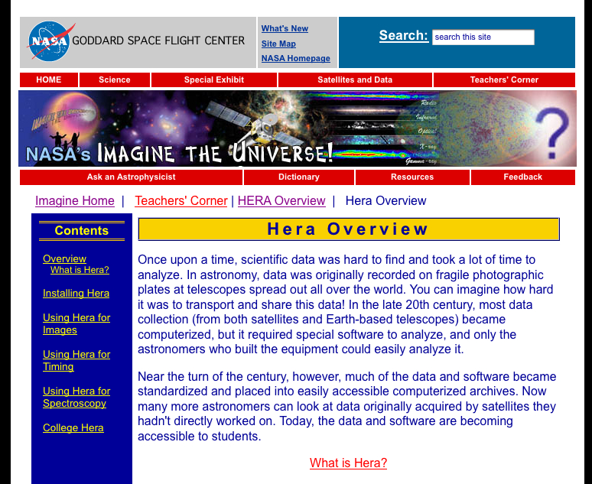
Student Hera Tutorials
Notes:
The Student Hera tutorials are available on the Student Hera web pages on the imagine site (full URL is given later).

Slide 15
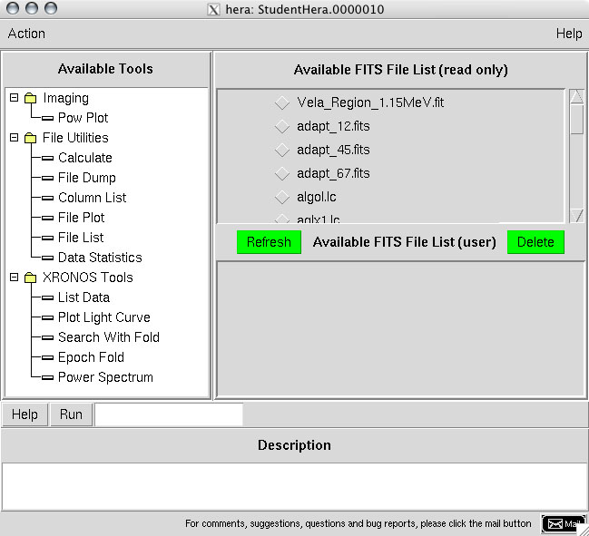
Student Hera Interface
Student Hera offers a variety of tools and data to explore.
Notes:
Using Student Hera is easy!
Just select a Tool (in the left hand menu), a data set (upper right hand menu), and click “Run”. A dialogue box will appear. The tutorial guides students in choosing parameter inputs.

Slide 16
From Tutorials to Research
Once students have mastered the analysis techniques, they can expand analysis to other objects
  Group or individual research projects
  Science fair projects
Tutorials parallel historical research done by scientists – results can be researched and verified in scientific literature

Slide 17
Classroom uses for Student Hera
Use software and exercises within lessons on related concepts, such as light curves, X-ray astronomy, or binary stars. Plotting tools can create useful visual aids!
Assign students individual or group projects using Student Hera. Projects can be based on the guided activities on the website -- many variations are possible.
Integrate into lessons on mission design and technology. Student Hera offers a look at the real data that comes back from satellites, as well as the specialized analysis and manipulation that scientists perform.
Use with related lessons and activities from online learning resources such as Imagine the Universe! and mission-related sites like the RXTE Learning Center.

Slide 18
College Hera Lab
Timing Tutorial is also available as a 2-hour lab experience for 1st year college astronomy courses.
  Guided web course tracks student progress and tests concept understanding
  http://imagine.gsfc.nasa.gov/docs/teachers/hera_college/
  Developed by Dr. Beth Hufnagel, Anne Arundel Community College, Maryland

Slide 19
New Ideas?
How would you use Student Hera
in your classroom?

Slide 20
Check us out online!
http://imagine.gsfc.nasa.gov/docs/teachers/hera/

