Slide 1
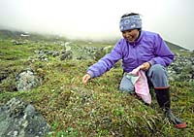
Air Toxics deposition over Alaska
2002 PBT Monitoring Strategy workshop: Raleigh, NC
April 22 – 24, 2002

Slide 2
Boundaries of the Arctic
  In the North Atlantic, the southern boundary follows 62°N, and includes the Faroe Islands.
  To the west, the Labrador and Greenland Seas.
  In the Bering Sea area, the southern boundary is the Aleutian chain.
  Hudson Bay and the White Sea are considered part of the Arctic for the purposes of the assessment.
  In the terrestrial environment, the southern boundary in each country is determined by that country, but lies between the Arctic Circle and 60°N.

Slide 3
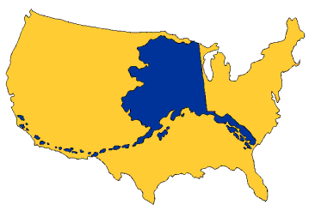

Slide 4
Study Areas in Alaska
Radiation/Persistent Organic Pollutants:
Health - unknown, unfair, and scary
Solutions -
Local Sources
Cultural Considerations - Is my food safe? Is my culture safe?

Slide 5
Atmospheric processes
Air from mid-latitudes moves northward with its load of contaminants, it rises, forming layers of dirty air at higher altitudes.
Pollution released into the Arctic air mass tends to remain within a couple of kilometers of the ground because of temperature inversions that create a lid of cold air.

Slide 6
Arctic haze
Arctic haze is seasonal – Peak in Spring.
Originated from anthropogenic sources outside the Arctic.
The most severe episodes occur when stable high-pressure systems produce clear, calm weather.

Slide 7
Why is Arctic haze important?
It completely changed the earlier notion that aerosol pollution could only be local or regional.
  The cold, dry air in the polar regions allows particles to remain windborne for weeks rather than days.
  Allows contaminants to spread from industrial sources in Eurasia and North America across the entire Arctic.

Slide 8
Haze particles give metals and other contaminants a free ride to and within the polar region.
  Metals and some persistent organic compounds adhere to aerosols and deposited along with the aerosols
  Substantial amounts of industrial and agricultural contaminants wash out by precipitation occurring over the Arctic.

Slide 9
Some sources of contaminants to the Arctic
Organic/Inorganic toxics from sources such as: combustion of fossil fuels, agriculture, manufacturing and mining.
The major source regions are industrial and agricultural areas further south in Eurasia, North and Central America.

Slide 10
Comment from an elder:
Matthew Bean, a Yupik Eskimo elder from Bethel, Alaska, describes the changes he has seen in the sky:
‘Sometime back, the skies on a clear day used to be deep blue all over, even at the horizon. Now you hardly ever see that anymore, especially on the horizon. It is always pale blue, almost white or even dirty gray. It makes me sad to see what future generations are going to have to put up with.’

Slide 11
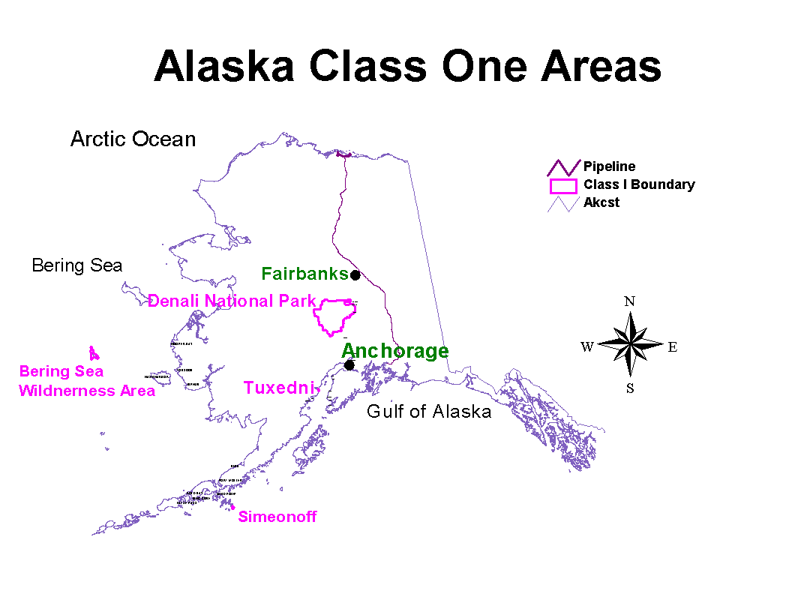
Study Areas in Alaska
Modeling/Monitoring - Status of Class I areas?

Slide 12
Study Areas in Alaska
Particulate Matter
Monitoring sites:
speciation monitor at the 16th & Garden CO/PM10/PM2.5 site in Anchorage
Most monitoring occurred in mid -1990s in Mat-Su Valley, Anchorage and Juneau in mid-1990s. All monitoring then was PM10
State and Tribes established a collaborative program, starting with PM, to assess general air quality in Tribal Alaska – initially, 17 Tribes.
- ~ 72 other Tribes on standby awaiting funding.

Slide 13
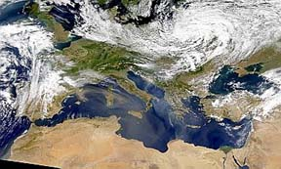

Slide 14
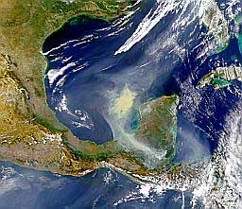

Slide 15
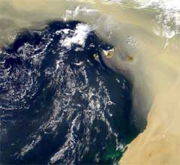

Slide 16
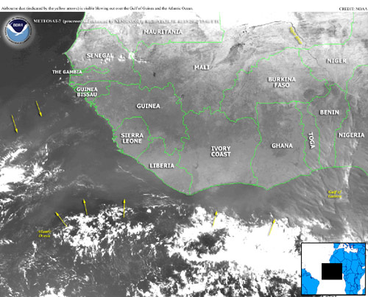

Slide 17
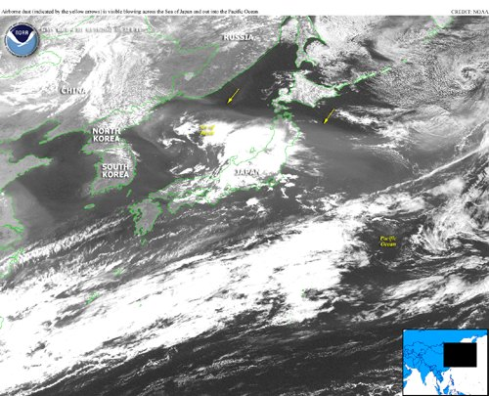

Slide 18
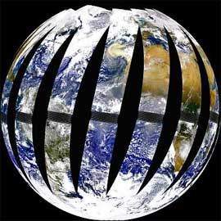

Slide 19
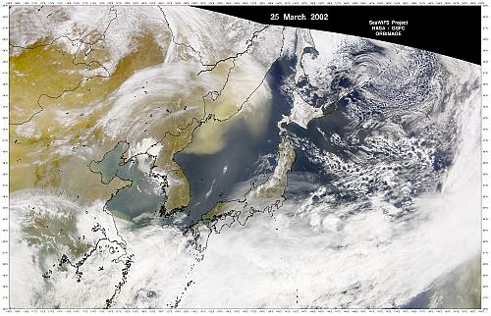

Slide 20
Measurements of toxic organic compounds in polar bears have shown unexpectedly high levels – Norway & Canada
Study of traditional foods from the sea showed that some people in native communities in Canada ingested high levels of PCB in their diet.
Study of sea mammals in the Bering sea region showed high levels of mercury and dioxins.
Studies on fish and plants indicate increases in levels mercury and organic toxics in Alaska

Slide 21
Speculation?
Local sources of Toxics could not explain the high levels.
It must have been transported from regions outside the Arctic.
Its geographical characteristics and cold climate make the Arctic a sink for many contaminants that are spread around the globe.

Slide 22
One-hop/Multi-hop contaminants
These contaminants start their journey with a ride on north flowing winds from the source.
They are often labeled one-hop contaminants. Sulfates, non-volatile metals, and radionuclides are some examples. Non-volatile organic compounds behave the same way.
Multi-hop Contaminants - Same as One-hop contaminants but their journey are characterized by deposition along the way and “re-volatizing” and be airborne multiple times.

Slide 23
The distances over which contaminants travel are determined:
the location of their sources in relation to the Arctic air mass
precipitation patterns
distances the air mass moves during the atmospheric lifetime of the particles
NOTE:
In the Arctic winter - particles can stay in the air as long as 20 to 30 days.
In summer - the contaminants usually stay in the air for only 2 to 5 days.

Slide 24
Modeling
Where do contaminants come from?
How do they get from one point to the other?
Much of what is known about contaminant transport comes from computer models that mathematically simulate pathways.
The input to the one-hop models:
Emissions
Meteorological conditions such as winds and precipitation
Equations describing processes that change/remove the chemical and physical characteristics of the compounds in/from the air.
Models for multi-hop compounds are much more complex.

Slide 25
The Common Denominator
Sovereignty and Local Control -
Sampling, Health Assessment, and Solutions
“Capacity Building”
Local and Cultural Considerations -
Respect
Trust
Consideration of Federal Rules - Sometimes do not address well the needs of Tribes and rural communities

Slide 26
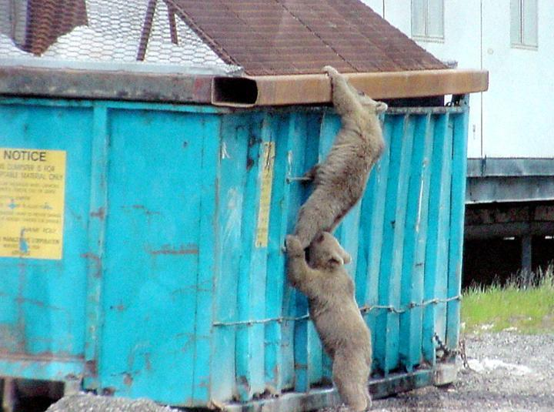
COOPERATION

Slide 27
Comments & Questions
Francis Chin
Environmental Program Manager
Maniilaq Association
P. O. Box 256
#733 2nd Avenue,
Kotzebue, AK 99752
Tel: 907-442-7639
Fax: 907-442-7678
Email: fchin@maniilaq.org
Website: maniilaq.org

