Slide 1
User Perception and Acceptance of Biometrics
M. Angela Sasse
Professor of Human-Centred Technology
Department of Computer Science
University College London, UK
a.sasse@cs.ucl.ac.uk
www.ucl.cs.ac.uk/staff/A.Sasse

Slide 2
Background
20+ years usability research, 10+ years usability and effectiveness of security systems
Specific biometrics experience
  2000/1 BIOVISION (EU Roadmap Project)
  2004 BioPII (German Federal Office for Information Security)
  2005- Member of the Biometrics Advisory Group to UK Home Office

Slide 3
Overview
User Perception – what is it?
Expectation management
Creeping functions, creepy missions

Slide 4
User perception
First impressions count
Problems with usability reduce confidence
Rejection is personal
Perceived utility and value
One technology – many systems, many experiences

Slide 5
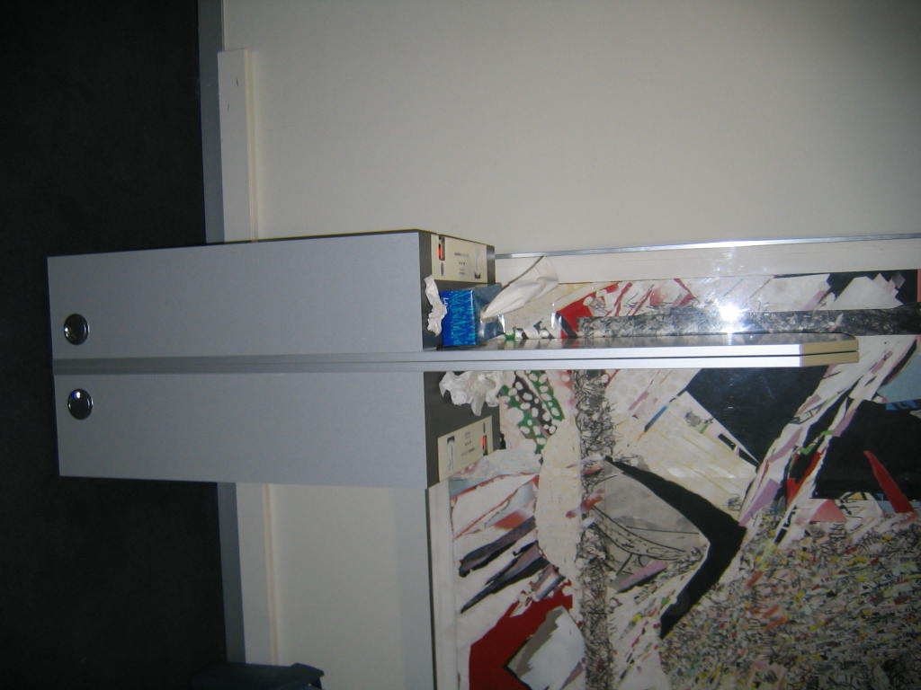
First impressions count
Offputting: systems that are
  Dirty/unhygienic
  Scary
  Rickety
Technology as a “barrier”
Violation of deeply engrained social norms (“What to you mean I can’t smile?”)

Slide 6
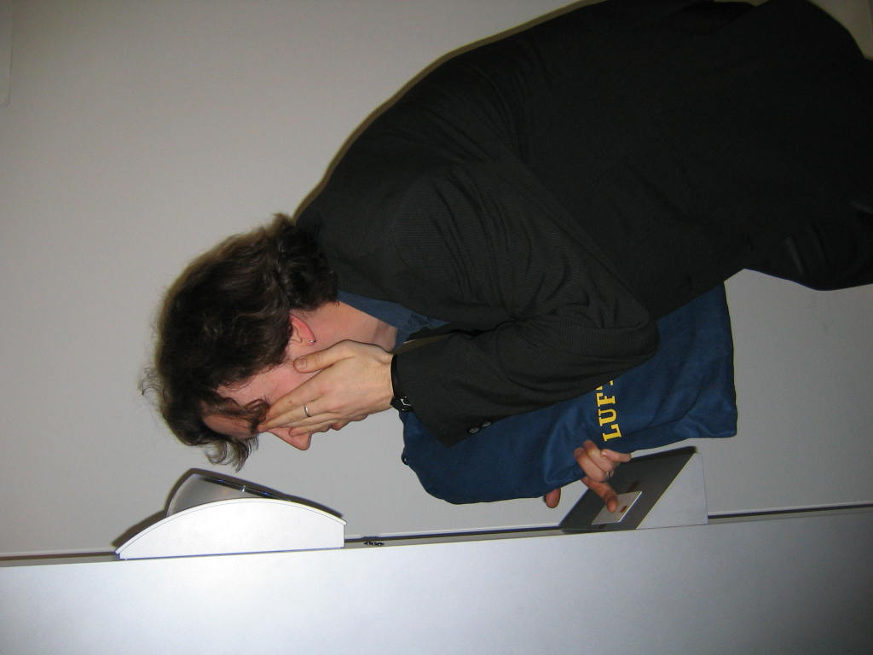
Low usability reduces confidence
In technology
Organisations who build/run it
Basics
What kind of system is it?
What do I have to do?
Don’t make user twist/turn/dance
Anything that requires posters & instruction is NOT “walk-up-and-use”

Slide 7
Rejection is personal
 | Face | Iris | Finger
Demo Rep. Group | 0.15% | 12.3% | 0.69%
Diff. ability Group | 2.73% | 39% | 3.91%
People are not “goats”
Don’t make them feel that their biometrics are “not good enough”
Impact on self-esteem and self-image
Minorities may be particularly sensitive
Impact on users’ lives

Slide 8
Utility & value
Utility for user?
  Better processes
  Convenience
  Value-added services
Depends to design of end-to-end process & environment, not just biometric system
Visible improvement of something they care about

Slide 9
Managing expectations
Users evaluate performance against expectations
Similar systems
But also: expectations created by communications about systems
Positive perception requires meeting or exceeding expectations

Slide 10
UK ID cards programme
Promised at the outset that introduction of ID card and National Identity Register would
  Prevent terrorism and serioius crime
  Reduce illegal immigration, welfare fraud, health tourism …
High support (85%) (responding to those ideas)
Today: well below 50%, especially with young & technology-literate
Much harder to work your way up from decline …

Slide 11
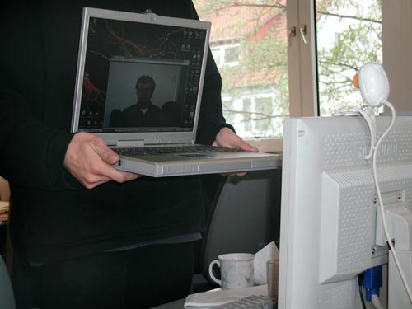
Many systems, many usages
Range of high-low performance
Cheap systems less likely to work & simple to overcome
But: users cannot tell difference
Intermingling with different purposes
  Border control vs. payment for drinks
  Integration with other systems - CCTV

Slide 12
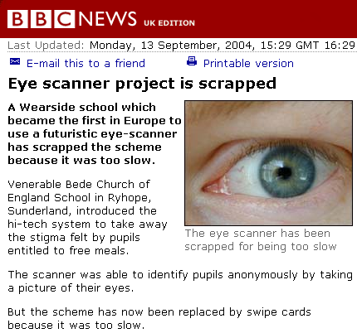

Slide 13
"We were aiming for it to scan 12 pupils a minute, but it was only managing 5 so has been temporarily suspended as we do not want pupils' meals getting cold while they wait in the queue."
Failure to identify + meet requirements = failure.
Perception spreads to technology in general

Slide 14
User Acceptance requires
Perceived need
Utility/convenience for users
Trust in operator
  reliability of recognition
  security of data
  use for advertised purposes only

Slide 15
Creeping functions, creepy missions
Shift of risk – ID theft vs. physical attack
Opportunistic usage of data
Advancements in technology of technology
Shifting policies

Slide 16
Opportunistic use of data
Law enforcement: investigation/evidence
Use of investigatory powers by local authorities in UK
  Residence in school district
  Infringement of rubbish policies
  Tax matters
  Shellfish harvesting

Slide 17
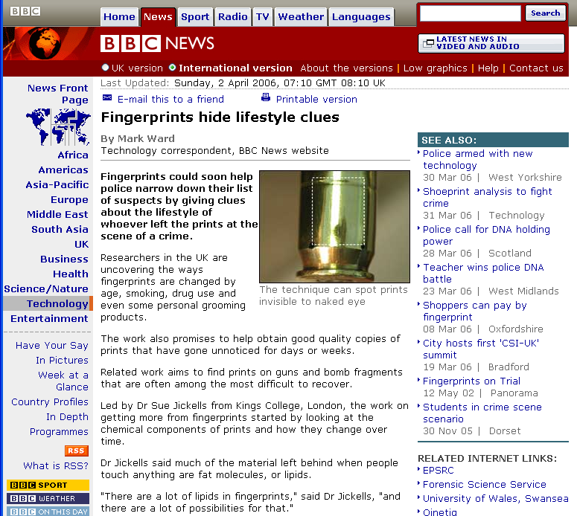

Slide 18
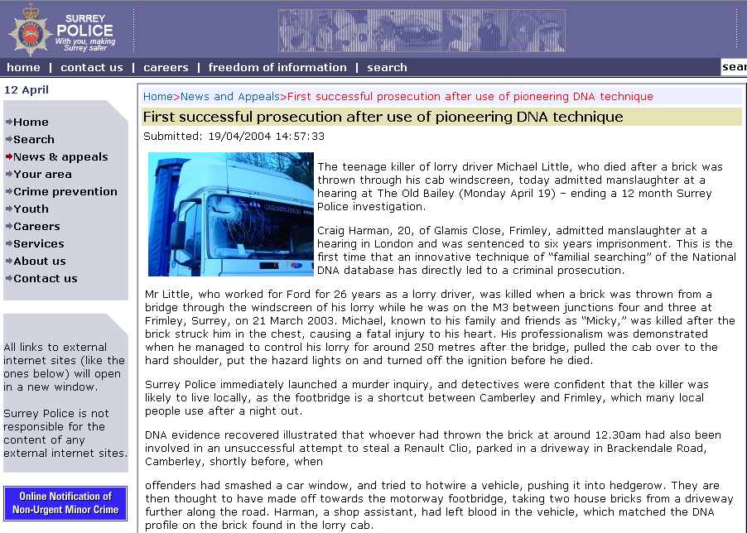

Slide 19
Conclusions
Much homework to be done:
  Usability
  Universal access
  Utility and convenience for users
Testing, testing, … and learning and improvement
Quality assurance, usability and performance standards

Slide 20
Conclusions
Continuing “arms race” of new technologies, more & more data increases burden on users
Careful management of expectations – don’t promise what you can’t deliver
Strategies for managing perceptions and expectations in face of increasing diversity of systems and applications
  Separate “high assurance” and “convenience” biometrics?

