Slide 1
Economic Effects of the Peaking of Conventional
Oil Supply
Hillard Huntington
Energy Modeling Forum
Stanford University
DOE/EPA workshop
Modeling the Oil Transition
April 20-21, 2006 / Washington, DC

Slide 2
Opening Remarks About
Oil Peaking
Peaking may not be a resource issue.
Oil peaking may already be happening in some sense.
No major impacts if a gradual transition.

Slide 3
How Important is
Resource Depletion?
Almost exactly 150 years ago,
Sir Henry Bessemer delivered
a paper to the Royal Society,
“Making Malleable Steel Without Energy.”

Slide 4
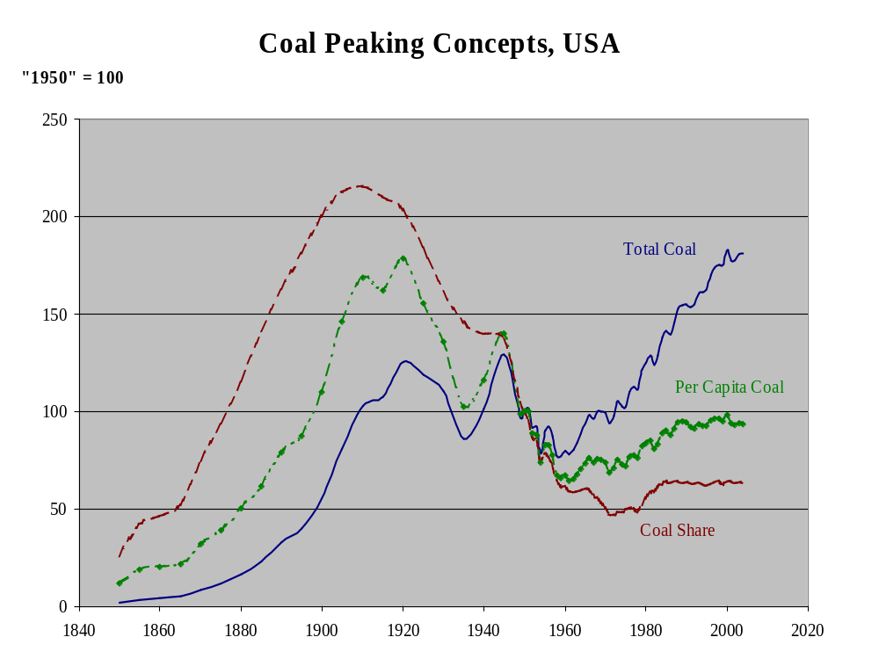

Slide 5
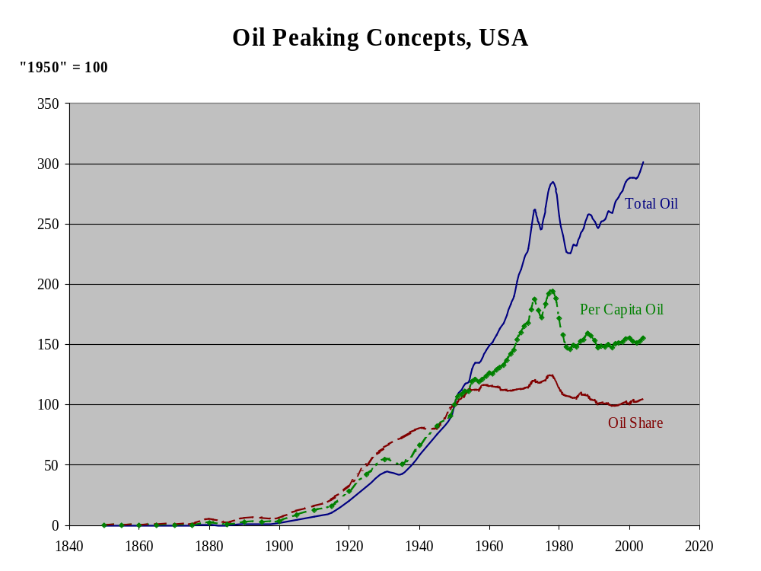

Slide 6
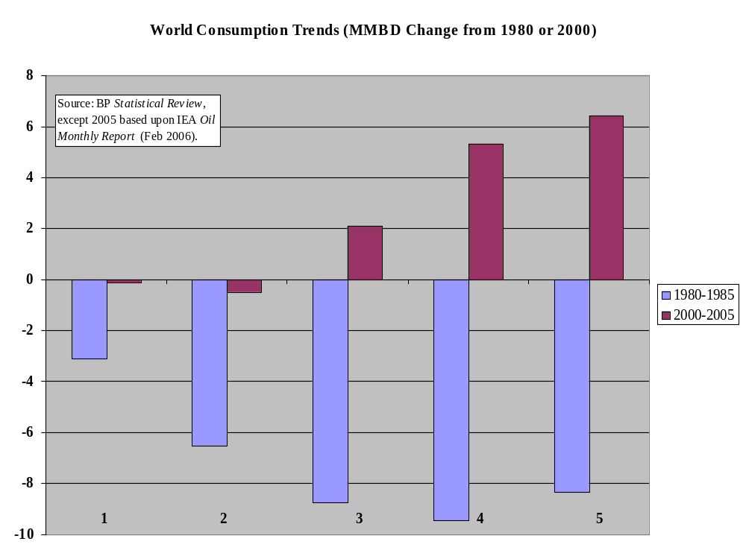
Years

Slide 7
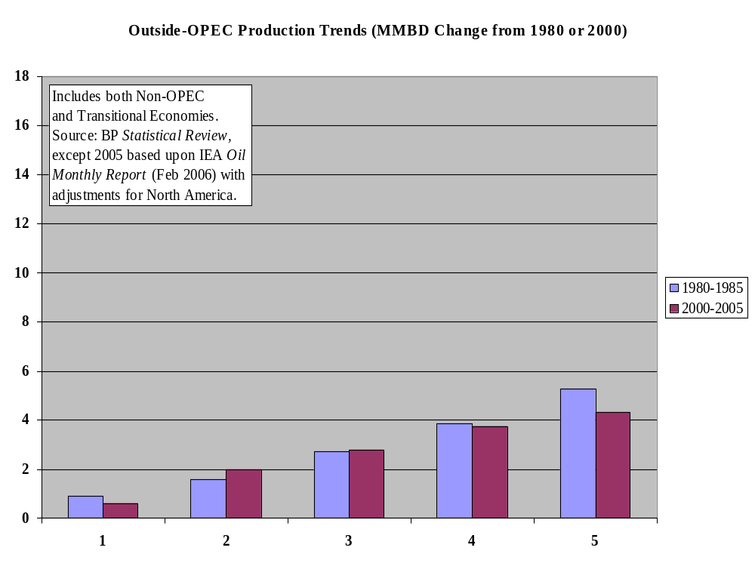
Years

Slide 8
Drilling Costs Rise with Oil Price
% p.a.
Years | Oil Prices | Multi-Factor Productivity# | Drilling Costs per Foot
1970-80 | 21.5% | -7.0% | 7.6%
1980-92 | -4.2% | 1.3% | -4.6%
1998-2003 | 12.3% | N.A. | 8.9%
# Ian Parry (1999)

Slide 9
Impacts of Energy
Prices/Availability
Reduces international purchasing power
Lowers productivity by reducing energy use
Temporarily depresses economic activity through macroeconomic frictions
  Idle capacity in key sectors (e.g., automobiles)
  Wage and price stickiness
  Caused by scary energy price surprises rather than by gradually higher energy prices.

Slide 10
σ=0.7
Reference
Point
Gross
Domestic
Product
σ=0.1
Energy Inputs
Source: EMF Report 1 (1977).

Slide 11
Reference
Point
Gross
Domestic
Product
Less
Saving
Energy Inputs
Source: EMF Report 1 (1977).

Slide 12
Final Reflections
Question that concerns policymakers?
Gradual transition with modest impacts, unless we have a policy panic scenario.
Demand adjustments critical for driving the transition.

