Slide 1
DTC Advertising and Its Impact of Patient Healthcare Behaviors
Angela Hausman, Ph.D.
The University of Texas – Pan American
Steven Kopp, Ph.D.
University of Arkansas

Slide 2
Background
Positive impact of DTC advertising:
  Obtain treatment - (Mossinghoff, 1992)
  Improve compliance - (Smith, 1998)
  Increase sales for advertised drugs
Negative impact of DTC advertising
  Treat unnecessarily – (Peyrot, et al. 1998)
  Select more expensive drugs – (Chandra and Holt, 1998)
  Self-medicate – (Chandra and Holt, 1999; Casner and Guerra, 1992)
  Impact physician choice - (Gönül, et al. 2001)

Slide 3
Research Questions
What do consumers think and believe about DTC ads?
How do DTC ads affect attitudes toward products?
How do DTC ads affect behaviors, i.e.. drug confidence and intentions to seek drug?
How do DTC ads affect self-medication?
How do DTC ads affect physician relationships?

Slide 4
Methods
Semi-structured interviews with Hispanic and non-Hispanic patients representing diverse ages and incomes and both genders.
Survey of Hispanic population (English) using a single ad for allergies.
Survey on non-Hispanics using ads for drugs used to treat diseases of differing severity.

Slide 5
Results
Attitudes toward DTC Ads and products
  “I just consider it a commercial of their own propaganda. They don’t share as much about their shortcomings.”
  “I think they are exaggerating”
  “I think they are honest because they are regulated and if they lie to you, you can sue them”
  “Isn’t it against the law to say that the drug can do something it can’t”

Slide 6
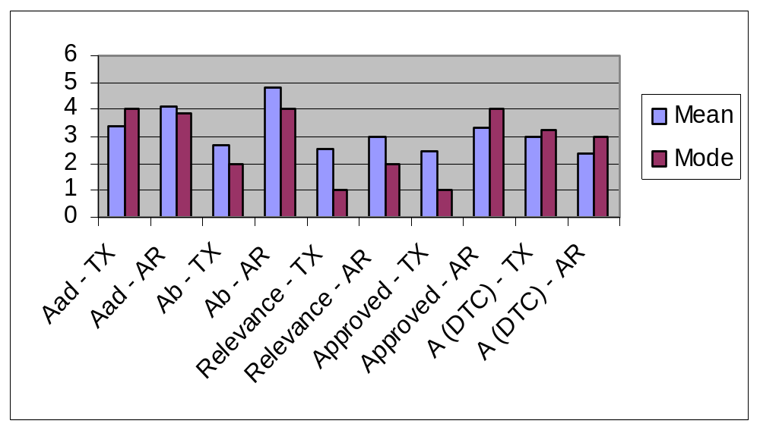
Table 1. Comparison of AR and TX data on attitudes toward ads and brands

Slide 7
Effect of DTC ads on behaviors
“I sometimes think they are too honest. They can be kind of scary.”
I think its kind of interesting how a drug is supposed to be the best thing for you and at the end of the commercial it is like side effects may be nausea, or bleeding, or stomach upset, etc. You are like ‘Why am I taking this drug – I’ve got one illness and I’m going to get 10 more.”
The one on depression was in a magazine and it said if you feel down or if you don’t do the hobbies you did before, it could be a symptom of depression.

Slide 8
Correlations Associated With DTC Ads
Positive association with attitude toward brands.
Positive association with information relevance.
Positive association with confidence in drug choice in Hispanic data only.
  (90% TX and 46.7% AR at least somewhat confident)
Positive association with likelihood of purchase in AR data only.
  (74.1% TX and 74.5% AR likely or very likely to buy)
No association between professional info sources and these attitudes and behaviors.

Slide 9
Correlations Associated With DTC Ads
Younger patients are somewhat more likely to use DTC ads to made drug choice decisions.
There is a positive association between DTC advertising and buying prescription drugs without a prescription – this is stronger among Hispanics (r=.132 vs. .218)

Slide 10
Regression Results Related to Drug Taking Behaviors.
Significant variables – Ab; Aad; A (DTC); informational relevance.
Model explains 47.5 % of variance in drug choice.
Model less effective in explaining variation among Hispanics, most of the effect is on informational relevance which in turn effects drug taking behavior.

Slide 11
Use of various sources of information about prescription drugs.
Hispanics are more likely to use DTC ads to find out about drugs. (μ=2.69 vs. 2.15)
Both groups use the internet for information about as much as they use advertising.
Doctors are still the most important source of drug information for both groups (μ=4.35 (TX) μ=4.42 (AR)).
Pharmacists are the next most commonly used source of information (μ=3.79 (TX) μ=3.73 (AR)).

Slide 12
Effect of DTC Ads on Healthcare and Physician/ Patient Relationships
About ¾ believed DTC ads were approved by the government.
About 40% said there should be more DTC advertising.
Approximately ½ of all respondents use DTC ads to help them find out about serious diseases.
About 40% ask their Dr. for advertised drugs.
Only about 13% of respondents felt DTC ads reduced their reliance on the Dr.

Slide 13
Effect of DTC Ads on Physician/ Patient Relationship
Dr. is still the primary source of prescription drug information.
Patients rely on DTC ads when they don’t trust their Dr. or have a poor relationship.
  “We can make our decision, not the Dr. The Dr. usually prescribes the drugs according to the vendors that go to his office.”
Or can’t afford one.
  “Some people cannot afford a doctor and by seeing the ad, they try it, and if they get well, the keep on using it.”

Slide 14
Conclusions
Patients generally like and trust DTC ads.
DTC ads affect patients attitudes about advertised products.
DTC ads help patients feel more empowered.
Patients use DTC ads primarily to supplement their Dr., not replace him/her – although they act as a vehicle to aid self-medication.
No economic effects were detected based on income, insurance, amount spent on drugs, or price consciousness.

Slide 15
Appendix 1 – Scales Used
Attitude toward the Ad (Aad) – semantic differential – 7 point
  Believable
  For me
  Informative
  Interesting
  Irritating
  Meaningful to me
  Phony
  Ridiculous
  Terrible
  Valuable
  Worth remembering
  Liked the ad
  Enjoyed the ad
  Found the ad good

Slide 16
Appendix 1 continued
Information Relevance
Semantic Differential – 7 point
  Relevant
  Meaningful
  Important
  Useful
  Helpful
  Government approved
Attitude toward the Brand (Ab) Semantic Differential – 7 point
  Bad product
  Disliked a lot
  Unpleasant
  Poor quality

Slide 17
Appendix 1 continued
Attitude toward prescription drug advertising A (DTC) – Likert scale
  Information in pharmaceutical ads helps me learn about diseases that might affect my health.
  I use information in pharmaceutical ads t o find out more about the drugs my doctor gives me.
  I think there should be more prescription drug advertising.
  I think prescription drug advertising will help reduce my reliance on my doctor.

Slide 18
Appendix 2. Surprising findings
Lack of correlation between any substantive variable and price consciousness at p=.001.
Lack of correlation between any substantive variable and income or amount spent on prescription drugs at p=.001.
High correlation between use of media and intentions to purchase a drug without a prescription r=.132 (AR) r=.218 (TX).
Lack of correlation between risk and drug seeking behavior.

Slide 19
Appendix 3. Additional Themes Identified
Ads approved by the FDA.
Mismatch between drugs, symptoms, properties described in ads, and associated side effects.
Belief that drugs are “for me”.

