Slide 1
InterLab 06
In conclusion…

Slide 2
Thank You …
For attending InterLab 06
We hope your experience was a positive one, that you gathered a lot of information that you can take back, that you met people and established collaborations, that you will continue to support InterLab with constructive input, new ideas, presentations ….

Slide 3
We heard about …
Usability …
Effective Web content …
Semantic web, trust, social networks …
Web 2.0 …
Ajax …
e-Labs …
Ruby, Rails
… …

Slide 4
We found that …
We all worry about similar things …
  Content
  Looks
  Design elements
  Search engines
  Accessibility
  ….

Slide 5
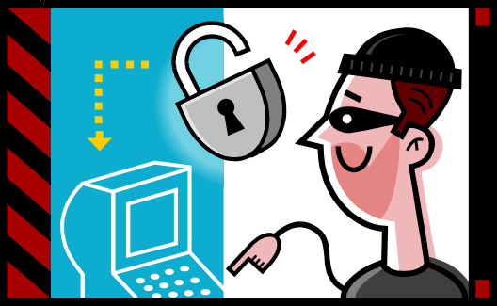
We saw …
New ways to present information …
We saw a web hacker (he even had the nerve to say it!) in action. Made us wonder on …
  What do we do wrong?
  Why are things different now for webmasters?
  What has changed?
  Where do we go from here?
  What’s coming up?
  Security, what does it involve?

Slide 6
Things are changing…
Web pages are not read only objects anymore
Web pages expect
  Our interaction
  Our willingness to provide information that can be used for lots of purposes
Dynamic Web pages are REALLY dynamic … Everyone has something to say, to add to change ...

Slide 7
We are heading for …
Web pages are evolving
  They look more and more like applications (blame everything on video games…)
New ways of communication
  E-mail is not a very effective collaborative tool.
    It can only reach the people on a list
    It takes too many messages to finalize an idea
    “Outsiders” cannot express their ideas or objections or …
Interactive Web pages (wikis …)
  Allow anyone (who has permission?) to edit the content.
  Is this the way to go for collaboration?
  Massive long e-mails, what’s their future?

Slide 8
Webmasters role?
Webmasters need to adjust
  What will be a web page, how will it look if everyone can edit it, what will be its content, its design…?
  How much work will it take to maintain such pages?
  What are the tools for webmasters?
  Security will play a big role, how can webmasters deal with the volume of attacks?
  What training will they need?

Slide 9
Where are we going?
The web started small, then became chaotic (still is, this will not change, you have to know something about where you are going, what you are looking for), now are we heading to total chaos and misinformation?
How can we protect our pages and yet follow the interactivity trends ?
Social networks how much will they get into our sites?

Slide 10
Future …
I am an optimist …
The web future is bright …
It will be different …
It will change our way of interacting with web pages
We need to adopt, take advantage of new “features” yet be cautious or skeptical(?) before adopting
We need to accept the evolution and work within it
New things might be scary at the beginning simply because we do not know

Slide 11
THANK YOU
See you all again at the next InterLab workshop, renewed, with new ideas and new innovative ways of designing web pages.

