Slide 1
NM Water Conservation Alliance Roundtable Discussion
Reducing Water Usage in Semiconductor Manufacturing
March 23, 2000
Rio Rancho,NM

Slide 2
Experience with a Recycle DI System
Kurt Eckert
EEEE
951 Amsterdam Dr.
Colorado Springs, CO 80907-4034
eckertk@asme.org
719-590-7133

Slide 3
Contributors
System design - Jacob’s Engineering
Manufacturer - Glegg Water
Atmel Project Manager - Kurt Eckert

Slide 4
Objective
What is DI recycle vs. DI reclaim?
Why is DI recycling necessary?
Why was this recycle system installed?
What are the hurdles for a recycle system?
Review the system design
Share actual operating
experience
Notes:
This talk is focused on the system I was the project manager on, with a few generalizations thrown in .

Slide 5
A recycle system
Collects a portion of the drains from process tools and reprocesses it back to a quality to be:
  Reintroduced back at some point in the primary UPW system
  Reutilized for a lower quality DI system such as CMP or central clean
Notes:
This is the most risky of options

Slide 6
A Reclaim System
Collects a portion of the drains from process tools and may or may not reprocess it back to a quality to be:
  Used in other applications such as:
    boilers
    cooling towers
    scrubber make up
    irrigation
Notes:
This is more common and involves less risk

Slide 7
Recycle/reclaim graphically
Primary UPW System
Make-up water
Fab UPW Utilization
Evaporation
Boilers, Scrubbers, Cooling Towers
Fab Drains
Recycle
WWT
Reclaim

Slide 8
Why is recycling necessary
Sematech (1995)- 2,275 gallons of water to process one 6 inch (150 mm) wafer
Semiconductor Industry (1996)- 8” wafers increase water consumption by 250% , over 6” wafers
Cleanrooms (1996)- Projects 7X increase in UPW consumption for 300mm wafers over 200mm wafers

Slide 9
Why was this recycle system installed
Fab expansion required more UPW capacity
WWT system did not have any capacity margin
City sewer line was at capacity
Lower first cost
Notes:
Now we’ll focus in more on this project

Slide 10
Major hurdles
Fear (paranoia) about contamination of DI system (TOC’s)
Financial, payback
Notion that water resources are without limit
Space

Slide 11
Design considerations for this system
Collect water only from the best sources. No solvent hoods.
Monitor TOC’s early in collection system with ability to dump on high TOC’s
Install a system to remove TOC’s
Notes:
Have slide of time line for RAT analysis

Slide 12
Design considerations for system (cont.)
Monitor TOC’s in final product with ability to dump before introducing into the UPW system

Slide 13
Schematic of Recycle system
City water backup
sodium
hydroxide
Drains
Low
ms
High
High
TOC
Low
Analysis
tank
Analysis
tank
Transfer
tank
WWT
Hydrogen
Peroxide
Cooling Heat Exchanger
Advanced Oxidative Process
sodium
bisulfite
sodium
hydroxide
Recirc
tank
RO
WWT
185 hm
filter 1mm
Low
filter .1mm
Electro-Deionization
TOC Destruct UV
TOC’s
Recycle to RO storage tanks UPW system
Reuse
boilers, scrubbers
WWT
Quartz Clean
Manual Valve
CMP

Slide 14
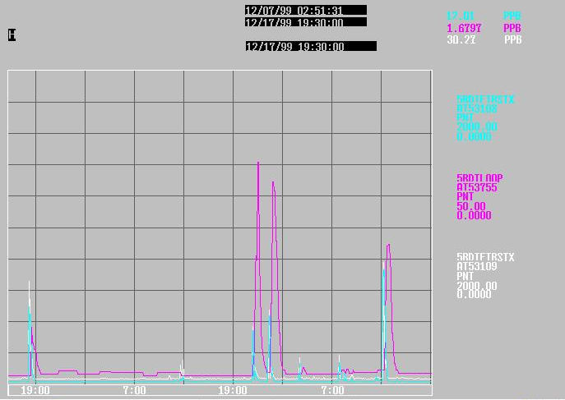
Actual Operating Data (TOC’s)
Analyzer A TOC’s 0-2000 ppb
Analyzer B TOC’s 0-2000 ppb
Recycle TOC’s 0-50 ppb

Slide 15
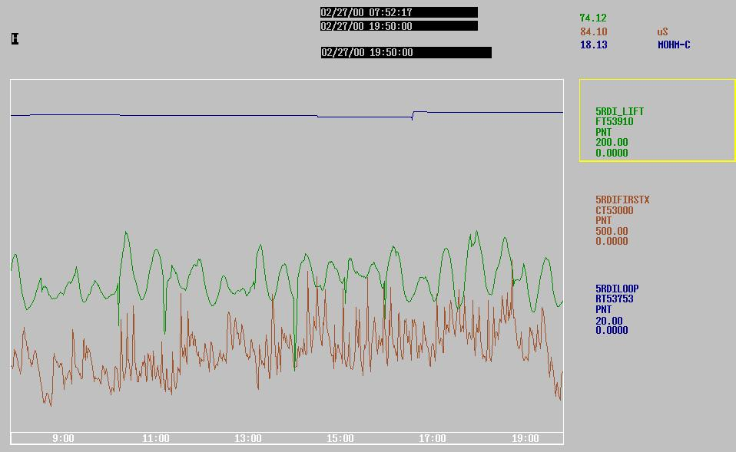
Actual Operating Data (conductivity)
Drain Flow 0-200 GPM
Drain Conductivity 0-500 mS
Recycle resistivity 0-20 mW
Notes:
90 GPM 85% RO recovery 95% CEDI recovery
38 M gallons/year

Slide 16
Operating Experience
Need to work with Line Maintenance and Production personnel
  Explain what the system does and how solvents impact the system
  Label each piece of equipment
  Repeat every 6 months
Also, need to work hand in hand
with operators
Notes:
Have slide of time line for RAT analysis

Slide 17
Operating Experience (Cont.)
There was a significant reduction in primary regenerations saving:
  manpower
  chemicals
  water
CEDI is not ready for polishing loop applications

Slide 18
Final Thoughts
The skeptics watch you closer and expect more of you when you have a recycle system
People are amazed at how much water (read $$$) are saved
The experience has been:
  Scary
  rewarding
  Frustrating
  exhilarating

