Slide 1

Domestic Violence
Understanding

Slide 2

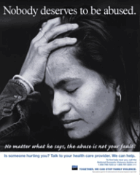
In order to respond to domestic violence effectively we need to have an understanding of …
  Defining Domestic Violence (1)
  Facts and Fiction(2)
  Perpetrators and victims (3)
  Forms of abuse (4)
  Why does she stay(5)
  Impacts (6)

Slide 3
Domestic Violence...
Is a Systematic Pattern of Intentional Intimidation Through the Use of Threats and Violence for the Purpose of Gaining Power and Control Over One’s Partner in a intimate relationship
(1)

Slide 4
Domestic violence occurs
in every race, religion, ethnic group and social class.
in both heterosexual and homosexual relationships.
male to female and female to male.
  Note: 95% of Domestic Violence Cases are women, so throughout presentation will use “she” to refer to the victim

Slide 5

Violence in the home is not…
  due to “a bad temper”
  due to the behavior of the victim, children or a problem in the relationship
  genetically inherited
  disagreement, a marital spat
Notes:
Reinforce by misconceptions from the public, police, medical, family TV, religion
what did you do to make him mad

Slide 6
Domestic Violence is NOT caused by . . .
  illness
  alcohol or drugs
  stress
  an anger management problem

Slide 7
Causes of Domestic Violence?
Domestic Violence is…
  a learned behavior.
  The abuser is responsible for the behaviors use in achieving his goal of power and control.
Notes:
Look for confusion about DV as an anger management issue,out of control behavior, alcohol, victim blaming , drug use
Studies of primates show violent behavior towards mates in order to maintain the harem, to control mating habits
Don’t get to carried away here

Slide 8




Cycle of Violence
Incident Any type of abuse occurs (physical/sexual/emotional)
Tension Building Abuser starts to get angry Abuse may begin There is a breakdown of communication Victim feels the need to keep the abuser calm Tension becomes too much Victim feels like they are 'walking on egg shells' | Making-Up Abuser may apologize for abuse Abuser may promise it will never happen again Abuser may blame the victim for causing the abuse Abuser may deny abuse took place or say it was not as bad as the victim claims
Calm Abuser acts like the abuse never happened Physical abuse may not be taking place | Promises made during 'making-up' may be met Victim may hope that the abuse is over Abuser may give gifts to victim

Slide 9
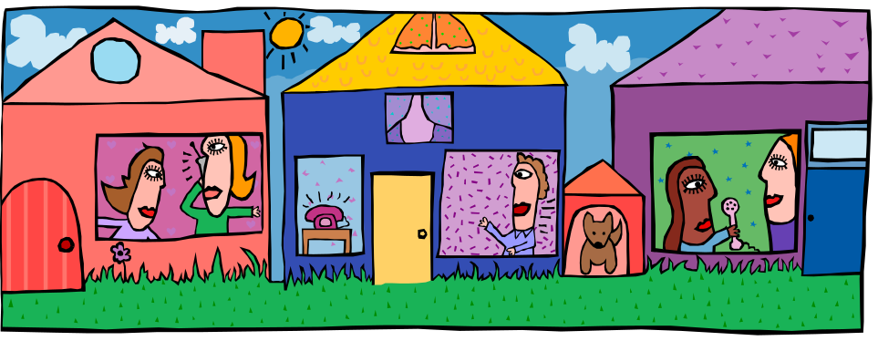
The facts of the matter
(2)

Slide 10
Family Violence is Very Common:
31% report lifetime prevalence
More prevalent among women than diabetes, breast cancer, and cervical cancer
  From Family Violence Prevention Fund

Slide 11
Alarming Statistics
  The American Medical Association estimates that over 4 million women are victims of severe assaults by boyfriends and husbands each year.
  “Violence Against Women,"
        CQ Researcher, Congressional Quarterly 1993
Notes:
54 %, I of murders in another estimate
Victoria BC 1990 71%
1991 42%

Slide 12
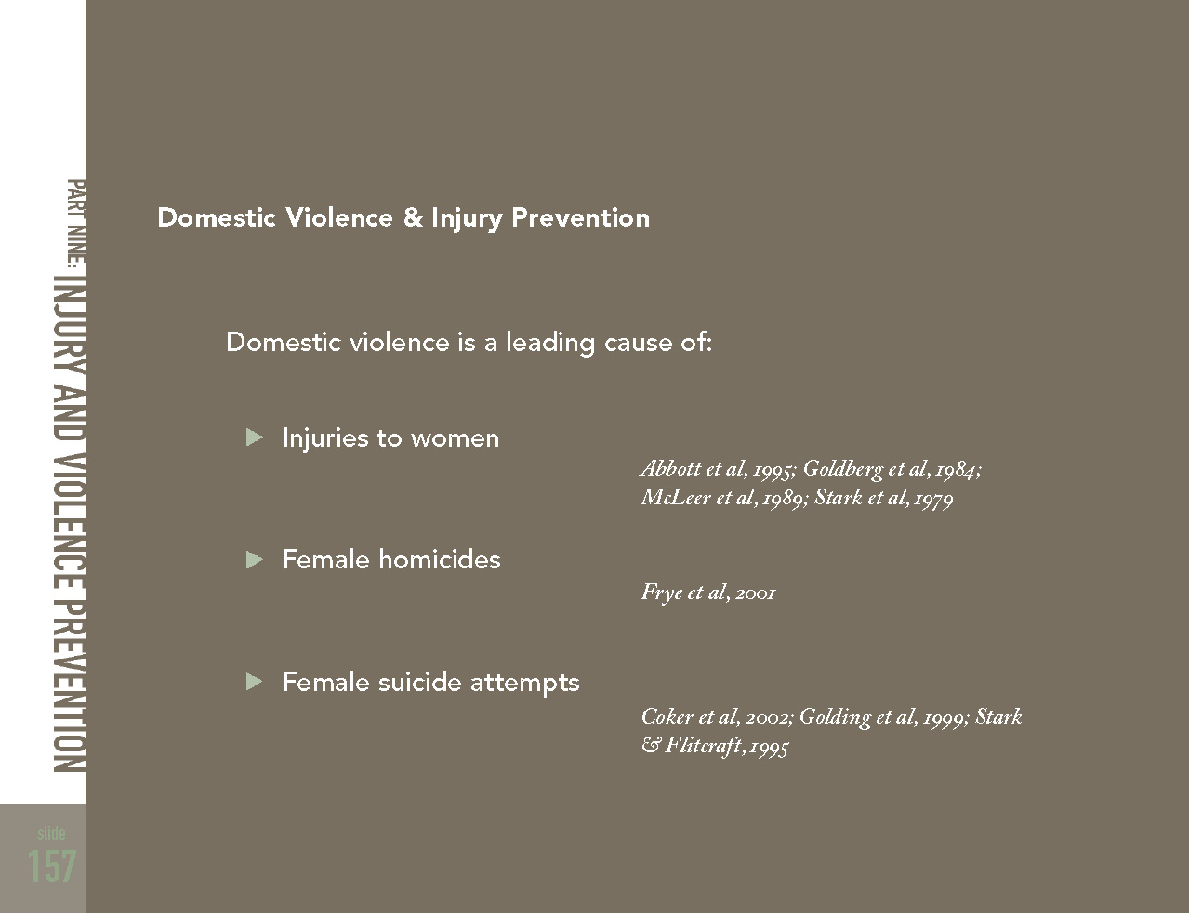

Slide 13
What is not true . . .
Top 4 Myths

Slide 14
Myth #1: Love and Violence Cannot Exist Together in a Relationship.
Fact: The Relationship Between an Abuser and a Victim Can Be Confusing. Many Batterers Act in Loving, Caring Ways Some of the Time. Victims May Love the Batterer and Want the Battering to Stop.
Over Time, However, the Loving Periods May Lessen or Change.

Slide 15
Myth #2: He Will Change When We Get Married.
Fact: Many Believe a Marriage License Will Change Him. The Abusive Behavior Is Deeply Rooted and Takes Years of Treatment to Change, a License Won’t Do It. The abuser may see the License as his Title to Property. He Sees It As a Paper Showing His Legal Right to Ownership.
The Physical Abuse May Begin at This Point After a Dating Relationship of Verbal and Emotional Abuse.

Slide 16
Myth #3: Stress, Drugs, or Alcohol Cause the Violence
Fact: Stress, Drugs, and Alcohol May Contribute to an Episode of Domestic or Dating Violence, but They Are Not the Cause. Stress, Drugs, and Alcohol Are Frequently Used As Excuses for the Violence by the Batterer and the Survivor.
The Responsibility for the Abuse Belongs to the Batterer.

Slide 17
Myth #4: Women Are at Great Risk of Being Assaulted by a Stranger.
Fact: Studies in the United States and Abroad Indicate That Women Are at Far Greater Risk of Being Assaulted by Men They Know Than by Strangers.
Most Violence Is Not Happening in the Shadows and Dark Alleys. Dating Partners Are More Dangerous Than Strangers.

Slide 18

So, who are the abusers and who are the victims?
(3)

Slide 19
Abusers are . . .
Politicians
Lawyers
Judges
Doctors
Athletes
Movie stars
Truck drivers
Teachers
Student body presidents
Police officers
Come from all races, religions, sexual orientations, education levels, and social groups.
Can be male or female
Can be adolescent to elderly

Slide 20

The Boogie Man Trap
Don’t Fall Into the Trap of Believing That Abusers All Look “Scary.”
Like the Villain in the Movies.

Slide 21
Victims are Survivors, who are …
Politicians
Lawyers
Judges
Doctors
Athletes
Movie stars
Truck drivers
Teachers
Student body presidents
Police officers
From all races, religions, social groups, educational levels, and sexual orientations.
Male or female
Adolescent to elderly
No specific personality traits, Any level of physical ability

Slide 22

The Victim . . .
Same Trap As With Abusers.
Survivors of Violence Do Not All Wear a Scarf Over Their Head and Dark Sunglasses.

Slide 23
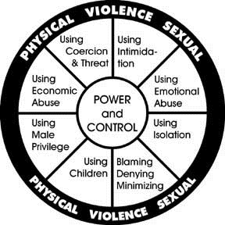
Abuse comes in many forms:
(5)
Notes:
Using Intimidation
Making you afraid by using looks, actions, or gestures.
Smashing things. Destroying property.
Abusing pets.
Displaying weapons.
Using Emotional Abuse
Putting you down.
Making you feel bad about yourself.
Calling you names. Making you feel guilty.
Making you think you are crazy.
Playing mind games.
Humiliating you.
Using Isolation
Controlling what you do, whom you see and talk to, what you read, and where you go. Limiting your outside involvement.
Using jealousy to justify actions.
Denying, Blaming, Minimizing
Making light of the abuse and not taking your concerns about it seriously.
Saying the abuse didn't happen Shifting responsibility for abusive behavior to other people or circumstances.
Saying you caused the abuse.
Using Children
Making you feel guilty about the children.
Using the children to relay messages. Using visitation to harass you.
Threatening to take the children away
Using Male Privilege
Making all the big decisions.
Acting like "Master of the Castle". Being the one to define men's and women's roles.
Treating you like a servant.
Using Economic Abuse
Preventing you from getting or keeping a job.
Making you ask for money.
Giving you an allowance. Taking your money.
Not letting you know about or have access to family income.
Using Coercion and Threats
Making and/or carrying out threats to do something to hurt you.
Threatening to "out" you. Threatening to leave you, to commit suicide, to report you to Welfare authorities.
Making you do illegal things.

Slide 24
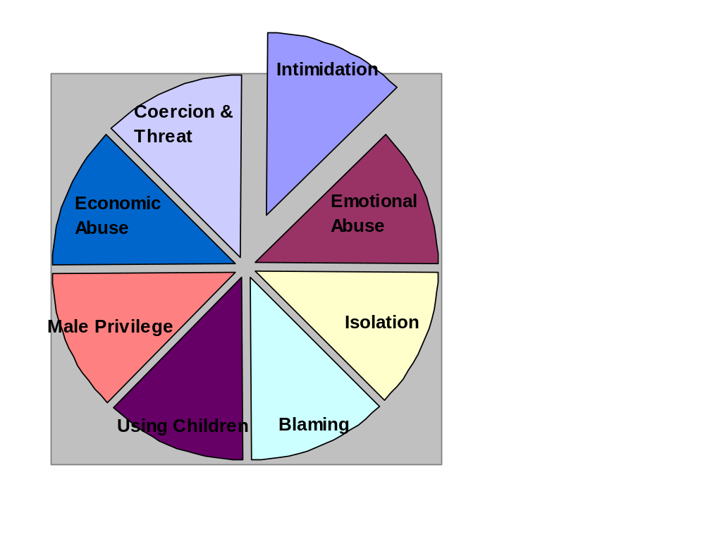
Intimidation
Reckless driving.
Kicking.
Destruction of her property.
Shouting.
Looks and gestures.
Threats to get her in trouble.
Abuse pets and tell her this could be her.
He is teaching her the power he has over her and his ability to control her.

Slide 25
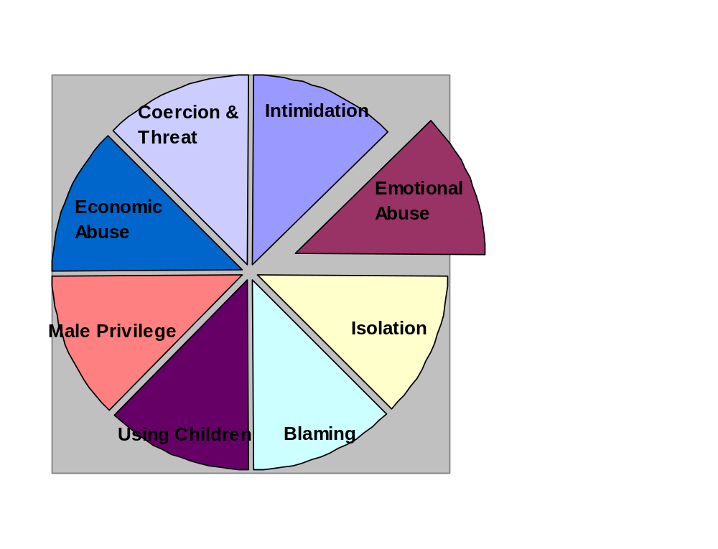
Emotional and Verbal Abuse
Abusers who brainwash their intimate partners use methods similar to those of prison guards who recognize that physical control is never easily accomplished without the cooperation of the prisoner.
These methods form the
core of emotional abuse.
Notes:
Use examples here
take examples from participants

Slide 26
Example
36 year old overweight married female in for annual exam states she does not need birth control
Her Husband sleeps in a different room because tells her he “ hates fat people”

Slide 27
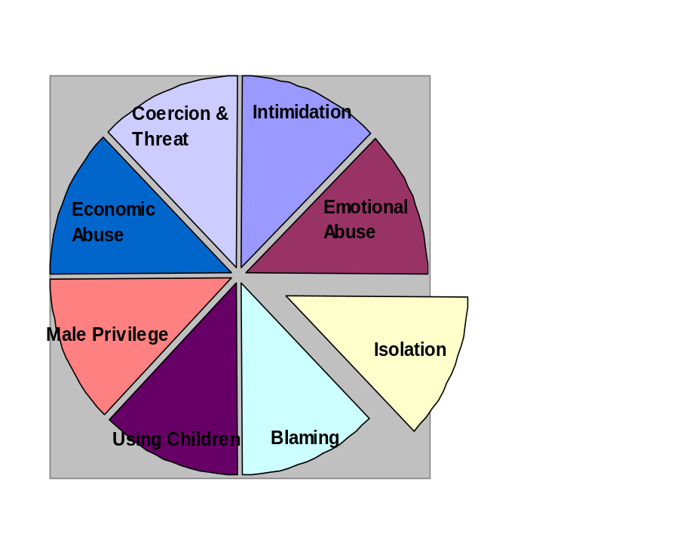
Isolation
Tells her she needs to chose between him and her family/friends.
Pressures her to quit work, school or extra-curricular activities.
Pressures her to not go to college or to a college of his choice.
Disrupts family and other social functions to prevent a future invitation.
Denies her access to a vehicle or disables her vehicle.

Slide 28
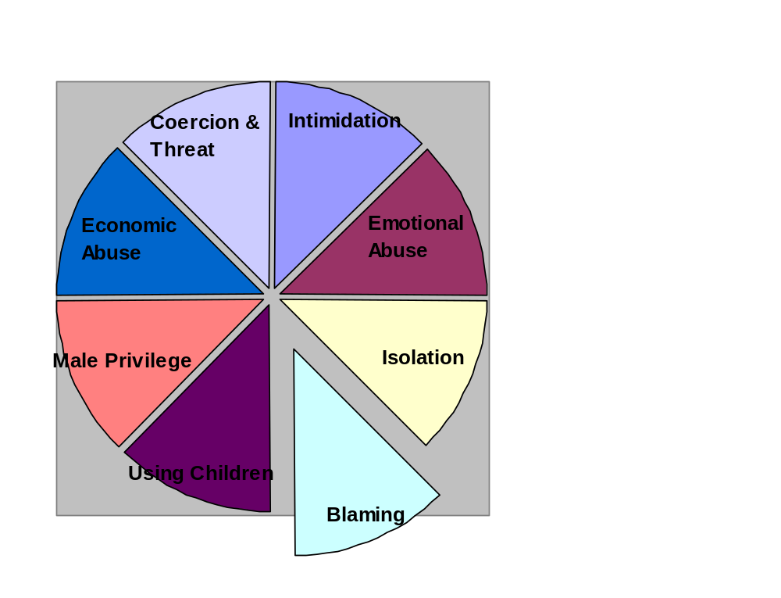
Blaming, Denying, Minimizing
If you would only . . . Then I would not hurt you.
It wasn’t that bad a beating
I never hurt you
It could have been worse

Slide 29
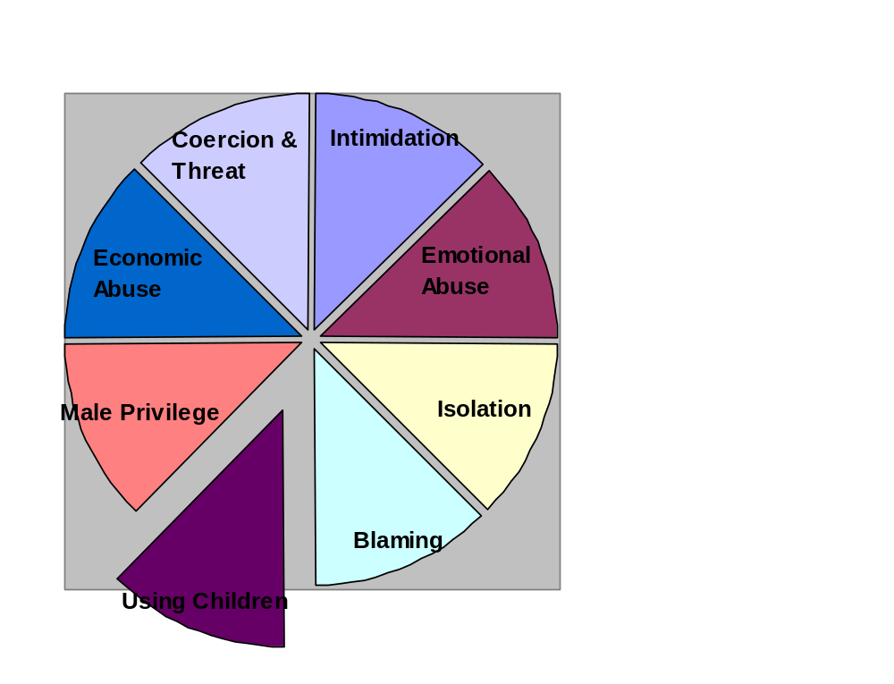
Using Children
forcing children to engage in abuse of the victim
physical and sexual abuse of children
As hostages
using children as spies
custody fights
The kids need a father

Slide 30
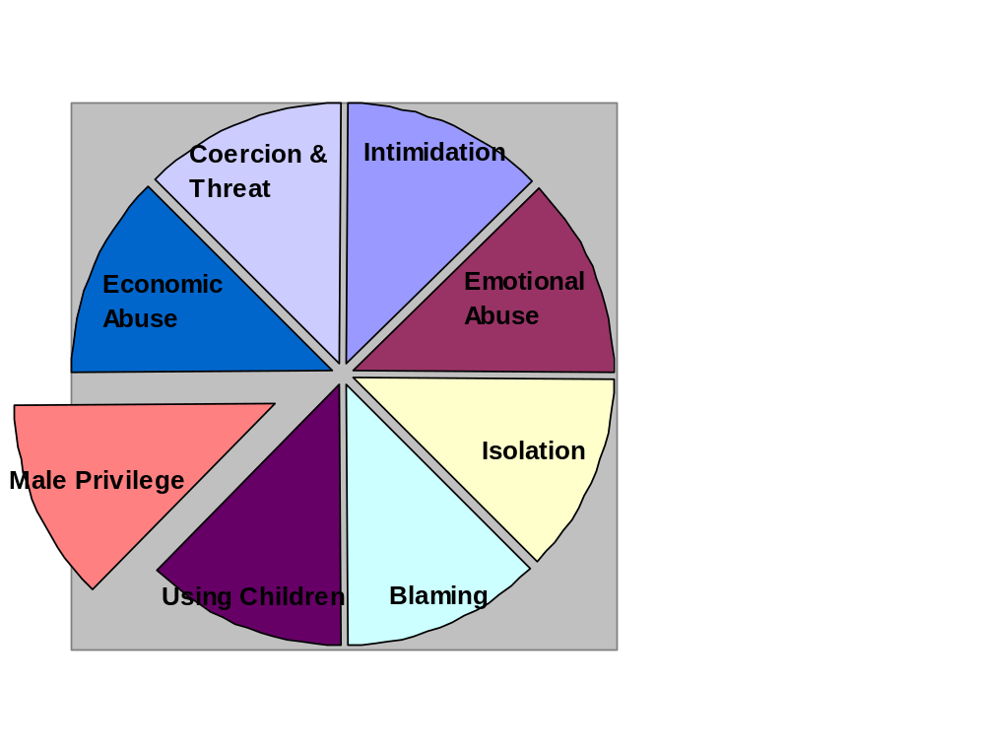
Patriarchal Society and Historical View of Women
It Will Certainly Not Come As a Surprise to Most People, but Society, the Patriarchal Society That Has Existed Throughout History Has Given Men Social Permission to Control Women and Children.

Slide 31
Using Male Privilege
He acts like “he is the boss.”
He acts like she is a slave for him.
He acts like the “master” of his castle.
She must ask him for and to do anything.
He is teaching her about his power and control.

Slide 32
An Abuser’s Suicide Note
“I don’t want to live without you. You and (daughter) are my most precious possessions”

Slide 33
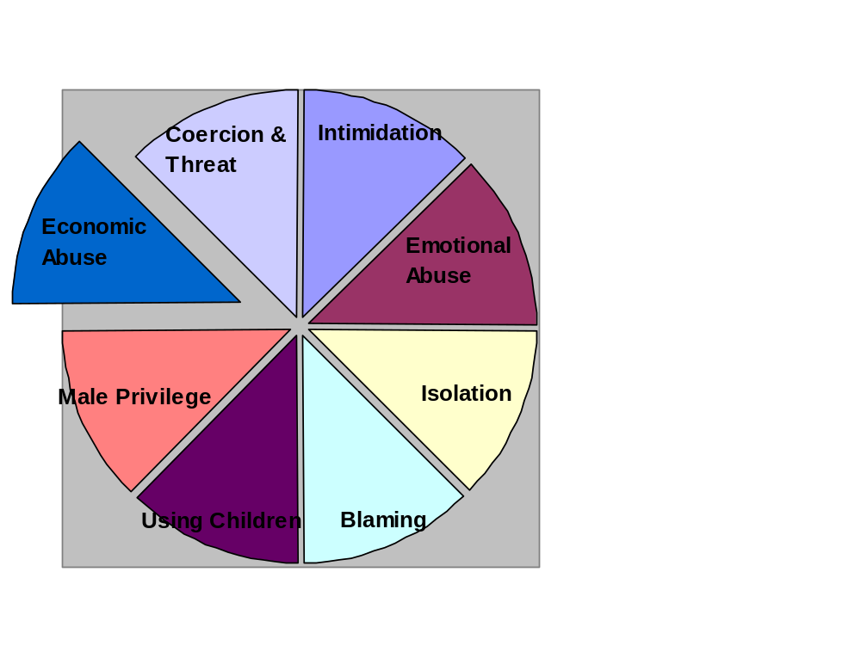
Financial Abuse
Controlling and manipulating you by threatening your economic status and basic needs.

Slide 34
Financial Abuse
24 year old female violent relationship for 10 years
Quit school at 16 to stay home with second child
Wants to leave, unable to find employment with no experience
Abuser states he will quit work in order not to provide child support if she leaves

Slide 35
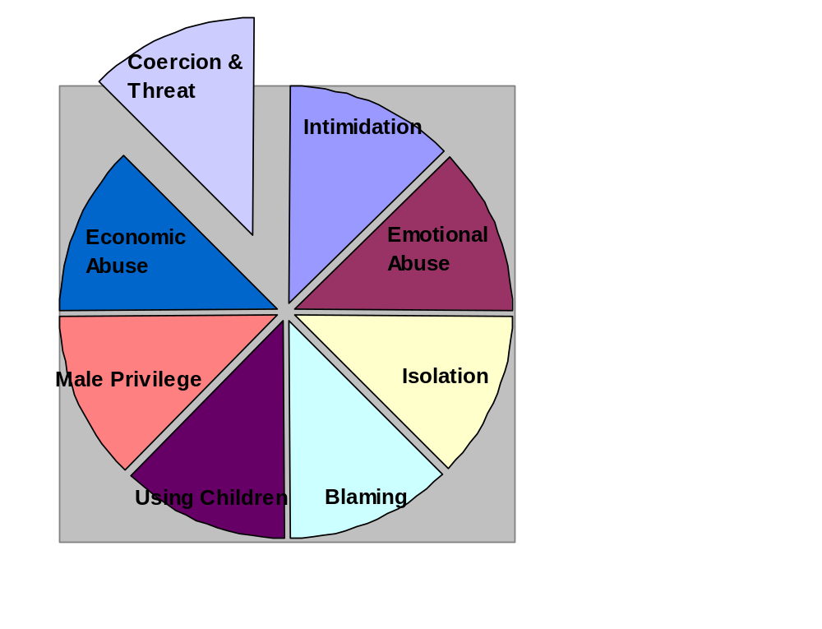
Threats
Harm her or her family.
Commit suicide.
Share private information.
Break up with her.
Take or destroy property.

Slide 36
He Uses Threats To:
Keep her from calling the police.
Keep her from telling her family.
Force her to participate in illegal activities.
Control what she does, who she sees and how she acts.
Embarrass her publicly.
Tell people what a horrible mother she is.
Rape her.
Teach her about the power and control he has over her.

Slide 37

Violence is an effective means of gaining and maintaining control
  War
  Training animals
  Slavery
Physical Sexual Violence

Slide 38
Physical
  any acts which may harm a body.
    Kicking
    punching
    shoving
    slapping
    pushing
    choking
    burning

Slide 39
Example
31 year old female present to clinic with c burns to the left for arm – appear to be cigarette burns
Review of records reveal past broken ribs, suturing to lower lip and rupture tympanic membrane

Slide 40
Sexual Abuse
vulgar names
forced or pressured sexual acts
rape

Slide 41
Example
52 year old female reports 25 years of forced sexual intercourse with her husband

Slide 42
What are the Forces that make Victims stay in Abusive Situations?
Victims are frequently
blamed for being victims.
(5)

Slide 43
So, why would someone stay??
People stay in abusive relationships for many different reasons. It is not a simple situation and no one should judge someone who decides to stay.

Slide 44
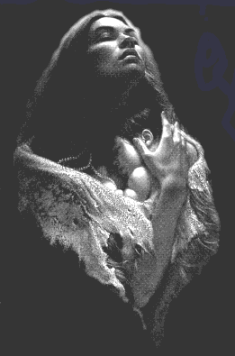
Emotional reasons:
Fear
Low self-esteem
Experienced abuse as a child and doesn’t know anything else
Feel isolated
Shame or embarrassment
LOVE
Depression
Guilt
A desire to make it better
Hope and dreams of a certain way of life
Children

Slide 45

Economic Reasons:
Unemployment
Lack of education
Home belongs to partner
Money controlled by partner
Children

Slide 46
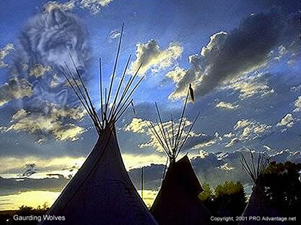
Social reasons:
Cultural issues
Community's response
Isolation from community
Lack of information and resources
Lack of support from friend, family and/or community
Religious beliefs
Family beliefs
Inadequate response from the police or court system

Slide 47
Special Issues For
Teens in Violent Relationships
Lack of Experience
Might think it’s normal
May be involved with Drugs and Alcohol
Peer Pressure
Jealousy and Possessiveness thought to be a sign of love
Status
Isolation
Heavily influenced by the media/role models
Stalking - on the campus

Slide 48

Impact on Society
Unaddressed,
Domestic Violence is Costly

Slide 49
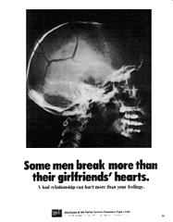
The Effects of Violence
Personal Health
Public Health
Economic Health
Violence Has an Impact on All of Us.

