Slide 1



Understanding Personal Preparedness Motivators & Barriers
Insights from Ad Council Research for the Ready Campaign
National Citizens Corps Council Meeting
June 1, 2006

Slide 2
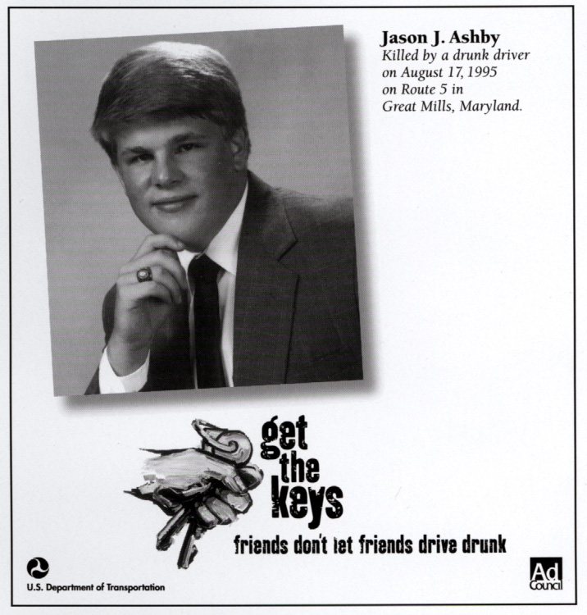




The Advertising Council
Mission: To identify a select number of significant public issues and stimulate action on those issues through communications programs that make a measurable difference in our society.
For more than 60 years, the Ad Council has created memorable campaigns that increase awareness and inspire social change.
  “Loose Lips Sink Ships”
  “Only You Can Prevent Wildfires”
  “A Mind is a Terrible Thing to Waste”
  “Together We Can Take a Bite Out of Crime”
  “Friends Don’t Let Friends Drive Drunk”

Slide 3
The Ready Campaign
Objective
To empower and educate Americans to prepare for and respond to emergencies, including natural disasters and terrorist attacks
  Get a kit
  Make a plan
  Be informed
The PSA campaign initially launched in spring 2003.
To date, we have launched several rounds of communications, across a variety of media and a variety of target audiences
  Ready America (General Market)
  Listo (Hispanic Market)
  Ready Business (Small- to medium-sized businesses)
  Ready Kids (Kids)
Notes:
The objective of this PSA campaign is much the same of other organizations represented in this room.
In addition to helping to produce the PSAs with our pro bono advertising agency (BBDO), we also assisted in the development of fulfillment vehicles – the website and toll-free number
Will focus on the general market effort in this talk.
Launch presidential PSAs shortly
Will launch the BBDO campaign XXXX

Slide 4
Donated Media Results
2003-2006 Donated Media Support Valued At:
$532 Million
Television
Radio
Print (Newspaper & Magazine)
Web
Out-of-Home (Billboards & Posters)
Alternative (e.g., Yellow Pages)
Notes:
Strong level of support
Typically one of the Ad Council’s top performers

Slide 5
Consumer Response, 2003-Present
Ready.gov
23 million unique visitors
1.9 billion hits
1-800-BE-READY
256,000 calls
Brochures
5.5 million brochures have been requested/downloaded
Notes:
PSA was a key driver to Ready.gov, though of course not the only driver
Activity goes up after disasters (Katrina) and warnings

Slide 6
Ready Campaign Tracking Survey
July 2005
One-fifth of all adults (20%) recall seeing or hearing a Ready PSA from the latest round of the campaign
Those with recall of the advertising were also significantly more likely to say they:
  Have created a family emergency plan
  Strongly agree that taking some simple steps beforehand can do a lot to protect me/my family in the event of an emergency
Notes:
Representative, Random Digit Dial Telephone Survey of the general public, adults 18+
Chicken and egg – Ad recall vs. desired attitudes/behaviors

Slide 7
Ready Campaign Tracking Survey
Self-reported preparedness behaviors (Terrorism-specific):
 | Benchmark Feb 2003 | Wave 2 Feb 2004 | Wave 3 Sept 2004 | Wave 4 July 2005
% responding | A | B | C | D
Stocked emergency supplies at your home in preparation for the possibility of a terrorist attack | 26 | 33 | 36 A | 33
Created an emergency plan so that everyone in your family will know what to do in the event of a terrorist attack | 15 | 19 | 24 AB | 20
Visited a website or called a toll-free number for information about what you can do in the event of a terrorist attack | 5 | 10 | 16 ABD | 10
A/B/C/D – Statistically significant difference at the 90% level.
Notes:
Different surveys report very different results, based on question wording, the survey’s sample, and whether questions are about all-hazards vs. terrorism specific
Slow but steady gains until the last wave

Slide 8
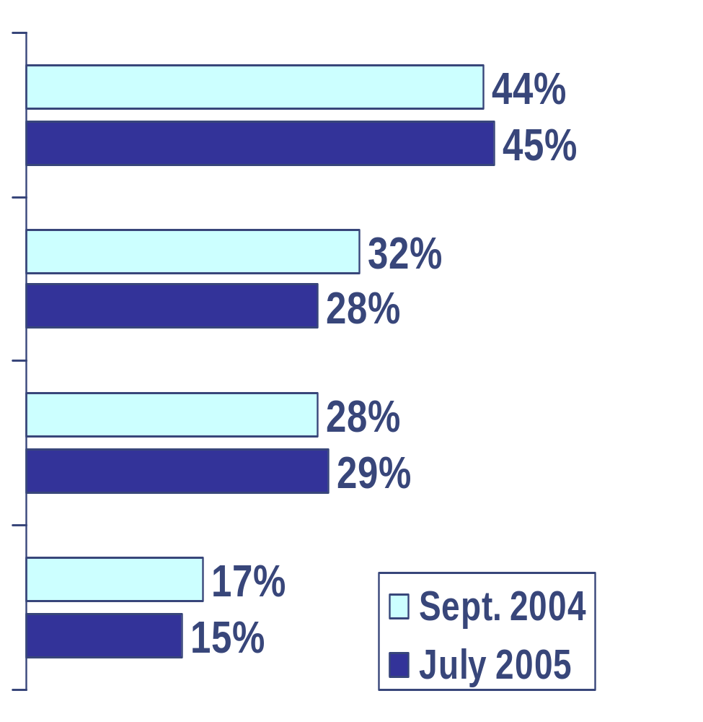
Ready Campaign Tracking Survey
Self-reported preparedness behaviors (All-Hazards):
Put together disaster or emergency kit that contains three-day supply of food & water, first aid kit w/your family’s prescription medications, battery powered radio, flashlight & extra batteries
Created a family emergency plan, including a place where your family would meet if your neighborhood were evacuated, and emergency contact information including at least one out-of-town contact
Searched for information about what you can do to prepare for a catastrophic disaster
Joined or volunteered with a local community watch or preparedness group such as the Citizens Corps or a neighborhood watch
Notes:
As our mandate changed to encompass all-hazards, we added other questions
Showed no change
Remarkably, even in surveys conducted by my colleagues on the panel, we did not see a jump in these types of behaviors in surveys immediately following Katrina and Rita

Slide 9
Barriers to Action
Apathy
“It won’t happen here.”
“I won’t be affected.”
“I won’t worry about this until a threat is imminent.”
Fatalism
“Whatever I do won’t make a difference in the event of a big disaster.”
COMPLACENCY
Not on my radar
“I just haven’t thought about it.”
Avoidance
“I don’t like to think about it.”
Lack of information
“I don’t know how to do this.”
Lack of resources
“I don’t have the money/time.”
“I’m unable to do this.”
Notes:
Review of quantitative research and risk-preparedness literature
Conducted Qualitative Research – Focus groups, in-home interviews in places as diverse as NYC, LA, Cincinnati
Quantitative concept testing

Slide 10
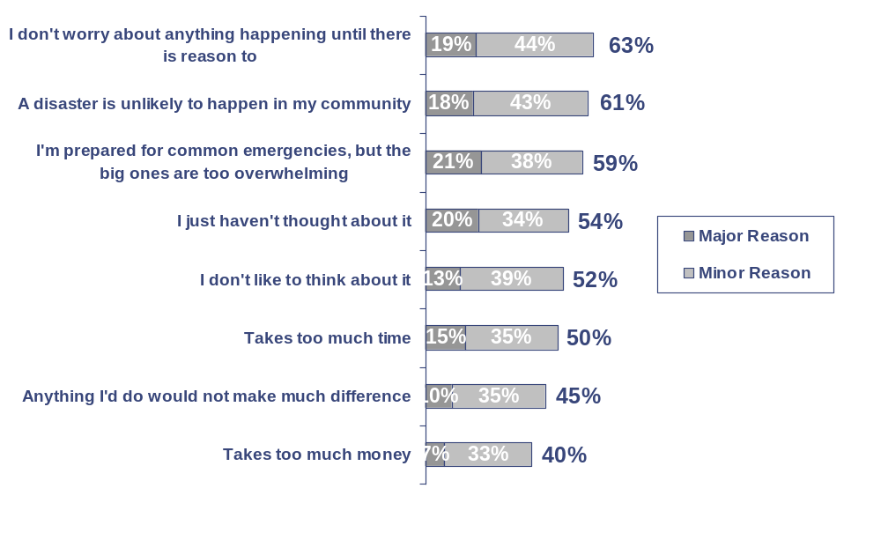
Barriers to Action
Here some reasons that people often give for not doing things to prepare for an emergency situation. Thinking about yourself, please tell me whether each of the following is a MAJOR reason you have not done more, a MINOR reason, or not really a reason.
Notes:
Online survey of 500 adults nationwide
Part of concept test

Slide 11
Public Service Advertising Considerations
Message clutter
Media fragmentation
The need to be single-minded and clear
Logic vs. Emotion
Ineffectiveness of scare tactics

Slide 12
Motivators
Focus on personal responsibility
  You are your family’s first line of defense
Focus on family
  “Low hanging fruit” = Parents, particularly moms
Clear and simple call to action (“Make a plan”)
Provide a solution (Ready.gov)
Tonality: Positive, relatable, straightforward
Provocative, not scary
Notes:
Sources:
Qualitative Research
Quantitative concept test
Ad Council experience with social marketing

Slide 13
Ready Campaign Strategy
Point A
What types of emergencies are we talking about?
Fire (at home or in nature), hurricane, flood, severe weather, earthquake, terrorist attack.
How will we grow this idea?
Previous efforts have focused on terrorism, but this year will about being ready for any emergency, “big” or “small.”
Where will this growth come from?
Parents who are willing to take preparedness steps but have not done so and don’t know where to begin.
What do they do today?
Although they acknowledge they should be prepared in case an emergency strikes, they do not begin to prepare unless a threat is imminent.
Point B
What do we want the target audience to think/feel?
I am the first line of defense for my family. I need to sit down with my family so we can create an emergency plan together. I can find details at Ready.gov.
What will be the promise to fulfill the unmet need and take the target from Point A to B?
Taking the time to talk about specific steps that you and your family can take will give you the comfort that you and those you love will know what to do if any kind of emergency occurs.
What is the brand personality?
Empowering. Relatable. Straightforward.

