Slide 1
Test of the high voltage strength of Pelletron’s gas insulation
(18-Dec-2008)
Recycler Meeting
January 21, 2009
A. Shemyakin

Slide 2
Introduction
By now, we are almost certain that SF6 gas in the Pelletron tank is heavily contaminated by air (up to 40%).
  Cost of replacement by a pure SF6 is ~100 k$
The Pelletron performance can be affected by the contamination in several ways
  Increased frequency of equipment failures due to a high oxygen content
    A serious concern; however, there were no failures in the last 2 months
    Replacing today’s gas by a SF6 + N2 mixture would be a solution
  Possible changes in cooling efficiency of elements inside the tank
    Data logger data do not show any measurable changes
  Changes in HV electric insulation properties of the gas
    Subject of the test
Question for the test to answer:
  How close is the operational voltage to the HV limit in the gas?

Slide 3
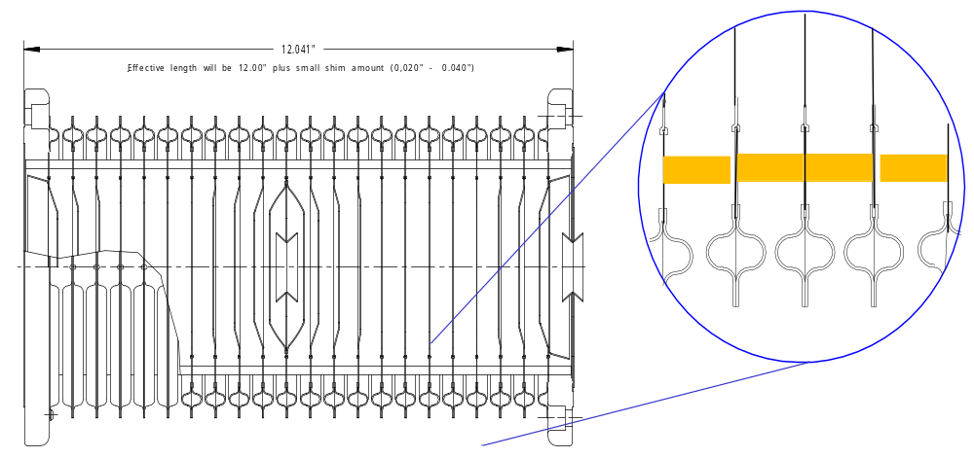
Two types of HV limitation in the Pelletron
Emission and finally a discharge in vacuum
  The main limit in operation
  Much worse with the beam in the tube
    Back in 2004, it was the reason to increase the total length of acceleration tubes
  Always accompanied by a burst in the vacuum pressure
  Should not significantly depend on properties of the outside gas
Discharge on the gas side
  Before the test, there was only one instance of gas –side discharge in this Pelletron
    The first day of HV operation in WB, in air
  Strongly depends on the gas type and pressure
In operation, the HV strength in the gas should always exceed the one in vacuum.
Section of acceleration tube.

Slide 4
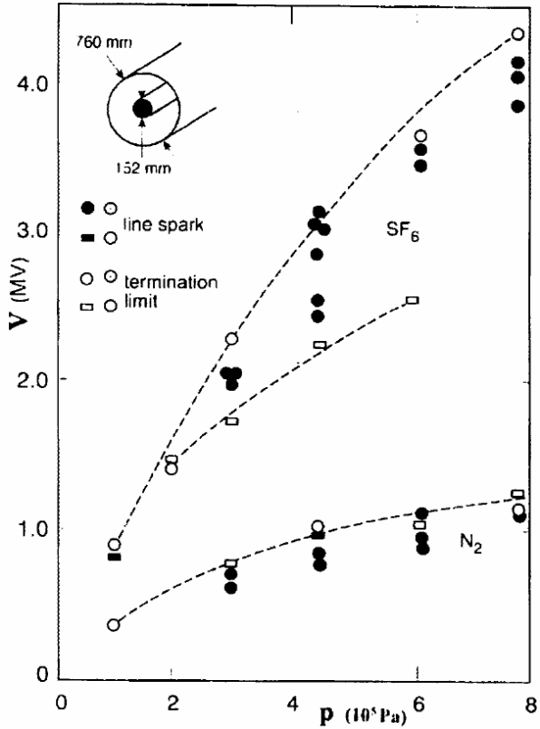
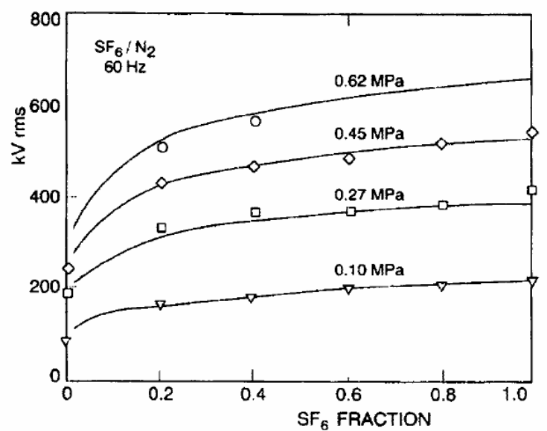
SF6 as an insulation gas
230kV/cm
6%
Conversion:
  1 atm = 14.7 psi
  73.5 psig = 6 atm abs
Just straight line
60 Hz AC breakdown voltage for SF6/N2 mixture.
DC breakdown voltage.
From IEE Trans.on Dielectric and Electric Insulation, V2 N5 (1995), p.977
Range where the test was done
Two types of SF6 applications
  Arc quenching in breakers
    needs pure SF6
  HV insulation
    While pressurized, most of effect is reached by adding a small portion of SF6 to N2

Slide 5
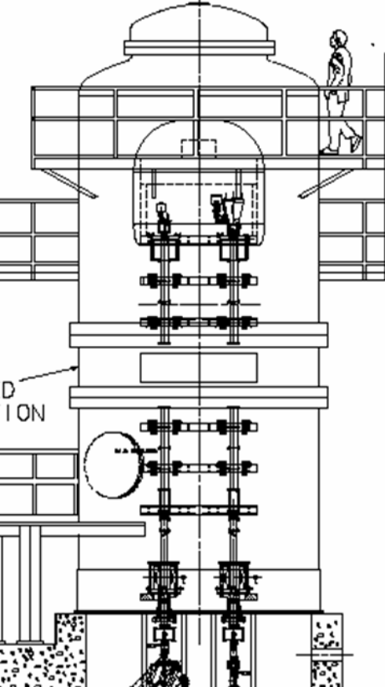
Motivation for the HV test
Because dependence on N2 contamination is weak, one may hope that operation with 60% of SF6 in the mixture is OK
Still, it’s better to make sure by a direct measurement
Usually, such measurements are done by conditioning and observing full discharges until the breakdown level is reproducible
  We prefer to have the gas strength is ~twice above the HV strength on the vacuum side
    To protect the tubes during discharges in vacuum
  Also, we are afraid of breaking the equipment in the Pelletron in the time of discharges
The idea of the HV test
  Look at the lost current as a precursor of a full discharge
  Make measurements at several values of the gas pressure to interpolate toward the nominal one
R1
R2
R2/R1= e; R1 = 1m; E_{term}= U_{term}/R1;
For U_{term}= 5 MV
E_{term}= 50 kV/cm

Slide 6
Lost current
Lost current from terminal
The current lost from the terminal can be calculated from the balance of currents in the Pelletron column
  R:LOSTI = Chain current -(Current through all resistive dividers + Needle current)
    Works only for a steady state
If the terminal voltage changes, the R:LOSTI reading needs to be corrected
  If changes are not fast (several sec),
    R_{term}*C_{term} ~15 sec
    R1*C1~ 1 sec
Terminal-to-tank capacitance
Needle current
R1
C1
Chain current
Corona current through the last gaps
Resistive divider current (3)

Slide 7
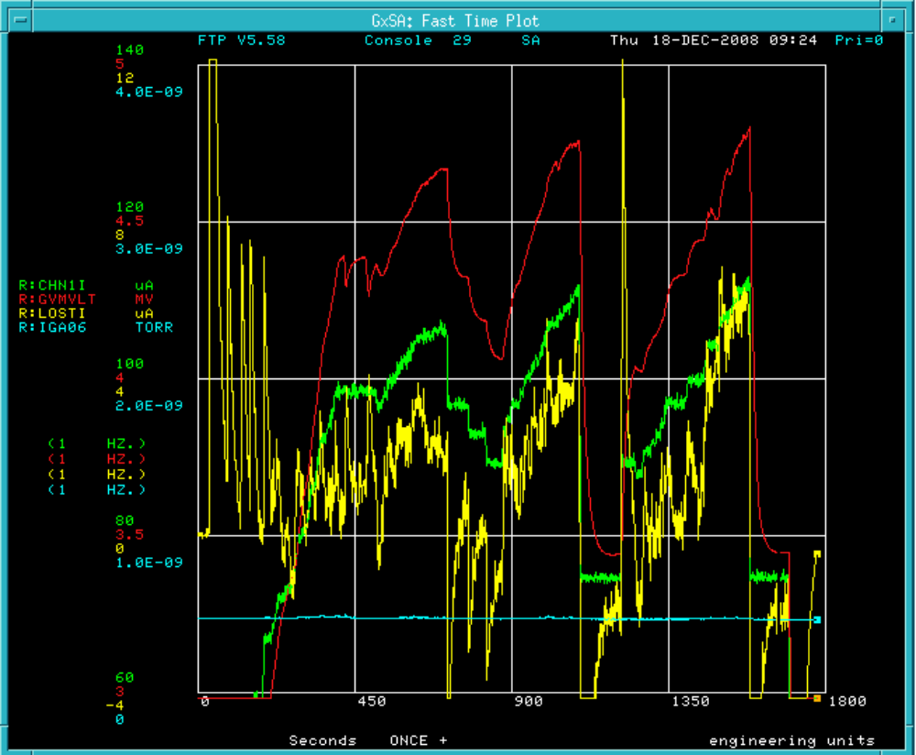
Typical measurement
HV (R:GVMVLT), 0.5MV/div
Chain current (R:CHN1I), 20microA/div
Lost current (R:LOSTI), 4microA/div
Pressure (R:IGA06), 1.E-09/div
0
Here the lost current never comes to its minimum steady state level.
30 min
HV test at 50.2 psig.
Large peaks of R:LOSTI correspond to fast increasing of HV. Also, it has ~ -2 microA offset.

Slide 8
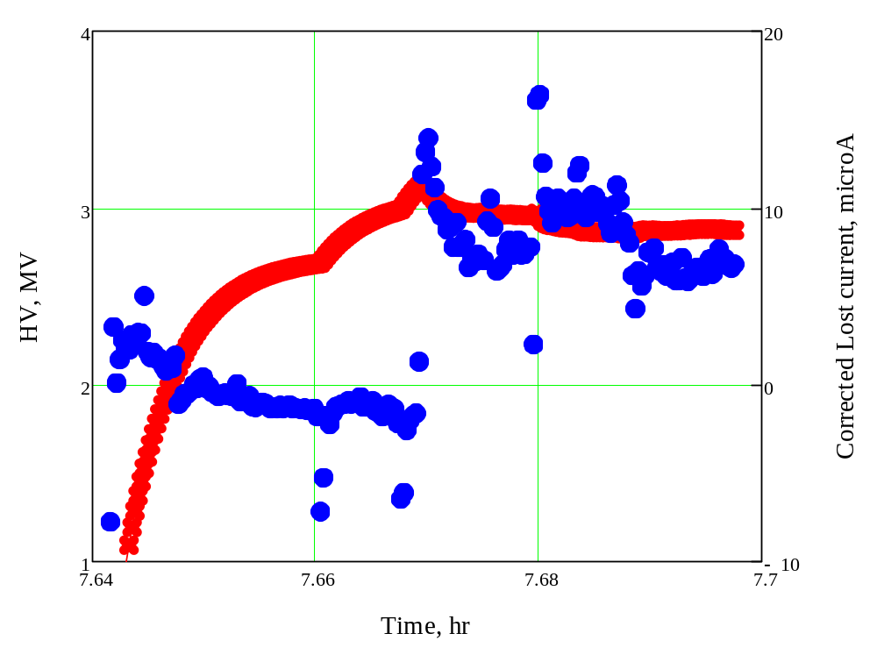
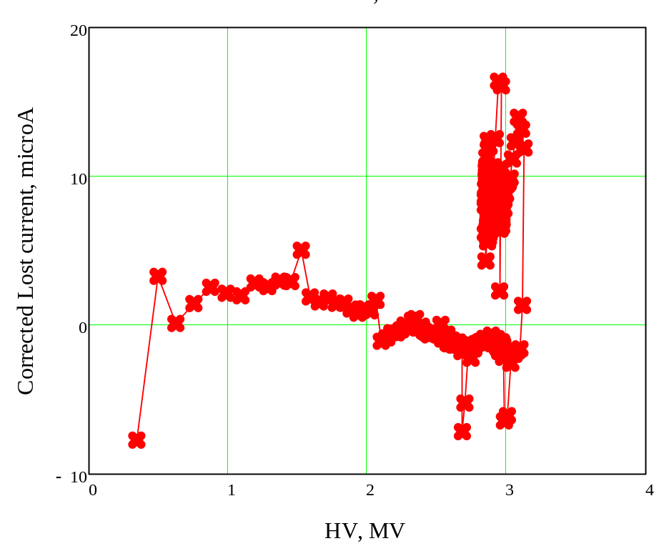
Corrected Lost current
Example of data with Lost current corrected with the HV time derivative
  The first voltage increase at 60.2 psig
    Later HV was increased up to 4.9 MV, so the dust redistribution is probably significant
  For this measurement, the point of the Lost current jump is taken as the “limitation”

Slide 9
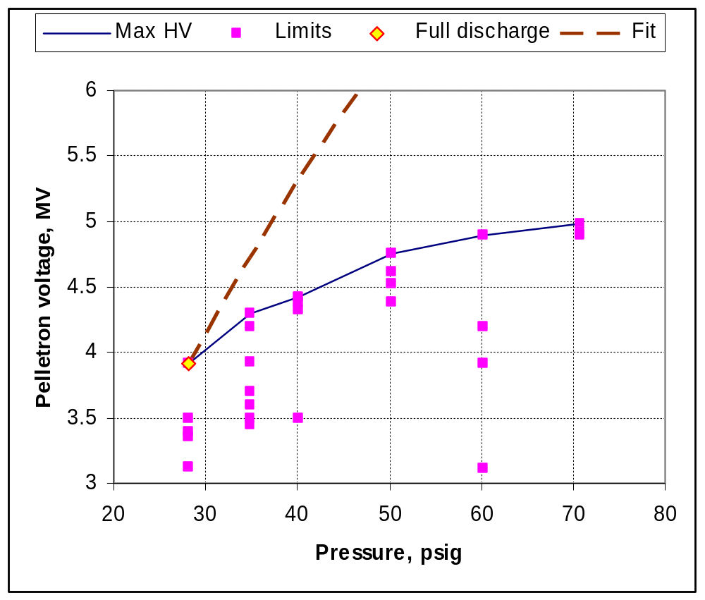
Results
“Limitation” points were determined typically by “noticeable” changes in the lost current
Maximum voltage
  At 70 and 60 psig, HV was eventually limited by vacuum activity
  At 28 psig, HV was increased up to a full discharge
  For other pressure values, the rise of the lost current was too scary
Vacuum limit
HV limitations at various gas pressure in the Pelletron tank. Blue line indicates maximum observed voltage at the given pressure. Brown dashed line is a rough extrapolation from the point with a full discharge based on the data for pure SF6 from Slide 4. It promises a safety factor of 1.9 at nominal pressure.

Slide 10
Summary
There is a good safety factor in the HV strength of gas insulation in the Pelletron
  Most likely, the strength is close to its design value, and the gas contamination does not have a dramatic impact on HV performance of the Pelletron
From the point of view of HV strength, replacing the gas by a pure SF6 is not needed
  Judging by this measurement and by the publish data, adding small amount SF6 or N2 into the tank in a case of a leak should have a similar effect
The procedure used in the test for determining the limiting voltage with the lost is not reliable enough to be used in a quantitative scaling
After each gas manipulation, the lost current first appeared at a significantly lower voltage than it eventually did after several voltage increases. Therefore, a necessity of conditioning the gas side after accessing the tank could be related primarily to the gas transfers and to the access itself.

