Slide 1
MCS Systems Group Update &
Computing Environment Directions for (the rest of) 1999
Rémy Evard
systems@mcs.anl.gov
http://www.mcs.anl.gov/systems/
630-252-6813

Slide 2
Topics
Systems Group Issues
Upcoming Significant Changes
Computing Environment Update
Purpose:
  Communication
  Discussion and feedback

Slide 3
The Realities of Systems Administration
Our primary function is to enable science at MCS.
  A few activities are fundable in and of themselves, but most aren’t.
The job market out there is really great.
The pile of work is infinite.
Because there are so many “immediate” problems, it is nearly impossible to make forward progress.
The users hate us.
Happily - not true at MCS.

Slide 4
Our Opinion: MCS is Great
Cool toys.
Plenty of challenges and new problems.
We’re fairly happy with how the infrastructure is developing.
The Systems Group is a good bunch of folks.
MCS people are supportive, friendly, and fun to work with.

Slide 5
The Focus Teeter-totter
Interrupt-driven:
Concentration:
Fixing problems
Emergencies
Questions
Restores
.....
Hardware installs
Software installs
New abilities
New tools
Testing
...
2 TONS
Support mode
Project mode

Slide 6
The Req Flow - a simplified version...
A user sends
a req to “systems”.
The help desk human
either fixes it or assigns it
to someone.
The req owner tries
to solve that problem.
The owner notifies the
user that the req has been
solved.

Slide 7
The Req Flow - identifying problems
A user sends
a req to “systems”.
No owner assigned.
The help desk human
either fixes it or assigns it
to someone.
Mail not sent to systems.
User doesn’t hear back.
The req owner tries
to solve them problem.
The owner notifies the
user that the req has been
solved.
Slow resolution of problem.

Slide 8
Improving the Req Flow
The monthly req buzz.
Make sure someone owns every req:
  The help desk human owns all incoming reqs.
Emphasize the need to respond to the user.
Coming soon:
  Automatic response to let you know your req #.
Coming later:
  Better support for users to check on req status.

Slide 9
Req Statistics
The following charts are data from the last 3+ years of reqs.
Caveats:
  1999 data is, of course, not complete.
  Reqs are often resolved “late” - weeks after the real problem is solved.
  Reqs generally don’t include help desk requests, which have been a serious factor since 1998.
  These do not include SP-related requests.
  None of these numbers indicate actual satisfaction with the resolution.

Slide 10
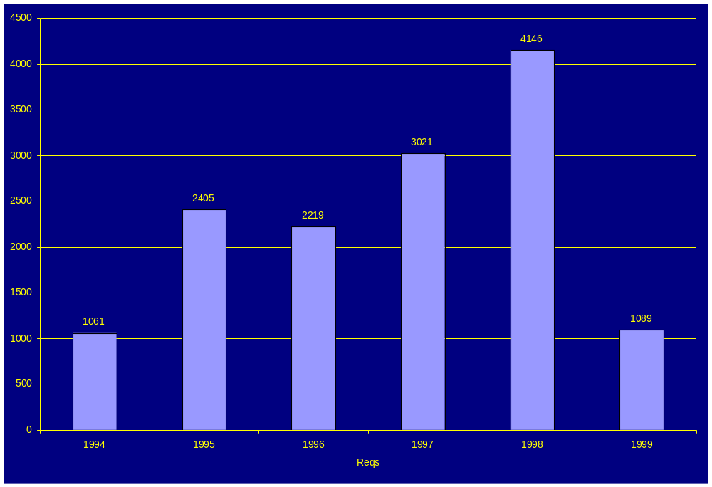
Reqs Per Year

Slide 11
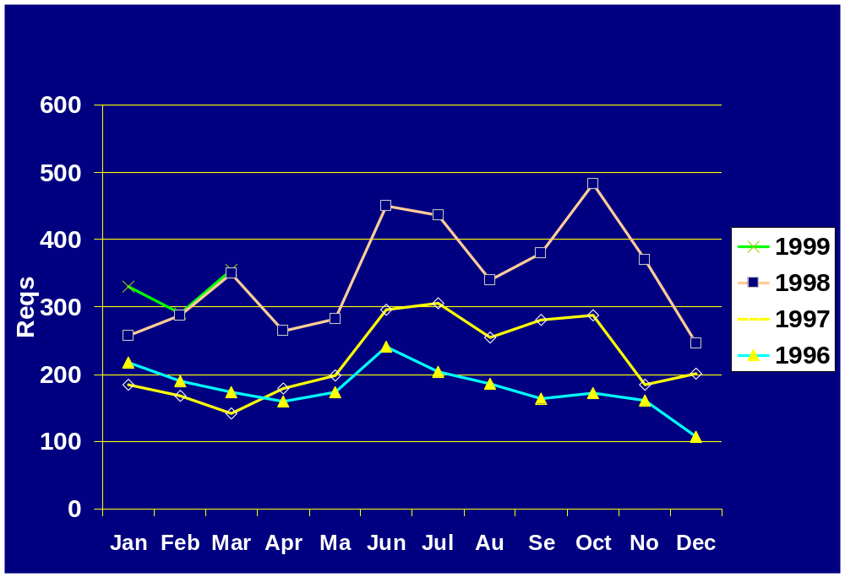
Reqs Per Month

Slide 12
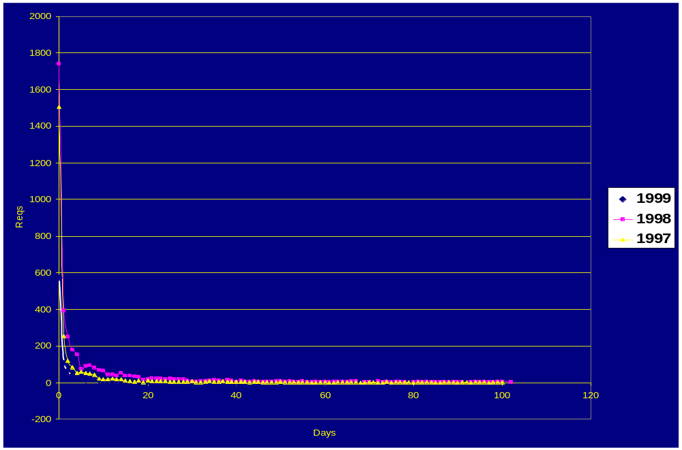
Req Resolution Speed

Slide 13
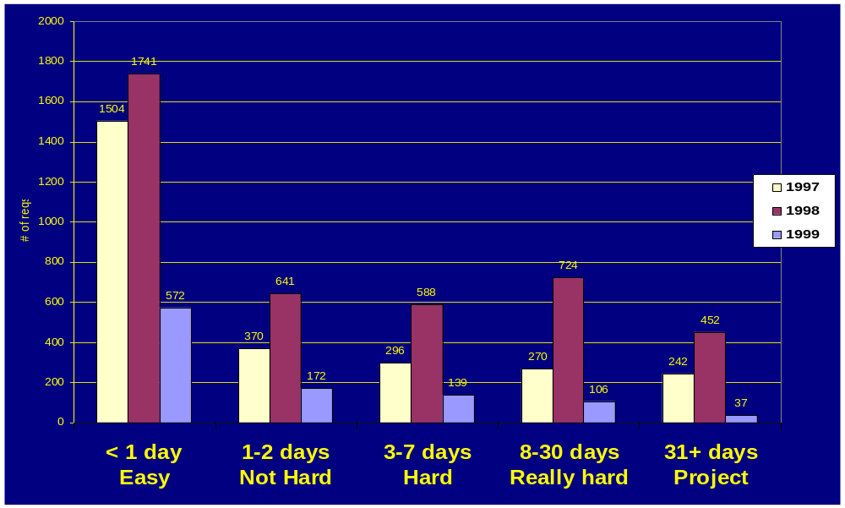
Req Resolution by Category

Slide 14
Observations
The number of reqs just keeps on growing.
Peaks around summer and SCXX.
Each year, the steady state is the level of SCXX the year before.
50% of the reqs are resolved in < 1 day.
More reqs means more difficult reqs.

Slide 15
External Activities
NCSA PACS
  Scheduling & Resource Management
  Storage
  Accounting
SP XXL
Cray/SGI Users Group
Some sysadmin interaction with:
  UofC
  LANL
  ...
Networking
  Cyberbelt
  ESNet
  ...
Usenix LISA NT
  1998 Program Chair
  1998 and 1999 Paper Acceptance

Slide 16
Upcoming Big Events
Eliminating clear-text passwords.
Email system upgrades.
y2k.

Slide 17
Clear Text Password Elimination
The problem:
Motivation to fix:
  Reduce serious security threat to MCS systems.
  Compliance with our collaborators - PACI, NASA, ...
The computer asks:
I type:
login:
password:
evard
2+2!=5
2 + 2 ! = 5
A cracker
can see:

Slide 18
Securing Passwords - Options
1. SSH - Secure Shell
  A secure alternative to telnet and rlogin.
  Widely available.
2. Kerberos, DCE, DFS, ...
3. SecureID cards
4. Firewalls

Slide 19
Securing Passwords - The Fix
1. Use “ssh” instead of rlogin and telnet:
ssh fire.mcs.anl.gov
  All MCS systems have ssh installed. Remote Unix systems are likely to.
  PC client available for your PCs: SecureCRT.
  Worst case, dial in to MCS modems.
2. Use “scp” instead of rcp.
3. Tunnel ftp and POP through ssh:
ssh -L 1234:fire.mcs.anl.gov:21 ssh-server

Slide 20
Securing Passwords - The Schedule
Now:
  ssh available on all systems.
  PC client available.
  FAQ sheet coming out soon.
  You should:
    Switch to using ssh or SecureCRT
    Tunnel POP through SecureCRT.
    Bring up sshd on any red MCS systems you run.
    Install ssh on your home unix system.
June 1st:
  We will disable rlogin, telnet, and ftp for all MCS systems.
  Selected hosts will be enabled.
    Tell us if you want a host on the enabled list.
October 1st:
  All hosts will have rlogin, telnet, and ftp disabled.
    Except the anonymous ftp server.

Slide 21
Mail System - The Problem
Our existing mail architecture can not scale much farther.
  The total number of email messages is increasing.
    Currently around 9000 messages / day.
  The number of email users is increasing.
  Individual email messages are getting larger - attachments.
Simply installing a bigger, faster server doesn’t help.
  NFS file locking problems result in lost messages.
  The current ‘mbox’ format stores mail in a single file for each user.
    This guarantees a bottlenecked server, simply from “new mail” checks.

Slide 22
Mail System - The Solution
Install a new server with substantially more disk space.
Dedicate it to nothing but email.
Switch to a different internal mail format.
Only support mail access using POP and IMAP.
Mail client support:
  MH, Pine, Eudora, Outlook, ...
  Not ‘mail’. Not ‘elm’.
Biff support is a problem.

Slide 23
Mail System - User Issues
Not-so-good things:
  If you use ‘mail’ or ‘elm’, you will need to switch mail readers.
    Try out ‘pine’, which is a lot better than either of those.
  We need to find UNIX ‘biff’ solutions, and those will be different.
Not-so-bad things:
  No real change for MH, Eudora, & Outlook users.
  IMAP will be supported.
    Good for those of you who read email on more than one PC.
  Substantially better support for humongous email messages.
    (Rick.)
  Virtual mail hosting.
  Centralized spam and virus control.

Slide 24
Mail System - The Schedule
Now:
  New server is on order.
  Switch to ‘pine’ if you’re using mail or elm.
  FAQ sheet being built to help users transition.
May:
  Early testing for thrill-seekers.
June:
  Testing for other folks; gradual migration
September:
  Switch the real system over from antares to the new system.
January:
  The old antares gets really confused.

Slide 25
y2k - Threat or Menace?
MCS does not have any operational responsibility, such as power or paychecks. Nor do we run any ancient, custom-built software.
This reduces our y2k problem enormously.
Thus we have three classes of y2k problems:
  Dependence on others who have y2k problems.
  Dependence on vendors of our systems.
  MCS-written code.

Slide 26
y2k Problem - Summary
Physical / External problems
  The electronic door locks break. These are on schedule to be fixed.
  Argonne facilities & systems. Unknown.
  Illinois facilities. Unknown.
Vendor Systems problems
  Older PCs and older Sun4s will break.
    These will all be decommissioned this fall, even if they didn’t have y2k problems.
  Possibly other systems.
    We’re tracking fixes as they get posted.
MCS Code
  Systems utilities (req, for example...)
  Check your own projects.
  ECT has a y2k test facility available.

Slide 27
MCS Computing Environment
UNIX
Workstations & Servers
Windows
Network
Special Projects
Supercomputers
& Storage
Visualization
Home Systems

Slide 28
MCS Computing Environment
UNIX
Workstations & Servers
Windows
200 hosts
SunOS, Solaris, IRIX,
AIX, Linux
110 NT Desktops
60 Laptops
Network
Special Projects
ATM backbone
10/100 ethernet
OC-3/12 external
Supercomputers
Linux clusters,
lab systems
128 cpu Reality M
80+ node IBM SP2
64 node IBM SP1
Visualization
Home Systems
CAVE, Idesks,
Active Mural
… approximately 600 machines.

Slide 29
Networking Update
Wiring:
  Completed downstairs wiring. 
  Continued upstairs wiring. 
Services:
  Multicast works to all new wiring. 
  DHCP is now a production service. 
  Have begun to upgrade wireless.
Architecture:
  Merged the main network into one large, switched net. 
  Substantially more reliable. 
External Link:
  Up to OC-12 (655mbits).

Slide 30
Networking Update - Stats
Host connectivity:
  26 hosts on dedicated100baseT ports
  ?? hosts on 43 shared 100baseT ports
  ?? hosts on 94 shared 10baseT ports, which includes old scary thicknet
  3 OC-12 hosts
  34 OC-3 hosts
Thus, the majority of hosts are still on 10mb ethernet, but this is steadily shifting to 100mb.
For maps and stats:
http://www.mcs.anl.gov/net/equipment.html

Slide 31
Networking Update - Anchor
The Argonne Network Anchor - a collaboration between MCS and ECT to leverage research and production networking in order to increase our external networking capability and opportunity.
Before
Now
World
World
ECT
Anchor
MCS
ECT
MCS
ANL
ANL

Slide 32
Networking Goals - 1999
Complete building wiring project.
Shift off of old, scary thicknet.
100baseT port increase.
Complete the wireless upgrade.
Continue to expand external networking.
Fully implement Anchor and start to take advantage of it.
Improved monitoring.

Slide 33
MCS High Performance Computing
ADSM and HPSS* HSMs
MPI-IO/ADIO
Oracle Database Server
ATM, HIPPI, FC
and Gb-Ethernet
Parallel I/O and HSM Systems
IBM
SP-2
SGI
Origin
PC
Cluster
80 node IBM SP-2
128 node SGI O2K
200 node PC cluster*
1 CAVE
4 ImmersaDesks
1 Display Wall*
Visualization Servers
Desktop Media Servers
Visualization and Interaction Systems

Slide 34
SP - Update
Tested the HPGN and wrote a paper. 
Shifted to using the Maui Scheduler.
Generally quite stable.
Missed goals:
  Double the memory in all nodes.
  Go to 140 nodes.
  Install HPSS, GPFS, latest PSSP, etc.
  Production mode around March.
  Users Group Meeting.

Slide 35
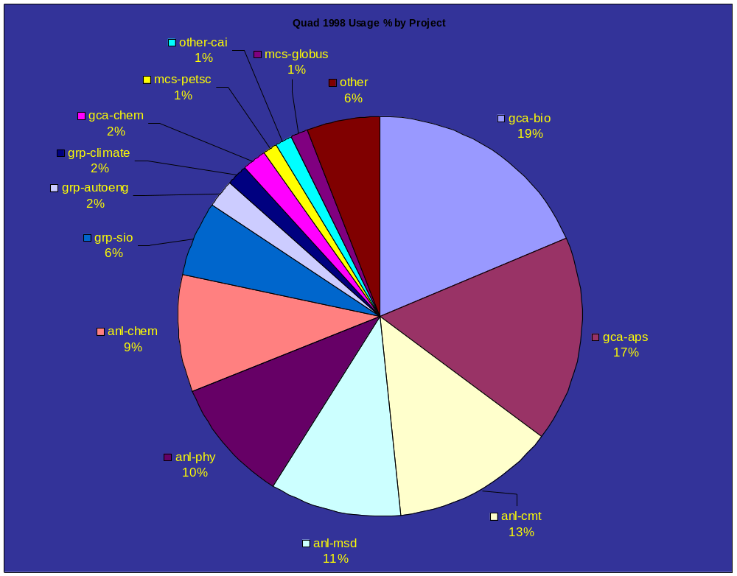
SP Usage By Type - 1998

Slide 36
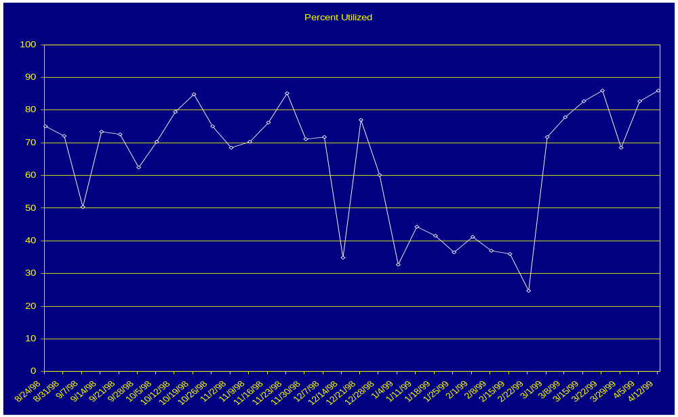
SP Percent Utilization

Slide 37
SP Goals - 1999
It’s really unclear - wait and see.
At the moment:
  No OS upgrade.
  No memory upgrade.
  Continuing to work on HPSS installation.
Expect the old SP to go away:
  Old, unsupported technology.
  Floor space issues.

Slide 38
SGI Origin 2000, err, Reality Monster
Update:
It’s here! It’s pretty cool!
Plans:
Scheduler installed any day now.
Nail down policy. But, certainly:
  More users will be added at that point.
  Users will generally be more closely affiliated with MCS than, say, the current users of the SP.

Slide 39
Chiba City
“Chiba City” is the name for the Big Linux Cluster project.
Plans are fairly fluid at this point, but it’s a major focus of activity.

Slide 40
Visualization - Update
Viz Systems:
  CAVE going to 4 walls 
  New Idesk for Numerical Group 
  New Portadesk 
  Active Mural
Computing Systems:
  Yukon, Tundra, & Denali arrived.
Organization:
  Viz support work is split between the FL and Systems.
  Established the “vizcom” group.
  Realized that to be involved in the viz work in MCS, one needs to be participating in the research activities. Policy issues related to this are still open.

Slide 41
Unix Servers - Update
Servers:
  New Solaris servers:
    fire, ember, soot
  New MOO server.
  Generally more stable.
Critical Tools:
  “cfg” system in regular use.
Missed goals:
  Many other critical tools need serious development work:
    account system, /software tools, .software upgrade
  Servers re-architected for security, reliability.

Slide 42
Unix Servers - Goals 1999
Servers rearchitected:
  Order of magnitude user space storage increase.
  SunOS gone from servers.
  Separate and rebuild functionality of:
    mail, DNS, NIS, central NFS
  Move servers to “hidden” network for security.
More compute servers - Solaris, Linux, IRIX.
Complete some of the critical tools.

Slide 43
Unix Environment - Update
New Platforms:
  Replaced FreeBSD with Linux. 
  Solaris 2.7, IRIX 6.5, linux 2.2, all quite useable. 
New/Upgraded Tools:
  latex, perl, ssh, ...
  More to go.
Issues:
  Solaris software installation is messy. Different systems will have to have different versions of vendor software, like compilers.

Slide 44
Storage - Update
ADSM backup problems.
NFS access to HSM disabled.
ADSM backups stabilized.
We moved all backups to ADSM.
The big RAID fiasco.

Slide 45
Storage - Goals
Solve home directory space problems.
Install HPSS.
Upgrade ADSM hardware to improve response time for backups and restores.

Slide 46
Web Servers - Update
New servers and web pages up. 
Help people migrate over. 
Decommission the old web server. 
Virtual hosting. 
Statistics gathering. 
Search capability. 
Intranet. 
Integrate with Visual Source Safe.

Slide 47
Web Server - 1999 Plans
Server upgrades.
SSL capability.
  Address “authenticated” intranet need.
  Secure code distribution support.
Respond to issues from the MCS community.

Slide 48
NT - Update
Create an actual server environment. 
Organize \\dfs . 
Create standard NT build and methods. 
Wrote a paper on it.
Install software remotely. 
Punted. All NT desktops are now yellow.
Missed goals:
  Sort out software licensing.
  Try our hardest to integrate with Unix
  Start a “collaboration tools” test project.

Slide 49
NT - Goals
NT 2000, perhaps.
Unix password and account synchronization.
File crossmounting.
Better centralized management.

Slide 50
Desktop Update
The “PC as desktop” strategy is working well.
We will continue this plan, improving the systems here and there as costs drop.
SunOS is still out there, but may have y2k issues.
All old, old, old suns and 486s gone after summer.

Slide 51
Laptops - The Issue
Laptops are a challenge, because:
  For the system to be useful the owner must be the primary administrator.
  Laptop configs change constantly, because they frequently get new software & hardware, so they have frequent problems.
  No laptop OS is particularly reliable.
  Fixing a single problem can take hours or days.

Slide 52
Laptops - Policy Clarification
Whatever you run on it is up to you.
Backups and restores are up to you.
  ADSM does work. Slowly.
If you want us to help you with it, we can:
  Install win95 or win98, depending on what the vendor ships for that system.
  Get the network working if it’s win95 or win98.
  Hack on ThinkPad hardware to debug the hardware if it’s running win95 or win98.
  Expect that if we get stuck, we will have to do a complete rebuild.
We will offer friendly advice for other OSs if we happen to have some knowledge about the issue, but we can not help you work on them.
We’ll be putting together NT and Linux “advice” FAQs.

Slide 53
Home Computing - Update
Using ISPs to get into the lab is a real option.
  Cable modems
  *DSL (iffy results)
  ISDN
  Be aware of security issues. Use ssh, at the least.
Goals:
  Improve MCS modem situation.
    Debate: Should MCS play ISP or not?

Slide 54
User Support
Progress:
  Continued / improved help desk
    (What should we do about summer students on help desk?)
  Lots of info on the web.
    http://www.mcs.anl.gov/faq/
  win-users mailing list a success
Goals:
  Better organized web info.
  More in-depth talks.

Slide 55
Summary
We’re busy, but generally keeping up.
  Development projects are the places where we are weakest.
Lots of things are going on.
Tell us what’s important to you so that we can adjust plans and prioritize.
Most of the time, this is a lot of fun.

Slide 56
MCS Systems Group Update &
Computing Environment Directions for (the rest of) 1999
Rémy Evard
systems@mcs.anl.gov
http://www.mcs.anl.gov/systems/
630-252-6813

