Slide 1
DØ Collaboration meeting
October 13, 2000
SUMMARY
News
Status for Run II
Announcements

Slide 2
News I
Complete new building ~june 2001
Conference room, where ? DAB, new bldg
Until then: severe squeeze, starting now
Office space
Started with shifts
Sign up is in place
Need for people is increasing
NEED more PEOPLE TO SIGN UP
Shifts before March 1, 2001
ACAT 2000, Oct 16-20.
Still subsidized registration available for students & postdocs: contact Pushpa Bhat (bhat@fnal.gov)
Tevatron working groups ( a la LEP)
Joint letter from CDF & DØ to directorate, urging to start Tevatron working groups
Not the first attempt
Both CDF & DØ would like to do this
Had another meeting with Shaevitz
Do it before Run II starts and it seems like we have to do it ourselves…….

Slide 3
News II
Publications
Today Oct 13, 2000 DØ submitted the 100th paper
(89 publish, 2 Accept, 9 submit)
Strong Authentication for logon to DØ systems
See talks by M.Crawford and W.Merritt
Pay attention to D0news, email etc warning of upcoming deadlines.
Avoid delays due to this.
Budget for this year (FY01)
This was a major concern in August and September
Budget for next year is now clear
Despite continuing resolution do not expect an impact on start of Run II
Of course operating & visitor budget less than we like
Forward funding
Forward funding from SUNYSB, MSU, NIU and ND saved us in FY00 ( $2.2M)
Thank you !!

Slide 4
News III
Schedule
BD is bringing up Tevatron: Commisioning run
1x8 stores have happened
CDF is in beam with incomplete detector
DØ has luminosity monitors, radiation monitors + FPD parts in beam ( with results)
Nominal end of the run is Nov. 1, but want to establish 36x36 bunch operation
Any delay in Nov 1 at most a few days
DØ : collision wall down on Nov. 1
DØ : any delay in Nov. 1 date is a delay in March 1 readiness

Slide 5
FPD Status
  Antiproton side Dipole and Proton side Quadrupole castles installed in the tunnel
  Dipole spectrometers have full scale detectors; some Quadrupole pots have trigger scintillators
  Several tests being performed using online interface (Rack Monitor) for control/monitor
  First pot insertion rate planned for 10/13
  Possibly some data taking next week
Good progress on Software front
Tracking in C++ (1st version)
DPGeant implemented in d0gstar
MI studies using LM finished
POMPYT interface to d0gstar underway
Part of Run II detector where funding is still unclear, but large contributions from institutions.

Slide 6
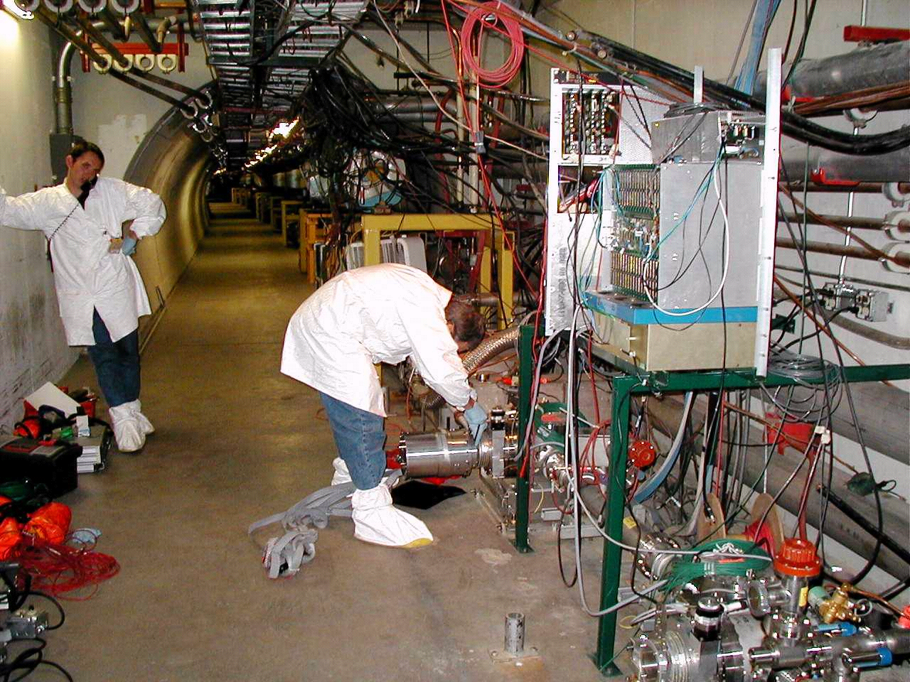
Detector Installation

Slide 7
Status I
List of milestones in recent DØ history; part 1
Fiber tracker installed & south side is cabled
Crysostat + VLPC’s operational
LED induced signals observed in fiber tracker; noise performance good
Detector in final position for roll in (BIG pieces are in place)
SMT progressing well (slips in time, but making it); SMT-S ready soon
10% test give confidence on performance of SMT
Lab F forward muon assembly complete; installation is ongoing
A lot of work on infrastructure in hall
One production line left: VLPC cassettes: difficult & building for long life.
No fallback options have been initiated (most likely none will be)

Slide 8
Status II
The future; part 2
Detectors will be at DØ in time for March 1, 2001
However readout electronics are late. ==➔
No integrated cosmic ray commissioning of detector before March 1; partial yes
integrated & complete commissioning difficult
Unless the “March 1” strategy changes, we will start the run with a mechanically complete, but electronically incomplete detector.
Start discussions about this with directorate next week; how to approach this.
There are 139 days left to March 1, 2001

Slide 9
Status III
Monte Carlo production (DØGSTAR + DØSIM)
Several offsite MC production centers are online
Producing MC events at a very high rate
Capabilities are expending
Current centers:
Location | # CPU’s
NIKHEF | 100
UTA | 50
Lyon | 100
Boston Univ. | O2000 (192)
Prague | ~15
Lancaster | 200
Rio | proposal
~10⁶
evts/day
soon
To set he scale:
For Run I Mcphysics (1990): produce 100K events in 6 months
For Run II in 6 months produce (now only):
180 Million events. Will double soon.
---Excellent for physics in Run II---
CPU power so large that there is talk of not saving intermediate data, but if needed……. just regenerate

Slide 10
Announcements
Meetings for remainder of 2000
Nov 3-5, FNAL PAC; present Run IIb plans
Nov 10-11, Run II Top Thinkshop
Dec 8 , Run II mtg & DØ Top/Higgs workshop
2001 dates
Joint CDF & DØ workshop on Monte Carlo’s (generators)
G.Brooijmans, S.Protopopescu
Future DØ meetings for 2001 (DRAFT)
February 7-9
April 25-27
June/July workshop*
September 12-14
November 7-9
* Try wrkshp in Chicago area (not FNAL)
Will try to move to collaboration week style meetings

Slide 11
Closing remarks
Progress has been immense over last year and continues
Not mentioned Run 2B: a lot of discussion, converging on finite number of options; resources are main concern
(bad timing but…..have to deal with it)
Detectors are nearing completion; shift from priority on hardware to commissioning and software ➔ people available
A lot of activity in assembly hall; next few months even scary
However I can see the beginning of Run 2a

