Slide 1
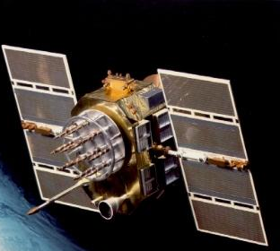

U.S. DOT/Volpe Center
Vulnerability Assessment
of the Transportation Infrastructure
Relying on GPS
DOT/OST Outreach Meeting
October 5th, 2001
Dr. James V. Carroll

Slide 2
Briefing Outline
Overview
Risk, Vulnerabilities & Disruption Mechanisms
Mitigating Vulnerabilities
Findings & Recommendations
Summary
Conclusion

Slide 3
Assessment Overview
Report Assessed Possible Impact to Civilian Users
  GPS-Based Systems in the United States
  Projected Over 10 Years
Covered All Transportation Modes
  Also Telecommunications, Banking, Commerce
This Briefing • •
  Examines Vulnerabilities
  Recommends Mitigations
BOTTOM LINE:
  GPS Users are Vulnerable to Signal Loss or Degradation
  Awareness & Planning Can Mitigate the Worst Vulnerabilities
  The Vulnerability Will Not be Fully Eliminated
Notes:
THIS REPORT CAME FROM A LOW-BUDGET STUDY !!!

Slide 4
Risk Considerations
GPS System
Vulnerabilities
Probability of
Loss/Degradation of
GPS Signal
Threats –
RISK
Unintentional
Intentional
Consequences of GPS
Loss:
Human Life & Health
Environment
Economy
Notes:
RISK TO USERS !!!
THERE WAS NO THREAT ASSESSMENT; THIS NEVERTHELESS IS VERY IMPORTANT IN DEVELOPING THE OVERALL PICTURE.

Slide 5
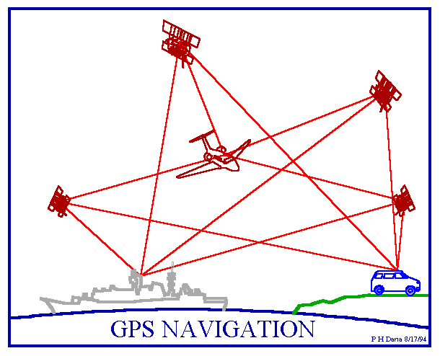
Civil Transportation Uses
Aviation
  Navigation, ATC, Surface Guidance
Maritime
  Harbor, Inland Waterway
  Traffic Service
Surface
  Railroads
  Intelligent Transportation Systems
Transportation Infrastructure
  Timing; Communication Networks; Power Grids
Notes:
Based on an analysis of consequences if GPS was lost, these critical transportation applications were selected for further study. For example, airline accidents, an oil tanker spill, train collision, can cause severe property damage, safety-of-life, economic, or environmental consequences.
There also are major civil uses of GPS - timing, network synchronization - in banking, commerce, and the Internet.

Slide 6
Timing & Synchronization Uses
Global Fiber Networks
  SDH, SONET
Global Wireless Networks
  PCS, GSM, TDMA, CDMA
Transportation & Public Safety
  National Airspace System (VDL, NEXCOM, UAT)
  Land, Rail, Marine
GPS Features:
  Low Cost, High Reliability & Performance
  Big Asset for Synchronization of Digital Networks
  GPS ( and Cesium, Loran-C) - Stratum 1
Notes:
The planned NEXCOM (using VDL Mode 3), VDL Mode 4, and UAT rely on GPS in varying degrees to provide precise timing for synchronizing message transmissions.
SDH = Synchronous Digital Hierarchy
SONET = Synchronous Optical Network
PCS = ?
GSM = ?
TDMA = Time Division Multiple Access
CDMA = Code Division Multiple Access
VDL = “VHF Data Link”
UAT = “Universal Access Transponder”

Slide 7
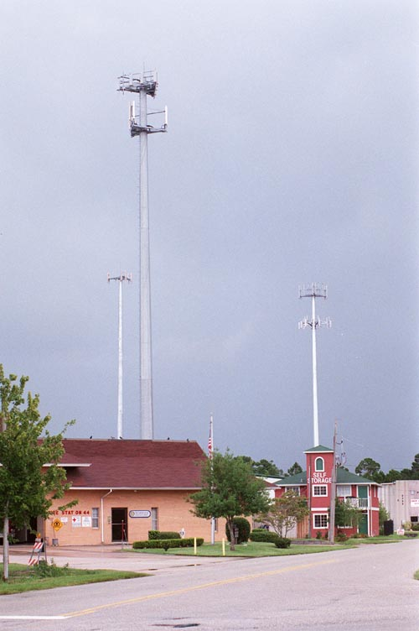
Factors Impacting GPS Vulnerability
Very Low Signal Power
Single Civil Frequency
  Known Signal Structure
Spectrum Competition
Worldwide Military Applications Drive a GPS Disruption Industry
  Jamming Techniques are Well Known
  Devices Available, or Can be Built Easily
GPS Timing for EW

Slide 8
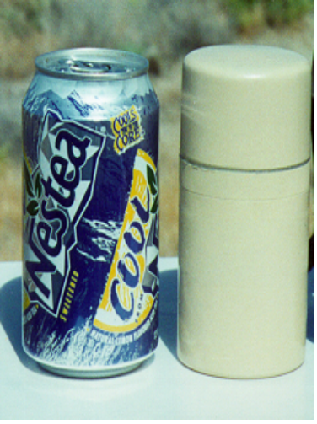
GPS System Vulnerabilities
Unintentional Interference
  Radio Frequency Interference (RFI)
  GPS Testing
  Ionospheric; Solar Max
  Spectrum Congestion
Intentional Interference
  Jamming
  Spoofing – Counterfeit Signals
  System Damage
Human Factors
  User Equipment & GPS SV Design Errors
  Over-Reliance
  Lack of Knowledge/Training
1 Watt
Jammer
Notes:
SPOOFING – SPAWAR Meeting Reinforces its Importance as a Potential Threat, Along with RFI and Growing Dependence on GPS.
Meaconing is the Delay and Re-broadcast of the GPS signal.
UNINTENTIONAL INTERFERENCE GENERALLY IS SHORT_TERM
INTENTIONAL INTERFERENCE USUALLY IS SHORT TERM ALSO, BUT SYSTEM DAMAGE CAN BE LONG TERM.
GPS Constellation Damage – Space Attack
Ground Control Damage – Natural disaster (quake?); Terrorist or Missile.
HUMAN FACTORS – Royal Majesty incident epitomizes this issue.
MORE DETAIL – NIST Charts #17 & 18.

Slide 9
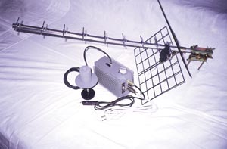
Disruption Mechanisms - Jamming
Jamming Power Required at GPS Antenna
  On order of a Picowatt (10⁻¹² watt)
Many Jammer Models Exist
  Watt to MWatt Output – Worldwide Militaries
  Lower Power (<100 watts); “Hams” Can Make
Jamming Signal Types
  Narrowband
  Broadband
  Spread Spectrum - PRN Modulation
Russian Jammer
Notes:
“WATT TO MWATT OUTPUT – WORLDWIDE MILITARIES” LAST 2 WORDS MAY MEAN THAT
MILITARY GROUPS CAN FIELD JAMMERS IN THIS RANGE.
“PRN” = pseudo-random noise.

Slide 10
Disruption Mechanisms -
Spoofing/Meaconing
100
Spoof – Counterfeit GPS Signal
  C/A Code Short and Well Known
  Widely Available Signal Generators
Meaconing – Delay & Rebroadcast
  Applicability of EW Components
Possible Effects
  Long Range Jamming
  Injection of Misleading PVT Information
No “Off-the-Shelf” Mitigation
Correlation %
Code Phase (t)
L P E
100
1. Match Real Code
Correlation %
Code Phase (t)
L P E
2. Capture
100
Correlation %
Code Phase (t)
L P E
Spoof Code
3. Pull Off
GPS S.V. Code
Successful Spoof
Notes:
DRFM = Dynamic RF Memory. ADC = Analog/Digital Converters.
Given the bandwidth, these components can execute the capture in the required time.

Slide 11
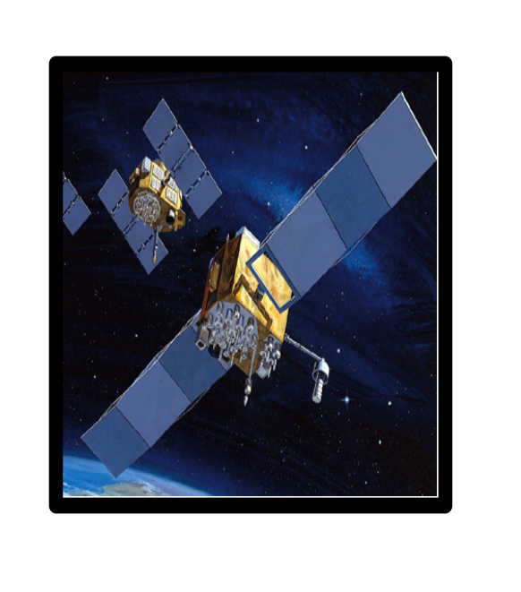
Consequences of GPS Loss/Degradation
Depending on …
  Transportation Mode Involved
  Duration of GPS Loss/Degradation
Impact Can Be
  Minimal - Quick Recovery
  Operational - Reduced Effectiveness & Efficiency
  Safety - Potential Loss of Life, Environmental,
  Economic Damage
Timing & Synchronization
  GPS Outage Can Disrupt Communications/Networks
Notes:
#2 Reduced Effectiveness = Safe Operation
Safety impact uses = “Critical Applications”
#3 Serious Consequences if Loss Lasts Days & if No Backup Accurate Clock.
Timing Linked to Transportation, Commerce, Banking, Web

Slide 12
Impact of GPS Loss on Timing Applications
Long-Term Outage (~ 2 or More Weeks)
  Possible Severe Damage
Shorter-Term Outages
  With Planning - Manageable
Many Timing Services are Involved:
  E-911
  GSM Wireless
  CDMA Wireless
  Tele-Medicine
  Digital Video, Teleconferencing
Notes:
LONG-TERM OUTAGES ARE VERY UNLIKELY.

Slide 13
Mitigating GPS System Vulnerabilities
For Unintentional Disruptions -
  GPS Spectrum Protection Efforts
  GPS Modernization
For Intentional Disruptions -
  Military Anti-Jam Technology
  Characterize Civil Spoof Effects\Observables
Vulnerability Cannot Be Fully Eliminated
Notes:
MITIGATION of RFI will involve location of source(s) and termination of
Emission of harmful signals.
VHF, TV, MSS, UWB, etc. (Bluetooth?)
“GPS MODERNIZATION:” NEW CIVIL SIGNALS, B’CAST POWER
GPS III
- Heighten Awareness Among NON-AVIATION Modal Users
INTENTIONAL DISRUPTION MITIGATION USER END HARDWARE (antennas, location, appliqués, etc.)
AVIATION - antenna arrays
polarization discrimination
spatial-temporal filtering
MARINE, LAND - address specific jam/spoofing threat
SPOOFING IS AN ONGOING CIVIL THREAT

Slide 14
Mitigation of User Risk
Implement Appropriate Mitigation Strategies
  For Each Individual Mode, Choose or Maintain Appropriate Backup System or Procedure
  Be Cognizant of Timing Applications
  Reflect Interference Impact in Application Designs
  Implement Systems to Monitor/Report/Locate Interference
  Assess Applicability of Military Anti-Jam Technology
Encourage User Training in Use of Backups
Determine Tolerable Levels of Risk and Cost for the Critical Infrastructure Applications
  Determine Costs of Lowering Risks to an Acceptable Level
Notes:
#1 Convince service providers & users of need to mitigate the vulnerabilities.
#2 Routinely Validate GPS With Other Information Sources.

Slide 15
Findings (1 of 3)
Transportation Community is Aware of Risks in Using Sole Means GPS in Critical Applications
GPS is Vulnerable to Radiofrequency Interference
GPS Augmentations (e.g., WAAS, NDGPS) Improve
  Accuracy
  Availability
  Reliability
  Integrity
BUT: Use of GPS Can Still be Disrupted

Slide 16
Findings (2 of 3)
GPS Will Become an Increasingly Tempting Target as its Civil Uses Proliferate
  Increasing Civil Dependence
GPS is Susceptible to Unintentional Disruptions
  Ionospheric, Solar
  Blockage
  Narrowband & Wideband RFI
Use of GPS-based Timing Synchronization Must be Assessed, Application by Application
  Transportation, Communications, Commerce

Slide 17
Findings (3 of 3)
Military Experience: Hostile Interests Will Attempt to Disrupt/Destroy GPS if They See an Advantage in Doing So
Risk Can be Reduced, But Not Eliminated
  GPS Cannot be Sole Source in Critical Applications
  Safety of Civilians is “Number 1”
Backup Systems or Procedures are Necessary for All Critical Applications Involving GPS

Slide 18
Candidate Independent Backup Systems
Ground-Based Aviation Systems - VOR/DME, ILS
Inertial Systems
Loran-C
Other Satellite Navigation Systems
“Procedures”
  Missed Approach (Radar, Ground Support)
  Maritime: Radar, Radio, Sextant, Lighthouse, etc.
• • • •

Slide 19
Recommendations (1 of 4)
Public Policy Must Ensure Safety if GPS Use is Lost
Acceptable Level of Risk Must be Determined for Critical Applications
  Costs to Lower Present Risk to this Level Must be Determined
Continue GPS Modernization
  More Civil Signals & Improved Code
  Higher Broadcast Power
Continue Spectrum Protection Activities
Enhance Receiver Performance & Certification Standards in All Modes Where Feasible
Notes:
LAND TRAVEL - HAZMAT, EMERGENCY RESCUE OPS

Slide 20
Recommendations (2 of 4)
All Critical Applications Need Quick Alert of GPS Disruption
  Reporting
  User Training
Civil Community Should Track Military Anti-Jam Developments for Possible Use
  Anti-Spoofing Technology
  Identify, Use Spoof Indicators

Slide 21
Recommendations (3 of 4)
Whenever Possible, Maximize Military-Civil Exchange of System Status, Incipient Threats
Create Awareness of Need for Backups in Critical Applications
All GPS Receivers Used in Critical Applications Need to Provide Integrity Warnings
  Consider Autonomous Integrity Monitoring
Augment, Enhance, and Implement Appropriate Backup Systems or Procedures
  Assess Impact of GPS-Based Timing Loss

Slide 22
Recommendations (4 of 4)
Continue Re-Capitalization and Enhancement of Loran-C
  Modes Should Assess Potential Role of “New” Loran
  Firm Decision Needed Soon - Industry Needs Direction
DOT Take an Active Role in Developing Roadmap for the Future Navigation Infrastructure
  Federal Radionavigation Plan
  Modal Agencies to Assess Risk Impacts

Slide 23
Report Summary
GPS Vulnerability Can be Reduced But Not Fully Eliminated
Augmentations are Important for Integrity, But Can Not Eliminate Disruptions
GPS Disruptions also Impact Timing
Increasing Use Makes GPS a Tempting Target
Independent Backup Systems or Procedures Essential in Critical Civil Transportation Uses
Notes:
# 4 - INVITE A LOW-COST, ASYMMETRIC ATTACK

Slide 24
Main Message to the Civil GPS Community:
GPS provides many benefits to civilian users. It is vulnerable, however, to interference and other disruptions that can have harmful consequences. GPS users must ensure that adequate independent backup systems or procedures can be used when needed.
Notes:
• Right now, unintentional disruptions occur fairly often (e.g., Florida ~ 2/8/01).
• Besides backup systems, user training for awareness of when to switch to backup, etc., are important

Slide 25
Conclusion
Report available from the U.S. Coast Guard Navigation Center website
  http://www.navcen.uscg.gov
“If the government expeditiously develops
and executes a plan based on these
recommendations, there is every reason to
be optimistic that GPS will fulfill its potential
as a key element of the national transportation
infrastructure.”

Slide 26
Contacts
Jim Carroll
U.S. Dept. of Transportation
Volpe National Transportation Systems Center
55 Broadway, Kendall Sq., Cambridge, MA 02142
(617) 494-2908; fax: (617) 494-2628
carrollj@volpe.dot.gov
Chuck Rodgers
OPTIMUS Corp.
8601 Georgia Avenue, Suite 700
Silver Spring, MD 20910
(301) 585-7075; fax: (301) 585-7976
Chuck.Rodgers@optimuscorp.com

