Slide 1
Dengue
Clinical Manifestations and Epidemiology
CENTERS FOR DISEASE CONTROL
AND PREVENTION
Notes:
1

Slide 2
I. Virus, Vector and Transmission
Notes:
2

Slide 3
Dengue Virus
Causes dengue and dengue hemorrhagic fever
Is an arbovirus
Transmitted by mosquitoes
Composed of single-stranded RNA
Has 4 serotypes (DEN-1, 2, 3, 4)
Notes:
3

Slide 4
Dengue Viruses
Each serotype provides specific lifetime immunity, and short-term cross-immunity
All serotypes can cause severe and fatal disease
Genetic variation within serotypes
Some genetic variants within each serotype appear to be more virulent or have greater epidemic potential
Notes:
4

Slide 5
Transmission of Dengue Virus by Aedes aegypti
Mosquito feeds /
Mosquito refeeds /
acquires virus
transmits virus
Extrinsic
Intrinsic
incubation
period
incubation
period
Viremia
Viremia
0
5
8
12
16
20
24
28
DAYS
Illness
Illness
Human #1
Human #2
Notes:
5

Slide 6

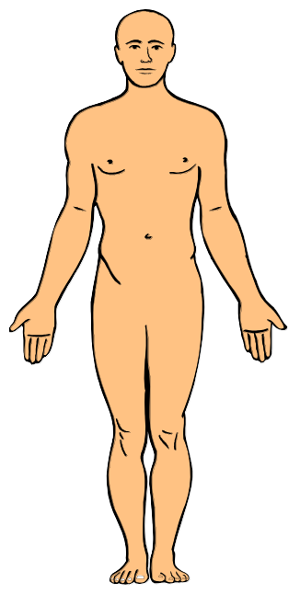
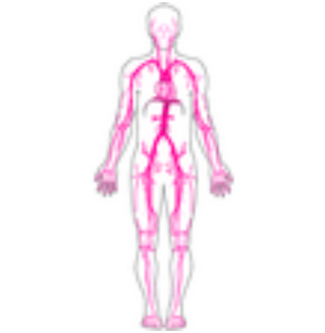

Replication and Transmission of Dengue Virus (Part 1)
1
1. Virus transmitted
to human in mosquito
saliva
2
2. Virus replicates
in target organs
4
3
3. Virus infects white
blood cells and
lymphatic tissues
4. Virus released and
circulates in blood
Notes:
6

Slide 7
Replication and Transmission of Dengue Virus (Part 2)
6
5. Second mosquito
ingests virus with blood
6. Virus replicates
in mosquito midgut
and other organs,
infects salivary
glands
7
5
7. Virus replicates
in salivary glands
Notes:
7

Slide 8
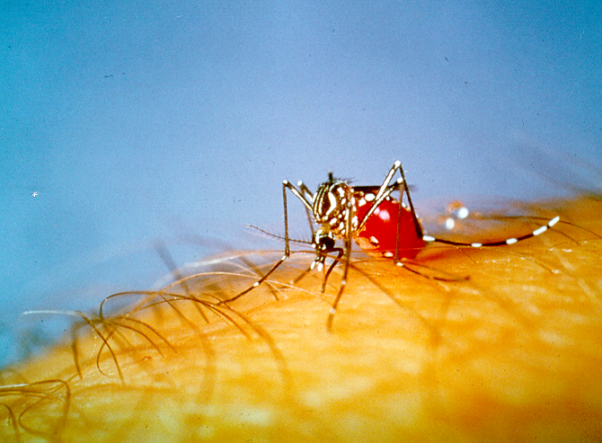
Aedes aegypti Mosquito
Notes:
8

Slide 9
Aedes aegypti
Dengue transmitted by infected female mosquito
Primarily a daytime feeder
Lives around human habitation
Lays eggs and produces larvae preferentially in artificial containers
Notes:
9

