Slide 1


Computational Sprinting on a Real System: Preliminary Results
Arun Raghavan*, Marios Papaefthymiou⁺, Kevin P. Pipe^{+#},
Thomas F. Wenisch⁺, Milo M. K. Martin*
University of Pennsylvania, Computer and Information Science*
University of Michigan, Electrical Eng. and Computer Science⁺ University of Michigan, Mechanical Engineering#
Notes:
Change title:
From Feasible to Practical Computational Sprinting?
Computational Sprinting: Preliminary Findings with a real system prototype
Applying sprinting to a real system: preliminary results

Slide 2
Overview
What is Computational Sprinting?
Summary of feasibility study [HPCA’12]
Simulation results:
10x responsiveness improvements in short bursts
Same dynamic energy consumption
Preliminary results with sprinting on prototype-proxy
Characterize real thermal/energy/performance behavior
Sprinting can improve energy efficiency due to race to halt
Notes:
In contrast to our expectation to being energy neutral, sprinting is actually energy efficient

Slide 3
Computational Sprinting and Dark Silicon
Problem: Dark Silicon/Utilization Wall
Cannot use all transistors on chip all the time
Cooling constraints limit mobile systems
One approach: Use few transistors for long durations
Specialized functional units [Accelerators, GreenDroid]
Targeted towards sustained compute, e.g. media playback
Our approach: Use many transistors for short durations
Computational Sprinting by activating many “dark cores”
Unsustainable power for short, intense bursts of computation
Responsiveness for bursty/interactive applications
Notes:
Transition

Slide 4
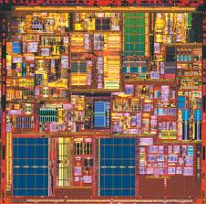
Sprinting v/s Sustainable Operation
power
time
T_{max}
temperature
time

Slide 5
Why Not Use All Cores?
power
time
T_{max}
temperature
time
Notes:
Start with sustainable computation?

Slide 6
Why Not Use All Cores?
N cores
power
time
Effect of thermal capacitance
T_{max}
temperature
time

Slide 7
Parallel Computational Sprinting
power
time
T_{max}
temperature
time

Slide 8
Why Not Use All Cores?
N cores
power
time
T_{max}
temperature
time

Slide 9
Parallel Computational Sprinting
N cores
power
1 core
time
T_{max}
temperature
time

Slide 10
Parallel Computational Sprinting
N cores
power
1 core
time
T_{max}
temperature
time

Slide 11
Parallel Computational Sprinting
N cores
power
1 core
time
T_{max}
State of the art:
Turbo Boost 2.0 exceeds sustainable power with DVFS (~25% for 25s)
Our goal: 10x, ~1s
temperature
time

Slide 12

Sprinting Challenges and Opportunities
Thermal challenges
How to extend sprint duration and intensity?
Latent heat from phase change material close to the die
Electrical challenges
How to supply peak currents? Ultracapacitor/battery hybrid
How to ensure power stability? Ramped activation (~100μs)
Architectural challenges
How to control sprints? Thermal resource management
How do applications benefit from sprinting?
10x responsiveness improvements; small energy overhead
PCM
Die

Slide 13
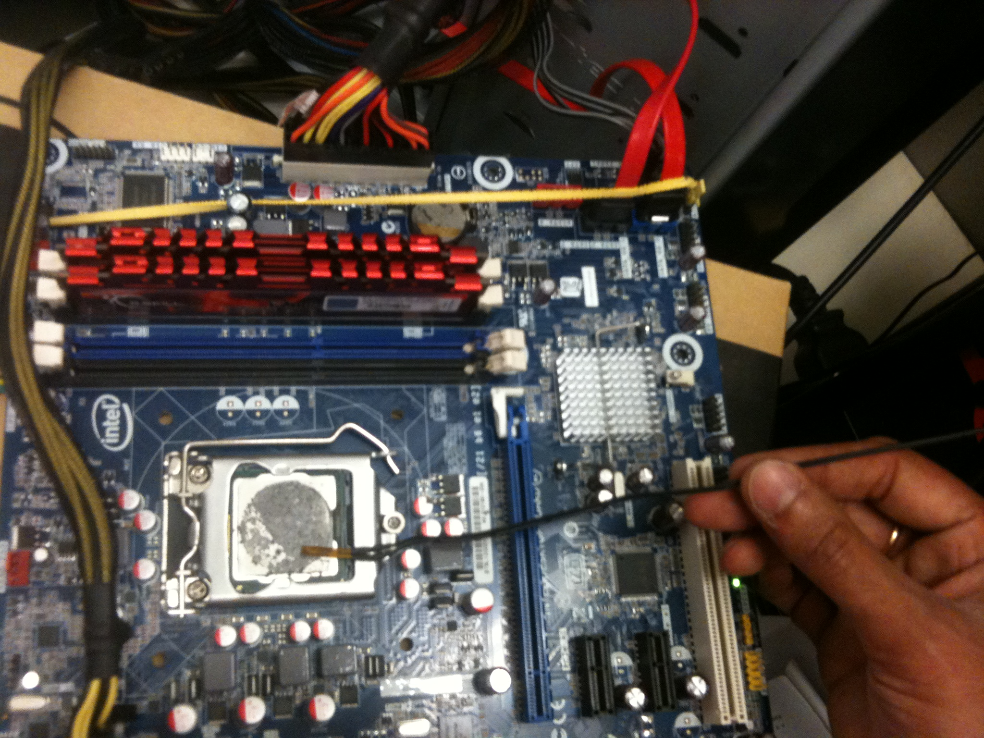
Moving Beyond Simulation: Can we make a real system sprint?

Slide 14
Characterize real system energy/performance
How might sprinting behave on real system?
Notes:
Move methodology to here

Slide 15
Multiple Cores: Energy and Performance
4x
normalized speedup
Power increases with core count
But < 2x for 4 cores
Why? background power
1 core
2 cores
4 cores
2x
power
1 core
2 cores
4 cores
Energy consumption improves due to early completion
Race to halt
normalized energy
1 core
2 cores
4 cores
Notes:
Background power

Slide 16
DVFS: Energy and Performance
Power increases by ~3x for 2x speedup
2x
normalized speedup
Frequency | Voltage
1.6 GHz | 0.95V
3.2 GHz | 1.25V
frequency
3x
Min frequency is not always min energy
power
frequency
normalized energy
frequency

Slide 17
Energy/Performance/Power Tradeoffs
4 cores, 3.2 GHz
Max speedup
4 cores, 1.6 GHz
normalized speedup
Min energy
1 core, 3.2 GHz
1 core, 1.6 GHz
normalized energy
What if this is the maximum sustainable power?
4 cores, 3.2 GHz
4 cores, 1.6 GHz
Sprinting enables higher responsiveness and greater energy efficiency
normalized speedup
Min power
1 core, 3.2 GHz
1 core, 1.6 GHz
power

Slide 18
Emulating Sprinting with Limited Energy Budget
Emulate effect of being TDP constrained
Not currently physically limiting cooling constraints
Estimate thermal capacity for sprinting based on energy
Sprint operation:
Execute with all cores at maximum frequency
Monitor energy consumption via MSR
Terminate sprinting when energy capacity is exceeded
Migrate threads to single core
Shutdown additional cores
Lower frequency to minimum

Slide 19
Effect of Thermal Capacity
Speedup sensitive to amount of computation within sprint
normalized speedup
Thermal Capacity (J)
Energy overhead from extremely short sprints
Longer sprints enable greater energy saving
Caveat: Mobile system background power characteristics likely differ
normalized energy
Thermal Capacity (J)

Slide 20
Conclusions and Work in Progress
Sprinting utilizes dark silicon for energy improvement
Race to halt
Lower system idle power ➔ more energy saved
Work in Progress: constrain cooling system
Approximate thermal characteristics of mobile systems
Correlate temperature with measured energy
Use presented results to guide sprint implementation

Slide 21


