Slide 1

Website Resources and Support for Two-Year College Geoscience Educators
John McDaris, SERC, Carleton College R. Heather Macdonald, College of William and Mary Robert Blodgett, Austin Community College Cathryn A. Manduca, SERC, Carleton College Mark Maier, Glendale Community College
This body of work is supported by the National Science Foundation under a number of grants from the DUE and GEO divisions.

Slide 2
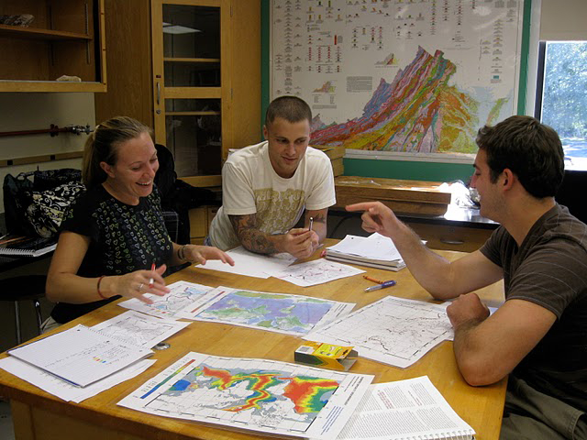
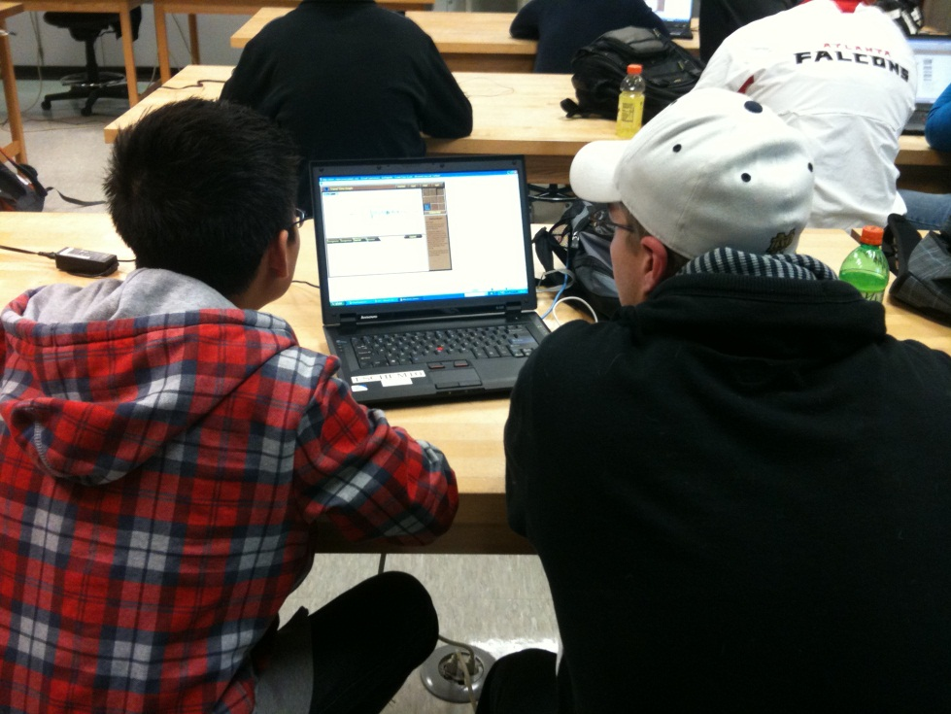
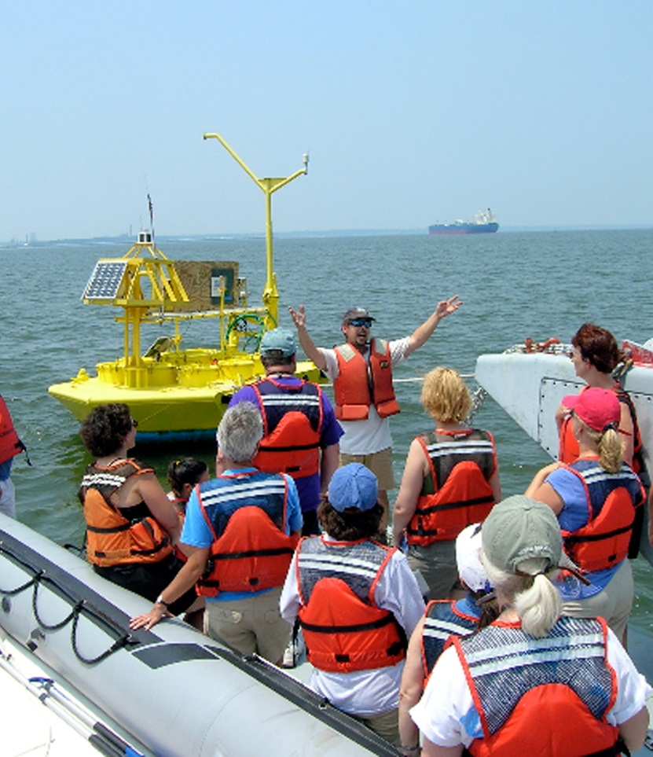

Slide 3
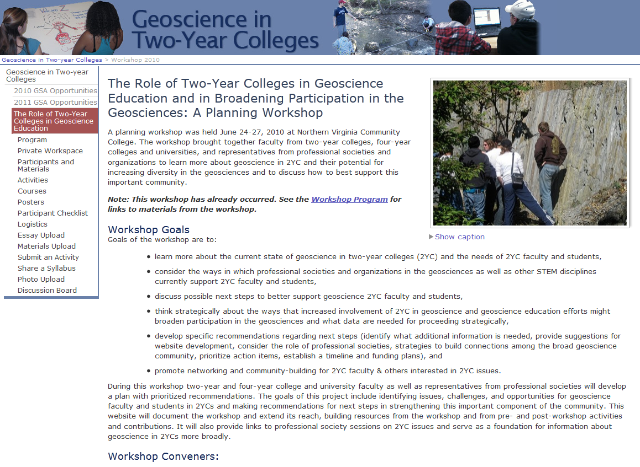
2010 Planning Workshop
GEO 0939671
http://serc.carleton.edu/geo2yc/workshop2010/index.html

Slide 4
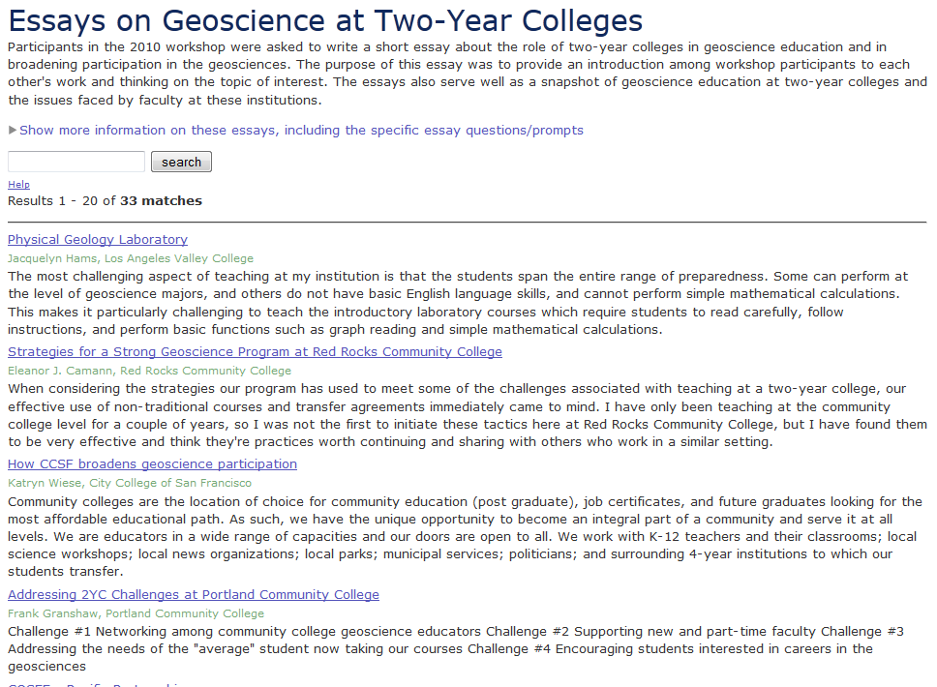
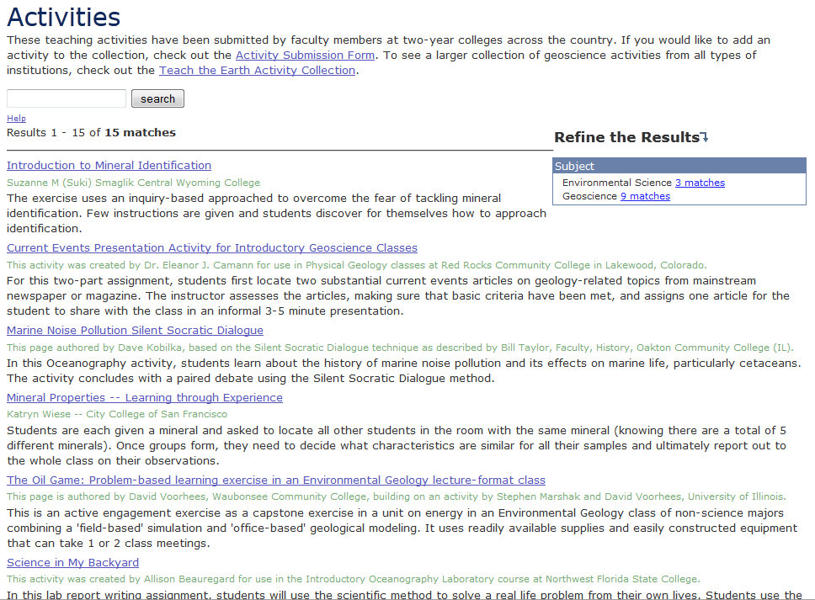
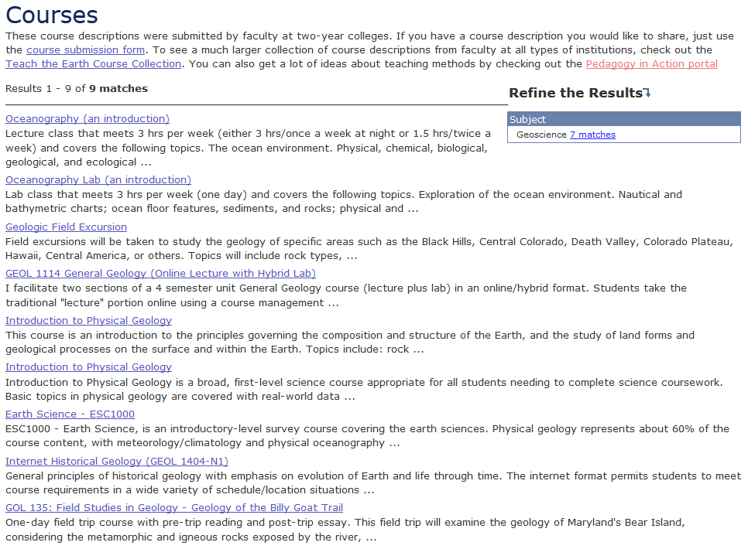

Slide 5

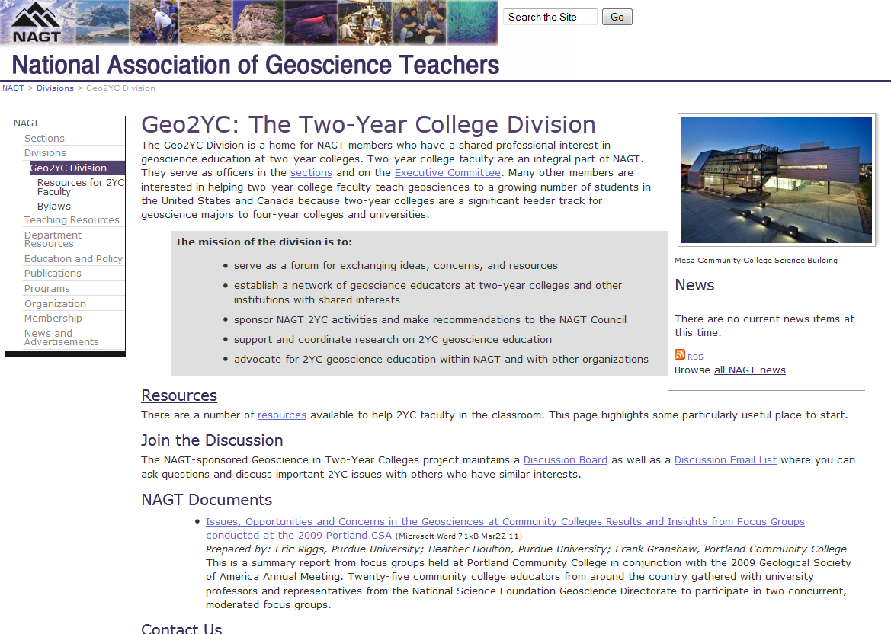
NAGT 2YC Division
http://nagt.org/nagt/divisions/2yc/index.html

Slide 6
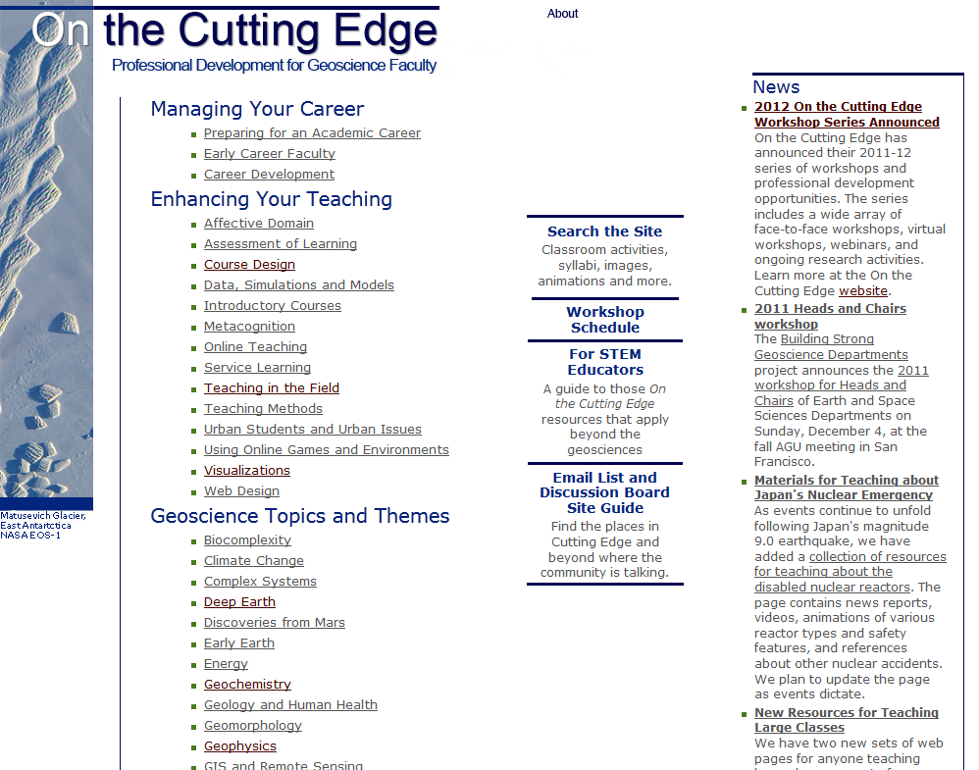
On the Cutting Edge
DUE 0127310, 0127141, 0127257, 0127018, 0618482, 0618725,
0618533, 1022680, 1022776, 1022844, and 1022910
http://nagt.org/nagt/divisions/2yc/index.html

Slide 7
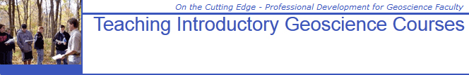

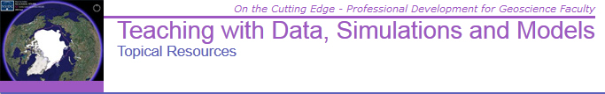
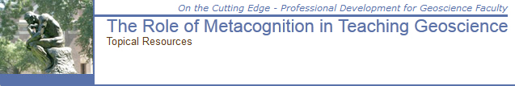
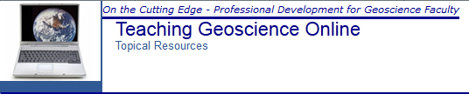
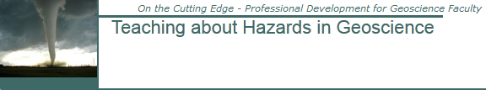
On the Cutting Edge
And many others…

Slide 8
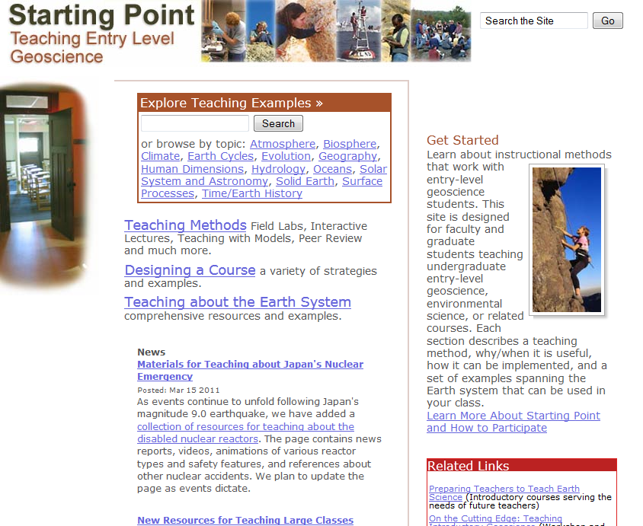
Starting Point
DUE 0226243
http://serc.carleton.edu/introgeo/index.html

Slide 9
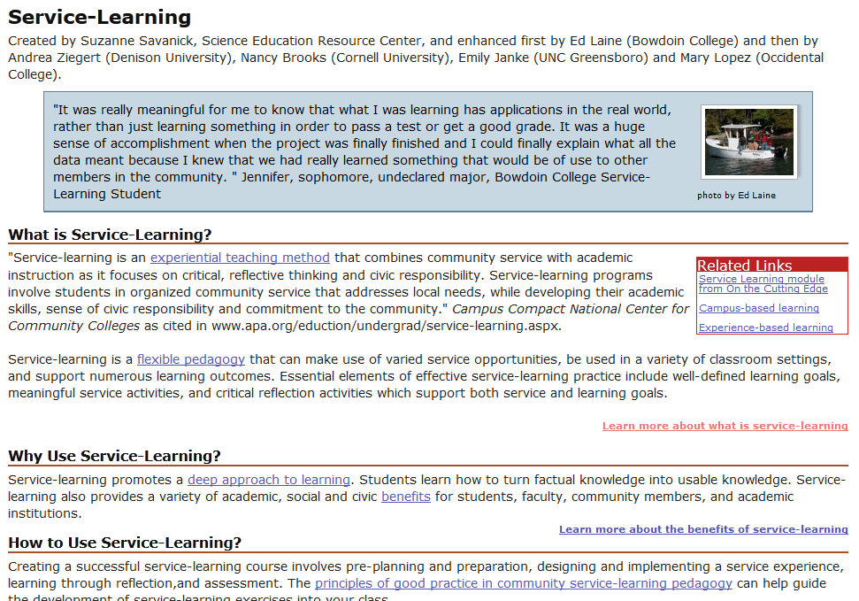
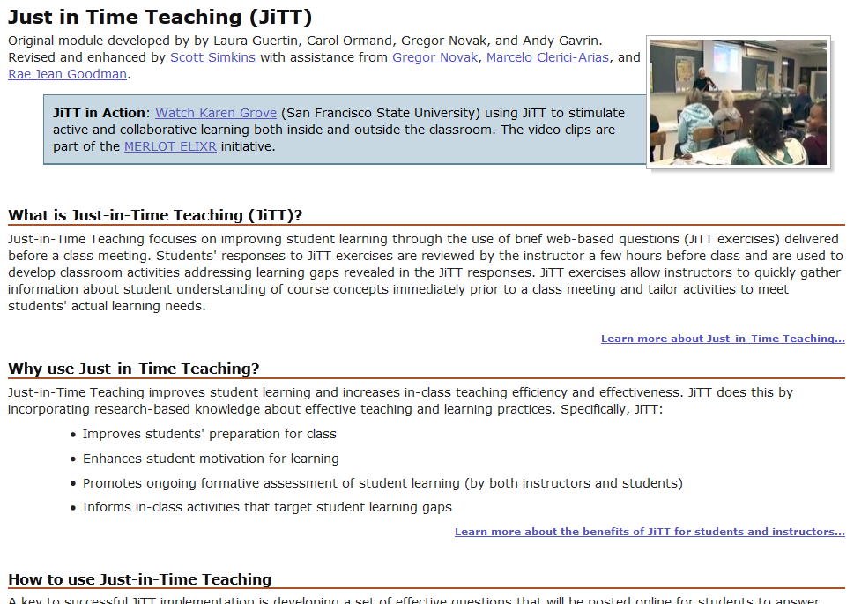
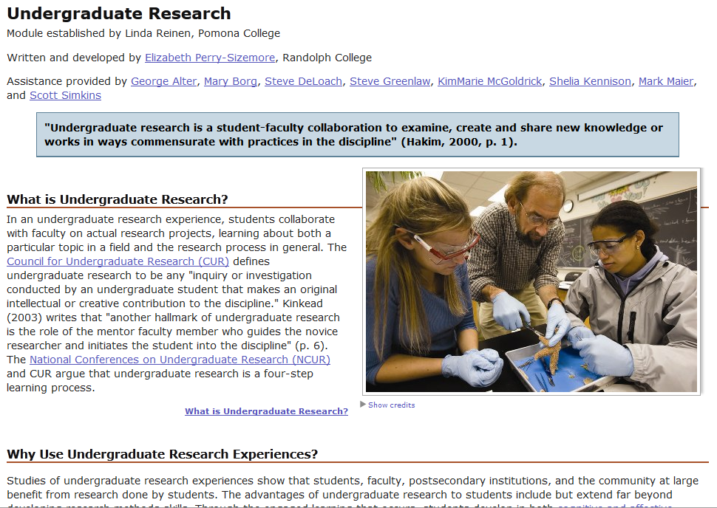
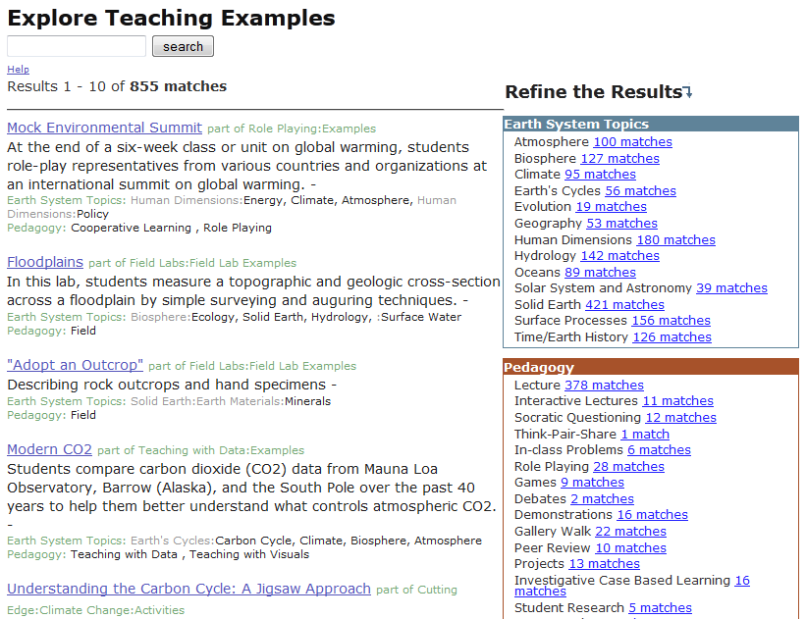
Starting Point
A total of 38 teaching methods modules.

Slide 10
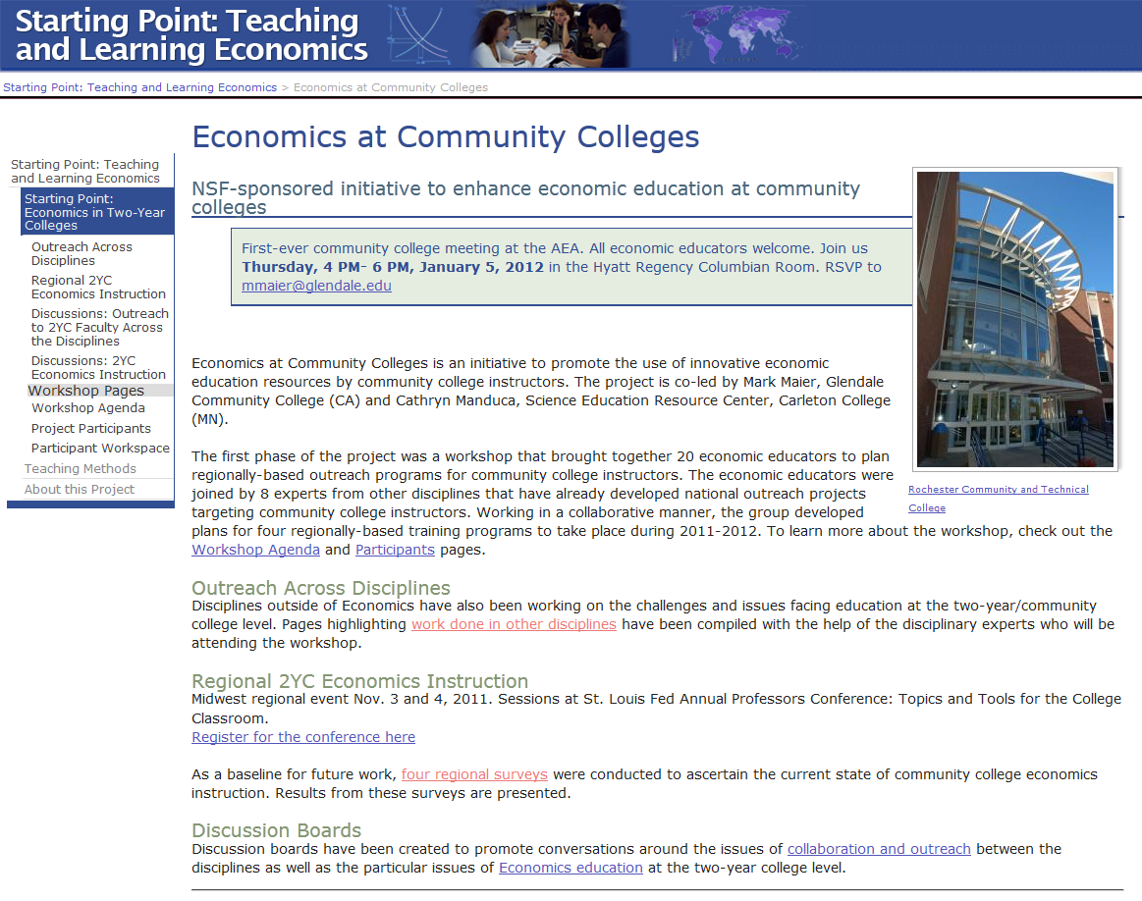
Econ 2YC
DUE 1043245
http://serc.carleton.edu/econ/2yc/index.html

Slide 11
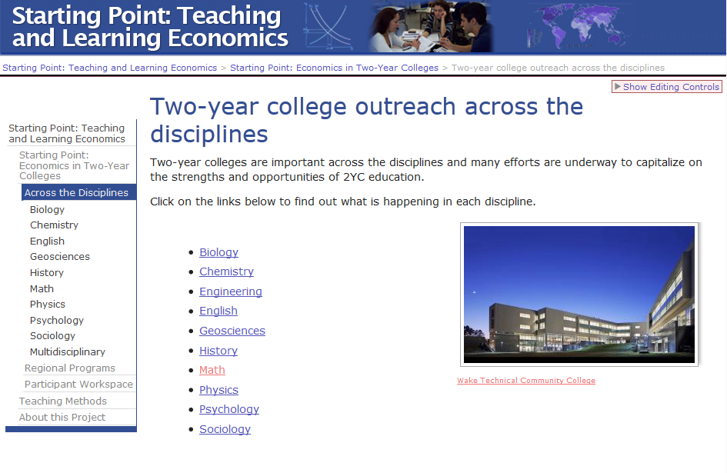
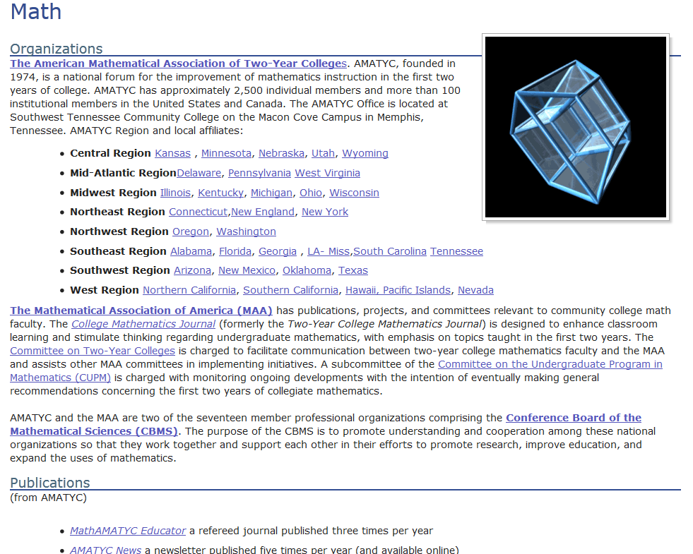
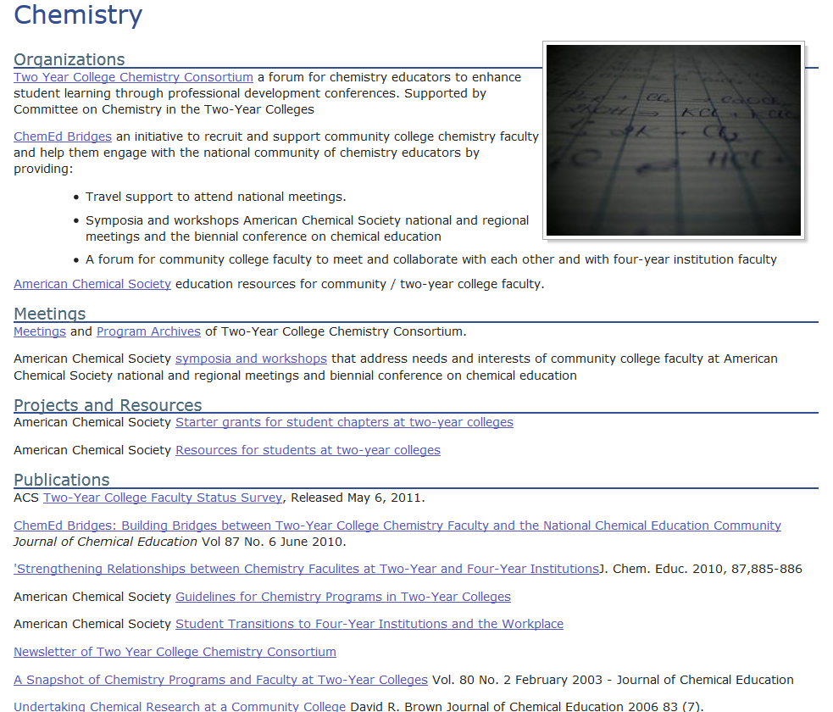
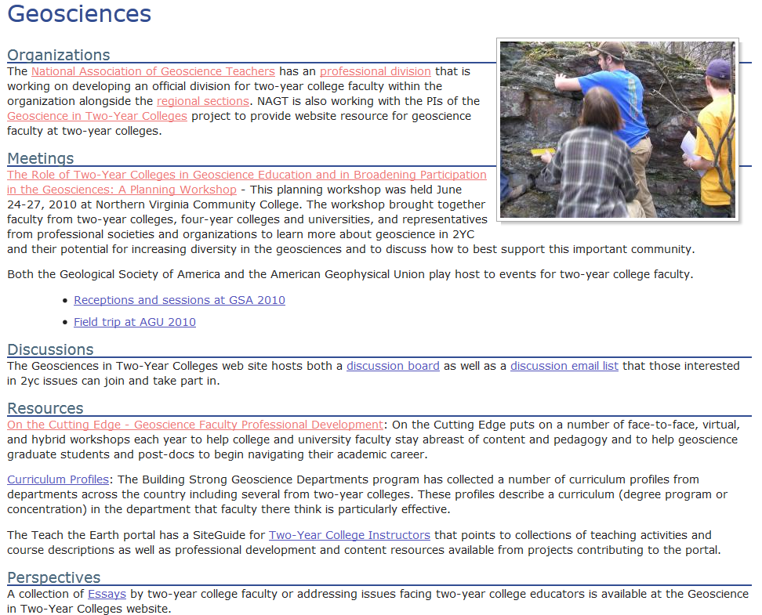

Slide 12
Supporting and Advancing Geoscience Education at Two-year Colleges
(SAGE 2YC)
Macdonald, Baer, Blodgett, Hodder – DUE 11225921, 1122640, 1122660, 1122737
Project Goals:
Provide professional development opportunities for 2YC faculty and web resources focused on topics of importance for 2YC geoscience education
Develop effective models of professional development for 2YC geoscience faculty
Establish geoscience networks focused on 2YC education that include full-time and adjunct faculty
Build leadership within the 2YC geoscience community
Notes:
New work that’s just beginning. SAGE 2YC

Slide 13
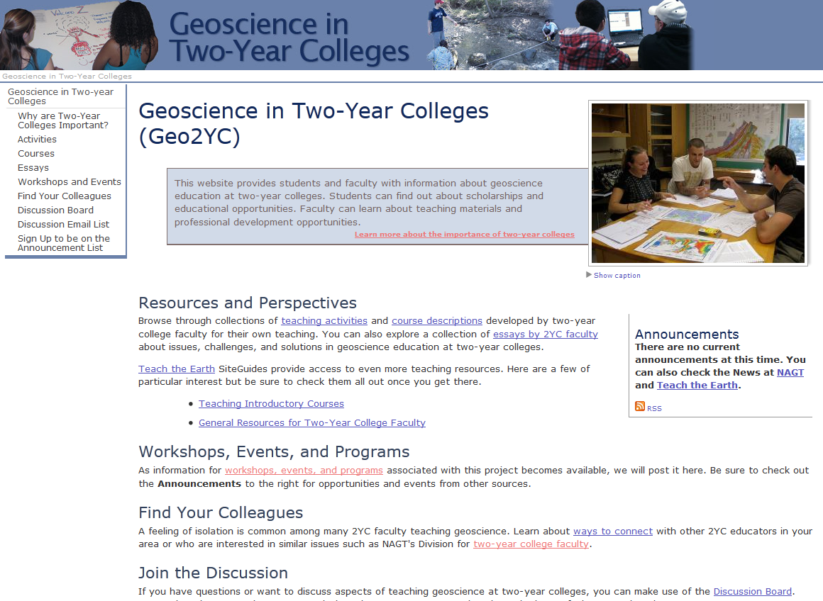
Two-Year College Portal
http://serc.carleton.edu/geo2yc/index.html
Notes:
In the process of building on the platform created for the original workshop to provide a one-stop-shop for two-year college geoscience-related materials and resources at the Geoscience in Two-Year Colleges website. This evolving portal will provide links to projects and resources that already exist as well as a place for new 2YC projects to connect their work to what has come before.

Slide 14
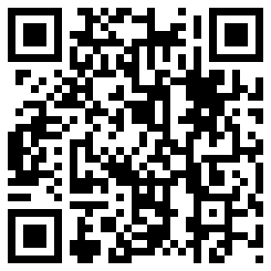

Geoscience in
Two-Year Colleges
http://serc.carleton.edu/geo2yc/index.html

