Slide 1


Computational Sprinting
Arun Raghavan*, Yixin Luo⁺, Anuj Chandawalla⁺,
Marios Papaefthymiou⁺, Kevin P. Pipe^{+#},
Thomas F. Wenisch⁺, Milo M. K. Martin*
University of Pennsylvania, Computer and Information Science*
University of Michigan, Electrical Eng. and Computer Science⁺ University of Michigan, Mechanical Engineering#

Slide 2
Technology and Mobile Application Trends
Technology trends ➔ Increasing power density
10x increase over next few generations
Limited to passive cooling in mobile devices
Application trends ➔ Bursty applications
Interactive, separated by relatively long idle durations
Need fast response times
But, conventional designs focus on sustained perf.
How would we design systems differently to focus on responsiveness?

Slide 3
Designing for Responsiveness
Computational Sprinting
Intensely, but briefly exceed Thermal Design Power (TDP)
Exploit heat buffer via thermal capacitance
State of the art: boost voltage (and frequency)
~25% boost in recent designs (e.g., Sandy Bridge) for ~30s
But, energy inefficient and limited benefit
Alternative: parallel sprinting
Sustained operation of 1 core
Sprint by activating 10s of otherwise idle cores
Goal: responsiveness of 16W chip in 1W platform
Is this feasible?

Slide 4
This Work: Challenges & Feasibility of Sprinting
Thermal challenges
How/where to add thermal capacitance?
Phase change material close to the die
Electrical challenges
How to supply peak currents? Ultracapacitor/battery hybrid
How to ensure power stability? Ramped core activation
Architectural challenges
How to control sprints? Thermal resource management
How do applications benefit from sprinting?
10.2x responsiveness for vision workloads
via 16-core sprints within 1W TDP

Slide 5
Outline
Motivation
Computational Sprinting
Feasibility Study
Performance Evaluation
Conclusion

Slide 6
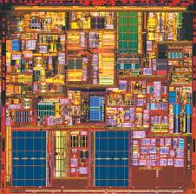
Power Density Trends for Sustained Compute
power
> 10x
time
temperature
Thermal limit
T_{max}
time
How to meet thermal limit despite
power density increase?

Slide 7
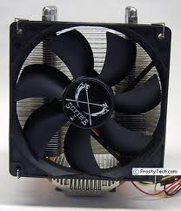
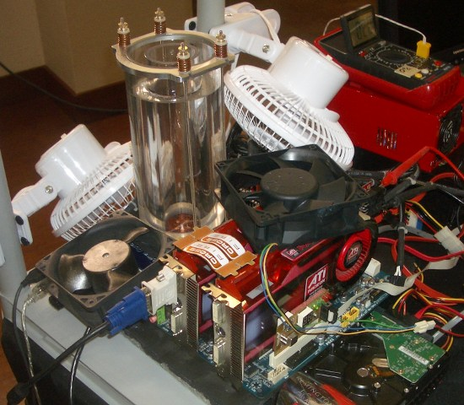
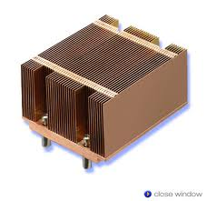
Option 1: Enhance Cooling?
⇧
temperature
T_{max}
time
Mobile devices limited to passive cooling
Notes:
L

Slide 8
Option 2: Decrease Chip Area?
Reduces cost, but sacrifices
benefits from Moore’s law

Slide 9
Option 3: Decrease Active Fraction?
How do we extract application performance
from dark silicon?

Slide 10
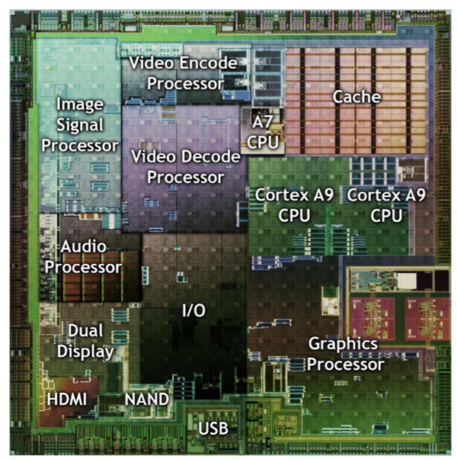
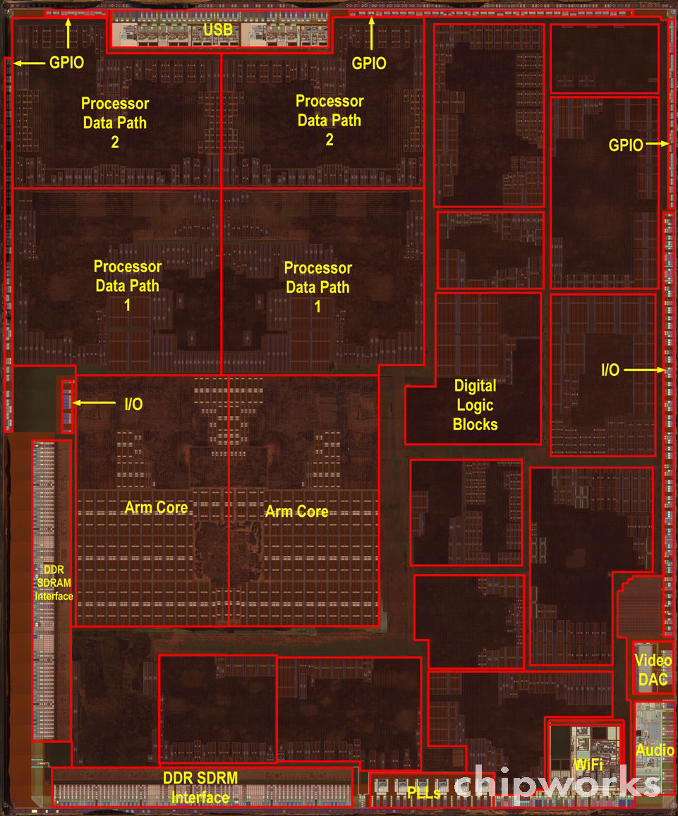
Accelerator Cores?
Heterogeneous cores [Conservation Cores ASPLOS’10, GreenDroid IEEE Comm., QsCores MICRO’11]
Activate different parts of chip based on application
Mobile chips already employ accelerators
?
?
NVIDIA Tegra 2 (49 mm²)
Apple A5 (122 mm²)

Slide 11

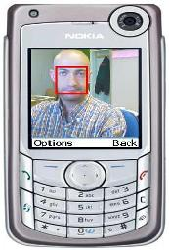
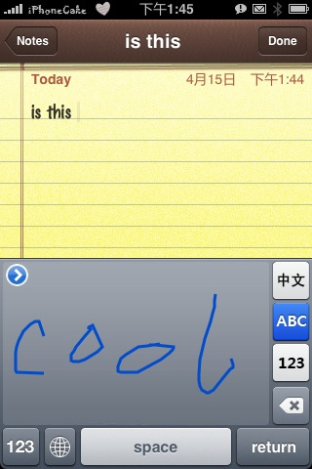
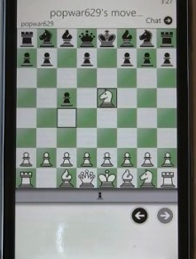
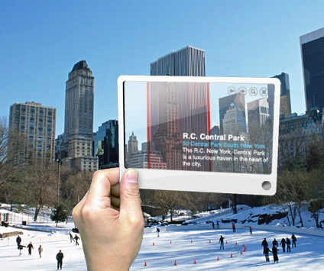
Design for Responsiveness
Observation: Today, design for sustained performance
But, consider emerging interactive mobile apps… [Clemons+ DAC’11, Hartl+ ECV’11, Girod+ IEEE Signal Processing’11]
Intense compute bursts in response to user input, then idle
Humans demand sub-second response times [Doherty+ IBM TR ‘82, Yan+ DAC’05, Shye+ MICRO’09, Blake+ ISCA’10]
Peak performance during sub-second bursts limits what applications can do

Slide 12
Computational Sprinting
Designing for Responsiveness

Slide 13
Parallel Computational Sprinting
power
T_{max}
temperature

Slide 14
Parallel Computational Sprinting
N cores
power
T_{max}
temperature

Slide 15
Parallel Computational Sprinting
N cores
power
1 core
T_{max}
temperature

Slide 16
Parallel Computational Sprinting
N cores
power
1 core
T_{max}
temperature

Slide 17
Parallel Computational Sprinting
N cores
power
1 core
Only small duration available for sprinting
Why?
T_{max}
temperature

Slide 18

Extending Sprint Duration: Role of Thermal Capacitance
Current systems designed for thermal conductivity
Limited capacitance close to die
To design for sprinting, add thermal capacitance close to die
Exploit latent heat from phase change material (PCM)
Die
PCM
Die

Slide 19
Augmented Sprinting with PCM
power
T_{max}
Melting
Point
temperature

Slide 20
Augmented Sprinting with PCM
Sustainable
(single core)
power
T_{max}
Melting
Point
temperature

Slide 21
Augmented Sprinting with PCM
Sustainable
(single core)
power
T_{max}
Melting
Point
Re-solidification
temperature

Slide 22
Outline
Motivation
Computational Sprinting
Feasibility Study
Thermal
Electrical
Hardware/Software
Performance Evaluation
Conclusion

Slide 23
Thermal Challenges
Goal: 1s of 16x sprinting (16 1W cores)
How much thermal capacitance does sprinting need?
16W for 1s = 16J of heat, for PCM with latent heat 100J/g
150mg, which is 2mm thick on 64mm² die
Study based on thermal model of mobile phone
1s of sprint time
~22s cool down time
temperature (ºC)
time (s)
time (s)
Heat flux and time constant like desktop chips

Slide 24
Electrical Challenge #1: Peak Current Demands
16x sprinting exceeds limits of today’s phone batteries
Requires 16x peak current over baseline
In contrast, ultracapacitors have high peak currents
Promising for sprinting (25F, 6.5g, 182J)
But today, lower energy density than batteries
Leverage recent research on battery-ultracap hybrids [Mirhoseini+ ‘11, Palma+ ‘03, Pedram+ ’10]
Active research at all levels (batteries, ultracaps, hybrids)
Cost of extra power/ground pins
Voltage
Regulator
+
Battery
Ultracap
Sprinting
Chip
-

Slide 25
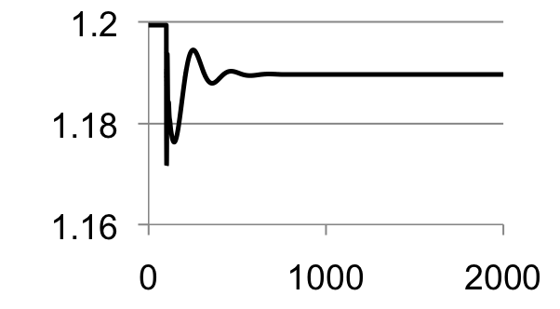
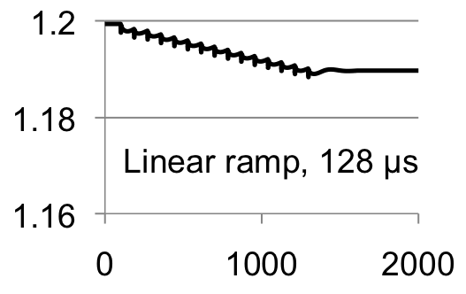
Electrical Challenge #2: On-chip Voltage Stability
16x current spike can cause supply voltage instability
Potential timing errors and state loss
Study of core activation induced instability
SPICE model of board, package, chip
Abrupt activation violates; gradual activation ok
supply voltage
supply voltage
Instantaneous
time
time
Core activation latency << sprint duration

Slide 26
Hardware/Software Challenges
Activation
Sprinting activated when parallel work available
Deactivation
Hardware detects impending overheating
Monitor thermal budget
Energy from activity count + thermal model of system
If thermal budget nearing, ask runtime to migrate
If software is unable to respond, lower frequency
Throttle by factor = number of cores (keep at TDP)

Slide 27
Performance Evaluation

Slide 28
Methodology
In-order x86 many-core simulator
32K, 8-way L1, 4MB 16-way shared LLC, directory cache coherence, 60ns memory latency, dual-channel 4GB/s memory interface
Energy estimates from McPAT (1GHz, 1W, LOP)
Used to drive thermal model
Workloads:
Vision kernels [SD-VBS], feature extraction app. [MEVBench]

Slide 29
Responsiveness Evaluation
normalized speedup
Lack of thermal capacity
1.5mg
Too little work
image size (Megapixels)
⬅ Less compute
More compute ➔
DVFS completes less computation before exhausting thermal capacity

Slide 30
Responsiveness Evaluation
normalized speedup
feature
disparity
sobel
texture
segment
kmeans
Average 10.2x improvement in responsiveness

Slide 31
Conclusions
Computational Sprinting:
Design for responsiveness by far exceeding TDP
Exploit phase change material as thermal buffer
Explored feasibility of sprinting
Promising avenues for managing electrical, thermal and architectural barriers to sprinting
Can enable order-of-magnitude improvements in responsiveness within the constraints of a 1W device
Opportunity to rethink the stack around responsiveness

Slide 32


