Slide 1

Who is Coming to College? 2012 CIRP Freshman Survey Results
John H. Pryor
Director, Cooperative Institutional Research Program
Higher Education Research Institute at UCLA

Slide 2
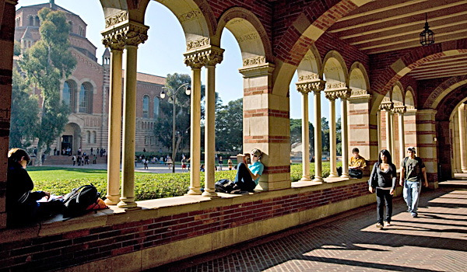
Higher Education Research Institute
We believe in
the transformative power
of higher education

Slide 3
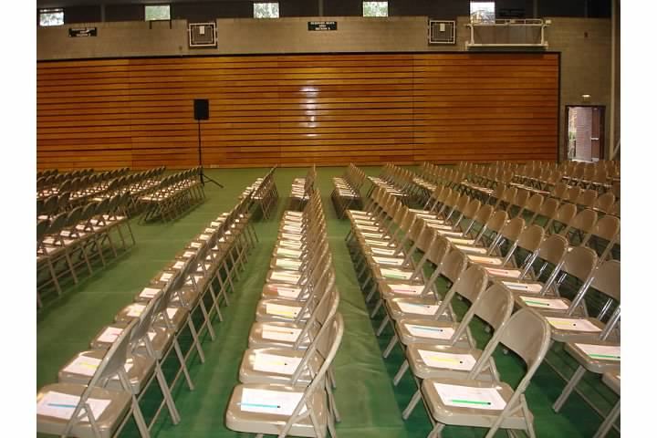
CIRP Freshman Survey
Comprehensive survey of incoming first-time full-time college students at four-year institutions
Beginning of longitudinal research program that continues with the YFCY, DLE, and CSS
47th year and over 15 million students total

Slide 4
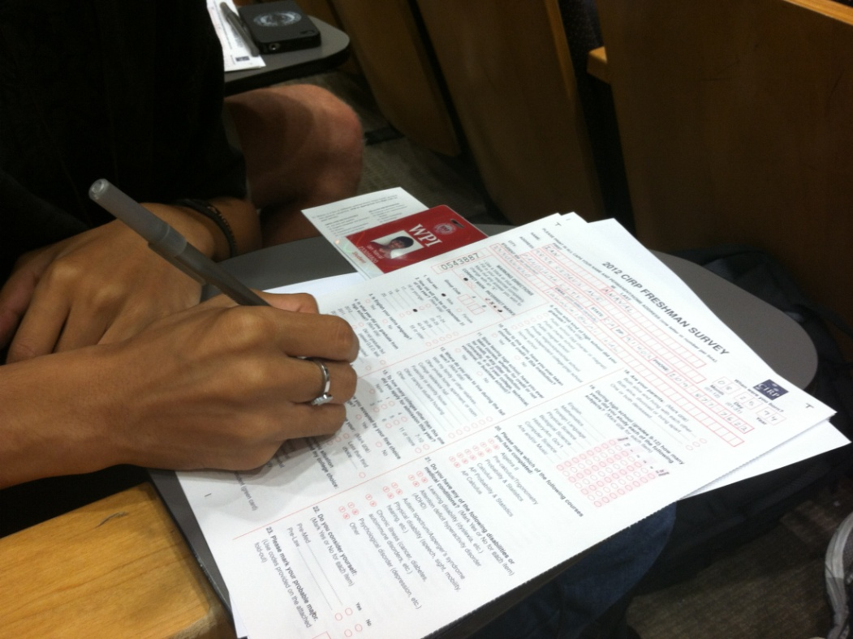
CIRP Freshman Survey 2012
Administered at
389 four-year institutions
236,937 students
“Norms”
283 four-year institutions
192,912 students
Weighted to 1.5 million entering four-year institutions

Slide 5
CIRP Conceptual Framework
Student experience is comprehensive, multifaceted and inter-related, not focused on one or two issues
Look at cognitive and affective domains
Collect data that is:
Behavioral (what students do, i.e., study, interact, etc)
Psychological (attitudes, values, self-concept)
Environmental (campus climate, residence type)

Slide 6



Astin’s I-E-O Model
ENVIRONMENT
YFCY/DLE/CSS
(e.g., residence, interactions
with peers and faculty, curricular
and co-curricular experiences)
INPUT
CIRP Freshman Survey
(previous academic performance, financial concerns,
expectations, degree aspirations,
self-concept in high school, race, sex)
OUTCOME
YFCY/DLE/CSS
(gains in college, satisfaction with college, retention,
post-college plans)

Slide 7
Impact of Economics
Expectations and Reality of Time to Graduation
Support of Same-Sex Marriage
Political Views and Orientation between 2008 and 2012
Revised Majors in 2012
Pre-Med or Pre-Law Track
Differences in Math Preparation
Specific Habits of Mind on the Rise
Feeling Overwhelmed as High School Seniors
Where Students Reside

Slide 8
Impact of Economics
Expectations and Reality of Time to Graduation
Support of Same-Sex Marriage
Political Views and Orientation between 2008 and 2012
Revised Majors in 2012
Pre-Med or Pre-Law Track
Differences in Math Preparation
Specific Habits of Mind on the Rise
Feeling Overwhelmed as High School Seniors
Where Students Reside

Slide 9
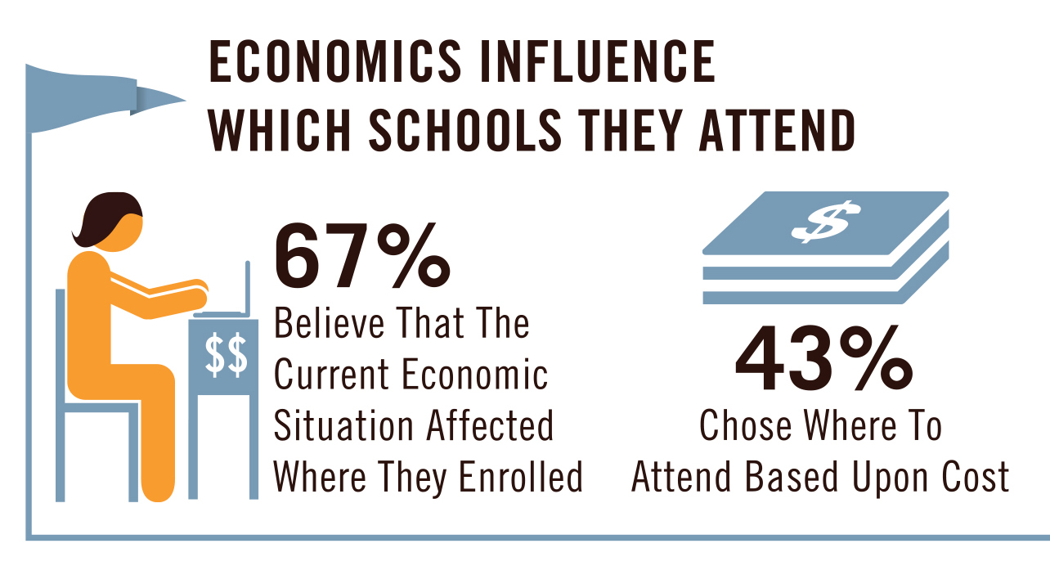

Slide 10


Slide 11
Reasons to go to College (% Indicating “Very Important”)

Slide 12


Slide 13
Most important objective: Being well off financially

Slide 14
Most important objective: Being well off financially

Slide 15
Increased Importance of Financial Reasons (% Indicating “Very Important”)

Slide 16
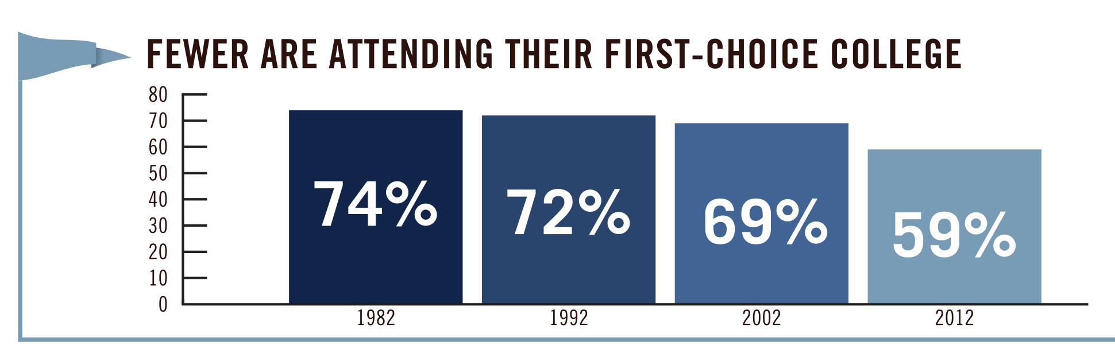

Slide 17
The First Choice Gap
Notes:
Gap increased from 16.5% in 2007 to 17.4% in 2012

Slide 18
Impact of Economics
Expectations and Reality of Time to Graduation
Support of Same-Sex Marriage
Political Views and Orientation between 2008 and 2012
Revised Majors in 2012
Pre-Med or Pre-Law Track
Differences in Math Preparation
Specific Habits of Mind on the Rise
Feeling Overwhelmed as High School Seniors
Where Students Reside

Slide 19
Time to Degree
New in 2012
“How many years do you expect it will take you to graduate from this college?”
Importance in college choice:
“The percentage of students who graduate from this college”

Slide 20
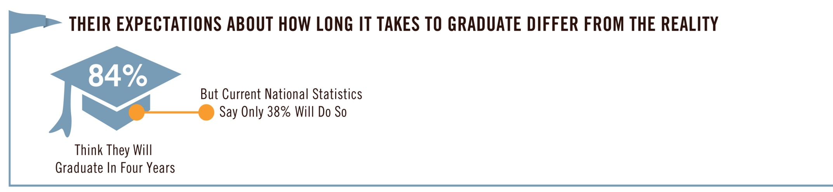

Slide 21
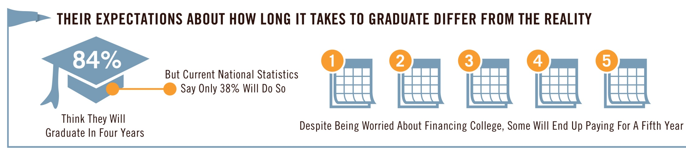

Slide 22
Time to Degree
Only 8.6% believe they will take 5 years
National figure is 15.8%
2.7% believe they will take 6 years
National figure is 4.5%

Slide 23
5yr Degree and Prospective Major
19.1% Engineering
14.0% English
 | Public | Private
College | 11.3% | 4.3%
University | 7.8% | 15.0%

Slide 24
Time to Degree
“The percentage of students that
graduate from this college”
was “very important” to only
30.4%
Notes:
23 reasons…this is number 9

Slide 25
Impact of Economics
Expectations and Reality of Time to Graduation
Support of Same-Sex Marriage
Political Views and Orientation between 2008 and 2012
Revised Majors in 2012
Pre-Med or Pre-Law Track
Differences in Math Preparation
Specific Habits of Mind on the Rise
Feeling Overwhelmed as High School Seniors
Where Students Reside

Slide 26
Support for Same-Sex Marriage (% Indicating “Agree Strongly” or “Agree Somewhat”)

Slide 27
Support for Same-Sex Marriage
(% Indicating “Agree Strongly” or “Agree Somewhat”)

Slide 28
Impact of Economics
Expectations and Reality of Time to Graduation
Support of Same-Sex Marriage
Political Views and Orientation between 2008 and 2012
Revised Majors in 2012
Pre-Med or Pre-Law Track
Differences in Math Preparation
Specific Habits of Mind on the Rise
Feeling Overwhelmed as High School Seniors
Where Students Reside

Slide 29
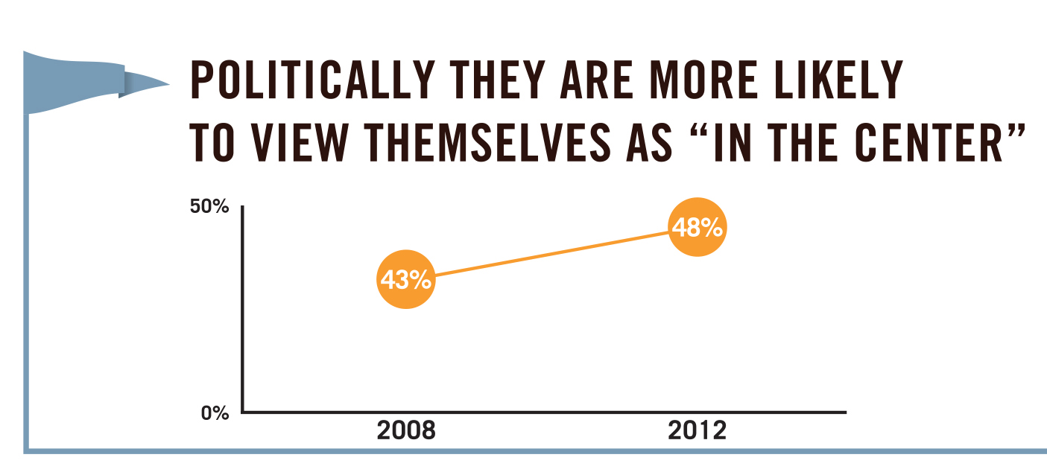

Slide 30
Political Orientation in 2008 and 2012, by Sex

Slide 31
Support for Social and Political Views, by Year (% Indicating “Agree Strongly” or “Agree Somewhat”)

Slide 32
Wealthy Should Pay More Taxes
(% Indicating “Agree Strongly” or “Agree Somewhat”)

Slide 33
Impact of Economics
Expectations and Reality of Time to Graduation
Support of Same-Sex Marriage
Political Views and Orientation between 2008 and 2012
Revised Majors in 2012
Pre-Med or Pre-Law Track
Differences in Math Preparation
Specific Habits of Mind on the Rise
Feeling Overwhelmed as High School Seniors
Where Students Reside

Slide 34
Updated Majors
Reflect contemporary majors
Biology (from 8 to 12)
Engineering (from 8-13)
Business (from 8 – 12)
No large changes between categories
Business continues to be the largest (14.4%)
14.1% Health professions
12.6% Biological sciences
10.4% Engineering

Slide 35
Impact of Economics
Expectations and Reality of Time to Graduation
Support of Same-Sex Marriage
Political Views and Orientation between 2008 and 2012
Revised Majors in 2012
Pre-Med or Pre-Law Track
Differences in Math Preparation
Specific Habits of Mind on the Rise
Feeling Overwhelmed as High School Seniors
Where Students Reside

Slide 36
New for 2012
19.3% Pre-med
6.3% Pre-law

Slide 37
Academic Major Intentions among
Pre-Med and Pre-Law Students
 | Pre-Med |  | Pre-Law
Biological & Life Sciences | 43.7 |  | 2.7
Health Professions | 31.7 |  | 1.5
Social Science | 5.7 |  | 12.7
Undecided | 4.3 |  | 6.7
Engineering | 3.7 |  | 2.4
Physical Science | 3.7 |  | 0.7
Other (Agriculture, Education, English, Fine Arts, Math/Computer Scienced, Library Science, Other Non-technical) | 3.6 |  | 9.0
Business | 1.7 |  | 18.1
Arts & Humanities | 0.9 |  | 5.0
History or Political Science | 0.4 |  | 26.6
Justice and Security | 0.4 |  | 14.6

Slide 38
HBCU Differences
Historically Black Colleges and Universities enroll the largest percentage of both
Pre-med
22.9% vs 19.3%
Pre-law
10.5% vs 6.3%

Slide 39
Occupational Connections
Pre-med
35.7% Physicians
11.7% Nurses
2.1% Research Scientists

Slide 40
Occupational Connections
Pre-law
46.8% Attorney
11.3% Business
6.8% Law enforcement
5.1% Government

Slide 41
Impact of Economics
Expectations and Reality of Time to Graduation
Support of Same-Sex Marriage
Political Views and Orientation between 2008 and 2012
Revised Majors in 2012
Pre-Med or Pre-Law Track
Differences in Math Preparation
Specific Habits of Mind on the Rise
Feeling Overwhelmed as High School Seniors
Where Students Reside

Slide 42
New for 2012
Historically asked how many years of a subject (English, Math, Music, etc)
recommended years in Nation at Risk
Research on math level indicates a connection with retention

Slide 43
Type of High School Math Courses Completed

Slide 44
Type of High School Math Courses Completed, by Pre-Med Intention

Slide 45
Impact of Economics
Expectations and Reality of Time to Graduation
Support of Same-Sex Marriage
Political Views and Orientation between 2008 and 2012
Revised Majors in 2012
Pre-Med or Pre-Law Track
Differences in Math Preparation
Specific Habits of Mind on the Rise
Feeling Overwhelmed as High School Seniors
Where Students Reside

Slide 46
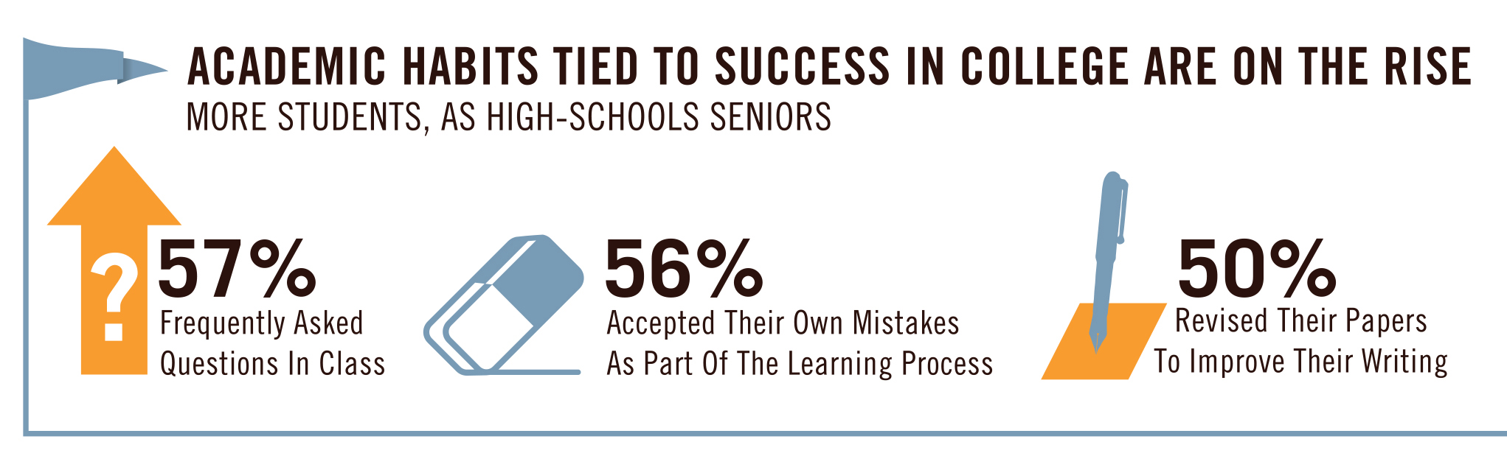

Slide 47
Slight Rise in Selected Habits of Mind (% Indicating “Frequently” or “Occasionally”)

Slide 48
Impact of Economics
Expectations and Reality of Time to Graduation
Support of Same-Sex Marriage
Political Views and Orientation between 2008 and 2012
Revised Majors in 2012
Pre-Med or Pre-Law Track
Differences in Math Preparation
Specific Habits of Mind on the Rise
Feeling Overwhelmed as High School Seniors
Where Students Reside

Slide 49
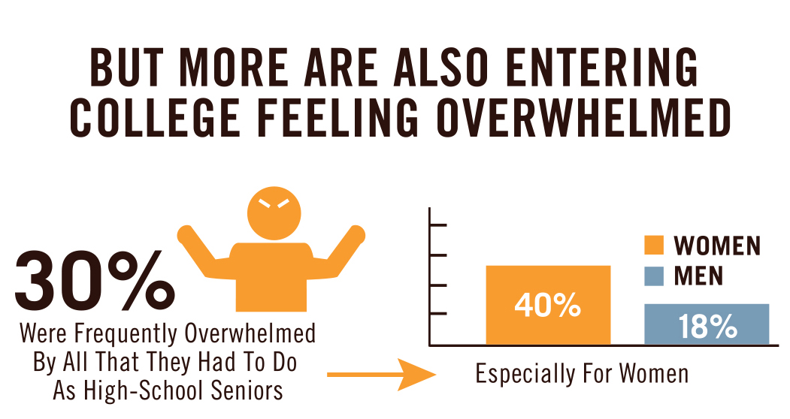

Slide 50
Trend of “Felt Overwhelmed by All I Had to Do” (% Indicating “Frequently”)
Notes:
30.7 in 1999

Slide 51
Felt Overwhelmed by All I had To Do
(% Indicating “Frequently”)

Slide 52
Impact of Feeling Overwhelmed

Slide 53
Impact of Economics
Expectations and Reality of Time to Graduation
Support of Same-Sex Marriage
Political Views and Orientation between 2008 and 2012
Revised Majors in 2012
Pre-Med or Pre-Law Track
Differences in Math Preparation
Specific Habits of Mind on the Rise
Feeling Overwhelmed as High School Seniors
Where Students Reside

Slide 54
Living Plans for Fall

Slide 55
Students Living with Family
Important factor in college choice
Cost (57.3% vs 40.1%)
Live near home (49.0% vs 13.7%)
Financing college
Using loans (48.7% vs 62.3%)
Not using any family resources (21.1% vs 12.7%)

Slide 56
Students Living with Family
“Very good” chance of transfer
10.0% vs 5.2%
Need extra time to complete degree
7.9% vs 5.4%

Slide 57
Conclusions
Economic impact intensifies
All time highs
At the same time, few see time to degree as important as it should be
Students identify more with “middle of the road” politically, yet hold liberal views
More students entering having felt overwhelmed

Slide 58

For More Information
www.heri.ucla.edu
john.pryor@ucla.edu

