Slide 1
Introduction to Communication-Avoiding Algorithms www.cs.berkeley.edu/~demmel/SC12_tutorial
Jim Demmel
EECS & Math Departments
UC Berkeley

Slide 2
Why avoid communication? (1/2)
Algorithms have two costs (measured in time or energy):
Arithmetic (FLOPS)
Communication: moving data between
levels of a memory hierarchy (sequential case)
processors over a network (parallel case).
CPU
Cache
CPU
DRAM
CPU
DRAM
DRAM
CPU
DRAM
CPU
DRAM

Slide 3
Why avoid communication? (2/3)
Running time of an algorithm is sum of 3 terms:
# flops * time_per_flop
# words moved / bandwidth
# messages * latency
communication
Time_per_flop << 1/ bandwidth << latency
Gaps growing exponentially with time [FOSC]
Avoid communication to save time
Annual improvements
Time_per_flop |  | Bandwidth | Latency
 | Network | 26% | 15%
 | DRAM | 23% | 5%
59%
Goal : reorganize algorithms to avoid communication
Between all memory hierarchy levels
L1 L2 DRAM network, etc
Very large speedups possible
Energy savings too!
Notes:
2008 DARPA Exascale report has similar prediction:
Gap between DRAM access time and flops will increase
100x over coming decade to balance power usage between
processors, DRAM
2011 NRC Report: “The Future of Computing Performance: Game Over or Next Level?”
Millett and Fuller

Slide 4
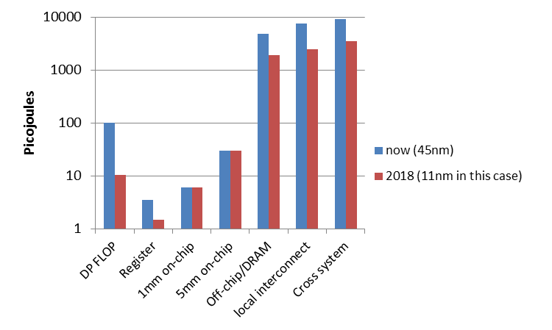
Why Minimize Communication? (2/2)
Source: John Shalf, LBL

Slide 5
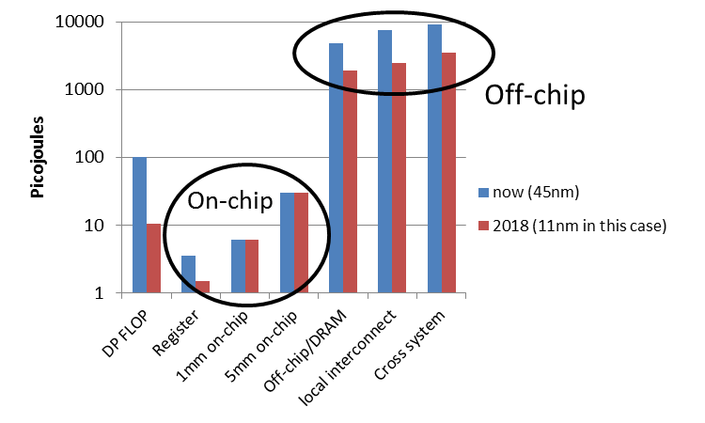
Why Minimize Communication? (2/2)
Minimize communication to save energy
Source: John Shalf, LBL

Slide 6
Goals
Redesign algorithms to avoid communication
Between all memory hierarchy levels
L1 L2 DRAM network, etc
Attain lower bounds if possible
Current algorithms often far from lower bounds
Large speedups and energy savings possible
Notes:
2008 DARPA Exascale report has similar prediction:
Gap between DRAM access time and flops will increase
100x over coming decade to balance power usage between
processors, DRAM

Slide 7
President Obama cites Communication-Avoiding Algorithms in the FY 2012 Department of Energy Budget Request to Congress:
“New Algorithm Improves Performance and Accuracy on Extreme-Scale Computing Systems. On modern computer architectures, communication between processors takes longer than the performance of a floating point arithmetic operation by a given processor. ASCR researchers have developed a new method, derived from commonly used linear algebra methods, to minimize communications between processors and the memory hierarchy, by reformulating the communication patterns specified within the algorithm. This method has been implemented in the TRILINOS framework, a highly-regarded suite of software, which provides functionality for researchers around the world to solve large scale, complex multi-physics problems.”
FY 2010 Congressional Budget, Volume 4, FY2010 Accomplishments, Advanced Scientific Computing Research (ASCR), pages 65-67.
CA-GMRES (Hoemmen, Mohiyuddin, Yelick, JD)
“Tall-Skinny” QR (Grigori, Hoemmen, Langou, JD)

Slide 8
Collaborators and Supporters
Michael Christ, Jack Dongarra, Ioana Dumitriu, Armando Fox, David Gleich, Laura Grigori, Ming Gu, Mike Heroux, Mark Hoemmen, Olga Holtz, Kurt Keutzer, Julien Langou, Tom Scanlon, Michelle Strout, Sam Williams, Hua Xiang, Kathy Yelick
Michael Anderson, Grey Ballard, Austin Benson, Abhinav Bhatele, Aydin Buluc, Erin Carson, Maryam Dehnavi, Michael Driscoll, Evangelos Georganas, Nicholas Knight, Penporn Koanantakool, Ben Lipshitz, Marghoob Mohiyuddin, Oded Schwartz, Edgar Solomonik
Other members of ParLab, BEBOP, CACHE, EASI, FASTMath, MAGMA, PLASMA, TOPS projects
Thanks to NSF, DOE, UC Discovery, Intel, Microsoft, Mathworks, National Instruments, NEC, Nokia, NVIDIA, Samsung, Oracle
bebop.cs.berkeley.edu

Slide 9
Summary of CA Algorithms
“Direct” Linear Algebra
Lower bounds on communication for linear algebra problems like Ax=b, least squares, Ax = λx, SVD, etc
New algorithms that attain these lower bounds
Being added to libraries: Sca/LAPACK, PLASMA, MAGMA
Large speed-ups possible
Autotuning to find optimal implementation
Ditto for “Iterative” Linear Algebra
Ditto (work in progress) for programs accessing arrays (eg n-body)

Slide 10
Outline
“Direct” Linear Algebra
Lower bounds on communication
New algorithms that attain these lower bounds
Ditto for “Iterative” Linear Algebra
Ditto (work in progress) for programs accessing arrays (eg n-body)

Slide 11
Outline
“Direct” Linear Algebra
Lower bounds on communication
New algorithms that attain these lower bounds
Ditto for “Iterative” Linear Algebra
Ditto (work in progress) for programs accessing arrays (eg n-body)

Slide 12
Lower bound for all “direct” linear algebra
Let M = “fast” memory size (per processor)
#words_moved (per processor) = Ω(#flops (per processor) / M^{1/2} )
#messages_sent (per processor) = Ω(#flops (per processor) / M^{3/2} )
Parallel case: assume either load or memory balanced
Holds for
Matmul, BLAS, LU, QR, eig, SVD, tensor contractions, …
Some whole programs (sequences of these operations, no matter how individual ops are interleaved, eg A^{k})
Dense and sparse matrices (where #flops << n³ )
Sequential and parallel algorithms
Some graph-theoretic algorithms (eg Floyd-Warshall)

Slide 13
Lower bound for all “direct” linear algebra
Let M = “fast” memory size (per processor)
#words_moved (per processor) = Ω(#flops (per processor) / M^{1/2} )
#messages_sent ≥ #words_moved / largest_message_size
Parallel case: assume either load or memory balanced
Holds for
Matmul, BLAS, LU, QR, eig, SVD, tensor contractions, …
Some whole programs (sequences of these operations, no matter how individual ops are interleaved, eg A^{k})
Dense and sparse matrices (where #flops << n³ )
Sequential and parallel algorithms
Some graph-theoretic algorithms (eg Floyd-Warshall)

Slide 14
Lower bound for all “direct” linear algebra
Let M = “fast” memory size (per processor)
#words_moved (per processor) = Ω(#flops (per processor) / M^{1/2} )
#messages_sent (per processor) = Ω(#flops (per processor) / M^{3/2} )
Parallel case: assume either load or memory balanced
Holds for
Matmul, BLAS, LU, QR, eig, SVD, tensor contractions, …
Some whole programs (sequences of these operations, no matter how individual ops are interleaved, eg A^{k})
Dense and sparse matrices (where #flops << n³ )
Sequential and parallel algorithms
Some graph-theoretic algorithms (eg Floyd-Warshall)
SIAM SIAG/Linear Algebra Prize, 2012
Ballard, D., Holtz, Schwartz

Slide 15
Can we attain these lower bounds?
Do conventional dense algorithms as implemented in LAPACK and ScaLAPACK attain these bounds?
Often not
If not, are there other algorithms that do?
Yes, for much of dense linear algebra
New algorithms, with new numerical properties, new ways to encode answers, new data structures
Not just loop transformations
Only a few sparse algorithms so far
Lots of work in progress
Case study: Matrix Multiply

Slide 16
Naïve Matrix Multiply
{implements C = C + A*B}
for i = 1 to n
for j = 1 to n
for k = 1 to n
C(i,j) = C(i,j) + A(i,k) * B(k,j)
C(i,j)
C(i,j)
A(i,:)
=
+
*
B(:,j)

Slide 17
Naïve Matrix Multiply
{implements C = C + A*B}
for i = 1 to n
{read row i of A into fast memory}
for j = 1 to n
{read C(i,j) into fast memory}
{read column j of B into fast memory}
for k = 1 to n
C(i,j) = C(i,j) + A(i,k) * B(k,j)
{write C(i,j) back to slow memory}
C(i,j)
C(i,j)
A(i,:)
=
+
*
B(:,j)

Slide 18
Naïve Matrix Multiply
{implements C = C + A*B}
for i = 1 to n
{read row i of A into fast memory} … n² reads altogether
for j = 1 to n
{read C(i,j) into fast memory} … n² reads altogether
{read column j of B into fast memory} … n³ reads altogether
for k = 1 to n
C(i,j) = C(i,j) + A(i,k) * B(k,j)
{write C(i,j) back to slow memory} … n² writes altogether
C(i,j)
C(i,j)
A(i,:)
=
+
*
B(:,j)
n³ + 3n² reads/writes altogether – dominates 2n³ arithmetic

Slide 19
Blocked (Tiled) Matrix Multiply
Consider A,B,C to be n/b-by-n/b matrices of b-by-b subblocks where b is called the block size; assume 3 b-by-b blocks fit in fast memory
for i = 1 to n/b
for j = 1 to n/b
{read block C(i,j) into fast memory}
for k = 1 to n/b
{read block A(i,k) into fast memory}
{read block B(k,j) into fast memory}
C(i,j) = C(i,j) + A(i,k) * B(k,j) {do a matrix multiply on blocks}
{write block C(i,j) back to slow memory}
C(i,j)
C(i,j)
A(i,k)
b-by-b
block
=
+
*
B(k,j)

Slide 20
Blocked (Tiled) Matrix Multiply
Consider A,B,C to be n/b-by-n/b matrices of b-by-b subblocks where b is called the block size; assume 3 b-by-b blocks fit in fast memory
for i = 1 to n/b
for j = 1 to n/b
{read block C(i,j) into fast memory} … b² × (n/b)² = n² reads
for k = 1 to n/b
{read block A(i,k) into fast memory} … b² × (n/b)³ = n³/b reads
{read block B(k,j) into fast memory} … b² × (n/b)³ = n³/b reads
C(i,j) = C(i,j) + A(i,k) * B(k,j) {do a matrix multiply on blocks}
{write block C(i,j) back to slow memory} … b² × (n/b)² = n² writes
C(i,j)
C(i,j)
A(i,k)
b-by-b
block
=
+
*
B(k,j)
2n³/b + 2n² reads/writes << 2n³ arithmetic - Faster!

Slide 21
Does blocked matmul attain lower bound?
Recall: if 3 b-by-b blocks fit in fast memory of size M, then #reads/writes = 2n³/b + 2n²
Make b as large as possible: 3b² ≤ M, so #reads/writes ≥ 3^{1/2}n³/M^{1/2} + 2n²
Attains lower bound = Ω (#flops / M^{1/2} )
But what if we don’t know M?
Or if there are multiple levels of fast memory?
How do we write the algorithm?

Slide 22
Recursive Matrix Multiplication (RMM) (1/2)
For simplicity: square matrices with n = 2^{m}
C = = A · B = · ·
=
True when each A_{ij} etc 1x1 or n/2 x n/2
C₁₁ C₁₂ C₂₁ C₂₂
A₁₁ A₁₂ A₂₁ A₂₂
B₁₁ B₁₂ B₂₁ B₂₂
A₁₁·B₁₁ + A₁₂·B₂₁ A₁₁·B₁₂ + A₁₂·B₂₂ A₂₁·B₁₁ + A₂₂·B₂₁ A₂₁·B₁₂ + A₂₂·B₂₂
func C = RMM (A, B, n)
if n = 1, C = A * B, else
{ C₁₁ = RMM (A₁₁ , B₁₁ , n/2) + RMM (A₁₂ , B₂₁ , n/2)
C₁₂ = RMM (A₁₁ , B₁₂ , n/2) + RMM (A₁₂ , B₂₂ , n/2)
C₂₁ = RMM (A₂₁ , B₁₁ , n/2) + RMM (A₂₂ , B₂₁ , n/2)
C₂₂ = RMM (A₂₁ , B₁₂ , n/2) + RMM (A₂₂ , B₂₂ , n/2) }
return

Slide 23
Recursive Matrix Multiplication (RMM) (2/2)
func C = RMM (A, B, n)
if n=1, C = A * B, else
{ C₁₁ = RMM (A₁₁ , B₁₁ , n/2) + RMM (A₁₂ , B₂₁ , n/2)
C₁₂ = RMM (A₁₁ , B₁₂ , n/2) + RMM (A₁₂ , B₂₂ , n/2)
C₂₁ = RMM (A₂₁ , B₁₁ , n/2) + RMM (A₂₂ , B₂₁ , n/2)
C₂₂ = RMM (A₂₁ , B₁₂ , n/2) + RMM (A₂₂ , B₂₂ , n/2) }
return
For big speedups, see SC12 poster on “Beating MKL and ScaLAPACK at Rectangular Matmul” 11/13 at 5:15-7pm
A(n) = # arithmetic operations in RMM( . , . , n)
= 8 · A(n/2) + 4(n/2)² if n > 1, else 1
= 2n³ … same operations as usual, in different order
W(n) = # words moved between fast, slow memory by RMM( . , . , n)
= 8 · W(n/2) + 12(n/2)² if 3n² > M , else 3n²
= O( n³ / M^{1/2} + n² ) … same as blocked matmul
“Cache oblivious”, works for memory hierarchies, but not panacea
Notes:
Speedups are for very rectangular matrices, not square

Slide 24
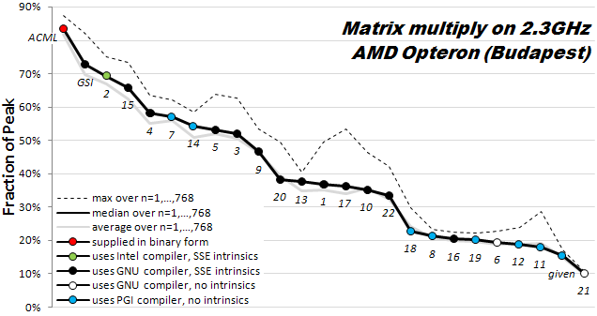
How hard is hand-tuning matmul, anyway?
Results of 22 student teams trying to tune matrix-multiply, in CS267 Spr09
Students given “blocked” code to start with (7x faster than naïve)
Still hard to get close to vendor tuned performance (ACML) (another 6x)
For more discussion, see www.cs.berkeley.edu/~volkov/cs267.sp09/hw1/results/

Slide 25
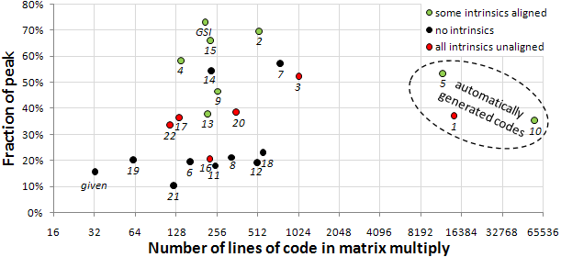
How hard is hand-tuning matmul, anyway?

Slide 26
Parallel MatMul with 2D Processor Layout
P processors in P^{1/2} x P^{1/2} grid
Processors communicate along rows, columns
Each processor owns n/P^{1/2} x n/P^{1/2} submatrices of A,B,C
Example: P=16, processors numbered from P₀₀ to P₃₃
Processor P_{ij} owns submatrices A_{ij}, B_{ij} and C_{ij}
C = A * B
P₀₀ P₀₁ P₀₂ P₀₃
P₀₀ P₀₁ P₀₂ P₀₃
P₀₀ P₀₁ P₀₂ P₀₃
P₁₀ P₁₁ P₁₂ P₁₃
P₁₀ P₁₁ P₁₂ P₁₃
P₁₀ P₁₁ P₁₂ P₁₃
P₂₀ P₂₁ P₂₂ P₂₃
P₂₀ P₂₁ P₂₂ P₂₃
P₂₀ P₂₁ P₂₂ P₂₃
P₃₀ P₃₁ P₃₂ P₃₃
P₃₀ P₃₁ P₃₂ P₃₃
P₃₀ P₃₁ P₃₂ P₃₃

Slide 27
SUMMA Algorithm
SUMMA = Scalable Universal Matrix Multiply
Comes within factor of log P of lower bounds:
Assume fast memory size M = O(n²/P) per processor – 1 copy of data
#words_moved = Ω( #flops / M^{1/2} ) = Ω( (n³/P) / (n²/P)^{1/2} ) = Ω( n² / P^{1/2} )
#messages = Ω( #flops / M^{3/2} ) = Ω( (n³/P) / (n²/P)^{3/2} ) = Ω( P^{1/2} )
Can accommodate any processor grid, matrix dimensions & layout
Used in practice in PBLAS = Parallel BLAS
www.netlib.org/lapack/lawns/lawn{96,100}.ps
Comparison to Cannon’s Algorithm
Cannon attains lower bound
But Cannon harder to generalize to other grids, dimensions, layouts, and Cannon may use more memory
Notes:
SUMMA with more complicated implementation can attain bandwidth lower bound

Slide 28
SUMMA – n x n matmul on P^{1/2} x P^{1/2} grid
k
j
B(k,j)
k
*
=
i
C(i,j)
A(i,k)
C(i, j) is n/P^{1/2} x n/P^{1/2} submatrix of C on processor P_{ij}
A(i,k) is n/P^{1/2} x b submatrix of A
B(k,j) is b x n/P^{1/2} submatrix of B
C(i,j) = C(i,j) + Σ_{k} A(i,k)*B(k,j)
summation over submatrices
Need not be square processor grid

Slide 29
SUMMA– n x n matmul on P^{1/2} x P^{1/2} grid
k
j
B(k,j)
k
*
=
Brow
i
C(i,j)
A(i,k)
Acol
For k=0 to n-1 … or n/b-1 where b is the block size
… = # cols in A(i,k) and # rows in B(k,j)
for all i = 1 to p_{r} … in parallel
owner of A(i,k) broadcasts it to whole processor row
for all j = 1 to p_{c} … in parallel
owner of B(k,j) broadcasts it to whole processor column
Receive A(i,k) into Acol
Receive B(k,j) into Brow
C_myproc = C_myproc + Acol * Brow
For k=0 to n/b-1
for all i = 1 to P^{1/2}
owner of A(i,k) broadcasts it to whole processor row (using binary tree)
for all j = 1 to P^{1/2}
owner of B(k,j) broadcasts it to whole processor column (using bin. tree)
Receive A(i,k) into Acol
Receive B(k,j) into Brow
C_myproc = C_myproc + Acol * Brow

Slide 30
SUMMA Communication Costs
For k=0 to n/b-1
for all i = 1 to P^{1/2}
owner of A(i,k) broadcasts it to whole processor row (using binary tree)
… #words = log P^{1/2} *b*n/P^{1/2} , #messages = log P^{1/2}
for all j = 1 to P^{1/2}
owner of B(k,j) broadcasts it to whole processor column (using bin. tree)
… same #words and #messages
Receive A(i,k) into Acol
Receive B(k,j) into Brow
C_myproc = C_myproc + Acol * Brow
Total #words = log P * n² /P^{1/2}
Within factor of log P of lower bound
(more complicated implementation removes log P factor)
Total #messages = log P * n/b
Choose b close to maximum, n/P^{1/2},
to approach lower bound P^{1/2}

Slide 31
Can we do better?
Lower bound assumed 1 copy of data: M = O(n²/P) per proc.
What if matrix small enough to fit c>1 copies, so M = cn²/P ?
#words_moved = Ω( #flops / M^{1/2} ) = Ω( n² / ( c^{1/2} P^{1/2} ))
#messages = Ω( #flops / M^{3/2} ) = Ω( P^{1/2} /c^{3/2})
Can we attain new lower bound?
Special case: “3D Matmul”: c = P^{1/3}
Dekel, Nassimi, Sahni [81], Bernsten [89], Agarwal, Chandra, Snir [90], Johnson [93], Agarwal, Balle, Gustavson, Joshi, Palkar [95]
Processors arranged in P^{1/3} x P^{1/3} x P^{1/3} grid
Processor (i,j,k) performs C(i,j) = C(i,j) + A(i,k)*B(k,j), where each submatrix is n/P^{1/3} x n/P^{1/3}
Not always that much memory available…

Slide 32
2.5D Matrix Multiplication
Assume can fit cn²/P data per processor, c>1
Processors form (P/c)^{1/2} x (P/c)^{1/2} x c grid
(P/c)^{1/2}
(P/c)^{1/2}
Example: P = 32, c = 2
c

Slide 33
2.5D Matrix Multiplication
Assume can fit cn²/P data per processor, c > 1
Processors form (P/c)^{1/2} x (P/c)^{1/2} x c grid
j
i
Initially P(i,j,0) owns A(i,j) and B(i,j)
each of size n(c/P)^{1/2} x n(c/P)^{1/2}
k
(1) P(i,j,0) broadcasts A(i,j) and B(i,j) to P(i,j,k)
(2) Processors at level k perform 1/c-th of SUMMA, i.e. 1/c-th of Σ_{m} A(i,m)*B(m,j)
(3) Sum-reduce partial sums Σ_{m} A(i,m)*B(m,j) along k-axis so P(i,j,0) owns C(i,j)

Slide 34
2.5D Matmul on BG/P, 16K nodes / 64K cores

Slide 35
2.5D Matmul on BG/P, 16K nodes / 64K cores
c = 16 copies
2.7x faster
12x faster
Distinguished Paper Award, EuroPar’11
SC’11 paper by Solomonik, Bhatele, D.
Notes:
SC’11 paper about need to fully utilize 3D torus network on BG/P to get this to work

Slide 36
Perfect Strong Scaling – in Time and Energy (1/2)
Every time you add a processor, you should use its memory M too
Start with minimal number of procs: PM = 3n²
Increase P by a factor of c ➔ total memory increases by a factor of c
Notation for timing model:
γ_{T} , β_{T} , α_{T} = secs per flop, per word_moved, per message of size m
T(cP) = n³/(cP) [ γ_{T}+ β_{T}/M^{1/2} + α_{T}/(mM^{1/2}) ]
= T(P)/c
Notation for energy model:
γ_{E} , β_{E} , α_{E} = joules for same operations
δ_{E} = joules per word of memory used per sec
ε_{E} = joules per sec for leakage, etc.
E(cP) = cP { n³/(cP) [ γ_{E}+ β_{E}/M^{1/2} + α_{E}/(mM^{1/2}) ] + δ_{E}MT(cP) + ε_{E}T(cP) }
= E(P)

Slide 37
Perfect Strong Scaling in Time of 2.5D Matmul on BG/P, n=64K
As P increases, available memory grows ➔ c increases proportionally to P
#flops, #words_moved, #messages per proc all decrease proportionally to P
Perfect strong scaling! But only up to c = P^{1/3}

Slide 38
Perfect Strong Scaling – in Time and Energy (2/2)
Perfect scaling extends to N-body, Strassen, …
We can use these models to answer many questions, including:
What is the minimum energy required for a computation?
Given a maximum allowed runtime T , what is the minimum energy E needed to achieve it?
Given a maximum energy budget E , what is the minimum runtime T that we can attain?
The ratio P = E/T gives us the average power required to run the algorithm. Can we minimize the average power consumed?
Given an algorithm, problem size, number of processors and target energy efficiency (GFLOPS/W), can we determine a set of architectural parameters to describe a conforming computer architecture?

Slide 39
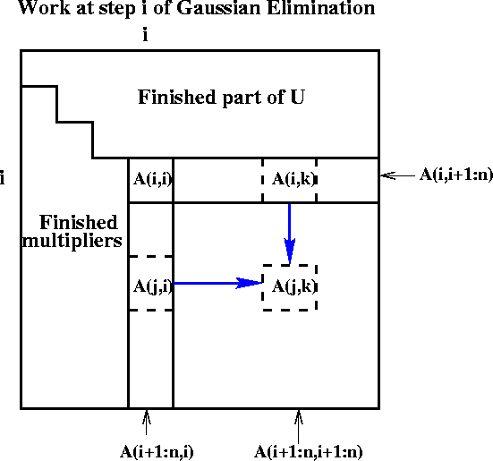
Extending to rest of Direct Linear Algebra Naïve Gaussian Elimination: A =LU
Last version
Express using matrix operations (BLAS)
for i = 1 to n-1
A(i+1:n,i) = A(i+1:n,i) * ( 1 / A(i,i) )
… scale a vector
A(i+1:n,i+1:n) = A(i+1:n , i+1:n )
- A(i+1:n , i) * A(i , i+1:n)
… rank-1 update
for i=1 to n-1
update column i
update trailing matrix
➔
for i = 1 to n-1
for j = i+1 to n
A(j,i) = A(j,i)/A(i,i)
for j = i+1 to n
for k = i+1 to n
A(j,k) = A(j,k) - A(j,i) * A(i,k)

Slide 40
Communication in sequential One-sided Factorizations (LU, QR, …)
Naive Approach
for i=1 to n-1
update column i
update trailing matrix
#words_moved = O(n³)
Blocked Approach (LAPACK)
for i=1 to n/b - 1
update block i of b columns
update trailing matrix
#words moved = O(n³/M^{1/3})
Recursive Approach
func factor(A)
if A has 1 column, update it else
factor(left half of A)
update right half of A
factor(right half of A)
#words moved = O(n³/M^{1/2})
None of these approaches
minimizes #messages
handles eig() or svd()
works in parallel
Need more ideas
Notes:
Recursive approach”
QR: Elmroth, Gustavson
LU: Toledo

Slide 41
TSQR: QR of a Tall, Skinny matrix
W₀
W₁
W₂
W₃
Q₀₀ R₀₀
Q₁₀ R₁₀
Q₂₀ R₂₀
Q₃₀ R₃₀
Q₀₀
Q₁₀
Q₂₀
Q₃₀
R₀₀
R₁₀
R₂₀
R₃₀
W =
=
=
.
R₀₀
R₁₀
R₂₀
R₃₀
Q₀₁ R₀₁
Q₁₁ R₁₁
Q₀₁
Q₁₁
R₀₁
R₁₁
=
=
.
R₀₁
R₁₁
=
Q₀₂ R₀₂

Slide 42
TSQR: QR of a Tall, Skinny matrix
W₀
W₁
W₂
W₃
Q₀₀ R₀₀
Q₁₀ R₁₀
Q₂₀ R₂₀
Q₃₀ R₃₀
Q₀₀
Q₁₀
Q₂₀
Q₃₀
R₀₀
R₁₀
R₂₀
R₃₀
W =
=
=
.
R₀₀
R₁₀
R₂₀
R₃₀
Q₀₁ R₀₁
Q₁₁ R₁₁
Q₀₁
Q₁₁
R₀₁
R₁₁
=
=
.
R₀₁
R₁₁
=
Q₀₂ R₀₂
Output = { Q₀₀, Q₁₀, Q₂₀, Q₃₀, Q₀₁, Q₁₁, Q₀₂, R₀₂ }

Slide 43
TSQR: An Architecture-Dependent Algorithm
W₀
W₁
W₂
W₃
R₀₀
R₁₀
R₂₀
R₃₀
R₀₁
Parallel:
W =
R₀₂
R₁₁
W₀
W₁
W₂
W₃
R₀₀
Sequential:
R₀₁
W =
R₀₂
R₀₃
W₀
W₁
W₂
W₃
R₀₀
R₀₁
Dual Core:
R₀₁
W =
R₀₂
R₁₁
R₀₃
R₁₁
Multicore / Multisocket / Multirack / Multisite / Out-of-core: ?
Can choose reduction tree dynamically
Notes:
Oldest reference for idea of tree: Golub/Plemmons/Sameh 1988,
But didn’t avoid communication

Slide 44
TSQR Performance Results
Parallel
Intel Clovertown
Up to 8x speedup (8 core, dual socket, 10M x 10)
Pentium III cluster, Dolphin Interconnect, MPICH
Up to 6.7x speedup (16 procs, 100K x 200)
BlueGene/L
Up to 4x speedup (32 procs, 1M x 50)
Tesla C 2050 / Fermi
Up to 13x (110,592 x 100)
Grid – 4x on 4 cities (Dongarra et al)
Cloud – 1.6x slower than accessing data twice (Gleich and Benson)
Sequential
“Infinite speedup” for out-of-Core on PowerPC laptop
As little as 2x slowdown vs (predicted) infinite DRAM
LAPACK with virtual memory never finished
SVD costs about the same
Joint work with Grigori, Hoemmen, Langou, Anderson, Ballard, Keutzer, others
Data from Grey Ballard, Mark Hoemmen, Laura Grigori, Julien Langou, Jack Dongarra, Michael Anderson
Notes:
Transition: TSQR -> CAQR

Slide 45
Back to LU: Using similar idea for TSLU as TSQR: Use reduction tree, to do “Tournament Pivoting”
W₁
W₂
W₃
W₄
P₁·L₁·U₁
P₂·L₂·U₂
P₃·L₃·U₃
P₄·L₄·U₄
Choose b pivot rows of W₁, call them W₁’
Choose b pivot rows of W₂, call them W₂’
Choose b pivot rows of W₃, call them W₃’
Choose b pivot rows of W₄, call them W₄’
W^{nxb} =
=
W₁’
W₂’
W₃’
W₄’
P₁₂·L₁₂·U₁₂
P₃₄·L₃₄·U₃₄
Choose b pivot rows, call them W₁₂’
Choose b pivot rows, call them W₃₄’
=
W₁₂’
W₃₄’
= P₁₂₃₄·L₁₂₃₄·U₁₂₃₄
Choose b pivot rows
Go back to W and use these b pivot rows
Move them to top, do LU without pivoting
Extra work, but lower order term
Thm: As numerically stable as Partial Pivoting on a larger matrix

Slide 46
Exascale Machine Parameters Source: DOE Exascale Workshop
2^20 ≈ 1,000,000 nodes
1024 cores/node (a billion cores!)
100 GB/sec interconnect bandwidth
400 GB/sec DRAM bandwidth
1 microsec interconnect latency
50 nanosec memory latency
32 Petabytes of memory
1/2 GB total L1 on a node

Slide 47
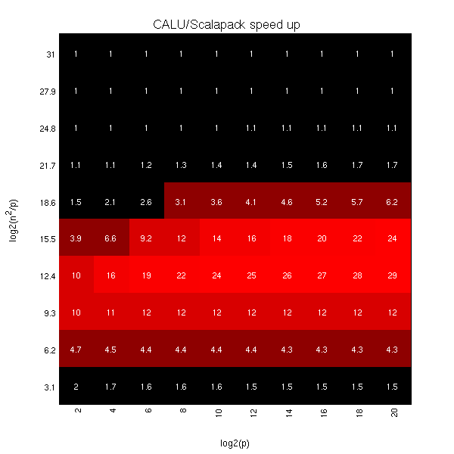
Exascale predicted speedups for Gaussian Elimination: 2D CA-LU vs ScaLAPACK-LU
log₂ (n²/p) =
log₂ (memory_per_proc)
log₂ (p)
Notes:
Vertical axis log2(n^2/p) is memory per processor
Horizontal axis log2(p) is processor count

Slide 48
2.5D vs 2D LU With and Without Pivoting

Slide 49
Summary of dense sequential algorithms attaining communication lower bounds
Algorithms shown minimizing # Messages use (recursive) block layout
Not possible with columnwise or rowwise layouts
Many references (see reports), only some shown, plus ours
Cache-oblivious are underlined, Green are ours, ? is unknown/future work
Algorithm | 2 Levels of Memory |  | Multiple Levels of Memory
 | #Words Moved | and # Messages | #Words Moved | and #Messages
BLAS-3 | Usual blocked or recursive algorithms |  | Usual blocked algorithms (nested), or recursive [Gustavson,97]
Cholesky | LAPACK (with b = M^{1/2}) [Gustavson 97] [BDHS09] | [Gustavson,97] [Ahmed,Pingali,00] [BDHS09] | (←same) | (←same)
LU with pivoting | LAPACK (sometimes) [Toledo,97] , [GDX 08] | [GDX 08] partial pivoting? | [Toledo, 97] [GDX 08]? | [GDX 08]?
QR Rank-revealing | LAPACK (sometimes) [Elmroth,Gustavson,98] [DGHL08] | [Frens,Wise,03] but 3x flops? [DGHL08] | [Elmroth, Gustavson,98] [DGHL08] ? | [Frens,Wise,03] [DGHL08] ?
Eig, SVD | Not LAPACK [BDD11] randomized, but more flops; [BDK11] |  | [BDD11, BDK11?] | [BDD11, BDK11?]
Notes:
Questions:
Was [Gustavson,97] not cache oblivious?
[Frigo, Leiserson, Prokop, Ramachandran,99]

Slide 50
Summary of dense parallel algorithms attaining communication lower bounds
Assume nxn matrices on P processors
Minimum Memory per processor = M = O(n² / P)
Recall lower bounds:
#words_moved = Ω( (n³/ P) / M^{1/2} ) = Ω( n² / P^{1/2} )
#messages = Ω( (n³/ P) / M^{3/2} ) = Ω( P^{1/2} )
Algorithm | Reference | Factor exceeding lower bound for #words_moved | Factor exceeding lower bound for #messages
Matrix Multiply
Cholesky
LU
QR
Sym Eig, SVD
Nonsym Eig
Notes:
ScaLAPACK assumes best block size chosen
Many references, green are ours

Slide 51
Summary of dense parallel algorithms attaining communication lower bounds
Assume nxn matrices on P processors (conventional approach)
Minimum Memory per processor = M = O(n² / P)
Recall lower bounds:
#words_moved = Ω( (n³/ P) / M^{1/2} ) = Ω( n² / P^{1/2} )
#messages = Ω( (n³/ P) / M^{3/2} ) = Ω( P^{1/2} )
Algorithm | Reference | Factor exceeding lower bound for #words_moved | Factor exceeding lower bound for #messages
Matrix Multiply | [Cannon, 69] | 1
Cholesky | ScaLAPACK | log P
LU | ScaLAPACK | log P
QR | ScaLAPACK | log P
Sym Eig, SVD | ScaLAPACK | log P
Nonsym Eig | ScaLAPACK | P^{1/2} log P
Notes:
ScaLAPACK assumes best block size chosen
Many references, green are ours

Slide 52
Summary of dense parallel algorithms attaining communication lower bounds
Assume nxn matrices on P processors (conventional approach)
Minimum Memory per processor = M = O(n² / P)
Recall lower bounds:
#words_moved = Ω( (n³/ P) / M^{1/2} ) = Ω( n² / P^{1/2} )
#messages = Ω( (n³/ P) / M^{3/2} ) = Ω( P^{1/2} )
Algorithm | Reference | Factor exceeding lower bound for #words_moved | Factor exceeding lower bound for #messages
Matrix Multiply | [Cannon, 69] | 1 | 1
Cholesky | ScaLAPACK | log P | log P
LU | ScaLAPACK | log P | n log P / P^{1/2}
QR | ScaLAPACK | log P | n log P / P^{1/2}
Sym Eig, SVD | ScaLAPACK | log P | n / P^{1/2}
Nonsym Eig | ScaLAPACK | P^{1/2} log P | n log P
Notes:
ScaLAPACK assumes best block size chosen
Many references, green are ours

Slide 53
Summary of dense parallel algorithms attaining communication lower bounds
Assume nxn matrices on P processors (better)
Minimum Memory per processor = M = O(n² / P)
Recall lower bounds:
#words_moved = Ω( (n³/ P) / M^{1/2} ) = Ω( n² / P^{1/2} )
#messages = Ω( (n³/ P) / M^{3/2} ) = Ω( P^{1/2} )
Algorithm | Reference | Factor exceeding lower bound for #words_moved | Factor exceeding lower bound for #messages
Matrix Multiply | [Cannon, 69] | 1 | 1
Cholesky | ScaLAPACK | log P | log P
LU | [GDX10] | log P | log P
QR | [DGHL08] | log P | log³ P
Sym Eig, SVD | [BDD11] | log P | log³ P
Nonsym Eig | [BDD11] | log P | log³ P
Notes:
ScaLAPACK assumes best block size chosen
Many references, green are ours

Slide 54
Can we do even better?
Assume nxn matrices on P processors
Use c copies of data: M = O(cn² / P) per processor
Increasing M reduces lower bounds:
#words_moved = Ω( (n³/ P) / M^{1/2} ) = Ω( n² / (c^{1/2} P^{1/2} ) )
#messages = Ω( (n³/ P) / M^{3/2} ) = Ω( P^{1/2} / c^{3/2} )
Algorithm | Reference | Factor exceeding lower bound for #words_moved | Factor exceeding lower bound for #messages
Matrix Multiply | [DS11,SBD11] | polylog P | polylog P
Cholesky | [SD11, in prog.] | polylog P | c² polylog P – optimal!
LU | [DS11,SBD11] | polylog P | c² polylog P – optimal!
QR | Via Cholesky QR | polylog P | c² polylog P – optimal!
Sym Eig, SVD | ?
Nonsym Eig | ?
Notes:
LU with or without pivoting
With pivoting requires a probabilistic analysis regarding which
processors own pivot rows; assume reasonably evenly distributed to attain lower bound.
ScaLAPACK assumes best block size chosen
Many references, green are ours

Slide 55
Symmetric Band Reduction
Grey Ballard and Nick Knight
A ⇒ QAQ^{T} = T, where
A=A^{T} is banded
T tridiagonal
Similar idea for SVD of a band matrix
Use alone, or as second phase when A is dense:
Dense ⇒ Banded ⇒ Tridiagonal
Implemented in LAPACK’s sytrd
Algorithm does not satisfy communication lower bound theorem for applying orthogonal transformations
It can communicate even less!

Slide 56
Successive Band Reduction
b+1
b+1
Notes:
Does not minimize communication by itself, but does no more communication
Than reduction to band form, so overall ok.

Slide 57
Successive Band Reduction
b+1
b+1
d+1
1
c
b = bandwidth
c = #columns
d = #diagonals
Constraint: c+d ≤ b
Notes:
Does not minimize communication by itself, but does no more communication
Than reduction to band form, so overall ok.

Slide 58
Successive Band Reduction
b+1
b+1
d+1
Q₁
1
c
b = bandwidth
c = #columns
d = #diagonals
Constraint: c+d ≤ b
Notes:
Does not minimize communication by itself, but does no more communication
Than reduction to band form, so overall ok.

Slide 59
Successive Band Reduction
b+1
d+c
b+1
d+1
Q₁
2
d+c
1
c
b = bandwidth
c = #columns
d = #diagonals
Constraint: c+d ≤ b
Notes:
Does not minimize communication by itself, but does no more communication
Than reduction to band form, so overall ok.

Slide 60
Successive Band Reduction
b+1
d+1
Q₁^{T}
1
c
d+c
b+1
d+1
Q₁
2
d+c
1
c
b = bandwidth
c = #columns
d = #diagonals
Constraint: c+d ≤ b
Notes:
Does not minimize communication by itself, but does no more communication
Than reduction to band form, so overall ok.

Slide 61
Successive Band Reduction
b+1
d+1
Q₁^{T}
1
c
d+c
b+1
d+1
Q₁
2
d+c
1
c
d+c
2
d+c
b = bandwidth
c = #columns
d = #diagonals
Constraint: c+d ≤ b
Notes:
Does not minimize communication by itself, but does no more communication
Than reduction to band form, so overall ok.

Slide 62
Successive Band Reduction
b+1
d+1
Q₁^{T}
1
c
d+c
b+1
Q₂^{T}
d+1
Q₁
2
d+c
1
c
d+c
Q₂
2
3
d+c
3
b = bandwidth
c = #columns
d = #diagonals
Constraint: c+d ≤ b
Notes:
Does not minimize communication by itself, but does no more communication
Than reduction to band form, so overall ok.

Slide 63
Successive Band Reduction
b+1
d+1
Q₁^{T}
1
c
d+c
b+1
Q₂^{T}
d+1
Q₁
2
d+c
1
c
Q₃^{T}
d+c
Q₂
2
3
d+c
Q₃
4
3
b = bandwidth
c = #columns
d = #diagonals
Constraint: c+d ≤ b
4
Notes:
Does not minimize communication by itself, but does no more communication
Than reduction to band form, so overall ok.

Slide 64
Successive Band Reduction
b+1
d+1
Q₁^{T}
1
c
d+c
b+1
Q₂^{T}
d+1
Q₁
2
d+c
1
c
Q₃^{T}
d+c
Q₂
2
3
d+c
Q₄^{T}
Q₃
4
3
5
b = bandwidth
c = #columns
d = #diagonals
Constraint: c+d ≤ b
Q₄
4
5
Notes:
Does not minimize communication by itself, but does no more communication
Than reduction to band form, so overall ok.

Slide 65
Successive Band Reduction
b+1
d+1
Q₁^{T}
1
c
d+c
b+1
Q₂^{T}
d+1
Q₁
2
d+c
1
c
Q₃^{T}
d+c
Q₂
2
3
d+c
Q₄^{T}
Q₃
4
3
Q₅^{T}
5
b = bandwidth
c = #columns
d = #diagonals
Constraint: c+d ≤ b
Q₄
4
Q₅
5
Notes:
Does not minimize communication by itself, but does no more communication
Than reduction to band form, so overall ok.

Slide 66
Successive Band Reduction
To minimize #words moved (when n > M^{1/2} )
after reducing to bandwidth b = M^{1/2} :
if n > M
Use d=b-1 and c=1
else if M^{1/2} < n ≤ M
Pass 1: Use d=b – M/(4n) and c=M/(4n)
Pass 2: Use d=M/(4n)-1 and c=1
b+1
d+1
Q₁^{T}
1
c
Only need to zero out leading
parallelogram of each trapezoid:
6
d+c
b+1
Q₂^{T}
d+1
Q₁
2
d+c
1
6
c
Q₃^{T}
2
d+c
Q₂
2
3
d+c
Q₄^{T}
Q₃
4
3
Q₅^{T}
5
b = bandwidth
c = #columns
d = #diagonals
Constraint: c+d ≤ b
Q₄
4
Q₅
5
Notes:
Does not minimize communication by itself, but does no more communication
Than reduction to band form, so overall ok.

Slide 67
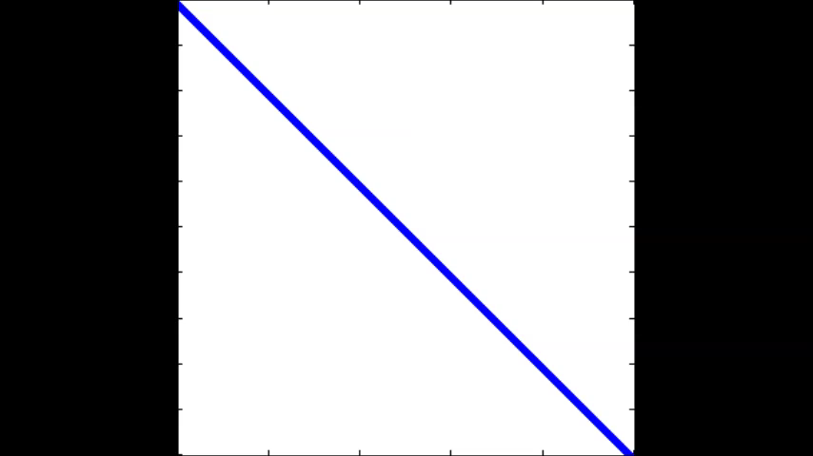

Conventional vs CA - SBR
Touch all data 4 times
Touch all data once
Conventional
Communication-Avoiding
Many tuning parameters:
Number of “sweeps”, #diagonals cleared per sweep, sizes of parallelograms
#bulges chased at one time, how far to chase each bulge
Right choices reduce #words_moved by factor M/bw, not just M^{1/2}

Slide 68
Speedups of Sym. Band Reduction vs DSBTRD
Up to 17x on Intel Gainestown, vs MKL 10.0
n=12000, b=500, 8 threads
Up to 12x on Intel Westmere, vs MKL 10.3
n=12000, b=200, 10 threads
Up to 25x on AMD Budapest, vs ACML 4.4
n=9000, b=500, 4 threads
Up to 30x on AMD Magny-Cours, vs ACML 4.4
n=12000, b=500, 6 threads
Neither MKL nor ACML benefits from multithreading in DSBTRD
Best sequential speedup vs MKL: 1.9x
Best sequential speedup vs ACML: 8.5x

Slide 69
Communication Lower Bounds for Strassen-like matmul algorithms
Classical
O(n³) matmul:
#words_moved =
Ω (M(n/M^{1/2})³/P)
Strassen’s
O(n^{lg7}) matmul:
#words_moved =
Ω (M(n/M^{1/2})^{lg7}/P)
Strassen-like
O(n^{ω}) matmul:
#words_moved =
Ω (M(n/M^{1/2})^{ω}/P)
Proof: graph expansion (different from classical matmul)
Strassen-like: DAG must be “regular” and connected
Extends up to M = n² / p^{2/ω}
Best Paper Prize (SPAA’11), Ballard, D., Holtz, Schwartz
to appear in JACM
Is the lower bound attainable?

Slide 70
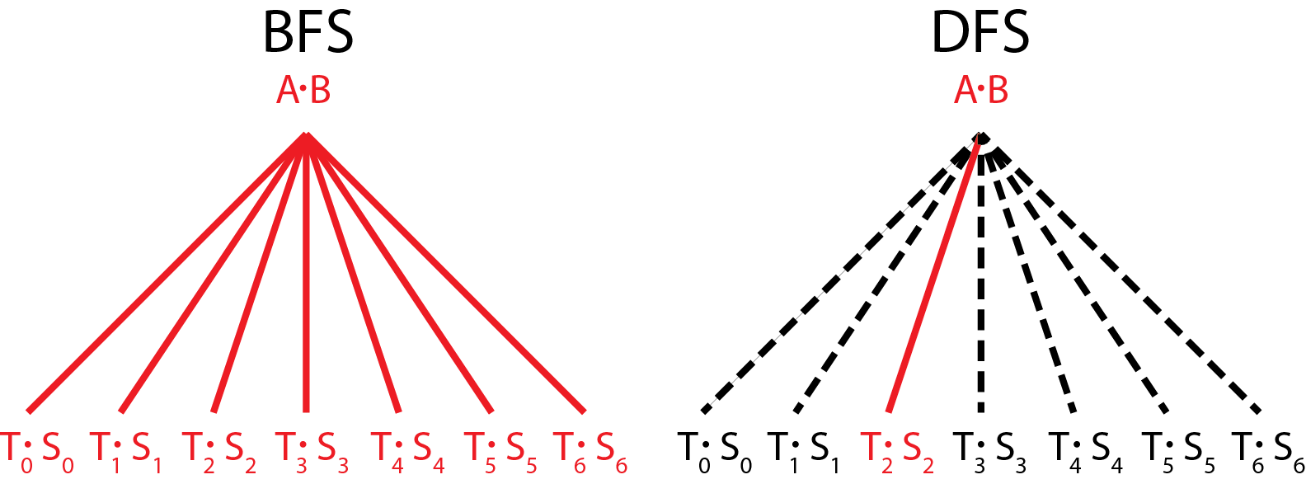
vs.
Communication Avoiding Parallel Strassen (CAPS)
Runs all 7 multiplies in parallel
Each on P/7 processors
Needs 7/4 as much memory
Runs all 7 multiplies sequentially
Each on all P processors
Needs 1/4 as much memory
CAPS
If EnoughMemory and P ≥ 7
then BFS step
else DFS step
end if
In practice, how to best interleave
BFS and DFS is
a “tuning parameter”
Notes:
Say what BFS and DFS are

Slide 71
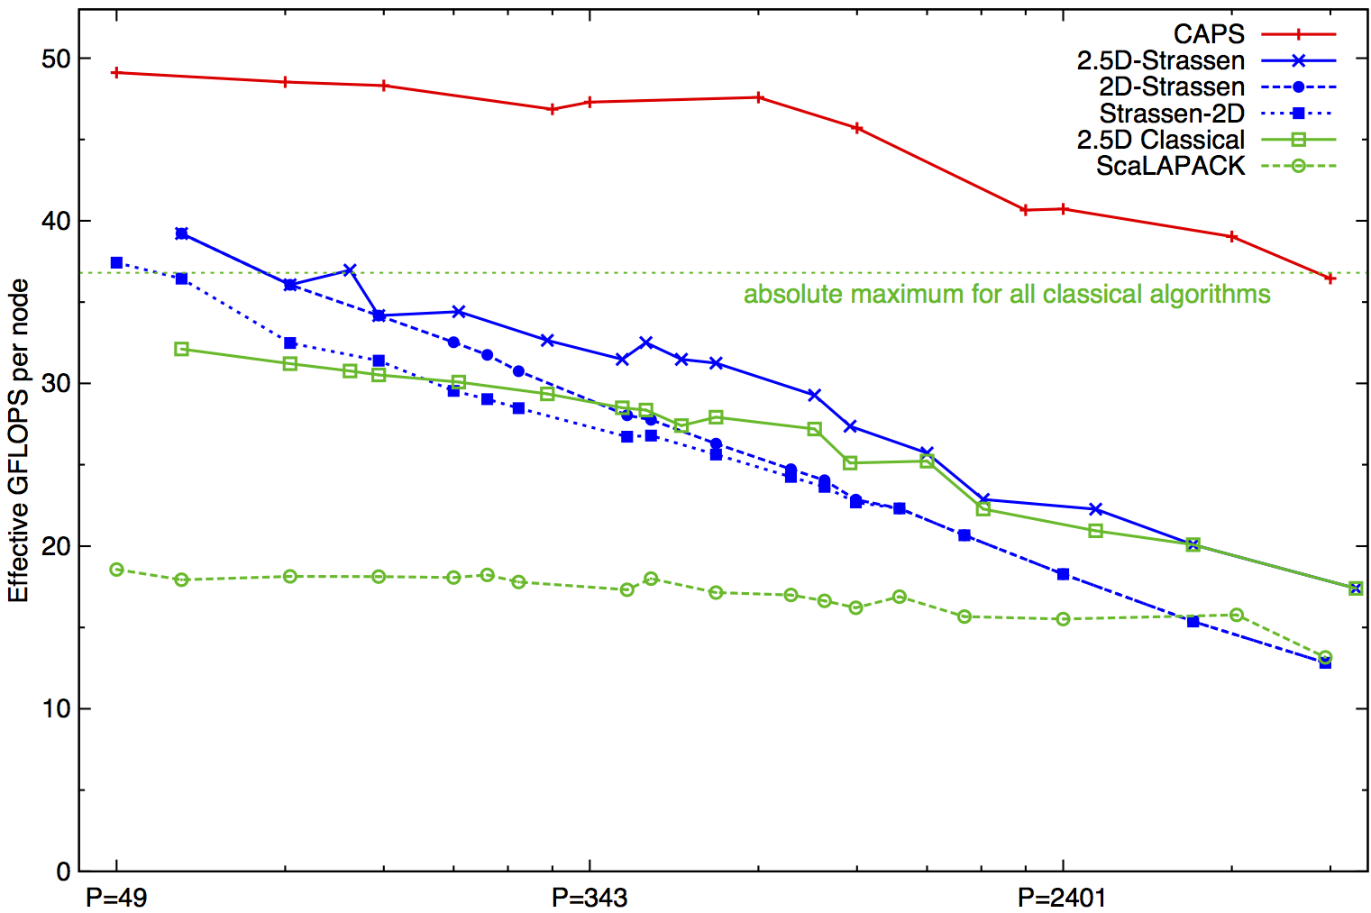
Performance Benchmarking, Strong Scaling Plot
Franklin (Cray XT4) n = 94080
For details, see SC12 talk on
“Communication-Avoiding Parallel Strassen” by
Grey Ballard et al 11/15 at 4pm
Speedups: 24%-184% (over previous Strassen-based algorithms)
Notes:
2n^3/time 184% is at 7203 ours 7056 theirs (per node).
Strong scaling range up to about p=1000
Top on this plot: p = 7200, recent data up to 20K
2(.5)D-Strassen means 2(.5)D-outer, and Strassen-inner, on the small local matrices
Strassen-2D means x DFS Strassen steps, followed by 2D classical for the 7^x subproblems
For details, see SC12 talk by Grey Ballard on CAPS

Slide 72
Summary of Direct Linear Algebra
New lower bounds, optimal algorithms, big speedups in theory and practice
Lots of ongoing work on
Algorithms:
LDL^{T}, QR with pivoting, other pivoting schemes, eigenproblems, …
All-pairs-shortest-path, …
Both 2D (c=1) and 2.5D (c>1)
But only bandwidth may decrease with c>1, not latency
Sparse matrices
Platforms:
Multicore, cluster, GPU, cloud, heterogeneous, low-energy, …
Software:
Integration into Sca/LAPACK, PLASMA, MAGMA,…
Integration into applications (on IBM BG/Q)
Qbox (with LLNL, IBM): molecular dynamics
CTF (with ANL): symmetric tensor contractions
Notes:
Qbox code – Francois Gygi @ UC Davis, also LLNL, first principle molecular dynamics,
uses Density Functional Theory to solve Kohn Sham equations, won Gordon Bell Prize in 2006
CTF – Cyclops Tensor Framework,
faster symmetric tensor contractions for “coupled cluster” electronic structure calculations

Slide 73
Outline
“Direct” Linear Algebra
Lower bounds on communication
New algorithms that attain these lower bounds
Ditto for “Iterative” Linear Algebra
Ditto (work in progress) for programs accessing arrays (eg n-body)

Slide 74
Avoiding Communication in Iterative Linear Algebra
k-steps of iterative solver for sparse Ax=b or Ax=λx
Does k SpMVs with A and starting vector
Many such “Krylov Subspace Methods”
Goal: minimize communication
Assume matrix “well-partitioned”
Serial implementation
Conventional: O(k) moves of data from slow to fast memory
New: O(1) moves of data – optimal
Parallel implementation on p processors
Conventional: O(k log p) messages (k SpMV calls, dot prods)
New: O(log p) messages - optimal
Lots of speed up possible (modeled and measured)
Price: some redundant computation
74
Notes:
Well – partitioned = modest surface-to-volume ratio
See bebop.cs.berkeley.edu
CG: [van Rosendale, 83], [Chronopoulos and Gear, 89]
GMRES: [Walker, 88], [Joubert and Carey, 92], [Bai et al., 94]

Slide 75
Communication Avoiding Kernels: The Matrix Powers Kernel : [Ax, A²x, …, A^{k}x]
Replace k iterations of y = A⋅x with [Ax, A²x, …, A^{k}x]
Example: A tridiagonal, n=32, k=3
Works for any “well-partitioned” A
A³·x
A²·x
A·x
x
1 2 3 4 …
… 32
Notes:
C. J. Pfeifer, Data flow and storage allocation for the PDQ-5 program on the Philco-2000, Comm. ACM 6, No. 7 (1963), 365366.
Referred to in paper by Leiserson/Rao/Toledo/ in 1993 paper on blocking covers

Slide 76
Communication Avoiding Kernels: The Matrix Powers Kernel : [Ax, A²x, …, A^{k}x]
Replace k iterations of y = A⋅x with [Ax, A²x, …, A^{k}x]
Example: A tridiagonal, n=32, k=3
A³·x
A²·x
A·x
x
1 2 3 4 …
… 32

Slide 77
Communication Avoiding Kernels: The Matrix Powers Kernel : [Ax, A²x, …, A^{k}x]
Replace k iterations of y = A⋅x with [Ax, A²x, …, A^{k}x]
Example: A tridiagonal, n=32, k=3
A³·x
A²·x
A·x
x
1 2 3 4 …
… 32

Slide 78
Communication Avoiding Kernels: The Matrix Powers Kernel : [Ax, A²x, …, A^{k}x]
Replace k iterations of y = A⋅x with [Ax, A²x, …, A^{k}x]
Example: A tridiagonal, n=32, k=3
A³·x
A²·x
A·x
x
1 2 3 4 …
… 32

Slide 79
Communication Avoiding Kernels: The Matrix Powers Kernel : [Ax, A²x, …, A^{k}x]
Replace k iterations of y = A⋅x with [Ax, A²x, …, A^{k}x]
Example: A tridiagonal, n=32, k=3
A³·x
A²·x
A·x
x
1 2 3 4 …
… 32

Slide 80
Communication Avoiding Kernels: The Matrix Powers Kernel : [Ax, A²x, …, A^{k}x]
Replace k iterations of y = A⋅x with [Ax, A²x, …, A^{k}x]
Example: A tridiagonal, n=32, k=3
A³·x
A²·x
A·x
x
1 2 3 4 …
… 32

Slide 81
Communication Avoiding Kernels: The Matrix Powers Kernel : [Ax, A²x, …, A^{k}x]
Replace k iterations of y = A⋅x with [Ax, A²x, …, A^{k}x]
Sequential Algorithm
Example: A tridiagonal, n=32, k=3
Step 1
A³·x
A²·x
A·x
x
1 2 3 4 …
… 32

Slide 82
Communication Avoiding Kernels: The Matrix Powers Kernel : [Ax, A²x, …, A^{k}x]
Replace k iterations of y = A⋅x with [Ax, A²x, …, A^{k}x]
Sequential Algorithm
Example: A tridiagonal, n=32, k=3
Step 1
Step 2
A³·x
A²·x
A·x
x
1 2 3 4 …
… 32

Slide 83
Communication Avoiding Kernels: The Matrix Powers Kernel : [Ax, A²x, …, A^{k}x]
Replace k iterations of y = A⋅x with [Ax, A²x, …, A^{k}x]
Sequential Algorithm
Example: A tridiagonal, n=32, k=3
Step 1
Step 2
Step 3
A³·x
A²·x
A·x
x
1 2 3 4 …
… 32

Slide 84
Communication Avoiding Kernels: The Matrix Powers Kernel : [Ax, A²x, …, A^{k}x]
Replace k iterations of y = A⋅x with [Ax, A²x, …, A^{k}x]
Sequential Algorithm
Example: A tridiagonal, n=32, k=3
Step 1
Step 2
Step 3
Step 4
A³·x
A²·x
A·x
x
1 2 3 4 …
… 32

Slide 85
Communication Avoiding Kernels: The Matrix Powers Kernel : [Ax, A²x, …, A^{k}x]
Replace k iterations of y = A⋅x with [Ax, A²x, …, A^{k}x]
Parallel Algorithm
Example: A tridiagonal, n=32, k=3
Each processor communicates once with neighbors
Proc 1
Proc 2
Proc 3
Proc 4
A³·x
A²·x
A·x
x
1 2 3 4 …
… 32

Slide 86
Communication Avoiding Kernels: The Matrix Powers Kernel : [Ax, A²x, …, A^{k}x]
Replace k iterations of y = A⋅x with [Ax, A²x, …, A^{k}x]
Parallel Algorithm
Example: A tridiagonal, n=32, k=3
Each processor works on (overlapping) trapezoid
Proc 1
Proc 2
Proc 3
Proc 4
A³·x
A²·x
A·x
x
1 2 3 4 …
… 32

Slide 87
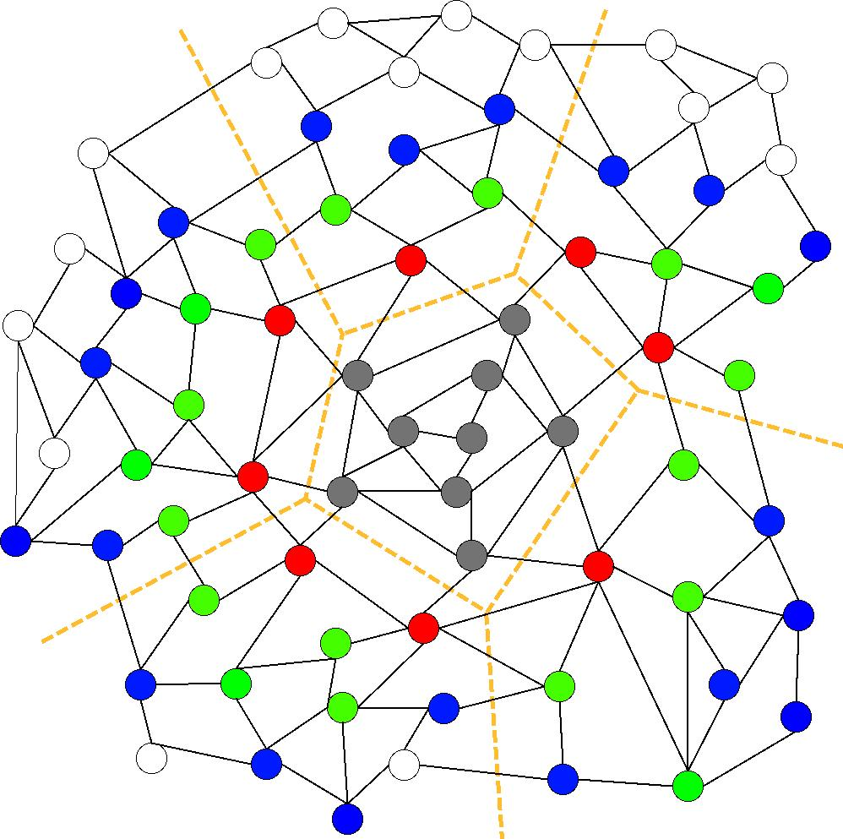
Communication Avoiding Kernels: The Matrix Powers Kernel : [Ax, A²x, …, A^{k}x]
Same idea works for general sparse matrices
Simple block-row partitioning ➔
(hyper)graph partitioning
Top-to-bottom processing ➔
Traveling Salesman Problem
Notes:
Red needed for k=1
Green also needed for k=2
Blue also needed for k=3

Slide 88
Minimizing Communication of GMRES to solve Ax=b
GMRES: find x in span{b,Ab,…,A^{k}b} minimizing || Ax-b ||₂
Standard GMRES
for i=1 to k
w = A · v(i-1) … SpMV
MGS(w, v(0),…,v(i-1))
update v(i), H
endfor
solve LSQ problem with H
Communication-avoiding GMRES
W = [ v, Av, A²v, … , A^{k}v ]
[Q,R] = TSQR(W)
… “Tall Skinny QR”
build H from R
solve LSQ problem with H
Sequential case: #words moved decreases by a factor of k
Parallel case: #messages decreases by a factor of k
Oops – W from power method, precision lost!
88

Slide 89
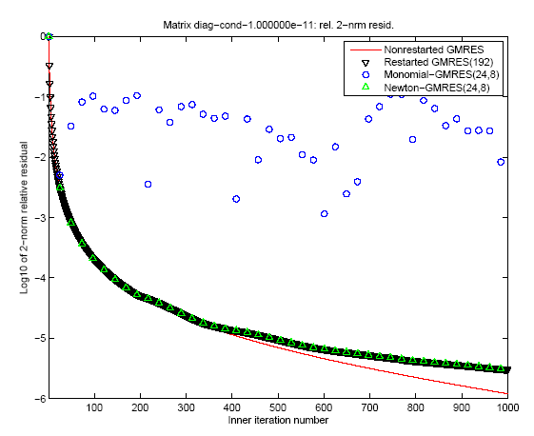
“Monomial” basis [Ax,…,A^{k}x]
fails to converge
Different polynomial basis [p₁(A)x,…,p_{k}(A)x]
does converge
89

Slide 90
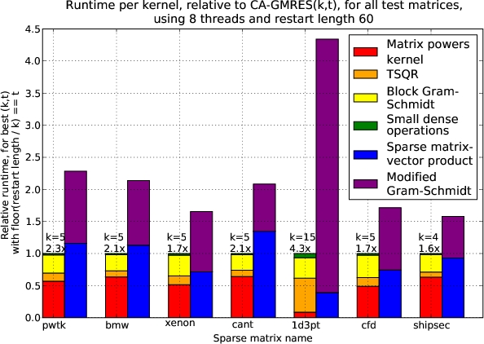
Speed ups of GMRES on 8-core Intel Clovertown
Requires Co-tuning Kernels
[MHDY09]
90

Slide 91
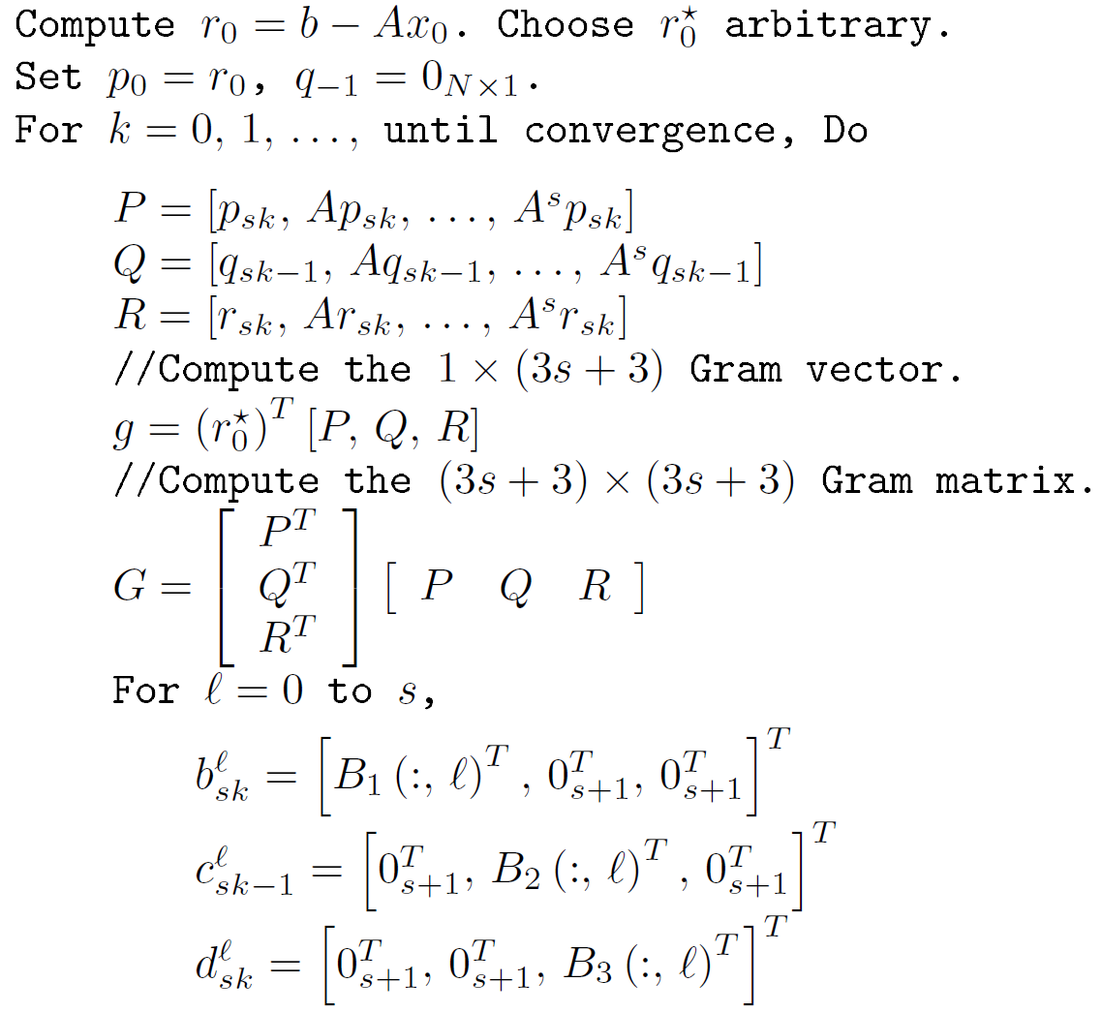
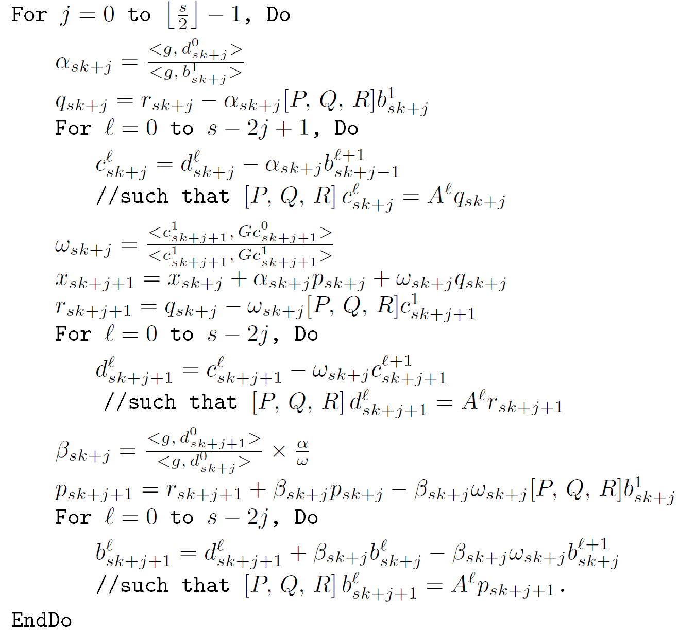
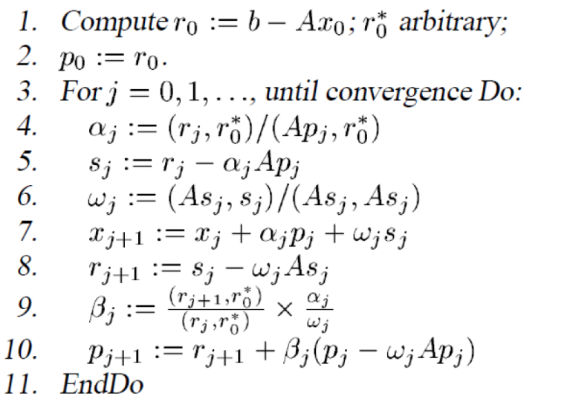

CA-BiCGStab

Slide 92
Notes:
For Matrix pde900, U Florida collection, 2D Model problem, Nx=30, Ny=30, non-normal.
Cond ~ 120

Slide 93
With Residual Replacement (RR)
a la Van der Vorst and Ye
 | Naive | Monomial | Newton | Chebyshev
Replacement Its. | 74 (1) | [7, 15, 24, 31, …, 92, 97, 103] (17) | [67, 98] (2) | 68 (1)

Slide 94
Tuning space for Krylov Methods
Classifications of sparse operators for avoiding communication
Explicit indices or nonzero entries cause most communication, along with vectors
Ex: With stencils (all implicit) all communication for vectors
Indices
 | Explicit (O(nnz)) | Implicit (o(nnz))
Explicit (O(nnz)) | CSR and variations | Vision, climate, AMR,…
Implicit (o(nnz)) | Graph Laplacian | Stencils
Nonzero
entries
Operations
[x, Ax, A²x,…, A^{k}x ] or [x, p₁(A)x, p₂(A)x, …, p_{k}(A)x ]
Number of columns in x
[x, Ax, A²x,…, A^{k}x ] and [y, A^{T}y, (A^{T})²y,…, (A^{T})^{k}y ], or [y, A^{T}Ay, (A^{T}A)²y,…, (A^{T}A)^{k}y ],
return all vectors or just last one
Cotuning and/or interleaving
W = [x, Ax, A²x,…, A^{k}x ] and {TSQR(W) or W^{T}W or … }
Ditto, but throw away W
Preconditioned versions

Slide 95
Summary of Iterative Linear Algebra
New Lower bounds, optimal algorithms, big speedups in theory and practice
Lots of other progress, open problems
Many different algorithms reorganized
More underway, more to be done
Need to recognize stable variants more easily
Preconditioning
Hierarchically Semiseparable Matrices
Autotuning and synthesis
pOSKI for SpMV – available at bebop.cs.berkeley.edu
Different kinds of “sparse matrices”

Slide 96
Outline
“Direct” Linear Algebra
Lower bounds on communication
New algorithms that attain these lower bounds
Ditto for “Iterative” Linear Algebra
Ditto (work in progress) for programs accessing arrays (eg n-body)

Slide 97
Recall optimal sequential Matmul
Naïve code
for i=1:n, for j=1:n, for k=1:n, C(i,j)+=A(i,k)*B(k,j)
“Blocked” code
for i1 = 1:b:n, for j1 = 1:b:n, for k1 = 1:b:n
for i2 = 0:b-1, for j2 = 0:b-1, for k2 = 0:b-1
i=i1+i2, j = j1+j2, k = k1+k2
C(i,j)+=A(i,k)*B(k,j)
Thm: Picking b = M^{1/2} attains lower bound:
#words_moved = Ω(n³/M^{1/2})
Where does 1/2 come from?
b x b matmul

Slide 98
New Thm applied to Matmul
for i=1:n, for j=1:n, for k=1:n, C(i,j) += A(i,k)*B(k,j)
Record array indices in matrix Δ
Solve LP for x = [xi,xj,xk]^{T}: max 1^{T}x s.t. Δ x ≤ 1
Result: x = [1/2, 1/2, 1/2]^{T}, 1^{T}x = 3/2 = s
Thm: #words_moved = Ω(n³/M^{S-1})= Ω(n³/M^{1/2})
Attained by block sizes M^{xi},M^{xj},M^{xk} = M^{1/2},M^{1/2},M^{1/2}
 | i | j | k
 | 1 | 0 | 1 | A
Δ = | 0 | 1 | 1 | B
 | 1 | 1 | 0 | C

Slide 99
New Thm applied to Direct N-Body
for i=1:n, for j=1:n, F(i) += force( P(i) , P(j) )
Record array indices in matrix Δ
Solve LP for x = [xi,xj]^{T}: max 1^{T}x s.t. Δ x ≤ 1
Result: x = [1,1], 1^{T}x = 2 = s
Thm: #words_moved = Ω(n²/M^{S-1})= Ω(n²/M¹)
Attained by block sizes M^{xi},M^{xj} = M¹,M¹
 | i | j
 | 1 | 0 | F
Δ = | 1 | 0 | P(i)
 | 0 | 1 | P(j)

Slide 100
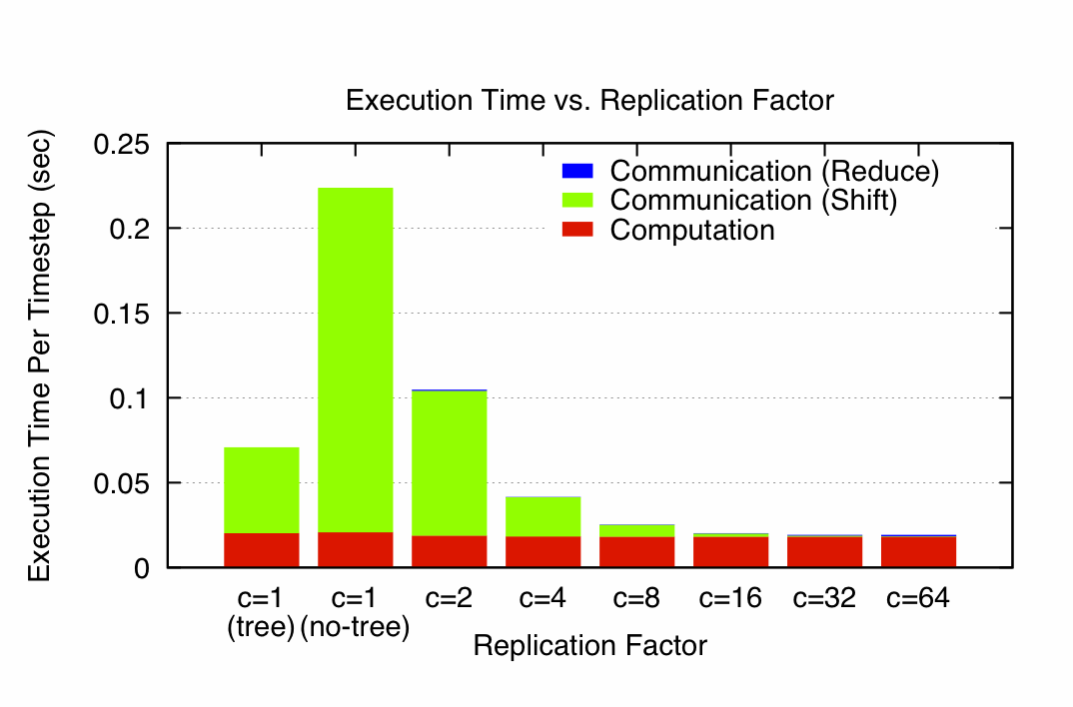
N-Body Speedups on IBM-BG/P (Intrepid) 8K cores, 32K particles
K. Yelick, E. Georganas, M. Driscoll, P. Koanantakool, E. Solomonik
11.8x speedup
Notes:
Intrepid: 163,480 core IBM BG/P at Argonne NL (ALCF)
Each node is one quad-core in a 3D torus
C=1(tree) uses special HW collective network, (no tree) just used regular network

Slide 101
New Thm applied to Random Code
for i1=1:n, for i2=1:n, … , for i6=1:n
A1(i1,i3,i6) += func1(A2(i1,i2,i4),A3(i2,i3,i5),A4(i3,i4,i6))
A5(i2,i6) += func2(A6(i1,i4,i5),A3(i3,i4,i6))
Record array indices
in matrix Δ
Solve LP for x = [x1,…,x7]^{T}: max 1^{T}x s.t. Δ x ≤ 1
Result: x = [2/7,3/7,1/7,2/7,3/7,4/7], 1^{T}x = 15/7 = s
Thm: #words_moved = Ω(n⁶/M^{S-1})= Ω(n⁶/M^{8/7})
Attained by block sizes M^{2/7},M^{3/7},M^{1/7},M^{2/7},M^{3/7},M^{4/7}
 | i1 | i2 | i3 | i4 | i5 | i6
 | 1 | 0 | 1 | 0 | 0 | 1 | A1
 | 1 | 1 | 0 | 1 | 0 | 0 | A2
Δ = | 0 | 1 | 1 | 0 | 1 | 0 | A3
 | 0 | 0 | 1 | 1 | 0 | 1 | A3,A4
 | 0 | 0 | 1 | 1 | 0 | 1 | A5
 | 1 | 0 | 0 | 1 | 1 | 0 | A6

Slide 102
Approach to generalizing lower bounds
Matmul
for i=1:n, for j=1:n, for k=1:n,
C(i,j)+=A(i,k)*B(k,j)
=> for (i,j,k) in S = subset of Z³
Access locations indexed by (i,j), (i,k), (k,j)
General case
for i1=1:n, for i2 = i1:m, … for ik = i3:i4
C(i1+2*i3-i7) = func(A(i2+3*i4,i1,i2,i1+i2,…),B(pnt(3*i4)),…)
D(something else) = func(something else), …
=> for (i1,i2,…,ik) in S = subset of Z^{k}
Access locations indexed by “projections”, eg
φ_{C} (i1,i2,…,ik) = (i1+2*i3-i7)
φ_{A} (i1,i2,…,ik) = (i2+3*i4,i1,i2,i1+i2,…), …
Can we bound #loop_iterations / points in S
given bounds on #points in its images φ_{C} (S), φ_{A} (S), … ?

Slide 103
General Communication Bound
Def: Hölder-Brascamp-Lieb Linear Program (HBL-LP)
for s₁,…,s_{m}:
for all subgroups H < Z^{k}, rank(H) ≤ Σ_{j} s_{j}*rank(φ_{j}(H))
Thm: Given a program with array refs given by φ_{j}, choose s_{j} to minimize s_{HBL} = Σ_{j} s_{j} subject to HBL-LP. Then
#words_moved = Ω (#iterations/M^{sHBL-1})
Proof depends on recent result in pure mathematics by Christ/Tao/Carbery/Bennett
Given S subset of Z^{k}, group homomorphisms φ₁, φ₂, …, bound |S| in terms of |φ₁(S)|, |φ₂(S)|, … , |φ_{m}(S)|
Thm (Christ/Tao/Carbery/Bennett): Given s₁,…,s_{m}
|S| ≤ Π_{j} |φ_{j}(S)|^{sj}
Notes:
Note: there are infinitely many subgroups H, but only finitely many possible constraints
Michael Chris (UCB), Terry Tao (UCLA), Anthony Carbery (Edinburgh), Jonathan Bennett (Birmingham),
Published in Geometric Functional Analysis, 2008

Slide 104
Is this bound attainable (1/2)?
But first: Can we write it down?
Thm: (bad news) Reduces to Hilbert’s 10th problem over Q (conjectured to be undecidable)
Thm: (good news) Can write it down explicitly in many cases of interest (eg all φ_{j} = {subset of indices})
Thm: (good news) Easy to approximate
If you miss a constraint, the lower bound may be too large (i.e. s_{HBL} too small) but still worth trying to attain, because your algorithm will still communicate less
Tarski-decidable to get superset of constraints (may get . s_{HBL} too large)
Notes:
Note: real “relaxation” is Tarski decidable.

Slide 105
Is this bound attainable (2/2)?
Depends on loop dependencies
Best case: none, or reductions (matmul)
Thm: When all φ_{j} = {subset of indices}, dual of HBL-LP gives optimal tile sizes:
HBL-LP: minimize 1^{T}*s s.t. s^{T}*Δ ≥ 1^{T}
Dual-HBL-LP: maximize 1^{T}*x s.t. Δ*x ≤ 1
Then for sequential algorithm, tile i_{j} by M^{xj}
Ex: Matmul: s = [ 1/2 , 1/2 , 1/2 ]^{T} = x
Extends to unimodular transforms of indices

Slide 106
Ongoing Work
Identify more decidable cases
Works for any 3 nested loops, or 3 different subscripts
Automate generation of approximate LPs
Extend “perfect scaling” results for time and energy by using extra memory
Have yet to find a case where we cannot attain lower bound – can we prove this?
Incorporate into compilers
Notes:
Qbox code – Francois Gygi @ UC Davis, also LLNL, first principle molecular dynamics,
uses Density Functional Theory to solve Kohn Sham equations, won Gordon Bell Prize in 2006
CTF – Cyclops Tensor Framework,
faster symmetric tensor contractions for “coupled cluster” electronic structure calculations

Slide 107
For more details
Bebop.cs.berkeley.edu
CS267 – Berkeley’s Parallel Computing Course
Live broadcast in Spring 2013
www.cs.berkeley.edu/~demmel
Prerecorded version planned in Spring 2013
www.xsede.org
Free supercomputer accounts to do homework!

Slide 108
Summary
Time to redesign all linear algebra, n-body,…
algorithms and software
(and compilers…)
Don’t Communic…

