Slide 1
Interactive and Anisotropic Geometry Processing Using the Screened Poisson Equation
Ming Chuang and Misha Kazhdan Johns Hopkins University
Notes:
Good afternoon.
In this talk, Ming and I will describe our research in developing a real-time system for anisotropic geometry-processing.

Slide 2
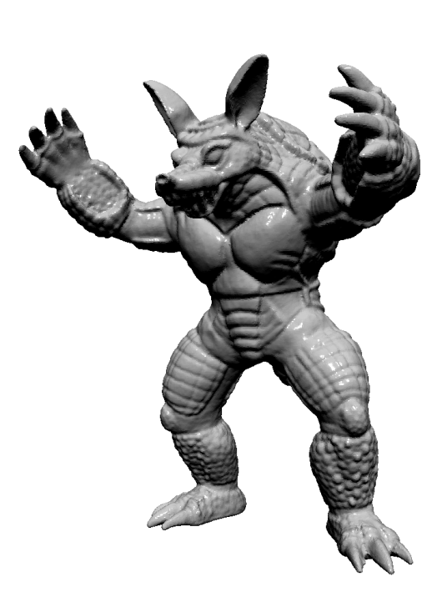
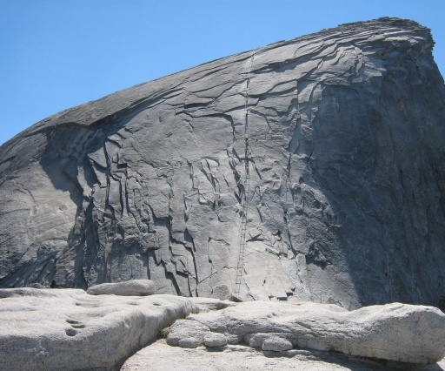
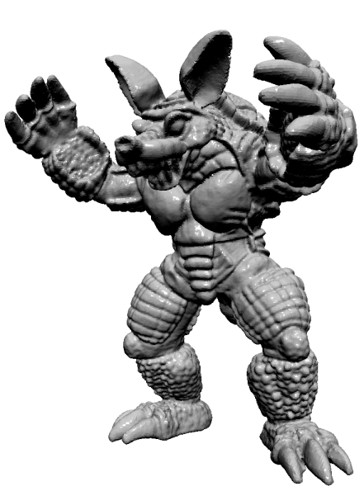
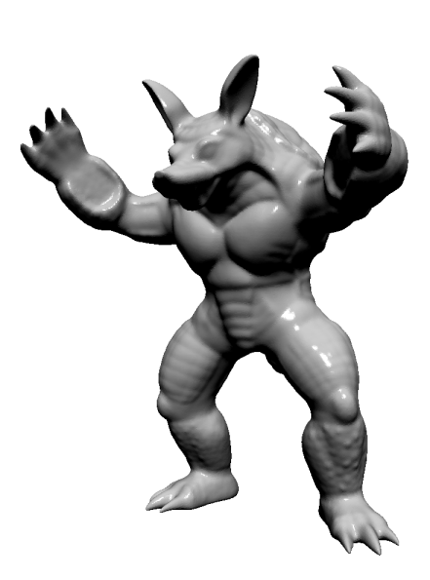

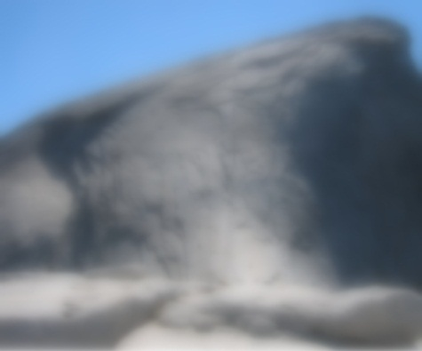
Goal
Extend gradient-domain image processing techniques to processing of high-res geometry.
Sharpening
Smoothing
Notes:
The goal of our work is to take a class of gradient-domain techniques developed for image-processing
[Click]
And generalize them to the editing of geometry in 3D.

Slide 3
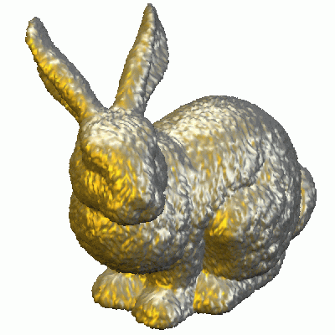
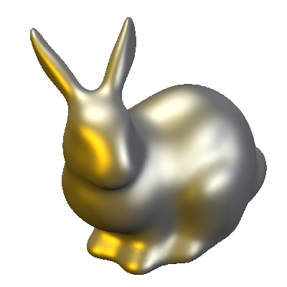
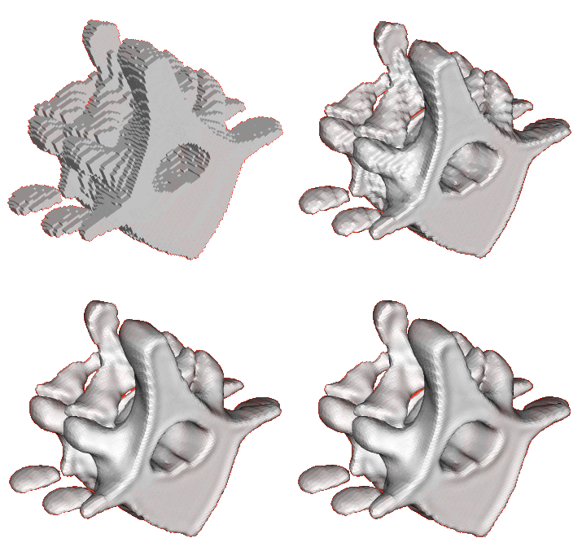
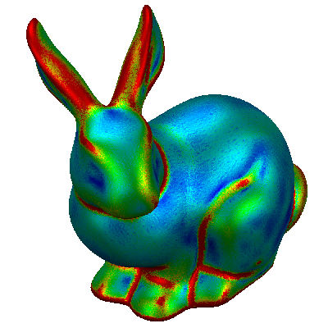
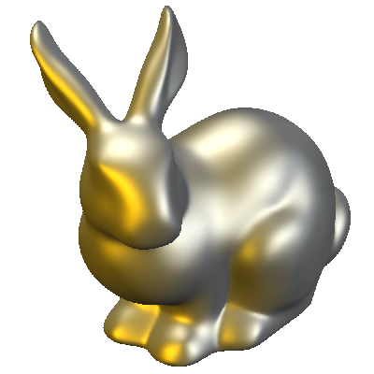
Goal
Homogenous Filtering:
Space: [Taubin ’95] [Desbrun et al. ’99]
Frequency: [Guskov et al. ’99] [Vallet and Levy ’08]
Anisotropic Filtering:
[Clarenz et al. ’00] [Meyer et al. ’02] [Bajaj et al. ’02] [Tasdizen et al. ’02]
In real time!
[Taubin 1995]
[Clarenz et al. 2002]
Notes:
In particular, we would like to develop a system that supports the Poisson-based techniques that for geometry fairing,
[Click]
And the anisotropic methods that perform feature-aware mesh filtering.
[Click]
And we would like to do all of this in real-time, allowing a user to edit large meshes at interactive frame rates.

Slide 4
Outline
Introduction
Approach
Variational Formulation
Discretization
Implementation
Results
Conclusion
Notes:
I will begin by presenting the general approach we use, and then Ming will describe our implementation.

Slide 5


Approach
Extend the image-processing formulation of [Bhat et al. ’08]:
Fº
β>1
value fidelity
gradient modulation
F^{new}
[Bhat et al. 2008]
Notes:
Our approach begins with the variational formulation, used to characterize a broad class of image filters.
Here, image filtering is expressed as an optimization problem in which an input image is given, and we find a new image that simultaneously satisfies two constraints.
First,
[Click]
The values of the new image should match the values of the original.
And second,
[Click]
The gradients of the new image should match the scaled gradients of the input.
For example,
[Click]
By setting the gradient modulation to a value greater than one, we amplify gradients, and obtain a sharpened image.
Since this formulation optimizes a quadratic energy,
[Click]
The problem has a minimum which can be obtained by solving a system of linear equations.

Slide 6
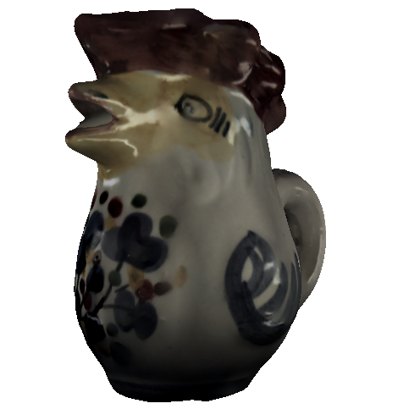
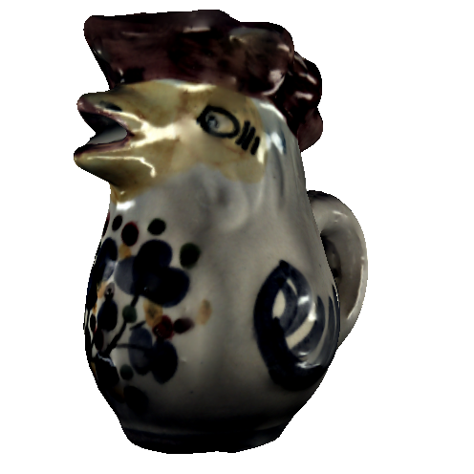
Approach
Extend the image-processing formulation of [Bhat et al. ’08]:
This also works for signals on meshes.
Fº
β>1
value fidelity
gradient modulation
F^{new}
Notes:
Examining this formulation, we note that there is nothing that restricts it to image processing, and exactly the same approach can be used for editing signals on meshes.
So, for example, given a texture on a mesh,
[Click]
We can sharpen the details by specifying that the gradients should be amplified.

Slide 7
Approach
Extend the image-processing formulation of [Bhat et al. ’08]:
Three different parameters:
The original signal
The gradient modulation
The metric
Fº
β>1
value fidelity
gradient modulation
F^{new}
Notes:
More generally, we see that there are three types of choices we can make when processing the signal.
[Click]
We can choose the original function.
[Click]
We can choose the gradient modulation.
[Click]
And we can choose the notion of lengths and areas used to define and combine the energy contributed by each point.
Let’s look at these in more detail.

Slide 8
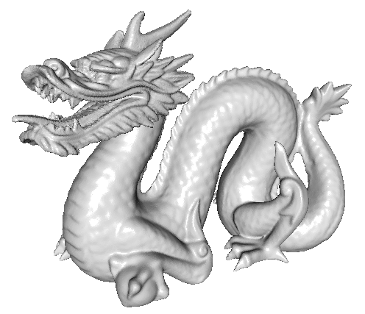
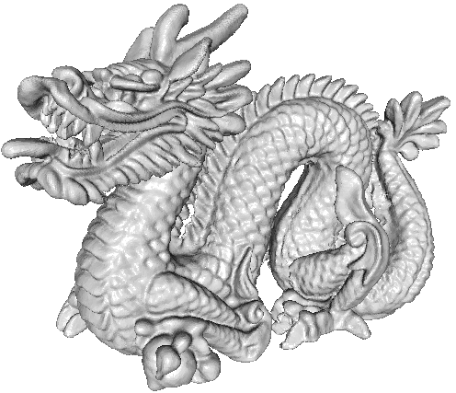
1) Original Signal
Support geometry processing by using the embedding:
Fº
value fidelity
gradient modulation
β>1
F^{new}
Notes:
Since the goal of our work is to edit the surface, we use the embedding function as the input signal.
This is the function whose value at a point is its position in 3D.
In this case,
[Click]
By specifying that gradients should be amplified, we sharpen the geometry itself.

Slide 9
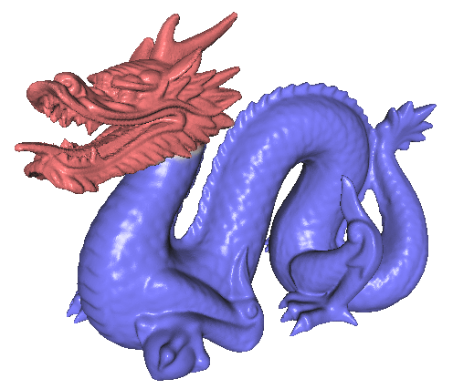
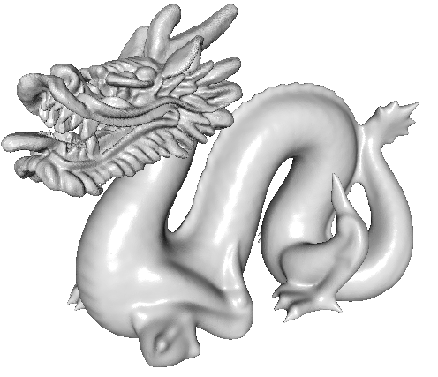
2) Gradient Modulation
β=2
Support inhomogenous edits by allowing the modulation to be spatially varying.
Fº
value fidelity
gradient modulation
β=0
F^{new}
Notes:
Additionally, we observe that the modulation term does not have to be constant.
So we can localize the edits by assigning different modulation values to different regions.
In this example, we specify that gradients should be amplified in the head and dampened in the body,
[Click]
Resulting in smoothing and sharpening in the respective regions.

Slide 10
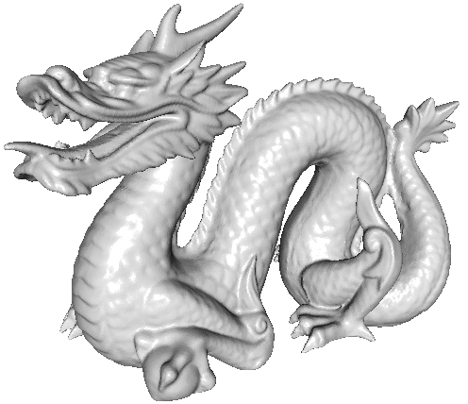
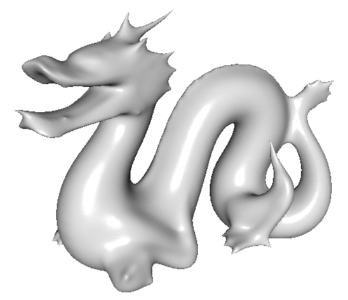
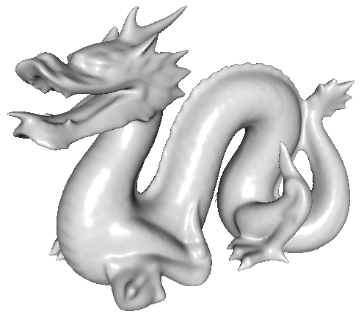

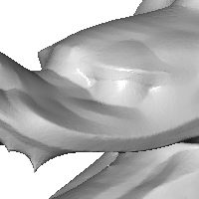
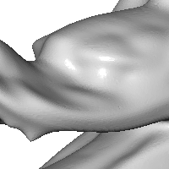
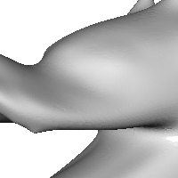
3) Metric
Support direction-aware editing by letting the metric scale anisotropically.
Fº
value fidelity
gradient modulation
β<1
F^{new}
Notes:
And finally, though we require some notion of lengths and areas to define the energy, we don’t have to use the metric defined by the embedding.
Consider the case of smoothing.
[Click]
Here we replace the position of a point by the weighted average of its neighbors.
If we scale up the distance,
[Click]
Then neighbors appear further way and the smoothing averages over a narrower region, allowing us to preserve more of the sharp features.
More interestingly, if we only increase distances across feature edges, that is along directions of high positive and negative curvature, we separate points on opposite sides of a crease
[Click]
And preserve the sharp features of the model.

Slide 11
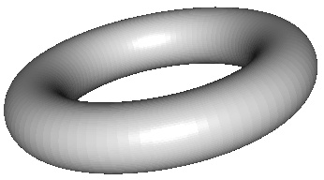
Defining a Metric
General Formulation:
Choose a basis for each tangent plane
Prescribe a symmetric positive definite matrix:
v₂(q)
r
v₂(r)
|u|
q
v₁(q)
v₁(r)
v₂(p)
w
v₁(p)
p
Notes:
In the most general context, we specify a metric by
[Click]
Choosing a basis for each tangent plane.
And then,
[Click]
Associating a symmetric, positive definite matrix with each basis.
This matrix defines an inner-product,
[Click]
Allowing us to compute lengths and angles in the tangent space

Slide 12
Defining a Metric
Feature-Aware Formulation [Clarenz et al. ’00]:
Use principal directions as a basis
Prescribe a diagonal positive definite matrix
v₂(r)
v₂(q)
v₁(r)
r
v₂(p)
q
v₁(q)
p
v₁(p)
Notes:
In our work, we follow the observation of Clarenz et al., that for many edge-aware applications, the metric should align with the curvature.
So, instead of choosing an arbitrary basis at each point,
[Click]
We use the principal curvature directions.
And, instead of allowing for arbitrary inner products,
[Click]
We restrict ourselves to diagonal matrices.

Slide 13
Defining a Metric
Feature-Aware Formulation [Clarenz et al. ’00]:
Area grows with scale
Derivatives shrink with scale
value fidelity
gradient modulation
gradient modulation
v₂(r)
v₂(q)
v₁(r)
r
v₂(p)
q
v₁(q)
p
v₁(p)
Notes:
Recall that in our original formulation, we expressed the energy in terms of the differences between the values and scaled derivatives of the old and new signals.
In the new formulation,
[Click]
The general structure remains the same.
The only differences are that we must now account for the fact that scaling up the geometry
[Click]
Increases the areas of surface patches, and
[Click]
It decreases the speed with which the function changes.

Slide 14
Outline
Introduction
Approach
Variational Formulation
Discretization
Implementation
Results
Conclusion
Notes:
Now let’s see how we can realize this system in practice.

Slide 15
Discretization
Finite Elements:
Choose a basis {B₁(p),…,B_{n}(p)}
Discretize the system
Notes:
To use the variational formulation we need to discretize the continuous system of equations.
Using a finite-elements approach, we do this by choosing a function space in which our solutions reside.
[Click]
This allows us to express our geometry as the linear combination of the basis functions,
[Click]
And transforms the continuous system of equations into a finite-dimensional linear system.
While the formulation itself is pretty standard, replacing the identity with the mass matrix and the Laplace operator with the discretized Laplacian,
[Click]
The expression for the matrix coefficients is more complicated, due to the incorporation of the modulation and scaling terms within the integration.

Slide 16
Discretization
In our system:
Modulate gradient
Scale metric
system matrix
system constraints
To make the system interactive:
Fast integration
Fast solver w/o pre-factorization
Notes:
This has significant implications on designing an interactive geometry-processing system.
[Click]
Consider a situation in which the user changes the gradient scale.
In this case, we would need to compute new system constraints, which would require integrating all of the basis functions over the mesh.
[Click]
And things get still more complicated when the users change the metric, since this requires not only updating the constraint vector, but also computing new system matrices.
In practice, this means that a system supporting these types of anisotropic edits needs to satisfy two conditions
[Click]
It needs to efficiently compute the integrals that define the system coefficients
And it must support an efficient solver that does not depend on pre-factorization, since the system matrix will change over the course of editing.

Slide 17
Outline
Introduction
Approach
Implementation
Finite Elements
Integration
Results
Conclusion
Notes:
At this point, let me turn things over to Ming, who will describe how we address these issues in practice.
Thanks Misha!
I will start by describing our choice of finite-elements and how they can be used to design an efficient solver,
And then I will describe how the integration can be performed efficiently.

Slide 18
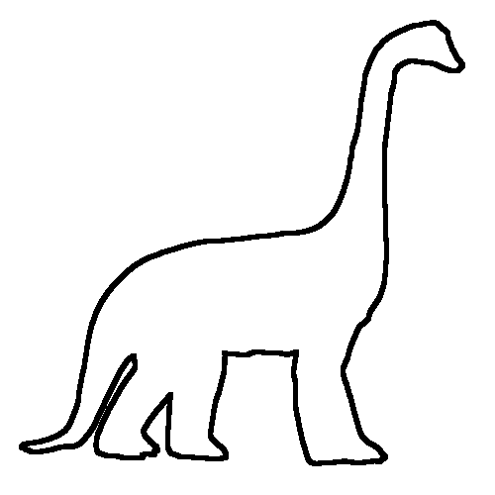
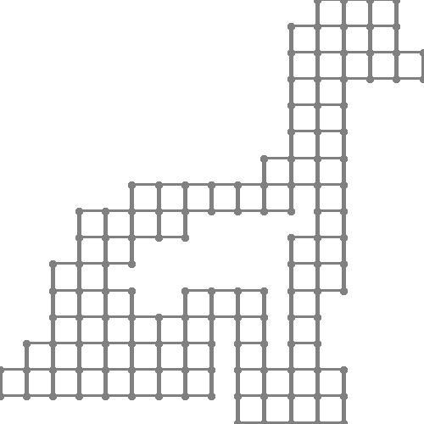
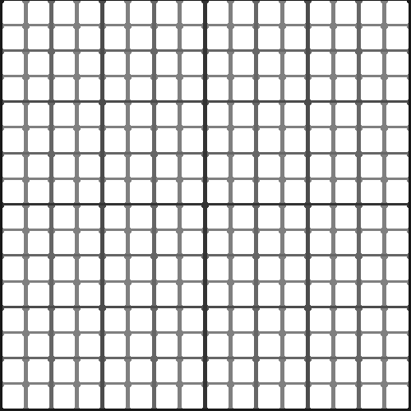
Grid-Based Finite Elements
Imposing regularity [Chuang et al. 2009]
Notes:
We define a regular function space
[Click]
by embedding the mesh within a grid.
Then, we define functions on the mesh by
[Click]
centering first-order B-splines on the grid vertices,
[Click]
And considering the value of these functions on the surface.
Note that in this example
[Click]
The functions associated with the white vertices do not overlap the shape.
As a result,
[Click]
We only have to use the basis functions centered near the geometry.

Slide 19
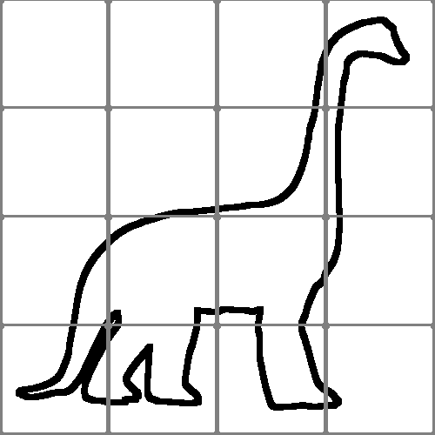
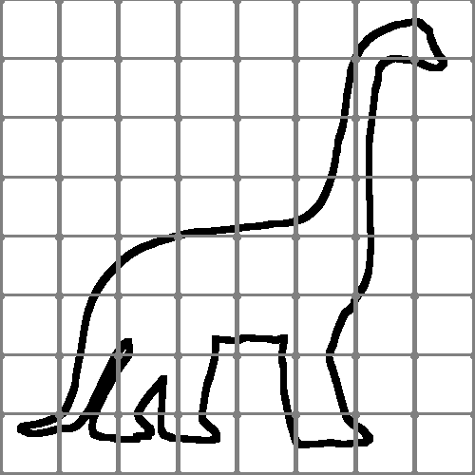
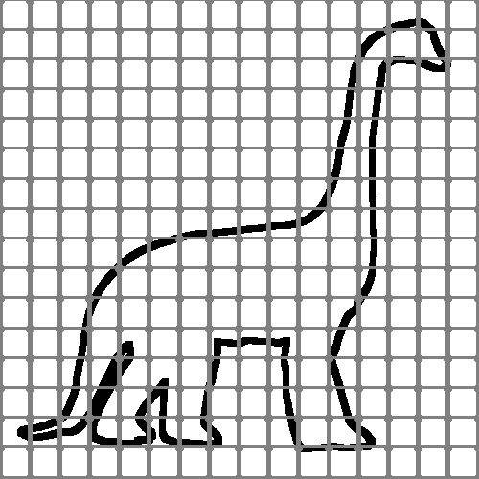
Grid-Based Finite Elements
Advantages:
Supports multigrid
⇒ System can change at run-time
Relax
Relax
Down- Sample
Up- Sample
Solve
Notes:
There are several advantages in doing this.
First, by leveraging the multi-resolution nature of this function-space, we can use a multigrid solver.
[Click]
This allows us to solve the system without pre-factorization.

Slide 20
Grid-Based Finite Elements
Advantages:
Supports multigrid
Controllable dimension
Notes:
Second, using these elements, the dimension of the linear system is independent of the tessellation of the mesh,
[Click]
And only depends on the resolution of the grid.

Slide 21
Grid-Based Finite Elements
Advantages:
Supports multigrid
Controllable dimension
Supports parallelization
Notes:
And finally, using this discretization, we can implement a parallel solver.

Slide 22
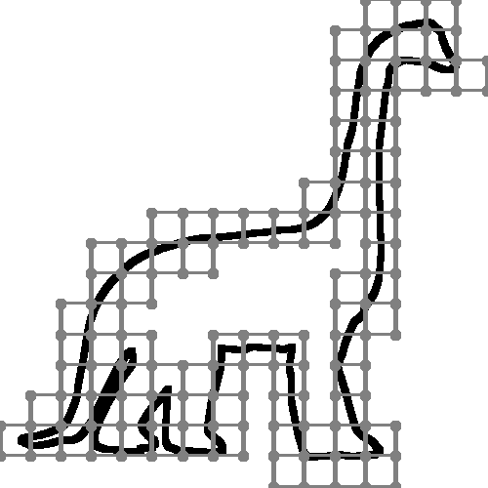
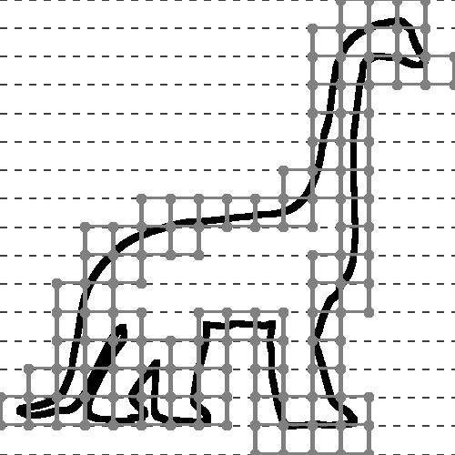
Parallel Gauss-Seidel Relaxation
Use “safe-zones” [Weber et al. 2008]:
`
`
`
`
Notes:
To do this, we use a “safe zones” approach when implementing the Gauss-Seidel relaxation
[Click]
We start by grouping our basis functions into horizontal slices.

Slide 23
Parallel Gauss-Seidel Relaxation
Function assignment
Thread 1
Thread 2
Notes:
We then assign these slices evenly to the different threads.
The difficulty is that Gauss-Seidel relaxation updates a coefficient based on the values of its neighbors.
As a result,
[Click]
Coefficients on boundary slices cannot be relaxed since threads do not have access to all neighboring values.

Slide 24
Parallel Gauss-Seidel Relaxation
Function assignment
Safe-zone expansion
Thread 1
Thread 2
Notes:
We address this problem by expanding the domain of each thread, duplicating the slices near the threads’ boundaries.

Slide 25

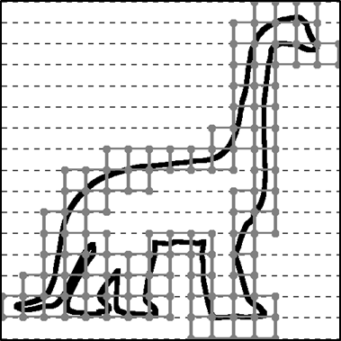
Parallel Gauss-Seidel Relaxation
Function assignment
Safe-zone expansion
Thread 1
Thread 2
Notes:
We address this problem by expanding the domain of each thread, duplicating the slices near the threads’ boundaries.

Slide 26
Parallel Gauss-Seidel Relaxation
Function assignment
Safe-zone expansion
Thread 1
Thread 2
Notes:
We address this problem by expanding the domain of each thread, duplicating the slices near the threads’ boundaries.

Slide 27
Parallel Gauss-Seidel Relaxation
Function assignment
Safe-zone expansion
Thread 1
Thread 2
Notes:
We address this problem by expanding the domain of each thread, duplicating the slices near the threads’ boundaries.

Slide 28
Parallel Gauss-Seidel Relaxation
Function assignment
Safe-zone expansion
Eroding relaxation
Thread 1
Thread 2
Notes:
Let’s look at how the first thread can use these safe zones to perform three Gauss-Seidel relaxations.
Since we cannot update the coefficients near the boundary
[Click]
The first iteration relaxes all but the last slice.
Since the last slice was not updated in the first iteration, we should not read its value on the second.
[Click]
Which means that the second iteration cannot relax the last two slices.
Similarly, on the third iteration,
[Click]
We cannot relax the last three rows.
Note that because of extended safe zones,
[Click]
all coefficients assigned to the first thread are updated exactly three times.

Slide 29
Parallel Gauss-Seidel Relaxation
Function assignment
Safe-zone expansion
Eroding relaxation
Iteration #1
Iteration #2
Iteration #3
Iteration #1
Done!
Iteration #2
Iteration #3
Done!
Thread 1
Thread 2
Notes:
The same thing can be done when we have multiple threads.
[Click]
In this case, the two threads are independent, and we do not have to synchronize them between successive iterations.

Slide 30
Outline
Introduction
Approach
Implementation
Finite Elements
Integration
Results
Conclusion
Notes:
We also need an efficient way to compute the integrals forming the system coefficients.

Slide 31
Fast System Computation
B(p)
Requirements:
Differentiable basis functions
Integrable scale and modulation
⇒ α_{i} and β can be piecewise constant
α_{i}(p)|β(p)
Notes:
To do this, we make the observations that
[Click]
while the basis functions need to be differentiable, since we take their derivatives,
[Click]
the scaling and modulation functions only need to be integrable.
[Click]
This means that it we can use piecewise constant functions to represent them.

Slide 32
Fast System Computation
B(p)
Integration is done per-element
Integrals be computed off-line.
Run-time
α(p)
Pre-processing
Notes:
Let’s see how this effects the computation of integrals.
For simplicity, we will only look at integrating one basis function against one scale function.
Though the actual integrals are more complicated, they can be evaluated in a similar manner.
To compute the integral,
[Click]
We consider the contribution from each grid cell separately.
Within each cell,
[Click]
The scale function is constant.
So,
[Click]
We can move its contribution out of the integral.
[Click]
This means that we can perform the expensive integration in a pre-processing step, independent of the scaling and modulation weights.
And then
[Click]
Take the linear combination of the integrals at run-time to get the system coefficients.

Slide 33
Outline
Introduction
Approach
Implementation
Results
Conclusion
Notes:
Now let’s take a look at the system itself.

Slide 34
Our Interactive System
Three editing interfaces:
Notes:
To support geometry editing, our system has three interfaces:

Slide 35
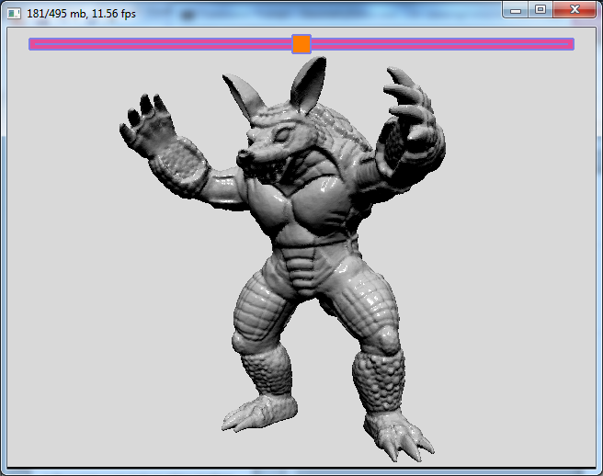
Our Interactive System
Three editing interfaces:
Slider
Spray can
Curvature profile
β=0
β=1
β>1
system matrix
system constraints
Notes:
The first is a slider, shown at the top of the image.
This allows the user to specify the global gradient modulation.
When centered, the modulation value is one, so that geometry is unaltered.
Dragging the slider to the left results in smoothing,
While dragging it to the right results in sharpening.

Slide 36
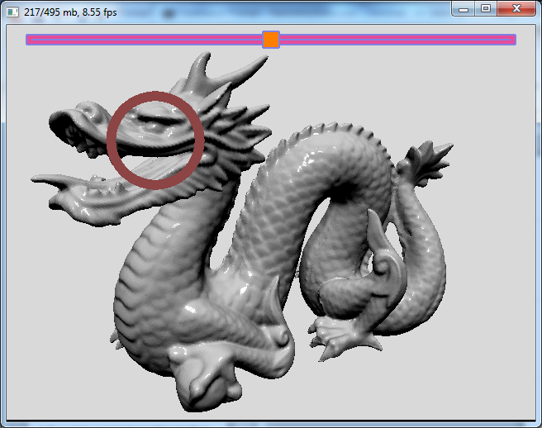
Our Interactive System
Three editing interfaces:
Slider
Spray can
Curvature profile
β>1
system matrix
system matrix
system constraints
Notes:
The second interface is the spray can, drawn as a circle,
This allows a user to localize modulation values.
In our visualization, red corresponds to amplifying the gradients while blue corresponds to dampening.

Slide 37
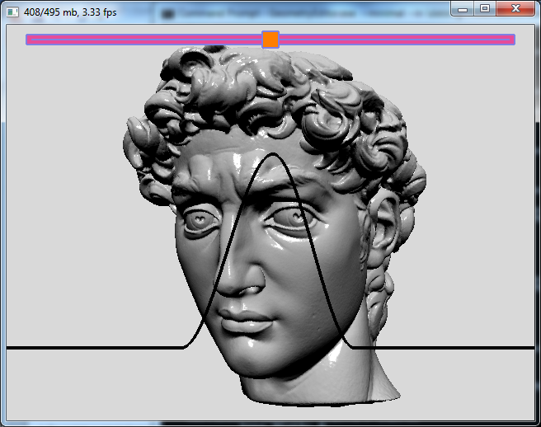
Our Interactive System
Three editing interfaces:
Slider
Spray can
Curvature profile
α>1
system matrix
system constraints
α<1
κ<0
κ=0
κ>0
Notes:
The third interface allows the user to specify how the metric is scaled along principal curvature directions, and is drawn as a profile curve.
For each curvature value, ranging from negative on the left to positive on the right,
The associated metric scaling is given by the height of the plot.
So in this example, we would be specifying that distances should be increased along directions of low curvature, minimizing the effects of the edits, and should be decreased along directions of large curvature.

Slide 38
Demo
Notes:
We’ll look at editing the david head.
This models consists of 2 million vertices, and defines a linear system with half a million degrees of freedom.
As you will see, despite the high dimension, our editing system runs at interactive frame-rates.
[Drag left]
[Let go]
[Drag right]
Here we’re seeing the effects of global modulation, as we smooth and then sharpen the model.
[Hit ‘p’]
We can also change the way in which the sharpening is being performed by changing the curvature profile.
[Click point on curve mid to right]
[Drag point on curve mid to left]
For example, dragging up the plot on the left side, scales up distances along negative curvature directions, reducing the effects of the edits there.
[Drag point on curve mid to right]
More generally as we change the profile curve, we generate different sharpened geometries.
[Hit ‘p’]
Finally,
[Spray on eyes]
If we want to undo the effects locally, we can spray back a gradient modulation value of 1.

Slide 39
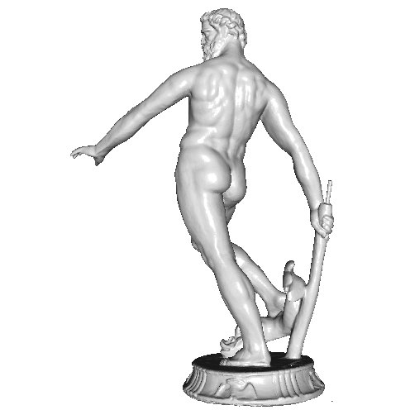
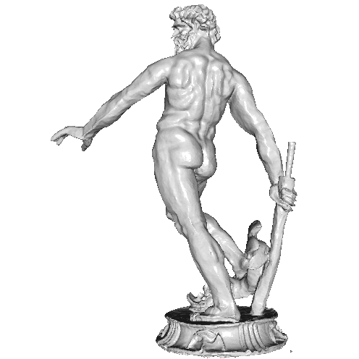
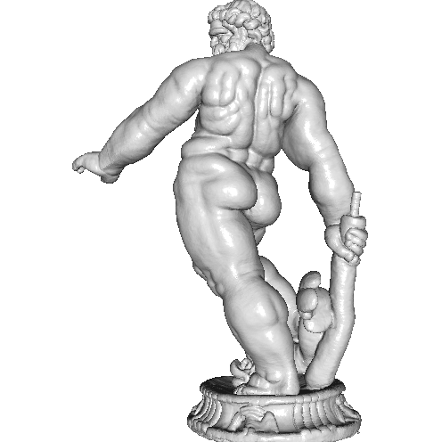
Performance
 | Vertices | Functions | Frames/Second |  |  | Solver Speed-Up
 |  |  | Relax | Constraint | Matrix
Neptune | 7.0 x10⁵ | 1.8x10⁵ | 40 | 30 | 11 | 2.8x
Armadillo | 1.7x10⁵ | 3.2 x10⁵ | 24 | 18 | 6 | 3.0x
Dragon | 4.4x10⁵ | 3.3 x10⁵ | 20 | 16 | 6 | 2.7x
Forma Urbis | 1.0x10⁶ | 4.0 x10⁵ | 20 | 15 | 5 | 3.0x
David Head | 2.0x10⁶ | 5.0 x10⁵ | 17 | 12 | 4 | 3.2x
Notes:
Here are performance numbers for a variety of different models.
The first thing we can observe is that
[Click]
The dimensionality of the linear system is defined not by the tessellation of the mesh but by the number of basis functions whose support overlaps the geometry.
As a result, models towards the bottom, which have the largest surface areas, define the systems with highest dimensions.
Next we note that, at each frame, our system is in one of three states.
[Click]
If no edits are specified, the system performs a full multigrid V-cycle to relax the solution.
[Click]
If the gradient modulation is changed, the system updates the constraints before relaxing.
[Click]
And if the metric scale is changed, the system updates both the matrix and the constraints before relaxing.
Looking at these numbers, we see that even at the most expensive stage, our system continues to run at interactive rates.
Finally, comparing the performance of serial and parallel implementations on a quad-core desktop,
[Click]
We see a roughly three-fold speed-up across the different models, confirming the benefits of using a regularly indexed finite-elements system.

Slide 40
Conclusion
Anisotropic geometry processing
Generalizes image processing
Extends to anisotropic editing
Real-time system
Fast integral
Parallel multigrid solver
Notes:
In summary, we have presented a novel system for performing anisotropic geometry processing.
We have shown how a classical image processing formulation can be applied to edit a surface,
And have extended it to support anisotropic edits
[Click]
Using this approach, we have developed a real-time system
Which efficiently computes the integrals making up the matrix and constraint coefficients
And supports a parallel multigrid solver that allows the matrices to be changed interactively.

Slide 41
Conclusion
Future Work
General metrics
Spatially varying
Non-diagonal
Surface deformation
Notes:
In future work, we would like to address two issues.
[Click]
First, we would like to extend our method to support more general metrics.
This includes extending our interface to support the use of different curvature profiles for different parts of the model.
And, more generally, to support metrics that do not align with curvature directions.
[Click]
In addition, we would like to explore applications to surface deformation, where the evolution of the surface is defined by the geometry in the previous frame as well as the input geometry.

Slide 42
~ Thank You~
Code & Executable:
http://www.cs.jhu.edu/~misha/Code/PoissonMesh/GeometryEditor/
Notes:
With that, we would like to thank you very much for your attention.

Slide 44
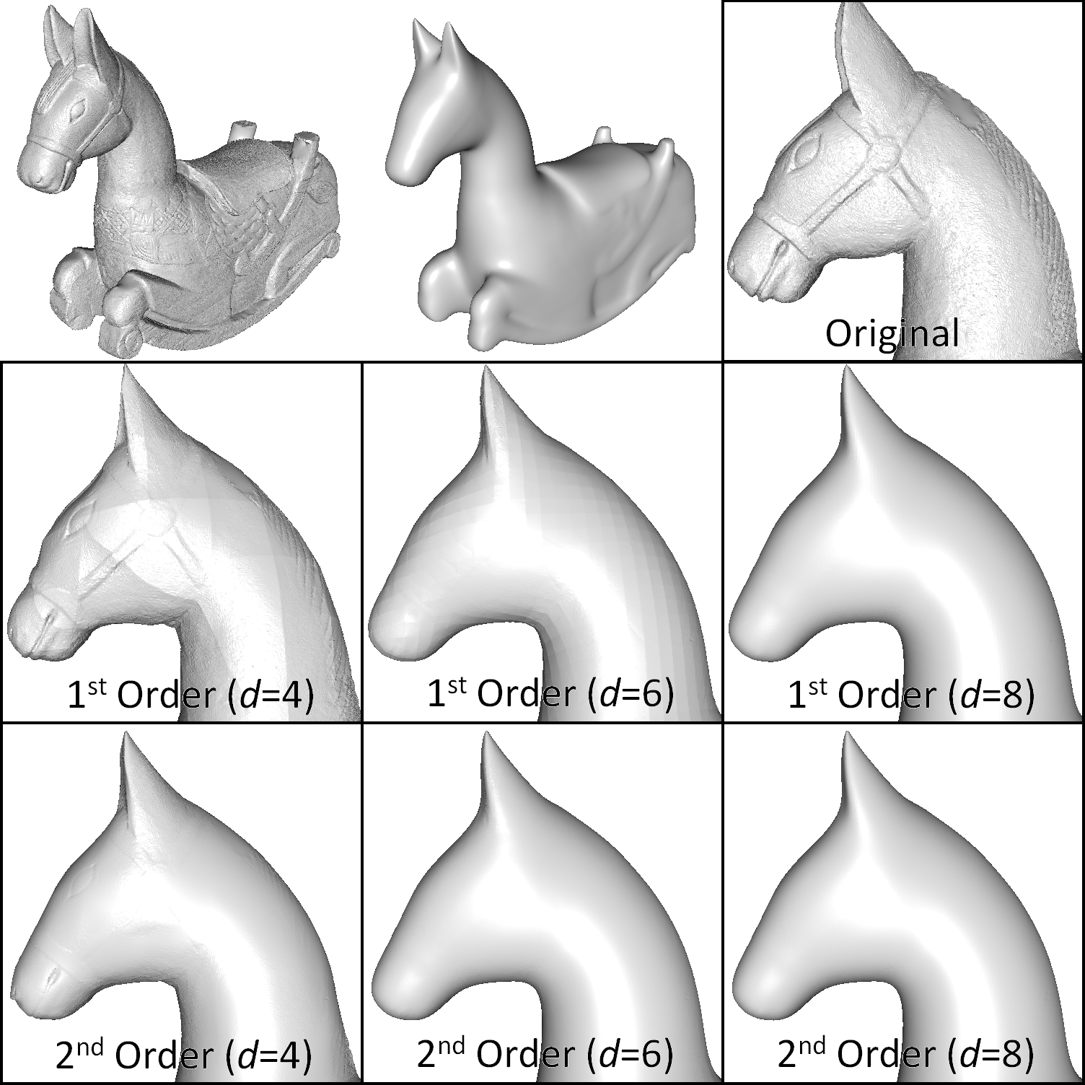
Limitation
Coarser resolution reveal the p.-linear nature of the basis.
(This disappears with second order splines.)

Slide 45
