Slide 1
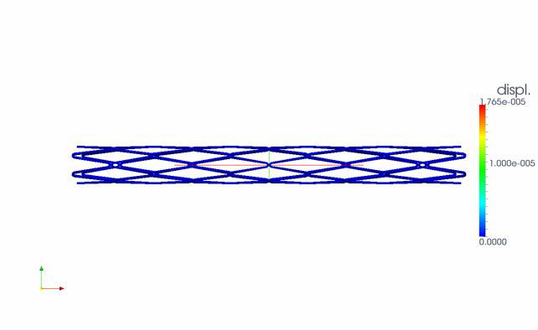
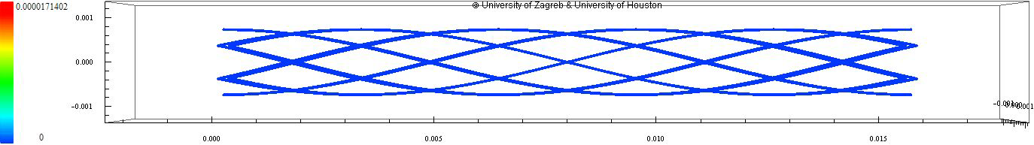

COMPARISON WITH 3D MODEL
3D simulation: freeFEM++, P2 elements, computational mesh (h=1/10,…,1/40)
1D SIMULATION
30x displacement magnification
3D SIMULATION
QUANTITATIVE DIFFERENCE BETWEEN 1D and 3D DISPLACEMENT FOR 2 ZIG-ZAGS
3D simulations converge with mesh refinement to 1D solution with #3D nodes: 211337 v.s. #1D nodes: 474 for 2.7% diff.
mesh diff | h=1/10 19705 nodes | h=1/20 24868 nodes | h=1/30 51549 nodes | h=1/40 64826 nodes | h=1/50 123921 nodes | h=1/60 211337 nodes
 | 0.07563 | 0.046564 | 0.0381521 | 0.0314075 | 0.0277053 | 0.0258485

