Slide 1
Efficient Evaluation of HAVING Queries on a Probabilistic Database
Christopher Re and Dan Suciu
University of Washington

Slide 2
High level Overview
Evaluation of conjunctive Boolean queries with aggregate tests on probabilistic DBs:
HAVING in SQL, e.g. is the SUM(profit) > 100k?
Looking for optimal algorithms (dichotomies):
For all queries q with aggregate A want
P time algorithm, call this A-Safe [DS04,DS07]
Some instance s.t. q is hard (#P).
Technique:
In safe plans, use multiplication
In A-safe plans, use convolution (on monoids)

Slide 3
Motivation
Item | Forecaster | Amount | P
Widget | Alice | $-99k | 0.99
 | Bob | $100M | 0.01
Whatsit | Alice | $1M | 1
Profit
Expectation Style [Prior Art]
HAVING style
SELECT SUM(Amount)
FROM Profit
WHERE item=‘Widget’
SELECT item FROM Profit
WHERE item =‘Widget’
GROUP BY item
HAVING SUM(Amount) > 0
Ans: -99k *.99 +100M*0.01 ~900K
Ans: 0.01

Slide 4
Overview
Preliminaries
Formal Problem Description
Query plans and Datalog
Monoid Random Variables and Convolutions
Max,Min,Count and hints for others
Conclusions

Slide 5
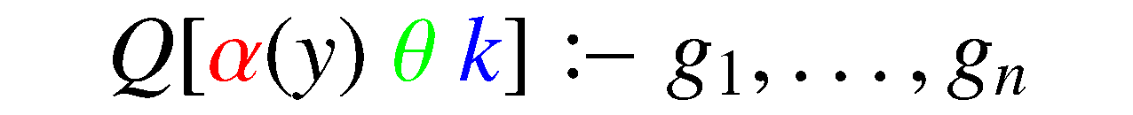

HAVING Query semantics
Conjunctive rule:
No repeated symbols
Aggregates
Comparision:
k, is a constant
NB: Assume SQL-like semantics
SELECT ITEM FROM PROFIT
WHERE ITEM=‘Widget’
GROUP BY ITEM
HAVING SUM(PROFIT) > 0
Notes:
Paste in def.s here. Explain restrictions for talk v. paper

Slide 6
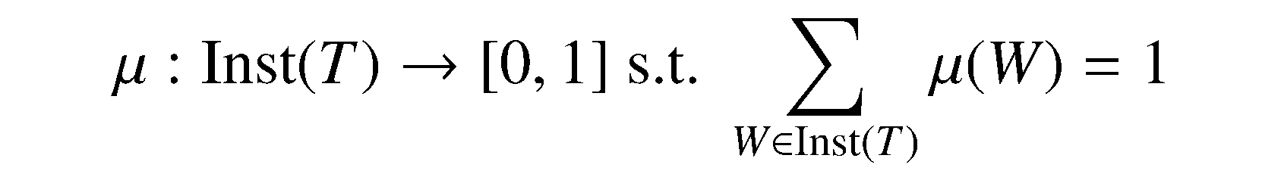
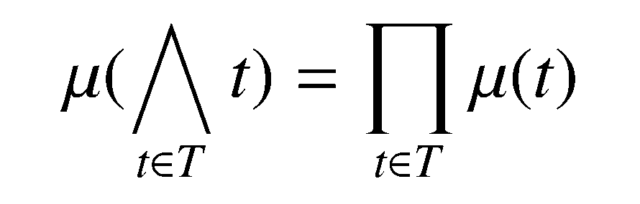
Probabilistic Semantics
Possible worlds, model
Query Semantics
In talk, restrict to tuple independence
NB: In paper, allow disjoint tuples
Notes:
GIVE EXAMPLE HERE

Slide 7
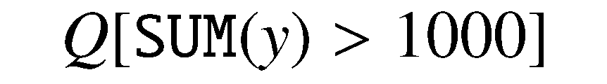
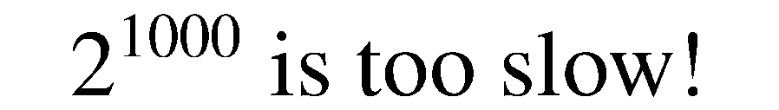
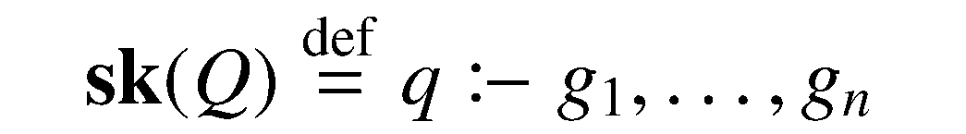
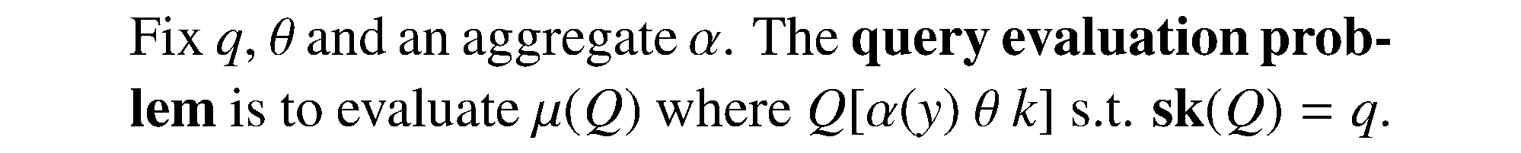

Complexity and formal problem
Data complexity: Fix Query. Instance grows.
In practice, query is small.
Consider k, i.e. 1000, as part of the input
Skeleton,

Slide 8
Overview
Preliminaries
Formal Problem Description
Query plans and Datalog
Monoid Random Variables and Convolutions
Max,Min,Count and hints for others
Conclusions

Slide 9
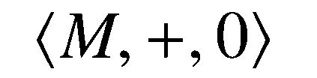



Monoids and Semirings
A monoid is a triple where M is a set and + is associative with identity 0.
e.g.
Commutative Semiring is
Both are commutative monoids
* distributes over +
e.g. a Boolean algebra
NB: n=1 is logical OR

Slide 10
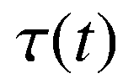
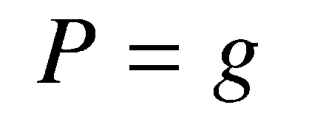
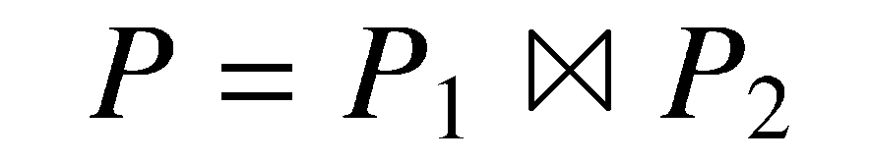
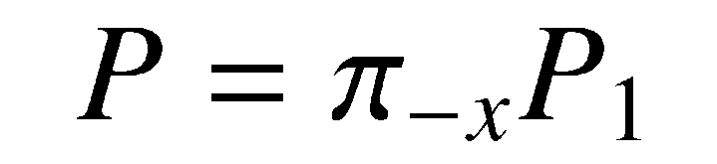
[GKT07] : Datalog + Semirings
Fix a Semiring S.
Annotation is a function to S with finite support
Plans defined inductively:

Slide 11
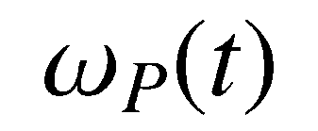
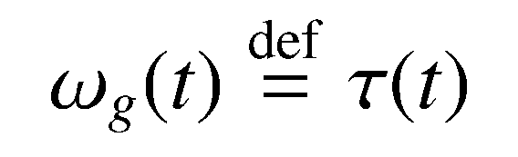
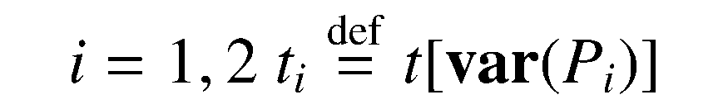
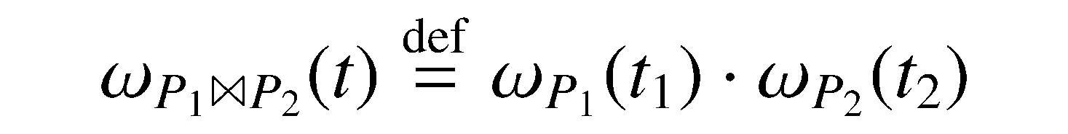
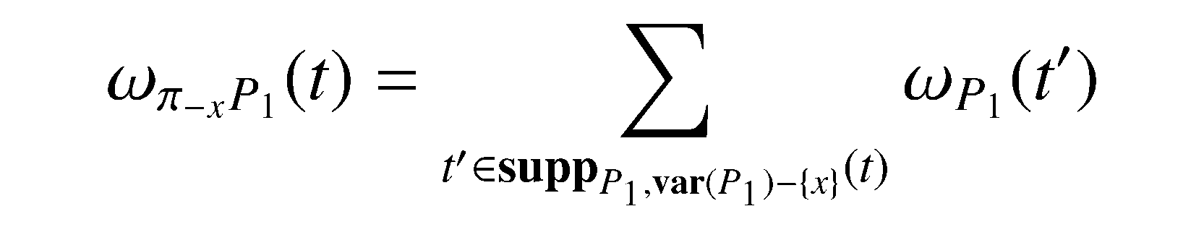
[GKT07] Inductive definition
Goal: define value of tuple t in a plan P,
support, i.e. tuples contributing to a value
Value of a plan, i.e, the annotation computes

Slide 12
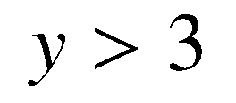

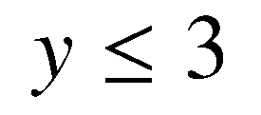
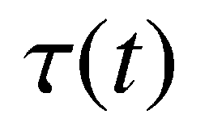
Annotations and HAVING
Monoids and Aggregates
0 is tuple not present
1 is tuple present, y > 3
2 is tuple present,
X | Y
A | 10
B | 100
C | 1
probabilities
t(Y)
1
1
2
0.2
How can we deal with probabilities?
0.4
0.1
Monoid sum is 1 iff all values are bigger than 3

Slide 13
Overview
Preliminaries
Formal Problem Description
Query plans and Datalog
Monoid Random Variables and Convolutions
Max,Min,Count and hints for others
Conclusions

Slide 14
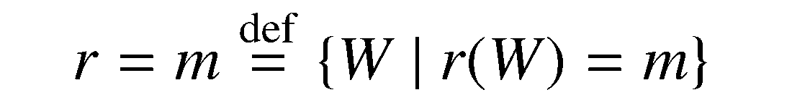
Monoid Random Variables
An M-random variable (rv) is
Correlations
r,s are independent if for any m,m’ in M
Extended to sets via total independence
Notes:
Switch text to have running example in the corner! Use min/max.

Slide 15
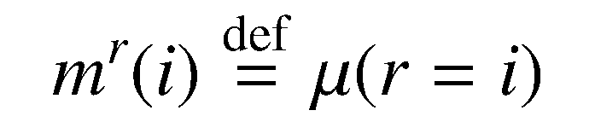
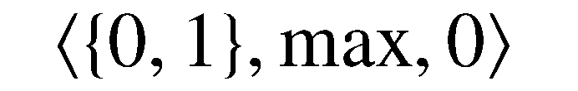
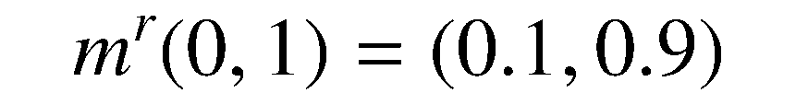
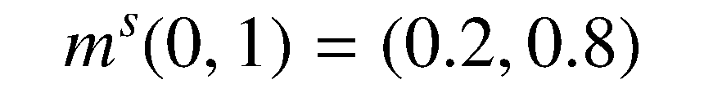
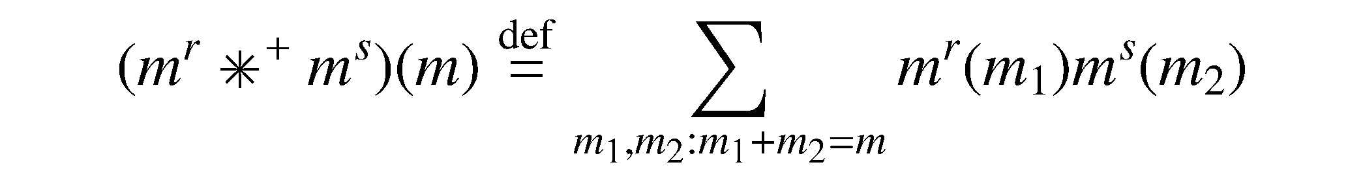
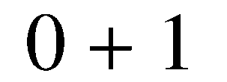
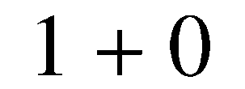

Monoid Convolutions
Let r be an rv. A marginal vector is
The monoid convolution * (depending on +) is
Notes:
1. Label vectors 0,1 for monoid values (SAY MONOID)
2. Below convolution, label how derived, \ie 0 + 1 , 1 + 0, 1 + 1

Slide 16
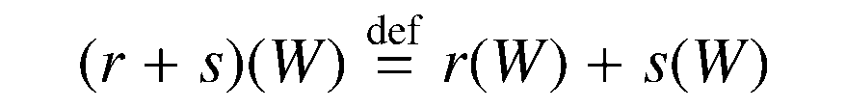
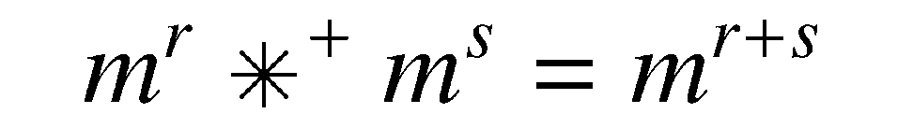
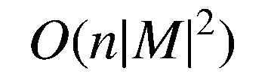
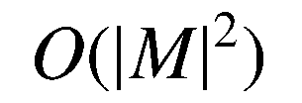
Convolutions
If r,s monoid rvs then r+s is an rv defined as
PROP: If r,s are independent then the distribution of r + s is given by convolution:
PROP: The convolution of n r.v.s can be computed in
Single convolution in time
Convolution is associative.
Convolutions are efficient, if M is not too big

Slide 17
Overview
Preliminaries
Formal Problem Description
Query plans and Datalog
Monoid Random Variables and Convolutions
Max,Min,Count and hints for others
Conclusions

Slide 18
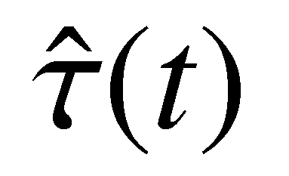
Annotations and HAVING
Monoids and Aggregates
0 is tuple not present
1 is tuple present, y > 3
2 is tuple present,
X | Y
A | 10
B | 100
C | 1
probabilities
t(Y)
1
1
2
marginal vectors
0.2
(0.8,0.2,0)
0.4
(0.6,0.4,0)
0.1
(0.9,0,0.1)
Marginal of 1 after convolution = value of query
Monoid sum is 1 iff all values are bigger than 3

Slide 19
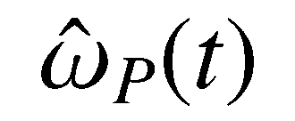
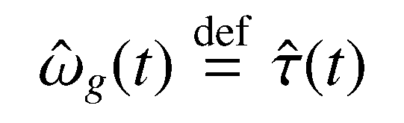
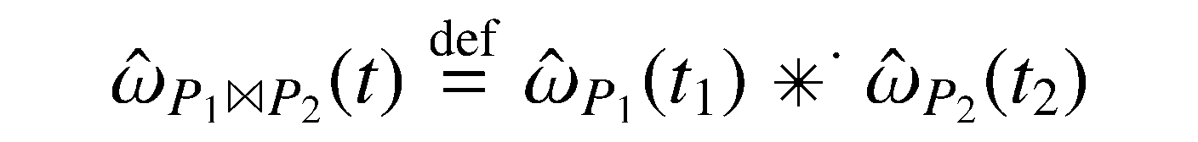
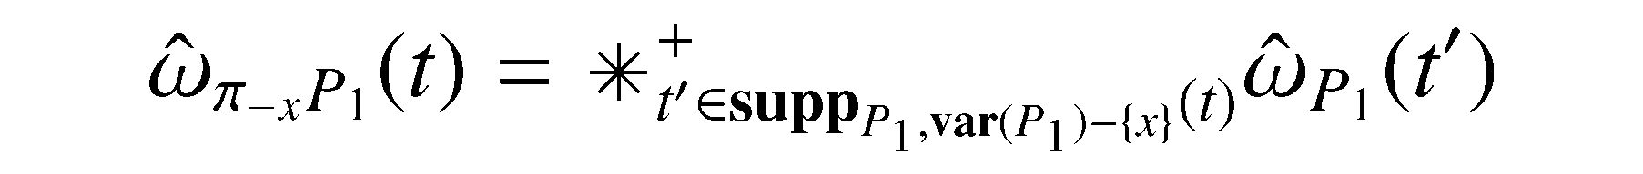
“Safe plans” for semirings
Compute value of “Safe Plans”:
Plan is safe [DS04], if all projects and joins are independent tuples, else #P
THM: value is correct if the plan is safe.
Only efficient if the semiring is “small”
Gives dicohotomy for MIN,MAX,COUNT – not the others

Slide 20
Additional Results
Dichotomy for SUM,AVG,COUNT DISTINCT
Not all safe plans allowed!
e.g. cannot have independent projections “on top”
Disjoint tuples in the paper
Need a “disjoint projection” operation
More work for dichotomies
Algorithms for finding safe plans (P time)

Slide 21
Conclusion
Semantic for aggregation queries on prob DBs
Similar to HAVING in SQL
Proposed a complexity measure for such queries
Central technique was marginal vectors and convolutions
Dichotomy for HAVING queries w.o. self-joins

Slide 23
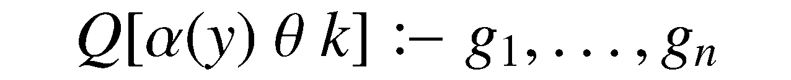
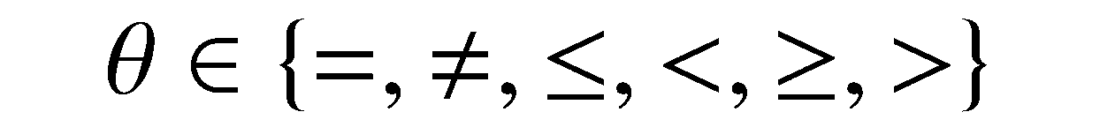
HAVING Query semantics
Conjunctive rule:
No repeated subgoals
Aggregates
Comparision:
k, is a constant
NB: Assume SQL-like semantics
SELECT ITEM FROM PROFIT
WHERE ITEM=‘Widget’
GROUP BY ITEM
HAVING SUM(PROFIT) > 0
Notes:
Paste in def.s here. Explain restrictions for talk v. paper

Slide 24
Annotations and HAVING
Monoids and Aggregates
0 is tuple not present
1 is tuple present, y > 3
2 is tuple present,
X | Y
A | 10
B | 100
C | 1
probabilities
t(Y)
1
1
2
marginal vectors
0.2
(0.8,0.2,0)
0.4
(0.6,0.4,0)
0.1
(0.9,0,0.1)
Marginal of 1 after convolution = value of query
Monoid sum is 1 iff all values are bigger than 3

