Slide 1

Network Architecture for Joint Failure Recovery and Traffic Engineering
Martin Suchara
in collaboration with:
D. Xu, R. Doverspike,
D. Johnson and J. Rexford

Slide 2
Failure Recovery and Traffic Engineering in IP Networks
Uninterrupted data delivery when links or routers fail
Failure recovery essential for
Backbone network operators
Large datacenters
Local enterprise networks
Goal: re-balance the network load after failure
Notes:
1. Why failure recovery essential:
For backbone network operators: accidental cuts
Datacenters: with increasing sizes of datacenters the probability of a failed hardware component increases
Local enterprise networks: the same reasons, link and router failures
2. Load rebalancing: focus of research in this area. Network vulnerable to congestion when a link fails.

Slide 3

Challenges of Failure Recovery
Existing solutions reroute traffic to avoid failures
Can use, e.g., MPLS local or global protection
primary tunnel
primary tunnel
global
local
backup tunnel
backup tunnel
Drawbacks of the existing solutions
Local path protection highly suboptimal
Global path protection often requires dynamic recalculation of the tunnels
Notes:
1. Drawbacks of current path protection mechanisms. Local path protection in MPLS on the left and global path protection on the right.
2. Explain local path protection.
3. Explain global path protection.
4. Hard to balance load with local protection because traffic can be only rerouted in the neighborhood of the failure.
5. Global path protection usually requires dynamic establishment of the end-to-end backup tunnel. Moreover, current schemes usually only shift the load to the backup tunnel after the primary tunnel fails; this gives worse performance compared to flexible splitting on the paths.
6. To set up the next section, explain at the end how complicated these mechanisms are – often they are used in succession.

Slide 4
Overview
Architecture: goals and proposed design
Optimizations: of routing and load balancing
Evaluation: using synthetic and realistic topologies
Conclusion

Slide 5
Architectural Goals
Simplify the network
Allow use of minimalist cheap routers
Simplify network management
Balance the load
Before, during, and after each failure
Detect and respond to failures
Notes:
The three architectural goals.

Slide 6
The Architecture – Components
Minimal functionality in routers
Path-level failure notification
Static configuration
No coordination with other routers
Management system
Knows topology, approximate traffic demands, potential failures
Sets up multiple paths and calculates load splitting ratios
Notes:
Goal of this slide: emphasize points of the work that are interesting and novel.
1. Router functionality:
- Path level notification: topology discovery no longer necessary, can use protocols such as BFD (Bidirectional Forwarding Detection)
- Static configuration: definition; no need to reconfigure for each failure
- No coordination: saves time
2. Management system
- Has all the information to set up paths that are diverse enough to work for all failures, and that allow load balancing.

Slide 7

The Architecture
• topology design
• list of shared risks
• traffic demands
• fixed paths
• splitting ratios
t
0.25
0.25
s
0.5
Notes:
The workings of our architecture is shown in this picture. The server represents the management system. … Let’s consider what happens when a link fails.

Slide 8
The Architecture
• fixed paths
• splitting ratios
t
0.25
0.25
s
0.5
link cut

Slide 9
The Architecture
• fixed paths
• splitting ratios
t
0.25
0.25
s
0.5
link cut
path probing

Slide 10
The Architecture
• fixed paths
• splitting ratios
t
0.5
0.5
s
0
link cut
path probing

Slide 11
Overview
Architecture: goals and proposed design
Optimizations: of routing and load balancing
Evaluation: using synthetic and realistic topologies
Conclusion

Slide 12
Goal I: Find Paths Resilient to Failures
A working path needed for each allowed failure state (shared risk link group)
e₁
R1
e₃
R2
e₂
e₄
e₅
Example of failure states:
S = {e₁}, { e₂}, { e₃}, { e₄}, { e₅}, {e₁, e₂}, {e₁, e₅}
Notes:
1. Introduce failure states.
2. Explain why some links fail together: links in one cable bundle may be cut together, a router breaks down, etc.
3. For each failure state, at least one path works.

Slide 13
Goal II: Minimize Link Loads
links indexed by e
failure states indexed by s
aggregate congestion cost weighted for all failures:
cost
Φ(u_{e}^{s})
u_{e}^{s} =1
minimize ∑_{s} w^{s}∑_{e} Φ(u_{e}^{s})
while routing all traffic
link utilization u_{e}^{s}
failure state weight
Cost function is a penalty for approaching capacity
Notes:
1. Piecewise linear function that penalizes link load. Small penalty for increasing load, very steep penalty close to the link capacity. Chose this function so that our optimization problem formulation does not have to include explicit capacity constraints.
2. Optimization problem objective:
inner sum
failure state weight as a probability of failure
outer sum

Slide 14
Possible Solutions
Suboptimal solution
Good performance and practical?
congestion
Solution not scalable
capabilities of routers
Overly simple solutions do not do well
Diminishing returns when adding functionality
Notes:
Clarify that a “solution” means two things: (i) functionality of the routers and (ii) resulting optimization performed by the management system.
Allow any functionality -> low congestion.
Take away too much functionality -> too much congestion.
In this work we are looking for the sweet spot. How much functionality can we take away and still do well?

Slide 15
The Idealized Optimal Solution: Finding the Paths
Assume edge router can learn which links failed
Custom splitting ratios for each failure
configuration:
Failure | Splitting Ratios
- | 0.4, 0.4, 0.2
e₄ | 0.7, 0, 0.3
e₁ & e₂ | 0, 0.6, 0.4
… | …
one entry per failure
0.4
e₁
e₂
0.7
0.4
e₃
e₄
e₅
0.2
e₆
0.3
Notes:
Introduce optimal solution. Not practical because each router must store separate configuration for each network failure (there are 1000s of possible failures)
Each router must learn which links failed. This violates our assumption.
Nonetheless, solution interesting. It serves as a building block for the subsequent solutions. It provides performance benchmark due to its optimality.

Slide 16
The Idealized Optimal Solution: Finding the Paths
Solve a classical multicommodity flow for each failure case s:
min load balancing objective
s.t. flow conservation
demand satisfaction
edge flow non-negativity
Decompose edge flow into paths and splitting ratios
Notes:
Explain the three constraints.
Decompose solution into paths and splitting ratios. These diverse paths are used by our subsequent solutions.

Slide 17
1. State-Dependent Splitting: Per Observable Failure
Edge router observes which paths failed
Custom splitting ratios for each observed combination of failed paths
NP-hard unless paths are fixed
configuration:
Failure | Splitting Ratios
- | 0.4, 0.4, 0.2
p2 | 0.6, 0, 0.4
… | …
at most 2^{#paths} entries
p₁
0.4
0.6
0.4
p₂
p₃
0.2
0.4
Notes:
In contrast to the previous approach, here the router does not know which edge failed. In this example, it cannot distinguish which of the two links failed, it only knows p_2 doesn’t work.
Show how to look up the configuration, and say how large the configuration is.
NP hardness result.

Slide 18
1. State-Dependent Splitting: Per Observable Failure
Heuristic: use the same paths as the idealized optimal solution
If paths fixed, can find optimal splitting ratios:
min load balancing objective
s.t. flow conservation
demand satisfaction
path flow non-negativity
Notes:
Explain why it is a good idea to use the same paths as the optimal solution: (i) at least one path guaranteed to work for all failures, (ii) paths are diverse and allow load balancing
Optimization problem different: per path flow.
Optimization problem is an LP, easily solvable.

Slide 19
2. State-Independent Splitting: Across All Failure Scenarios
Edge router observes which paths failed
Fixed splitting ratios for all observable failures
Non-convex optimization even with fixed paths
configuration:
p1, p2, p3:
0.4, 0.4, 0.2
p₁
0.4
0.667
0.4
p₂
p₃
0.2
0.333
Notes:
A simpler yet solution. The configuration determines fixed splitting ratios. Traffic is renormalized on the working paths.
Show the example.
Non-convex optimization, must use heuristics.

Slide 20
2. State-Independent Splitting: Across All Failure Scenarios
Heuristic to compute paths
Paths from the idealized optimal solution
Heuristic to compute splitting ratios
Averages of the idealized optimal solution weighted by all failure case weights
r_{i} = ∑_{s} w^{s} r_{i}^{s}
fraction of traffic on the i-th path

Slide 21
The Two Solutions
State-dependent splitting
State-independent splitting
How do they compare to the idealized optimal solution?
How well do they work in practice?

Slide 22
Overview
Architecture: goals and proposed design
Optimizations: of routing and load balancing
Evaluation: using synthetic and realistic topologies
Conclusion

Slide 23
Simulations on a Range of Topologies
Topology | Nodes | Edges | Demands
Tier-1 | 50 | 180 | 625
Abilene | 11 | 28 | 110
Hierarchical | 50 | 148 - 212 | 2,450
Random | 50 - 100 | 228 - 403 | 2,450 – 9,900
Waxman | 50 | 169 - 230 | 2,450
Shared risk failures for Tier-1 topology
954 failures, up to 20 links simultaneously
Single link failures
Notes:
Failure with 20 simultaneous link failures is very large because we are talking about the city-level IP backbone here.

Slide 24
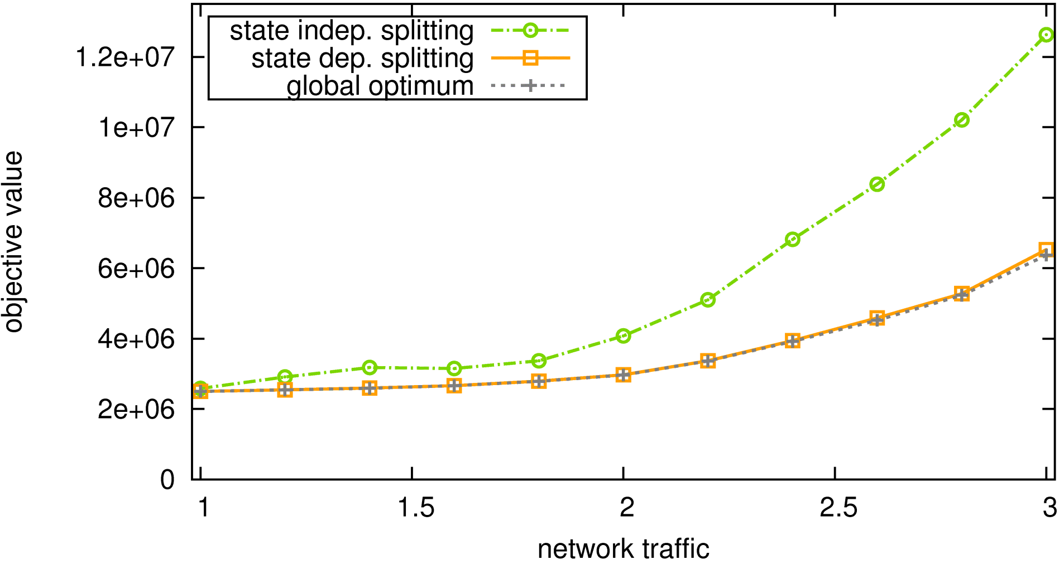
Congestion Cost – Tier-1 IP Backbone with SRLG Failures
How do we compare to OSPF? Use optimized OSPF link weights [Fortz, Thorup ’02].
State-independent splitting not optimal but simple
objective value
State-dependent splitting indistinguishable from optimum
increasing load
network traffic
Additional router capabilities improve performance up to a point
Notes:
State-dependent splitting does as well as the optimal solution. This demonstrates that additional router capabilities only improve performance up to a point.
State-independent splitting does worse, but it uses simpler routers. If too much functionality is removed, the performance suffers.
OSPF:
- used for load balancing in the Tier-1 network today
- recent work on optimizing OSPF weights, how do we compare?

Slide 25
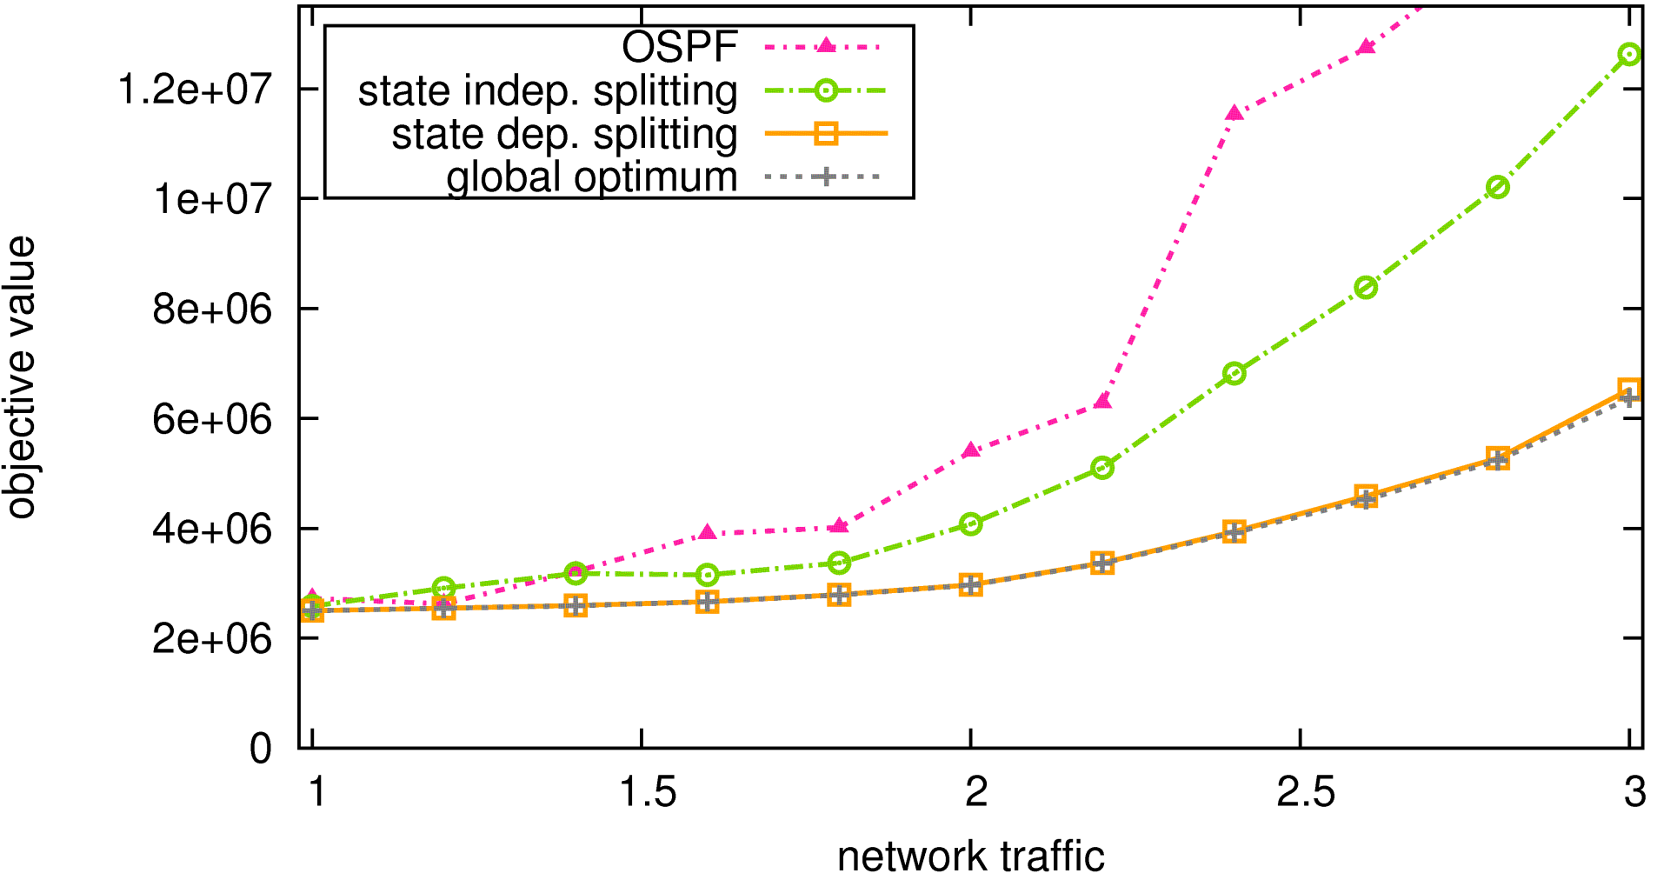
Congestion Cost – Tier-1 IP Backbone with SRLG Failures
OSPF with optimized link weights can be suboptimal
objective value
increasing load
network traffic
OSPF uses equal splitting on shortest paths. This restriction makes the performance worse.
Notes:
The performance of OSPF with optimized link weights can be worse, especially for higher traffic loads.
This is despite the fact that we obtained custom OSPF weights for each of the load levels.
This does not mean that the link weight setting algorithm is suboptimal. Rather, our more detailed investigation revealed the restrictions imposed by OSPF, which splits the load equally on paths with equal weights, make the protocol less flexible, and hence it is impossible for OSPF to achieve the same performance as our solution.

Slide 26
Average Traffic Propagation Delay in Tier-1 Backbone
Service Level Agreements guarantee 37 ms mean traffic propagation delay
Need to ensure mean delay doesn’t increase much
Algorithm | Delay (ms)
OSPF (current) | 31.38
Optimum | 31.75
State dep. splitting | 31.51
State indep. splitting | 31.76
Notes:
Increase a few ms. Satisfies SLAs.

Slide 27
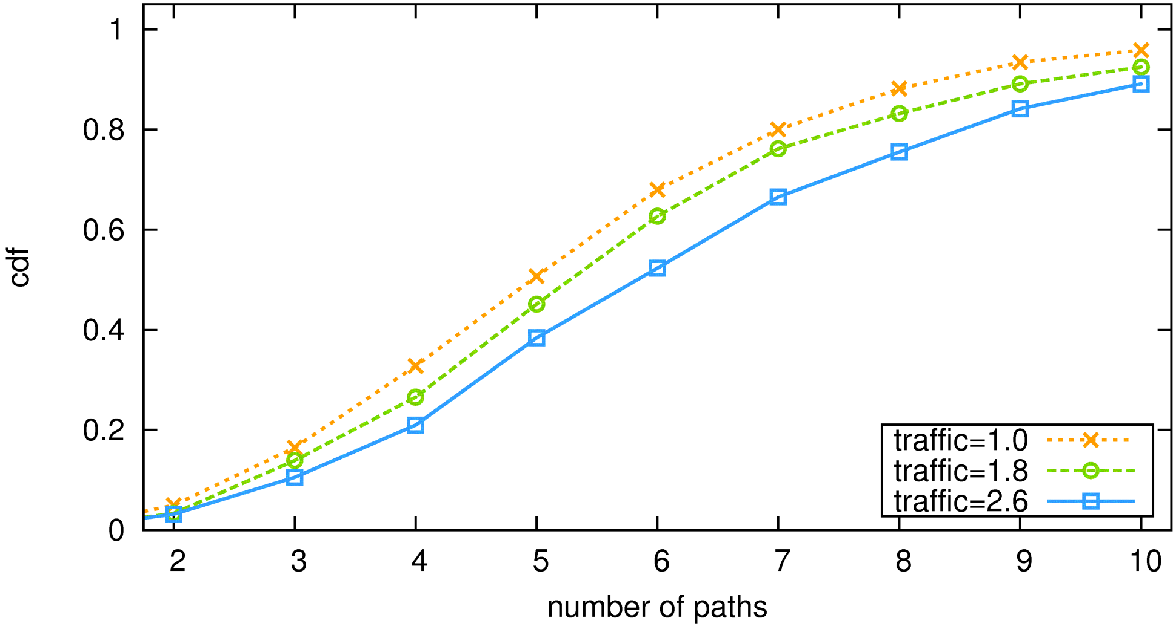
Number of Paths (Tier-1)
cdf
For higher traffic load slightly more paths
number of paths
number of paths
Number of paths almost independent of the load
Notes:
Here we study the number of paths needed between the ingress-egress router pairs.
The cdf is plotted. For example, 50% of the ingress routers split traffic on 5 or fewer paths.
The number of paths does not increase much when optimizing for higher loads.

Slide 28
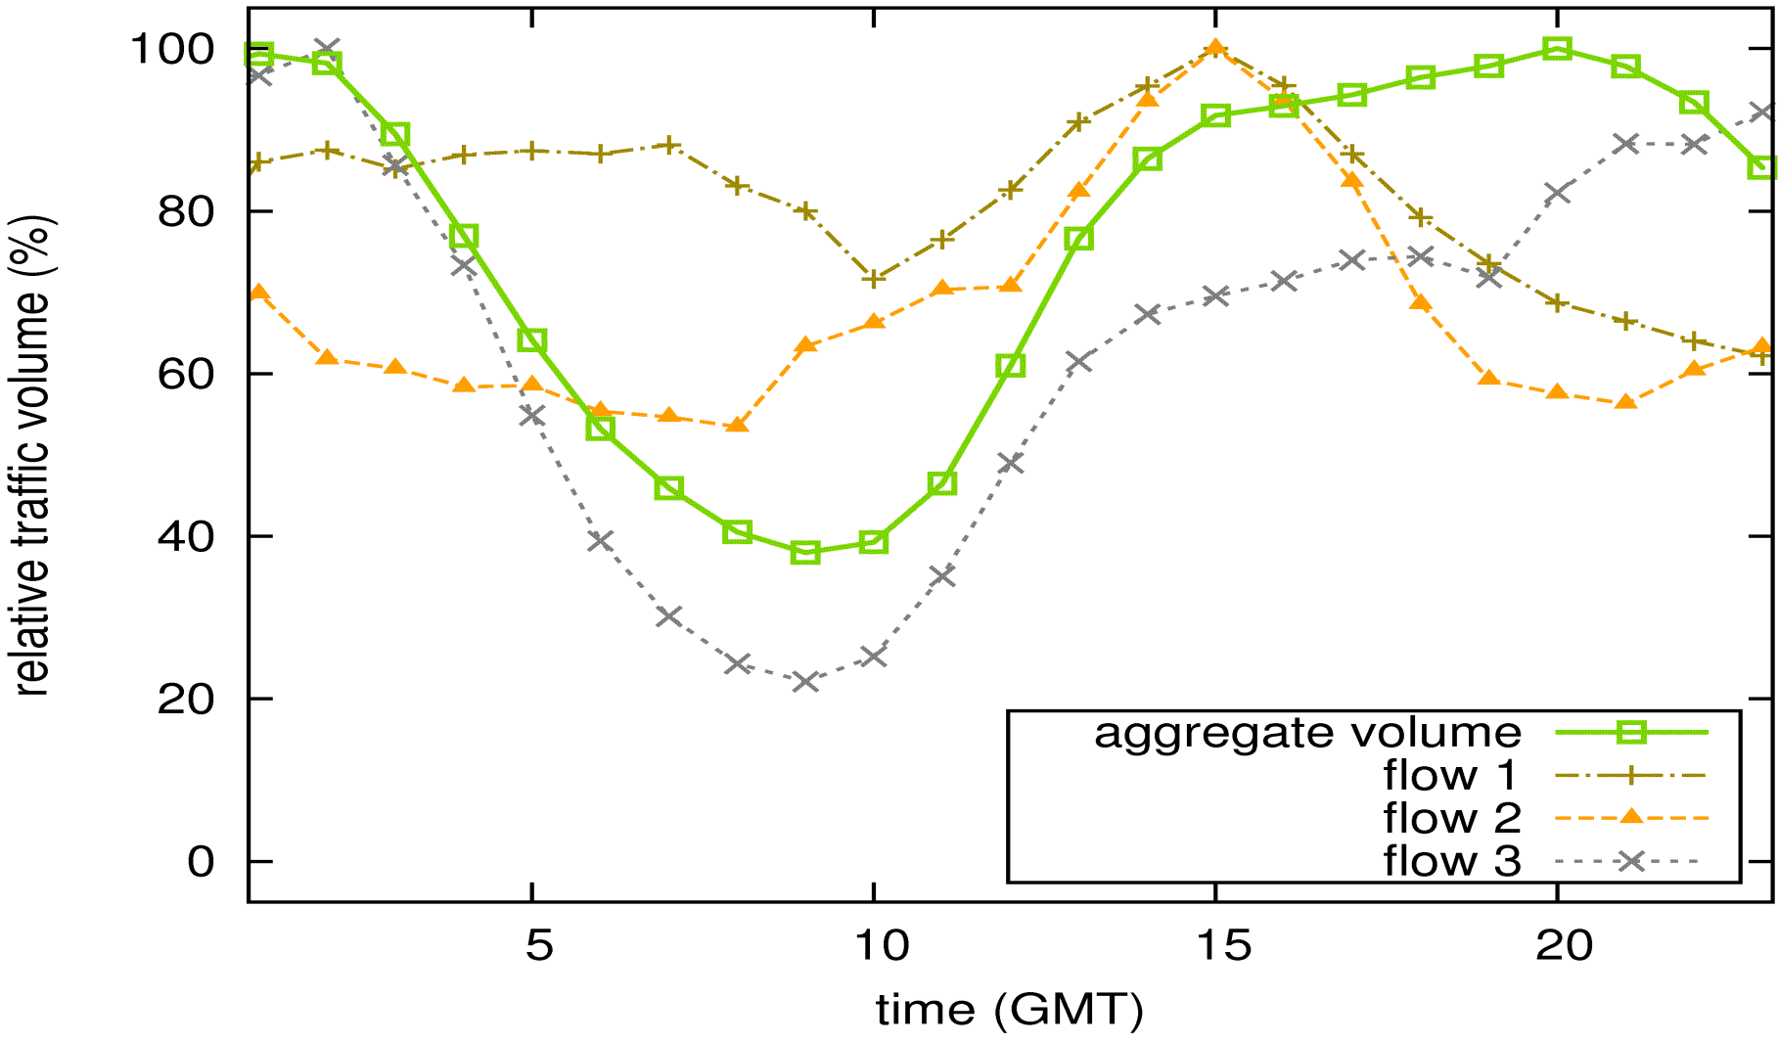
Traffic is Highly Variable (Tier-1)
relative traffic volume (%)
No single traffic peak (international traffic)
number of paths
Time (GMT)
Can a static configuration cope with the variability?

Slide 29
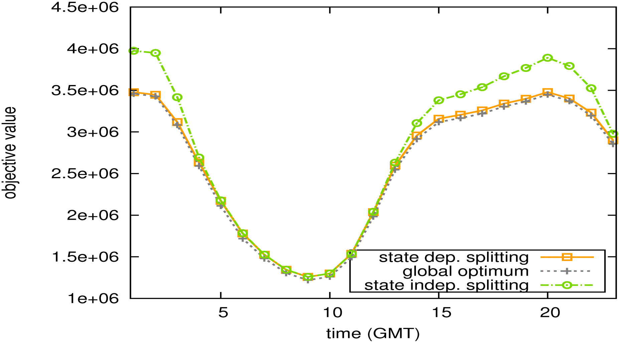
Performance with Static Router Configuration (Tier-1)
objective value
number of paths
time (GMT)
State dependent splitting again nearly optimal

Slide 30
Overview
Architecture: goals and proposed design
Optimizations: of routing and load balancing
Evaluation: using synthetic and realistic topologies
Conclusion

Slide 31
Conclusion
Simple mechanism combining path protection and traffic engineering
Favorable properties of state-dependent splitting algorithm:
(i) Simplifies network architecture
(ii) Optimal load balancing with static configurations
(iii) Small number of paths
(iv) Delay comparable to current OSPF
Path-level failure information is just as good as complete failure information
Notes:
We present a simple mechanism that combines path protection and traffic engineering.
We show a number of favorable properties of our solutions.
We make the exciting observation that if the ingress routers obtain path-level failure information, they can still balance the load just as well as if they had the full topology information.
Our solution is attractive because it simplifies network management and design.

Slide 32
Thank You!

Slide 33
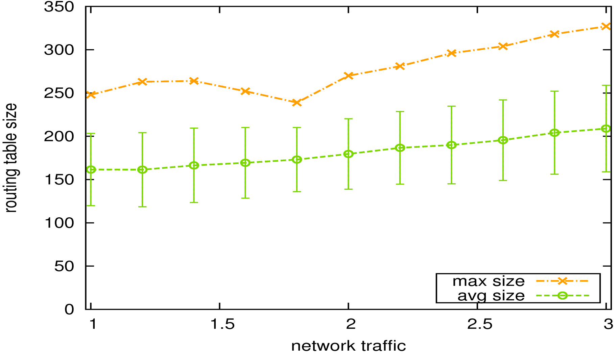
Size of Routing Tables (Tier-1)
Largest routing table among all routers
routing table size
number of paths
network traffic
Size after compression: use the same label for routes that share path

