Slide 1
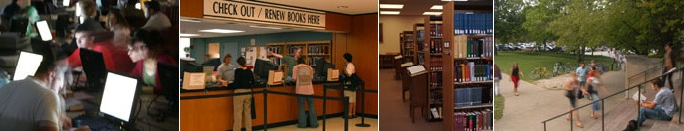

The IUB Libraries: Fire, Space and Staff May 7, 2012

Slide 2
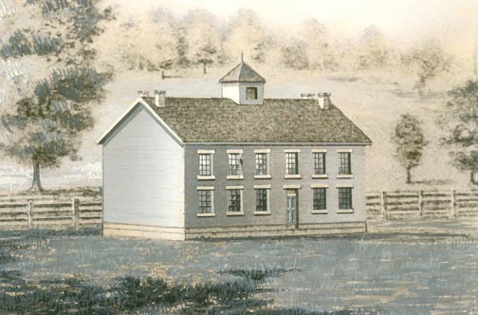
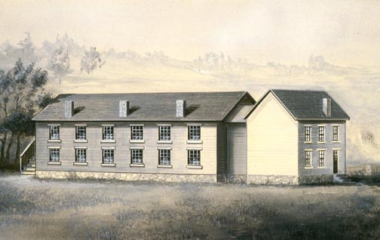
Indiana's state government founded Indiana University in 1820 as the State Seminary, and officially changed the name to "Indiana University" in 1838.

Slide 3
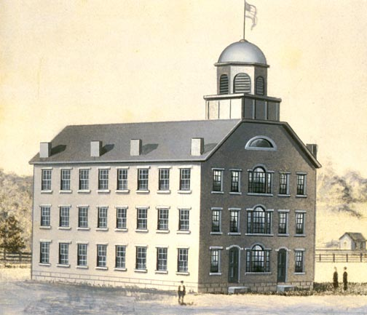
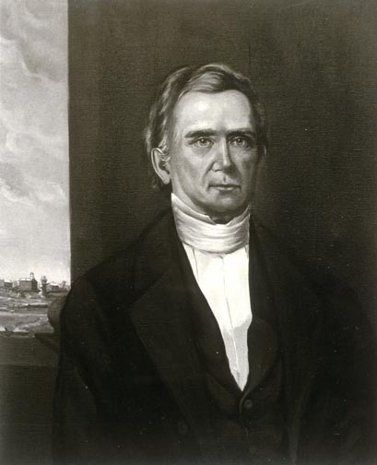
President Andrew Wylie and Prof. Bernard Hall

Slide 4
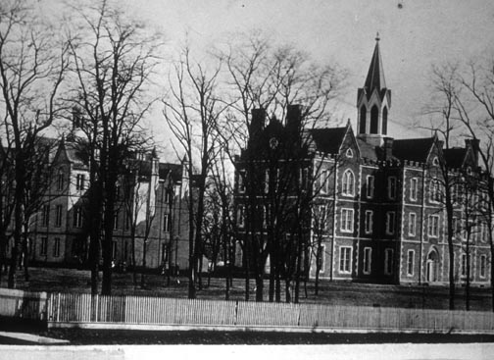
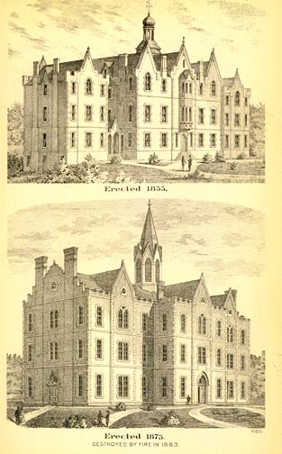
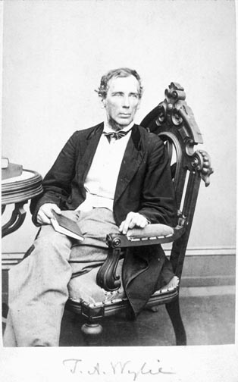
Seminary Square see also history at: http://www.iub.edu/about/history.shtml

Slide 5
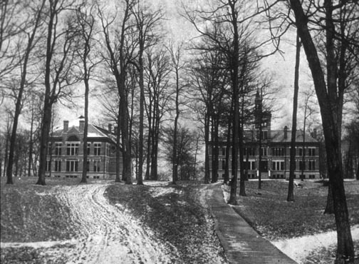
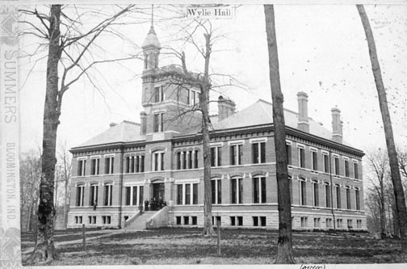
Collection housed in Wylie Hall by 1891 was 9,000 volumes.
There were 98 periodical subscriptions in 1887.

Slide 6
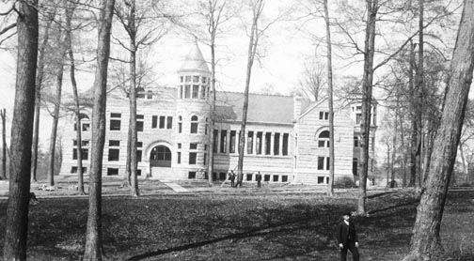
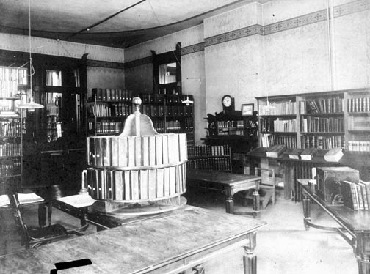
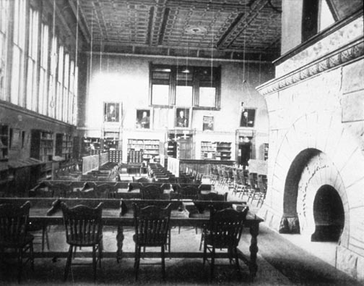
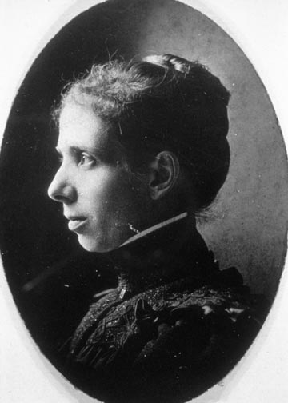
Library Hall, named after David Maxwell, first president of the IU Board of Trustees.

Slide 7
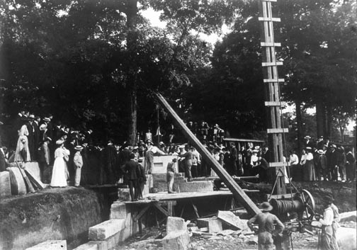
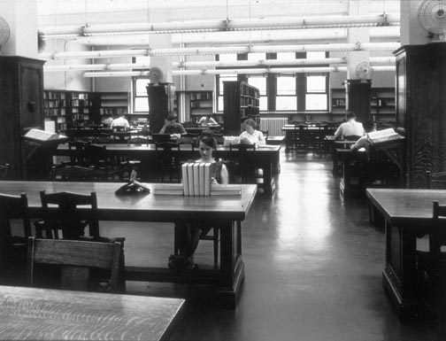
Space became an issue as Maxwell Hall reached capacity in 1901-1902.
Construction on the “New” Library began

Slide 8
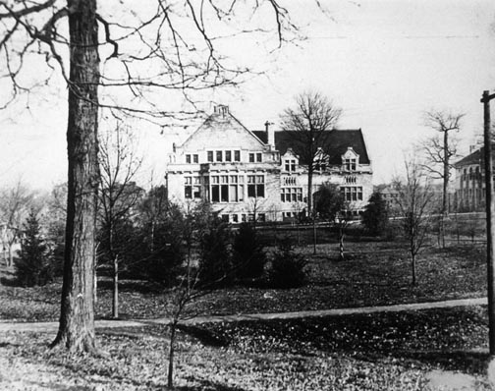
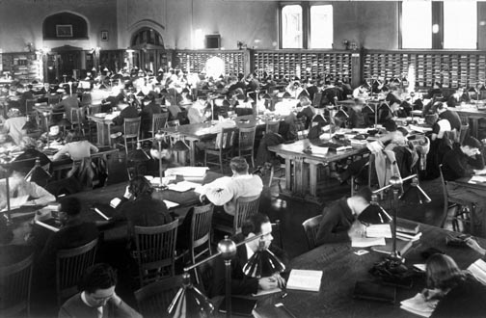
The “New” Library was funded by the Indiana General Assembly at a little more than half the anticipated costs.
Franklin Hall 1904-1969

Slide 9
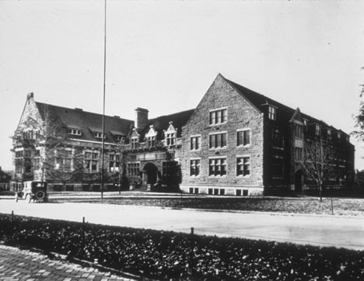
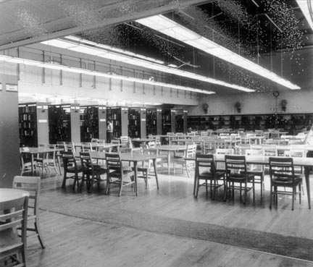
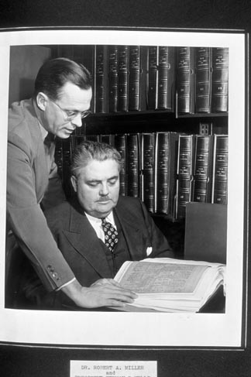
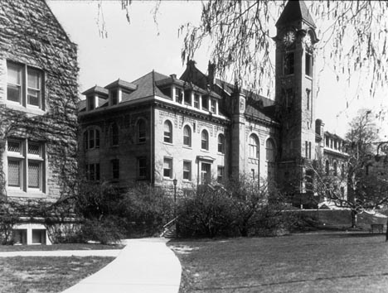
Trend in the 1950s towards having a special place for undergraduates – Harvard first.
Volumes held
1904 53,000
Inventory of the stacks in 1921
1925 167,592
1969 2,300,000
2005 7,241,929

Slide 10
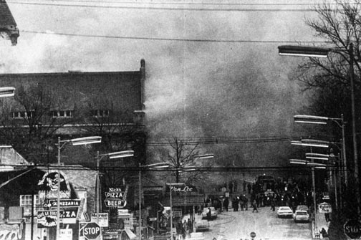
Fire…. May 1969 courtesy IDS

Slide 11
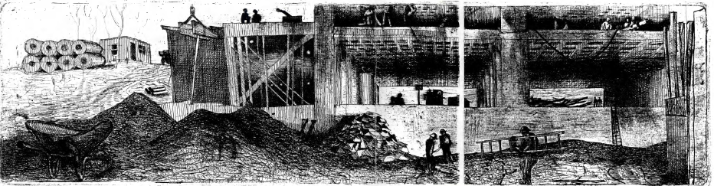
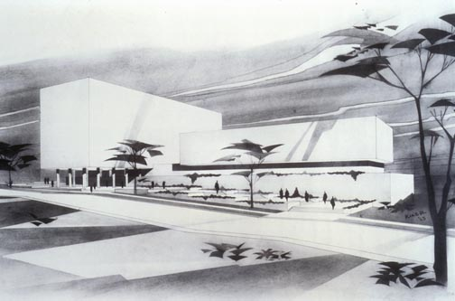
The “New” Library as conceived!

Slide 12
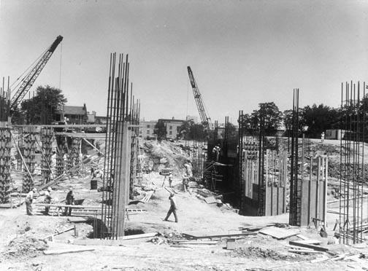
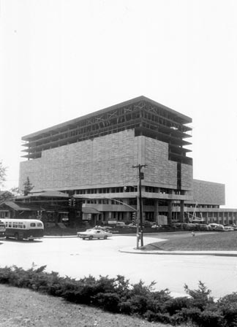
The “New” Library Construction 1966-1969

Slide 13
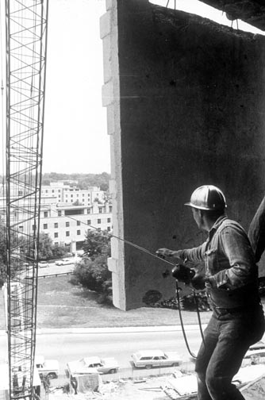
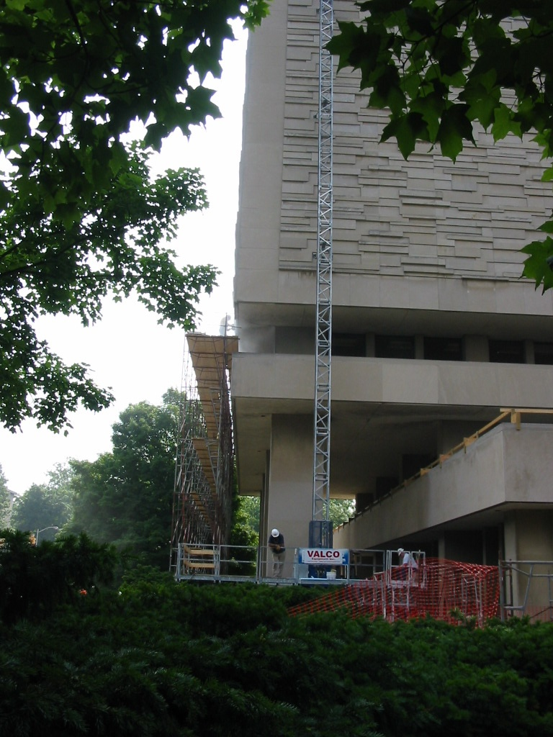
Stoned 1969 Re-stoned 2007

Slide 14
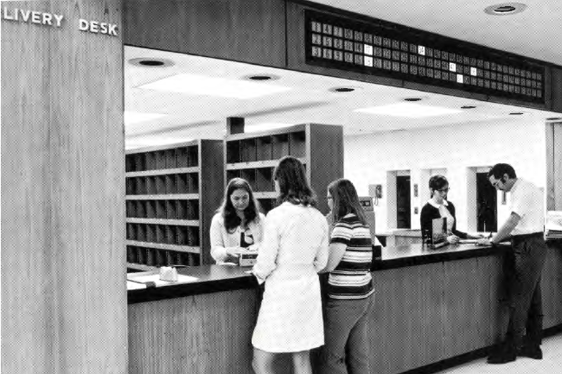
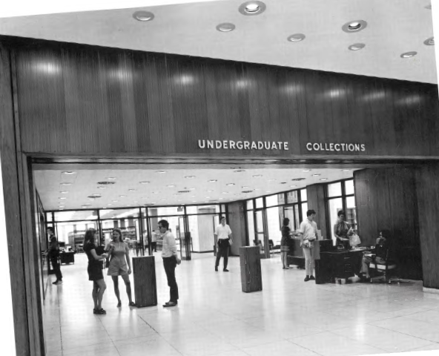
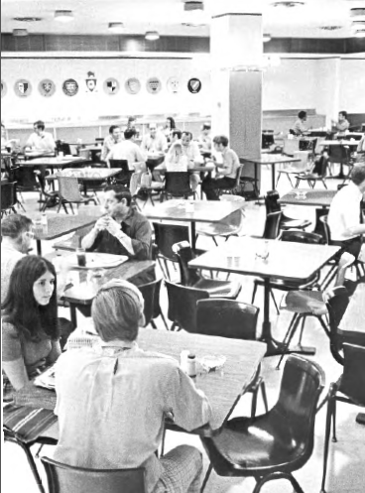
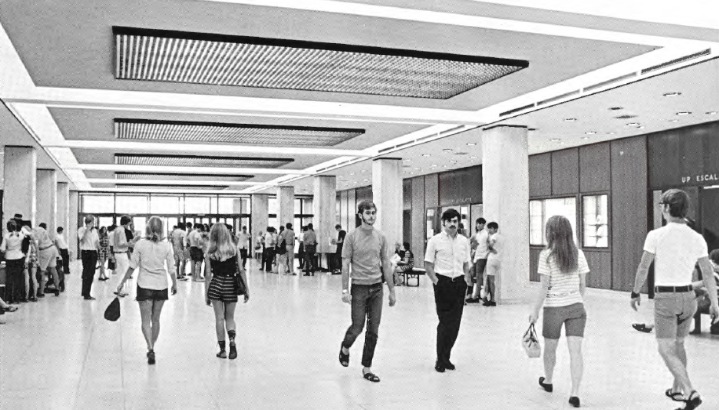

Slide 15
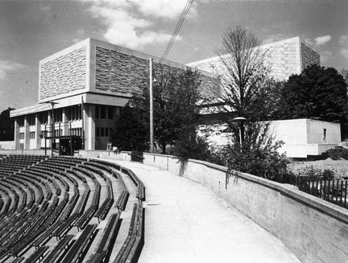
The “New” Library Summer 1969….

Slide 16
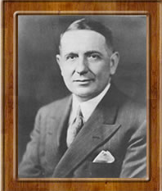
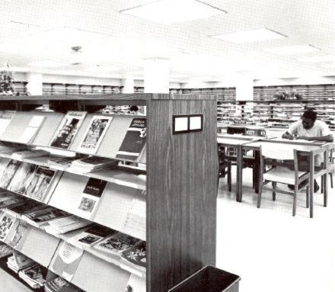
Periodical/Journal Access
1918 Bound Periodicals RR: 150
1969: 19,000 est.
2011 Serials subscriptions:
(print) 11,778; (electronic) 60,315

Slide 17
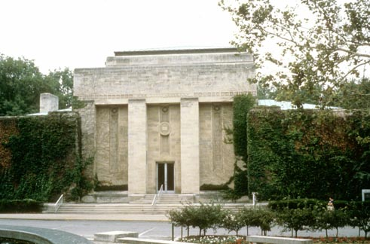
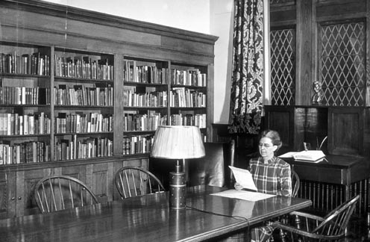
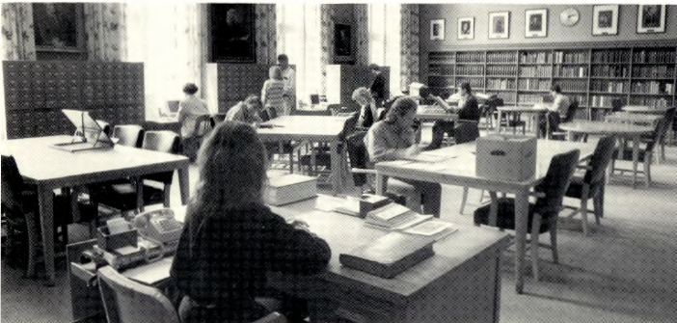
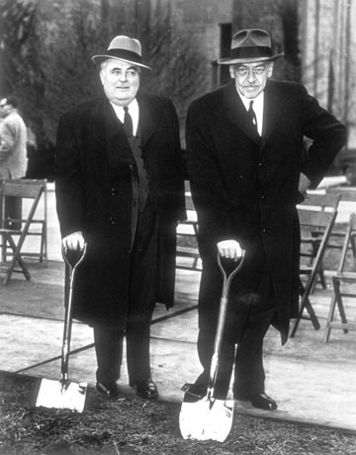
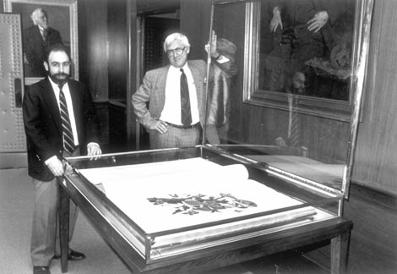
Special Collections consisted of a small room in the Main Library (Franklin) but then with gift from the Lilly Family, moved into the Lilly Library in the sixties.
LILLY LIBRARY

Slide 18
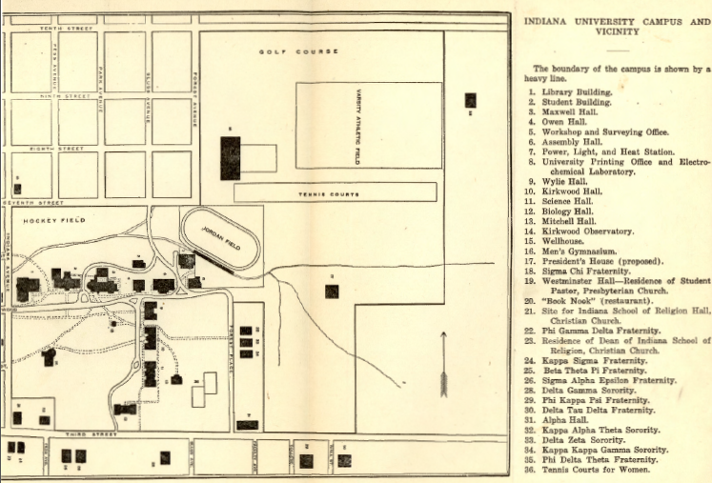
IU Bloomington – 1930s

Slide 19
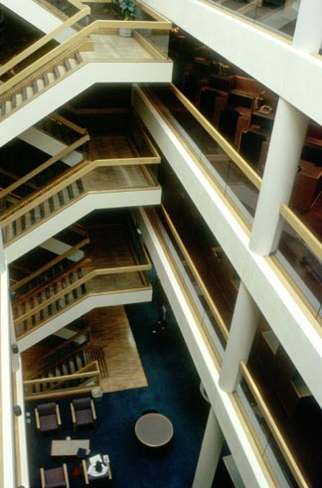
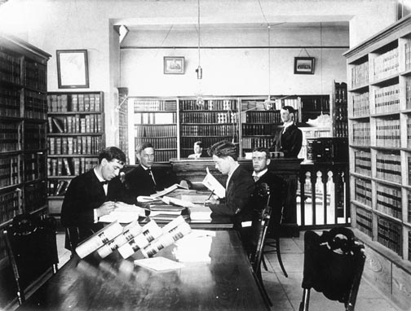
Law Library
The oldest departmental library, established in the 1840s.

Slide 20
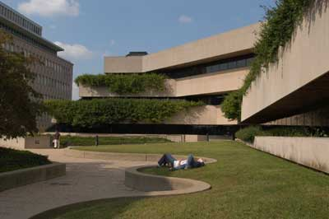
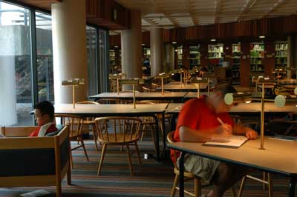

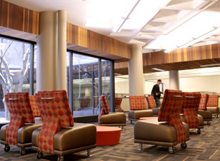
The Business SPEA Information Commons developed from the Business SPEA Library, which was a merger of the Business Library and the Bureau of Public Affairs Library in the 1970s.
A Library Committee appointed by Wells in 1935; Pilot study room in 1936 led to the Business Administration Reading Room in 1937 in the Social Sciences Building; In 1942, the Business and Economics Library was housed in Rawles Hall.
BUSINESS-SPEA

Slide 21
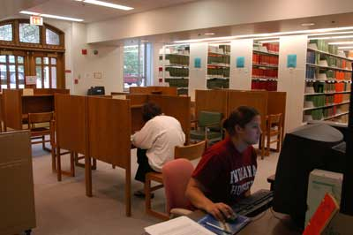
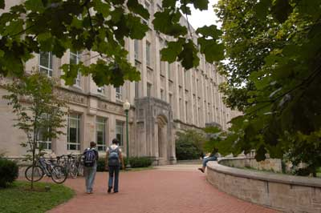
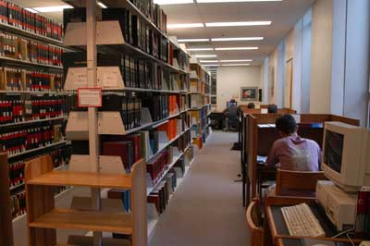
The core collection of the original Chemistry Library was donated by Dr. Robert Edward Lyons around 1895. From 1895-1931, the Chemistry Library was housed in a room in Wylie Hall. It was moved to the ground floor of the new Chemistry Building in the early 1930s. The library was extensively remodeled and enlarged around 1965, and the present quarters were occupied during the remodeling and expansion of the Chemistry Building in the early 1990s.
http://www.libraries.iub.edu/index.php?pageId=2048
CHEMISTRY LIBRARY

Slide 22



University School Library may have been the beginning of both the former SLIS Library and the Education Library. The Education Library was known as the Education Reading Room until the 1970s when it became an official branch library. The Education Library was housed in the Education Building (now the Music Library Building) until 1993 when it moved into the new Wright Education Building.
EDUCATION LIBRARY

Slide 23




IU-Bloomington's first Fine Arts Library was established in the late 1930s as part of the Departmental office on the second floor, east wing of the University Library which was then located in Franklin Hall.
http://www.libraries.iub.edu/index.php?pageId=1854
FINE ARTS LIBRARY

Slide 24




The Geography and Map Library, closed in January 2010 and many of its materials were merged with the Geology Library to form the…
In 1871, the collection of David Dale Owen, geologist, was purchased by the University (housed in the Main Library). The Geology and Geography Library was mentioned in 1894-95 (departments separated in 1946). The library was moved to Science Hall (now Lindley Hall) in 1903, but returned to Owen Hall in 1937. Upon completion of the current Geology Building in 1962, the collection was moved to its present location.
http://www.libraries.iub.edu/index.php?pageId=1494
GEOSCIENCES LIBRARY

Slide 25




The HPER Library is one of the youngest branch libraries, established in 1978 to support the School of Health, Physical Education and Recreation.
HPER LIBRARY

Slide 26


Established in the 1960s, the Journalism Library was renovated in 2004 then books/journals moved to Wells or ALF in 2007. Now operated by the School of Journalism instead of the Libraries.
WEIL JOURNALISM LIBRARY

Slide 27



Life Sciences’ history begins with the Zoology Library and also the Botany Library (described in the University catalog in 1891-92). These two libraries were merged in 1937-38 to establish the Biology Library.
Included Jordan-Eigemann collection of fishes (solid in 1929 for $5,000 to buy more journals); Dr. Kinsey’s private entomology collection in the 1940’s; and the Dean Library of 1308 items on Indiana botany.
The Medical Library was housed in the Main Library as a seminar room; moved to Science Hall in 1907; Anatomy and Physiology Library existed in 1913 in Owen Hall. These merged when the new Medical Building was finished in 1937 (Myers).
In the late 1990’s Medical Sciences Library merged with Biology to for the…
LIFE SCIENCES LIBRARY

Slide 28



The Black Culture Center Library was established in the 1970s.
Neal-Marshall Black Culture Center Library

Slide 29


OPTOMETRY LIBRARY

Slide 30


Individual departmental libraries for math, physics, astronomy were merged when Swain Hall opened in June 1940.
Math collection dates to 1891-92
Astronomy collection dates to Kirkwood Observatory 1900
Physics collection dates to 1902-03
SWAIN HALL LIBRARY
Math, Physics, Astronomy, Computer Science

Slide 31




Housed in Mitchell Hall in the Dean’s Office, the Music Library began around 1922; moved to new Music Building in 1937; moved to the renovated Education Building in January 1996.
http://www.libraries.iub.edu/index.php?pageId=3723 and Lowell’s dissertation.
William & Gayle Cook MUSIC LIBRARY

Slide 32



University Archives and Records Management was housed in Bryan Hall until 2009 when it moved to the Herman B Wells Library.
It’s primary mission is to collect, organize, make accessible and preserve records documenting Indiana University's origins and development and the activities and achievements of its officers, faculty, students, alumni and benefactors
UNIVERSITY ARCHIVES AND RECORDS MANAGEMENT

Slide 33



Built in 1835, Wylie House was the home of Indiana University's first president, Andrew Wylie, and his family.
http://www.indiana.edu/~libwylie/about.html
WYLIE HOUSE MUSEUM

Slide 34






THE BEST--ALF

Slide 35






8

Slide 36











1841 – 1879
1880 – 1893
1896 – 1898
1898 – 1903
1904 – 1921
1921 – 1943
2010 -
1942 – 1972
1989 – 1996
1996 – 2005
2005 – 2010

Slide 37













Slide 38

“A good book is the lifeblood of the master spirit”
http://www.indiana.edu/~libweb/info/history/

