Slide 1
Reciprocity Attacks
Presented at “Symposium On Usable Privacy and Security 2011”, Carnegie Mellon University campus, Pittsburgh, PA
By
Feng Zhu¹, Sandra Carpenter², Ajinkya Kulkarni¹, Swapna Kolimi¹
¹Department of Computer Science
University of Alabama in Huntsville
Huntsville, AL, USA
{fzhu@cs.uah.edu, akulkarni@itsc.uah.edu, spk0006@cs.uah.edu}
²Department of Psychology
University of Alabama in Huntsville
Huntsville, AL, USA
carpens@uah.edu

Slide 2
Outline
Experiment’s Goals
Introduction to
Pervasive Computing Environment
Importance of Identity Elements
Norm of Reciprocity
Reciprocity Attack
Experiment’s Details
Results and Lessons Learned
Conclusion and Future Work

Slide 3
Experiment’s Goals
Understanding
Identity Exposure
229 students participated in an online survey.
Identify
69 students participated in the reciprocity lab experiment.
78 students participated in the pilot studies.
Reciprocity Attacks
to get identity elements
Pervasive Computing Environment
>375
students
participated

Slide 4
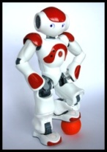
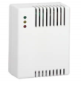


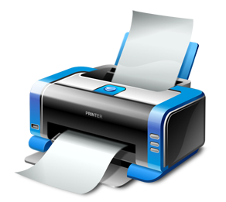


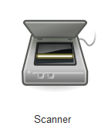
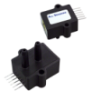
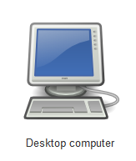
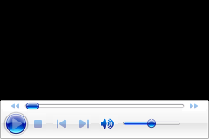
Pervasive Computing Environment
Pervasive Computing Environment integrates networked computing devices with people and their ambient environments enabling the device and the service to communicate with each other.
Smoke Detector
Gas Detector
Humanoid
Flood Sensors
Microsoft’s Vision for 2019 Video (2 Min)
Printer
Mobile Devices
Pressure Sensors

Slide 5
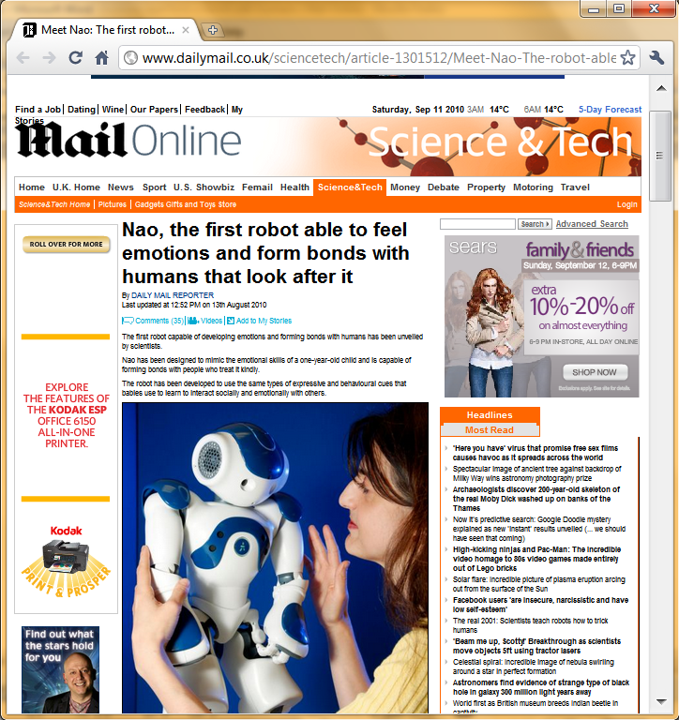

Slide 6
Importance of Identity Elements
A study shows that the combination of zip code, birth date, and gender can uniquely identify 87% individuals in the United States.
According to study, 36% of ID theft victims had their name and phone number compromised.
Identity theft is increased by 11% from 2008 to 2009 affecting the lives of 11 million people in U.S. 1 in every 10 U.S consumer has already experienced some sort of identity theft.
Studies indicate that information about an individual’s state and date of birth can be sufficient to statistically infer narrow ranges of values wherein that individual's SSN is likely to fall.

Slide 7
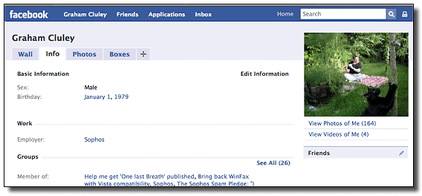
Identity Exposure Behavior
Studies show that people are very concerned about their privacy, but they may not protect their personal information well and may unnecessarily expose their information on the Internet.

Slide 8
Norm of Reciprocity
A helps B
A gives B
A
B
A
B
B helps back A
B gives back A
Reciprocity in a nutshell
Reciprocity makes people say ‘yes’ without thinking first.
Reciprocity can trigger unfair exchanges.
It does not matter whether second person liked first one or not; sense of indebtedness makes second person repay the favor.
Reciprocity Related Work
The Moon’s study.
A greeting card study.
The Regan’s Coca-Cola experiment.
Others.

Slide 9
Reciprocity Attack

Slide 10
“Reciprocity Attack”
This study is the first attempt to understand the impact of the norm of reciprocity as an attack in pervasive computing environments.
We did an in-depth study and quantitative analysis of impact of the norm of reciprocity as an attack in pervasive computing environments.
A gives identity information to B
A
B
B gives identity information to A
Phone Number Exchange Example
Birthday Exchange Example

Slide 11
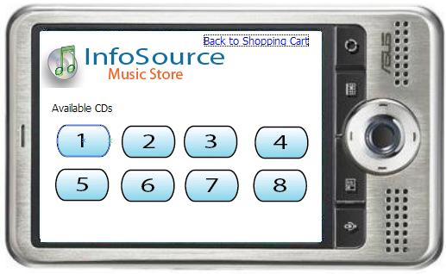
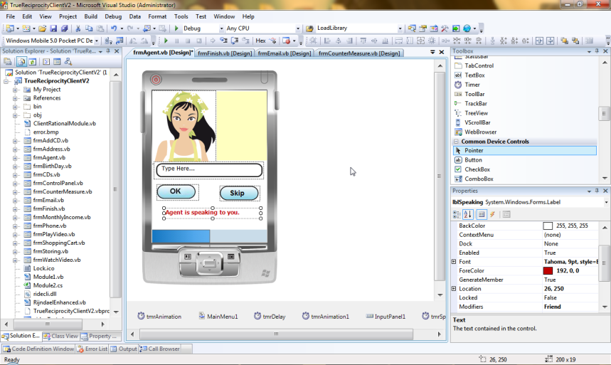
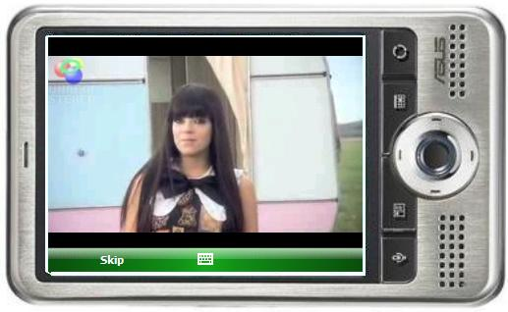
InfoSource Technology
InfoSource software technology consists of following 3 software components:
InfoSource Music Store App
InfoSource Survey
InfoSource Server
Music playback capability
Development of Alice

Slide 12
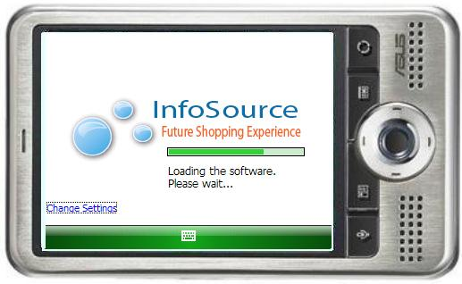
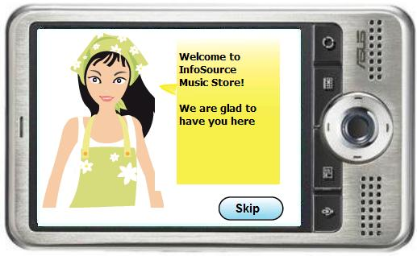

A Welcome Screen
Studies shows that an animated interface agents increase a sense of social presence

Slide 13
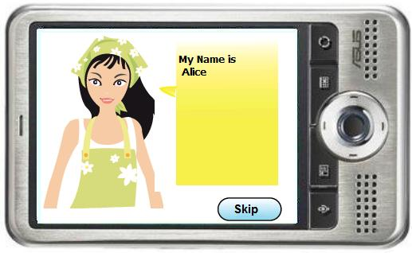
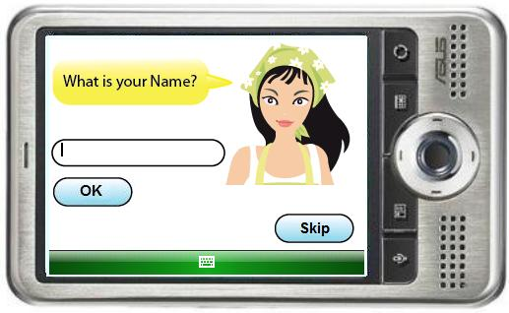
A Reciprocity Example

Slide 14
Participants & Experiment Procedure
Participants:
Sixty-nine participants attended our main experiment (Seventy-eight participants attended our pilot studies).
About 68% of the participants were female students.
Their ages ranged from 18 to 40, with an average of 22.
Procedure:
We posted signup sheets in Psychology Department.
Students came to CS lab and signed a consent form.
We gave them introduction about the experiment and handed over a PDA.
Experiment lasted for approximately 20 minutes.
Students completed a survey in approximately in 15 minutes.

Slide 15
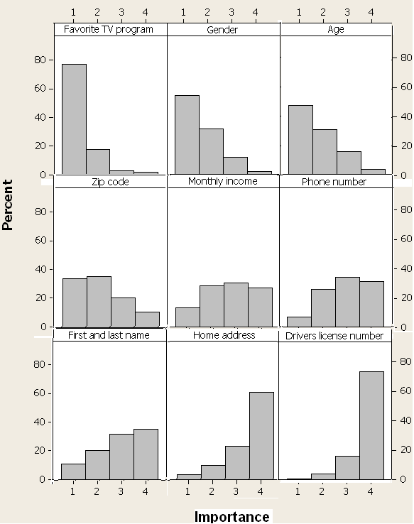
Selection of the Identity Elements
In one of our previous research projects, we asked 229 participants to rate how important it is to keep 26 identity elements private.
Selected Identity Elements:
Birthday
Email
Monthly Income
Phone Number
Home Address

Slide 16
The Script Used in the Experiment

Slide 17
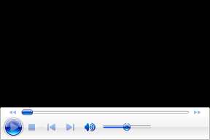
1. Birthday
Reciprocity Attack: Country pop music album Fearless has its roots in soft pop which is usually popular with people born under the zodiac sign of Aquarius (born in between Jan 21 and Feb 19) as they are known to be sensitive, gentle and patient.
Question: What is your date of birth?

Slide 18
2. Email
Reciprocity Attack: Tune-Nation maintains a fan club website. The current screen shows one of the web pages. It can be viewed via your computer, a smart phone such as iPhone, or a handheld device such as iPod Touch.
Unlike other fan club sites, our website focuses on new releases, customer ratings, and their recommendations. We will use your email addresses as your identification, while you specify your own display name to be displayed on the website. We will not send you any email unless you explicitly request it.
Question: Type your email address and your display name.

Slide 19
3. Monthly Income
Reciprocity Attack: At Tune-Nation, we seek to provide great customer satisfaction by accurately recommending songs and music CD albums that our customers are going to love.
We are building a world class music genre recommendation system to bring you great value and accuracy. More than 75% of the customers like the CD albums that we suggested. I would like to recommend another CD album for you.
Question: Select one of your favorite genres and please select your monthly income or monthly expenses.

Slide 20
4. Phone Number
Reciprocity Attack: You may choose to maintain your purchase records within Tune-Nation. Any songs, CD albums, and movies that you purchase at Tune-Nation stores may be downloaded from Tune-Nation website to your smart phone or cell phone.
Your phone number is your identification. You may switch to another phone number later. Remember Tune-Nation does not make any sales calls to the phone number that you provide.
Question: Provide your phone number to maintain your purchase records with Tune-Nation.

Slide 21
5. Home Address
Reciprocity Attack: Throughout the year, we mail coupons to our customers. You will save 20% - 30% on any regular or “on sale” music and video products in store or online. On your birthday, you will receive an exclusive 40% off coupon.
Question: What is your home address?

Slide 22
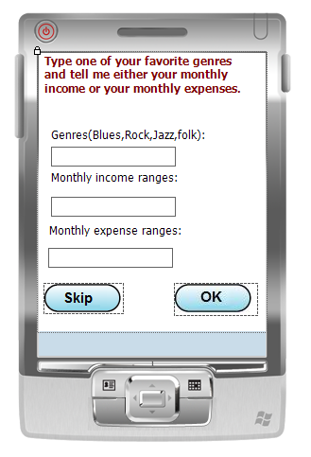
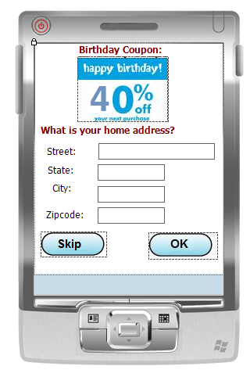
Screenshot for Home Address Question
Screenshot for Monthly Income Question

Slide 23
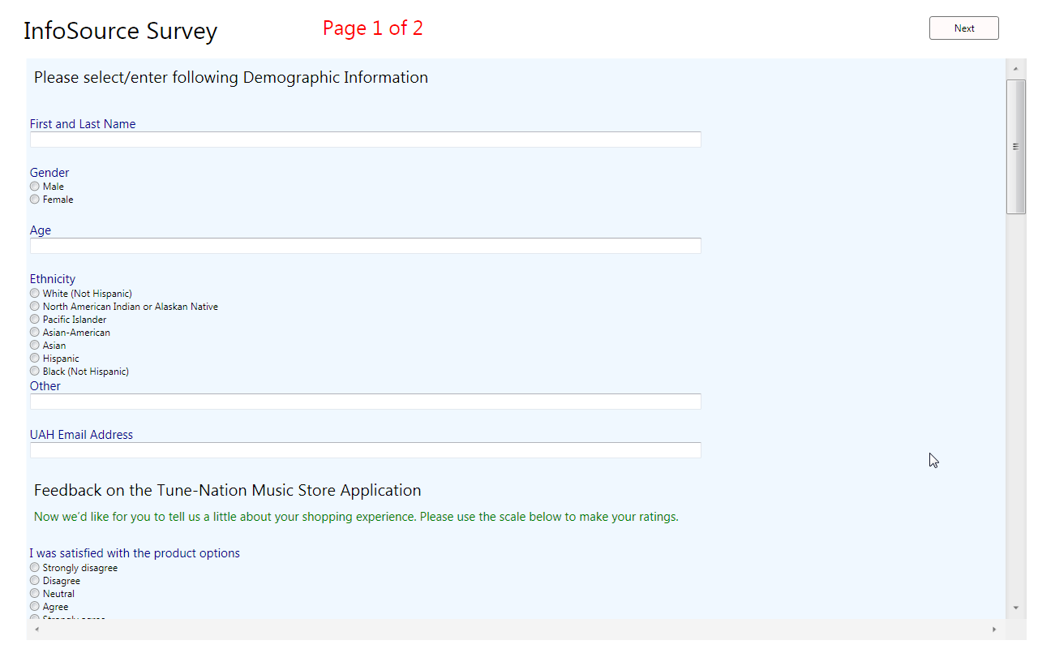
Questionnaire
The questionnaire had three sections:
Demographic data
Users’ feedback on our software
Dedicated to privacy-related questions

Slide 24
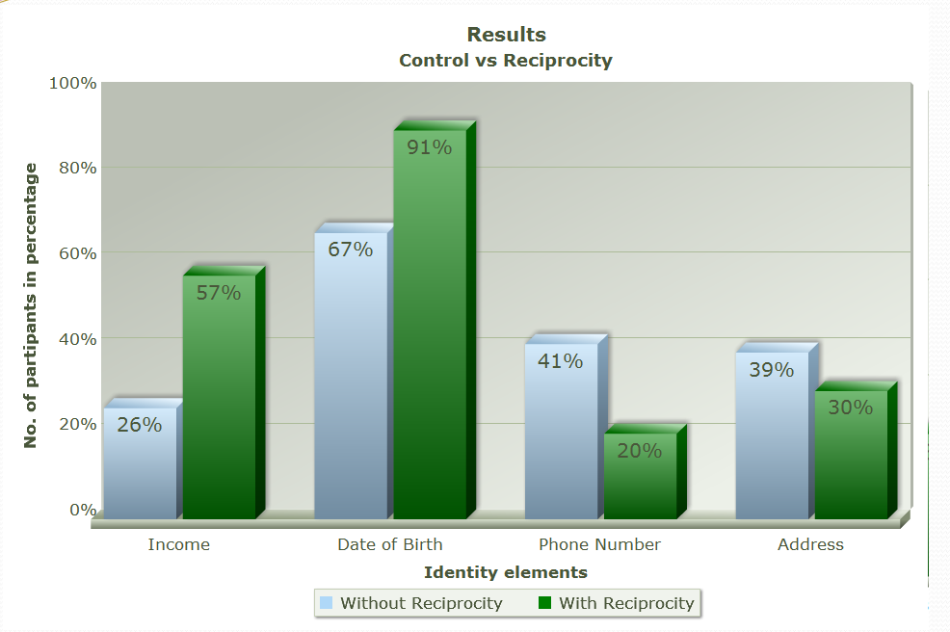
Experimental Results
 | Control |  | Reciprocity
Income | 12 | 26% | 13 | 57%
DoB | 31 | 67% | 21 | 91%
Phone | 19 | 41% | 7 | 30%
Address | 18 | 39% | 7 | 30%
No. of Participants | 46 |  | 23

Slide 25
Other Findings and Lessons Learned

Slide 26
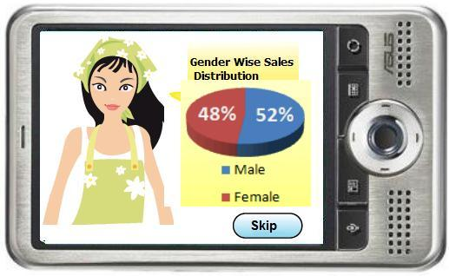
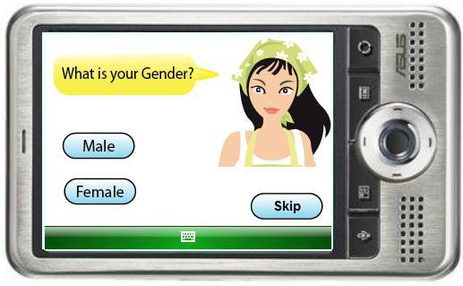
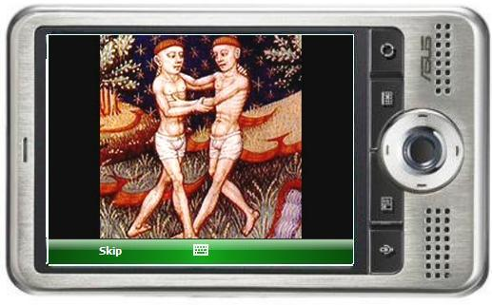
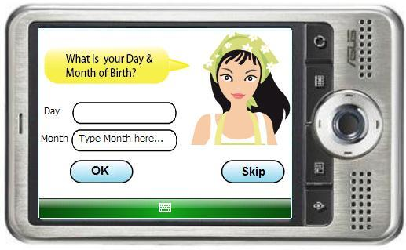
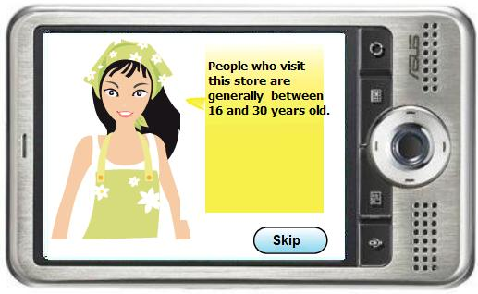
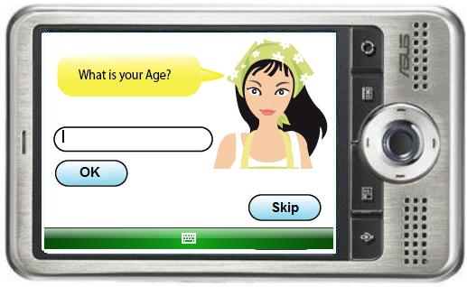

Slide 27
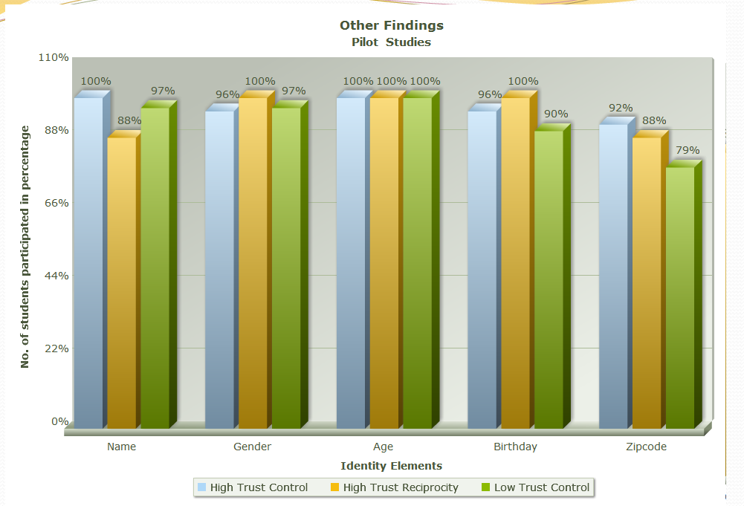
Other Findings and Lessons Learned
 | High Trust Reciprocity |  | High Trust Control |  | Low Trust Control
Name | 21 | 88% | 25 | 100% | 28 | 97%
Gender | 24 | 100% | 24 | 96% | 28 | 97%
Age | 24 | 100% | 25 | 100% | 29 | 100%
Birthday | 24 | 100% | 24 | 96% | 26 | 90%
Zip code | 21 | 88% | 23 | 92% | 23 | 79%
No. of Participants | 24 |  | 25 |  | 29

Slide 28
Conclusion
Reciprocity attacks can be successfully used to get Identity elements from customers.
Results show that when participants are under reciprocity attack they are more likely to expose their sensitive identity information.
Our study confirm that trust is a leading factor that make people expose identity elements and reciprocity can be used to increase the trust between service providers and customers.
We also learned that the way questions are phrased affects the people’s behavior towards revealing the sensitive identity information.
We learned that experimental research on privacy is inherently challenging. A number of different factors may affect one’s privacy protection decisions.

Slide 29
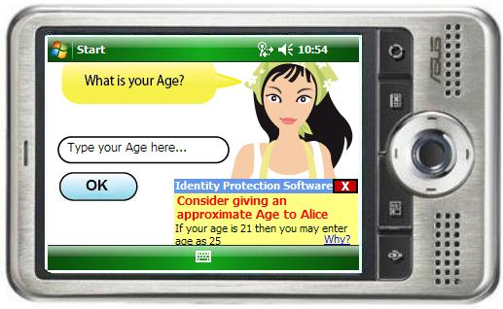
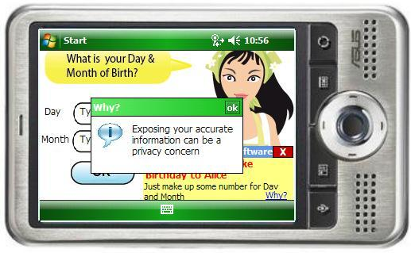
Future Work
Reciprocity attacks may be designed for phone number and home address that are more compelling than ours.
Increase awareness of the sensitivity of Identity elements.
Help people to understand the Identity exposure consequences and technologies.
Develop the mitigation approach.

Slide 30
Questions?
This presentation can be downloaded from www.tinyurl.com/reciprocitySOUPS11
About me: www.ajinkyakulkarni.com

