Slide 1
CHCI Visit by Dean Benson, Associate Dean Lesko KW II Rm. 1127 – 10/10/2011 Digital Library Research Laboratory Torgersen Hall Rm 2030 – www.dlib.vt.edu by Edward A. Fox
fox@vt.edu http://fox.cs.vt.edu
Dept. of Computer Science, Virginia Tech
Blacksburg, VA 24061 USA

Slide 2
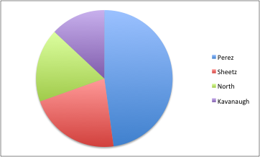
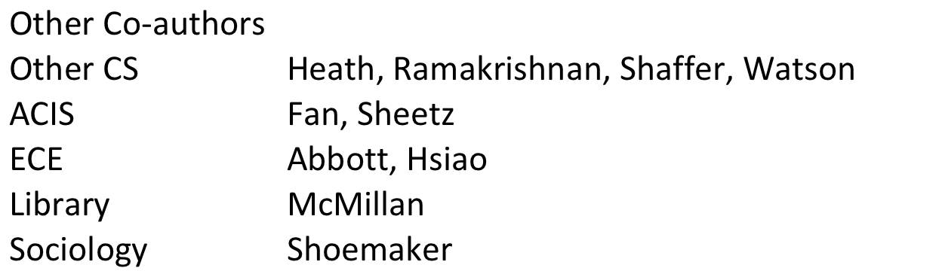
Co-authors
CHCI

Slide 3
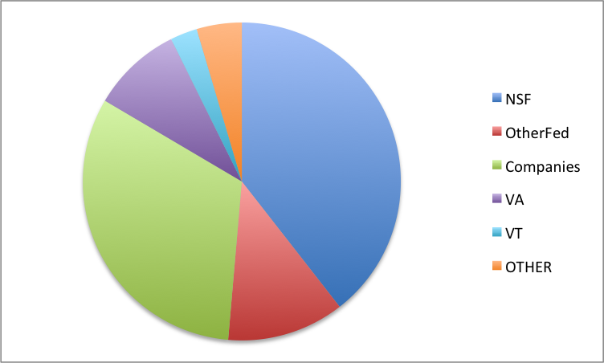
Sponsors for 110 Grants

Slide 4
Selected DL Projects
Digital Library Curricular Resources
NSF IIS-0535057 & 0535060
CTRnet (Crisis, Tragedy & Recovery Net)
NSF IIS-0916733
Ensemble (Computer Science Education)
NSF DUE-0840719
Digital Preserve
NSF IIS-0910183 & 0910465
http://slurl.com/secondlife/Digital%20Preserve/140/126/29

Slide 5
Selected DL Projects - 2
CINET: Network Science Middleware
NSF SDCI 1032677
Simulation, Cyberinfrastructure
Metadata-based Generation
Establishing a Qatari Arabic-English DL Institute: NPRP 4 - 029 - 1 – 007 pending
Fingerprint Analysis/Distortion/Training DLs
National Inst of Justice, BAE Systems
ETD Analysis, Extraction, Classification

Slide 6
DL Curriculum Framework

Slide 7
Areas of Research and Teaching
Digital Libraries
Information Retrieval
Library, Information Science
Search (engines), WWW, Web 2.0
Human-Computer Interaction
Visualization, Interfaces, VR, Usability, …
Multimedia / Hypermedia / ePublishing
Computing-related education

Slide 8
DL Book Draft Chapter Authors
Monika Akbar, Pranav Angara, Yinlin Chen, Lois M. Delcambre (Portland), Noha Elsherbiny, Eric Fouh, Marcos André Gonçalves (Brazil), Nádia P. Kozievitch (Brazil), Spencer Lee, Jonathan Leidig, Lin Tzy Li (Brazil), Mohamed Magdy Gharib Farag, Uma Murthy (Seattle), Sung Hee Park, Rao Shen (Yahoo!), Venkat Srinivasan, Ricardo da Silva Torres (Brazil), and Seungwon Yang

Slide 9
Book Draft - 1
Frontmatter
1 Basic Concepts
1 Introduction (5S Formal framework)
2 Exploration (Archaeology)
3 Evaluation (Quality Assessment Toolkit)
2 Advanced Concepts
4 Complex objects (Fingerprints)
5 Integration (Archaeology)
6 Subdocuments (Fish Species Identification)
7 Ontologies (Crisis, Tragedy, and Recovery network)
8 Classification (Electronic Theses & Dissertations)

Slide 10
Book Draft - 2
3 Applications
9 Content-based Image Retrieval (CBIR)
10 Online Communities & Social Networks (AlgoViz)
11 Education (AlgoViz, Ensemble)
12 Bioinformatics, Scientific, and Simulation DLs (Epidemiology, Fingerprints, Network Simulations)
13 Geospatial Information (VT Buildings)
14 Security (CTR network)
15 Text Extraction (References in ETDs)
Backmatter: References, Mathematical Preliminaries, Glossary

Slide 11
Questions? Discussion?
Thank You!
(fox@vt.edu)

