Slide 1
Estimating the Laplace-Beltrami Operator by Restricting 3D Functions
Ming Chuang¹, Linjie Luo², Benedict Brown³, Szymon Rusinkiewicz², and Misha Kazhdan¹
¹Johns Hopkins University
²Princeton University
³Katholieke Universiteit Leuven

Slide 2
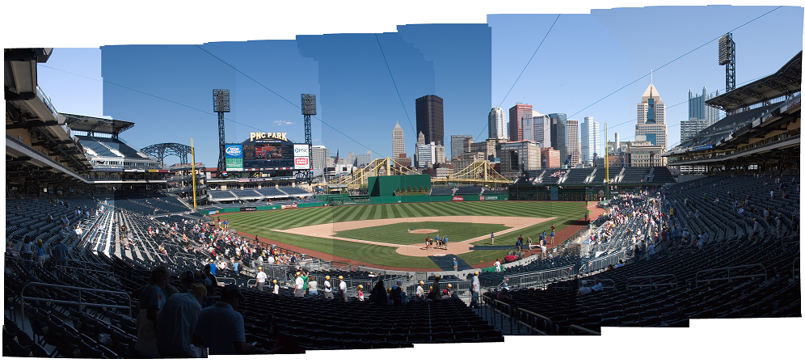
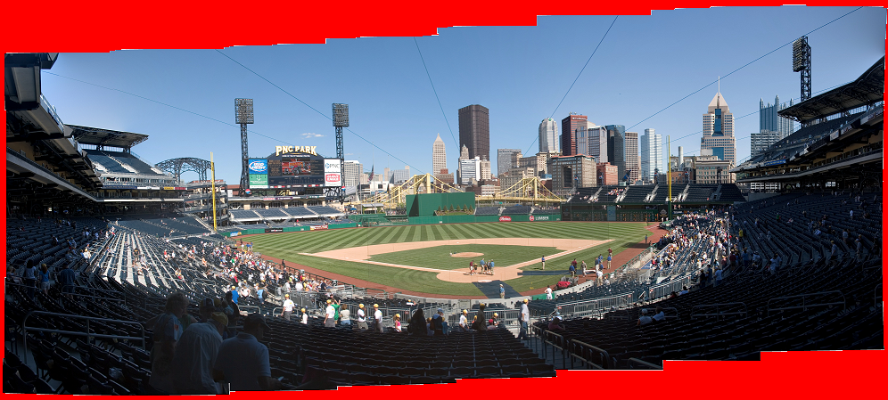
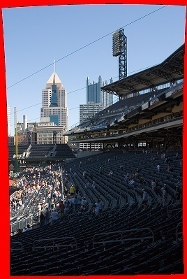
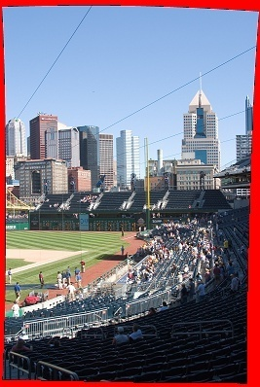
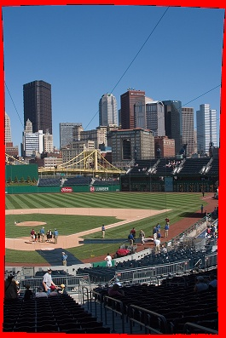
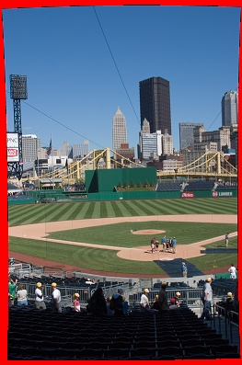
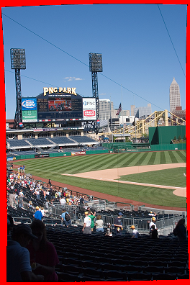
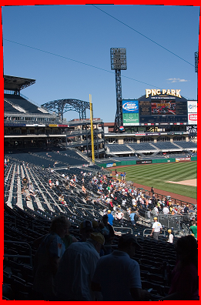
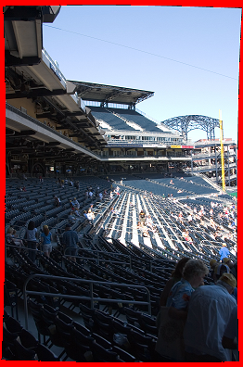
Motivation
Image Stitching
Compute image gradients
Set seam-crossing gradients to zero
Fit image to the new gradient field

Slide 3
Motivation
Gradient-Domain Image Processing
Solving for the scalar field u whose gradients best match the vector field g amounts to solving a Poisson system:
This approach is popular in image-processing because multigrid makes solving the system simple and fast.
Can the analog on meshes also be made easy to implement?

Slide 4
Outlook
To address this question, we consider two related problems:
How to define the Laplace-Beltrami operator.
How to implement a hierarchical solver.

Slide 5
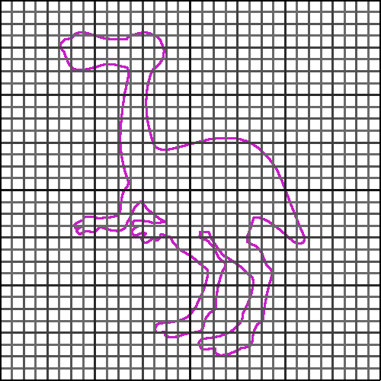
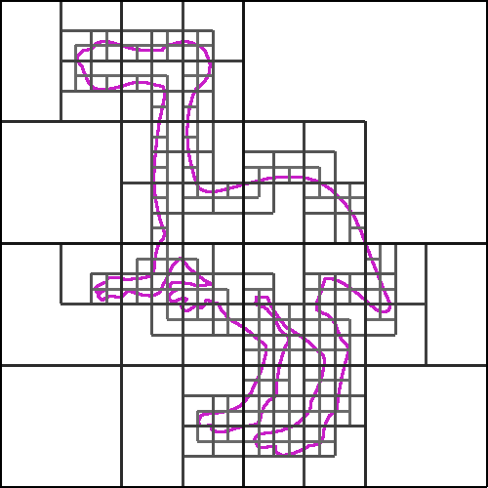
Outlook
To address this question, we consider two related problems:
How to define the Laplace-Beltrami operator.
How to implement a hierarchical solver.
Impose regular structure by restricting functions defined on a voxel grid

Slide 6
Outline
Introduction
Review
Defining the system
Solving the system
Our Approach
Results
Discussion of Limitations
Conclusion and Future Work

Slide 7
Defining the System
Finite Elements (Galerkin)
Define a set of test functions {b₁,…,b_{n}} and discretize the problem:
if appropriate boundary conditions are met.
When n test functions are used, this results in an nxn system:
where L is the Laplacian matrix: and y is the constraint vector:

Slide 8
Solving the System
Multigrid Solvers
Relax the system at the finest resolution
Down-sample the residual
Solve at the coarser resolution
Up-sample the coarse correction
Relax the system at the finest resolution
Relax
Relax
Down- Sample
Up- Sample
Solve

Slide 9
Solving the System
Multigrid Solvers
Relax the system at the finest resolution
Down-sample the residual
Solve at the coarser resolution
Up-sample the coarse correction
Relax the system at the finest resolution
Relaxation: Gauss-Seidel
Solver: Recurse/direct-solve
Up/Down-Sampling: ???
Relax
Relax
Down- Sample
Up- Sample
Solve

Slide 10
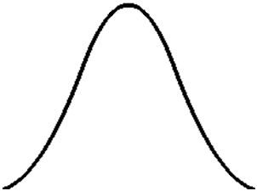
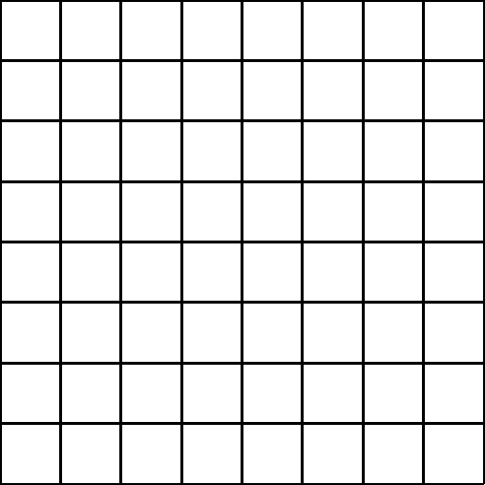
Defining the System (Regular Grids)
In one dimension, use translates of B-splines:
In higher dimensions, use translates of tensor-products:
…
…
b_{i-1}(x)
b_{i}(x)
b_{i+1}(x)
b(x)
-1.5
1.5
(i,j)
b_{i}(x)
b_{j}(y)

Slide 11

Up/Down-Sampling (Regular Grids)
Use the fact that the B-splines nest, so that coarser elements can be expressed as linear combinations of finer elements:
3/4
3/4
1/4
1/4

Slide 12
Defining the System (Meshes)
Associate a function with each vertex and use the span to define a function space.
b_{i}(p)
When the b_{i}(p) are hat functions, we get the cotangent-weight Laplacian:
p_{i}
p_{i-1}
p_{i+1}
p_{i}
α
β
p_{k}
b_{i}(p)
p_{j}

Slide 13
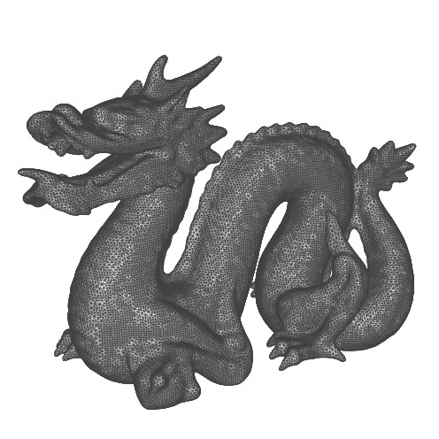
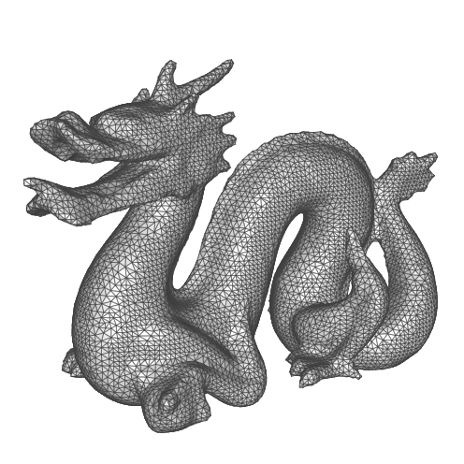
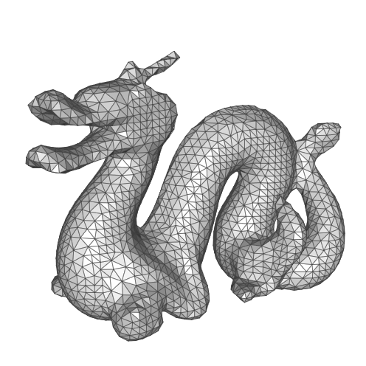
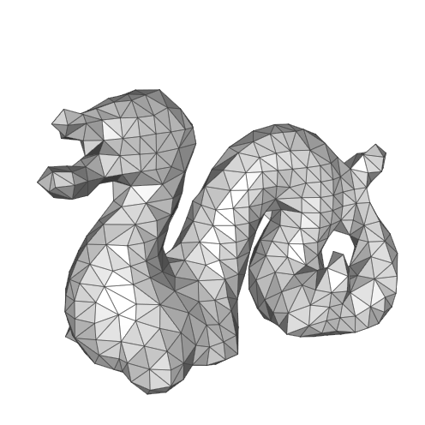
Up/Down-Sampling (Meshes)
Define a coarser surface/graph and a mapping from the coarser topology into the finer:
Geometric Multigrid
[Kobbelt et al., 1998] [Ray and Lévy, 2003] [Aksolyu et al., 2005] [Ni et al., 2004]
Algebraic Multigrid
[Ruge and Stueben, 1987] [Cleary et al., 2000] [Brezina et al., 2000] [Chartier et al. 2003] [Shi et al., 2006]

Slide 14
Outline
Introduction
Review
Our Approach
Key Idea
Implementation
Results
Discussion of Limitations
Conclusion and Future Work

Slide 15
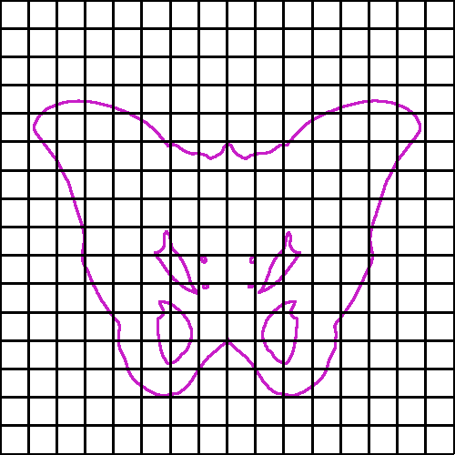
Our Approach
Key Idea
Start with elements defined over a regular grid, and only consider the restriction to the surface.
b_{i}(x)
b_{j}(y)

Slide 16
Our Approach
Key Idea
Start with elements defined over a regular grid, and only consider the restriction to the surface.
Properties
Tesselation Independence The definition only depends on the position of points on the surface
b_{i}(x)
b_{j}(y)

Slide 17
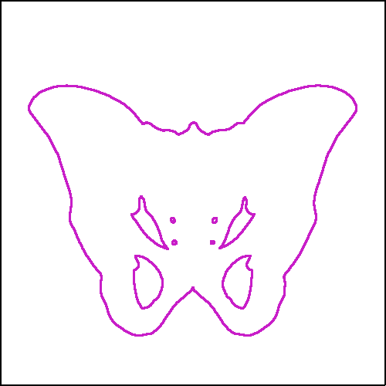
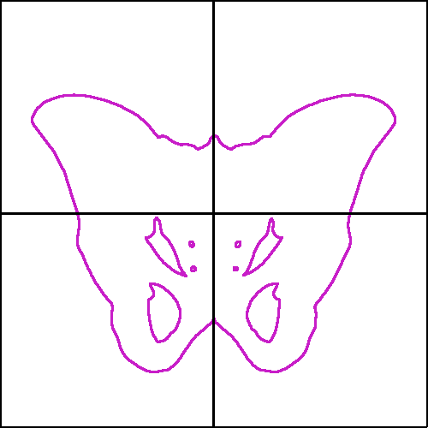
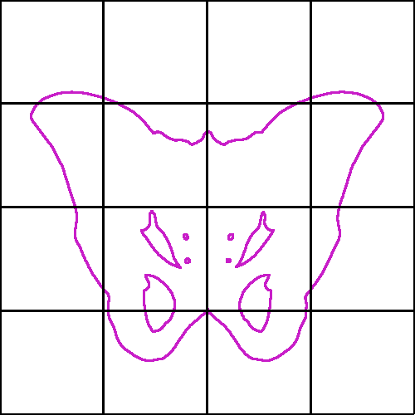
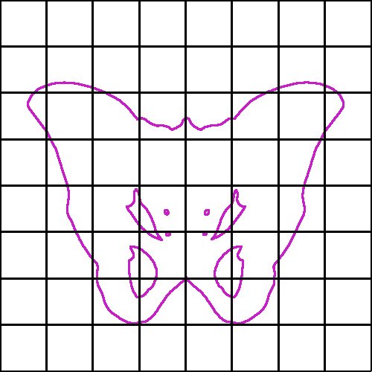
Our Approach
Key Idea
Start with elements defined over a regular grid, and only consider the restriction to the surface.
Properties
Tesselation Independence
Multi-resolution hierarchy Nested spaces remain nested after restriction

Slide 18
Our Approach
Implementation
We must address three concerns:
Define the system
Index the elements
Solve with multigrid

Slide 19
Our Approach
Defining the System
Given elements {b₁,…,b_{n}} defined on a regular grid, we define the coefficients of the Laplace-Beltrami operator as integrals of gradients:

Slide 20
Our Approach
Defining the System
Given elements {b₁,…,b_{n}} defined on a regular grid, we define the coefficients of the Laplace-Beltrami operator as integrals of gradients:
When M={T₁,…,T_{m}}, the coefficients of the Laplace-Beltrami operator can be expressed as:

Slide 21
Defining the System
Computing the Integrals
Explicit Integration
Approximate Integration

Slide 22
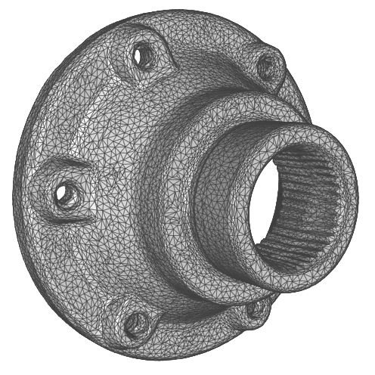
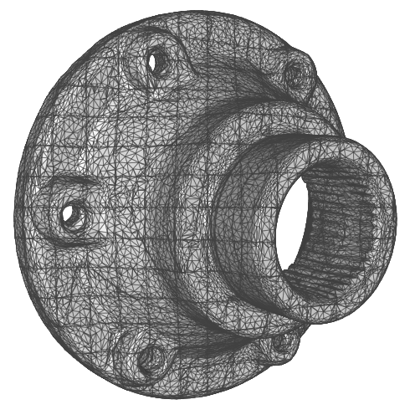
Defining the System
Computing the Integrals
Explicit Integration B-splines are strictly polynomial within a cell, so split the triangles to the grid and integrate the over the split triangles. [Taylor, 2008]

Slide 23
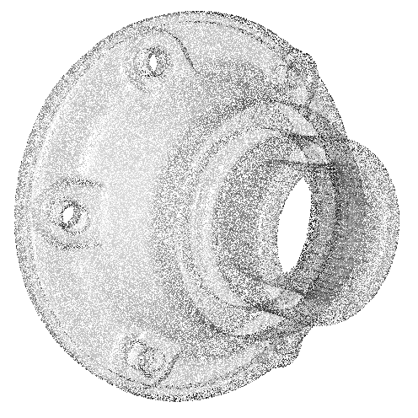
Defining the System
Computing the Integrals
Explicit Integration
Approximate Integration Sample the surface and approximate the integral as a sum over the oriented point-set.

Slide 24
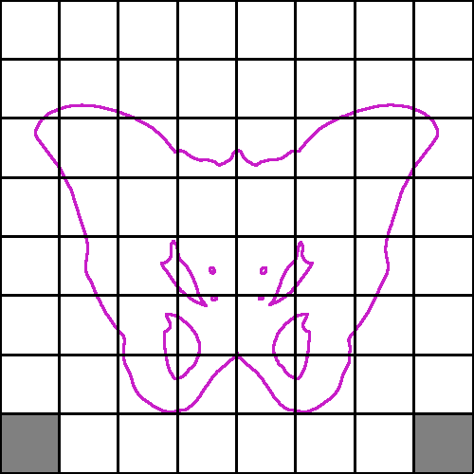
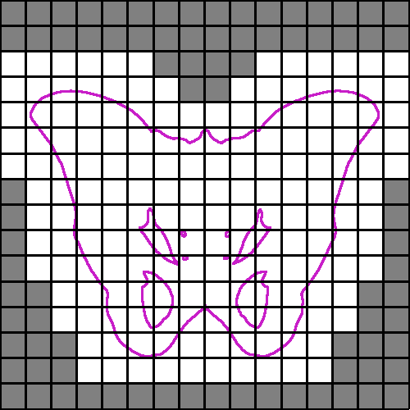
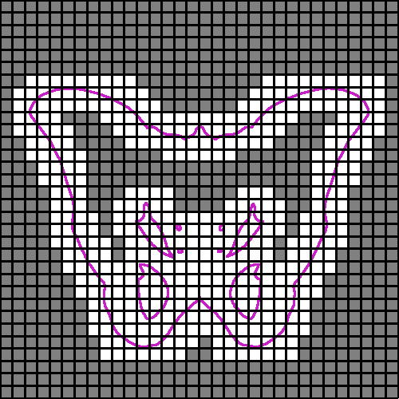
Indexing the Elements
Most elements’ supports do not overlap the surface so their restriction is the zero-function.

Slide 25
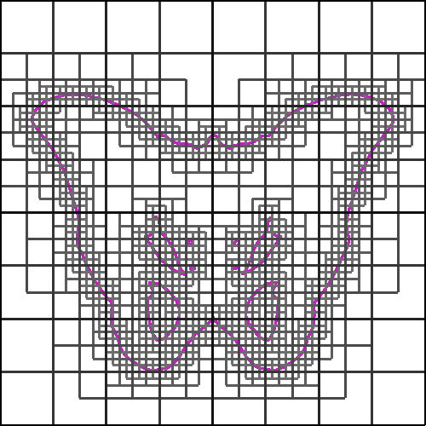
Indexing the Elements
Most elements’ supports do not overlap the surface so their restriction is the zero-function.
Adapted Octree Discard all cells whose support does not overlap the shape.

Slide 26
Solving with Multigrid
Because the restricted functions remain nested, the up-/down-sampling operators do not change and we can solve just like with regular grids.
Relax
Relax
Down- Sample
Up- Sample
Solve

Slide 27
Outline
Introduction
Review
Our Approach
Results
Gradient-Domain Processing
Spectral Analysis
Discussion of Limitations
Conclusion and Future Work

Slide 28
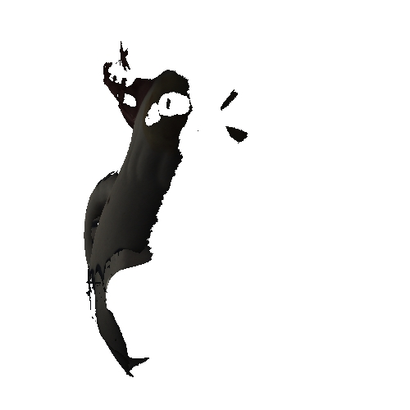
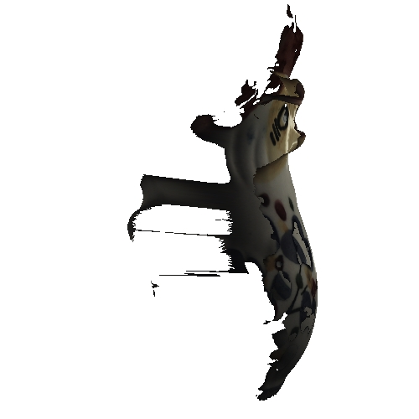
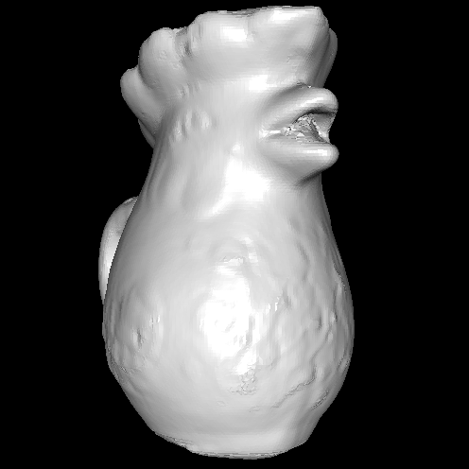
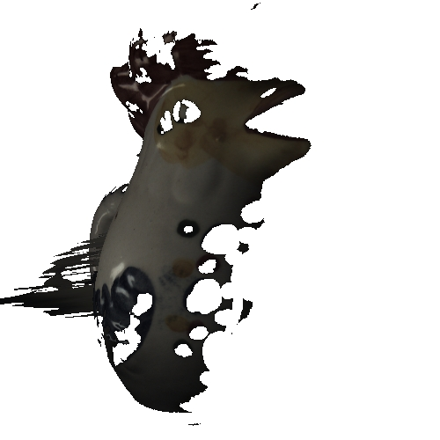
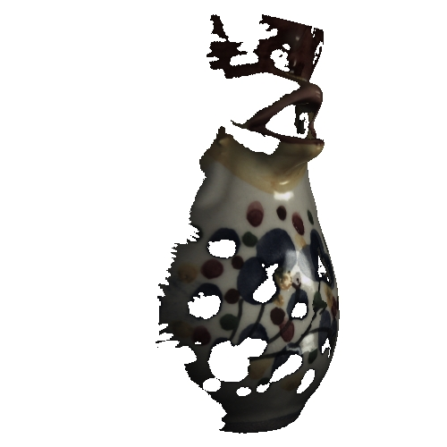
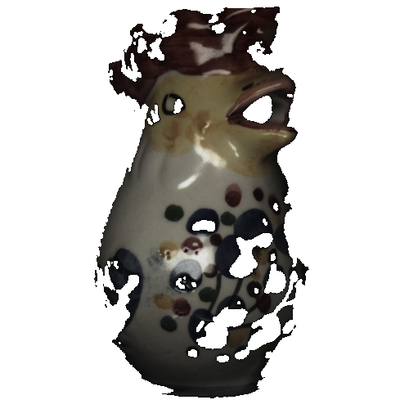
Gradient-Domain Processing
Goal
Given a base mesh and a set of scans, generate a seamless texture on the mesh.
S₅
M
S₁
S₄
S₃
S₂

Slide 29
Gradient-Domain Processing
Goal
Given a base mesh and a set of scans, generate a seamless texture on the mesh.
Back-project surface points onto the scans and use data from the closest, consistent scan.
S₅
M
S₁
S₄
S₃
S₂

Slide 30
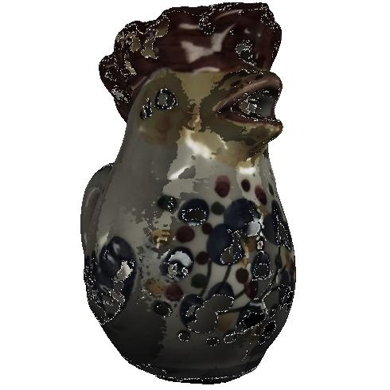
Gradient-Domain Processing
Challenge
Pulling colors from the nearest scan results in a discontinuous texture.
S₅
M
S₁
S₄
S₃
S₂

Slide 31
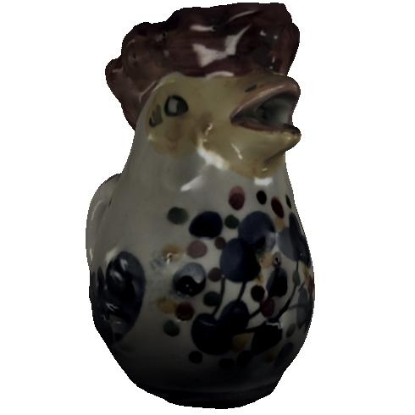
Gradient-Domain Processing
Solution
Pulling gradients and integrating gives seamless textures (which are smooth in undefined areas).
S₅
M
S₁
S₄
S₃
S₂

Slide 32
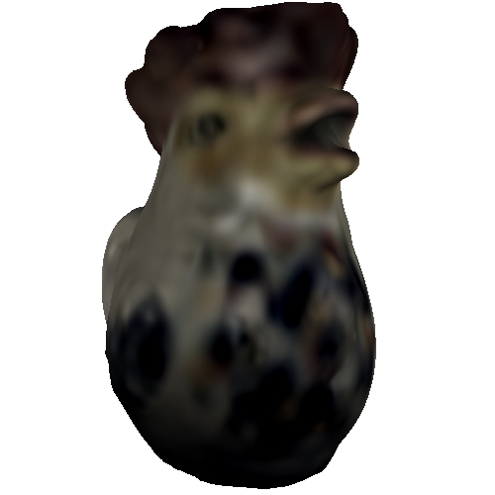


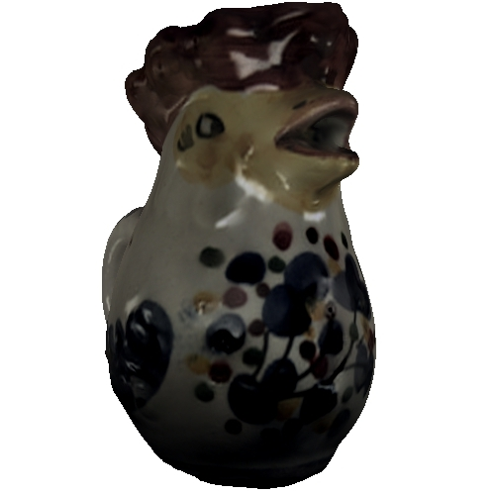

Gradient-Domain Processing
Complexity
System scales as O(4^{depth})
Solver is linear in system size/dimension
Depth: 4
Dim: 1,576
Solved: <0.1
Depth: 5
Dim: 6,555
Solved: 0.3 (s)
Depth: 6
Dim: 26,771
Solved: 1.4 (s)
Depth: 7
Dim: 107,690
Solved: 6.6 (s)
Depth: 8
Dim: 431,859
Solved: 28.5 (s)

Slide 33
Gradient-Domain Processing
Comparison with AMG (Residual Ratio of 10⁻³)
AMG1 Classical AMG [Ruge and Stueben, 1987]
AMG2 BoomerAMG [Griebel et al., 2006]
AMG1: AMG2: Ours:
0.5 (s)
0.4 (s) 0.1 (s)
AMG1: AMG2: Ours:
3.6 (s)
1.6 (s) 0.9 (s)
AMG1: AMG2: Ours:
10.9 (s)
4.0 (s) 2.6 (s)
AMG1: AMG2: Ours:
34.5 (s)
12.3 (s) 7.6 (s)
AMG1: AMG2: Ours:
100.1 (s)
36.2 (s) 20.8 (s)

Slide 34
Spectral Analysis
We can measure the quality of our Laplace-Beltrami operator by evaluating its spectrum.

Slide 35
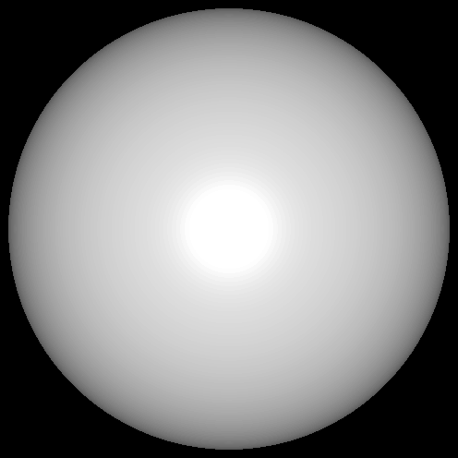
Spectral Analysis (Sphere)
We can measure the quality of our Laplace-Beltrami operator by evaluating its spectrum.
For a sphere, eigenvalues come in groups, with:
(2l+1) eigenvectors in the l-th group, and
all vectors in the l-th group having eigenvalue l⋅(l+1)
True

Slide 36
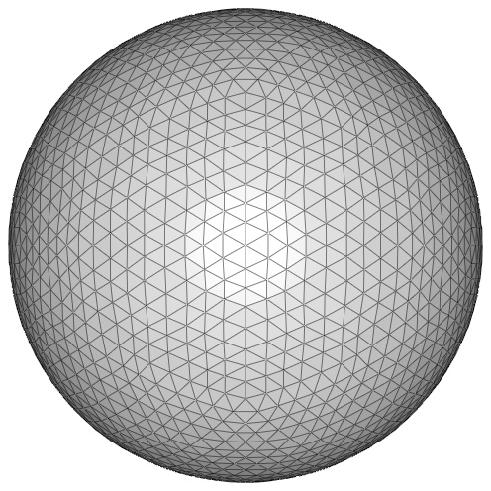
Spectral Analysis (Sphere)
Computing the spectra of the Cotangent-Weight Laplace-Beltrami operator on a coarse mesh, we can lose accuracy at high frequencies.
Dim = 2,562
True
Cotangent (coarse)

Slide 37
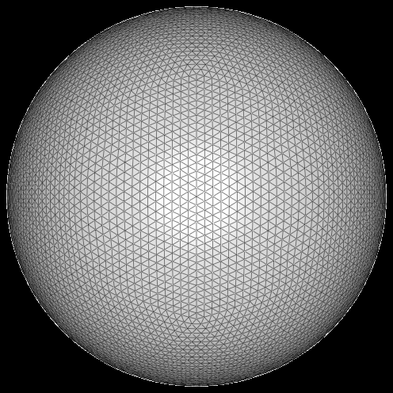
Spectral Analysis (Sphere)
Refining the tesselation, we can obtain a more accurate spectrum at the cost of a larger system.
Dim = 2,562
Dim = 10,242
True
Cotangent (coarse)
Cotangent (fine)

Slide 38
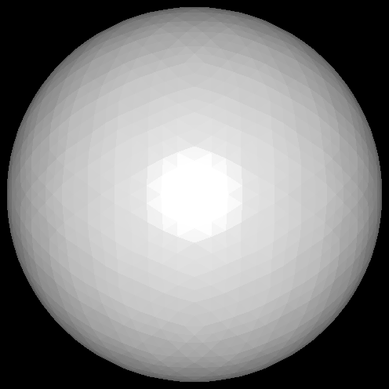
Spectral Analysis (Sphere)
Using our Laplace-Beltrami operator, we obtain a more accurate spectrum from a matrix that is independent of the tesselation.
Dim = 2,562
Dim = 10,242
Dim = 2,832
True
Cotangent (coarse)
Cotangent (fine)
Ours

Slide 39
Spectral Analysis (Sphere)
Using our Laplace-Beltrami operator, we obtain a more accurate spectrum from a matrix that is independent of the tesselation.
Dim = 2,562
Dim = 10,242
Dim = 2,832
True
Cotangent (coarse)
Cotangent (fine)
Ours

Slide 40
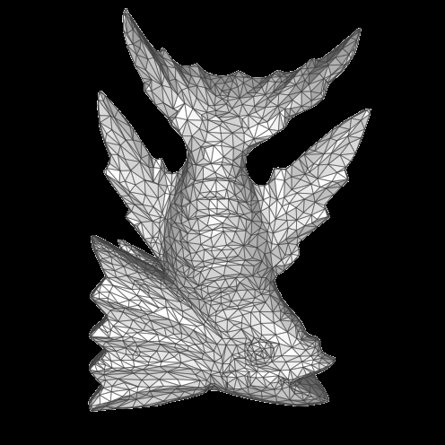

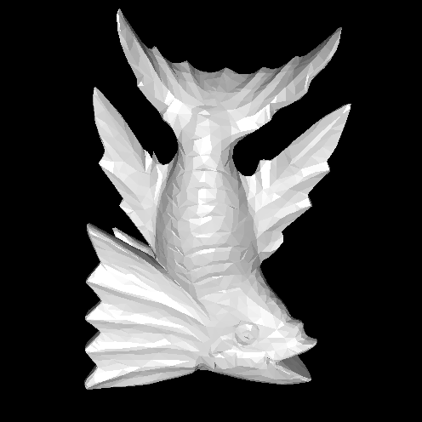
Spectral Analysis (Fish)
When the true spectrum is not known, we can compare against the spectrum of the Cotangent-Weight operator at a fine tesselation.
Dim = 3,700
Dim = 14,800
Dim = 3,619
“True” (59,200)
Cotangent (coarse)
Cotangent (fine)
Ours

Slide 41
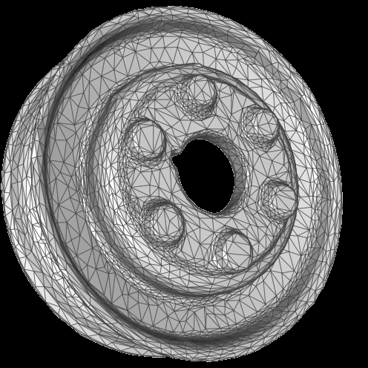
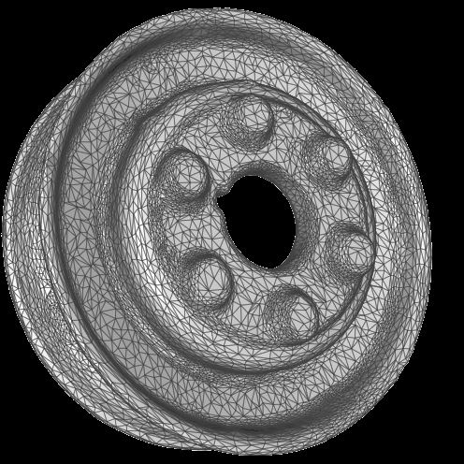
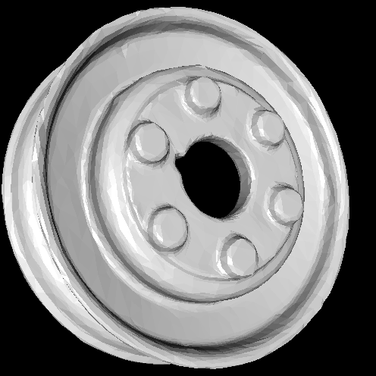
Spectral Analysis (Pulley)
When the true spectrum is not known, we can compare against the spectrum of the Cotangent-Weight operator at a fine tesselation.
Dim = 6,459
Dim = 19,499
Dim = 6,160
“True” (45,676)
Cotangent (coarse)
Cotangent (fine)
Ours

Slide 42
Limitations
Euclidean vs. Geodesic proximity
Poor Conditioning

Slide 43
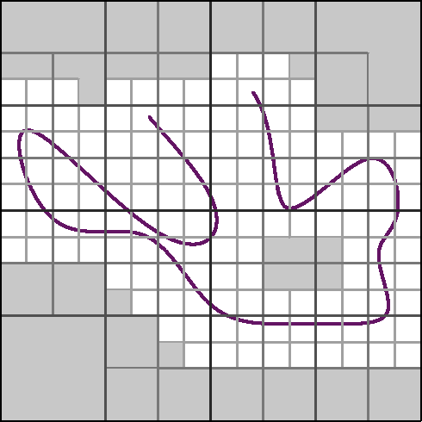
Limitations
Euclidean vs. Geodesic proximity
Poor Conditioning

Slide 44
Limitations
Euclidean vs. Geodesic proximity
Poor Conditioning

Slide 45
Outline
Introduction
Review
Our Approach
Results
Discussion of Limitations
Conclusion and Future Work

Slide 46
Conclusion
Considered a representation of finite elements on meshes that are defined over a regular grid:
Tesselation invariant Laplace-Beltrami
Regularly indexed elements
Multigrid without remeshing
Simple up-/down-sampling

Slide 47
Future Work
Implementation
Parallelize Solvers
Stream Solvers
Applications
Deformation
Surface Reconstruction
Address Limitations
Duplicate nodes for disconnected components
Use WEB-splines for handling ill-conditioning

Slide 48
Thank You!

Slide 50
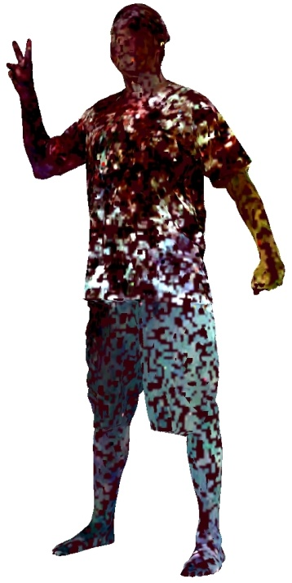










Gradient-Domain Processing
Convergence
Using large point samples allows for accurate linear systems with much lower set-up time.
255
0
Points: 10⁴
Set-Up: 9(s)
Points: 10⁵
Set-Up: 10(s)
Points: 10⁶
Set-Up: 14(s)
Points: 10⁷
Set-Up: 49(s)
Points: ∞
Set-Up: 786(s)
Dimension: 1.1-1.4 x 10⁵
Solve: 5-6 (s)

Slide 51


Slide 52





Slide 53



