Slide 1
Communication-Avoiding Algorithms
Jim Demmel
EECS & Math Departments
UC Berkeley

Slide 2
Why avoid communication? (1/3)
Algorithms have two costs (measured in time or energy):
Arithmetic (FLOPS)
Communication: moving data between
levels of a memory hierarchy (sequential case)
processors over a network (parallel case).
CPU
Cache
CPU
DRAM
CPU
DRAM
DRAM
CPU
DRAM
CPU
DRAM

Slide 3
Why avoid communication? (2/3)
Running time of an algorithm is sum of 3 terms:
# flops * time_per_flop
# words moved / bandwidth
# messages * latency
communication
Time_per_flop << 1/ bandwidth << latency
Gaps growing exponentially with time [FOSC]
Avoid communication to save time
Annual improvements
Time_per_flop |  | Bandwidth | Latency
 | Network | 26% | 15%
 | DRAM | 23% | 5%
59%
Goal : reorganize algorithms to avoid communication
Between all memory hierarchy levels
L1 L2 DRAM network, etc
Very large speedups possible
Energy savings too!
Notes:
2008 DARPA Exascale report has similar prediction:
Gap between DRAM access time and flops will increase
100x over coming decade to balance power usage between
processors, DRAM
2011 NRC Report: “The Future of Computing Performance: Game Over or Next Level?”
Millett and Fuller

Slide 4
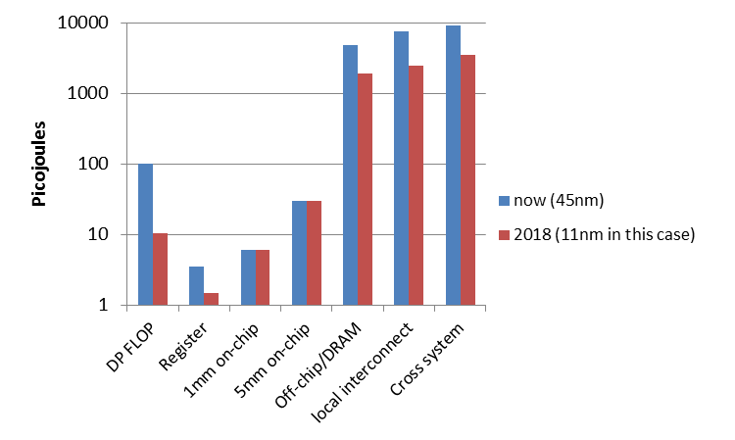
Why Minimize Communication? (3/3)
Source: John Shalf, LBL

Slide 5
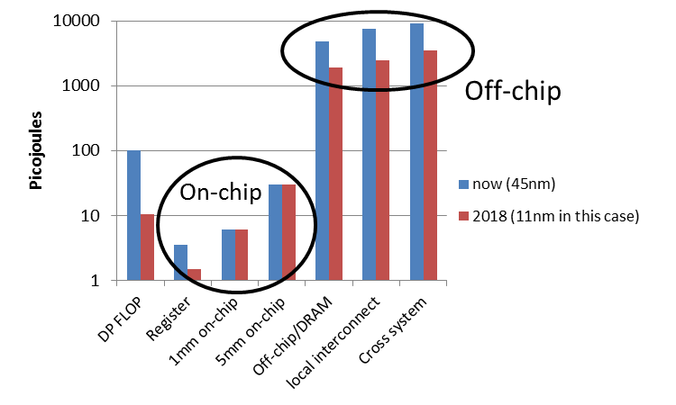
Why Minimize Communication? (3/3)
Minimize communication to save energy
Source: John Shalf, LBL

Slide 6
Goals
Redesign algorithms to avoid communication
Between all memory hierarchy levels
L1 L2 DRAM network, etc
Attain lower bounds if possible
Current algorithms often far from lower bounds
Large speedups and energy savings possible
Notes:
2008 DARPA Exascale report has similar prediction:
Gap between DRAM access time and flops will increase
100x over coming decade to balance power usage between
processors, DRAM

Slide 7
President Obama cites Communication-Avoiding Algorithms in the FY 2012 Department of Energy Budget Request to Congress:
“New Algorithm Improves Performance and Accuracy on Extreme-Scale Computing Systems. On modern computer architectures, communication between processors takes longer than the performance of a floating point arithmetic operation by a given processor. ASCR researchers have developed a new method, derived from commonly used linear algebra methods, to minimize communications between processors and the memory hierarchy, by reformulating the communication patterns specified within the algorithm. This method has been implemented in the TRILINOS framework, a highly-regarded suite of software, which provides functionality for researchers around the world to solve large scale, complex multi-physics problems.”
FY 2010 Congressional Budget, Volume 4, FY2010 Accomplishments, Advanced Scientific Computing Research (ASCR), pages 65-67.
CA-GMRES (Hoemmen, Mohiyuddin, Yelick, JD)
“Tall-Skinny” QR (Grigori, Hoemmen, Langou, JD)

Slide 8
Outline
Survey state of the art of CA (Comm-Avoiding) algorithms
CA O(n³) 2.5D Matmul
CA Strassen Matmul
Beyond linear algebra
Extending lower bounds to any algorithm with arrays
Communication-optimal N-body algorithm
CA-Krylov methods

Slide 9
Collaborators and Supporters
Michael Christ, Jack Dongarra, Ioana Dumitriu, Armando Fox, David Gleich, Laura Grigori, Ming Gu, Mike Heroux, Mark Hoemmen, Olga Holtz, Kurt Keutzer, Julien Langou, Tom Scanlon, Michelle Strout, Sam Williams, Hua Xiang, Kathy Yelick
Michael Anderson, Grey Ballard, Austin Benson, Abhinav Bhatele, Aydin Buluc, Erin Carson, Maryam Dehnavi, Michael Driscoll, Evangelos Georganas, Nicholas Knight, Penporn Koanantakool, Ben Lipshitz, Marghoob Mohiyuddin, Oded Schwartz, Edgar Solomonik
Other members of ParLab, BEBOP, CACHE, EASI, FASTMath, MAGMA, PLASMA, TOPS projects
Thanks to NSF, DOE, UC Discovery, Intel, Microsoft, Mathworks, National Instruments, NEC, Nokia, NVIDIA, Samsung, Oracle
bebop.cs.berkeley.edu

Slide 10
Outline
Survey state of the art of CA (Comm-Avoiding) algorithms
CA O(n³) 2.5D Matmul
CA Strassen Matmul
Beyond linear algebra
Extending lower bounds to any algorithm with arrays
Communication-optimal N-body algorithm
CA-Krylov methods

Slide 11
Summary of CA Linear Algebra
“Direct” Linear Algebra
Lower bounds on communication for linear algebra problems like Ax=b, least squares, Ax = λx, SVD, etc
Not attained by algorithms in standard libraries
New algorithms that attain these lower bounds
Being added to libraries: Sca/LAPACK, PLASMA, MAGMA
Large speed-ups possible
Autotuning to find optimal implementation
Ditto for “Iterative” Linear Algebra

Slide 12
Lower bound for all “n³-like” linear algebra
Let M = “fast” memory size (per processor)
#words_moved (per processor) = Ω(#flops (per processor) / M^{1/2} )
#messages_sent (per processor) = Ω(#flops (per processor) / M^{3/2} )
Parallel case: assume either load or memory balanced
Holds for
Matmul, BLAS, LU, QR, eig, SVD, tensor contractions, …
Some whole programs (sequences of these operations, no matter how individual ops are interleaved, eg A^{k})
Dense and sparse matrices (where #flops << n³ )
Sequential and parallel algorithms
Some graph-theoretic algorithms (eg Floyd-Warshall)

Slide 13
Lower bound for all “n³-like” linear algebra
Let M = “fast” memory size (per processor)
#words_moved (per processor) = Ω(#flops (per processor) / M^{1/2} )
#messages_sent ≥ #words_moved / largest_message_size
Parallel case: assume either load or memory balanced
Holds for
Matmul, BLAS, LU, QR, eig, SVD, tensor contractions, …
Some whole programs (sequences of these operations, no matter how individual ops are interleaved, eg A^{k})
Dense and sparse matrices (where #flops << n³ )
Sequential and parallel algorithms
Some graph-theoretic algorithms (eg Floyd-Warshall)

Slide 14
Lower bound for all “n³-like” linear algebra
Let M = “fast” memory size (per processor)
#words_moved (per processor) = Ω(#flops (per processor) / M^{1/2} )
#messages_sent (per processor) = Ω(#flops (per processor) / M^{3/2} )
Parallel case: assume either load or memory balanced
Holds for
Matmul, BLAS, LU, QR, eig, SVD, tensor contractions, …
Some whole programs (sequences of these operations, no matter how individual ops are interleaved, eg A^{k})
Dense and sparse matrices (where #flops << n³ )
Sequential and parallel algorithms
Some graph-theoretic algorithms (eg Floyd-Warshall)
SIAM SIAG/Linear Algebra Prize, 2012
Ballard, D., Holtz, Schwartz

Slide 15
Can we attain these lower bounds?
Do conventional dense algorithms as implemented in LAPACK and ScaLAPACK attain these bounds?
Often not
If not, are there other algorithms that do?
Yes, for much of dense linear algebra
New algorithms, with new numerical properties, new ways to encode answers, new data structures
Not just loop transformations (need those too!)
Only a few sparse algorithms so far
Lots of work in progress
Notes:
Sparse: depends on George, Rose, Tarjan

Slide 16
Summary of dense parallel algorithms attaining communication lower bounds
Assume nxn matrices on P processors
Minimum Memory per processor = M = O(n² / P)
Recall lower bounds:
#words_moved = Ω( (n³/ P) / M^{1/2} ) = Ω( n² / P^{1/2} )
#messages = Ω( (n³/ P) / M^{3/2} ) = Ω( P^{1/2} )
Does ScaLAPACK attain these bounds?
For #words_moved: mostly, except nonsym. Eigenproblem
For #messages: asymptotically worse, except Cholesky
New algorithms attain all bounds, up to polylog(P) factors
Cholesky, LU, QR, Sym. and Nonsym eigenproblems, SVD
Can we do Better?
Notes:
ScaLAPACK assumes best block size chosen
Many references, blue are ours
LU: uses tournament pivoting, different stability, speedup up to 29X predicted on exascale
QR uses TSQR, speedup up to 8x on Intel Clovertown, 13x on Tesla, up on cloud
Symeig uses variant of SBR, speedup up to 30x on AMD Magny-Cours, vs ACML 4.4
n=12000, b=500, 6 threads
Nonsymeig, uses randomization in two ways

Slide 17
Can we do better?
Aren’t we already optimal?
Why assume M = O(n²/p), i.e. minimal?
Lower bound still true (and smaller) if M larger
Can we attain it?

Slide 18
Outline
Survey state of the art of CA (Comm-Avoiding) algorithms
CA O(n³) 2.5D Matmul
CA Strassen Matmul
Beyond linear algebra
Extending lower bounds to any algorithm with arrays
Communication-optimal N-body algorithm
CA-Krylov methods

Slide 19
SUMMA– n x n matmul on P^{1/2} x P^{1/2} grid (nearly) optimal using minimum memory M=O(n²/P)
k
j
B(k,j)
k
*
=
Brow
i
C(i,j)
A(i,k)
For k=0 to n-1 … or n/b-1 where b is the block size
… = # cols in A(i,k) and # rows in B(k,j)
for all i = 1 to p_{r} … in parallel
owner of A(i,k) broadcasts it to whole processor row
for all j = 1 to p_{c} … in parallel
owner of B(k,j) broadcasts it to whole processor column
Receive A(i,k) into Acol
Receive B(k,j) into Brow
C_myproc = C_myproc + Acol * Brow
Acol
For k=0 to n/b-1
for all i = 1 to P^{1/2}
owner of A(i,k) broadcasts it to whole processor row (using binary tree)
for all j = 1 to P^{1/2}
owner of B(k,j) broadcasts it to whole processor column (using bin. tree)
Receive A(i,k) into Acol
Receive B(k,j) into Brow
C_myproc = C_myproc + Acol * Brow
Using more than the minimum memory
What if matrix small enough to fit c>1 copies, so M = cn²/P ?
#words_moved = Ω( #flops / M^{1/2} ) = Ω( n² / ( c^{1/2} P^{1/2} ))
#messages = Ω( #flops / M^{3/2} ) = Ω( P^{1/2} /c^{3/2})
Can we attain new lower bound?

Slide 20
2.5D Matrix Multiplication
Assume can fit cn²/P data per processor, c > 1
Processors form (P/c)^{1/2} x (P/c)^{1/2} x c grid
(P/c)^{1/2}
(P/c)^{1/2}
Example: P = 32, c = 2
c

Slide 21
2.5D Matrix Multiplication
Assume can fit cn²/P data per processor, c > 1
Processors form (P/c)^{1/2} x (P/c)^{1/2} x c grid
j
i
Initially P(i,j,0) owns A(i,j) and B(i,j)
each of size n(c/P)^{1/2} x n(c/P)^{1/2}
k
(1) P(i,j,0) broadcasts A(i,j) and B(i,j) to P(i,j,k)
(2) Processors at level k perform 1/c-th of SUMMA, i.e. 1/c-th of Σ_{m} A(i,m)*B(m,j)
(3) Sum-reduce partial sums Σ_{m} A(i,m)*B(m,j) along k-axis so P(i,j,0) owns C(i,j)

Slide 22
2.5D Matmul on BG/P, 16K nodes / 64K cores

Slide 23
2.5D Matmul on BG/P, 16K nodes / 64K cores
c = 16 copies
Distinguished Paper Award, EuroPar’11 (Solomonik, D.)
SC’11 paper by Solomonik, Bhatele, D.
Notes:
SC’11 paper about need to fully utilize 3D torus network on BG/P to get this to work

Slide 24
Perfect Strong Scaling – in Time and Energy
Every time you add a processor, you should use its memory M too
Start with minimal number of procs: PM = 3n²
Increase P by a factor of c ➔ total memory increases by a factor of c
Notation for timing model:
γ_{T} , β_{T} , α_{T} = secs per flop, per word_moved, per message of size m
T(cP) = n³/(cP) [ γ_{T}+ β_{T}/M^{1/2} + α_{T}/(mM^{1/2}) ]
= T(P)/c
Notation for energy model:
γ_{E} , β_{E} , α_{E} = joules for same operations
δ_{E} = joules per word of memory used per sec
ε_{E} = joules per sec for leakage, etc.
E(cP) = cP { n³/(cP) [ γ_{E}+ β_{E}/M^{1/2} + α_{E}/(mM^{1/2}) ] + δ_{E}MT(cP) + ε_{E}T(cP) }
= E(P)
Perfect scaling extends to n-body, Strassen, …
Notes:
We can use these models to answer many questions, including:
What is the minimum energy required for a computation?
Given a maximum allowed runtime T , what is the minimum energy E needed to achieve it?
Given a maximum energy budget E , what is the minimum runtime T that we can attain?
The ratio P = E/T gives us the average power required to run the algorithm. Can we minimize the average power consumed?
Given an algorithm, problem size, number of processors and target energy efficiency (GFLOPS/W), can we determine a set of architectural parameters to describe a conforming computer architecture?

Slide 25
Ongoing Work
Lots more work on
Algorithms:
LDL^{T}, QR with pivoting, other pivoting schemes, eigenproblems, …
All-pairs-shortest-path, …
Both 2D (c=1) and 2.5D (c>1)
Platforms:
Multicore, cluster, GPU, cloud, heterogeneous, low-energy, …
Software:
Integration into Sca/LAPACK, PLASMA, MAGMA,…
Integration into applications (on IBM BG/Q)
Qbox (with LLNL, IBM): molecular dynamics
CTF (with ANL): symmetric tensor contractions
Notes:
But only bandwidth may decrease with c>1, not latency
Qbox code – Francois Gygi @ UC Davis, also LLNL, first principle molecular dynamics,
uses Density Functional Theory to solve Kohn Sham equations, won Gordon Bell Prize in 2006
CTF – Cyclops Tensor Framework,
faster symmetric tensor contractions for “coupled cluster” electronic structure calculations

Slide 26
Outline
Survey state of the art of CA (Comm-Avoiding) algorithms
CA O(n³) 2.5D Matmul
CA Strassen Matmul
Beyond linear algebra
Extending lower bounds to any algorithm with arrays
Communication-optimal N-body algorithm
CA-Krylov methods

Slide 27
Communication Lower Bounds for Strassen-like matmul algorithms
Classical
O(n³) matmul:
#words_moved =
Ω (M(n/M^{1/2})³/P)
Strassen’s
O(n^{lg7}) matmul:
#words_moved =
Ω (M(n/M^{1/2})^{lg7}/P)
Strassen-like
O(n^{ω}) matmul:
#words_moved =
Ω (M(n/M^{1/2})^{ω}/P)
Proof: graph expansion (different from classical matmul)
Strassen-like: DAG must be “regular” and connected
Extends up to M = n² / p^{2/ω}
Best Paper Prize (SPAA’11), Ballard, D., Holtz, Schwartz
to appear in JACM
Is the lower bound attainable?

Slide 28
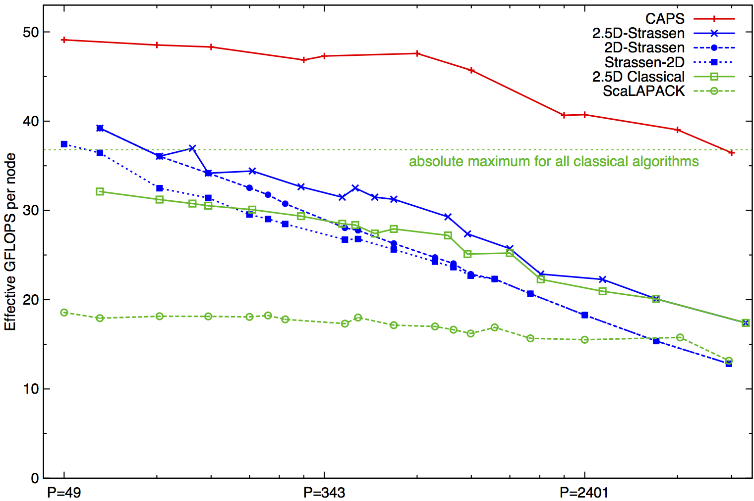
Strong Scaling of Strassen and other Matmuls
Franklin (Cray XT4) n = 94080
Speedups: 24%-184% (over previous Strassen-based algorithms)
Notes:
Detailed talk Thursday 4-4:30pm at SC12
2n^3/time 184% is at 7203 ours 7056 theirs (per node).
Strong scaling range up to about p=1000
Top on this plot: p = 7200, recent data up to 20K
2(.5)D-Strassen means 2(.5)D-outer, and Strassen-inner, on the small local matrices
Strassen-2D means x DFS Strassen steps, followed by 2D classical for the 7^x subproblems
Detailed talk Thursday 4-4:30pm at SC12

Slide 29
Strong Scaling of Strassen and other Matmuls
Franklin (Cray XT4) n = 94080
For details, see SC12 talk on
“Communication-Avoiding Parallel Strassen” by
Grey Ballard et al 11/15 at 4pm
Speedups: 24%-184% (over previous Strassen-based algorithms)
Notes:
Detailed talk Thursday 4-4:30pm at SC12
2n^3/time 184% is at 7203 ours 7056 theirs (per node).
Strong scaling range up to about p=1000
Top on this plot: p = 7200, recent data up to 20K
2(.5)D-Strassen means 2(.5)D-outer, and Strassen-inner, on the small local matrices
Strassen-2D means x DFS Strassen steps, followed by 2D classical for the 7^x subproblems
Detailed talk Thursday 4-4:30pm at SC12

Slide 30
Outline
Survey state of the art of CA (Comm-Avoiding) algorithms
CA O(n³) 2.5D Matmul
CA Strassen Matmul
Beyond linear algebra
Extending lower bounds to any algorithm with arrays
Communication-optimal N-body algorithm
CA-Krylov methods

Slide 31
Recall optimal sequential Matmul
Naïve code
for i=1:n, for j=1:n, for k=1:n, C(i,j)+=A(i,k)*B(k,j)
“Blocked” code
for i1 = 1:b:n, for j1 = 1:b:n, for k1 = 1:b:n
for i2 = 0:b-1, for j2 = 0:b-1, for k2 = 0:b-1
i=i1+i2, j = j1+j2, k = k1+k2
C(i,j)+=A(i,k)*B(k,j)
Thm: Picking b = M^{1/2} attains lower bound:
#words_moved = Ω(n³/M^{1/2})
Where does 1/2 come from?
b x b matmul

Slide 32
New Thm applied to Matmul
for i=1:n, for j=1:n, for k=1:n, C(i,j) += A(i,k)*B(k,j)
Record array indices in matrix Δ
Solve LP for x = [xi,xj,xk]^{T}: max 1^{T}x s.t. Δ x ≤ 1
Result: x = [1/2, 1/2, 1/2]^{T}, 1^{T}x = 3/2 = s
Thm: #words_moved = Ω(n³/M^{S-1})= Ω(n³/M^{1/2})
Attained by block sizes M^{xi},M^{xj},M^{xk} = M^{1/2},M^{1/2},M^{1/2}
 | i | j | k
 | 1 | 0 | 1 | A
Δ = | 0 | 1 | 1 | B
 | 1 | 1 | 0 | C

Slide 33
New Thm applied to Direct N-Body
for i=1:n, for j=1:n, F(i) += force( P(i) , P(j) )
Record array indices in matrix Δ
Solve LP for x = [xi,xj]^{T}: max 1^{T}x s.t. Δ x ≤ 1
Result: x = [1,1], 1^{T}x = 2 = s
Thm: #words_moved = Ω(n²/M^{S-1})= Ω(n²/M¹)
Attained by block sizes M^{xi},M^{xj} = M¹,M¹
 | i | j
 | 1 | 0 | F
Δ = | 1 | 0 | P(i)
 | 0 | 1 | P(j)

Slide 34
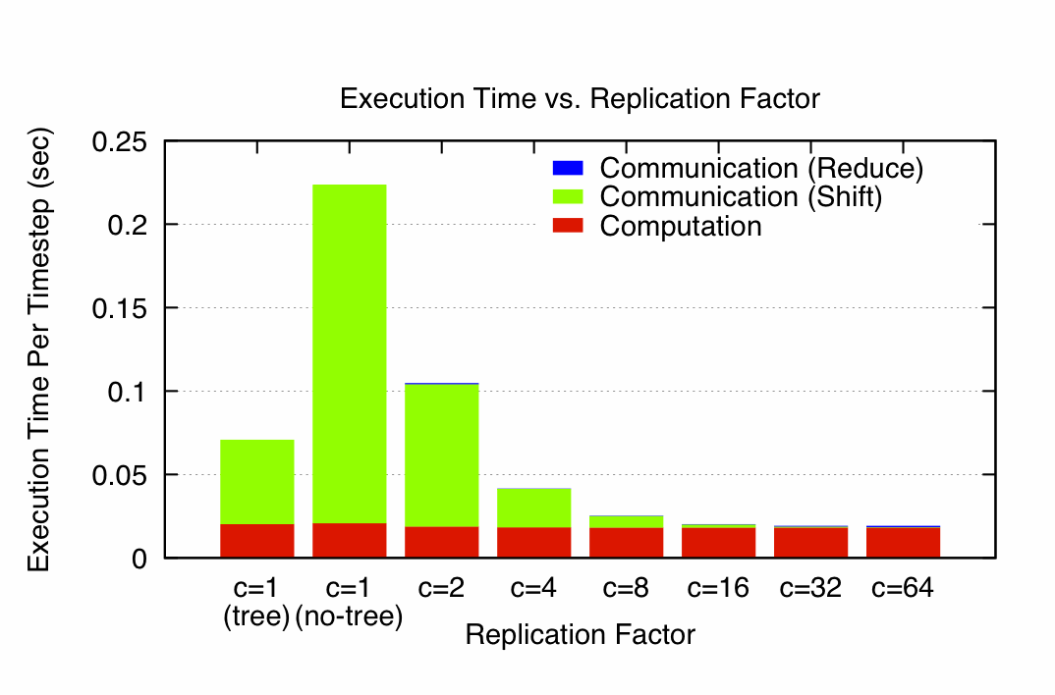
N-Body Speedups on IBM-BG/P (Intrepid) 8K cores, 32K particles
K. Yelick, E. Georganas, M. Driscoll, P. Koanantakool, E. Solomonik
11.8x speedup
Notes:
Intrepid: 163,480 core IBM BG/P at Argonne NL (ALCF)
Each node is one quad-core in a 3D torus
C=1(tree) uses special HW collective network, (no tree) just used regular network

Slide 35
New Thm applied to Random Code
for i1=1:n, for i2=1:n, … , for i6=1:n
A1(i1,i3,i6) += func1(A2(i1,i2,i4),A3(i2,i3,i5),A4(i3,i4,i6))
A5(i2,i6) += func2(A6(i1,i4,i5),A3(i3,i4,i6))
Record array indices
in matrix Δ
Solve LP for x = [x1,…,x7]^{T}: max 1^{T}x s.t. Δ x ≤ 1
Result: x = [2/7,3/7,1/7,2/7,3/7,4/7], 1^{T}x = 15/7 = s
Thm: #words_moved = Ω(n⁶/M^{S-1})= Ω(n⁶/M^{8/7})
Attained by block sizes M^{2/7},M^{3/7},M^{1/7},M^{2/7},M^{3/7},M^{4/7}
 | i1 | i2 | i3 | i4 | i5 | i6
 | 1 | 0 | 1 | 0 | 0 | 1 | A1
 | 1 | 1 | 0 | 1 | 0 | 0 | A2
Δ = | 0 | 1 | 1 | 0 | 1 | 0 | A3
 | 0 | 0 | 1 | 1 | 0 | 1 | A3,A4
 | 0 | 0 | 1 | 1 | 0 | 1 | A5
 | 1 | 0 | 0 | 1 | 1 | 0 | A6

Slide 36
Summary and Ongoing Work
Communication lower bounds extend to any program accessing arrays with subscripts that are “linear functions” of loop indices
Ex: A(i1+2*i2,i3-i2), B(pointer(i4+i5)), …
Sparsity, indirect addressing, parallelism all included
When can we write down LP for lower bound explicitly?
General case hard: Hilbert’s 10th problem over rationals
Works for many special cases
Ex: subscripts are subsets of loop indices
Can always approximate lower bound
When can we attain lower bound?
Works for many special cases (if loop dependencies permit)
Have yet to find a case where we cannot attain lower bound
Can we prove this?
Can extend “perfect scaling” results for time and energy
Incorporate into compilers
Notes:
Generality: indirection ok sparsity,

Slide 37
Outline
Survey state of the art of CA (Comm-Avoiding) algorithms
CA O(n³) 2.5D Matmul
CA Strassen Matmul
Beyond linear algebra
Extending lower bounds to any algorithm with arrays
Communication-optimal N-body algorithm
CA-Krylov methods

Slide 38
Avoiding Communication in Iterative Linear Algebra
k-steps of iterative solver for sparse Ax=b or Ax=λx
Does k SpMVs with A and starting vector
Many such “Krylov Subspace Methods”
Conjugate Gradients (CG), GMRES, Lanczos, Arnoldi, …
Goal: minimize communication
Assume matrix “well-partitioned”
Serial implementation
Conventional: O(k) moves of data from slow to fast memory
New: O(1) moves of data – optimal
Parallel implementation on p processors
Conventional: O(k log p) messages (k SpMV calls, dot prods)
New: O(log p) messages - optimal
Lots of speed up possible (modeled and measured)
Price: some redundant computation
Challenges: Poor partitioning, Preconditioning, Stability
38
Notes:
Well – partitioned = modest surface-to-volume ratio
See bebop.cs.berkeley.edu
CG: [van Rosendale, 83], [Chronopoulos and Gear, 89]
GMRES: [Walker, 88], [Joubert and Carey, 92], [Bai et al., 94]

Slide 39
Communication Avoiding Kernels: The Matrix Powers Kernel : [Ax, A²x, …, A^{k}x]
Replace k iterations of y = A⋅x with [Ax, A²x, …, A^{k}x]
Example: A tridiagonal, n=32, k=3
Works for any “well-partitioned” A
A³·x
A²·x
A·x
x
1 2 3 4 …
… 32
Notes:
C. J. Pfeifer, Data flow and storage allocation for the PDQ-5 program on the Philco-2000, Comm. ACM 6, No. 7 (1963), 365366.
Referred to in paper by Leiserson/Rao/Toledo/ in 1993 paper on blocking covers

Slide 40
Communication Avoiding Kernels: The Matrix Powers Kernel : [Ax, A²x, …, A^{k}x]
Replace k iterations of y = A⋅x with [Ax, A²x, …, A^{k}x]
Example: A tridiagonal, n=32, k=3
A³·x
A²·x
A·x
x
1 2 3 4 …
… 32

Slide 41
Communication Avoiding Kernels: The Matrix Powers Kernel : [Ax, A²x, …, A^{k}x]
Replace k iterations of y = A⋅x with [Ax, A²x, …, A^{k}x]
Example: A tridiagonal, n=32, k=3
A³·x
A²·x
A·x
x
1 2 3 4 …
… 32

Slide 42
Communication Avoiding Kernels: The Matrix Powers Kernel : [Ax, A²x, …, A^{k}x]
Replace k iterations of y = A⋅x with [Ax, A²x, …, A^{k}x]
Example: A tridiagonal, n=32, k=3
A³·x
A²·x
A·x
x
1 2 3 4 …
… 32

Slide 43
Communication Avoiding Kernels: The Matrix Powers Kernel : [Ax, A²x, …, A^{k}x]
Replace k iterations of y = A⋅x with [Ax, A²x, …, A^{k}x]
Example: A tridiagonal, n=32, k=3
A³·x
A²·x
A·x
x
1 2 3 4 …
… 32

Slide 44
Communication Avoiding Kernels: The Matrix Powers Kernel : [Ax, A²x, …, A^{k}x]
Replace k iterations of y = A⋅x with [Ax, A²x, …, A^{k}x]
Example: A tridiagonal, n=32, k=3
A³·x
A²·x
A·x
x
1 2 3 4 …
… 32

Slide 45
Communication Avoiding Kernels: The Matrix Powers Kernel : [Ax, A²x, …, A^{k}x]
Replace k iterations of y = A⋅x with [Ax, A²x, …, A^{k}x]
Sequential Algorithm
Example: A tridiagonal, n=32, k=3
Step 1
A³·x
A²·x
A·x
x
1 2 3 4 …
… 32

Slide 46
Communication Avoiding Kernels: The Matrix Powers Kernel : [Ax, A²x, …, A^{k}x]
Replace k iterations of y = A⋅x with [Ax, A²x, …, A^{k}x]
Sequential Algorithm
Example: A tridiagonal, n=32, k=3
Step 1
Step 2
A³·x
A²·x
A·x
x
1 2 3 4 …
… 32

Slide 47
Communication Avoiding Kernels: The Matrix Powers Kernel : [Ax, A²x, …, A^{k}x]
Replace k iterations of y = A⋅x with [Ax, A²x, …, A^{k}x]
Sequential Algorithm
Example: A tridiagonal, n=32, k=3
Step 1
Step 2
Step 3
A³·x
A²·x
A·x
x
1 2 3 4 …
… 32

Slide 48
Communication Avoiding Kernels: The Matrix Powers Kernel : [Ax, A²x, …, A^{k}x]
Replace k iterations of y = A⋅x with [Ax, A²x, …, A^{k}x]
Sequential Algorithm
Example: A tridiagonal, n=32, k=3
Step 1
Step 2
Step 3
Step 4
A³·x
A²·x
A·x
x
1 2 3 4 …
… 32

Slide 49
Communication Avoiding Kernels: The Matrix Powers Kernel : [Ax, A²x, …, A^{k}x]
Replace k iterations of y = A⋅x with [Ax, A²x, …, A^{k}x]
Parallel Algorithm
Example: A tridiagonal, n=32, k=3
Each processor communicates once with neighbors
Proc 1
Proc 2
Proc 3
Proc 4
A³·x
A²·x
A·x
x
1 2 3 4 …
… 32

Slide 50
Communication Avoiding Kernels: The Matrix Powers Kernel : [Ax, A²x, …, A^{k}x]
Replace k iterations of y = A⋅x with [Ax, A²x, …, A^{k}x]
Parallel Algorithm
Example: A tridiagonal, n=32, k=3
Each processor works on (overlapping) trapezoid
Proc 1
Proc 2
Proc 3
Proc 4
A³·x
A²·x
A·x
x
1 2 3 4 …
… 32

Slide 51
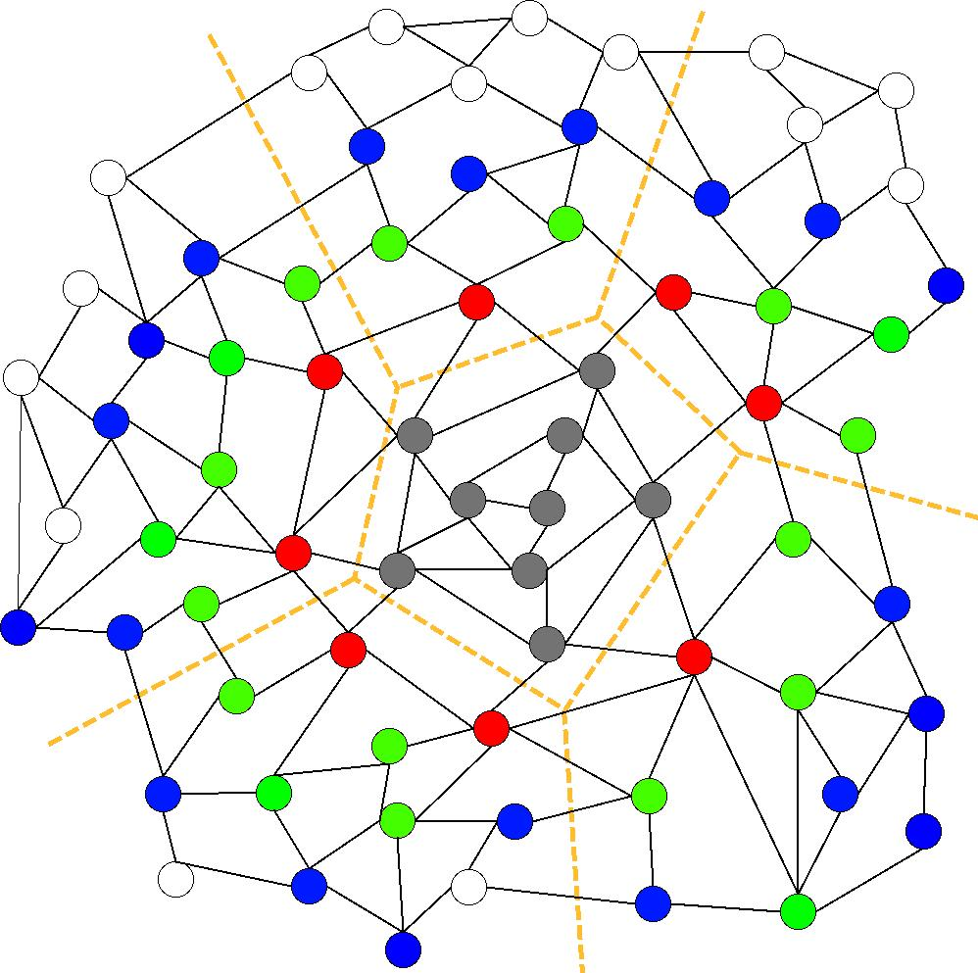
Communication Avoiding Kernels: The Matrix Powers Kernel : [Ax, A²x, …, A^{k}x]
Same idea works for general sparse matrices
Simple block-row partitioning ➔
(hyper)graph partitioning
Top-to-bottom processing ➔
Traveling Salesman Problem
Notes:
Red needed for k=1
Green also needed for k=2
Blue also needed for k=3

Slide 52
Minimizing Communication of GMRES to solve Ax=b
GMRES: find x in span{b,Ab,…,A^{k}b} minimizing || Ax-b ||₂
Standard GMRES
for i=1 to k
w = A · v(i-1) … SpMV
MGS(w, v(0),…,v(i-1))
update v(i), H
endfor
solve LSQ problem with H
Communication-avoiding GMRES
W = [ v, Av, A²v, … , A^{k}v ]
[Q,R] = TSQR(W)
… “Tall Skinny QR”
build H from R
solve LSQ problem with H
Sequential case: #words moved decreases by a factor of k
Parallel case: #messages decreases by a factor of k
Oops – W from power method, precision lost!
52

Slide 53
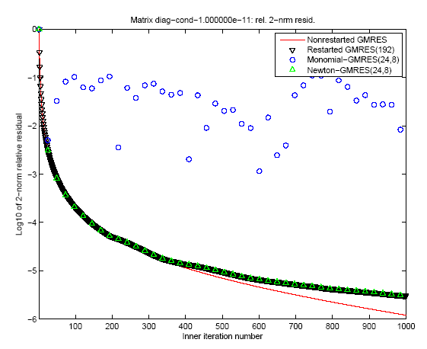
“Monomial” basis [Ax,…,A^{k}x]
fails to converge
Different polynomial basis [p₁(A)x,…,p_{k}(A)x]
does converge
53

Slide 54
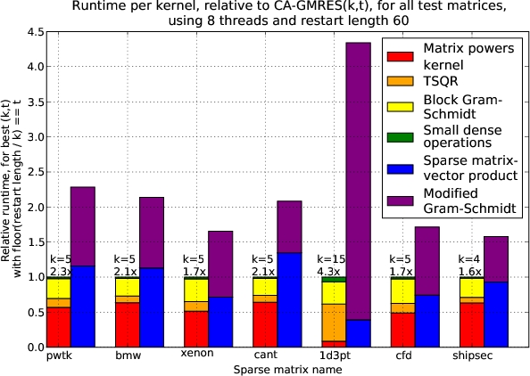
Speed ups of GMRES on 8-core Intel Clovertown
Requires Co-tuning Kernels
[MHDY09]
54

Slide 55
Notes:
For Matrix pde900, U Florida collection, 2D Model problem, Nx=30, Ny=30, non-normal.
Cond ~ 120

Slide 56
With Residual Replacement (RR)
a la Van der Vorst and Ye
 | Naive | Monomial | Newton | Chebyshev
Replacement Its. | 74 (1) | [7, 15, 24, 31, …, 92, 97, 103] (17) | [67, 98] (2) | 68 (1)

Slide 57
Summary of Iterative Linear Algebra
New lower bounds, optimal algorithms, big speedups in theory and practice
Lots of other progress, open problems
Many different algorithms reorganized
More underway, more to be done
Need to recognize stable variants more easily
Preconditioning
Hierarchically Semiseparable Matrices
Autotuning and synthesis
pOSKI for SpMV – available at bebop.cs.berkeley.edu
Different kinds of “sparse matrices”

Slide 58
For more details
Bebop.cs.berkeley.edu
CS267 – Berkeley’s Parallel Computing Course
Live broadcast in Spring 2013
www.cs.berkeley.edu/~demmel
All slides, video available from 2012
Prerecorded version planned in Spring 2013
www.xsede.org
Free supercomputer accounts to do homework!
Free autograding of homework!

Slide 59
Summary
Time to redesign all linear algebra, n-body, …
algorithms and software
(and compilers)
Don’t Communic…

