Slide 1
Inferring Viral Quasispecies Spectra from NGS Reads
Ion Măndoiu
Computer Science & Engineering Department
University of Connecticut

Slide 2
Outline
Background
Quasispecies spectrum reconstruction from shotgun NGS reads
Quasispecies spectrum reconstruction from amplicon NGS reads
Quasispecies spectrum reconstruction for IBV
Ongoing and future work

Slide 3
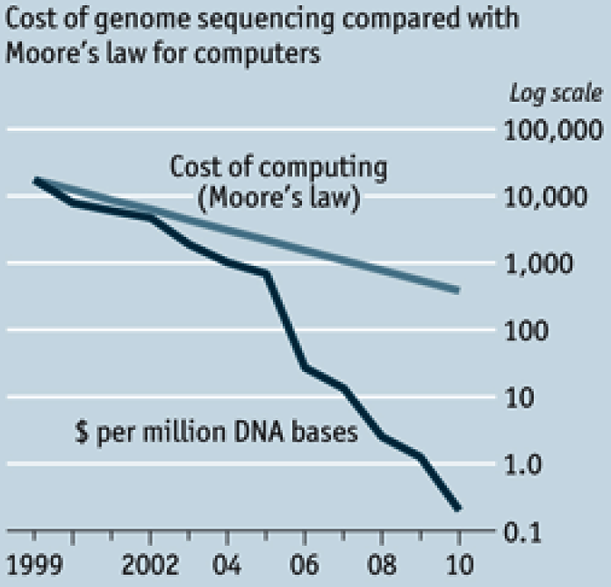
Cost of DNA Sequencing
http://www.economist.com/node/16349358
Notes:
3

Slide 4
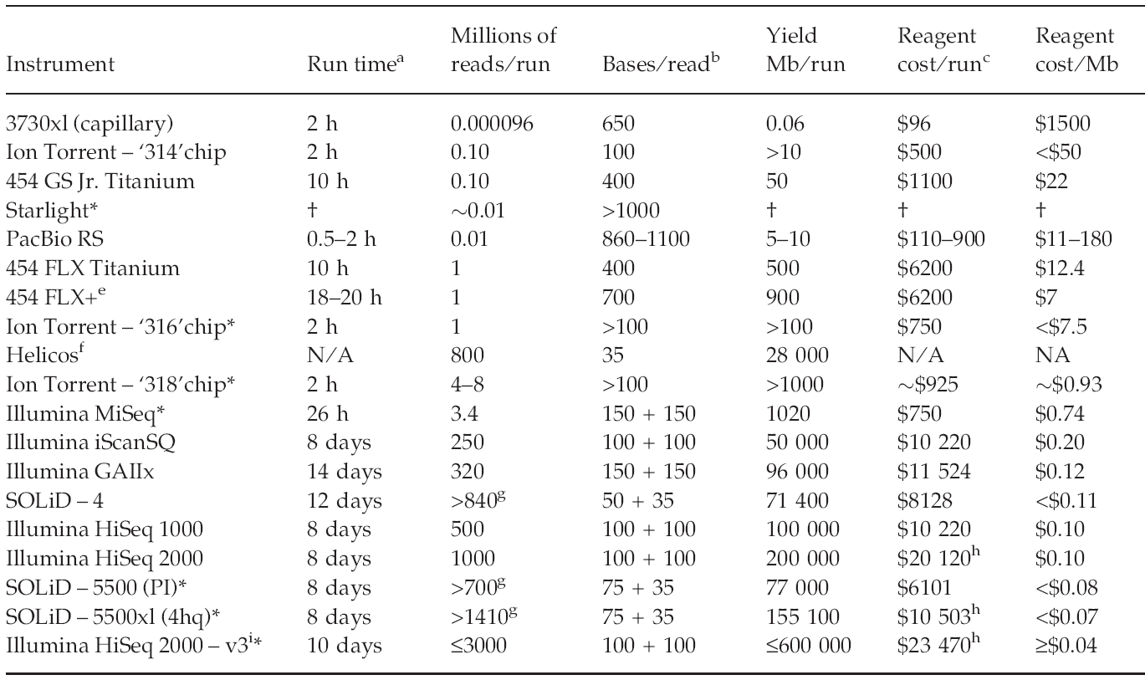
Cost/Performance Comparison [Glenn 2011]

Slide 5
Applications
De novo genome sequencing
Genome re-sequencing
RNA-Seq
Non-coding RNAs
Structural variation
ChIP-Seq
Methyl-Seq
Metagenomics
Paleogenomics
Viral quasispecies
… many more biological measurements “reduced” to NGS sequencing
Notes:
5

Slide 6
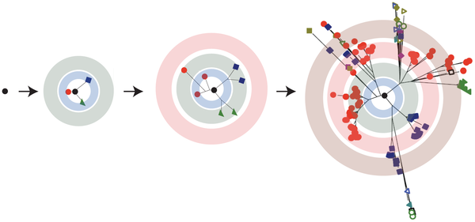
RNA Virus Replication
High mutation rate (~10⁻⁴)
Lauring & Andino, PLoS Pathogens 2011
Notes:
6

Slide 7
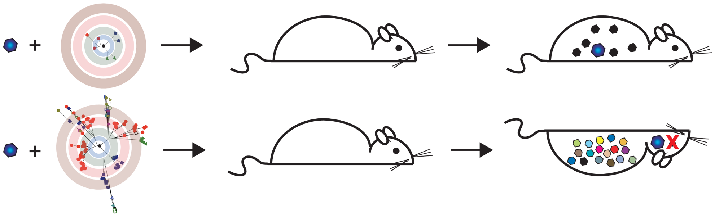
How Are Quasispecies Contributing to Virus Persistence and Evolution?
Variants differ in
Virulence
Ability to escape immune response
Resistance to antiviral therapies
Tissue tropism
Lauring & Andino, PLoS Pathogens 2011

Slide 8
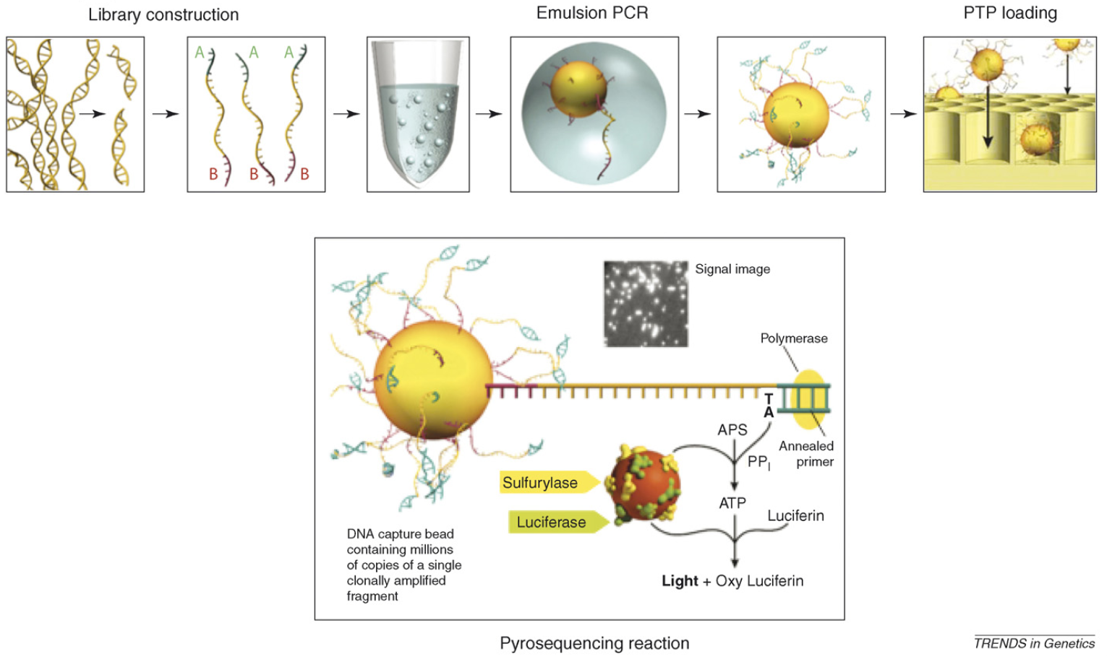
454 Pyrosequencing Workflow

Slide 9
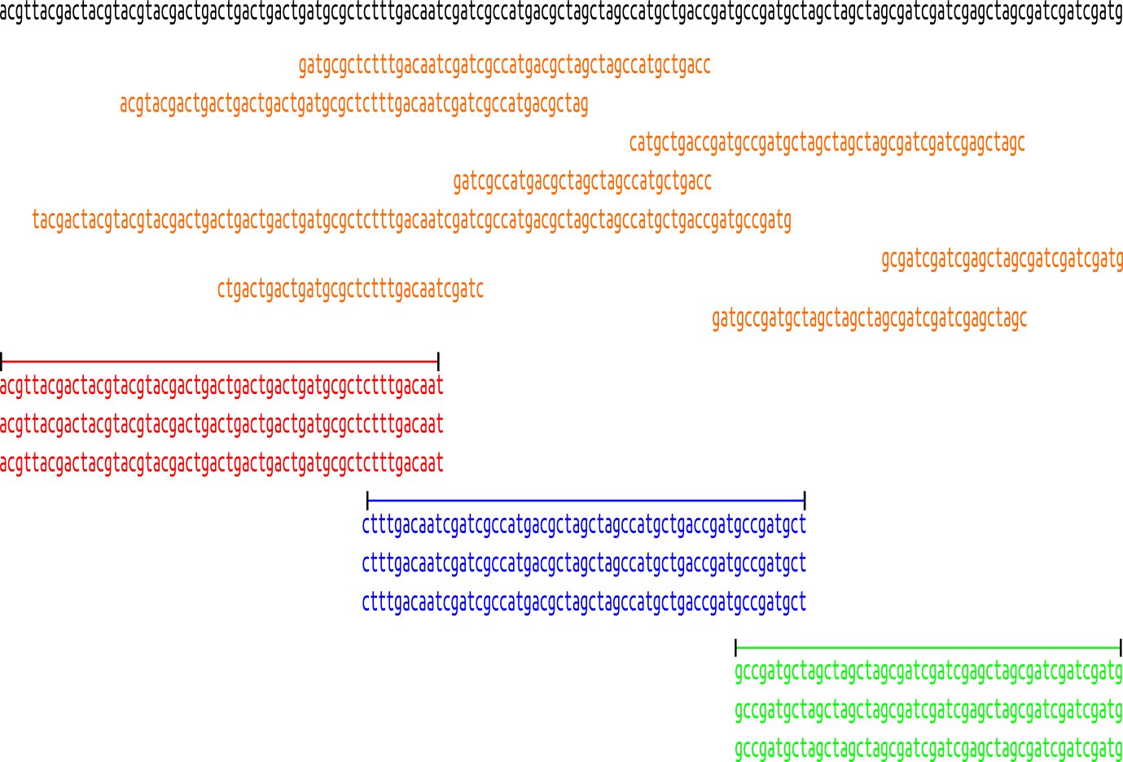
Shotgun vs. Amplicon Reads
Shotgun reads
starting positions
distributed ~uniformly
Amplicon reads
reads have
predefined start/end positions
covering fixed overlapping
windows
Notes:
9

Slide 10
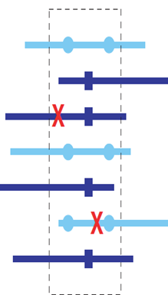
Quasispecies Spectrum Reconstruction (QSR) Problem
Given
Shotgun/amplicon pyrosequencing reads from a quasispecies population of unknown size and distribution
Reconstruct the quasispecies spectrum
Sequences
Frequencies

Slide 11
Prior Work
Eriksson et al 2008
maximum parsimony using Dilworth’s theorem, clustering, EM
Westbrooks et al. 2008
min-cost network flow
Zagordi et al 2010-11 (ShoRAH)
probabilistic clustering based on a Dirichlet process mixture
Prosperi et al 2011 (amplicon based)
based on measure of population diversity
Huang et al 2011 (QColors)
Parsimonious reconstruction of quasispecies subsequences using constraint programming within regions with sufficient variability

Slide 12
Outline
Background
Quasispecies spectrum reconstruction from shotgun NGS reads
Quasispecies spectrum reconstruction from amplicon NGS reads
Quasispecies spectrum reconstruction for IBV
Ongoing and future work

Slide 13
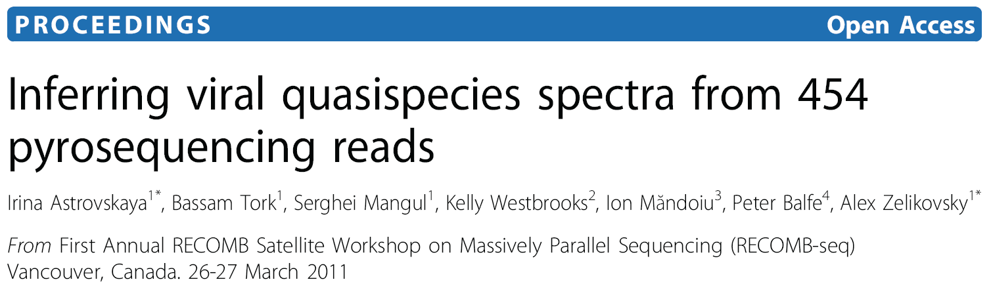
ViSpA: Viral Spectrum Assembler
Key features
Error correction both pre-alignment (based on k-mers) and post-alignment
Quasispecies assembly based on maximum-bandwidth paths in weighted read graphs
Frequency estimation via EM on all reads
Freely available at http://alla.cs.gsu.edu/software/VISPA/vispa.html

Slide 14
ViSpA Flow
Read
Error Correction
Read Alignment
Preprocessing of Aligned Reads
Shotgun 454 reads
Frequency Estimation
Contig Assembly
Read Graph Construction
Quasispecies sequences w/ frequencies

Slide 15
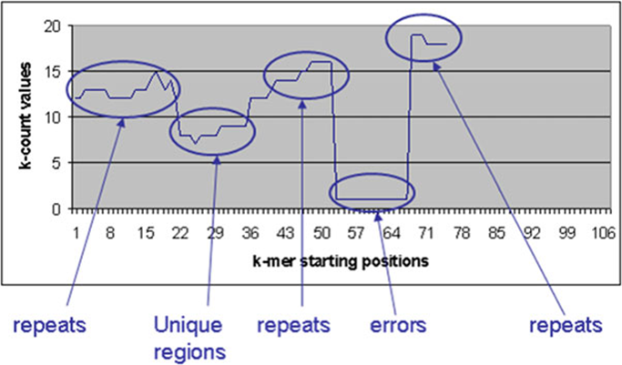

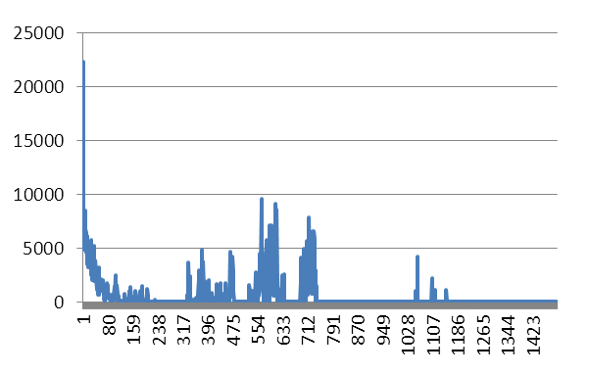
k-mer Error Correction [Skums et al.]
Zhao X et al 2010
Calculate k-mers and their frequencies (k-counts)
Assume that kmers with high k-counts (“solid” k-mers) are correct, while k-mers with low k-counts (“weak” k-mers) contain errors
Determine the threshold k-count (error threshold), which distinguishes solid kmers from weak k-mers.
Find error regions.
Correct the errors in error regions

Slide 16
Iterative Read Alignment
Read Alignment vs Reference
Build Consensus
Read Re-Alignment vs. Consensus
Yes
More Reads Aligned?
No
Post-
processing

Slide 17
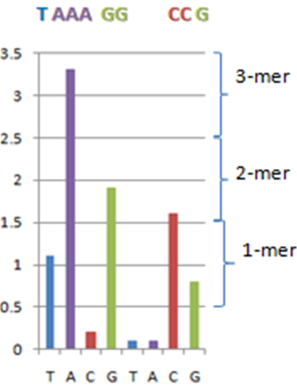
454 Sequencing Errors
Sequencing error rate ~ 0.1%
Most errors due to incorrect resolution of homopolymers
over-calls (insertions)
65-75% of errors
under-calls (deletions)
20-30% of errors
Notes:
Replace by defense

Slide 18
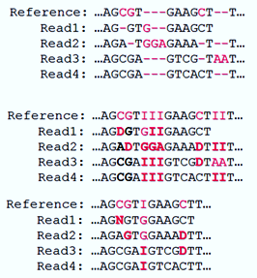
Post-processing of Aligned Reads
Deletions in reads: D
Insertions into reference: I
Additional error correction:
Replace deletions supported by a single read with either the allele present in all other reads or N
Remove insertions supported by a single read

Slide 19
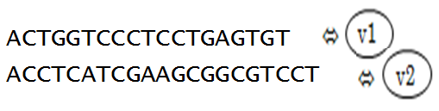
Read Graph: Vertices
ACTGGTCCCTCCTGAGTGT
GGTCCCTCCT
TGGTCACTCGTGAG
ACCTCATCGAAGCGGCGTCCT
Subread = completely contained in other read with ≤ n mismatches. Superreads = not subreads
=> vertices in the read graph

Slide 20
Read Graph: Edges
Edge b/w two vertices if there is an overlap between superreads and they agree on their overlap with ≤ m mismatches
Transitive reduction

Slide 21
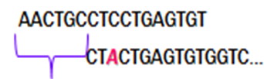
Edge Cost
Cost measures the uncertainty that two superreads belong to the same quasispecies.
Overhang Δ is the shift in start positions of two overlapping superreads.
Δ
where j is the number of mismatches
in overlap o, ε is 454 error rate

Slide 22
Contig Assembly - Path to Sequence
Compute an s-t-Max Bandwidth Path through each vertex (maximizing minimum edge cost)
Build coarse sequence out of each path’s superreads:
For each position: >70%-majority if it exists, otherwise N
Replace N’s in coarse sequence with weighted consensus obtained from all reads
Select unique sequences out of constructed sequences

Slide 23
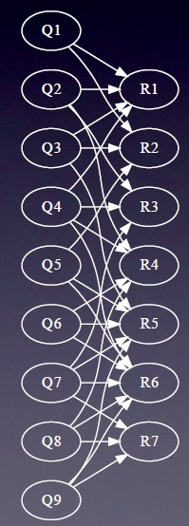
Frequency Estimation – EM Algorithm
Bipartite graph:
Q_{q} is a candidate with frequency f_{q}
R_{r} is a read with observed frequency o_{r}
Weight h_{q,r} = probability that read r is produced by quasispecies q with j mismatches
E step:
M step:

Slide 24
Experimental Validation
Simulations
Error-free reads from known HCV quasispecies
Reads with errors generated by FlowSim (Balser et al. 2010)
Real 454 reads
HIV and HCV data
Comparison with ShoRAH

Slide 25
Simulations: Error-Free Reads
44 real qsps (1739 bp long) from the E1E2 region of Hepatitis C virus (von Hahn et al. (2006))
Simulated reads:
4 populations sizes: 10, 20, 30, 40 sequences
Geometric distribution
The quasispecies population:
Number of reads between 20K and 100K
Read length distribution N(μ,400); μ varied from 200 to 500

Slide 26
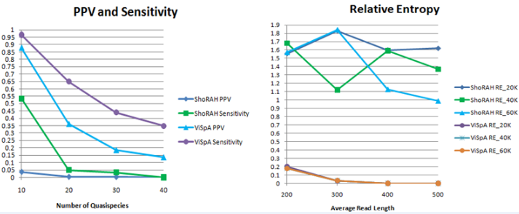



Results

Slide 27
Simulations with FlowSim
44 real quasispecies sequences (1739 bp long) from the E1E2 region of Hepatitis C virus (von Hahn et al. (2006))
30K reads with average length 350bp
100 bootstrapping tests on 10% - reduced data
For the i-th (i = 1, .., 10) most frequent sequence assembled on the whole data, we record its reproducibility = percentage of runs when there is a match (exact or with at most k mismatches) among 10 most frequent sequences found on reduced data.

Slide 28
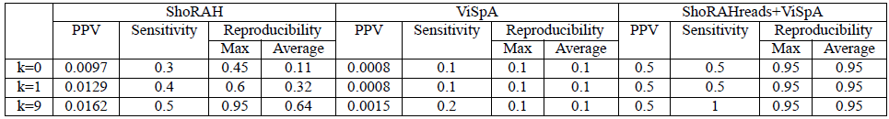
Bootstraping Tests
ShoRAH outperforms ViSpA due to its read correction
If ViSpA is used on ShoRAH-corrected reads (ShoRAHreads+ViSpA), the results drastically improve

Slide 29
454 Reads of HIV Qsps
55,611 reads (average read length 345bp) from ten 1.5Kbp long region of HIV-1 (Zagordi et al.2010)
No removal of low-quality reads
~99% of reads has at least one indel
~11.6 % of reads with at least one N
ShoRAH correctly infers only 2 qsps sequences with <=4 mismatches
ViSpA correctly infers 5 qsps with <=2 mismatches , 2 qsps are inferred exactly

Slide 30
Outline
Background
Quasispecies spectrum reconstruction from shotgun NGS reads
Quasispecies spectrum reconstruction from amplicon NGS reads
Quasispecies spectrum reconstruction for IBV
Ongoing and future work

Slide 31
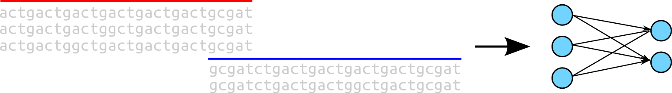
Amplicon Sequencing Challenges
Distinct quasispecies may be indistinguishable in an amplicon interval
Multiple reads from consecutive amplicons may match over their overlap
Notes:
31

Slide 32
Prosperi et al. 2011
First published approach for amplicons
Based on the idea of guide distribution
choose most variable amplicon
extend to right/left with matching reads, breaking ties by rank
220 | 200 | 140 | 160 | 150
200 | 140 | 130 | 150 | 140
70 | 130 | 120 | 140 | 130
10 | 20 | 110 | 130 | 120
0 | 10 | 100 | 20 | 60
Notes:
32

Slide 33
Read Graph for Amplicons
K amplicons → K-staged read graph
vertices → distinct reads
edges → reads with consistent overlap
vertices, edges have a count function
Notes:
33

Slide 34
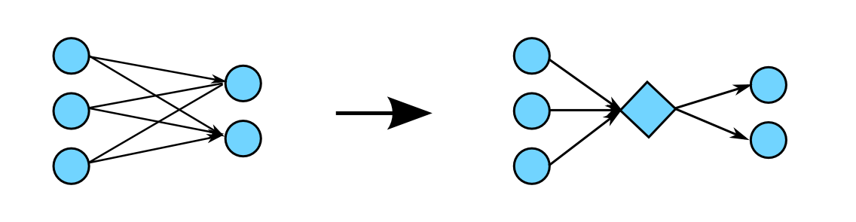
Read Graph
May transform bi-cliques into 'fork' subgraphs
common overlap is represented by fork vertex
Notes:
34

Slide 35
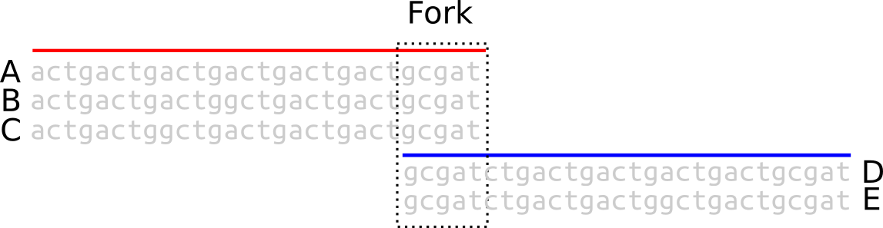
Observed vs Ideal Read Frequencies
Ideal frequency
consistent frequency across forks
Observed frequency (count)
inconsistent frequency across forks
Notes:
35

Slide 36
Fork Balancing Problem
Given
Set of reads and respective frequencies
Find
Minimal frequency offsets balancing all forks
Simplest approach is to scale frequencies from left to right
Notes:
36

Slide 37
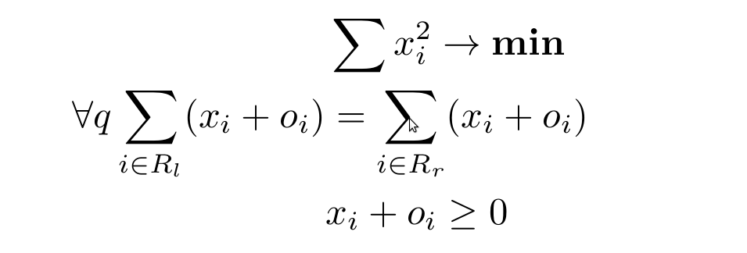
Least Squares Balancing
Quadratic Program for read offsets
q – fork, o_{i} – observed frequency, x_{i} – frequency offset
Notes:
37

Slide 38
Fork Resolution: Parsimony
6
8
4
2
8
6
6
12
6
8
6
4
4
8
2
4
8
4
2
4
4
2
2
4
2
4
2
4
2
2
(a)
(b)
Notes:
38

Slide 39
Fork Resolution: Max Likelihood
Given a forest, ML = # of ways to produce observed reads / 2^(#qsp):
Can be computed efficiently for trees: multiply by binomial coefficient of a leaf and its parent edge, prune the edge, and iterate
Solution (b) has a larger likelihood than (a) although both have 3 qsp’s
(a) (4 choose 2) * (8 choose 4) * (8 choose 4)/2^20 = 29400/2^20 ~ 2.8%
(b) (12 choose 6) * (4 choose 2)*(4 choose 2)/2^20 = 33264/2^20 ~ 3.3%
8
6
6
12
6
8
6
4
4
8
2
4
8
4
2
4
4
2
2
4
2
4
2
4
2
2
(a)
(b)
Notes:
39

Slide 40
Fork Resolution: Min Entropy
12
6
4
8
4
8
6
6
6
8
2
4
8
4
2
4
4
2
2
4
2
4
2
4
2
2
(a)
(b)
Solution (b) also has a lower entropy than (a)
(a) -[ (8/20)log(8/20) + (8/20)log(8/20) + (4/20)log(4/20) ] ~ 1.522
(b) -[ (12/20)log(4/20) + (4/20)log(4/20) + (4/20)log(4/20) ] ~ 1.37
Notes:
40

Slide 41
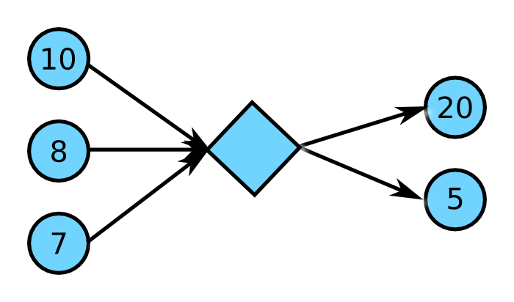
Local Optimization: Greedy Method
Notes:
41

Slide 42
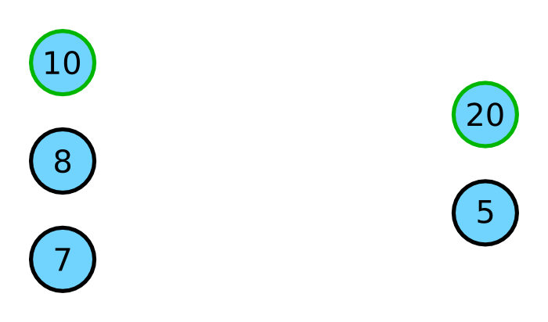
Greedy Method
Notes:
42

Slide 43
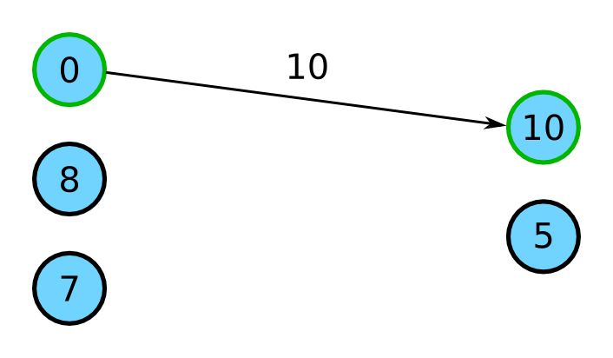
Greedy Method
Notes:
43

Slide 44
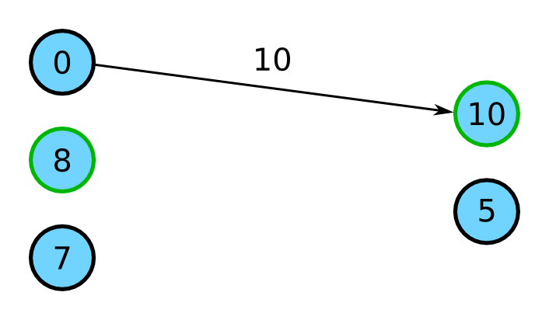
Greedy Method
Notes:
44

Slide 45
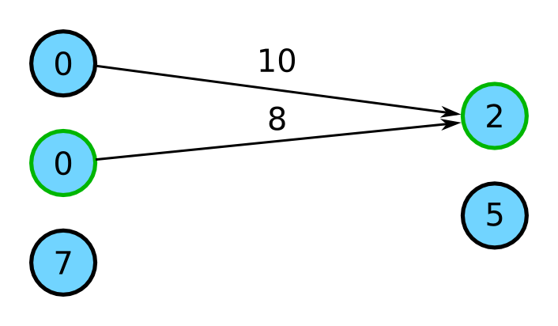
Greedy Method
Notes:
45

Slide 46
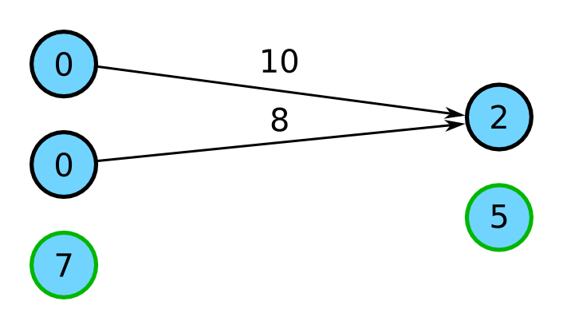
Greedy Method
Notes:
46

Slide 47
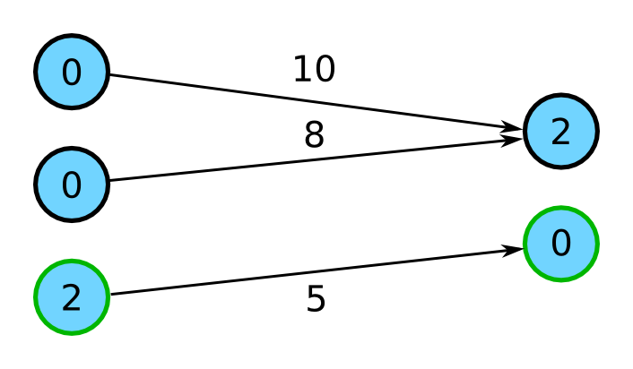
Greedy Method
Notes:
47

Slide 48
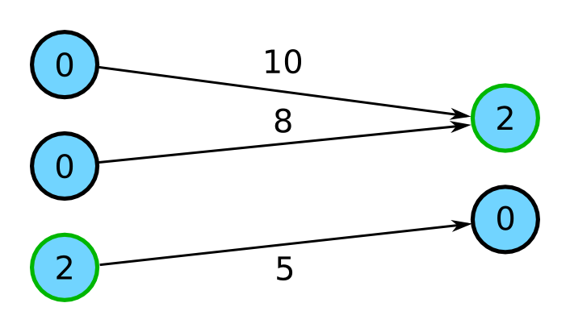
Greedy Method
Notes:
48

Slide 49
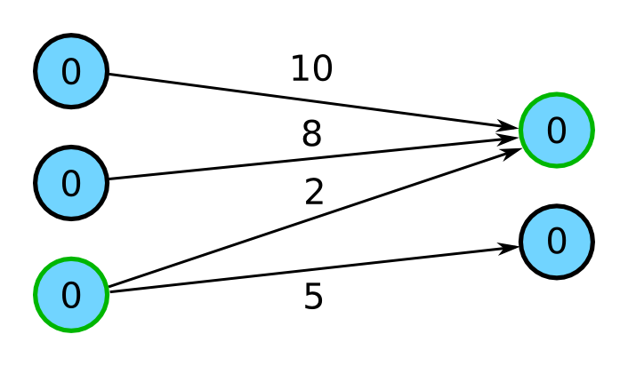
Greedy Method
Notes:
49

Slide 50
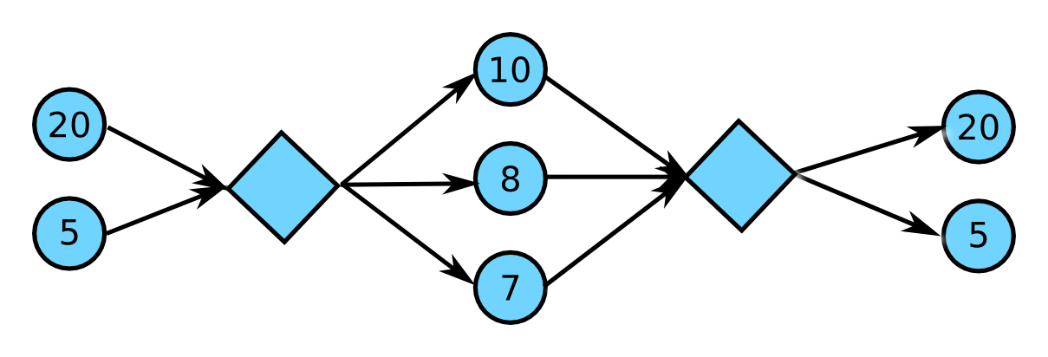
Global Optimization: Maximum Bandwidth
Notes:
50

Slide 51
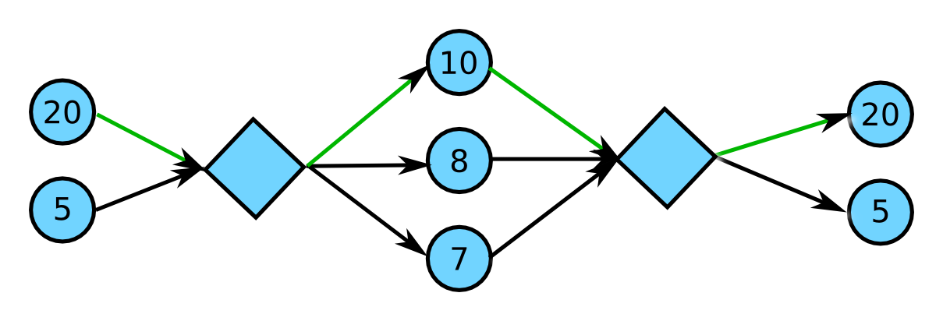
Maximum Bandwidth Method
Notes:
51

Slide 52
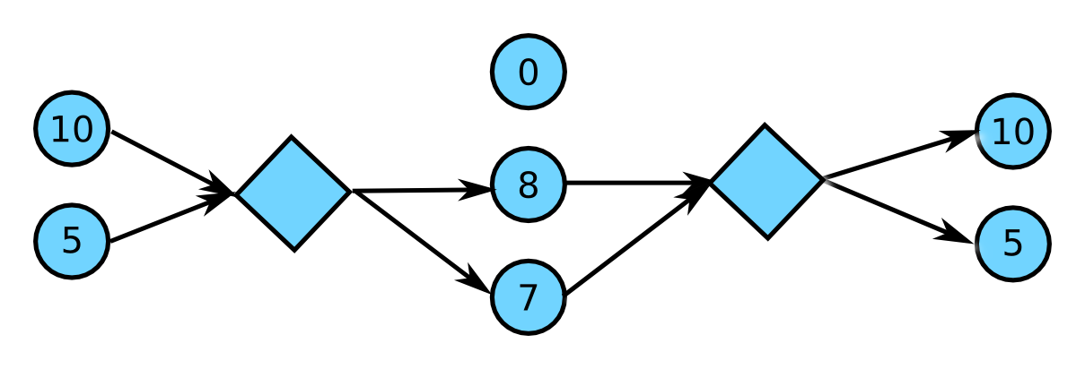
Maximum Bandwidth Method
Notes:
52

Slide 53
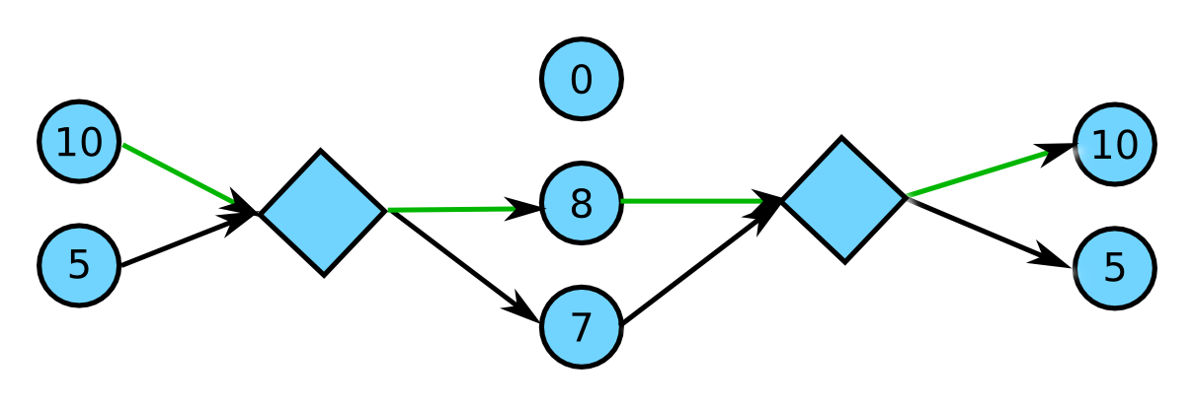
Maximum Bandwidth Method
Notes:
53

Slide 54
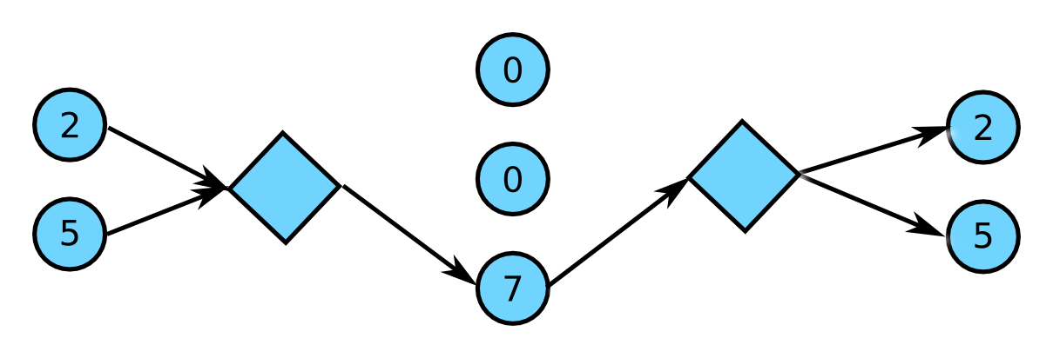
Maximum Bandwidth Method
Notes:
54

Slide 55
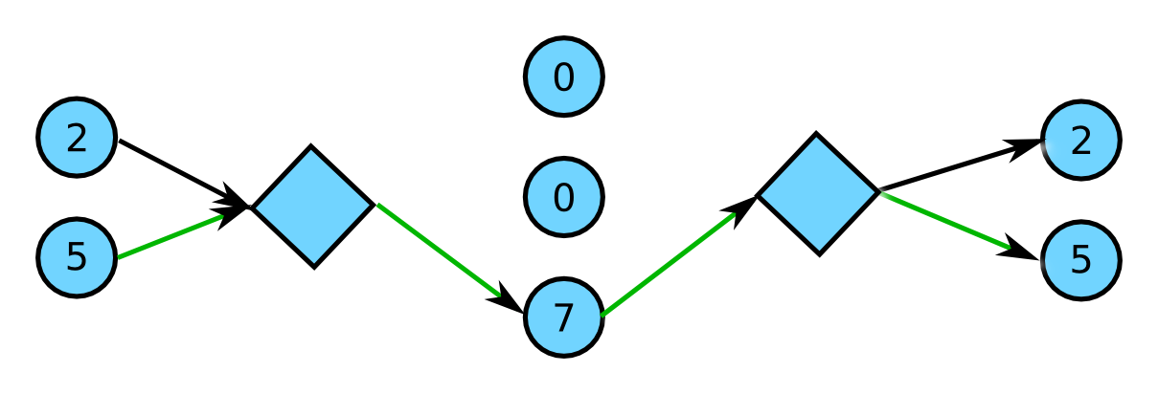
Maximum Bandwidth Method
Notes:
55

Slide 56
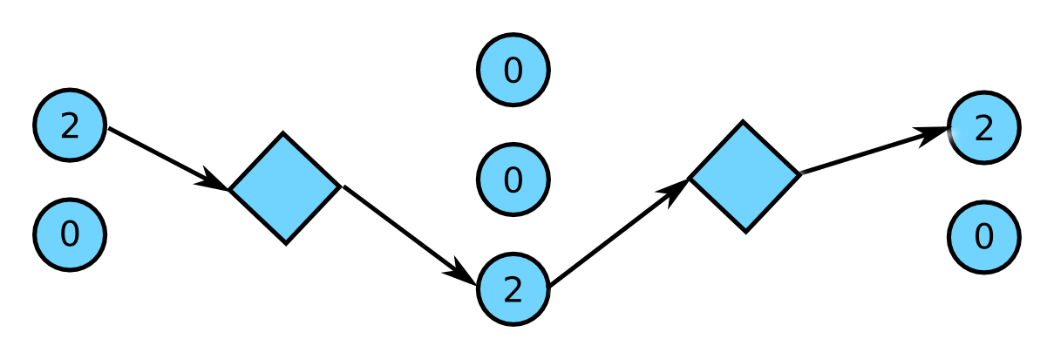
Maximum Bandwidth Method
Notes:
56

Slide 57
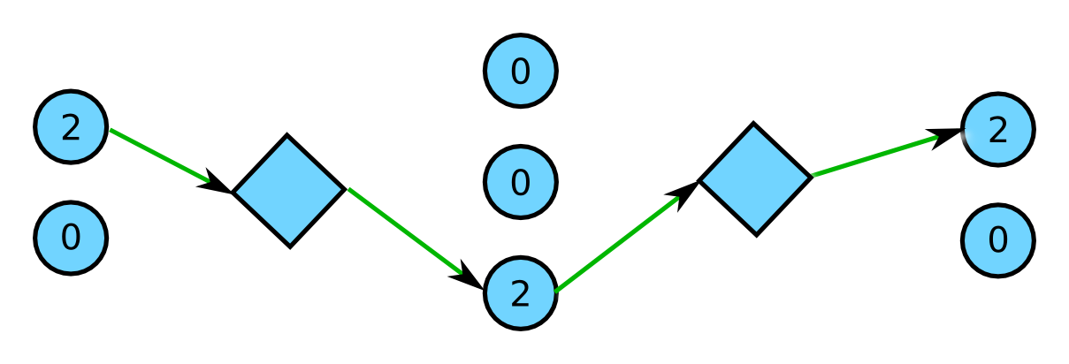
Maximum Bandwidth Method
Notes:
57

Slide 58
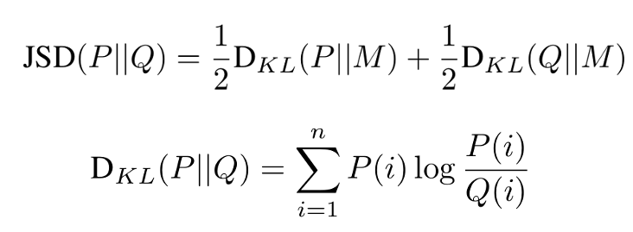
Experimental Setup
Error free reads simulated from 1739bp long fragments of HCV quasispecies
- Frequency distributions: uniform, geometric, …
5k-100k reads
- Amplicon width = 300bp
- Shift (= width – overlap, i.e., how much to slide the next amplicon) between 50 and 250
Quality measures
- Sensitivity
- PPV
- Jensen-Shannon divergence
Notes:
58

Slide 59
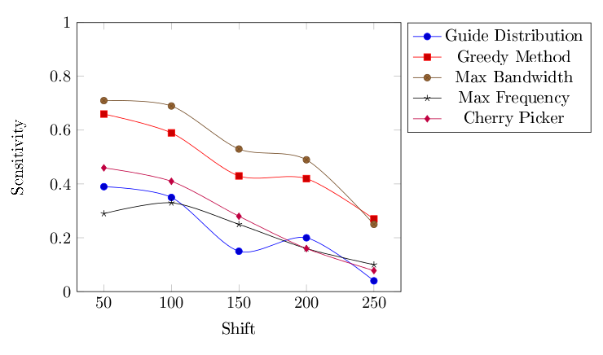
Sensitivity for 100k Reads
(Uniform Qsps)
Notes:
59

Slide 60
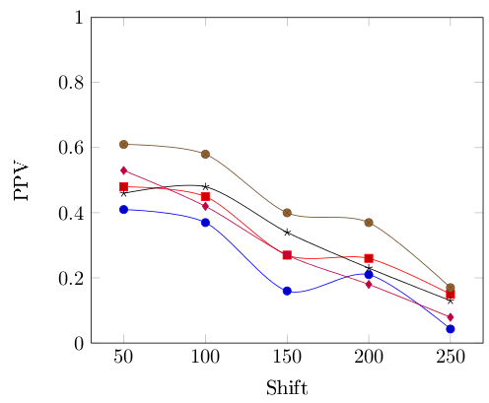
PPV for 100k Reads (Uniform Qsps)
Notes:
60

Slide 61
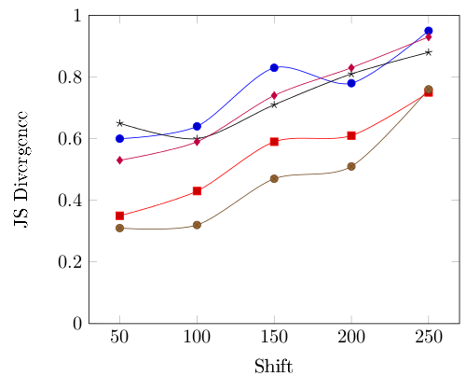
JS Divergence for 100k Reads (Uniform Qsps)
Notes:
61

Slide 62
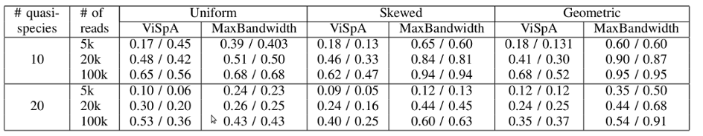
Amplicon vs. Shotgun Reads
(avg. sensitivity/PPV over 10 runs)
Notes:
62

Slide 63
Outline
Background
Quasispecies spectrum reconstruction from shotgun NGS reads
Quasispecies spectrum reconstruction from amplicon NGS reads
Quasispecies spectrum reconstruction for IBV
Ongoing and future work

Slide 64
Infectious Bronchitis Virus (IBV)
Group 3 coronavirus
Biggest single cause of economic loss in US poultry farms
Worldwide distribution, with dozens of serotypes in circulation
Co-infection with multiple serotypes creates conditions for recombination
Notes:
Signs occur after an incubation period of 18-48 hr. Spread to other birds is rapid, and morbidity may be nearly 100%. The nature and severity of the disease are influenced by the age and immune status of the flock and virulence of the causal strain. Young chickens cough, sneeze, and have tracheal rales for 10-14 days. Wet eyes and dyspnea may be seen, and facial swelling may also occur ccasionally, particularly with concurrent bacterial infection of the sinuses. In broiler chickens, IBV infection is a major cause of poor feed conversion, reduced growth rate, and condemnation of meat at processing. Nephropathogenic strains can produce interstitial nephritis with high mortality (up to 60%) in young chickens. In most outbreaks, however, mortality is 5%, although secondary bacterial infections may cause higher losses.
In layers, egg production may drop 5-50%, and eggs are often misshapen, thin-shelled, and contain watery albumen. Egg production and egg quality generally return to near normal levels in most birds on recovery.

Slide 65
IBV Vaccination
Broadly used, most commonly with attenuated live vaccine
Short lived protection
Layers need to be re-vaccinated multiple times during their lifespan
Vaccines might undergo selection in vivo and regain virulence [Hilt, Jackwood, and McKinley 2008]

Slide 66
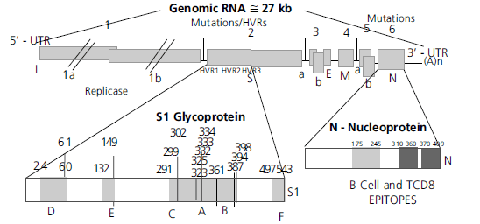
IBV Genome Organization
Rev. Bras. Cienc. Avic. vol.12 no.2 Campinas Apr./June 2010

Slide 67
454 Read Coverage
145K 454 reads of avg. length 400bp (~60Mb) sequenced from 2 samples (M41 vaccine and M42 isolate)

Slide 68
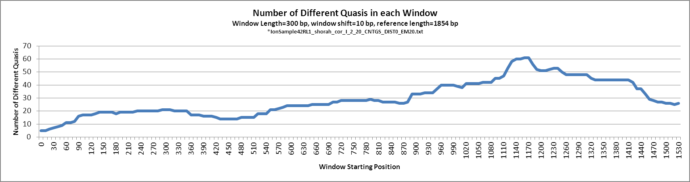
Reconstructed Quasispecies Variability
Sample42RL1.fas_KEC_corrected_I_2_20_CNTGS_DIST0_EM20.txt
Sequencing primer ATGGTTTGTGGTTTAATTCACTTTC
122 clones sequenced using Sanger

Slide 69
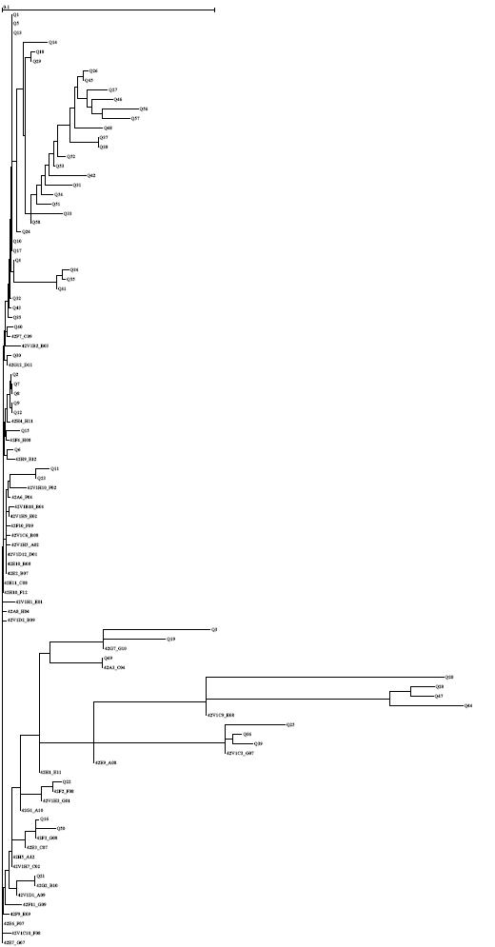
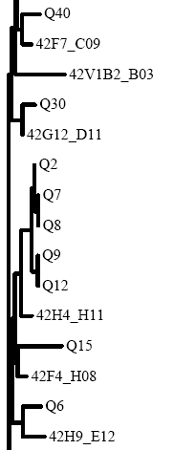
M42 Sanger + Vispa NJ Tree

Slide 70
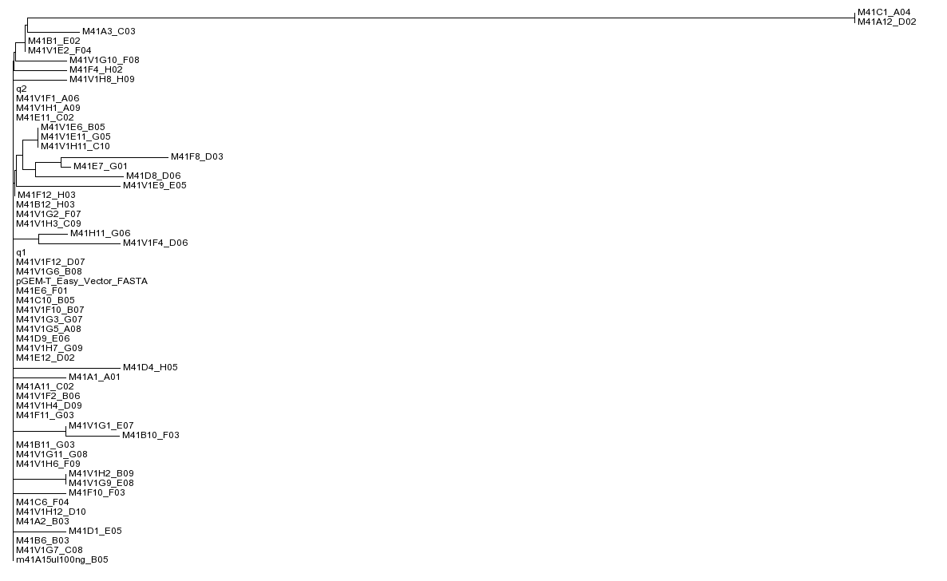
MA41 Sanger + Vispa NJ Tree

Slide 71
Outline
Background
Quasispecies spectrum reconstruction from shotgun NGS reads
Quasispecies spectrum reconstruction from amplicon NGS reads
Quasispecies spectrum reconstruction for IBV
Ongoing and future work

Slide 72
Ongoing and Future Work
Correction for coverage bias
Comparison of shotgun and amplicon based reconstruction methods on real data
Quasispecies reconstruction from Ion Torrent reads
Combining long and short read technologies
Study of quasispecies persistence and evolution in layer flocks following administration of modified live IBV vaccine
Optimization of vaccination strategies

Slide 73
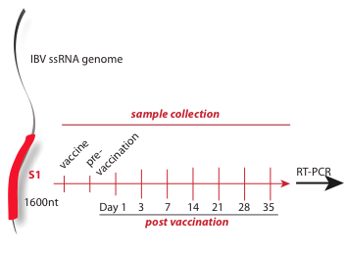
Longitudinal Sampling
Amplicon / shotgun sequencing

Slide 74







Acknowledgements
University of Connecticut
Rachel O’Neill, PhD.
Mazhar Kahn, Ph.D.
Hongjun Wang, Ph.D.
Craig Obergfell
Andrew Bligh
Georgia State University
Alex Zelikovsky, Ph.D.
Bassam Tork
Nicholas Mancuso
Serghei Mangul
Centers for Disease Control
and Prevention
Pavel Skums, Ph.D.
University of Maryland
Irina Astrovskaya, Ph.D.

