Slide 1
Space-Constrained Gram-Based Indexing for Efficient Approximate String Search
Alexander Behm¹, Shengyue Ji¹, Chen Li¹, Jiaheng Lu²
¹University of California, Irvine
²Renmin University of China

Slide 2
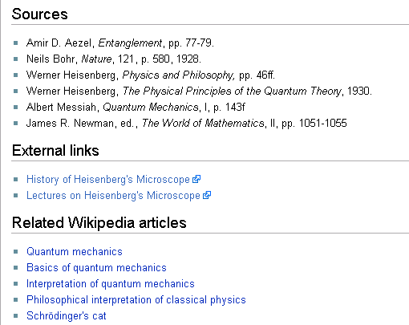
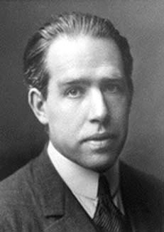
Motivation: Data Cleaning
Should clearly be “Niels Bohr”
Source: http://en.wikipedia.org/wiki/Heisenberg's_microscope, Jan 2008
Notes:
2
Real-world data is dirty
Typos
Inconsistent representations
(PO Box vs. P.O. Box)
Approximately check against clean dictionary

Slide 3

Motivation: Record Linkage
Phone | Age | Name
… | … | Brad Pitt
… | … | Arnold Schwarzeneger
… | … | George Bush
… | … | Angelina Jolie
… | … | Forrest Whittaker
No exact match!
Name | Hobbies | Address
Brad Pitt | … | …
Forest Whittacker | … | …
George Bush | … | …
Angelina Jolie | … | …
Arnold Schwarzenegger | … | …
Notes:
3
We want to link records belonging to the same entity
The same entity may have similar representations
Arnold Schwarzeneger versus
Arnold Schwarzenegger
Forrest Whittaker versus
Forest Whittacker

Slide 4
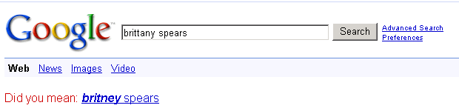
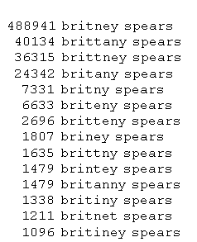

Motivation: Query Relaxation
Actual queries gathered by Google
http://www.google.com/jobs/britney.html
Notes:
4
Errors in queries
Errors in data
Bring query and meaningful results closer together

Slide 5
What is Approximate String Search?
String Collection
Brad Pitt
Forest Whittacker
George Bush
Angelina Jolie
Arnold Schwarzenegger
…
Query against collection:
Find entries similar to “Arnold Schwarseneger”
What do we mean by similar to?
Edit Distance
Jaccard Similarity
Cosine Similarity
Dice
Etc.
How can we support these types of queries efficiently?
Notes:
5
The similar to predicate can help our described applications!

Slide 6
Approximate Query Answering
irvine
Sliding Window
2-grams {ir, rv, vi, in, ne}
Intuition: Similar strings share a certain number of grams
Notes:
6
Main Idea: Use q-grams as signatures for a string
Inverted index on grams supports finding all data strings sharing enough grams with a query

Slide 7
Approximate Query Example
Query: “irvine”, Edit Distance 1
2-grams {ir, rv, vi, in, ne}
Lookup Grams
2-grams
…
in
tf
vi
ir
ef
rv
ne
un
…
1
3
4
5
7
9
5
9
1
5
1
2
3
9
7
9
5
6
9
1
2
4
5
6
1
3
4
5
7
9
1
5
1
2
3
9
3
9
7
9
5
6
9
Inverted Lists (stringIDs)
Count >= 3 → Candidates = {1, 5, 9}
May have false positives
Notes:
7
Each edit operations can “destroy” at most q grams
Answers must share at least T = 5 – 1 * 2 = 3 grams
T-Occurrence problem: Find elements occurring at least T=3 times among inverted lists. This is called list-merging. T is called merging-threshold.

Slide 8
T-Occurrence Problem
Merge
Ascending
order
Find elements whose occurrences ≥ T
Notes:
8
Each edit operations can “destroy” at most q grams
Answers must share at least T = 5 – 1 * 2 = 3 grams
T-Occurrence problem: Find elements occurring at least T=3 times among inverted lists. This is called list-merging. T is called merging-threshold.

Slide 9
Motivation: Compression
Inverted Index >> Source Data
Fit in memory? Space Budget?
Notes:
9

Slide 10
Motivation: Related Work
IR: lossless compression of inverted lists (disk-based)
Delta representation + compact encoding
Inverted lists in memory: decompression overhead
Tune compression ratio?
Overcome these limitations in our setting?
Notes:
10

Slide 11
Main Contributions
Two lossy compression techniques
Answer queries exactly
Index fits into a space budget
Queries → faster on the compressed indexes ☺
Flexibility to choose space / time tradeoff
Existing list-merging algorithms: re-use + compression specific optimizations
Notes:
11

Slide 12
Overview
Motivation & Preliminaries
Approach 1: Discarding Lists
Approach 2: Combining Lists
Experiments & Conclusion
Notes:
12

Slide 13
Approach 1: Discarding Lists
2-grams
…
in
tf
vi
ir
ef
rv
ne
un
…
1
3
4
5
7
9
5
9
1
5
1
2
3
9
3
9
7
9
5
6
9
1
2
4
5
6
Inverted Lists (stringIDs)
Lists discarded, “Holes”
Notes:
13

Slide 14
Effects on Queries
Decrease lower bound T on common grams
Smaller T → more false positives
T <= 0 → “panic”, scan entire string collection
Surprise ☺ Fewer lists → Faster Queries (depends)
Notes:
14

Slide 15
Query “shanghai”, Edit Distance 1
3-grams {sha, han, ang, ngh, gha, hai}
3-grams
uni
ing
sha
han
ang
ngh
gha
hai
ter
…
Basis: Edit Operations “destroy” q=3 grams
No Holes: T = #grams – ed * q = 6 – 1 * 3 = 3
With holes: T’ = T – #holes = 0 → Panic!
Really destroy q=3 grams per edit operation?
Dynamic Programming for tighter T
Hole grams
Regular grams
Notes:
15

Slide 16
Choosing Lists to Discard
Effect on Query
Unaffected ☺
☹ Panic
Slower or Faster
Good choice depends on query workload
Space budget: Many combinations of grams
Make a “reasonable” choice efficiently?
Notes:
16

Slide 17
Choosing Lists to Discard
INPUT: Space Budget, Inverted lists, Workload
Choose one list at a time
…
in
tf
vi
ir
ef
rv
ne
un
…
Estimated impact ∆t
Incremental Update
Query1
Query2
Query3
…
OUTPUT: Lists to discard
Total estimated running time t
ALGORITHM: Greedy & Cost-Based
Notes:
17
How can we do this efficiently?
Perhaps incrementally?
What exactly should we minimize?
benefit / cost?
cost only?
We could ignore benefit…
Times needed:
List-Merging Time
Post-Processing Time
Panic Time

Slide 18
Estimating Query Times
List-Merging:
cost function, offline with linear regression
Panic:
#strings * avg similarity time
Post-Processing:
#candidates * avg similarity time
Notes:
18
Many more ways to improve speed of DiscardLists, this is just one example…

Slide 19
Estimating #candidates
Incremental-ScanCount Algorithm
Counts
2
3
0
1
4
BEFORE
T = 3
#candidates = 2
un
StringIDs
0
1
2
3
4
1
3
4
Decrement
List to Discard
2
2
0
0
3
AFTER
T’ = T-1 = 2
#candidates = 3
Counts
StringIDs
0
1
2
3
4
Notes:
19
Many more ways to improve speed of DiscardLists, this is just one example…

Slide 20
Overview
Motivation & Preliminaries
Approach 1: Discarding Lists
Approach 2: Combining Lists
Experiments & Conclusion
Notes:
20

Slide 21
Approach 2: Combining Lists
2-grams
…
in
tf
vi
ir
ef
rv
ne
un
…
1
3
4
5
7
9
5
9
5
6
9
1
2
3
9
1
3
9
7
9
6
9
1
2
4
5
6
Inverted Lists (stringIDs)
Lists combined
Notes:
21

Slide 22
Effects on Queries
Lower bound T is unchanged (no new panics)
Lists become longer:
More time to traverse lists
More false positives
Notes:
22

Slide 23
Speeding Up Queries
Query
3-grams {sha, han, ang, ngh, gha, hai}
combined lists
refcount = 2
combined lists
refcount = 3
Traverse physical lists once.
Count for stringIDs increases by refcount.
Notes:
23

Slide 24
Choosing Lists to Combine
Discovering candidate gram pairs
Frequent q+1-grams → correlated adjacent q-grams
Locality-Sensitive Hashing (LSH)
Selecting candidate pairs to combine
Basis: estimated cost on query workload
Similar to DiscardLists
Different Incremental ScanCount algorithm

Slide 25
Overview
Motivation & Preliminaries
Approach 1: Discarding Lists
Approach 2: Combining Lists
Experiments & Conclusion
Notes:
25

Slide 26
Experiments
Datasets:
Google WebCorpus Word Grams
IMDB Actors
DBLP Titles
Overview:
Performance & Scalability of DiscardLists & CombineLists
Comparison with IR compression & VGRAM
Changing workloads
10k Queries: Zipf distributed, from dataset
q=3, Edit Distance=2, (also Jaccard & Cosine)
Notes:
26

Slide 27
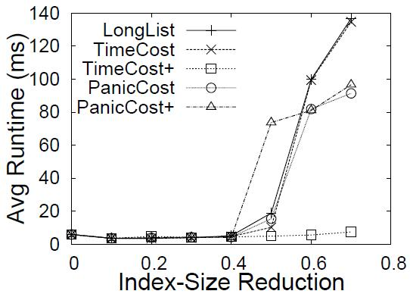
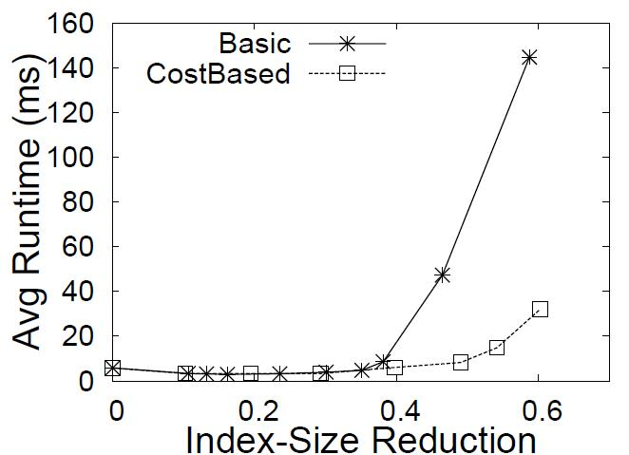
Experiments
DiscardLists
CombineLists
Runtime decreases!
Runtime decreases!
Notes:
27

Slide 28
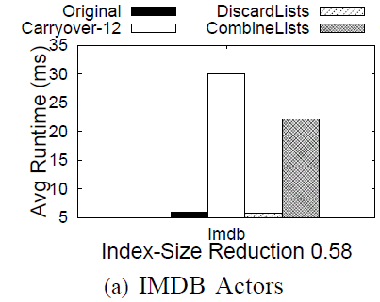
Comparison with IR compression Carryover-12
Compressed
Uncompressed
Notes:
28

Slide 29
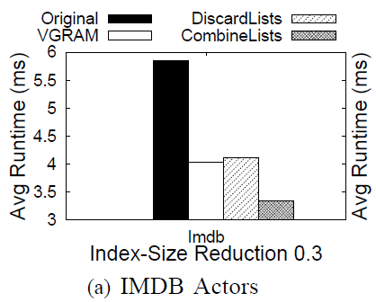
Comparison with variable-length grams, VGRAM
Uncompressed
Compressed
Notes:
29

Slide 30
Future Work
Combine: DiscardLists, CombineLists and IR compression
Filters for partitioning, global vs. local decisions
Dealing with updates to index
Notes:
30

Slide 31
Conclusions
Two lossy compression techniques
Answer queries exactly
Index fits into a space budget
Queries → faster on the compressed indexes ☺
Flexibility to choose space / time tradeoff
Existing list-merging algorithms: re-use + compression specific optimizations
Notes:
31

Slide 32
Thank You!
This work is part of
The Flamingo Project
http://flamingo.ics.uci.edu
Notes:
32

Slide 33
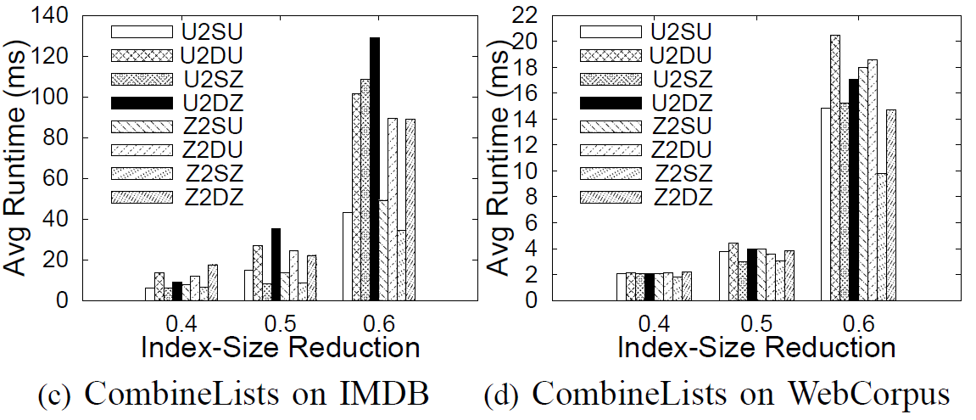
More Experiments
What if the workload changes from the training workload?
Notes:
33

Slide 34
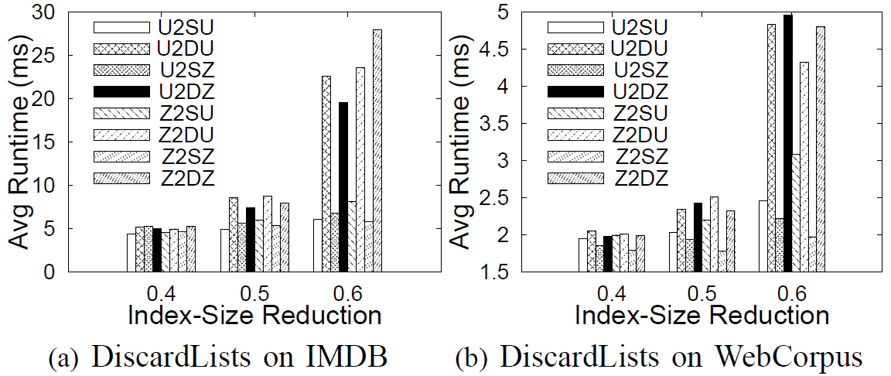
More Experiments
What if the workload changes from the training workload?
Notes:
34

