Slide 1
API Hyperlinking via Structural Overlap
Fan Long, Tsinghua University
Xi Wang, MIT CSAIL
Yang Cai, MIT CSAIL

Slide 2
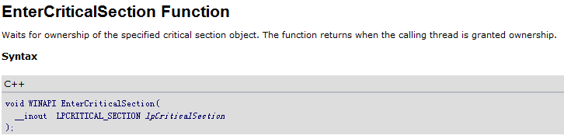
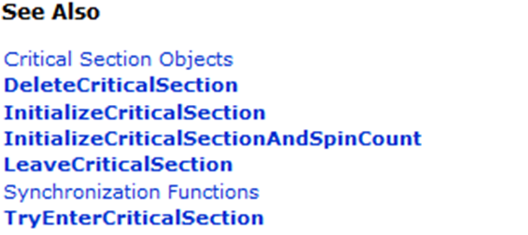
Example: MSDN
Help information for EnterCriticalSection API
……
See Also sections that lists related functions

Slide 3
Motivation
Cross-references are useful to organize API knowledge
Hyperlinks to related functions
“See Also” in MSDN
It is difficult to manually maintain cross-references
Huge libraries: more than 1400 functions in Apache
Tedious and error-prone
Goal
Auto-generate cross-references for documentation

Slide 4
Cross-references
Different users may need different kinds of cross-references in the document of a library
end-users, testers, developers, …
For end-users of the library, it needs to contain the functions that perform the same or a relevant task
In this paper, we focus on the documentation for end-users

Slide 5
Existing solutions
Documentation tools
@see and <seealso> tags with doxygen, javadoc…
only 15 out of 1461 APIs in httpd 2.2.10 are annotated
Developers cannot track all related functions, when the library is evolving
Usage pattern mining
Based on the call graph
Find functions f and g that is often called together
Sensitive to specific client code
May have missing or unreliable results

Slide 6
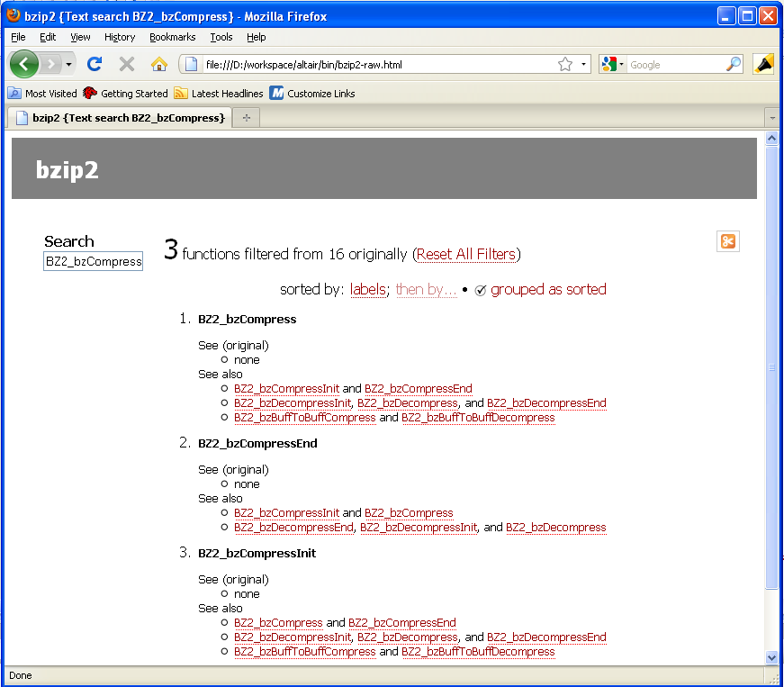
Altair Output

Slide 7
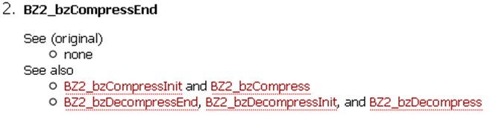
Altair Output
See (original): extracted from comment by doxygen
See also: auto-generated by Altair
Five related functions for compression and decompression
Results are organized in two modules

Slide 8
Basic idea
Hyperlink
Functions are related, if they access same data: The more data they share, the more likely that they are related.
Module
Tightly related functions → module.
Tense connection inside a module
Loose connection between two modules
Altair analyzes library implementation.

Slide 9
Altair Stages
Program analysis
Extract data access relations from the library code and summarize them in a data access graph
Ranking
Compute overlap rank to measure the relevance between two functions
Clustering
Group the functions that are tightly related into modules
Program analysis
Ranking
Clustering

Slide 10
Data access graph
g(A *a) {
g₀(a);
z = 42;
}
static g₀(A *a) {
a->x++;
a->y--;
}
f
g
h
f() {
return new A;
}
h() {
z++;
}
A.x
A.y
z
Data nodes are fields and global variables
g calls g₀, and g₀’s access effect is merged to g
f allocates objects of type A, and effects all of its fields

Slide 11
Overlap rank
N(f) denote the set of data that f may access
Given a function f, we define its overlap with function g as:
π(g|f) is the proportion of f’s data that is also accessed by g.

Slide 12
Overlap rank
π(h|f)=0, π(g|f)=1, π(f|g)=2/3
High π(g|f) value → g is related to f
Overlap rank is asymmetric; cross-references are also not bi-directional
f
g
h
A.x
A.y
z

Slide 13
Clustering
Overlap coefficient (symmetric measure):
Function set F is partitioned into two modules, S and its complement . We define the conductance as:
min( )
Inter-connection between two modules
The sum of vertex degrees in the module

Slide 14
Clustering
To find min( ) is NP-hard
Altair uses spectral clustering algorithm to get approximate result
Directly cluster functions into k modules, if k is known
Recursively bi-partition the function set until they have desired granularity, if k is unknown

Slide 15
Related work
API recommendation
Suade(FSE’05), FRAN, and FRIAR(FSE’07)
Importance: Suade, FRAN
Association: FRIAR
Change history mining(ROSE, ICSE’04)
Extract code examples: Strathcona(ICSE’05), XSnipppet(OOPSLA’06)
Module clustering
Arie, Tobias, Identifying objects using Cluster and Concept Analysis(ICSE’99)
Michael, Thomas, Identifying Modules via Concept Analysis(ICSM’97)

Slide 16
Ranking comparison
 | Suade | FRAN | FRIAR | Altair
apr_file_eof( apr_file_t *file) | do_emit_plain | apr_file_read ap_rputs do_emit_plain | N/A | apr_file_seek apr_file_read apr_file_dup apr_file_dup2 (… 5 more)
apr_hash_get( apr_hash_t *ht, const void *key, apr_ssize_t klen) | find_entry find_entry_def dav_xmlns… dav_xmlns… dav_get… (… 25 more) | apr_palloc apr_hash_set memcpy strlen apr_pstrdup (… 95 more) | apr_hash_set apr_palloc apr_hash_make strlen apr_pstrdup (… 18 more) | apr_hash_copy apr_hash_merge apr_hash_set apr_hash_make apr_hash_this (… 3 more)
Altair returns
APIs that perform related tasks
Functions that in the same module

Slide 17
Case study of module clustering
Module | Functions
Utility | BZ2_bzBuffToBuffCompress BZ2_bzBuffToBuffDecompress
Compress | BZ2_bzCompressInit BZ2_bzCompress BZ2_bzCompressEnd
Decompress | BZ2_bzDecompressInit BZ2_bzDecompress BZ2_bzDecompressEnd
File operations | BZ2_bzReadOpen BZ2_bzRead BZ2_bzReadClose (… 8 in total)
16 API functions in bzip2
1. File I/O and compression APIs
2. Decompress APIs from others.
3. Compress APIs and two utility functions

Slide 18
Analysis cost
Applied to several popular libraries
Analysis finished in seconds for fairly large libraries(>500K LOC)
Library package | KLOC(llvm bitcode) | Analysis time (sec) | Memory used (MB)
bzip2-1.0.5 | 30.0 | <1 | 4.6
sqlite-3.6.5 | 163.8 | 1 | 55.8
httpd-2.2.10 | 256.6 | 1 | 109.9
subversion-1.5.6 | 438.8 | 9 | 205.1
openssl-0.9.8i | 553.8 | 28 | 374.5

Slide 19
Limitations & Extensions
Limitations
Source code of the library is required
Low-level system calls, whose code is missing
Semantic relevance (SHA-1 and MD5 functions)
Extensions
Combination with client code mining
Heuristics like naming convention

Slide 20
Conclusion
Altair can auto-generate cross-references and cluster API into meaningful modules
Altair exploits data overlaps between functions
Data access graph
Overlap rank
Such structural information is reliable for API recommendation and module clustering

Slide 21
Download Altair
Altair is open source and available at:
http://pdos.csail.mit.edu/~xi/altair/
Including source code along with demos
Feel free to try it!

Slide 22
Thanks!
Questions?

Slide 23
Challenges
Open program
Parameters of two functions may point to same data.
Use fields to distinguish different data
Calls
Function may call other API in its implementation.
Merge their effect, if the callee is static.
Allocations
Functions like malloc and free create or destroy an object
These functions affect all fields of the object.

Slide 24
Example: Data access graph
f(A *a) {
a->x = 0xdead;
a->y = 0xbeaf;
}
g
g(A *a, B *b) {
g₀(a);
b->z = 42;
}
f
e
g₀
e() {
return new A;
}
h
x
y
z
w
static g₀(A *a) {
a->x++;
a->y--;
}
A
h() {
w++;
}

Slide 25
Graph construction
Function f access data d
An edge from f to d
Data d is a field of type t
An edge from t to d
Function f calls a static function g
An edge from f to g
Function f creates or destroys objects of type t
An edge from f to t

Slide 26
Bipartite graph
Computes the transitive closure of the graph
Removes type and static function nodes and leaves only edges from public function nodes to data nodes
g
e
f
g
h
f
e
g₀
h
x
y
z
w
A.x
A.y
z
w
A

Slide 27
Conductance
Overlap coefficient, symmetric measure:
Function set F is partitioned into two modules, S and its complement
The total overlap of all vertices in S defined as:
The overlap between vertices sets S and defined as:

Slide 28
Conductance
The intra-connection inside a module should be tense.
The inter-connection between modules should be loose.
Conductance for a partition is:
We need to minimize it

Slide 29
Modularity
Define modularity of function set F as minimized conductance:
NP-hard
Altair uses spectral clustering algorithm
Recursively bi-partition functions until they have desired granularity.

Slide 30
Goal
Precision
No unrelated functions
Few missing functions
Not sensitive to client code
Our tool does not need client code at all
Clustering the functions into modules
Better organization of the knowledge
Can further help program analysis tools such as specification mining

Slide 31
Overview
Motivation
Stages
Design
Data access graph
Overlap rank
Clustering
Experiment
Discussion
Conclusion

Slide 32
Framework
Source code
llvm bitcode
Program analysis
llvm frontend
Data access graph
Ranking
Overlap rank
Spectral Clustering
Modules
Output

Slide 33
Framework
Source code
llvm bitcode
Program analysis
llvm frontend
Data access graph
Ranking
Overlap rank
Spectral Clustering
Modules
Output

Slide 34
Framework
Source code
llvm bitcode
Program analysis
llvm frontend
Data access graph
Ranking
Overlap rank
Spectral Clustering
Modules
Output

Slide 35
Graph construction
Function f access a field x of type t
An edge from node f to node t.x
Function f access global variable v
An edge from node f to node v
Function f creates or destroys an object of type t
Edges from node f to data nodes of all fields of t
Function f calls function g, and g is static
For every data node d, if g accesses d, we add an edge from node f to node d

