Slide 1
Streaming Multigrid for Gradient-Domain Operations on Large Images
Misha Kazhdan
and
Hugues Hoppe
Johns Hopkins University
Microsoft Research
Notes:
Good morning.
In this talk I will present work, done in collaboration with Hugues Hoppe of Microsoft Research, on streaming the multigrid solver.
Our project is motivated by recent work in gradient-domain image processing, and focuses on the challenge of extending these techniques to huge images.
Let’s consider two examples.

Slide 2
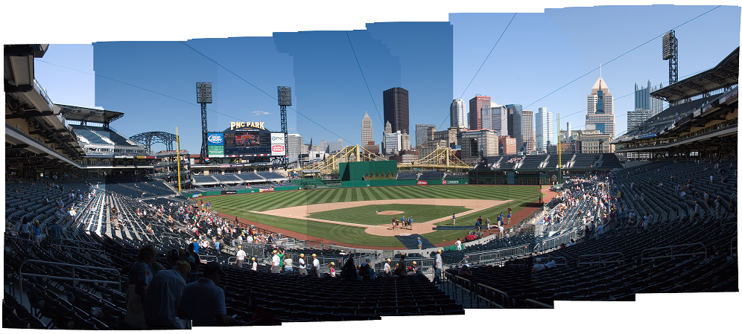
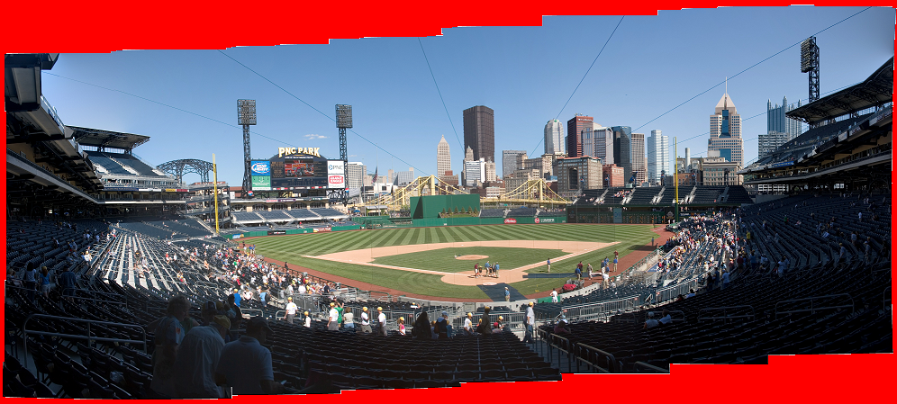
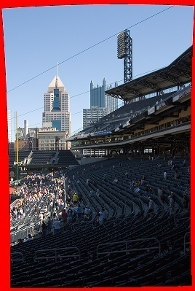
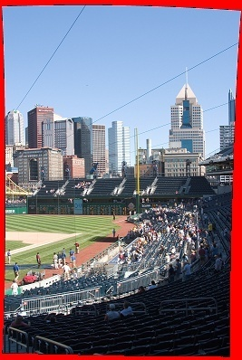
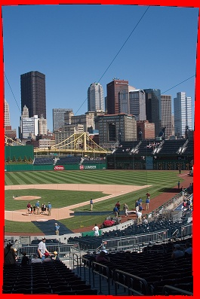
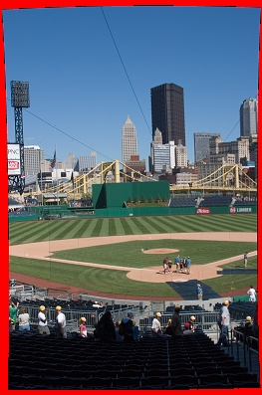
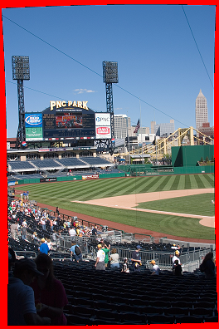
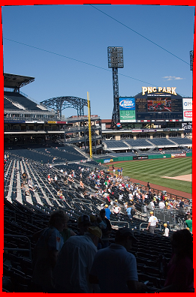
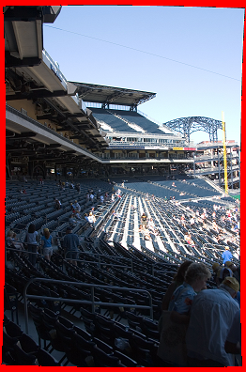
Stitching Image Panoramas
Gradient Domain Fix:
Set seam-crossing gradients to zero.
Different exposures ⇒ Seams in the panorama
Courtesy of Uyttendaele
Notes:
When compositing a set of images into a panorama…
[Click]
Even with well-chosen stitching boundaries, exposure differences can result in seams.
Correcting this is easily done in the gradient domain.
To remove the sharp transitions due to large gradients, we…
[Click]
Set the values of all boundary-crossing gradients to zero, and solve for the image with the new gradients, obtaining a seamless composition.

Slide 3
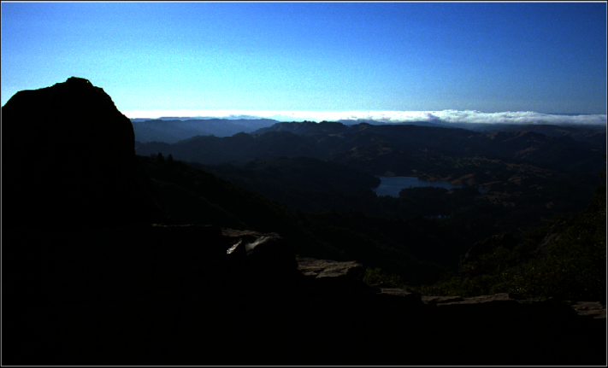
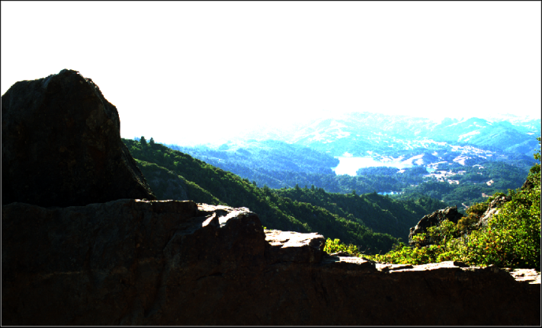
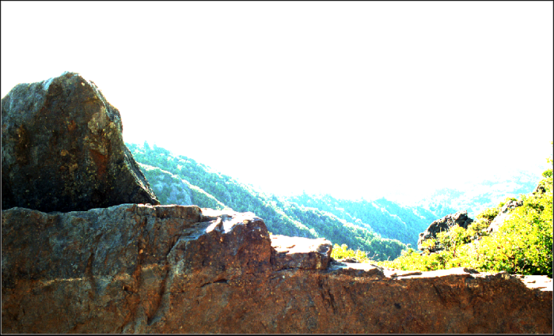
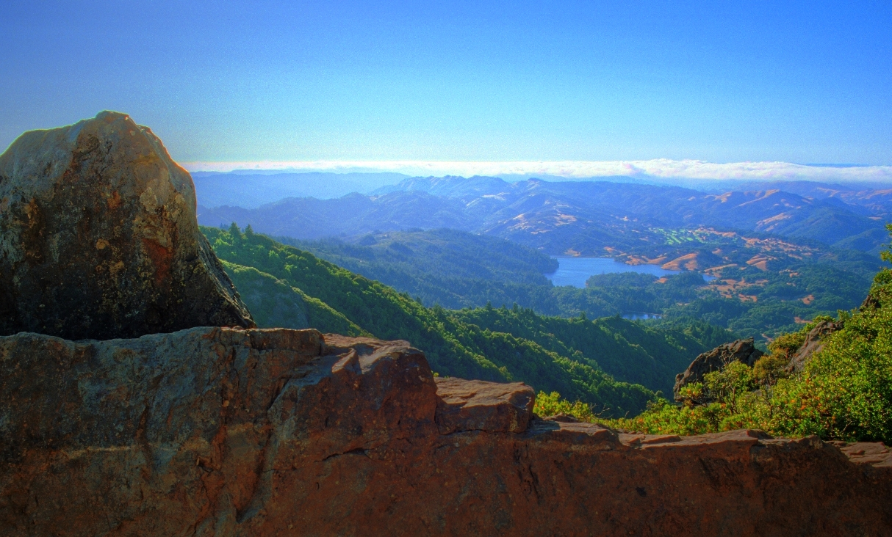
High Dynamic Range Compression
Gradient Domain Fix:
Amplify small gradients and dampen large ones.
No single image exposes all the detail
Short Exposure
Medium Exposure
Long Exposure
Courtesy of Industrial Light & Magic
Tone-Mapped Image
Notes:
Another challenging problem is visualizing high-dynamic-range images on low-dynamic-range displays.
Because of the limited range, no single exposure reveals all the detail.
Once again, this problem is easily addressed in the gradient domain.
Amplifying small gradients and dampening large ones…
[Click]
We can exaggerate subtle color variations to obtain a single visualization exposing all of the detail.

Slide 4
Gradient-Domain Image Processing
Many image processing operations are easier to implement in the gradient-domain.
Gradient Domain Operator
Image₀
Gradient Domain Operator
Image₀
∇
∇
Grad₀
Grad₀
Solver
∇
Solver
∇
Grad₁
Image₁
Grad₁
Image₁
Grad
Grad
Image
Image
Grad_{n}
Image_{n}
Grad_{n}
Image_{n}
∇
∇
Notes:
More generally, gradient-domain image processing proceeds as follows:
Starting with an image, or a set of images,
[Click]
We extract the gradients,
[Click]
Combine and modify them,
[Click]
And then solve for the image satisfying the new constraints.
[Click]

Slide 5
Gradient-Domain Image Processing
Many image processing operations are easier to implement in the gradient-domain.
Gradient Domain Operator
Image₀
Gradient Domain Operator
Image₀
∇
∇
Grad₀
Grad₀
Solver
∇
Solver
∇
Grad₁
Image₁
Grad₁
Image₁
Grad
Grad
Image
Image
Grad_{n}
Image_{n}
Grad_{n}
Image_{n}
∇
∇
Removing Lighting Effects
Range Compression
Image Compositing
Image Stitching
Image Authoring
[Horn ’74, Weiss ’01, Finlayson ’02, Agrawal ’05]
[Fattal ’02, Weyrich ’07]
[Perez ’03, Agarwala ’04, Jia ’06]
[Levin ’04, Agarwala ’07]
[McCann ’08]
Notes:
Previous works have shown that by processing gradients in different ways, a variety of visual effects can be realized.

Slide 6
Gradient-Domain Image Processing
Many image processing operations are easier to implement in the gradient-domain.
Gradient Domain Operator
Image₀
Gradient Domain Operator
Image₀
∇
∇
Grad₀
Grad₀
Solver
∇
Solver
∇
Grad₁
Image₁
Grad₁
Image₁
Grad
Grad
Image
Image
Grad_{n}
Image_{n}
Grad_{n}
Image_{n}
∇
∇
Removing Lighting Effects
Range Compression
Image Compositing
Image Stitching
Image Authoring
[Horn ’74, Weiss ’01, Finlayson ’02, Agrawal ’05]
[Fattal ’02, Weyrich ’07]
[Perez ’03, Agarwala ’04, Jia ’06]
[Levin ’04, Agarwala ’07]
[McCann ’08]
Notes:
Though they differ in how they process the gradients, they all must solve for the image that fits the new constraints.
And this is what we focus on: Finding the best-fit image, specifically when the image and the constraints are too large to fit into memory.

Slide 7
Outline
Introduction
Solving for the Image
The Poisson Equation
Solving the Linear System
Choosing the System
Solving for Big Images
Results and Discussion
Notes:
We begin by describing the linear system defined by the gradient constraints and reviewing traditional methods for solving the system when it is small enough to fit into memory.

Slide 8
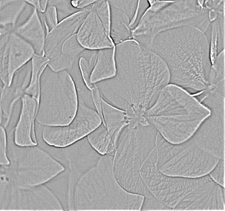
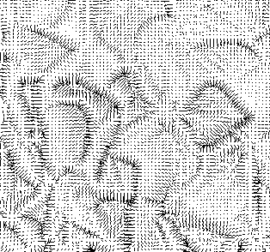
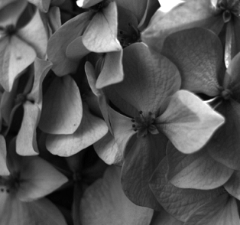
The Poisson Equation
Gradient-domain processing requires fitting an image to local-difference constraints:
^
averaged
f=div(g)
g
u
Notes:
To perform gradient-domain processing we must be able to fit an image to a desired gradient field.
That is, we must invert the gradient operator.
The problem is that this system of equations is over-constrained.
At each pixel, we have two constraints and only one color value.
To address this problem, we can apply the divergence operator to both sides.
[Click]
This transforms the constraints from a vector field…
[Click]
To a scalar field,
And changes the linear system…
[Click]
So that now we are left with the problem of inverting the Laplacian operator.

Slide 9
Gauss-Seidel Solvers
Gradient-domain processing requires fitting an image to local-difference constraints.
Iterative Algorithm:
For each pixel (i,j)
Assume the rest of the pixel values are correct
Update u[i][j] to satisfy the Laplacian:
^
averaged
u[i][j] ← (Average of Neighbors) + f[i][j]
Notes:
Since the Laplacian measures the average difference between a pixel and its neighbors, the system can be solved using a simple Gauss-Seidel solver:
Iterating over the pixels…
[Click]
We assume that the values of all but the current pixel are correct,
[Click]
And we update the value of the current pixel so that the averaged difference constraint is satisfied.
[Click]
We iterate, successively updating the values of the pixels, and converge to the correct solution.

Slide 10
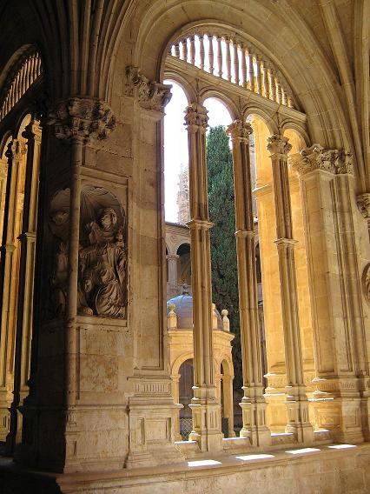
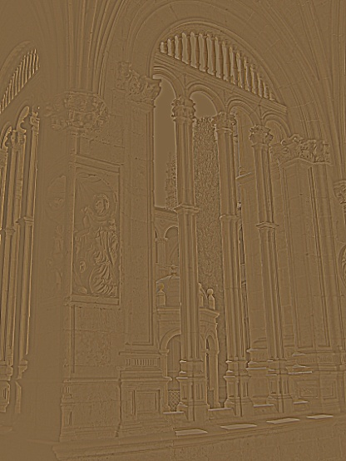
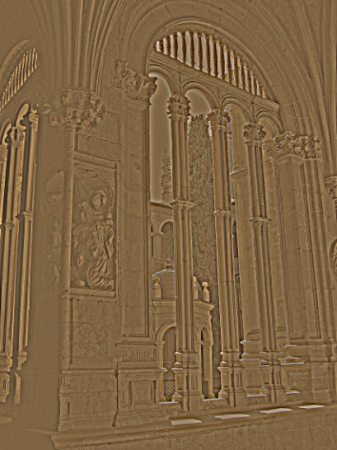
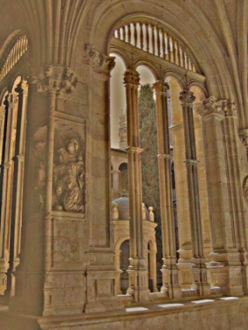



Gauss-Seidel Solvers
This quickly solves for the high frequencies, but the low frequencies converge slowly.
2 Iterations
10 Iterations
100 Iterations
2 Iteration
Residual
10 Iteration
Residual
100 Iteration
Residual
Desired Solution
Notes:
Though this approach converges, it does so slowly.
The problem is that after a small number of iterations, we only have a good solution for the high-frequency part of the image.
[Click]
And as a result, we are still left with the problem of solving for the lower frequencies.

Slide 11

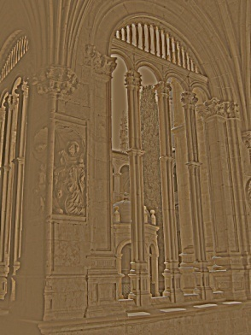


Multigrid Solvers
V-Cycle Algorithm:
The process is recursed for the low-res problem.
Perform a few updates on the high-res image
Compute the residual constraints
Down-sample, solve, and up-sample
Sum the low-res and high-res results
Refine the high-res image
+
Desired
Best-Guess
Best-Guess
Iterated
Iterated
-
Desired
Residual
Solved
Up-Sampled
Notes:
This problem is addressed by the V-cycle of the classic multigrid solver.
Starting with a set of desired constraints and an initial guess
[Click]
We perform a few Gauss-Seidel updates to get the high-frequency part of the solution.
[Click]
We subtract off the constraints satisfied by this solution, to get the low-frequency, residual constraints.
[Click]
Since these are low-frequency, we can solve them by:
Down-sampling to a lower resolution,
Solving the problem more efficiently in the lower-dimensional space,
And up-sampling back.
[Click]
We add in the previously computed high-frequency solution
[Click]
And refine by performing a few more Gauss-Seidel updates.
[Click]
To solve the lower-dimensional problem, we apply the multigrid solver recursively, repeating until the dimension is low enough that a brute-force solver can be used.

Slide 12
Outline
Introduction
Solving for the Image
Choosing the System
Solving for Big Images
Results and Discussion
Notes:
Due to the size of the images we will be processing, it is essential that our solver converge as efficiently as possible.
This implies that we must carefully choose how we define the up-sampling, down-sampling, and Laplacian operators.

Slide 13
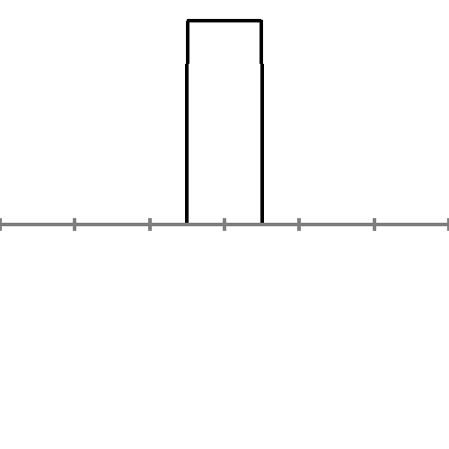
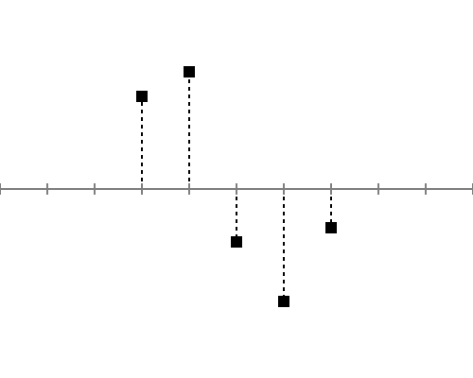
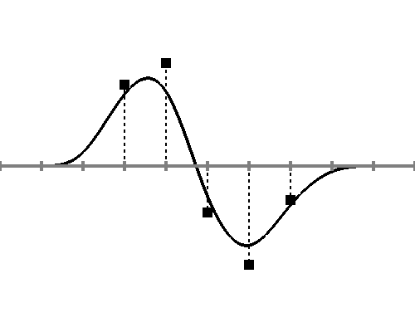
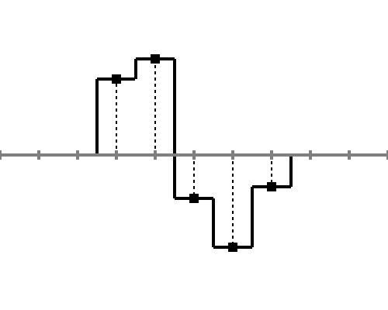
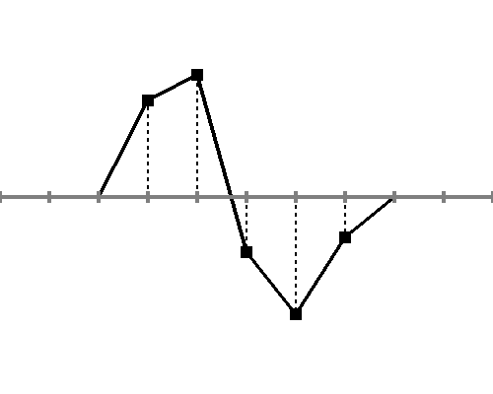
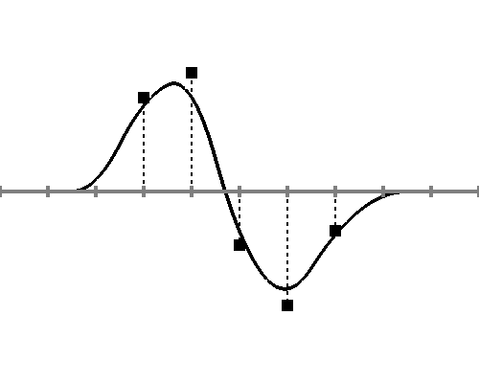
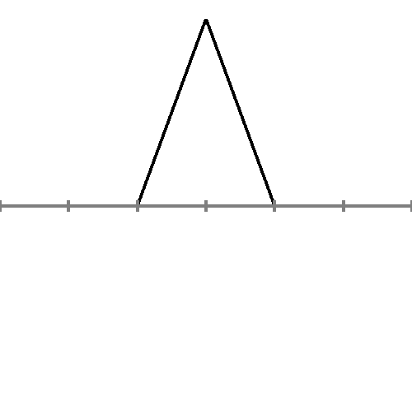
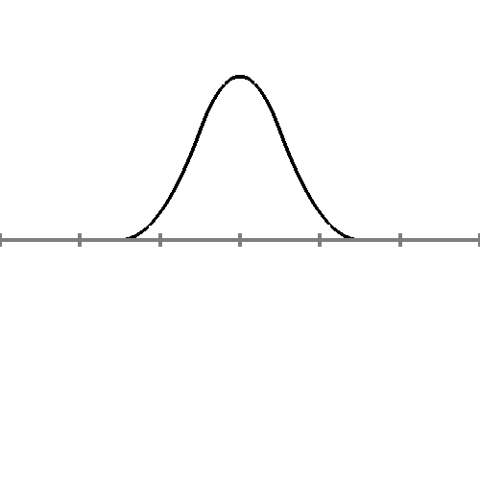
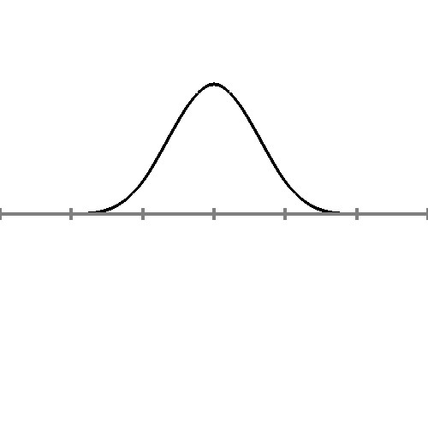
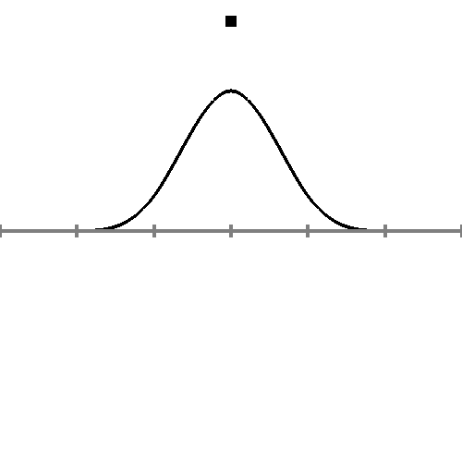
Choosing the System
The choice depends on the interpretation of pixels as elements of a continuous function.
Pixel values
0th-order interpretation
1st-order interpretation
2nd-order interpretation
3rd-order interpretation
Elements
Notes:
To define these operators, we must first choose how to interpret a discrete set of pixels as elements of a continuous function.
We could think of the elements as box functions…
[Click]
in which case a set of pixels defines a piecewise constant function.
We could think of them as tent functions, or first order B-splines…
[Click]
And then the pixels define the piecewise linear interpolant.
As second order B-splines…
[Click]
The pixels define a smoother function approximating the sample values.
Which becomes still smoother with third order B-splines.
[Click]
The choice we make defines both the re-sampling operators and the Laplacian.

Slide 14
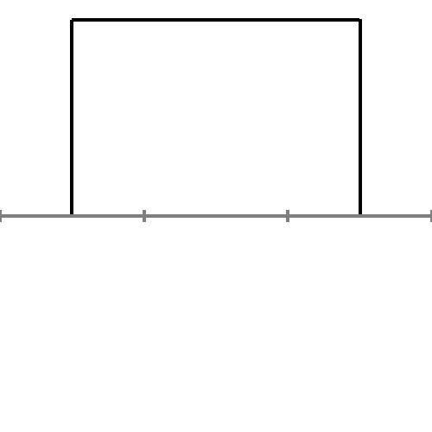
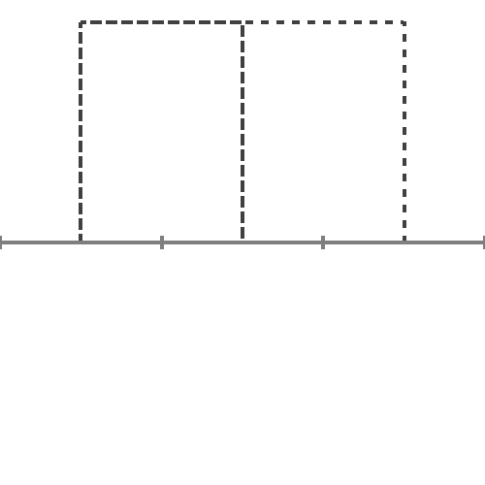
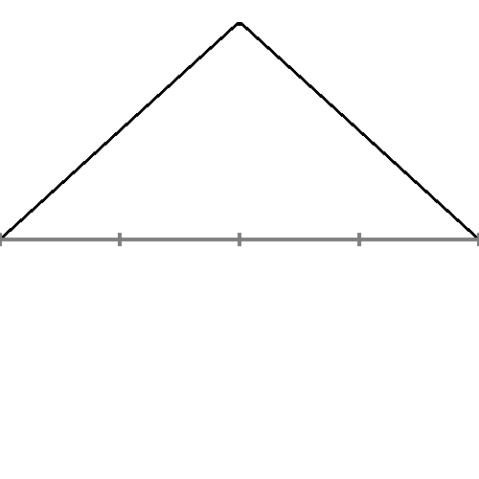
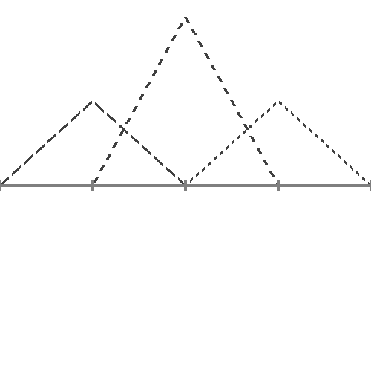
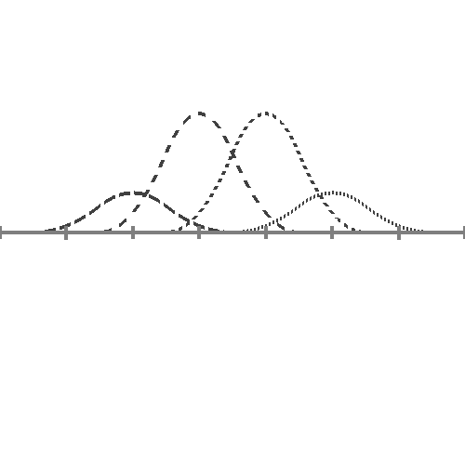
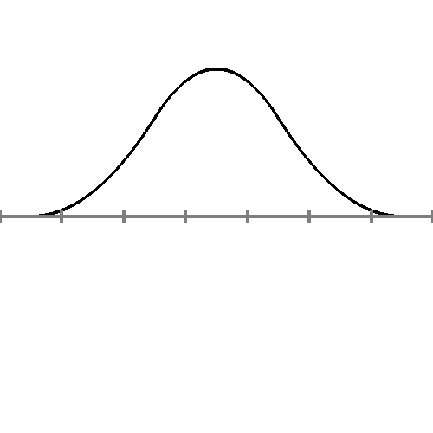
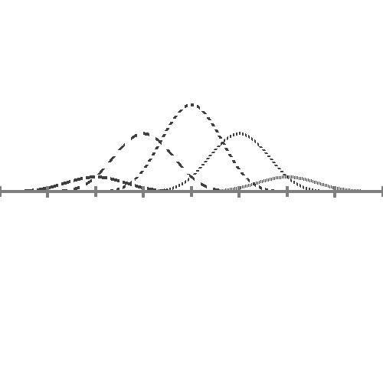
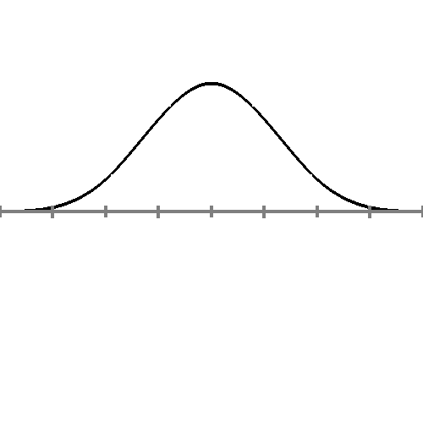
Choosing the System
Implementing Up-/Down-Sampling:
The nesting of the elements determines the transition between the levels of the solver.
0th-order elements
1st-order elements
2nd-order elements
3rd-order elements
1
1
1
1/2
1/2
3/4
3/4
3/4
1/4
1/2
1/2
1/4
1/8
1/8
Notes:
It defines the re-sampling operators because it dictates how we express coarser elements as linear combinations of finer ones.
For example, if we are using 0th order elements…
[Click]
Then we must express a coarser element as the sum of two finer elements.
Using 1st order elements…
[Click]
We must express a coarser element as the linear combination of three finer elements.
[Click]
And similarly for the higher order elements.

Slide 15
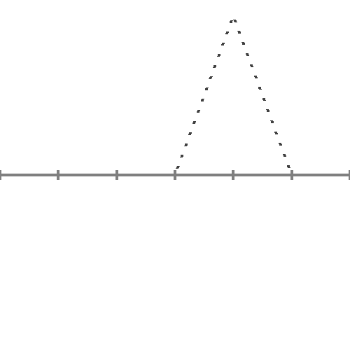
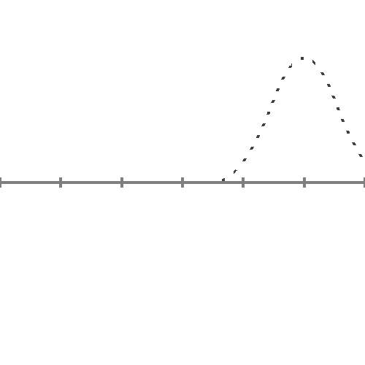
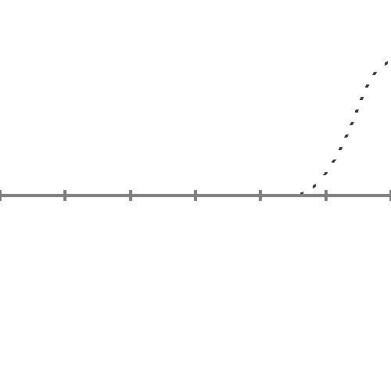
Choosing the System
Defining the Laplacian:
The neighborhood of the Laplacian is defined by the element overlap.
0th-order elements
1st-order elements
2nd-order elements
3rd-order elements
Undefined
1-Ring Average
2-Ring Average
3-Ring Average
Notes:
The choice of element also defines the notion of “neighborhood” used for computing the Laplacian.
For 0th-order elements…
[Click]
The supports of two different pixels never overlap, pixels don’t have “neighbors”, and the Laplacian can’t be defined.
For 1st order elements…
[Click]
The supports will only overlap if the pixels are adjacent to each other, so the Laplacian is defined by averaging over the 1-ring.
[Click]
And for higher order elements, the increased supports results in a Laplacian computed over a larger neighborhood.

Slide 16
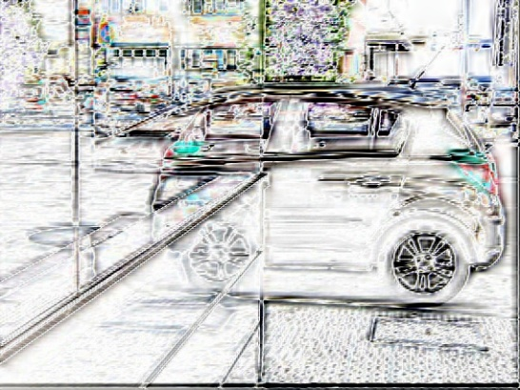
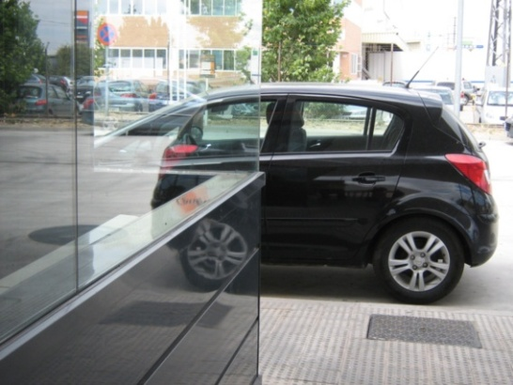
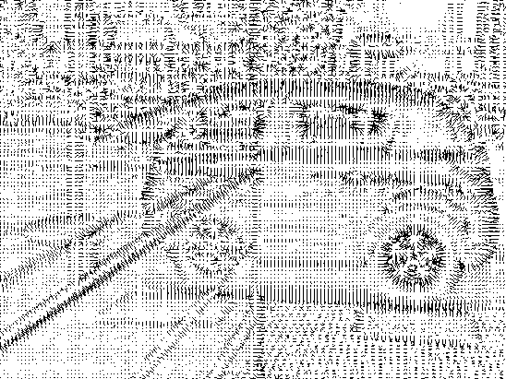
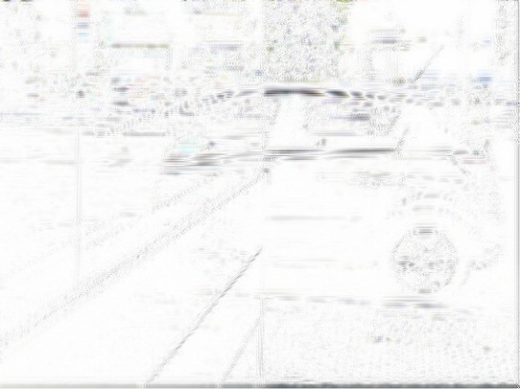
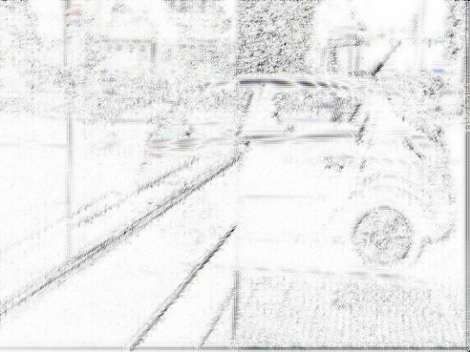
Second-Order Elements
Which order element converges fastest to an accurate solution?
1st-order error
2nd-order error
Original Image
Image Gradients
3rd-order error
Notes:
In implementing the solver, we choose the order of the element that converges fastest to an accurate solution.
This can be empirically evaluated by computing the gradient field of an image,
Using the different solvers to fit an image to the gradient field,
And measuring the difference between the original image and the solution.
The images on the right show these differences for the different order solvers.
Looking at these, it is clear that first order elements provide the worst accuracy and second order elements slightly outperform third order elements.
This trend becomes more evident when we look at the plots of the errors.
[Click]
The best performance is obtained using 2nd order elements,
Which reach an error of 1/256 in just 5 updates.
An error that would take almost twice as many updates to achieve with the less compact 3rd order elements, and would be still harder to achieve with 1st order elements.

Slide 17
Second-Order Elements
Spectral Analysis of Convergence:
The eigenvalues of the multigrid operator determine how efficiently the residual is dampened.
G.S Update
G.S Update
Down- Sample
Up- Sample
G.S Update
Two-Grid Operator
Notes:
The faster convergence can also be validated analytically by considering the simplified multigrid operator transitioning between two levels.
[Click]
We can measure the quality of the operator by considering the efficiency with which it dampens the residual error, a property captured by its dominant eigenvalues.
[Click]
The plots on the right show the eigenvalues for the two-grid operators defined by 1st-, 2nd-, and 3rd-order elements.
These reflect the empirical performance we saw in the previous slide.
[Click]
First order elements have the largest dominant eigenvalue and converge least efficiently.
[Click]
2nd and 3rd order elements have similar dominant eigenvalues, indicating that in the worst case their performances will converge with similar efficiency.
[Click]
However, the 2nd order elements have smaller subsequent eigenvalues, and converge more quickly in practice.
So we choose 2nd order elements for implementing the solver.

Slide 18
Outline
Introduction
Solving for the Image
Choosing the System
Solving for Big Images
Naïve Out-of-Core Multigrid
Temporal Blocking
Interleaved Multilevel Streaming
Results and Discussion
Notes:
Having decided on the solver, the challenge is to design an implementation that can handle large images.
We begin by describing a naïve, out-of-core, implementation that is heavily I/O bound, and then show how this can be improved to obtain a solver requiring just two streaming passes through the data.

Slide 19

Naïve Out-of-Core Multigrid
Components of the solver:
Gauss-Seidel updates
Down-sampling
Up-sampling
The multigrid solver can be streamed by advancing a fixed- size window.
Local data access
On Disk
In Memory
Notes:
Because of the locality of the data access, a streaming solver can be implemented by advancing a fixed size window over the data.
As an example, consider the simple case when computing the value at a pixel only requires access to information in a one-ring neighborhood.
Starting with an empty window…
[Click]
We read in the first two rows from disk.
And we compute the values in the top row…
[Click]
Since its one-ring neighbors are now in memory.
Reading in the next row…
[Click]
We compute the values in the second row because now its one-ring neighbors are in memory.
Since data in the top row won’t be required for subsequent computations we flush it to disk.
[Click]
And we continue in this fashion…
[Click]
Advancing the window and computing the values of the pixels in the middle row.
In doing so, we process all the pixels while keeping only three rows in memory at any time.

Slide 20
Naïve Out-of-Core Multigrid
The large linear system can be solved by streaming each step of the V-cycle.
Constraints
G.S.
Update
k
k
G.S. Update
Solution
Residual
Up-Sample
Down-Sample
G.S. Update
k
k
G.S. Update
Residual
Up-Sample
k Gauss-Seidel Updates ⇓ 2(k+2) Streaming Passes
Down-Sample
Low-Res Solve
Disk Streaming
Notes:
Using this approach, it is easy to implement a V-cycle with a small memory footprint.
Streaming through the constraints…
[Click]
We perform a Gauss-Seidel update of the values as we write the modified solution to disk.
Of course, if we want to perform multiple Gauss-Seidel updates…
[Click]
We can repeatedly read in the solution and constraints, update, and write the new values to disk.
Next…
[Click]
We read in the solution, subtract its Laplacian from the desired constraints, and write out the residual.
[Click]
And then we read in the residual, down-sample it, and write out the lower-dimensional constraints.
Continuing on we can perform the rest of the down-sampling phase…
[Click]
Repeating until we get to the coarsest resolution where the system fits into memory and can be solved in-core.
Similarly…
[Click]
We can perform the up-sampling phase of the V-cycle.
Though this is a low-memory implementation of the solver…
[Click]
It requires too many streaming passes through the data.
We improve on this simple approach in two ways.

Slide 21
Temporal Blocking
A pixel can be updated for the k^{th} time only if all other pixels have been updated k-1 times.
neighbor
Notes:
The first modification is motivated by earlier works on improving the cache-locality of Gauss-Seidel solvers.
The observation made in these works is that we don’t have to complete the updates of all the pixels before we can start on the next sequence of Gauss-Seidel updates.

Slide 22
Temporal Blocking
A pixel can be updated for the k^{th} time only if all other pixels have been updated k-1 times.
neighbor
Window
0
0 → 1
1 → 2
2
0
0 → 1
1 → 2
0
0 → 1
1 → 2
0
0 → 1
0
0 → 1
2nd-order elements
0
0
k=2 Gauss-Seidel Updates
Notes:
As an example, let’s look at performing two Gauss-Seidel updates in a single streaming pass.
[Click]
We start by loading the first three rows of the image into memory.
Since we are using second-order elements, a Gauss-Seidel update requires access to the two-ring neighborhood so we can’t update the two rows at the front of the window.
But we can update the back row.
[Click]
We can’t perform a second update on the back row, because its neighbors haven’t been updated.
So we advance the window.
[Click]
Again, we can’t update either of the front two rows, or the back row.
But we can update the pixels in the third row from the front.
[Click]
We advance the window and update again.
[Click]
And in the naïve approach, we would just keep going: advancing and updating, one row at a time.
But we can do better.
Having updated the third row, the back row’s two-ring neighbors have now all been updated…
[Click]
So we can update it a second time.
And now we proceed as follows:
[Click]
Advancing the window, updating the third row from the front and the row two behind that,
[Click]
Advancing one row and updating two.
So that as we flush the back row out to disk…
[Click]
All the pixels in this row have the desired property – in one streaming pass they have been updated multiple times.

Slide 23
Temporal Blocking
A pixel can be updated for the k^{th} time only if all other pixels have been updated k-1 times.
neighbor
Constraints
G.S.
Update
G.S. Update
Solution
Residual
Up-Sample
Down-Sample
G.S. Update
G.S. Update
Residual
Up-Sample
Down-Sample
Low-Res Solve
Disk Streaming
Notes:
Using this approach, we can replace the naïve streaming implementation, which requires a separate streaming pass for every Gauss-Seidel update…
[Click]
With an implementation that performs all the Gauss-Seidel updates in a single streaming pass.

Slide 24
Interleaved Multilevel Streaming
piped into
Processing at one level is buffered for the next.
Notes:
We can further reduce the number of streaming passes by observing that we don’t have to wait for the Gauss-Seidel updates at one level to complete before we begin processing the data at the next level.

Slide 25
Interleaved Multilevel Streaming
piped into
Processing at one level is buffered for the next.
High-Resolution
Low-Resolution
Residual
¼
¾
0
0
0 → 1
0 → 1
1 → 2
2
¾
0
¼
0 → 1
1 → 2
2
¼
0
¾
0
0 → 1
1 → 2
2
¾
0
¼
0 → 1
1 → 2
2
¼
0
¾
0
0 → 1
1 → 2
¾
0
0 → 1
1 → 2
¼
0
0 → 1
1 → 2
0
0 → 1
1 → 2
0
0 → 1
1 → 2
0
0 → 1
0
0 → 1
0
0
3/4
3/4
1/4
1/4
2nd-order elements
Notes:
As an example let’s look at implementing the down-sampling phase of the V-cycle.
[Click]
We start as before, reading in the first three rows and then repeatedly advancing one row and updating two.
And, after a few advances of the window, the values in the top three rows will have been finalized, since all of the pixels have been updated twice.
Since the Laplacian requires a two-ring neighborhood, and since the two-ring neighborhood of the first row has been finalized, we can compute the first row of residual constraints.
[Click]
Advancing the window again…
[Click]
The two-ring neighborhood of the second row has now been finalized, and we compute the second row of residual constraints.
[Click]
Repeating this process once more…
[Click]
we compute the residual constraints for the third row.
But, since we’re using 2nd order elements we can down-sample…
[Click]
to get the first row of the lower-resolution constraints.
[Click]
After two more advances, we can down-sample to get the second row of the lower-resolution constraints.
[Click]
And after another two advances, we have the first three rows of the lower resolution constraints in memory.
Which means that we can start processing at the coarser resolution…
[Click]
Providing an implementation in which we process the different levels simultaneously.

Slide 26
Interleaved Multilevel Streaming
piped into
Processing at one level is buffered for the next.
Streaming Pass 1
Streaming Pass 2
Constraints
G.S.
Update
G.S. Update
Solution
Residual
Up-Sample
Down-Sample
Globality of the Poisson equation
⇓
Two streaming passes is optimal
G.S. Update
G.S. Update
Residual
Up-Sample
Down-Sample
Low-Res Solve
Memory Streaming
Disk Streaming
Disk Streaming
Notes:
Streaming in this fashion allows us to replace the previous approach, in which we buffered the results of one phase of the solver on disk before proceeding on to the next,
[Click]
With a more efficient implementation in which the output at one level is piped directly into the next.
As a result
[Click]
We can implement the entire V-cycle of the multigrid solver in just two streaming passes, one for the down-sampling phase, and one for the up-sampling.
And it turns out that this is optimal.
[Click]
Since the Laplacian constraints at one pixel can effect colors values at a pixel arbitrarily far away, a pixel’s value can’t be finalized until all of the constraints have been read in from disk.
Since the image is too large to fit in memory, this implies that data has to be buffered during the processing, so at least two streaming passes are required to solve for the image.

Slide 27
Streaming through the Gradient-Domain
For gradient-domain operators that are local, processing only takes two streaming passes.
+1 streaming pass for each additional V-cycle.
u₀
g₀
∇
Op
Pass 1
Pass 2
Pass 3
u₁
g₁
∇
g
f
u
u
∇⋅
Update
Update
Update
…
…
…
Update
u_{n}
g_{n}
∇
Update
Update
Update
Update
Memory Streaming
Disk Streaming
Solve
Solve
Notes:
Putting everything together, we obtain a system capable of performing the full image processing pipeline in two streaming passes.
[Click]
In the first pass, we:
Read in the images from disk,
Compute the gradients,
Composite and edit the gradients to obtain the constraint field,
Compute the divergence to get the Laplacian constraints,
And perform the down-sampling phase of the multigrid solver.
[Click]
In the second pass, we:
Perform the up-sampling phase of the solver,
And write the solution out to disk.
Interestingly, if we want to further improve the accuracy of the solution by performing additional V-cycles…
[Click]
We can do this at the cost of only one extra streaming pass per V-cycle.

Slide 28
Outline
Introduction
Solving for the Image
Choosing the System
Solving for Big Images
Results and Discussion
Notes:
Now that we have an efficient streaming multigrid solver in place, let’s take a look at some results.

Slide 29
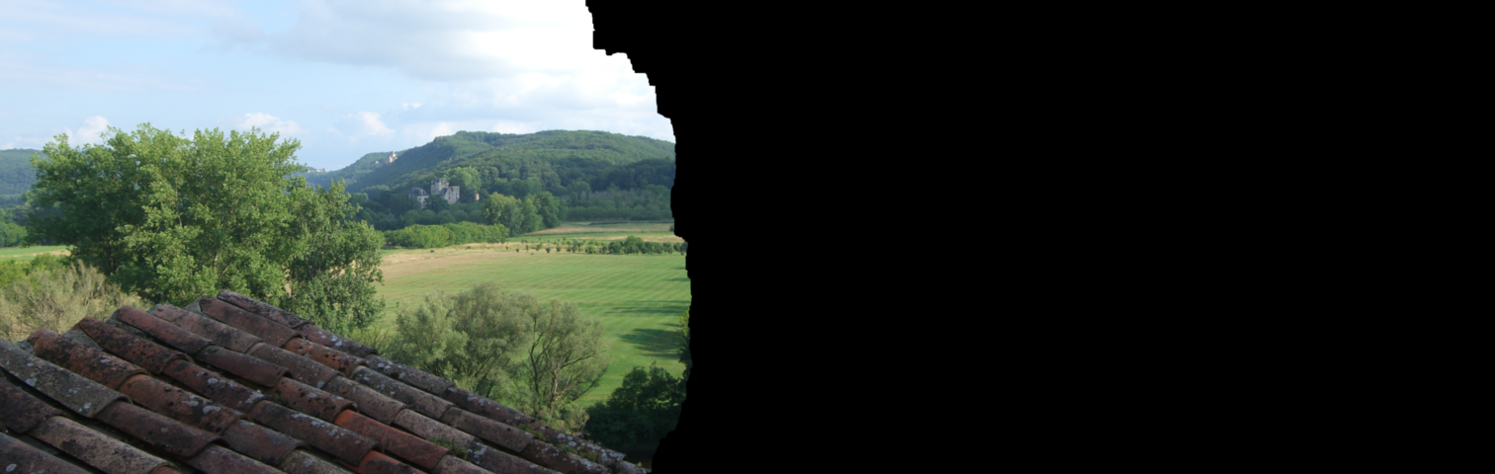
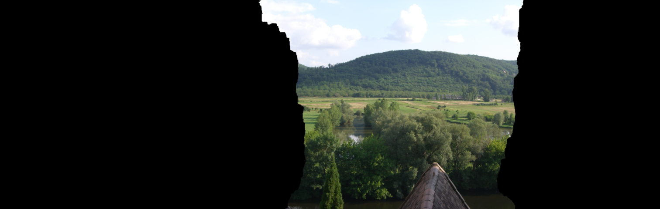
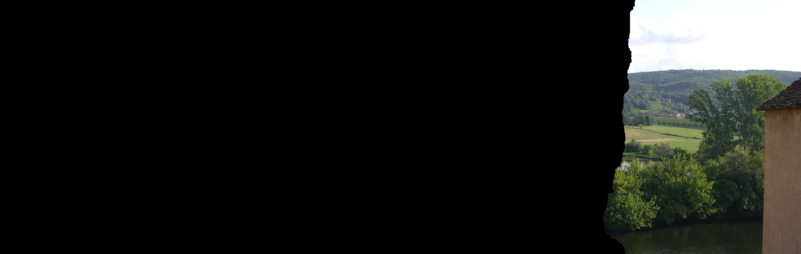


Stitching Big Images
Agarwala ’07:
A high-res solution is only required near the seams, so solve over an adapted quadtree.
Courtesy of Agarwala
Notes:
We’ll start with image stitching.
To date, the only technique that can stitch together large images by explicitly solving the Poisson equation is the one presented here last year by Aseem Agarwala.
[Click]
This approach was motivated by the observation that when stitching together images, the residual is low-frequency away from the seams. As a result, a high-frequency solution is only needed near the stitching boundaries, and the system can be solved over a quadtree.

Slide 30



Stitching Results
Beynac: 6,046×1,920
Rainier: 10,960×2,096
Edinburgh: 16,950×2,956
Redrock: 19,588×4,457
Dataset | Pixels | Images | Error [0,256) |  | Memory (MB) |  | Time (seconds)
 |  |  | Quadtree | Streaming | Quadtree | Streaming | Quadtree | Streaming
Beynac | 12x10⁶ | 3 | 0.01 | 0.01 | 16 | 190 | 8 | 17
Rainier | 23x10⁶ | 5 | 0.02 | 0.01 | 17 | 110 | 14 | 33
Edinburgh | 50x10⁶ | 25 |  | 0.01 | 123 | 203 | 122 | 79
Redrock | 87x10⁶ | 9 |  | 0.01 | 112 | 133 | 118 | 118
Courtesy of Agarwala and Curless
Notes:
We compared our results to those obtained using Agarwala’s adaptive quadtree approach, on a number of images, ranging in resolution from 12 to 87 megapixels.
[Click]
The results can be seen in the table below.
[Click]
Both methods accurately solve the linear system.
[Click]
They also both have a memory usage that is sub-linear in the number of pixels.
For the quadtree approach this is due to the fact that the system is much smaller than the total number of pixels.
For our approach this is due to the fact that we never have more than a few rows in memory at any one time.
[Click]
Even though our representation is everywhere high-resolution, and the system we solve is much larger than the one solved by the quadtree approach, we obtain an efficient implementation whose running time remains comparable, particularly for larger panoramas made up of many images.

Slide 31






Tone-Mapping Results
Bring out subtle details by amplifying small gradients and dampening large ones.
Notes:
As another application, we consider the problem of tone-mapping in which we modulate the gradient field of an image by amplifying smaller gradients and dampening larger ones…
[Click]
heightening perceptible detail in low-contrast regions.
Since tone-mapping modulates the gradients everywhere, the system can’t be localized and the quadtree approach can’t be applied.
To perform the tone-mapping we have to solve over a grid that is everywhere high-resolution, something that could not previously be done for large images.

Slide 32



Large Image Results
St James:
Stitched from 643 photographs
Contains 3.3 billion (88,309 x 37,842) pixels
Stitched
Memory: 408 MB
Time: 1:27:50
Max Error [0,256): 0.15
Tone-Mapped
Memory: 224 MB
Time: 45:10
Max Error [0,256): 0.5
Courtesy of Uyttendaele
Notes:
Now let’s take a look at something a little bit bigger.
This 3.3 gigapixel image was obtained by compositing 643 images of the Seattle skyline, taken at different exposures.
Zeroing out the seam-crossing gradients and using our method to solve for the image we obtain the following:
[Click]
A seamless reconstruction, obtained in less than 90 minutes and requiring less than half a gigabyte of RAM, with maximum error markedly below the color resolution of an 8-bit channel.
Using the gradients of this new image, we can also perform tone-mapping.
[Click]
Since the tone-mapping is performed solely on the luminance channel, both the running time and the memory usage have gone down.

Slide 33
Large Image Results
St James:
Peak Memory: 408 MB
Solver Time: 1:27:50
Total disk I/O:
Down-Sampling
Read in the gradient constraints: 40 GB
Write out solution and Laplacian: 53 GB
Up-Sampling
Read in solution and Laplacian: 53 GB
Write out the image: 20 GB
53GB in-core
1:19:02 I/O Time
Courtesy of Uyttendaele
Notes:
To get a better sense of the performance of our method, let’s revisit both the memory usage and the running time for the stitching application.
[Click]
Because we store pixels at two-bytes per channel, the down-sampling phase requires reading in 40 gigabytes worth of gradient constraints, and writing out 53 gigabytes of data.
Similarly, the up-sampling phase requires reading in the 53 gigabytes of data and writing out the 20 gigabyte image.
This means that had we tried solving the entire image in-core….
[Click]
We would have needed at least 53 gigabytes of RAM.
More interestingly, since the laptop on which this was run could perform between 30 and 35 megabytes of I/O a second, and since a total of 166 gigabytes of I/O needs to be performed, our solver could not complete in less than 80 minutes…
[Click]
So the 88 minutes of running time we end up taking is in fact pretty much optimal.

Slide 34
Summary
Streaming multigrid for big image processing:
2nd order elements
Temporal blocking
Interleaved streaming
Issues addressed in the paper:
Integration with finite-differences
Setting the average color
Non power-of-two images
Accurate solution in
two streaming passes
Notes:
In summary, we have presented a streaming multigrid solver, capable of performing gradient-domain image processing on gigapixel images.
Carefully choosing the elements defining the system and scheduling the operations to minimize the I/O, we are able to implement the entire solver in two streaming passes.
An implementation that is optimal, given the global nature of the Laplacian constraints.
Though not explicitly discussed in this talk, our work also addresses a number of practical issues.
[Click]
We show that the finite-difference representation traditionally used for gradient-domain processing, can be integrated with our finite-elements system.
We show that the mean color value, which is unconstrained by the system, can be set without requiring a separate pass through the data.
And we show that the system can be solved over images of arbitrary dimensions without requiring padding up to the next power-of-two.

Slide 35
Issues for Future Work
Non-trivial boundaries and constraints?
e.g. cut-and-paste, matting
Adaptive weighting?
e.g. local tone adjustment
Extensions to higher dimensions?
for incompressible fluid simulation
Less I/O in the streaming passes?
on-the-fly compression
Really big images?
parallelized and distributed solvers
Notes:
There are also a number of issues that we do not address – questions that we would like to consider in future work.
We would like to extend our system to support arbitrary stitching boundaries and adaptive weighting – allowing for the implementation of methods such as image cut-and-paste, image matting, and local tone adjustment.
We would like to extend our method to higher dimensions, providing a way for solving some of the linear systems arising in physical simulations.
And finally, we would like to consider ways of improving the performance of our solver; including minimizing the I/O by performing on-the-fly compression and decompression of data, and extending our method to parallelized and distributed settings.

Slide 36
Acknowledgments
Datasets:
Aseem Agarwala
Brian Curless
Matt Uyttendaele
Discussions and Ideas:
Ketan Dalal Rick Szeliski
Bill Bolosky Ann Wolverton
CAVGRAPH Reviewers SIGGRAPH Reviewers
Notes:
Finally, I would like to conclude by acknowledging the generosity of the community, in sharing their data, their thoughts, and their experiences.
Thank you to them…

Slide 37




Thank You!
Code & Images @ http://www.cs.jhu.edu/~misha/Code/SMG
Notes:
And thank you to you for your attention.

Slide 39
General Temporal Blocking
To perform k updates:
Updating the 3rd row from front, The row two behind that, The row two behind that,
k×
Window
…
2 → 3
0
0 → 1
1 → 2
3
2 → 3
0
0 → 1
1 → 2
2 → 3
0
0 → 1
1 → 2
1 → 2
0
0 → 1
1 → 2
0
0 → 1
0 → 1
0
0 → 1
0
0
0
k=3 Gauss-Seidel Updates

Slide 40
General Temporal Blocking
with d-th order elements
^
To perform k updates:
Updating the 3rd row from front, The row two behind that, The row two behind that,
…
(d+1)-st
d
k×
d
3
2 → 3
2 → 3
1 → 2
1 → 2
Window
0 → 1
0 → 1
0
0
k=3 Gauss-Seidel Updates

Slide 41
Finite Differences to Finite Elements
1st-order Element
Finite Differences
Differentiation
Coefficients of Derivative Elements
The derivative of a d-th order element is the difference of elements of order d-1.
0th-order Elements

Slide 42
Second-Order Elements
Which order element converges fastest to an accurate solution?
1st-order error
2nd-order error
Original Image
Image Gradients
1/256
1/256
3rd-order error

