Slide 1
System Aspects of Probabilistic DBs Part II: Advanced Topics
Magdalena Balazinska,
Christopher Re and Dan Suciu
University of Washington

Slide 2
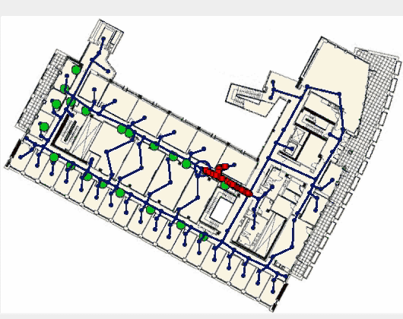
Recap of motivation
Data are uncertain in many applications
Business: Dedup, Info. Extraction
Data from physical-world: RFID
Probabilistic DBs (pDBs) manage uncertainty
Integrate, Query, and Build Applications
Value: Higher recall, without loss of precision
DB Niche: Community that knows scale

Slide 3
Highlights of Part II
Yesterday: Independence
Today: Correlations and continuous values.
Technical Highlights
Lineage and view processing
Events on Markovian Streams
Sophisticated factor evaluation
Continuous pDBs
GBs with materialized views
GBs of correlated data
Highly correlated data
Correlated, Continuous values

Slide 4
Overview of Part II
4 Challenges for advanced pDBs
4 Representation and QP techniques
Lineage and Views
Events on Markovian Streams
Sophisticated Factor Evaluation
Continuous pDbs
Discussion and Open Problems

Slide 5
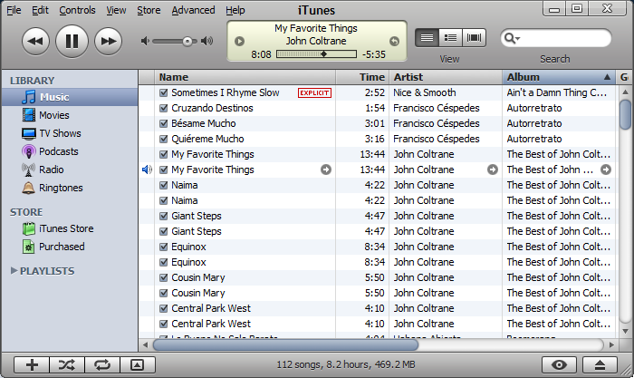
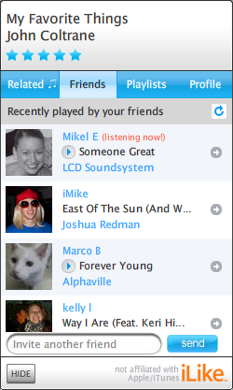
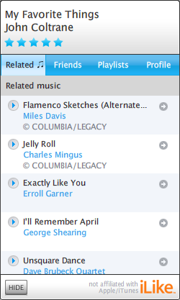
Application 1: iLike.com
R&S ‘07
Social networking site
Song similarity via user preferences
Recommend songs
Expensive to recompute on each query
materialized – but imprecise – view
Lots of users (8M+), Lots of playlists (Bs)
Challenge (1): Efficient querying on GBs of uncertain data

Slide 6
Application 2: Location Tracking
[R, Letchner, B,S ’08]
Antennas
6th Floor in CS building
Blue ring is ground truth
Each orange particle is a guess of Joe’s location
Guess are correlated; watch as goes through lab.

Slide 7
Application 2: Location Tracking
[R, Letchner, B,S ’08]
Antennas
6th Floor in CS building
Blue ring is ground truth
Each orange particle is a guess of Joe’s location
Guess are correlated; watch as goes through lab.
Challenge (2): track correlations across time
Joe’s location at time t=9 depends on his location at t=8

Slide 8
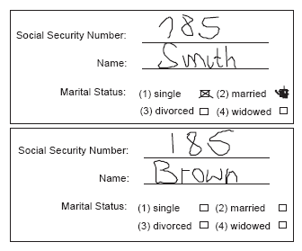
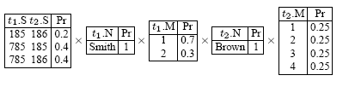
Application 3: the Census
[Anotva,Koch&Olteanu ’07]
185 or 785?
Each parse has own probability
SSN is a key
Product of all uncertainty
Choices are correlated
185 or 186?
Challenge (3): Represent highly correlated relational data

Slide 9
Application 4: Demand Curves
[Jampani et al ’08]
Consider TPC Database (Orders)
“What would our profits have been if we had raised all our prices by 5%?”
Problem: We didn’t raise our prices! Need to predict
Widget (per Order)
Price: 100 & Sold: 60
Price
linear demand curve
Challenge (4): Handle uncertain continuous values
D₀
Demand
Many such curves; a continuous distribution of them.
D₀ is demand after raise price

Slide 10

pDBs Challenges Summary
Challenges
Efficient Querying
Track complex correlations
Continuous Values
Efficiency: Storage and QP
Faithful: Model important correlations
This is the main tension!
Materialize all worlds is faithful, but not efficient
Single possible world efficient, but not faithful

Slide 11
Overview of Part II
4 Challenges for advanced pDBs
4 Representation and QP techniques
Lineage and Views
Events on Markovian Streams
Sophisticated Factor Evaluation
Continuous pDbs
Discussion and Open Problems

Slide 12
Taxonomy of Representations
Outline for the technical portion
1. Discrete Block Based
BID,x-tables,Lineage
2. Simple Factored
Markovian Streams
3. Sophisticated Factored
Sen et al, MayBMS
4. Continuous Function
Orion,MauveDB,MCDB
Correlations via views
Correlations through time
Complex Correlations
Continuous Values and correlations

Slide 13
Taxonomy of Representations
1. Discrete Block Based
BID,x-tables,Lineage
2. Simple Factored
Markovian Streams
3. Sophisticated Factored
Sen et al, MayBMS
4. Continuous Function
Orion,MauveDB,MCDB
Correlations via views

Slide 14
Discrete Block-based Overview
Brief review of representation & QP
Views in Block-based databases
3 Strategies for View Processing
Eager Materialization (Compile time)
Lazy Materialization (Runtime)
Approximate Materialization (Compile time)
Views introduce correlations
Allow GBs sized pDBs

Slide 15
Block-based pDB
[Barbara et al’92][Das Sarma et al 06], [Green&Tannen06],[R,Dalvi,S06]
Keys
Non-keys
Probability
Object | Time | Person | P
Laptop77 | 9:07 | John | 0.62
 |  | Jim | 0.34
Book302 | 9:18 | Mary | 0.45
 |  | John | 0.33
 |  | Fred | 0.11
Object | Time | Person
Laptop77 | 9:07 | John
Book302 | 9:18 | Mary
0.62 * 0.45 = 0.279
Semantics distribution over possible worlds
HasObject^{p}

Slide 16
Intensional Query Evaluation
[Fuhr&Roellke’97, Graedel et al. ’98, Dalvi & S ’04, Das Sarma et al 06]
Goal: Make relational ops compute expression f
v | f
v | f₁ ˅ f₂ ˅ …
v₁ | v₂ | f₁˄f₂
Each tuple ≈ variable
Projection eliminates duplicates
Π
σ
JOIN
v | f₁
v | f₂
Pr[q] = Pr[f is SAT].
v₁ | f₁
v₂ | f₂
v | f
QP builds Boolean Formulae f
Internal Lineage

Slide 17
Views in Block-based pDBs by example
[R&S 07]
Chef | Restaurant | P
Tom | D. Lounge | 0.9
Tom | P .Kitchen | 0.7
Chef | Dish | Rate | P
Tom | Crab | High | 0.8
Tom | Lamb | High | 0.3
p₁
q₁
p₂
q₂
W(Chef,Restaurant) WorksAt
R(Chef,Dish,Rate) Rated
Restaurant | Dish
D. Lounge | Crab
P. Kitchen | Crab
P. Kitchen | Lamb
“Chef and restaurant pairs where chef serves a highly rated dish”
V(c,r) :- W(c,r),S(r,d),R(c,d,’High’)
{c →`Tom’, r → `D. Lounge’, d →`Crab’}
S(Restaurant,Dish) Serves
Chef | Restaurant | P
Tom | D. Lounge | 0.72 | p₁˄q₁
Tom | P. Kitchen | 0.602 | p₂˄ (q₁˅q₂)
0.72 = 0.9 * 0.8

Slide 18
Views in BID pDBs
[R&S 07]
Chef | Restaurant | P
Tom | D. Lounge | 0.9
Tom | P .Kitchen | 0.7
Chef | Dish | Rate | P
Tom | Crab | High | 0.8
Tom | Lamb | High | 0.3
p₁
q₁
p₂
q₂
W(Chef,Restaurant) WorksAt
R(Chef,Dish,Rate) Rated
Restaurant | Dish
D. Lounge | Crab
P. Kitchen | Crab
P. Kitchen | Lamb
“Chef and restaurant pairs where chef serves a highly rated dish”
V(c,r) :- W(c,r),S(r,d),R(c,d,’High’)
S(Restaurant,Dish) Serves
Chef | Restaurant | P
Tom | D. Lounge | 0.72 | p₁˄q₁
Tom | P. Kitchen | 0.602 | p₂˄ (q₁˅q₂)
View has correlations
Thm [ R,Dalvi,S ’07] BID are complete with the addition of views

Slide 19
Discrete Block-based Overview
Brief review of representation & QP
Views in Block-based databases
Views introduce correlations.
3 Strategies for View Processing
Eager Materialization (Compile time)
Lazy Materialization
Approximate Materialization
Allow scaling to GBs of relational data

Slide 20
Eager Materialization of BID Views
[R&S 07]
Example coming…
Idea: Throw away the lineage, process views
Chef | Restaurant | P
Tom | D. Lounge | 0.72 | P₁˄q₁
Tom | P. Kitchen | 0.602 | p₂˄ (q₁˅q₂)
Chef | Restaurant | P
Tom | D. Lounge | 0.72
Tom | P. Kitchen | 0.602
Why?
Lineage can be much larger than view
Can do expensive prob. computations off-line
Use view directly in safe-plan optimizer
Interleave Monte-Carlo Sampling with safe-plan
pDB analog of Materialized Views
Allows GB scale pDB processing
Catch: need that tuples are independent for any instance.
independence test

Slide 21
Eager Materialization of pDB Views
[R&S 07]
Chef | Restaurant | P
Tom | D. Lounge | 0.9
Tom | P .Kitchen | 0.7
Chef | Dish | Rate | P
Tom | Crab | High | 0.8
Tom | Lamb | High | 0.3
p₁
q₁
p₂
q₂
W(Chef,Restaurant) WorksAt
R(Chef,Dish,Rate) Rated
“Chef and restaurant pairs where chef serves a highly rated dish”
Restaurant | Dish
D. Lounge | Crab
P. Kitchen | Crab
P. Kitchen | Lamb
V(c,r) :- W(c,r),S(r,d),R(c,d,’High’)
S(Restaurant,Dish) Serves
Chef | Restaurant | P
Tom | D. Lounge | 0.72 | p₁˄q₁
Tom | P. Kitchen | 0.602 | p₂˄ (q₁˅q₂)
Can we understand w.o. lineage?
Not every probabilistic view is good for materialization!

Slide 22
Eager Materialization of pDB Views
[R&S 07]
Chef | Restaurant | P
Tom | D. Lounge | 0.9
Tom | P .Kitchen | 0.7
Chef | Dish | Rate | P
Tom | Crab | High | 0.8
Tom | Lamb | High | 0.3
p₁
q₁
p₂
q₂
W(Chef,Restaurant) WorksAt
R(Chef,Dish,Rate) Rated
Restaurant | Dish
D. Lounge | Crab
P. Kitchen | Crab
P. Kitchen | Lamb
“chefs that serve a highly rated dish”
V₂(c) :- W(c,r),S(r,d),R(c,d,’High’)
Obs: if no prob. tuple shared by two chefs, then they are independent
S(Restaurant,Dish) Serves
Can we understand w.o. lineage?
Where could such a tuple live?
V₂ is a good choice for materialization

Slide 23
Is a view good or bad?
[R&S 07]
Allows GB+ Scale QP
Thm: Deciding if a view is representable as a BID is decidable & NP-Hard (Complete for Π₂)
Good News: Simple but cautious test
Thm: If view has no self-joins, test is complete.
V₁(c,r) :- W(c,r),S(r,d),R(c,d,’High’)
Test: “Can a prob tuple unify with different heads?”
Good!
V₂(c) :- W(c,r),S(r,d),R(c,d,’High’)
In wild, practical test almost always works
NB: Also, can take into account query q, i.e. can we use V₁ without the lineage to answer q?

Slide 24
Discrete Block-based Overview
Brief review of representation & QP
Views in Block-based databases
Views introduce correlations.
3 Strategies for View Processing
Eager Materialization
Lazy Materialization (Runtime test)
Approximate Materialization

Slide 25
Lazy Materialization of Block Views
[Das Sarma et al 08]
In Trio, queries ≈ views
Compute probs lazily
Separate confidence computation from QP
Memoization
Reuse/memoization + Independence Check
(z ˄ (x₁ ˅ x₂)) ˅ (y ˄ (x₁ ˅ x₂))
Cond: z and y independent of x1, x2
Compute only once
Check on lineage (instance data)
NB: Technique extends to complex queries

Slide 26
Approximate Lineage for Block Views
[R&S 08 – Here!]
Observation: Most of the lineage does not matter for QP
Idea: Keep only important correlations (tuples)
Exists an approximate formula α, that
implies the original formula λ (conservative QP)
has size is constant in the data. (orders smallers)
agrees with original func. λ on arbitrarily many inputs
NB: α is in the same language as λ so can use in pDBs

Slide 27
Block-based summary
Block-based models correlations via views
Some correlations expensive to express
3 Strategies for materialization:
Eager: compile-time, exact
Lazy: runtime, exact
Approximate: runtime, approximate
Allow GBs sized pDBs

Slide 28
Taxonomy of Representations
1. Discrete Block Based
BID,x-tables,Lineage
2. Simple Factored
Markovian Streams
3. Sophisticated Factored
Sen et al, MayBMS
4. Continuous Function
Orion,MauveDB,MCDB
Correlations through time

Slide 29
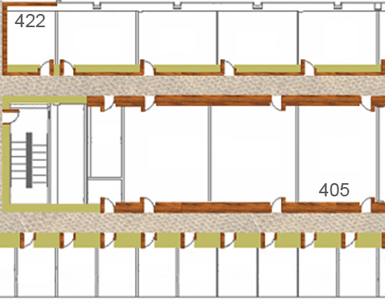




Example 1: Querying RFID
[R,Letchner,B&S’07] [http://rfid.cs.washington.edu]
Joe has a tag on him
E
D
C
B
Sensors in hallways
A
Query: “Alert when Joe enters 422”
Joe entered office 422 at t=8
i.e. Joe outside 422, inside 422
Uncertainty: Missed readings.
Markovian correlations
If we know t=8 then learning t=7 gives no (little) new info about t=9
Correlations: Joe’s location @ t=9 correlated with location @ t=8

Slide 30
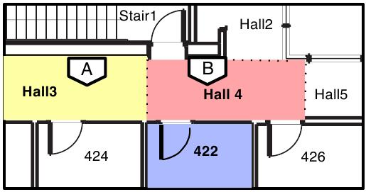
Capturing Markovian Correlations
[R, Letchner, B,S ’08]
Tag | t | Loc | P
Joe | 7 | 422 | 0.6
 |  | Hall4 | 0.4
Joe | 8 | 422 | 0.9
 |  | Hall5 | 0.1
Sue | 7 | … | …
add to 1
Time = 8
Time = 8
Time = 7
 | 422 | Hall4
422 | 1.0 | 0.75
Hall5 | 0.0 | 0.25
Loc
0.6
0.4
Loc
0.9
0.1
NEW: matrix per consecutive timesteps
=
Markov Assumption
Conditional Probability table (CPT)

Slide 31
Computing when Joe Enters a Room
[R, Letchner, B,S ’08]
Alert me when Joe enters 422
Tag | t | Loc | P
Joe | 7 | 422 | 0.6
 |  | Hall4 | 0.4
Joe | 8 | 422 | 0.9
 |  | Hall5 | 0.1
Sue | 7 | … | …
Last seen
 | other | 422 | Hall4
{} | 0.1 | 0.6
{1}
{2} |  | 0.3
{1,2}
 | other | 422 | Hall4
{} |  | 0.6
{1} |  |  | 0.4
{2}
{1,2}
 | other | 422 | Hall4
{} | 1.0
{1}
{2}
{1,2}
states
Time = 8
Time = 7
Last Time
 | 422 | Hall4
422 | 1.0 | 0.75
Hall5 | 0.0 | 0.25
Final
0.4 * 0.75 = 0.3
Joe in Hall4
Joe in 422
Accept t=8 with p = 0.3
1
2
Correlations map to simple matrix algebra with tricks

Slide 32
Markovian Streams (Lahar)
[R, Letchner, B,S ’08]
“regular expression” queries efficiently
Streaming: “Did anyone enter room 422?”
independence test, on an event language
“Safe queries” involve complex temporal joins
Time ≈ size(archive), i.e. not streaming, but PTIME
Event queries based on Cayuga
#P-Hard boundary found as well
Streaming in real-time

Slide 33
Taxonomy of Representations
1. Discrete Block Based
BID,x-tables,Lineage
2. Simple Factored
Markovian Streams
3. Sophisticated Factored
Sen et al, MayBMS
4. Continuous Function
Orion,MauveDB,MCDB
Complex Correlations

Slide 34
Sophisticated Factor Overview
Factored basics (representation & QP)
Processing SFW queries on Factor DBs
Building a factor for inference (intensional eval)
Sophisticated inference (memoization)
The MayBMS System
U of. Maryland

Slide 35
Sophisticated Factored
[Sen,Desphande, Getoor 07] [SDG08]
AD ID | Model | Price
201 | Civic (EX) | 6000 | 1.0
203 | Civic | 1000 | 0.6
 | Corolla |  | 0.4
Model | Pollutes
Civic (EX) | High | 1.0
Civic (Hybrid) | Low | 1.0
Civic | Low | 0.7
 | High | 0.3
Corolla | High | 1.0
Pollutes | Tax
Low | 1000
High | 2000
Extracted
Ambiguous
“If I buy car 203, how much tax will I pay?”
Challenge: Dependency (correlations) in the data between extracted car model and tax amount.

Slide 36
Factor graphs Semantics
Generalization of Bayes Nets
Relevant data from previous slide
Factors
M
MP
T
Model | Price
Civic | 1000 | 0.6
Corolla |  | 0.4
Model | Pollutes
Civic | Low | 0.7
 | High | 0.3
Corolla | High | 1.0
Pollutes | Tax
Low | 1000
High | 2000
Model (M)
(MP)
Tax (T)
Equivalent:
Graphical model
Joint Probability Factors
“If I buy this car how much tax will I pay?”
Joint(m,p,t) =M(m)MP(m,p)T(p,t)
Answer: ∑_{m,p}M(m)MP(m,p)T(p,t)

Slide 37
Factor graphs: Inference
Variable Elimination
M
MP
T
Model | Price
Civic | 1000 | 0.6
Corolla |  | 0.4
Model | Pollutes
Civic | Low | 0.7
 | High | 0.3
Corolla | High | 1.0
Pollutes | Tax
Low | 1000
High | 2000
Model (M)
(MP)
Tax (T)
Joint(m,p,t) =M(m)MP(m,p)T(p,t)
Pollutes
Low | 0.42
High | 0.58
Pollutes
Low | 0.42
High | ?
Pollutes
Low | ?
High | ?
Tax | P
1000 | 0.42
2000 | 0.58
Pollutes | Tax
Low | 1000
High | 2000
0.6 * 0.7 = 0.42
∑_{m} M(m)MP(m,p)T(p,t)
∑_{p}P(p)T(p,t) = Ans(t)
P
T
=P(p)T(p,t)

Slide 38
Factors can encode functions
Factors can encode logical fns
f₁˄f₂
f₁ ˅ f₂
f₁ | f₂ | Out
0 | 0 | 0
0 | 1 | 0
1 | 0 | 0
1 | 1 | 1
f₁ | f₂ | Out
0 | 0 | 0
0 | 1 | 1
1 | 0 | 1
1 | 1 | 1
˄
˅
f₁
f₂
f₁
f₂
Think of factors as functions.
More general aggregations & correlations

Slide 39
Sophisticated Factor Overview
Factored basics (representation & QP)
Processing SFW queries on Factor DBs
Building a factor for inference (intensional eval)
Sophisticated inference (memoization)
The MayBMS System
U of. Maryland

Slide 40
Processing SQL using Factors
[Fuhr&Roellke’97,Sen&Deshpande ‘07]
As factors
Goal: Make relational ops compute factor graph f
v | f
v | f₁ ˅ f₂ ˅ …
v₁ | v₂ | f₁˄f₂
Intensional Evaluation
Difference: v₁ and v₂ may be correlated via another tuple
Π
σ
JOIN
v | f₁
v | f₂
Fetch factors for correlated tuples
v₁ | f₁
v₂ | f₂
v | f
Output is a factor graph

Slide 41
Smarter QP: Factors are often shared
[Sen,Desphande & Getoor ’08 -- HERE]
AD ID | Model | Price
201 | Civic (EX) | 6000 | 1.0
203 | Civic | 1000 | 0.6
 | Corolla |  | 0.4
Model | Pollutes
Civic (EX) | High | 1.0
Civic (Hybrid) | Low | 1.0
Civic | Low | 0.7
 | High | 0.3
Corolla | High | 1.0
Pollutes | Tax
Low | 1000
High | 2000
All civic (EX) share common pollutes attribute.
Naïve Variable Elimination may perform this computation several times…

Slide 42
Smarter QP in factors
[Sen,Desphande & Getoor ‘08]
((x₁ ˅ x₂) ˄ z₁) ˅ ((y₁ ˅ y₂) ˄ z₂)
Variables may be correlated
Naïve: Inference using variable elimination
˅
˄
˄
Observation: c₁ and c₂ could have same values….
˅
˅
z₁
z₂
Value : c₁ and c₂ have same “marginals” same for (x₁,y₁) and (x₂,y₂)
Structural: same parent-child relationship
x₁
x₂
y₁
y₂
c₁
c₂
Likely due to sharing

Slide 43
Smarter QP in factors
[Sen,Desphande & Getoor ‘08]
((x₁ ˅ x₂) ˄ z₁) ˅ ((y₁ ˅ y₂) ˄ z₂)
Variables may be correlated
Naïve: Inference using variable elimination
˅
˄
˄
Observation: c₁ and c₂ could have same values….(x₁,x₂), (y₁,y₂)..
˅
˅
z₁
z₂
copy of output
Value : c₁ and c₂ have same “marginals” same for (x₁,y₁) and (x₂,y₂)
Structural: same parent-child relationship
x₁
x₂
y₁
y₂
c₁
c₂
Functional Reuse/Memoization + Independence
Likely due to sharing

Slide 44
Interesting Factor facts
[Sen,Desphande ‘07] [SD&Getoor08]
Factor graph is a tree, then QP is efficient
Exponential in the worst case
NP-Hard to pick best tree
If query is safe, then factor graph is a tree
The converse does not hold!
Obs: Good instance or constraint not known to optimizer, e.g. FD.

Slide 45
Factors: the Census
[Anotva,Koch&Olteanu ’07]
Represent succinctly
Name | SSN
Smith | 785:0.8 or 185:0.2
Brown | 185:0.4 or 186:0.6
T1
Different probs for each card
Unique SSN → Correlations
T2
Possible word: any subset of product of all these tables.
T2.Married | Pr
Single | 0.25
Married | 0.25
Divorced | 0.25
Widowed | 0.25
T1.SSN | T2.SSN
185 | 186 | 0.2
785 | 185 | 0.4
785 | 186 | 0.4
T1.Married
Single | 0.7
Married | 0.3
T1.Name
Smith
T2.Name
Brown

Slide 46
MayBMS System
[Anotva,Koch&Olteanu ’07][Koch’08][Koch & Olteanu ’08]
MayBMS represent data as factored
SFW QP is similar
Variable Elimination (Davis-Putnam)
Big difference: Query Language.
Compositional. Language features together arbitrarily.
Confidence Computation explicit in QL.
Predication on Probabilities
“Return people whose probability of being a criminal is in [0.2,0.4]”

Slide 47
Taxonomy of Representations
1. Discrete Block Based
BID, x-tables, Lineage
2. Simple Factored
Markovian Streams
3. Sophisticated Factored
Sen et al., MayBMS, BayesStores
4. Continuous Function
Orion, MauveDB, MCDB
Continuous Values and correlations

Slide 48
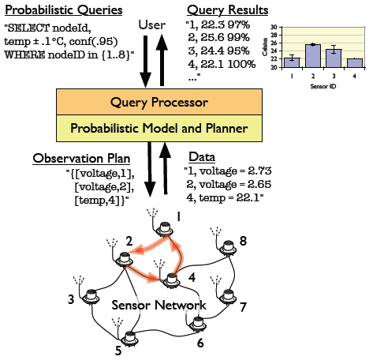
Continuous Representations
[Deshpande et al ’04]
Real-world data is often continuous
Temperature
Trait: View probability distribution as a Continuous function.
Highlights of 3 systems
Orion
BBQ
MCDB

Slide 49
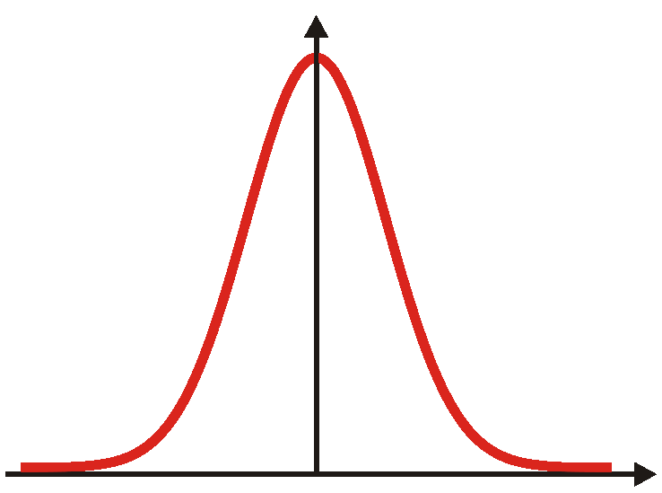
Representation in Orion
[Cheng, Kalashnikov and Prabhakar ‘03]
PDF of wind speed
Sensor-networks
Sensors measure wind-speed
Sensor value is approximate
Time, measurement errors
E.g. Gaussian
23
Wind Speed
S.ID | Wind Speed
3 | (μ: 23, σ:2)
7 | (μ: 17, σ:1)
8 | (μ: 9, σ:5)
Store the pdf via mean and variance
In general, store sufficient statistics or samples

Slide 50
Queries on Continuous pDBs
[Cheng, Kalashnikov and Prabhakar ‘03]
Value-based non-aggregate
“What is the wind speed recorded by sensor 8?”
Entity-based non-aggregate
“Which sensors have wind speed in [10,20] mph?”
Value-based aggregate
“What is the average wind speed on all sensors?”
Entity-based aggregate
“Which sensor has the highest wind speed?”
PDF of sensor 8
(3, 0.06),(7,0.99),…
PDF of average
(3, 0.95),(7, 0.04),..

Slide 51
QP in Orion (I)
[Cheng, Kalashnikov and Prabhakar ‘03]
Entity-based non-aggregate
“Which sensors have wind speed in [10,20] mph?”
SID | Wind Speed
3 | (μ: 23, σ²:2)
7 | (μ: 17, σ²:1)
8 | (μ: 9, σ²:5)
ERF
(3,0.06)
(7,.999)
New operation: Integration
(8,.327)
Selections, joins – not necessarily closed form.
Can write in terms of error function (ERF), known integral

Slide 52
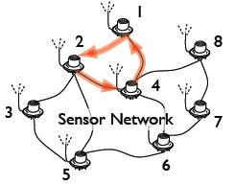
BarBie-Q (BBQ), a tiny model
[Deshpande et al ’04]
Physically close, so speeds close too
Wind-speeds not independent
model-based-view
Hide the uncertainty, correlations
User queries the model
DB may (1) acquire new data,
or (2) use model to predict values
or some combination

Slide 53
Monte Carlo DB - Overview
[Jampani et al 08]
Want: Sophisticated distributions & arbitrary SQL
QP: Approximate the answer.
Separate uncertainty from relational model
e.g. the means and standard deviations
Arbitrary (continuous and discrete) correlations
Technique: Variable Generation (VG) Functions
Challenge: Performance
Technique: Tuple bundles

Slide 54
Declaring Tables in MCDB
[Jampani et al 08]
Consider a patient DB with blood pressures
CREATE TABLE SBP_DATA
FOR EACH p in PATIENTS
WITH SBP as
NORMAL (SELECT s.mean, s.std FROM SBP_PARAM s)
SELECT p.PID, p.GENDER, b.VALUE
FROM SBP b
Declares a random sample
Normal, params from SBP_PARAM.
More generally, can depend on patient
NORMAL can be replaced with an arbitrary function, called a VG function

Slide 55
Variable Generation (VG) Functions
[Jampani et al 08]
VGs can be standard functions (Normal, Poisson) or User Defined Functions
e.g. seed per patient
Four C++ Methods
Initialize(seed) – Takes as input a seed for generation
TakeParams(tuples) – Consumes parameters
OutputVals() – Does the MC iteration
Finalize()
More generally, tuples
Output: Blood Pressure Samples
NB: Random choices are f(seed). Allows merging based on seed

Slide 56
A sophisticated VG Function
[Jampani et al 08]
“What would our profits have been if we had raised all our prices by 5%?”
On TPC Data
Price 105
Widget (per Order)
Price: 100 & Sold: 60
According to prior
Price
linear demand curve
Procedure:
Randomly generate line through Widget Point
Return d₀
d₀
Demand
D₀ is demand w. Raised Price

Slide 57
Monte Carlo DB - Overview
[Jampani et al 08]
Want: Sophisticated distributions & arbitrary SQL
QP: Approximate the answer.
Separate uncertainty from relational model
e.g. the means and standard deviations
Arbitrary (continuous and discrete) correlations
Technique: Variable Generation (VG) Functions
Challenge: Performance
Technique: Tuple bundles

Slide 58
MCDB QP: tuple bundles
[Jampani et al 08]
“Blood pressure higher than 135?”
Smarter: Tuple bundles
Patient | Gender
123 | M
456 | F
Patient | Gender | BP
123 | M | 160
 |  | 130
 |  | 170
456 | F | 110
VG
100s-1000s of samples
Patient & Gender constant – bundle BPs together
Patient | Gender | BP[]
123 | M | 160,130,170
456 | F | 110

Slide 59
MCDB: Late Materialization
[Jampani et al 08]
“Average BP of all patients who had a consult with a doctor on the third floor”
Slow! Many copies of same tuple!
Patient | Gender
123 | M
456 | F
Patient | Gender | BP
123 | M | 160
 |  | 130
 |  | 170
456 | F | 110
VG
Rest of SQL processing
Keep the random seeds instead of many tuples.
Remove duplicates, based on seed
Result: sampling on much smaller set.

Slide 60
Representation & QP Summary
Discrete Block Based
View Processing
Simple Factored
Temporal (simple) correlations
Sophisticated Factored
General Correlations
Continuous Function
Complex correlations
Measurement errors

Slide 61
Representation & QP Summary
3 Themes for Discrete Representations
Intensional Evaluation
Independence
Compile time. Conservative but allows optimization.
Run-time. Less conservative, but no optimization.
Memoization, Reuse
Continuous: Efficient representation of samples, models

Slide 62
Overview of Tutorial
Motivation Reprise:
What do we need from a pDBs representation?
Advanced Representation and QP
How do we store them?
How do we query them?
Discussion and Open Problems

Slide 63
Open Problems
Challenges
Community
Language
Algorithmic
There are many more. Enumerate them in the community.
If you want to elaborate, please do!

Slide 64
Community Challenges
Datasets for Uncertain Data
RFID ecosystem data released soon
http://MStreams.cs.washington.edu
IMDB data limited release
Avoid pDBs being seen as “bad AI”
Need to clearly identify our space.
Practice: Scale -- Theory: Data complexity
Export techniques, systems to other communities?
Make a solid business case

Slide 65
Model Challenges
How to choose right level of correlations to model?
Too many, QP expensive
Too few, low answer quality
How do we measure result quality?
Discussed by Cheng et al. ’03
Need a principled way to decide for DB apps

Slide 66
Language Challenges
Management of lineage/provenance/trust
Trust issues can cause uncertainty
Users want to take action
Is Hypothesis testing new decision support?
What-if analysis
Explore how answers change via updates
Due to Koch: Need usecases for a languages w. uncertainty.

Slide 67
Algorithmic Challenges
Indexing for Probabilistic Data
Can we compress, index or store probs on disk?
[Letchner,R,B 08] [Das Sarma et al 08] [Singh et al 08]
Combine discrete and continuous techniques
Updates: How to deal with changes in the probability model efficiently?
Mining uncertain data [Cormode and McGregor 08]

Slide 68
Day Two Takeaways
Taxonomy for pDBs based on (a) type of data (b) type of correlations
Saw three common techniques for scale:
intensional processing
independence
Reuse/Memoization
Get involved, lots of interesting work!
Tell our story to the larger CS community

Slide 69
Thank You

