Slide 1
Towards a Framework for Pattern Experimentation Understanding empirical validity in requirements engineering patterns Travis D. Breaux, Hanan Hibshi, Ashwini Rao Carnegie Mellon University Jean-Michel Lehker University of Texas at San Antonio
Second International Workshop on Requirements Patterns (RePa’12)
24 September 2012, Chicago, USA
In conjunction with 20th IEEE International Requirements Engineering Conference

Slide 2


Slide 3





SP 800-53
Catalog of Security Controls
15408:2005
Common Criteria
SECURITY REQUIREMENTS
HIPAA
603 A
Security of Personal Information
Functional Requirements

Slide 4
Identifying requirements is difficult
PCI - Data Security Standard
3.1.1 Implement data retention and disposal policy that includes: Limiting data storage Processes for secure deletion of data Specific retention requirements …

Slide 5
Patterns provide better cues
Pattern Name: Retention and Disposal Pattern
Pattern Activation:
Pattern Triggers:
Pattern Outcomes:

Slide 6
Patterns improve comprehension
Pattern Name: Retention and Disposal Pattern
Pattern Activation: Data is received, stored or processed
Pattern Triggers: Data is no longer needed Digital access to the media will change
Pattern Outcomes: Retain data; Dispose data
Notes:
When presenting the same information as the last slide, try to limit the “effects” applied to that text. The fact that the text appears will draw attention to it, or you could use color to highlight it (not bold, because that expands and moves the previously seen text). Too much color in odd places becomes too busy, however.

Slide 7
Patterns capture variability
Pattern Name: Retention and Disposal Pattern
Pattern Activation: Data is received, stored or processed
Pattern Triggers: The data is no longer needed Digital access to the media will change
Pattern Outcomes: Retain data; Dispose data
Mandatory Extension Points: When was the data acquired? What laws, regulations or business requirements exist to retain the data? …
Notes:
Be careful about using “gray” or “black” out. Readers may struggle trying to read what you wanted to hide, drawing their attention away from your main idea.

Slide 8
Not all patterns are equal
0101010011
0010100000
0001100000
0001000100
149162536496481
Sequence of squares of
numbers 1 to 9

Slide 9

Do you want to empirically know why patterns work?
Do you want to trust me that these patterns work?

Slide 10
What is pattern application?
Requirements analyst should
Recognize goal
Recognize cues in problem description
Apply pattern
Satisfy output constraints

Slide 11
What is pattern validity?
Input
Apply
Output
Probability of selecting the right pattern
Probability of correct output

Slide 12





Requirements Pattern Taxonomy
Goals
Sources
Representations
Notes:
We classify requirements patterns by the goals they achieve, sources from which they are derived, and the representation used to describe them

Slide 13
How to evaluate goal satisfaction?
We identified 5 goals to improve…
Requirements acquisition
Requirements quality
Compliance
Requirements engineering process
Runtime performance
Notes:
This slide is intended to really challenge people – because they may claim that, “how can we evaluate compliance when we still don’t know what it means”? We recognize this, but we believe eventually we can get there…
Measuring goal satisfaction statistically makes results more generalizable and repeatable. Stronger evidence of goal satisfaction implies higher pattern validity

Slide 14
Sources influence outcomes
Requirements knowledge can be highly or lightly structured
Structure affects individual interpretation
Lightly structured → more variation
Highly structured → less variation
Notes:
Structured: scenario, bug report, use case
Less structured: meeting notes, diaries, video
A bug report is more structured than a video recording, there is less misinterpretation which improves pattern validity

Slide 15


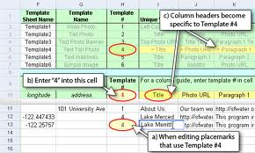
Source/Representation (Mis)match
Notes:
If source representation and pattern representation match, applying the pattern is easier -> implies higher pattern validity

Slide 16

Cognitive Psychology Theories
How do humans learn?
How do humans interact with abstractions?

Slide 17
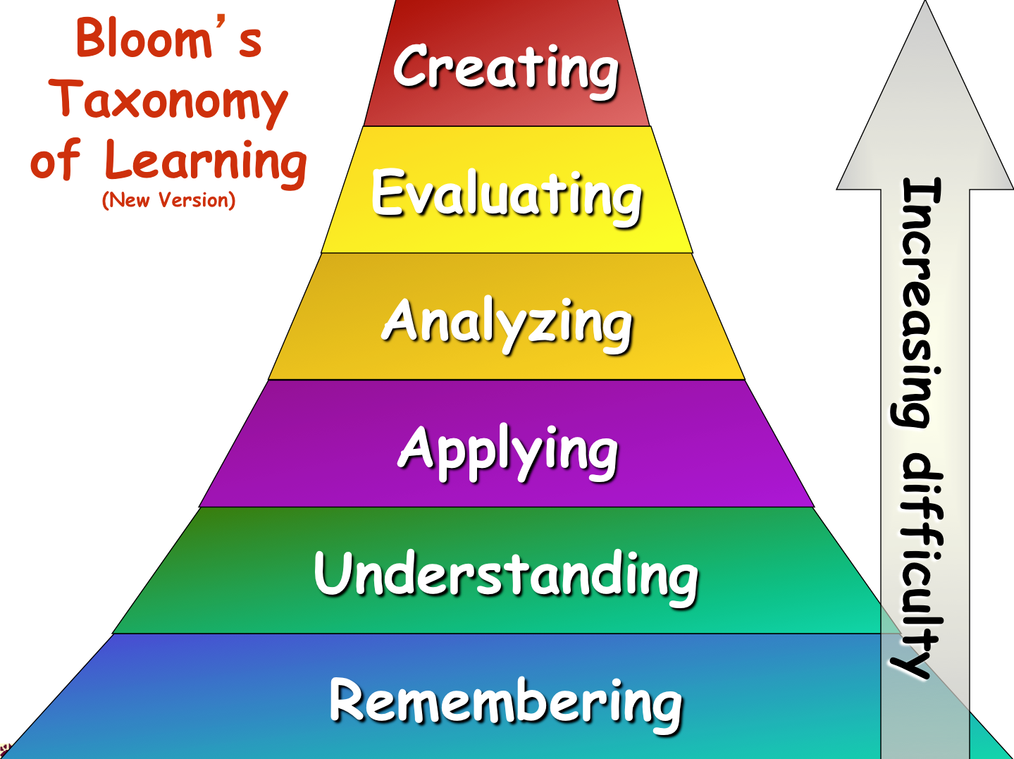
Does cognition affect application?
Notes:
Using Blooms taxonomy of learning we can identify who will perform better at pattern application. We believe valid patterns are ta the level 3, that is applying

Slide 18
What features of input description increase or decrease validity?
Category
Basic Level
Segmentation (Vertical)
B
A
C
D
Level of Inclusiveness (Horizontal)
Figure developed from E. Rosch, “Principles of Categorization,” Cognition and Categorization, pp. 27-48, 1978.
Notes:
Category theory can explain which cues are better for pattern application. A is most inclusive for example concept chair. B and C are kitchen chair and dining chair. Both are chair but different contexts. D is least inclusive, example door. We believe B and C will be most beneficial cues.

Slide 19
What features of input description increase or decrease validity?
Category
Basic Level
Segmentation (Vertical)
B
A
C
D
Level of Inclusiveness (Horizontal)
Figure developed from E. Rosch, “Principles of Categorization,” Cognition and Categorization, pp. 27-48, 1978.

Slide 20
What features of input description increase or decrease validity?
Category
Basic Level
Segmentation (Vertical)
B
A
C
D
Level of Inclusiveness (Horizontal)
Figure developed from E. Rosch, “Principles of Categorization,” Cognition and Categorization, pp. 27-48, 1978.

Slide 21
Ongoing Work
Diving deeper into cognitive psychology
Designing experiments for pilot studies
Extending literature review of our requirements pattern taxonomy

Slide 22
Acknowledgement This presentation is based on the Pecha Kucha template available at http://www.conferencesthatwork.com/index.php/presentations/2011/09/tips-for-organizing-pecha-kucha-sessions/
Second International Workshop on Requirements Patterns (RePa’12)
24 September 2012, Chicago, USA
In conjunction with 20th IEEE International Requirements Engineering Conference

