Slide 1
JCDL 2011 Tutorial (University of Ottawa– 13 June) “Guidelines and Resources for Teaching Digital Libraries” by Edward A. Fox
fox@vt.edu http://fox.cs.vt.edu
Dept. of Computer Science, Virginia Tech
Blacksburg, VA 24061 USA

Slide 2
Acknowledgements
Mentors (Licklider, Kessler, Salton)
Virginia Tech, CS, Digital Library Research Lab
NSF and other sponsors
Students, colleagues, co-investigators
Monika Akbar, Yinlin Chen, Marcos André Gonçalves, Doug Gorton, Nadia Kozievitch, Spencer Lee, Jonathan Leidig, Yi Ma, Uma Murthy, Sung Hee Park, Rao Shen, Venkat Srinivasan, Ricardo Torres, Xiaoyan Yu, ...
Barbara Wildemuth, Jeffrey Pomerantz, Sanghee Oh, Seungwon Yang

Slide 3
Theory-Based Initiatives
5S
DELOS Reference Model
DL.org Activities
IJDL call for contributions
Other Perspectives
DBMS, DSMS, VLDL
W3C, Semantic Web, Repositories

Slide 4
For More Information
Magazine: www.dlib.org
Books: http://fox.cs.vt.edu/DLSB.html (1994)
MIT Press: Arms, plus by Borgman, Licklider (1965)
Morgan Kaufmann: Witten... (several), Lesk (2nd edition)
Conferences
ICADL: www.icadl.org
JCDL: www.jcdl2011.org
TPDL: www.tpdl2011.org
Associations
ASIS&T DL SIG
IEEE TCDL: www.ieee-tcdl.org (student awards, …)
NSF: http://dli.grainger.uiuc.edu/national.htm, http://www.nsf.gov/pubs/1998/nsf9863/nsf9863.htm
Labs: VT: www.dlib.vt.edu, http://ei.cs.vt.edu/~dlib/ (old)

Slide 5
Introductions
Country, City, Languages you speak
Main discipline of training
# of digital libraries (DLs) used: list
# of DL conferences attended? JCDLs?
Other activities at conference
Why taking this course
Goals for today

Slide 6
Selected DL Projects
Digital Library Curricular Resources
NSF IIS-0535057 & 0535060
CTRnet (Crisis, Tragedy & Recovery Net)
NSF IIS-0916733
Ensemble (Computer Science Education)
NSF DUE-0840719
Digital Preserve
NSF IIS-0910183 & 0910465
http://slurl.com/secondlife/Digital%20Preserve/140/126/29

Slide 7
DL Curric. Project - 1
NSF awards to VT and UNC-CH
CS and LIS
Project server: http://curric.dlib.vt.edu/
Wikiversity: http://en.wikiversity.org/wiki/Curriculum_on_Digital_Libraries

Slide 8
DL Curric. Project - 2
Module 1-b: History of digital libraries and library automation
Module 2-c: File Formats, Transformation, and Migration
Module 3-b: Digitization
Module 4-b: Metadata
Module 5-a: Architecture overviews

Slide 9
DL Curric. Project - 3
Module 5-b: Application software
Module 5-d: Protocols
Module 6-a: Information needs/relevance
Module 6-b: Online information seeking behaviors and search strategies
Module 6-d: Interaction design and usability assessment

Slide 10
DL Curric. Project - 4
Module 7-b: Reference Services
Module 7-g: Personalization
Module 8-b: Web Archiving
Module 9-c: Digital library evaluation, user studies
Plus others, including 10+4 this past AY by VT’s CS grad/ugrad students

Slide 11
Module Development – What?
Digital Libraries
Information Retrieval tools (cloud)
Multimedia tools (cloud)
Biometrics Training
Especially fingerprint analysis

Slide 12
Module Development – Who?
Experts
DL
Biometrics
Teams in a 6000-level DL Course: 4
Teams in a 5000-level IR Course: 5 (+5)
Teams in a 4000 MM Course: 4

Slide 13
Pedagogy
Class use of 1-15 modules, 1 wk each
Independent study of a module of interest
Independent study preping for tool use
Discovery, Constructivism
Problem-based, Just-in-time
Learning by teaching, making modules

Slide 14
How to organize a DL course?
Various frameworks
What, Why, How
History, Current status, Future (research)
Economics: open source, sustainability
Social: users/patrons, management
Technical: HCI, HT, IR, LIS, Web
Suggest that concept maps be drawn by readers to help in working with this book
Instructors can access “expert” maps with IHMC tools

Slide 15
CC2001 Information Management Areas
IM1. Information models and systems* | IM8. Distributed DBs
IM2. Database systems* | IM9. Physical DB design
IM3. Data modeling* | IM10. Data mining
IM4. Relational DBs | IM11. Information storage and retrieval
IM5. Database query languages | IM12. Hypertext and hypermedia
IM6. Relational DB design | IM13. Multimedia information & systems
IM7. Transaction processing | IM14. Digital libraries
* Core components

Slide 16
BAE/NIJ Biometrics Training
Module 1: Introduction to biometrics
Module 2: Pattern recognition
Module 3: Current and emerging biometrics science and technology
Module 4: Biometrics technology devices and systems
Module 5: Image capture and enhancement
Module 6: Electronic data and knowledge management
Module 7: Conduct of biometric comparisons
Module 8: Principles of statistics, probability, and forensic statistics
Module 9: Error, bias, and uncertainty
Module 10: Applications of Biometrics
Module 11. Critical assessment and thinking
Module 12: Investigation and problem solving
Module 13: Investigative context and biometric comparisons
Module 14: Introduction to forensic science
Module 15: Emerging issues in the forensic community
Module 16: Legal admissibility of forensic evidence
Module 17: Communication of results in the legal system
Module 18: Forensic quality systems
Module 19: Friction ridge examinations and comparisons
Module 20: Practicum and examinations

Slide 17
DL Curriculum Framework

Slide 18
Book Parts
Ch. 1. Introduction (Motivation, Synopsis)
Part 1 – The “Ss”
Part 2 – Higher DL Constructs
Part 3 – Advanced Topics
Appendix

Slide 19
Book Parts and Chapters - 1
Ch. 1. Introduction (Motivation, Synopsis)
Part 1 – The “Ss”
Ch. 2: Streams
Ch. 3: Structures
Ch. 4: Spaces
Ch. 5: Scenarios
Ch. 6: Societies

Slide 20
Book Parts and Chapters - 2
Part 2 – Higher DL Constructs
Ch. 7: Collections
Ch. 8: Catalogs
Ch. 9: Repositories and Archives
Ch. 10: Services
Ch. 11: Systems
Ch. 12: Case Studies

Slide 21
Book Parts and Chapters - 3
Part 3 – Advanced Topics
Ch. 13: Quality
Ch. 14: Integration
Ch. 15: How to build a digital library
Ch. 16: Research Challenges, Future Perspectives
Appendix
A: Mathematical preliminaries
B: Formal Definitions: Ss
C: Formal Definitions: DL terms, Minimal DL
D: Formal Definitions: Archeological DL
E: Glossary of terms, mappings

Slide 22
Chapter 1 Overview
Why do we need this book?
What are digital libraries (DLs)?
Why is 5S helpful in a DL book?
How do digital libraries work?
History: Memex, 1990s, proliferation
Related areas: LIS, linguistics, IR, AI, DBs, knowledge management, content management, probability/statistics

Slide 23
Outline
Ch. 1. Introduction (Motivation, Synopsis)
Part 1 – The “Ss”
Ch. 2: Streams
Ch. 3: Structures
Ch. 4: Spaces
Ch. 5: Scenarios
Ch. 6: Societies

Slide 24
Informal 5S & DL Definitions DLs are complex systems that
help satisfy info needs of users (societies)
provide info services (scenarios)
organize info in usable ways (structures)
present info in usable ways (spaces)
communicate info with users (streams)

Slide 25
5Ss
Ss | Examples | Objectives
Streams | Text; video; audio; image | Describes properties of the DL content such as encoding and language for textual material or particular forms of multimedia data
Structures | Collection; catalog; hypertext; document; metadata | Specifies organizational aspects of the DL content
Spaces | Measure; measurable, topological, vector, probabilistic | Defines logical and presentational views of several DL components
Scenarios | Searching, browsing, recommending | Details the behavior of DL services
Societies | Service managers, learners, teachers, etc. | Defines managers, responsible for running DL services; actors, that use those services; and relationships among them

Slide 26
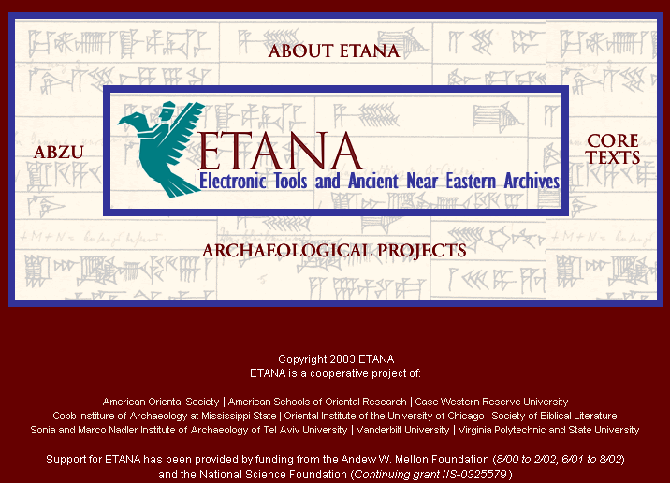

Slide 27
ETANA Societies - 1
Historic and pre-historic societies (being studied)
Archaeologists (in academic institutes, fieldwork settings, or local and national governmental bodies)
Project directors
Technical staff (consisting of photographers, technical illustrators, and their assistants)
Field staff (responsible for the actual work of excavation)
Camp staff (e.g., camp managers, registrars, tool stewards)
General public (e.g., educators, learners, citizens)

Slide 28
ETANA Societies - 2
Social issues
Who owns the finds?
Where should they be preserved?
What nationality and ethnicity do they represent?
Who has publication rights?
What interactions took place between those at the site studied, and others? What theories are proposed by whom about this?

Slide 29
Exercise 1
Forms groups of 2.
Select a digital library you wish to build, improve, or study.
As was done for ETANA, discuss it using the 5S perspective.
Present a summary to the class and lead a discussion.

Slide 30
Outline
Ch. 1. Introduction (Motivation, Synopsis)
Part 1 – The “Ss”
Ch. 2: Streams
Ch. 3: Structures
Ch. 4: Spaces
Ch. 5: Scenarios
Ch. 6: Societies

Slide 31
Chapter 2 Overview
Multiple media types and representation
See ch. 4 for IR (except some here for non-text)
Standards for each, and for some combinations
Text
Character strings, encoding (Unicode)
Morphology -> Stemming
Syntax, semantics -> stop words
** POS tagging, phrases
Images, Audio, Video, Graphics, Animation
Capture, digitization, representation
CBIR for each
** Compression, processing, analysis
**Synchronization, rendering, presentation, interchange
RealVideo, SMIL, QoS

Slide 32
Chapter 3 Overview
Digital Objects
Documents, digitization, packaging (METS, ORE, DCC), interchange, standards, format conversion
Genre: plays, encyclopedia, dictionaries, educational resources: courses (e.g., syllabi) and lessons
Structural organizations (books, chapters, sections), excerpts/spans (mark, superimposed info)
Metadata: standards, markup
Knowledge Structures & Representations
Databases, Schema, Ontologies, Thesauri, Lexicons, Authority files, Concept maps, Semantic networks
Indexes
Inverted files, signature files, R-trees, Quad trees, etc.
Clusters & Classification Schemes

Slide 33
Chapter 4 Overview
Retrieval models
Boolean, extended Boolean
Vector, LSI
Probabilistic: classical, belief network, inference network, language models
User interfaces and visualization

Slide 34
Chapter 5 Overview
Recall OO for streams – now have objects as well as scenarios – ex interface components
Information Access
Searching: ad hoc, filtering/routing
Browsing: using an organization, using a visualization, using links (i.e., hypertext, hypermedia)
Workflow: sessions, feedback, etc.
Scenario-based Design
Usability: goals, tasks, claims

Slide 35
Chapter 6 Overview
User communities
Authors, editors, teachers, students, readers
Personal(ization), group(ware), community, global
Accessibility, universal access
Librarians: reference, acquisition, operations
Research community
Associations, conferences, publications, labs, projects
Economics
Copyright, intellectual property rights, digital rights management, authorization, authentication, security, privacy, self-archiving (eprints)
Publishers, catalogers, distributors, sustainability
Open source, commercial, hybrid

Slide 36
Outline – Part 2
Part 2 – Higher DL Constructs
Ch. 7: Collections
Ch. 8: Catalogs
Ch. 9: Repositories and Archives
Ch. 10: Services
Ch. 11: Systems
Ch. 12: Case Studies

Slide 38
Outline – Part 2
Part 2 – Higher DL Constructs
Ch. 7: Collections
Ch. 8: Catalogs
Ch. 9: Repositories and Archives
Ch. 10: Services
Ch. 11: Systems
Ch. 12: Case Studies

Slide 39
Chapter 7 Overview
Terminology: set, “database”
Distributed: basis, efficiency/effectiveness
Parallelism: federation, harvesting
Scale: object size, compression, replication, stream splitting
Intelligence/processing granularity: object, cluster, collection, repository

Slide 40
Chapter 8 Overview
OPACs
Distributed vs. centralized
Coverage, breadth
Specificity, depth
Management: versioning, works

Slide 41
Chapter 9 Overview
Naming, identifiers
Architectures, interoperability
OAI: harvesting
SRU/SRW: federation
Preservation, archives
LOCKSS, UVC, emulation/migration
Scalability, storage

Slide 42
Chapter 10 Overview
Taxonomy of services
Ontology, composition, reuse
Evaluation
Key services in-depth:
Crawling, indexing
Clustering, classifying
Recommending, using social networks
Logging

Slide 43
Chapter 11 Overview
Architectures
Client-server, service-oriented
P2P, Grid
System descriptions and comparisons
Personal DLs; Institutional to global
DSpace, Eprints, Fedora, Greenstone, Kepler
ODL
5S Suite: language, visualization, generation, logging

Slide 44
Outline – Part 2
Part 2 – Higher DL Constructs
Ch. 7: Collections
Ch. 8: Catalogs
Ch. 9: Repositories and Archives
Ch. 10: Services
Ch. 11: Systems
Ch. 12: Case Studies

Slide 45
CS Teaching Center (CSTC)
Instead of building large, expensive multimedia packages, that become obsolete and are difficult to re-use, concentrate on small knowledge units.
Learners benefit from having well-crafted modules that have been reviewed and tested.
Use digital libraries to build a powerful base of support for learners, upon which a variety of courses, self-study tutorials & reference resources can be built.
ACM support led to Journal of Educational Resources in Computing (JERIC), accessible from www.cstc.org
Notes:
3
3

Slide 46
Computing and Information Technology Interactive Digital Educational Library (CITIDEL)
Domain: computing / information technology
Genre: one-stop-shopping for teachers & learners: courseware (CSTC, JERIC), leading DLs (ACM, IEEE-CS, DB&LP, CiteSeer), PlanetMath.org, NCSTRL (technical reports), …
Submission & Collection: sub/partner collections ➔ www.citidel.org

Slide 47
NSDL Information Architecture Essentially as developed by the Technical Infrastructure Workgroup
Portals &
Clients
Portals &
Clients
User Interfaces
Portals &
Clients
NSDL
Services
NSDL
Services
Other NSDL
Services
NSDL
Collections
Core NSDL
“Bus”
NSDL
Collections
NSDL
Collections
Usage Enhancement
Collection Building
Core Services:
information retrieval
CI Services
browsing
CI Services
authentication
referenced
items &
collections
Core Services:
metadata gathering
CI Services
personalization
referenced
items &
collections
Special Databases
Core Collection-
Building Services
protocols
CI Services
discussion
Core Collection-
Building Services
harvesting
CI Services
annotation

Slide 48
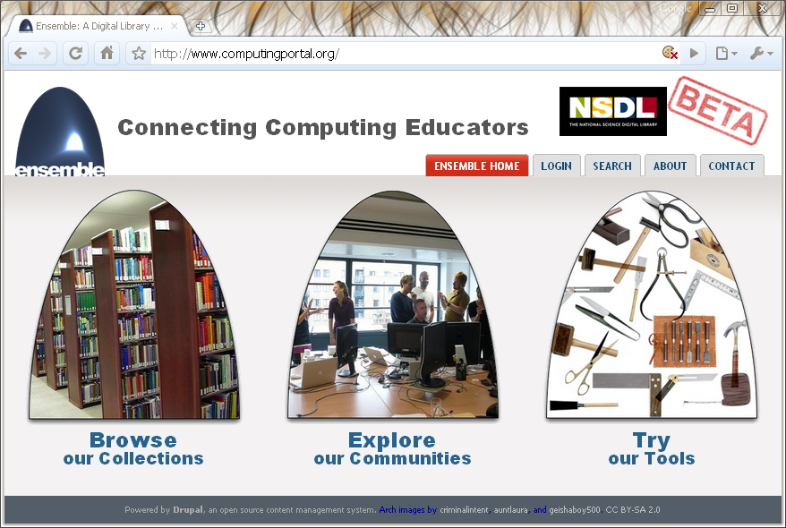
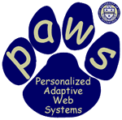




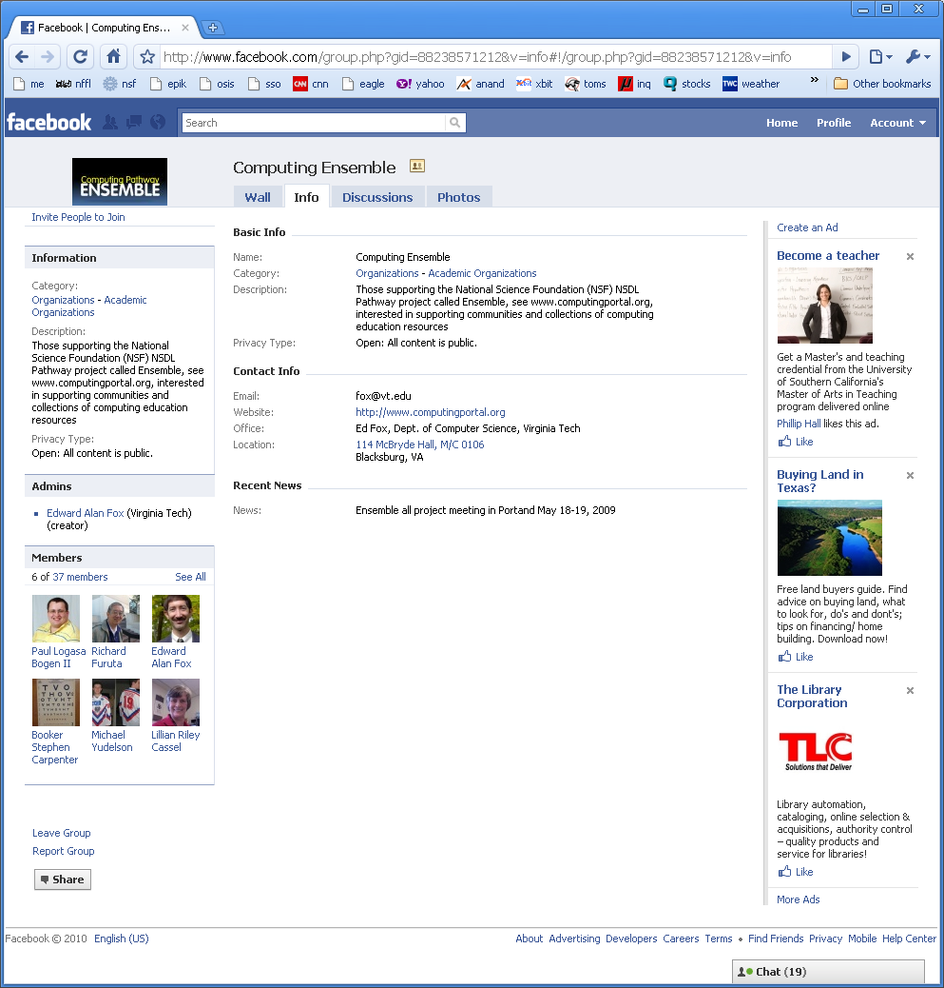
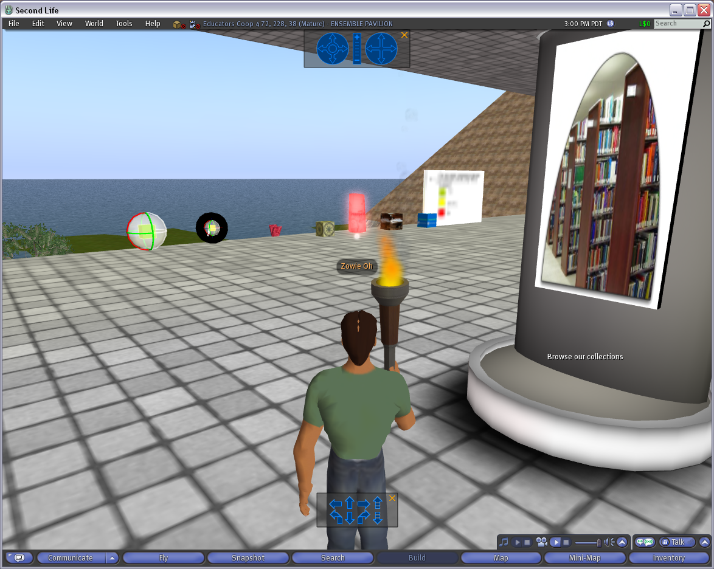
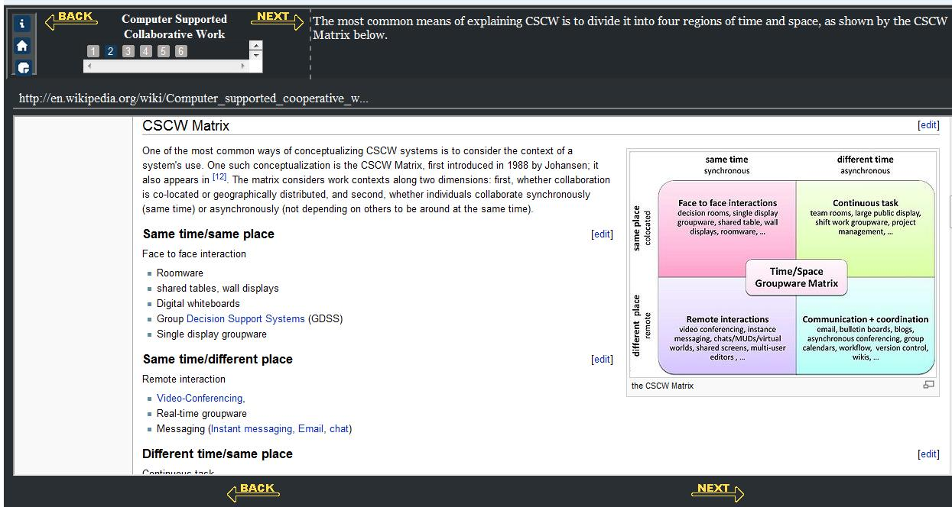
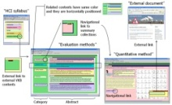



The Ensemble Computing Portal
Many-to-Many Information Connections in a Distributed Digital Library Portal
Collections
Communities
ACM
CS1
FOCES
TECH Developers
Ensemble
LIKES
AP CS
Services
Search
Distributed DL Portal
Forum
Group
Blog
Browse
Notification
Tools
A collaborative research project to build a distributed portal with up-to-date contents for all computing communities.
http://www.computingportal.org/

Slide 49
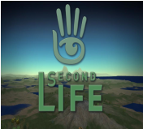
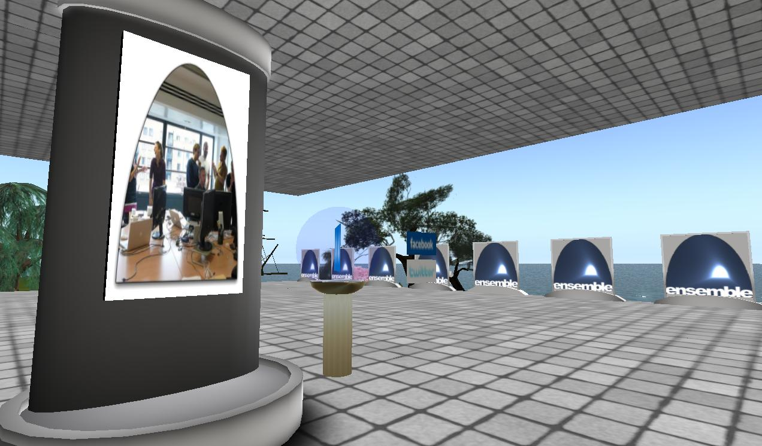
Ensemble in Second Life
http://slurl.com/secondlife/Educators%20Coop%204/66/236/28
The Ensemble Pavilion offers:
• teleports to other computing sites in Second Life like the Digital Preserve
• hyperlinks to related computing websites
• RSS readers with feeds from computing and computing education blogs
• membership in the Ensemble Computing group in Second Life, Facebook, and Twitter

Slide 50
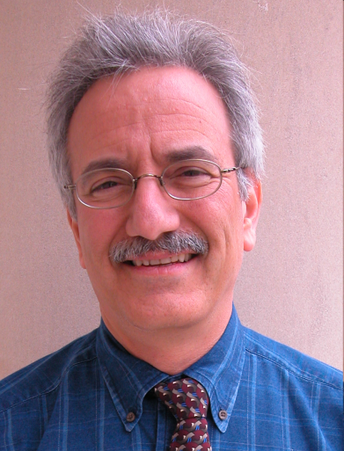
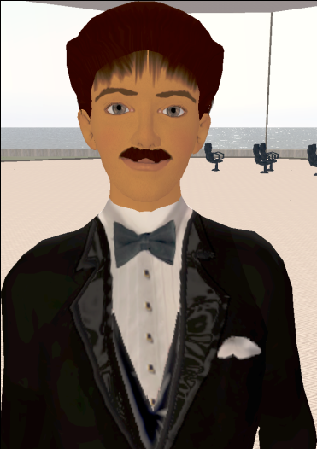
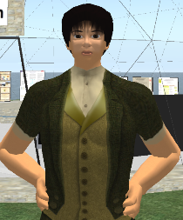
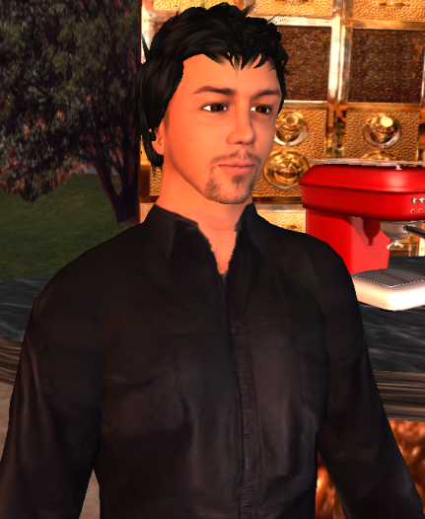
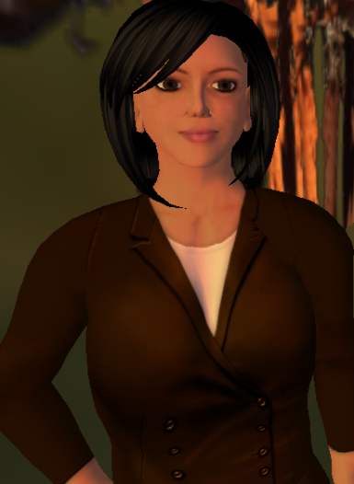
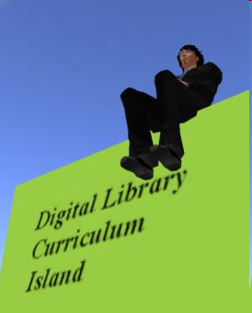
Selected Digital Preserve Personnel
Gary Octagon
Gary Marchionini
EdFox Rieko
Edward Fox
zamfir Paule
Spencer Lee
Uma Aldrin
Uma Murthy
Krad Proto
Seungwon Yang
mantruc Martian
Javier Velasco-Martin

Slide 51
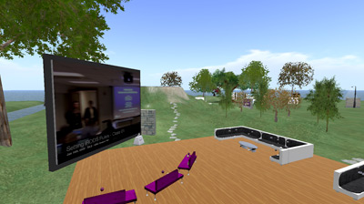
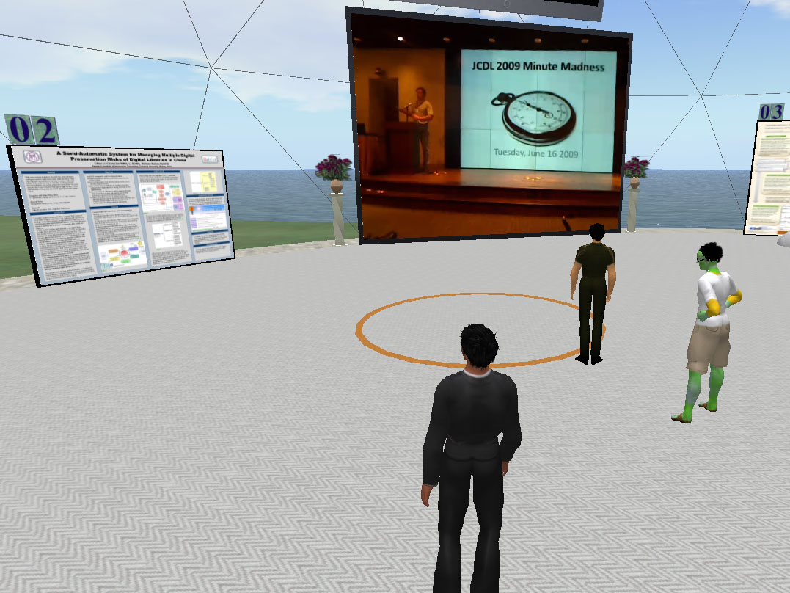
DP areas
Poster Building
18 posters on display
Poster view tips
Video screen
Cafe
Beverages
Screens
Discussion areas

Slide 52
A Digital Library Case Study
Domain: graduate education, research
Genre:ETDs=electronic theses & dissertations
Submission: http://etd.vt.edu
Collection: http://www.theses.org
Project:
Networked Digital
Library of Theses
& Dissertations
(NDLTD)
http://www.ndltd.org

Slide 53
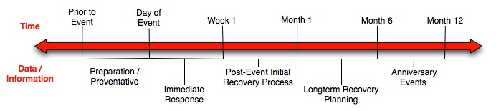
Crisis, Tragedy, and Recovery
Human tragedies that result from man-made and natural events affect humans and communities significantly.
During and after a tragic event, there are a series of needs that have to be addressed.
Compounded by communication failures and a confusing plethora of data and information

Slide 54
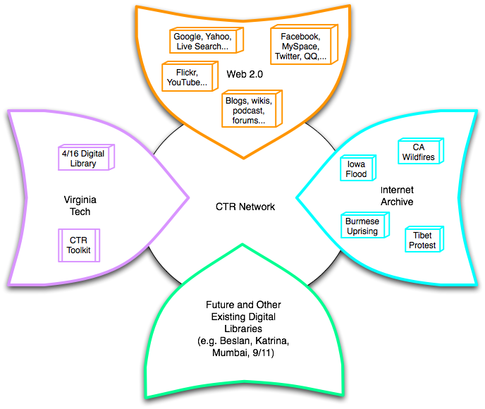
Build a networked digital library relating to CTR
www.citeulike.org group ctrnet
Citations
Papers, …
Integrate community, content, and services relating to CTR, making it accessible, and preserving it for long-term reuse
Support information exploration
Aided by an ontology
www.ctrnet.net

Slide 55
Outline – Part 3
Part 3 – Advanced Topics
Ch. 13: Quality
Ch. 14: Integration
Ch. 15: How to build a digital library
Ch. 16: Research Challenges, Future Perspectives
Appendix
A: Mathematical preliminaries
B: Formal Definitions: Ss
C: Formal Definitions: DL terms, Minimal DL
D: Formal Definitions: Archeological DL
E: Glossary of terms, mappings

Slide 56
Chapter 13 Overview
Information life cycle
Dimensions, Indicators
Definitions
Examples
Evaluation

Slide 57
Quality Dimensions

Slide 58
Quality and the Information Life Cycle

Slide 59
Exercise 2
Re-form into former groups of 2.
Recall the digital library you selected earlier.
Select the most important measures of quality for that digital library (from those discussed or others you feel are needed).
Work out the details of an evaluation using those measures.
Present a summary to the class and lead a discussion.

Slide 60
Outline – Part 3
Part 3 – Advanced Topics
Ch. 13: Quality
Ch. 14: Integration
Ch. 15: How to build a digital library
Ch. 16: Research Challenges, Future Perspectives
Appendix
A: Mathematical preliminaries
B: Formal Definitions: Ss
C: Formal Definitions: DL terms, Minimal DL
D: Formal Definitions: Archeological DL
E: Glossary of terms, mappings

Slide 61
DL Integration
What is “DL Integration”
Hide distribution
Hide heterogeneity
Enable autonomy of individual component
Why Integration
island-DLs
inability to seamlessly and transparently access knowledge across DLs
Utilize various autonomous DLs in concert

Slide 62
ArchDL Expert
5S Archaeology
MetaModel
ArchDL Designer
5SGraph
VN Metadata Format
HD Metadata Format
Scenario
Sub-model
ETANA-DL Metadata Format
ETANA-DL
Union Services
Descriptions
Harvesting
Mapping
Searching
Browsing
…
VN
Catalog
HD
Catalog
Mapping Tool
Wrapper4VN
Wrapper4HD
Structure
Sub-model
Inverted Files
XOAI
Search
Service
Web Interface
Index
Union
Catalog
Browse DB
Index
Browse
Service
Component
Pool
5SGen
Services DB
Other
ETANA-DL
Services
Browsing
XOAI
…

Slide 63
Outline – Part 3
Part 3 – Advanced Topics
Ch. 13: Quality
Ch. 14: Integration
Ch. 15: How to build a digital library
Ch. 16: Research Challenges, Future Perspectives
Appendix
A: Mathematical preliminaries
B: Formal Definitions: Ss
C: Formal Definitions: DL terms, Minimal DL
D: Formal Definitions: Archeological DL
E: Glossary of terms, mappings

Slide 64
Chapter 15 Overview
Requirements gathering
Modeling with 5S-based approach
Identifying good fit among existing systems or toolkits
Adapting an existing DL to fit new needs
Construction of new system from toolkit
Domain specific enhancement

Slide 65
Chapter 16 Overview
Future direction workshops
Challenges

Slide 66
As data, information, and knowledge play increasingly central roles … digital library research should focus on:
Increasing the scope and scale of information resources and services;
Employing context at the individual, community, and societal levels to improve performance;
Developing algorithms and strategies for transforming data into actionable information;
Demonstrating the integration of information spaces into everyday life; and
Improving availability, accessibility, and, thereby, productivity.

Slide 67
An appropriate infrastructure program will provide sustainability of digital knowledge resources among five dimensions:
Acquisition of new information resources;
Effective access mechanisms that span media type, mode, and language;
Facilities to leverage the utilization of humankind’s knowledge resources;
Assured stewardship over humanity’s scholarly and cultural legacy; and
Efficient and accountable management of systems, services, and resources.

Slide 68
Booklet for Fall 2011 - 1
0.0 Terminology Chart
1 Basic Concepts
1.1Tutorials, key ideas, TOIS, services (Fox, Goncalves)
1.2 Exploration (Shen)
1.3 Evaluation (Goncalves)
2 Advanced Concepts
2.1 Compound objects (Kozievitch, Torres)
2.2 Federation (Shen)
2.3 Subdocuments (Murthy)
2.4 Ontologies (Yang, Magdy)
2.5 Classification (Srinivasan)
…

Slide 69
Booklet for Fall 2011 - 2
3 Applications
3.1 CBIR (Torres, Murthy, Kozievitch)
3.2 Social Network and Personalization (Akbar)
3.3 Education (Chen)
3.4 Simulations and Scientific DLs (Leidig, Magdy)
3.5 Geospatial (Lin)
4 References

Slide 70
Other Activities
DL curriculum site, modules
Second Life Demonstration
Personal/Team Planning

Slide 71
Questions? Discussion?
Thank You!

