Slide 1

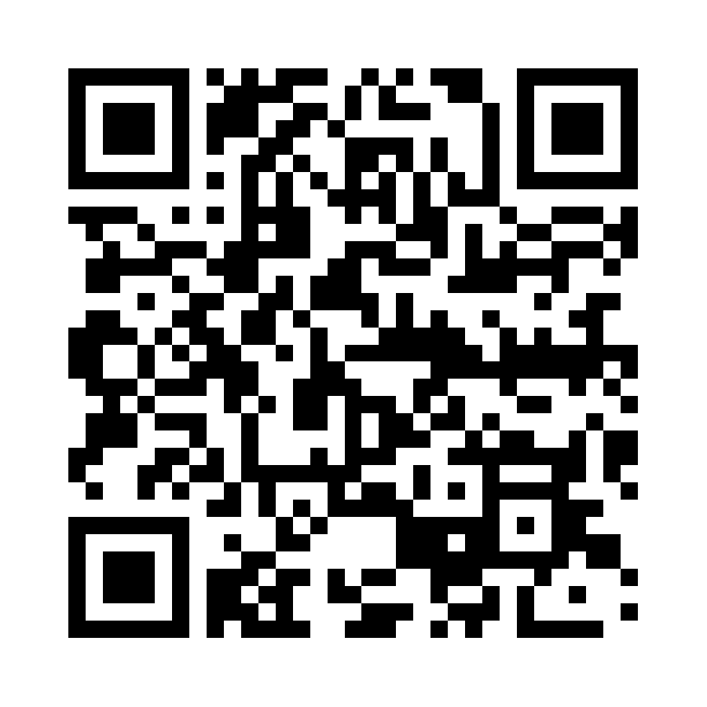
IT Accessibility Constituent Group
The IT Accessibility Group will help the EDUCAUSE community:
Identify resources and initiatives
Develop best practices on IT accessibility, policy, assistive program and service development
Strategize pathways to approach campus-wide universal access to information available via technology
8 Great Questions to Ask Vendors About Accessibility
Can the application be used with only the keyboard?
Is all content identified with headings and landmarks?
Do form controls and web widgets have an appropriate label?
Do images have appropriate text descriptions?
When styling and layout markup is removed is the document understanding?
Does audio content have transcripts and videos have captions?
Does text content have enough color contrast?
Do pages have a consistent look-and-feel?

