Slide 1
Introducing Embedded Systems: A Cyber- Physical Approach
Edward A. Lee
Robert S. Pepper Distinguished Professor UC Berkeley
Invited Keynote Talk
Workshop on Embedded Systems Education (WESE)
ES Week
Grenoble, France
October 15, 2009

Slide 2
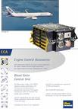
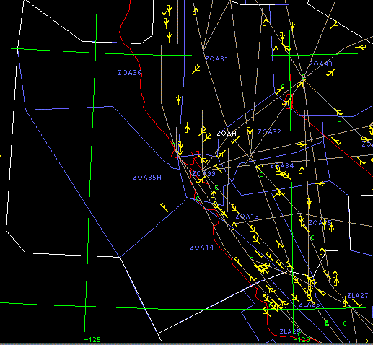
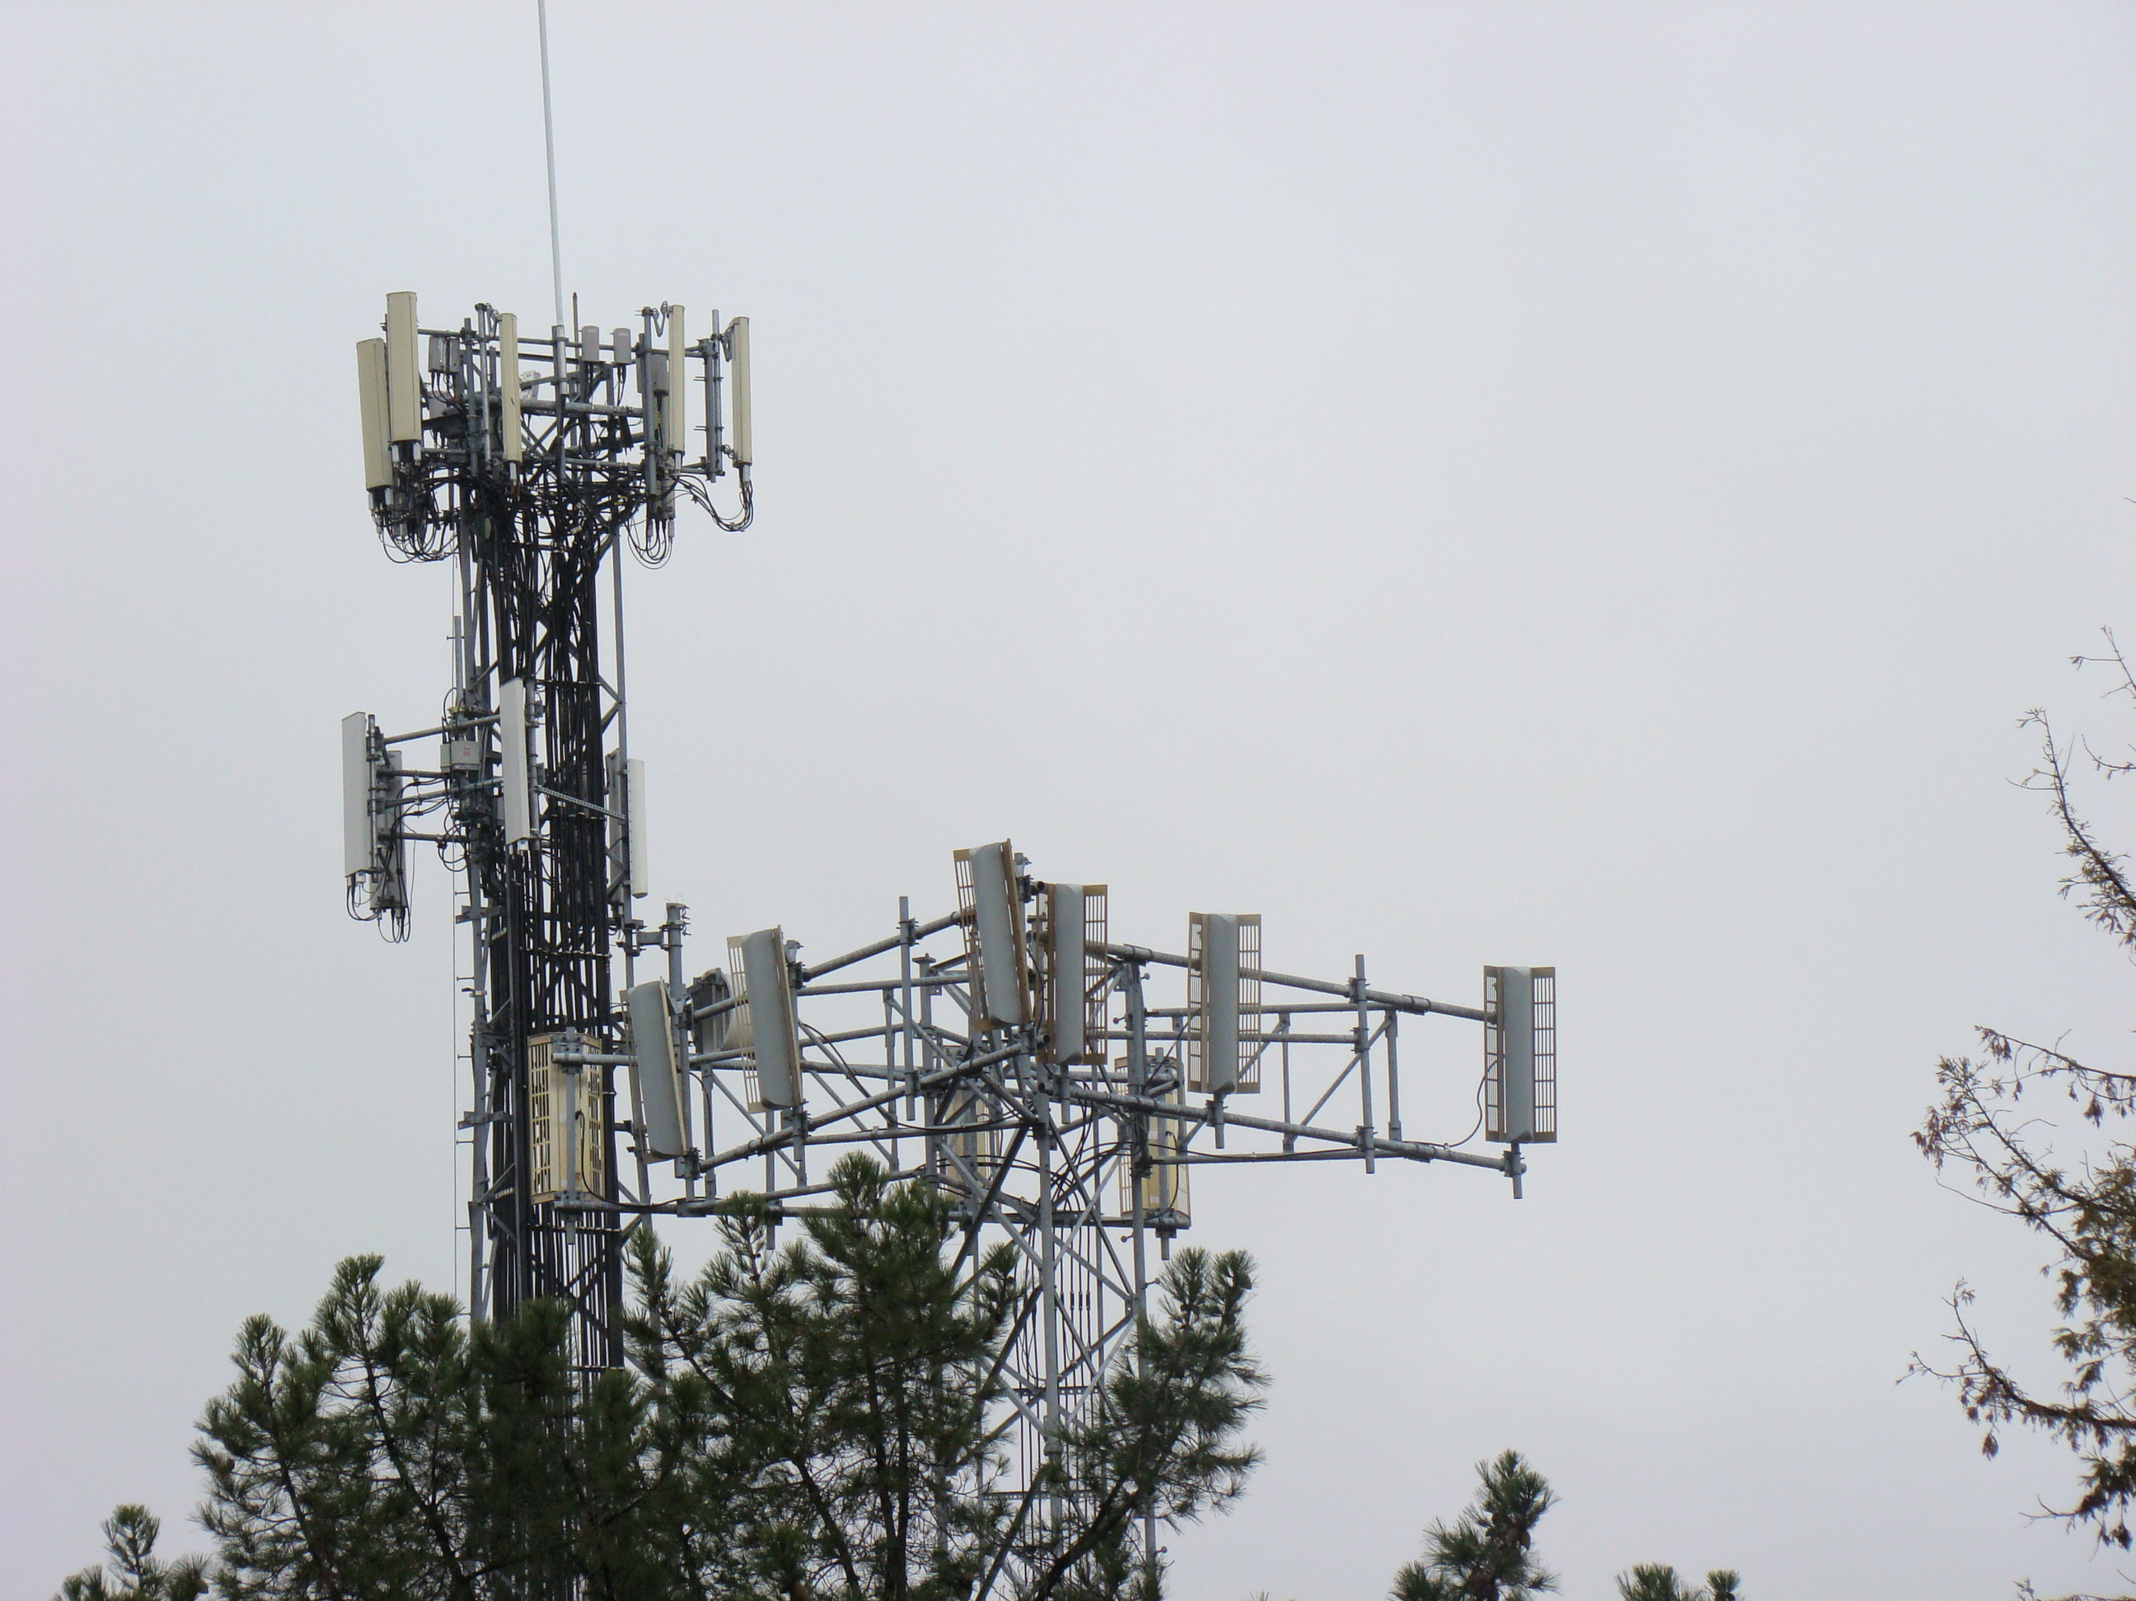
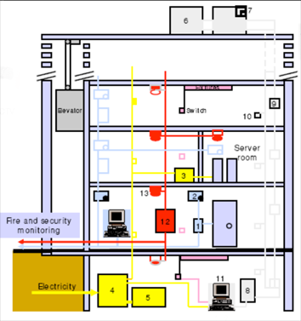
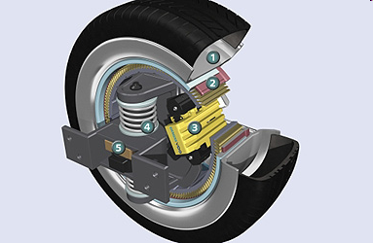
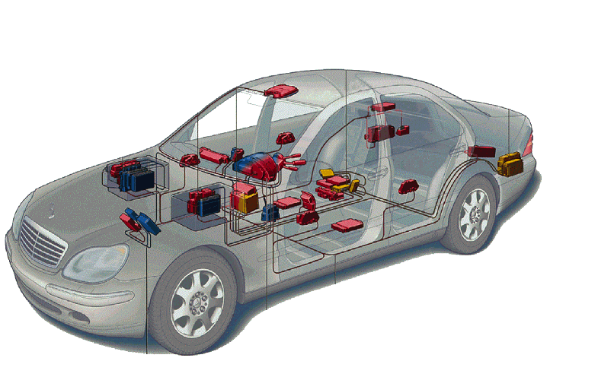
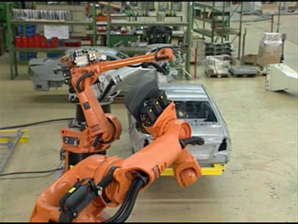
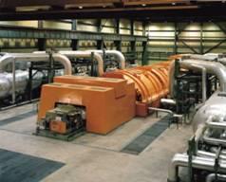
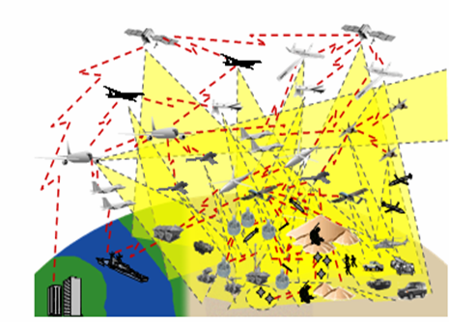

Cyber-Physical Systems (CPS): Orchestrating networked computational resources with physical systems
Transportation
(Air traffic control at SFO)
Avionics
Building Systems
Telecommunications
Automotive
Instrumentation
(Soleil Synchrotron)
E-Corner, Siemens
Factory automation
Power generation and distribution
Daimler-Chrysler
Military systems:
Courtesy of Doug Schmidt
Courtesy of
General Electric
Courtesy of Kuka Robotics Corp.

Slide 3
Where CPS Differs from the traditional embedded systems problem:
The traditional embedded systems problem:
Embedded software is software on small computers. The technical problem is one of optimization (coping with limited resources and extracting performance).
The CPS problem:
Computation and networking integrated with physical processes. The technical problem is managing dynamics, time, and concurrency in networked computational + physical systems.

Slide 4
Content of an Embedded Systems Course
Traditional focus
Hardware interfacing
Interrupts
Memory systems
C programming
Assembly language
FPGA design
RTOS design
…
CPS focus
Modeling
Timing
Dynamics
Imperative logic
Concurrency
Verification
…

Slide 5
A Theme in our CPS Courses: Model-based design
Models are abstractions of systems:
structural (OO design)
ontological (type systems)
imperative logic (“procedural epistemology”)
functional logic
actor-oriented (including dataflow models)
All of these have their place…

Slide 6
CPS is Multidisciplinary
Computer Science:
Carefully abstracts the physical world
System Theory:
Deals directly with physical quantities
Cyber Physical Systems:
Computational +
Physical

Slide 7
The Educational Challenge (1)
Models for the physical world and for computation diverge.
physical: time continuum, ODEs, dynamics
computational: a “procedural epistemology,” logic
There is a huge cultural gap.
Physical system models must be viewed as semantic frameworks, and theories of computation must be viewed as alternative ways of talking about dynamics.

Slide 8
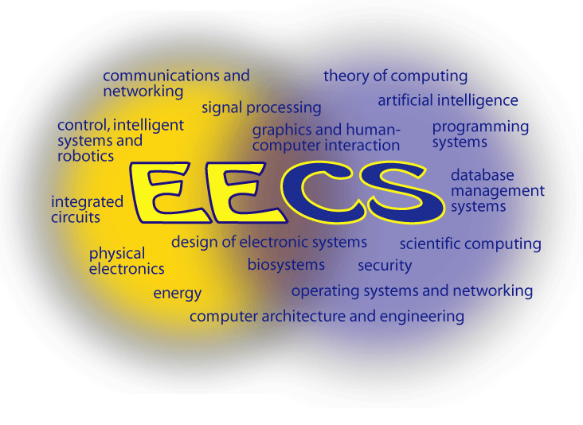
An Advantage: A Unified EECS Department

Slide 9
The Educational Challenge (2)
Students are taught to use modeling techniques, not to evaluate modeling techniques.
“this is how computers work”
“this equation describes that feedback circuit”
rather than
“this is how VonNeumann proposed that we control automatic machines”
“ignoring the intrinsic randomness and latency in this circuit, Black proposed that we could idealize its behavior in this way”
Students must be taught meta-modeling, not just modeling. They must learn to think critically about modeling methods, not just about models.

Slide 10
The Graduate Curriculum
We have developed courses in:
Hybrid Systems
Embedded Software and Systems Design
Algorithmic CAD
Model Integrated Computing
A key challenge is to define the durable intellectual heart of hybrid and embedded systems, not on ad hoc engineering practice.

Slide 11
New Undergraduate Course (Spring 2008) “Introduction to Embedded Systems”
This course is intended to introduce students to the design and analysis of computational systems that interact with physical processes. Applications of such systems include medical devices and systems, consumer electronics, toys and games, assisted living, traffic control and safety, automotive systems, process control, energy management and conservation, environmental control, aircraft control systems, communications systems, instrumentation, critical infrastructure control (electric power, water resources, and communications systems for example), robotics and distributed robotics (telepresence, telemedicine), defense systems, manufacturing, and smart structures.
A major theme of this course will be on the interplay of practical design with formal models of systems, including both software components and physical dynamics. A major emphasis will be on building high confidence systems with real-time and concurrent behaviors.
Cyber-Physical Systems
Model-Based Design
Sensors and Actuators
Interfacing to Sensors and Actuators
Actors, Dataflow
Modeling Modal Behavior
Concurrency: Threads and Interrupts
Hybrid Systems
Simulation
Specification; Temporal Logic
Reachability Analysis
Controller Synthesis
Control Design for FSMs and ODEs
Real-Time Operating Systems (RTOS)
Scheduling: Rate-Monotonic and EDF
Concurrency Models
Execution Time Analysis
Localization and Mapping
Real-Time Networking
Distributed Embedded Systems

Slide 12
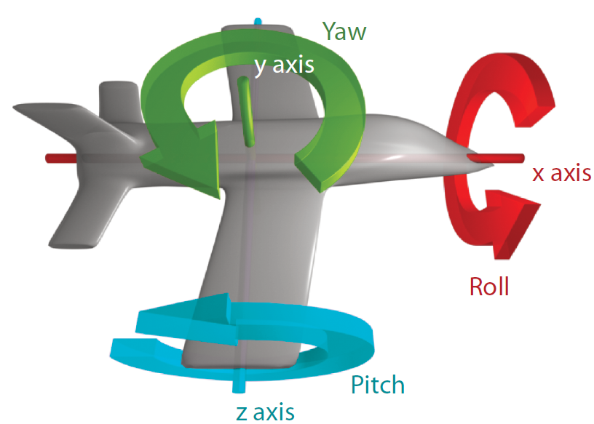
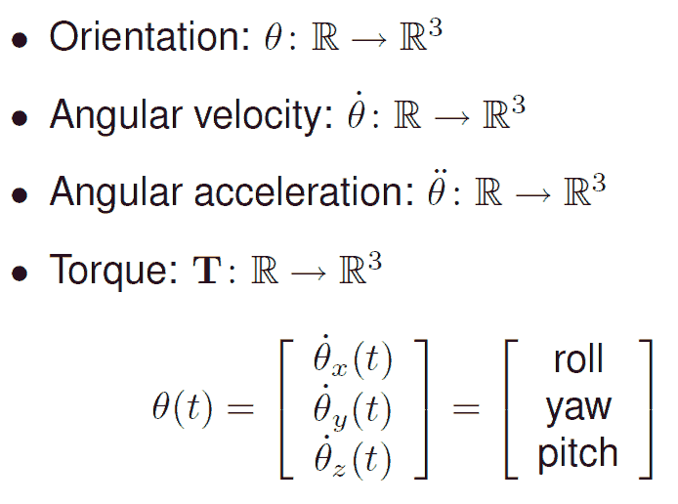
Modeling Physical Dynamics

Slide 13
Feedback Control Problem
A helicopter without a tail rotor, like the one below, will spin uncontrollably due to the torque induced by friction in the rotor shaft.
Control system problem: Apply torque using the tail rotor to counterbalance the torque of the top rotor.

Slide 14
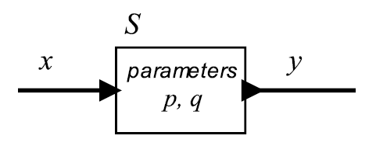



Actor Model of Systems
A system is a function that accepts an input signal and yields an output signal.
The domain and range of the system function are sets of signals, which themselves are functions.
Parameters may affect the definition of the function S.

Slide 15
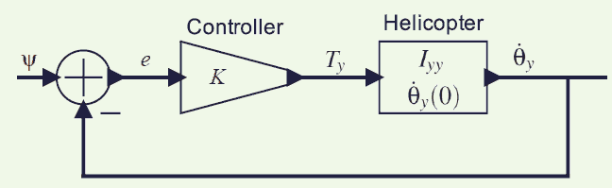


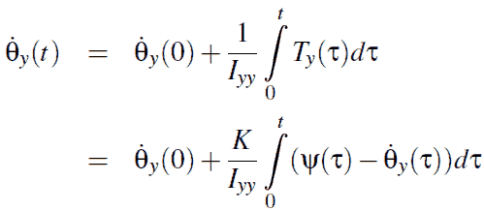
Proportional controller
_{desired}
_{angular}
_{velocity}
_{error}
_{signal}
_{net}
_{torque}
Note that the angular velocity appears on both sides, so this equation is not trivial to solve.

Slide 16
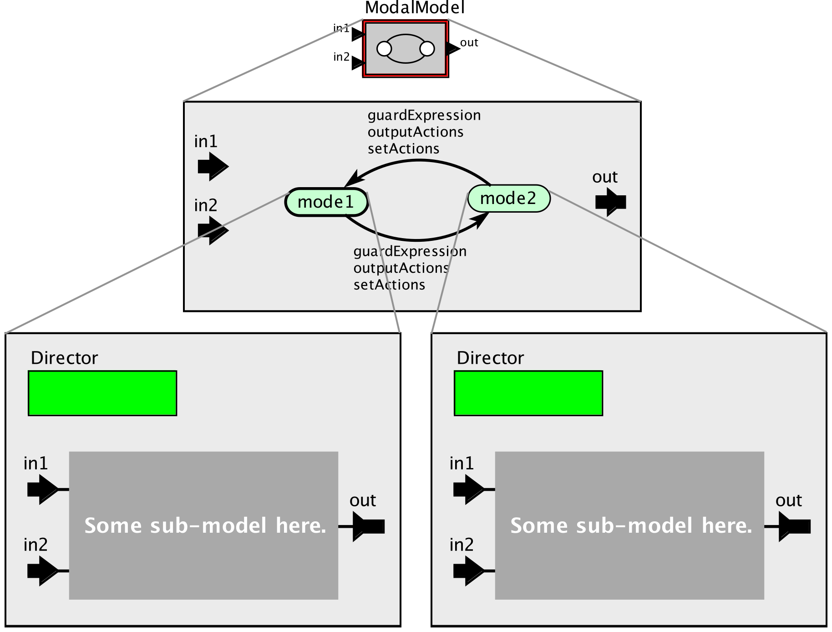
State Machines and Modal Models
Modal models combine such actor models with state machines, where each state of the machine represents a mode of operation.

Slide 17
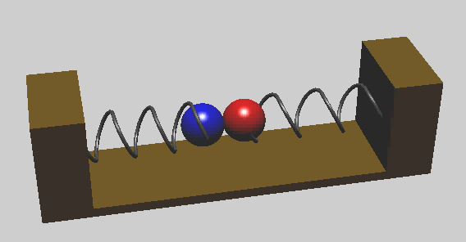
Hybrid Systems are Modal Models Example: Spring-mass system with collisions
A model of a spring-mass system with collisions:
Consider the velocity of each mass. Is it continuous? What about the acceleration?

Slide 18
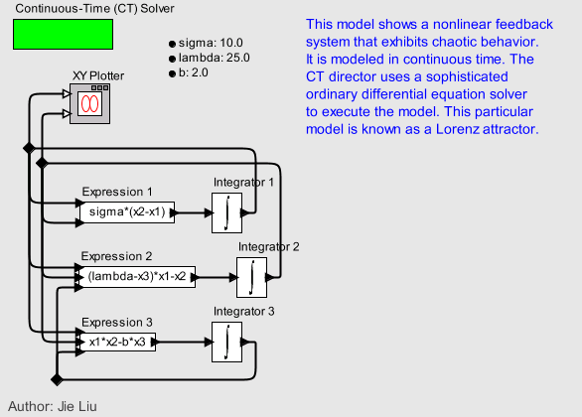
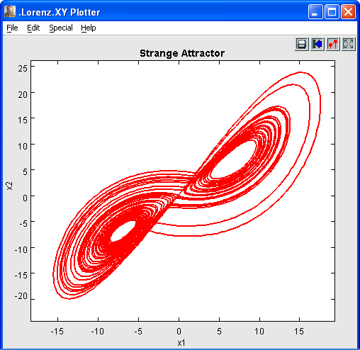
A bit about Simulation Technologies, both Discrete and Continuous
A basic continuous-time model describes an ordinary differential equation (ODE).

Slide 19
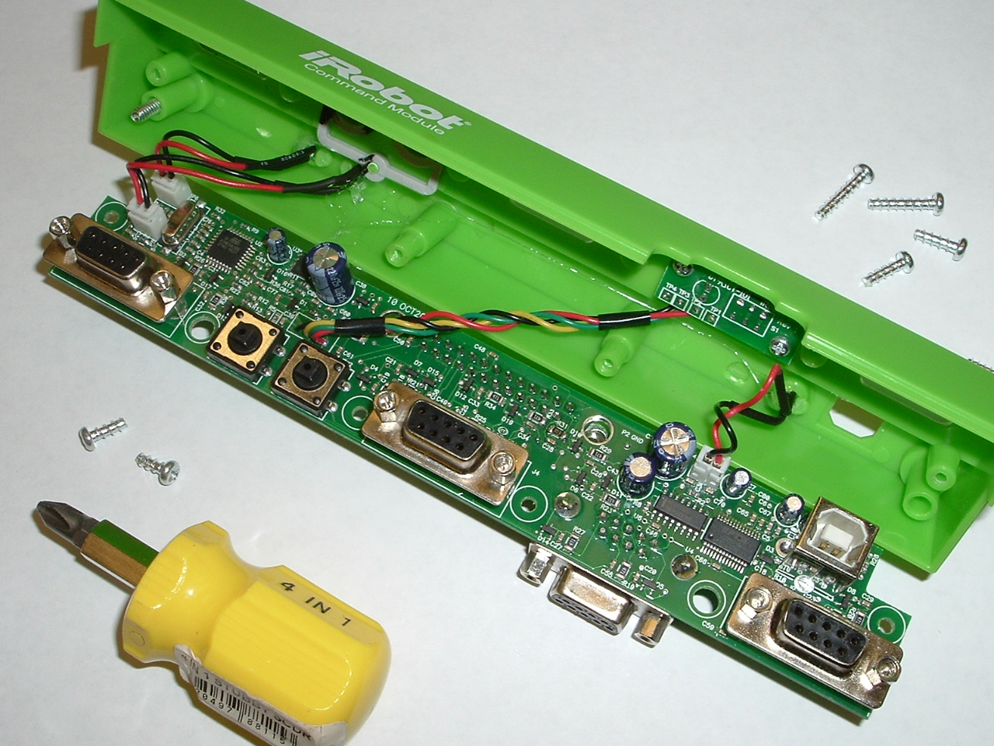
Lab Exercise – Version 1
Train a robot to climb a hill. We use the iRobot Create (the platform for the Roomba vacuum cleaner) with a pluggable Command Module containing an 8-bit Atmel microcontroller. Students have to extend it with sensors, construct models of its behavior, design a control system, and implement the control system in C.

Slide 20
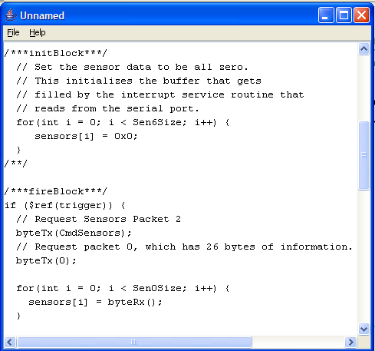
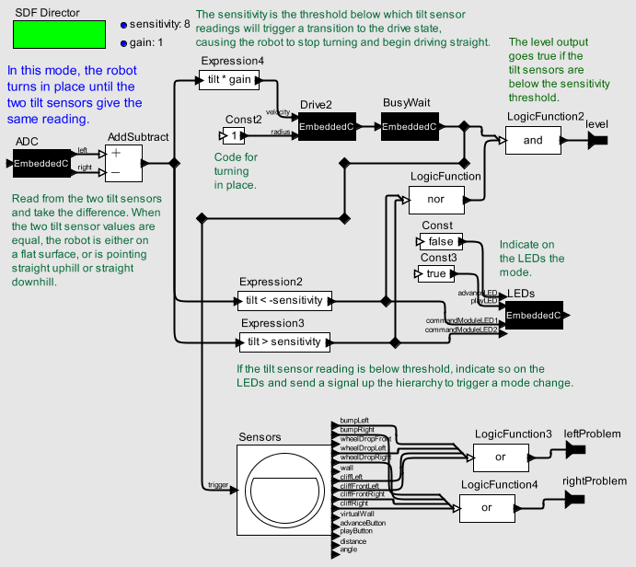
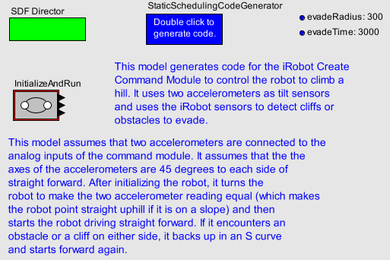
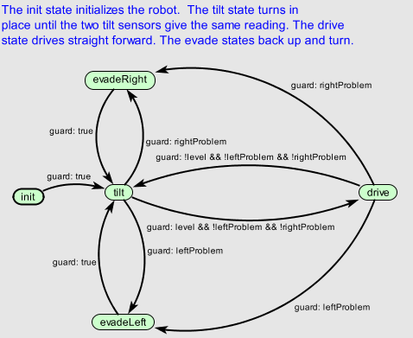
Model-Based Design Solution

Slide 21
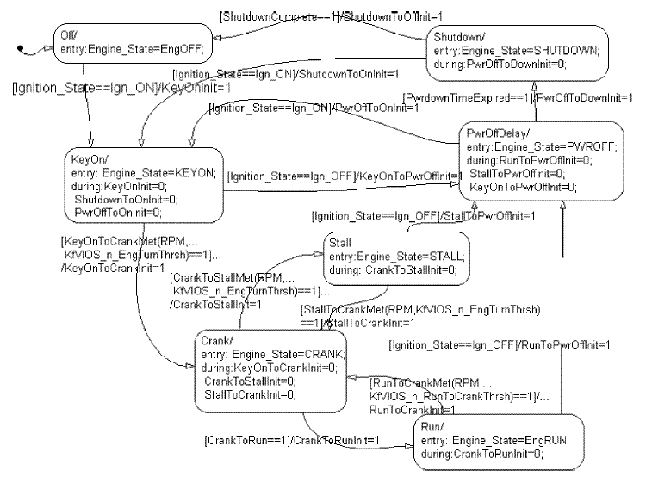
Real-World Version: Modal Model (Finite-State Machine) for Engine Control
Source:
Delphi Automotive Systems (2001)

Slide 22
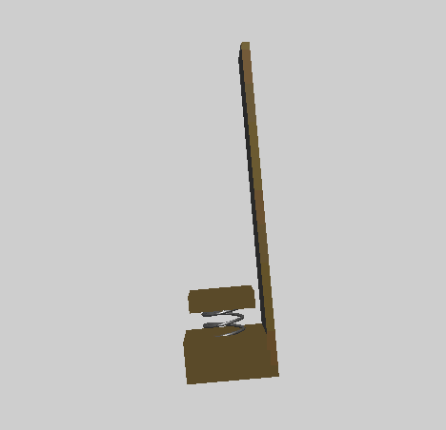
Sensors: Spring-Mass-Damper Model of an Accelerometer: Use as a Tilt Sensor
By Newton’s second law, F=ma, gravitational force and acceleration have the same effect (up to a scaling constant)

Slide 23
Silicon Accelerometer Design comes from Berkeley
The Berkeley Sensor and Actuator Center (BSAC) created the first silicon microaccelerometers, MEMS devices now used in airbag systems, computer games, disk drives (drop sensors), etc.
M. A. Lemkin, “Micro Accelerometer Design with Digital Feedback Control”,
Ph.D. dissertation, EECS, University of California, Berkeley, Fall 1997

Slide 24

What Sensors to Use: Kingvale Blower Berkeley PATH Project, March, 2005

Slide 25
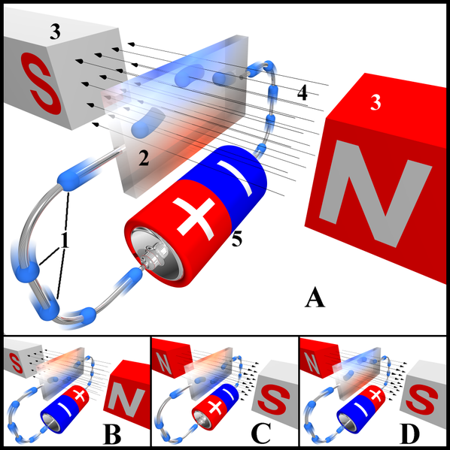
Sensors used here: Magnetometers
A very common type is the Hall Effect magnetometer.
Charge particles (electrons, 1) flow through a conductor (2) serving as a Hall sensor. Magnets (3) induce a magnetic field (4) that causes the charged particles to accumulate on one side of the Hall sensor, inducing a measurable voltage difference from top to bottom.
The four drawings at the right illustrate electron paths under different current and magnetic field polarities.
Image source: Wikipedia Commons
Edwin Hall discovered this effect in 1879.

Slide 26
Design Issues with Sensors
Calibration
Relating measurements to the physical phenomenon
Can dramatically increase manufacturing costs
Nonlinearity
Measurements may not be proportional to physical phenomenon
Correction may be required
Feedback can be used to keep operating point in the linear region
Sampling
Aliasing
Missed events
Noise
Analog signal conditioning
Digital filtering
Introduces latency
Students study these problems using LabVIEW.

Slide 27

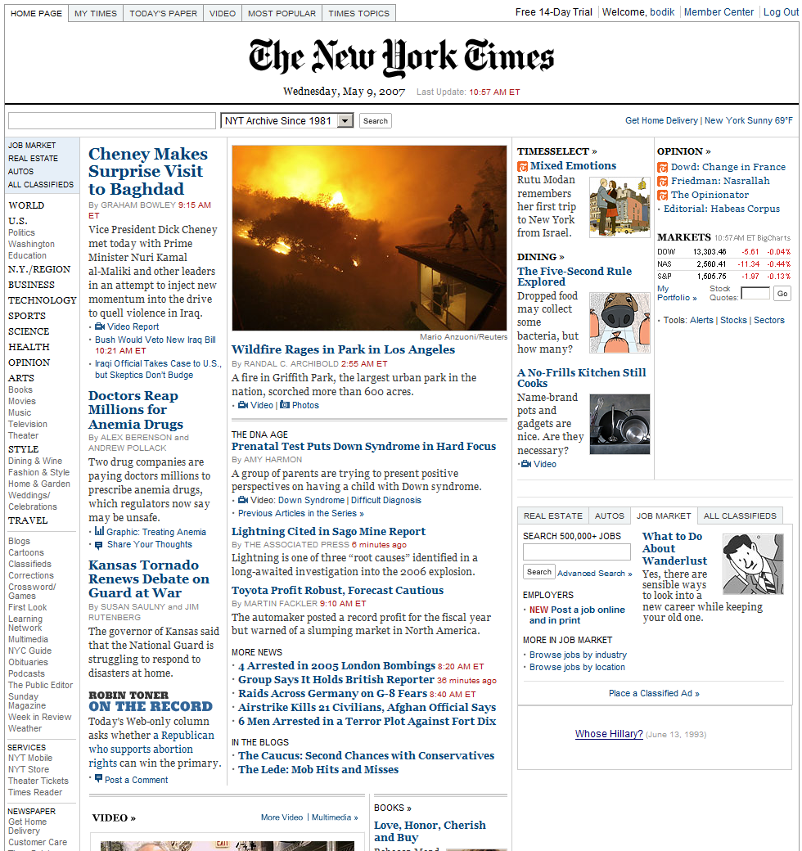



A thought experiment: Browser of the future? (courtesy of Ras Bodik, UCB)

Slide 28
Other Topics
Temporal logic
Reachability
Verification
Controller synthesis
Concurrency: threads and interrupts
Real-time operating systems
Concurrent models of computation

Slide 29
Lab Structure
5 weeks of structured labs introducing students to some of the tools of the trade.
10 weeks of group project efforts.

Slide 30
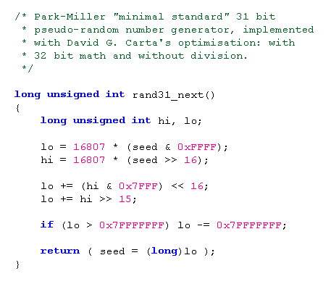

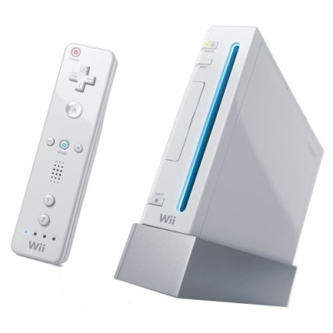
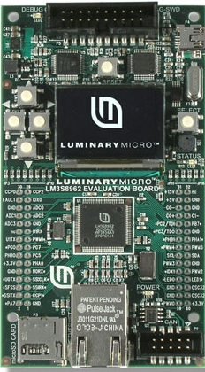
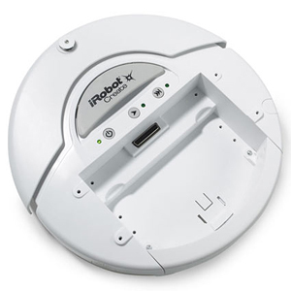
Tools Used in the Lab
LabVIEW
Nintendo Wii
Embedded C
Microcontroller
iRobot Create

Slide 31
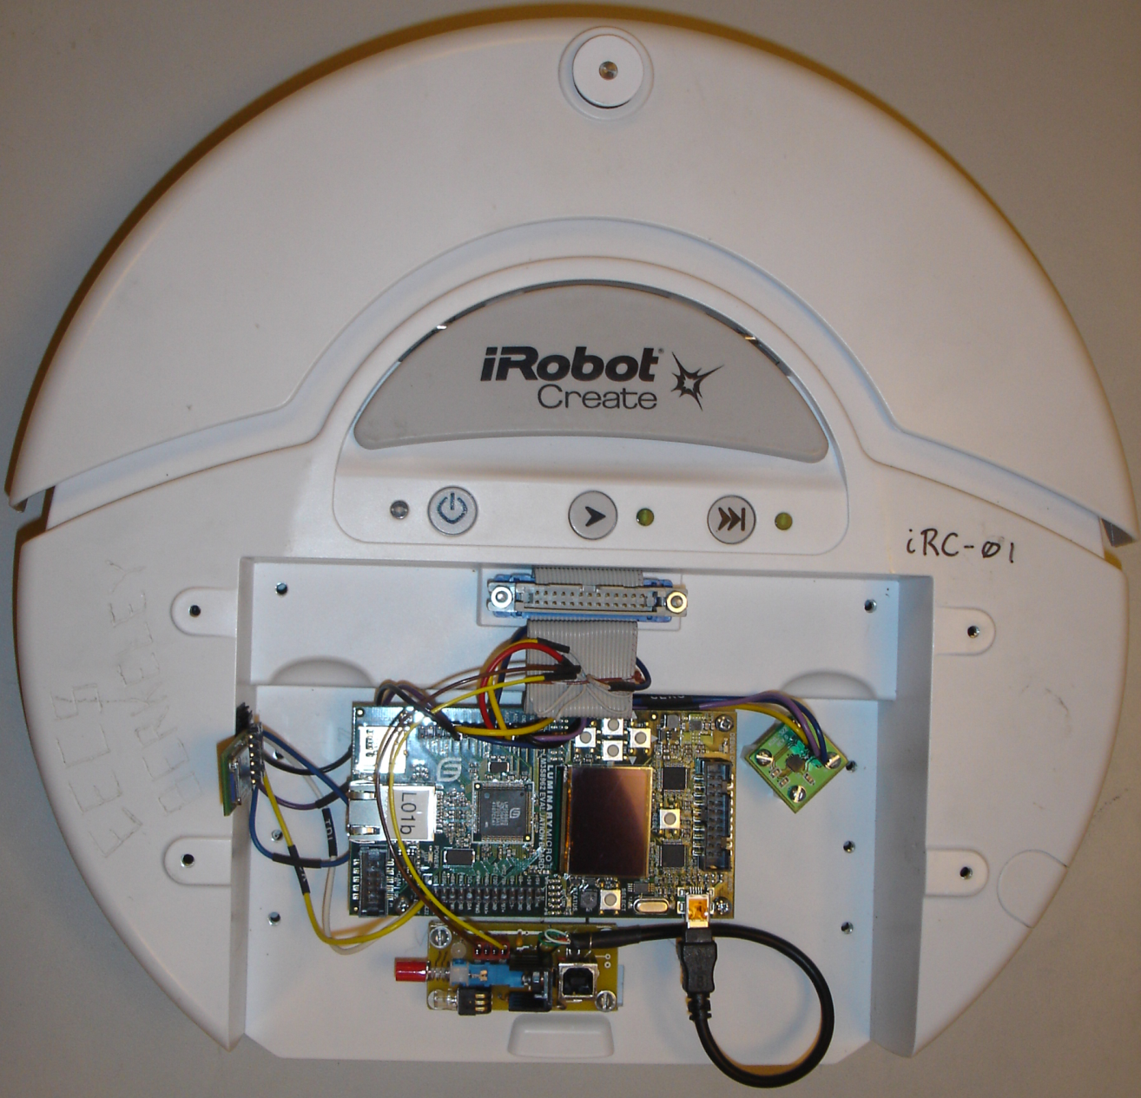
Version 2: Modified Platform
iRobot Create
Luminary Micro LM3s8962 (ARM)
ADXL-322 accelerometer
BlueSMiRF Bluetooth radio
Custom PCB for power and USB

Slide 32
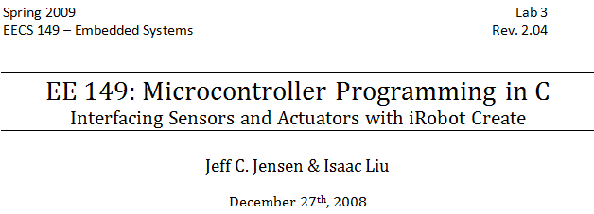
Structured Labs followed by Team Projects
Hill Climb
Sensing
Controller synthesis
Actuation
Embedded C
NI LabVIEW
Simulation
Embedded

Slide 33
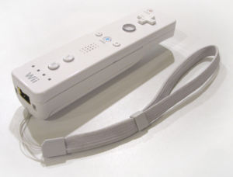
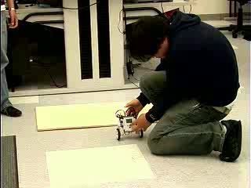
Example Class Project
May 16, 2008
One of the five project teams developed a balancing robot inspired by the Segway. They used a Nintendo Wiimote as a controller communicating with a PC running LabVIEW, communicating with a Lego Mindstorm NXT, which they programmed in C.

Slide 34
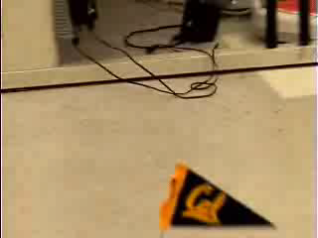
Example Class Project
Robot Mapping & Localization
Richard Schmidt Christopher Bakker Jeff C. Jensen
This team mounted lasers and photo detectors on instances of the iRobot Create platform and programmed the robots to identify their positions relative to one another and communicate wirelessly to a mapping application running on a host PC.

Slide 35
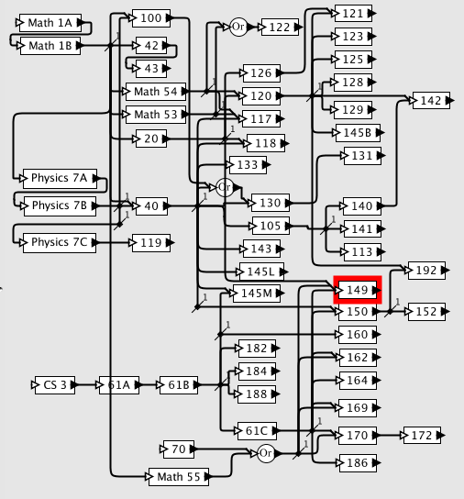
The Prerequisite Challenge
Core course
Introduction to Embedded Systems

Slide 36
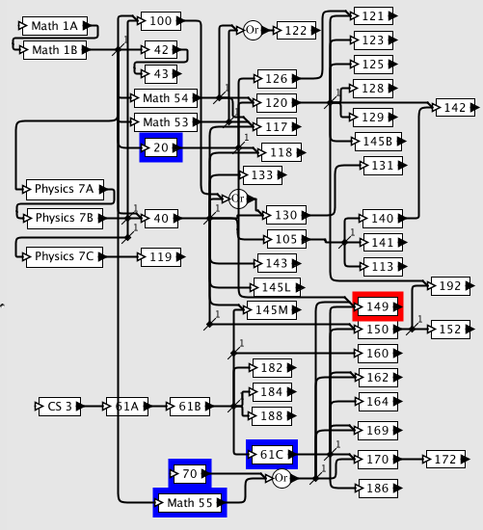
Structure and Interpretation of Signals and Systems
The Prerequisite Challenge
Core course
Prerequisites
Machine Structures
Discrete Mathematics and Probability Theory

Slide 37
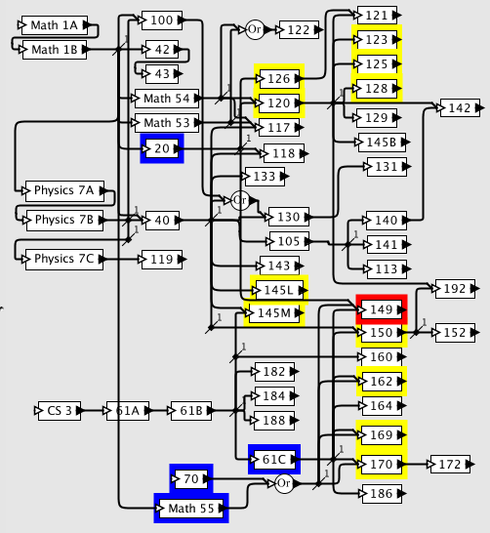
DSP
Random processes
Robotics
Signals and Systems
Control
The Prerequisite Challenge
Core course
Prerequisites
Defensible prerequisites
Transducers
Microcomputer interfacing
Digital Systems
Operating Systems
Software Engineering
Algorithms

Slide 38
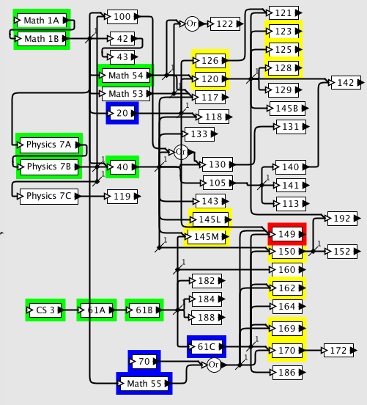
DSP
Random processes
Robotics
Signals and Systems
Control
The Prerequisite Challenge
Core course
Prerequisites
Defensible prerequisites
Transitive closure
Transducers
Microcomputer interfacing
Digital Systems
Operating Systems
Software Engineering
Algorithms

Slide 39
Conclusion
A reductionist approach (where we teach all the foundations first) cannot work!
We have to be prepared to review topics as needed, and deal with a mix of backgrounds in the students.
The intellectual core is MODELS (as approximations, as abstractions, as ways of understanding interaction, etc.).

